Slide 1
Learning the Word — “comfort”
河源市和平县阳明中学 陈思考
华南师范大学 汤瑞兰
华南师范大学 关容宾

Slide 2
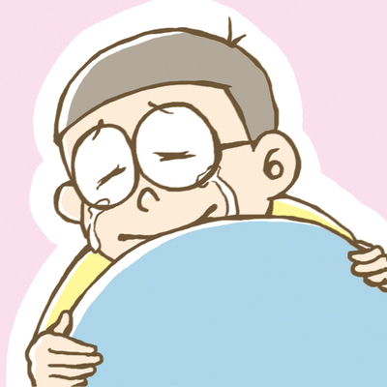
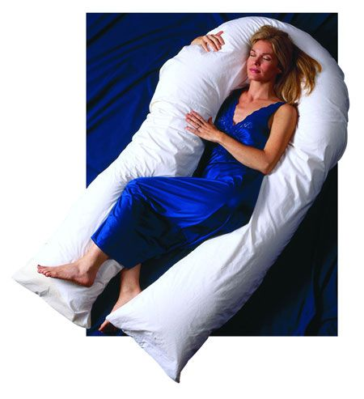
His friend is comforting him.
This seat is comfortable to sit on.

Slide 3
Meaning
n.
1. the state of being physically relaxed and free from pain; the
state of having a pleasant life, with everything that you need
e.g. Do something each day that moves you out of your
comfort zone.
2. a feeling of not suffering or worrying so much
e.g. I have not one word of comfort.
3. a person or thing that helps you when you are suffering
e.g. They are my only comfort.

Slide 4
Meaning
vt.
1. to make sb who is worried or unhappy feel better by being kind
and sympathetic towards them
e.g. Her mother's word comforted the sobbing girl.

Slide 5
Distortion
Plural： comforts
Past Tense： comforted
Past Participle：comforted
Present Participle： comforting
Third Person Singular： comforts

Slide 6
Word Family
comfort
n.
comfort
v.
unconfortable
comfortable
adj.
OPP
comfort
comfort
comforting
adj.
uncomfortably
OPP
comfortably
adv.

Slide 7
Comfortable
adj.
1. making you feel physically relaxed; pleasant to wear, sit
on, etc.
e.g. It's such a comfortable bed.
e.g. These new shoes are not so comfortable.

Slide 8
Useful Expressions
1. take/ draw comfort from sb's words
e.g. The little girl managed to take comfort from her
father's words.
2. too ...... for comfort
e.g. Changes are happening too rapidly for comfort.
3. it comforts sb to do sth
e.g. It comforts her to feel her mom's arms around her.

Slide 9
Useful Expressions
4. for comfort
e.g. These tennis shoes are designing for comfort
and performance.
5. in comfort
e.g. They have enough money to live in comfort in
their old age.

Slide 10
Common Errors
They live at comfort and luxury.
They live in comfort and luxury.

Slide 11
Homework
1. Finishing the True or False exercise of “comfort”
2. Using the useful expressions of “comfort” to make
several sentences and link them together to make up
a simple story

Slide 12
Thank you

