Slide 1
Unit 2 English around the world
Book 2
华南师范大学
张静楠

Slide 2
New words
gradual n. 词汇（量），词表
gradually n. 丹麦语 adj.丹麦的，丹麦
人的，丹麦语的
Danish adj. 逐渐的，逐步的
vocabulary 利用，使用
make use of adv. 逐渐地，逐步地

Slide 3
Careful reading
How did English develop to modern English?

Slide 4
At present
The next century
The end of the 16th century
More countries
Many countries
England
Development of English

Slide 5
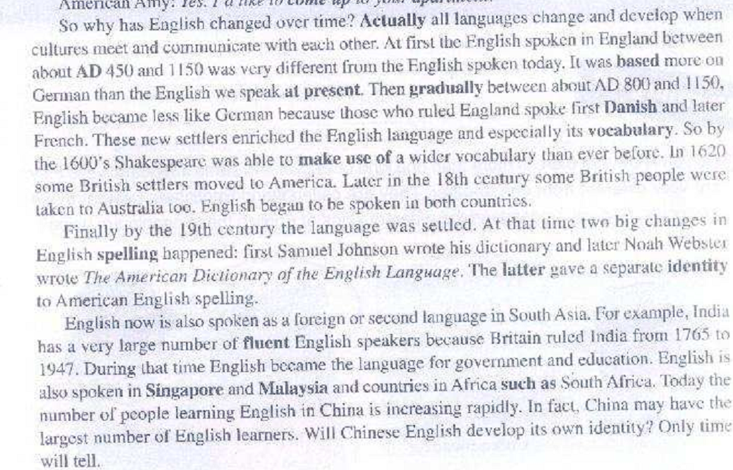

Slide 6
Skill points
Through some clues, like the place, the time and so on to master the passage.

Slide 7
Careful reading
True or false
Exercise 1 on page 10

Slide 8
Careful reading
Shakespeare’s English was spoken around _________?
1400’s
1150’s
450’s
1600’s

Slide 9
Careful reading

Slide 10
Skill points
Through locating the point exactly, the answer can be find quickly.
Key words
The first section
……
The end of paragraph
Logical signal words

Slide 11
Careful reading
Thinking
Will Chinese become one of the world language?
Only time will tell you!

Slide 12
Skill points
Through some deep thinking, enhance the ability of reading

Slide 13
Thank you !

