Slide 2
Reading Comprehension Lesson
—Paragraph 1

Slide 3
Content
Comprehension
Vocabulary
Grammar

Slide 4
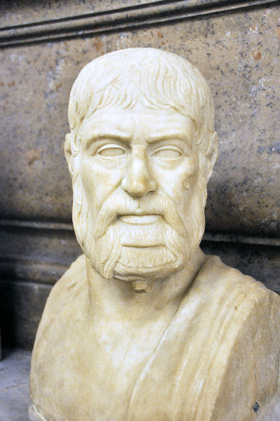
Pausanias, who was a Greek writer about 2,000 years ago, has come on a magical journey on March 18th, 2007 to find out about the present-day Olympic Games. He is now interviewing Li Yan, a volunteer for the 2008 Olympic Games.
帕萨尼亚斯是大约2000年前的一位希腊作家，在2007年3月18日他作了一次魔幻旅行，来了解关于当今奥林匹克运动会的情况。他现在正在采访一位2008奥林匹克运动会的志愿者—李岩。
Comprehension
Vocabulary
Grammar

Slide 5
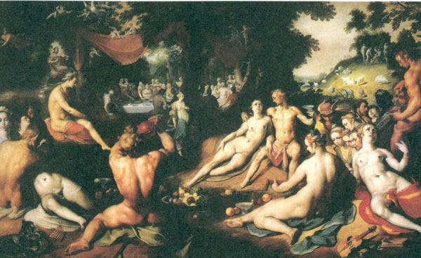
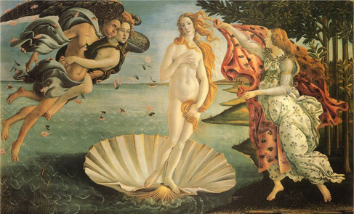
Greek
[grik]
n. 希腊人；希腊语
adj. 希腊的；希腊人的，希腊语的
Derivation:
Greece n. 希腊
Vocabulary
e.g. 希腊最出名的是希腊神话。
Greece is most famous for its Greek mythology.
Grammar

Slide 6
Magical
['mædʒɪk(ə)l]
adj. 魔术的；有魔力的
Derivation:
Magic n. 魔术，魔法
Magician n. 魔术师
Vocabulary
e.g. 魔术师在台上表演魔术，看起来就像他有魔力
一样。
The magician is performing magic on the stage, which seems that he had magical power.
Grammar

Slide 7
Present
['prezənt]; [pri'zent]
['prezənt]
adj. 现在的；出席的
n. 现在；礼物
[pri'zent]
v. 介绍，呈现
Vocabulary
e.g. 展览会展示了中国经济的现状。
The exhibition presented the present situation in China's economy.
Grammar

Slide 8
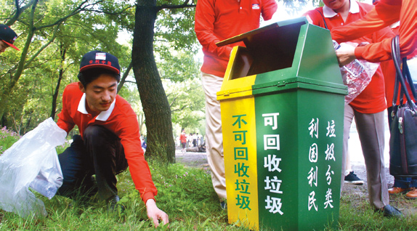
Volunteer
[,vɒlən'tɪə]
n. 志愿者
adj. 志愿的
v. 自愿做（~ +to do sth.）
（修饰人）
Derivation:
voluntary a. 志愿的，自发的
（修饰志愿者的工作、机构等）
Vocabulary
e.g. 志愿者们正在做志愿清洁工作。
The volunteers are doing voluntary cleaning work.
Grammar

Slide 9
Pausanias, who was a Greek writer about 2,000 years ago, has come on a magical journey…
非限定性定语从句
非限定性定语从句起补充、说明的作用，缺少也不会影响对整句话的理解，在其前面往往有逗号隔开。
限定性定语从句和非限定性定语从句功能不同，使用时应根据句子意思需要而定，不可随意替换。
（ ）Meat which came from Australia is tainted.
(受污染的)
（ ）Meat, which came from Australia, is tainted.
Vocabulary
Grammar

Slide 10
Thank you for listening!

