Slide 1
B2Unit3- Computers
华南师范大学外国语言文化学院 2013级 许盈盈
Discussion on computer

Slide 3
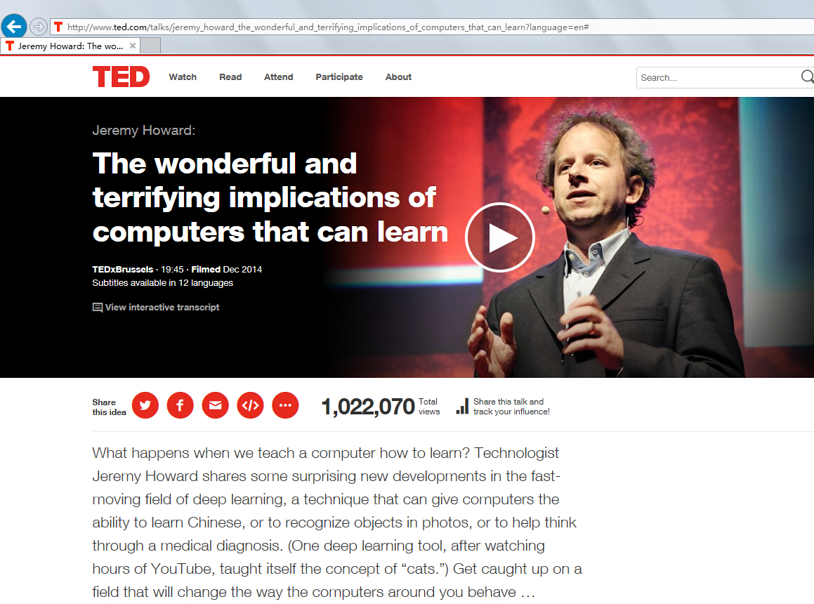
Deep learning

Slide 4
* Algorithm 算法

Slide 5
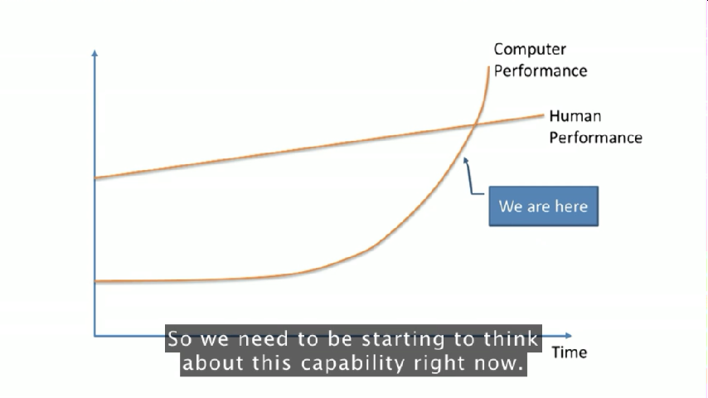
1. What can computers do?
Listen
See
Read
Deep
Learning
Revolution
*n. 进化

Slide 6
Questions
What do you think of the development of computer?
“ Computers are everywhere in our life.”
Good ? Bad ?
What’s the future relationship of human and computer?

Slide 7
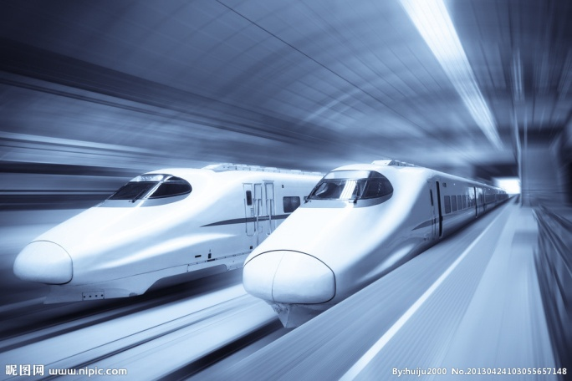
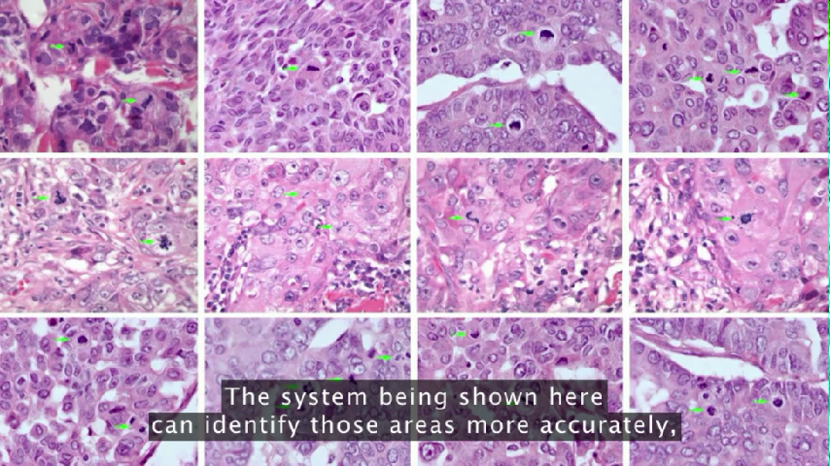
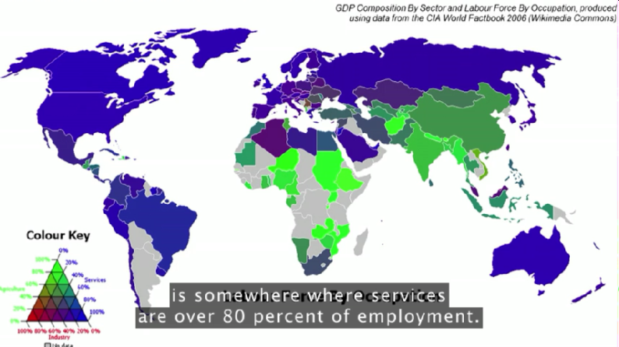
Advantages
Convenience in daily life ;
Changes in society/science/
technology/art…
……
Transportation
Medical research
Employment

Slide 8
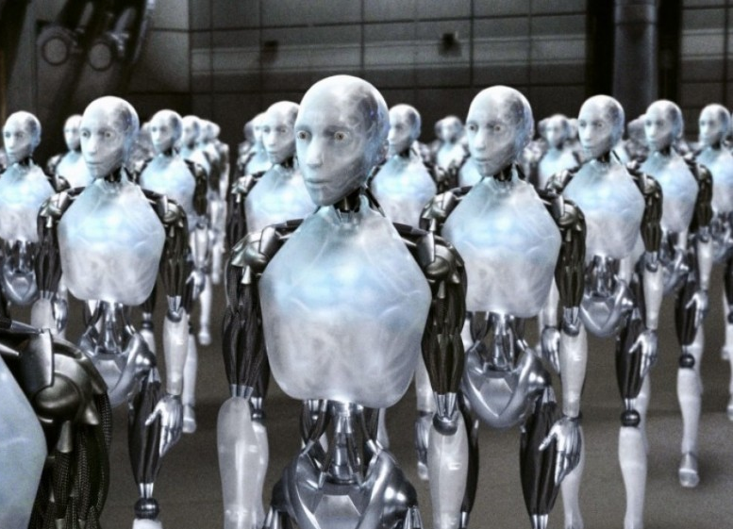
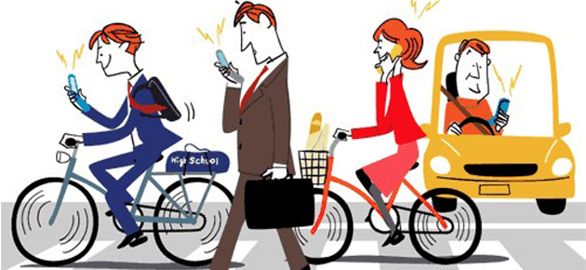
Disadvantages
Addiction to computers;
Fears of losing control over computers’ self-development ;
……

Slide 9
Questions
What do you think of the development of computer?
“ Computers are everywhere in our life.”
Good ? Bad ?
What’s the future relationship of human and computer?

Slide 10
Textbook Page 22
Discuss with your classmates about your opinions.

Slide 11
1. What: opinions
I think/ don’t think that …
As/ Since …, I think …
I believe that …
2. Why : reasons
I think … because (of) …
I agree / don’t agree … because
First … Second …
3. Ask :
Give me your reasons
What makes you think so?
4. Decision:
I’ve decided that …
Let’s decide …
Let’s make a decision.

Slide 12
Examples
1. I think/ don’t think that computers will become necessary in our life ……
2. I agree/ don’t agree that computers will do harm to people because it’s people that set the rules to computers and they must follow the rules……
3. What makes you think so that people can’t live without computers……?
4. I’ve decided that I will support the research on computer……

Slide 13
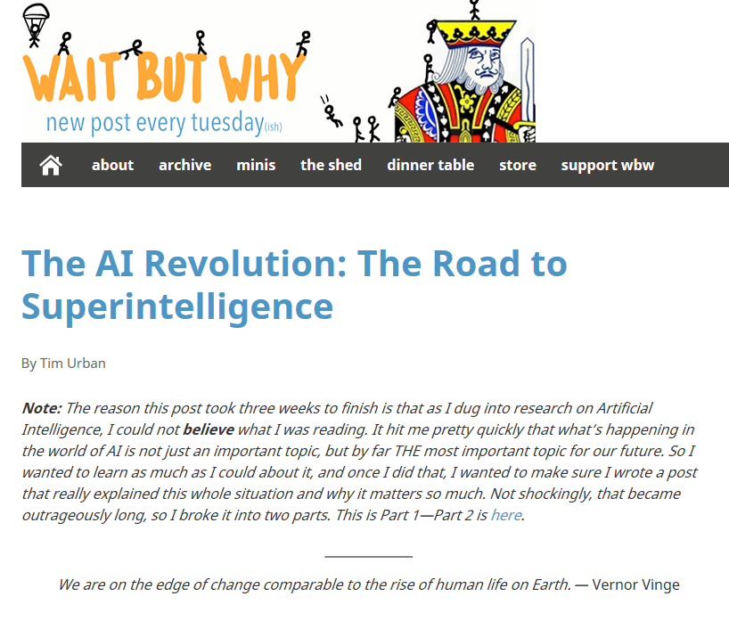
English version: http://waitbutwhy.com/2015/01/artificial-intelligence-revolution-1.html
More to read
Chinese translation:
http://zhuanlan.zhihu.com/xiepanda/19950456

Slide 14
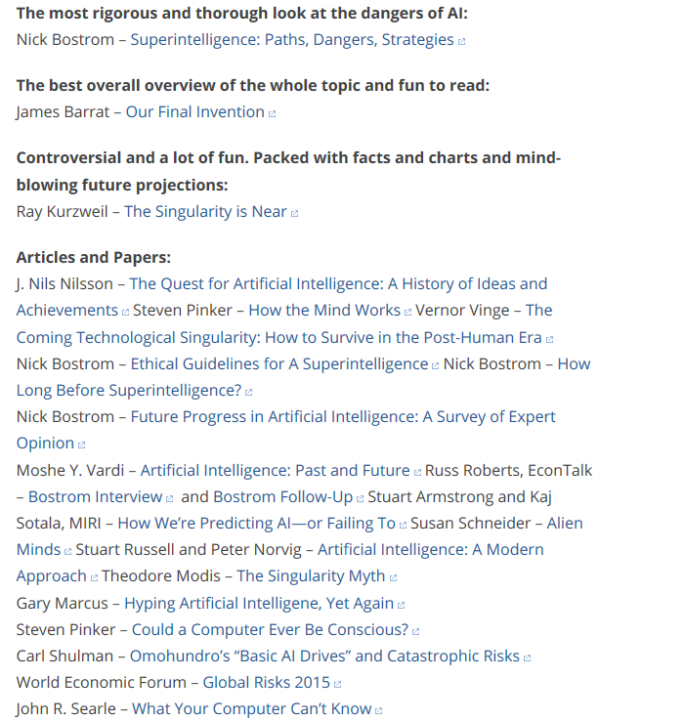

Slide 15
Assignments:
1. Have 5 minutes’ discussion with classmates about your opinions on computers in future.
2. Do research to find evidence supporting your ideas and share in the next class.
*3. Finish the video of TED speech if interested: http://www.ted.com/talks/jeremy_howard_the_wonderful_and_terrifying_implications_of_computers_that_can_learn?language=en

