Slide 1
新课标高中英语必修3 U1 Festivals
Thanksgiving Day
华南师范大学外文学院
麦梓靖

Slide 2
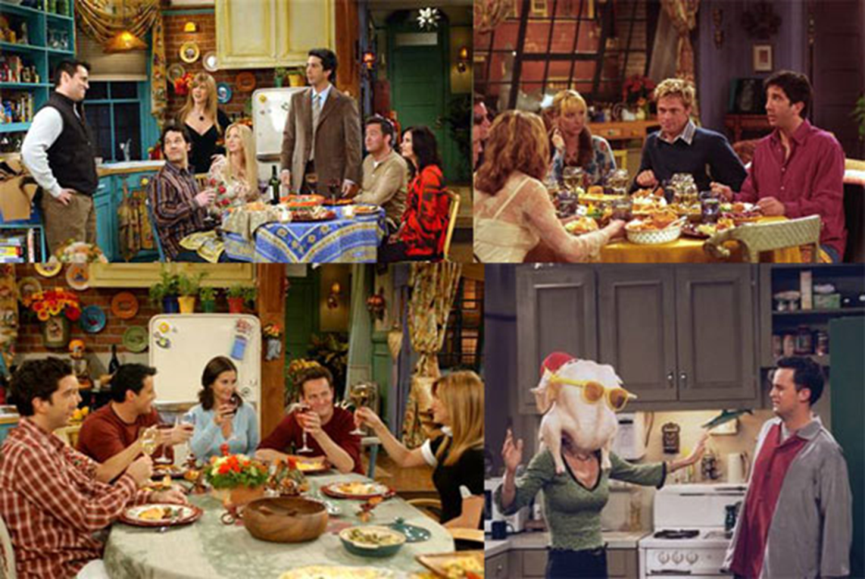
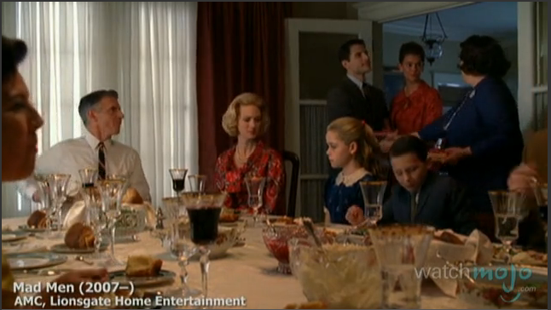
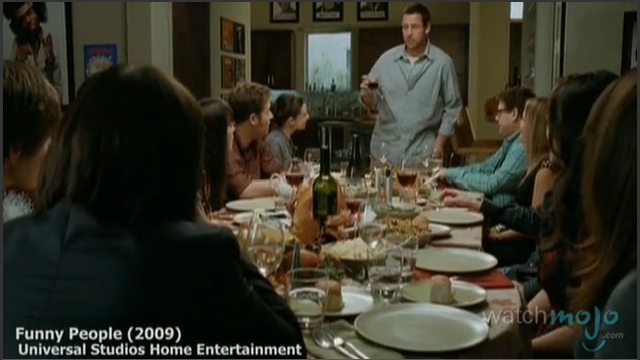
The Simpsons 2007
Friends 1994-2004

Slide 3
What is Thanksgiving Day?
Thanksgiving Day is a national holiday celebrated primarily in the United States and Canada to give thanks for the blessing of the harvest and of the preceding year. On that day, people take time to thank God for his constant grace and for all the material possessions . Thanksgiving is also the time to thank near and dear ones and being grateful for their kindness.

Slide 4
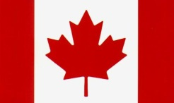
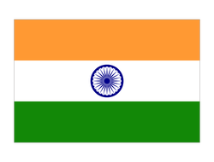
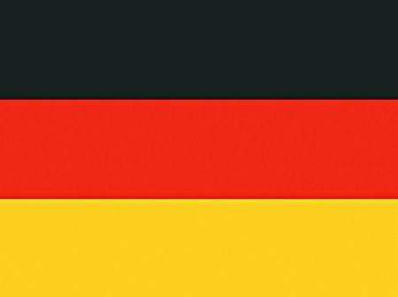
Thanksgiving Day around the world
the fourth Thursday in November
Thanksgiving Day
Thanksgiving Day
the second Monday in October
Unity in Diversity
August 15th
Labor Thanksgiving Day
November 23rd
The Harvest Thanksgiving Festival
early October

Slide 5
The origin
pilgrims[ˈpɪlɡrəm]
新来移民，1620年移居美洲的英国清教徒
The legendary pilgrims, crossed the Atlantic in the year 1620 in Mayflower-A 17th Century sailing vessel.

Slide 6
The origin
About 102 people traveled for nearly two months with extreme difficulty. The pilgrims reached Plymouth rock on December 11th 1620, after a sea journey of 66 days. Nearly 46 pilgrims died due to extreme cold in winter.

Slide 7
The origin
These new settlers were taught to harvest by local Native Americans. It is said that Pilgrims learnt to grow corn, beans and pumpkins from the Indians, which helped all of them survive .

Slide 8
The origin
In the autumn of 1621, the Pilgrims held a grand celebration where 90 people were invited including Indians to celebrate their success by their religious traditions.

Slide 9
The origin
In 1863, a proclamation [prɒkləˈmeɪʃn] by President Lincoln made Thanksgiving become an annual event observed on the last Thursday in November.

Slide 10
The origin
President Franklin Roosevelt officially signed the holiday into federal law in 1941 as the fourth Thursday during that month.

Slide 11
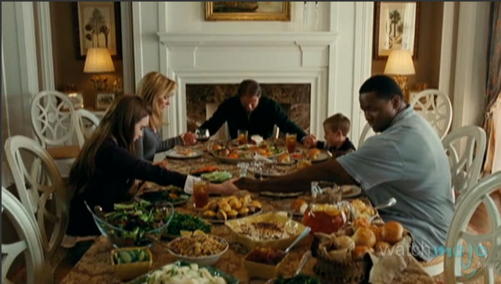
Tradition Family Reunion and Feasting
Dear Heavenly Father,
Thank You for this special day, a day to remember Your goodness to us.
Thank You for a roof over our heads, and more than enough food to eat.
Thank You for the family You have given to us, for family and friends who have gathered together to eat this Thanksgiving Day meal.
Amen.

Slide 12
Tradition of Food
why?
1. They were fresh, affordable, and big enough to feed a crowd.
2. Among the big birds, turkey was ideal for a fall feast.
3. While the bird had already been associated with Christmas, the turkey also gained iconic status as a yuletide [‘ju:ltaɪd](圣诞季节) meal around the same time.

Slide 13
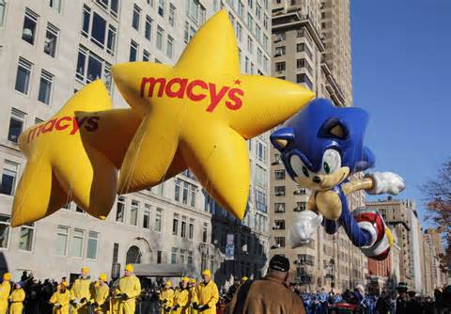
Tradition of Parade
Detroit’s American Thanksgiving Parade
New York City’s Macy’s Thanksgiving Day Parade

Slide 14
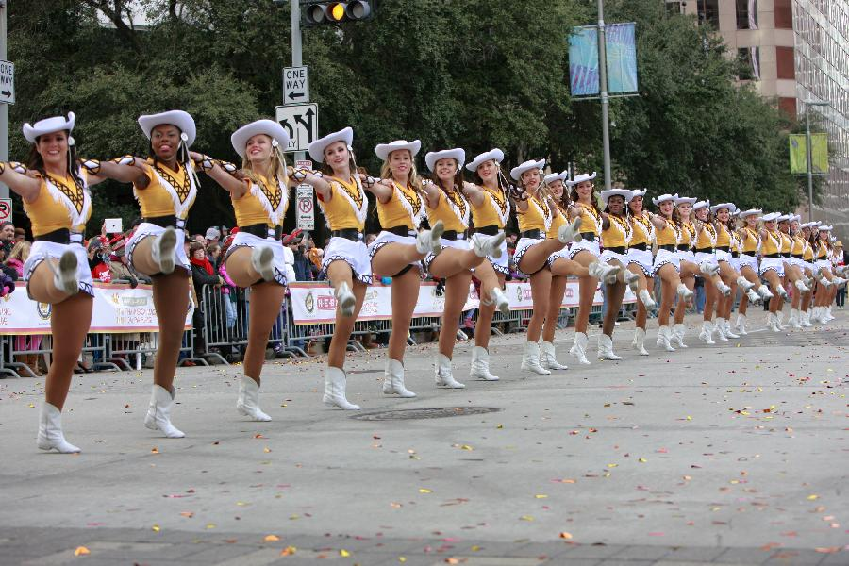
Tradition of Parade
Four important features
High school marching bands

Slide 15
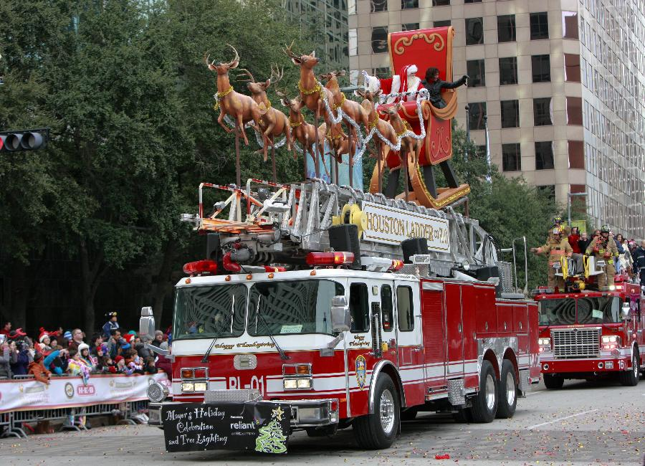
Tradition of Parade
Four important features
Moving stands with specific themes

Slide 16
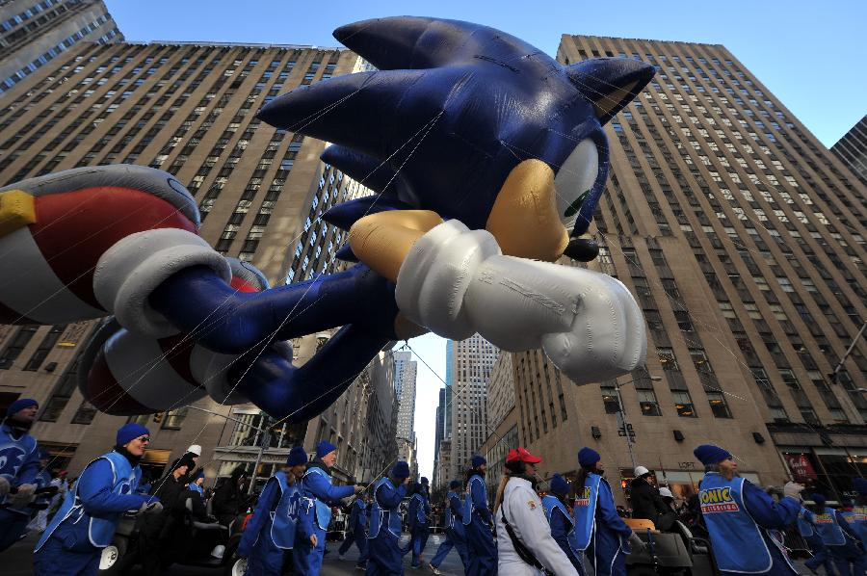
Tradition of Parade
Four important features
Large balloons of cartoon characters and TV personalities

Slide 17
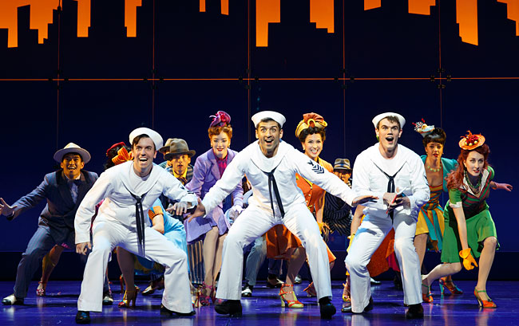
Tradition of Parade
Four important features
Scenes from Broadway plays

Slide 18
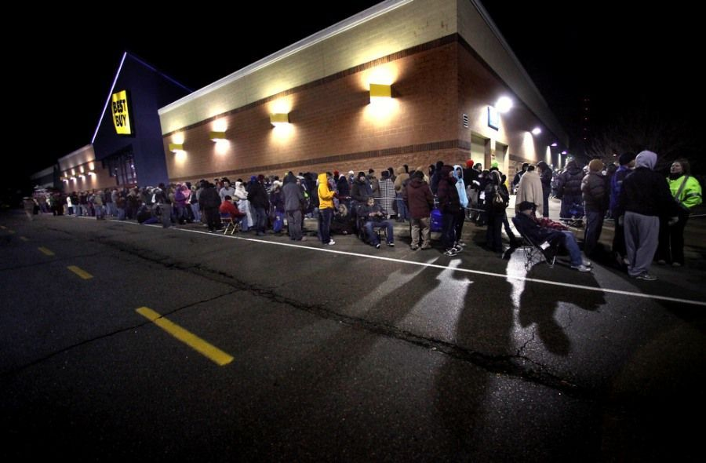
Tradition of Shopping
Thanksgiving day is the official beginning of the Christmas season. USA witnesses maximum sales volume on these days. The following Friday after thanksgiving is well known as 'Black Friday'. This is because of the standard accounting practice of writing profits in black. The ongoing festive spirit, shopping spree, helps the shopkeepers to register maximum sales and profits. The entire atmosphere during the time is euphoric, people get in a holiday mood.
volume [ˈvɒlju:m]
大量的
spree [spri:]
狂热行为
euphoric[ju:'fɒrɪk]
愉快的

Slide 19
Tradition of Decoration
wreaths [ri:θ]
花圈
interiors [inˈtiəriəz]
内部环境
Thanksgiving is a time to decorate homes with wreaths, fresh and dried flowers. People beautify their homes, give the interiors a whole new look and feel. They light lamps to brighten the environment.

Slide 20
Thanksgiving Day Quotes
We tend to forget that happiness doesn't come as a result of getting something we don't have, but rather of recognizing and appreciating what we do have.
——Fredrick Koeing
我们几乎快要忘了，快乐并不在于得到了没有的东西，而在于知道自己拥有什么，并心存感激。
Reflect upon your present blessings, of which every man has plenty; not on your past misfortunes of which all men have some.
——Charles Dickens (1812-1870)； Novelist
思考当下的福祉，而非过去的不幸。福祉，每个人都有很多；不幸，每个人都有一点。

Slide 21
Thanksgiving Day Quotes
Thanksgiving Day is a jewel, to set in the hearts of honest men; but be careful that you do not take the day, and leave out the gratitude.
——E.P. Powell (1833-1915)； American Author And Journalist
感恩节犹如一颗宝石，安放在每个坦诚之人心中；但是你可别拿走了“宝石”，却忘了感恩。
In all affairs it's a healthy thing now and then to hang a question mark on the things you have long taken for granted.
——Bertrand Russell (1872-1970)； Philosopher, Mathematician
无论对于什么事情，我们都应该时常问问自己，那些我们长久以来想当然的东西真的理所应当吗。

Slide 22
Be thankful to the one you loved
&
everything in life

