Slide 1
WELCOME
TO
MY
CLASS

Slide 2
Unit 4
Astronomy: the science of the stars
BOOK 3
华南师范大学 柯晓淳

Slide 3
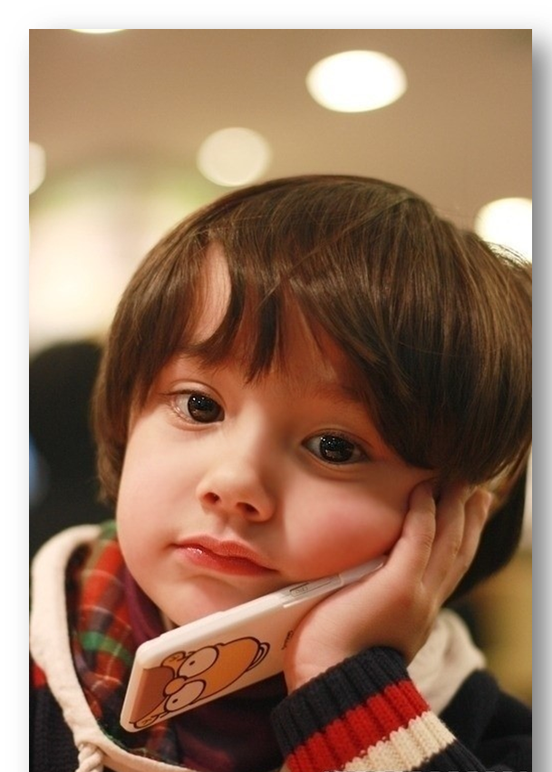
How I come to this world ?

Slide 4
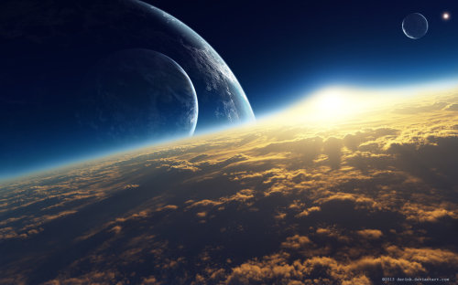
Reading
How Life Began on the Earth

Slide 5
How to find the main idea of the text ?
What’s the main idea of the text？

Slide 6
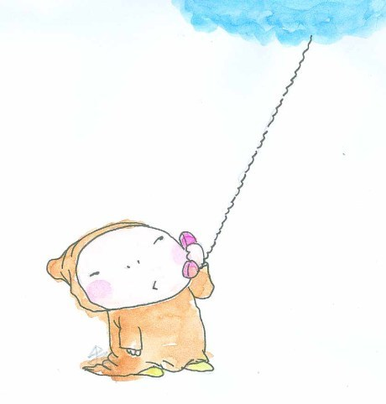
Skimming
When we skim,
what should we notice ?
three to four times faster than normal reading
word by word

Slide 7
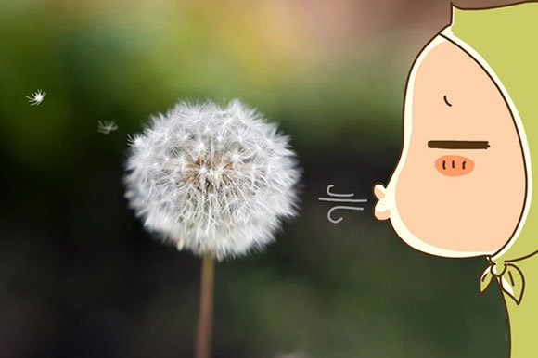
Title / headings
Subtitles
Pictures /diagrams
Important words/ sentences

Slide 8
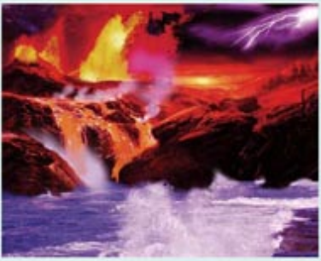
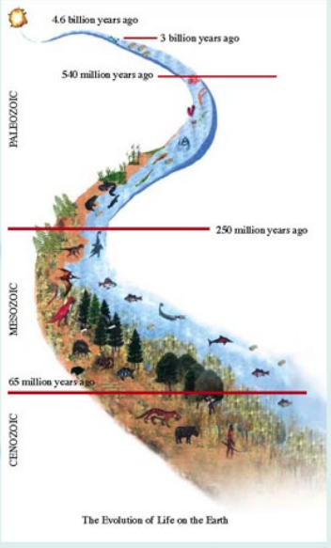

Slide 9
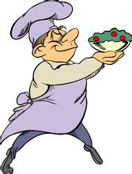
Have a try!
People have different tastes in food. Some feel that they haven't eaten a meal unless they have had steak or other red meat. Some prefer chicken or fish and eat one or the other at every meal. Others prefer vegetables and fruits or grains and would enjoy a meal of spaghetti, eggplant, and fresh fruit. Others could live on what were called fast-foods: a hamburger or hot dog, French fries and a soft drink.
People have different tastes in food.
People have different tastes in food. Some feel that they haven't eaten a meal unless they have had steak or other red meat. Some prefer chicken or fish and eat one or the other at every meal. Others prefer vegetables and fruits or grains and would enjoy a meal of spaghetti, eggplant, and fresh fruit. Others could live on what were called fast-foods: a hamburger or hot dog, French fries and a soft drink.

Slide 10
Hi, my name is Marty Fielding and I guess you could say that I am "one in a million". In other words, there are not many people like me. You see, I have a muscle disease which makes me very weak, so I can't run or climb stairs as quickly as other people. In addition, sometimes I am very clumsy and drop things or bump into furniture. Unfortunately, the doctors don't know how to make me better, but I am very outgoing and have learned to adapt to my disability. My motto is: live one day at a time.
Hi, my name is Marty Fielding and I guess you could say that I am "one in a million". In other words, there are not many people like me. You see, I have a muscle disease which makes me very weak, so I can't run or climb stairs as quickly as other people. In addition, sometimes I am very clumsy and drop things or bump into furniture. Unfortunately, the doctors don't know how to make me better, but I am very outgoing and have learned to adapt to my disability. My motto is: live one day at a time.
an introduction to his muscle disease

Slide 11
Tip: 利用各种体裁的本身特点
narration 记叙文
5 w
argumentation 议论文
Titles/
Key words/
Important
sentences
exposition 说明文
practical writing 应用文

Slide 12
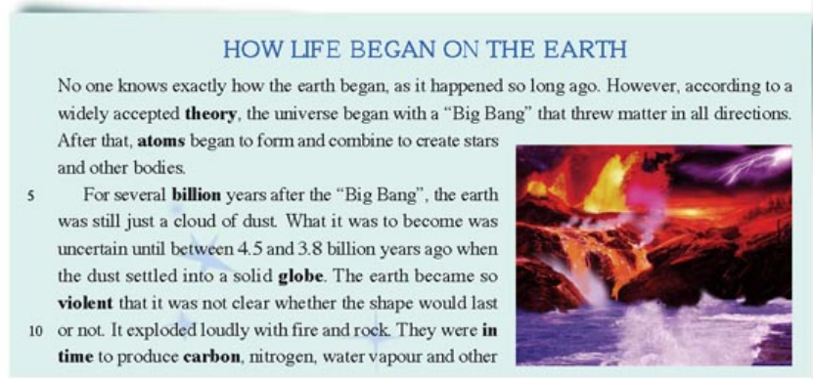
Reading

Slide 13
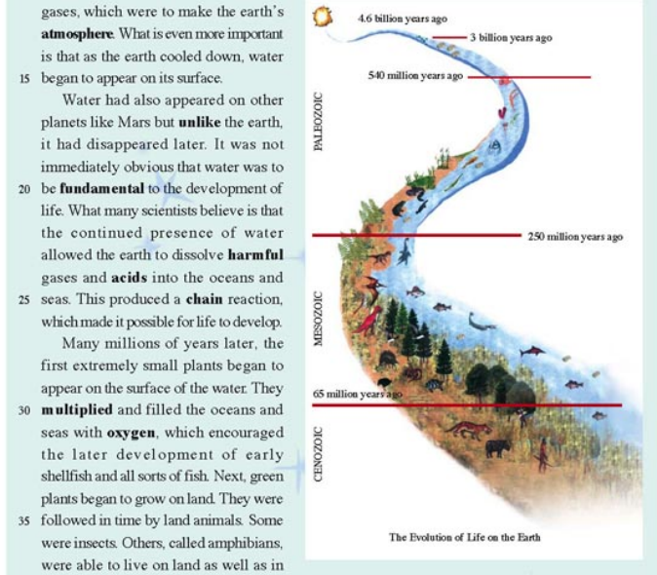

Slide 14
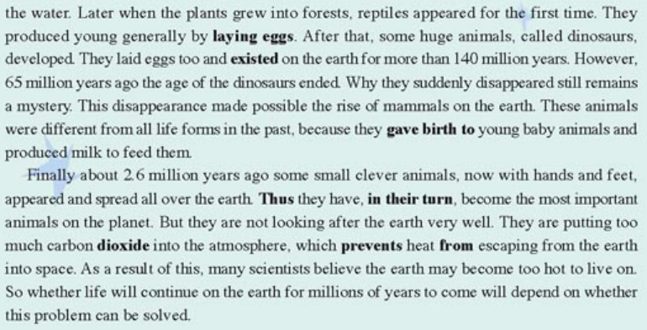

Slide 15
Skimming
1.What ‘s the main idea of the passage ?
How life began on the earth.

Slide 16
Skimming
2. Try to match each paragraph
with its main idea .
Para 1
The importance of the water
Para 2
The formation of the universe
Para 3
The formation of the earth
The arrival of the human and their impacts
Para 4
The development of plants and animals on earth
Para 5

Slide 17
Practice makes perfect
Thanks for listening

