Slide 1
A TRIP ON “ THE TRUE NORTH”
人教版高中英语 M3U5
Words and expressions
华南师范大学外文学院
余夏竹

Slide 2
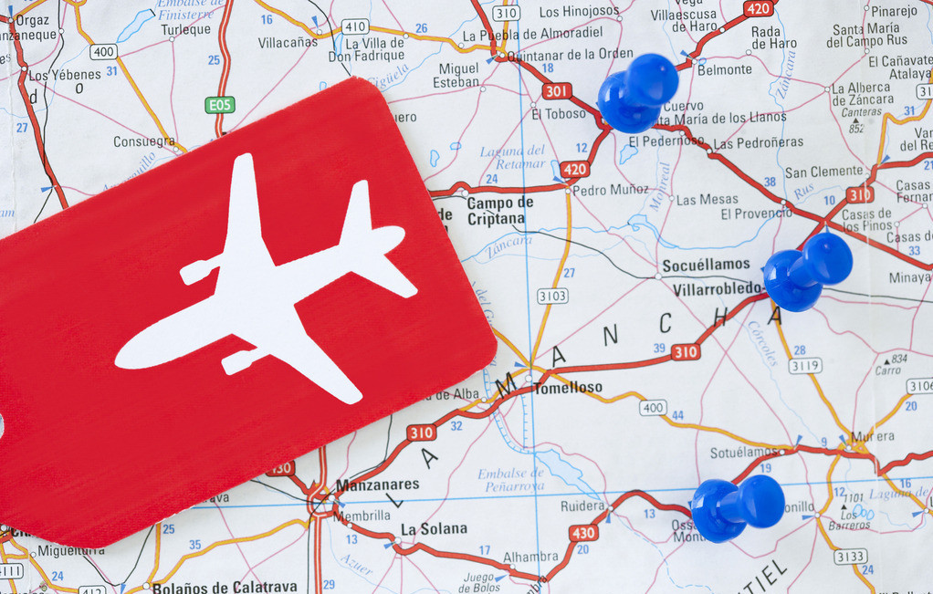
When mention travel,
what words do you think of?

Slide 4
Jack’s Travel Experience

Slide 5
Jack has travelled to seven continents
and seen a lot of beautiful scenery.
continent
n.洲，大陆
scenery
n.景色，风景

Slide 6
For convenience, Jack brought only some baggage.
baggage
n.行李
Notes:
bags

Slide 7
How did Jack travel?
Did he travel by ship? Like what Columbers do?
Or did he travel by train?

Slide 8
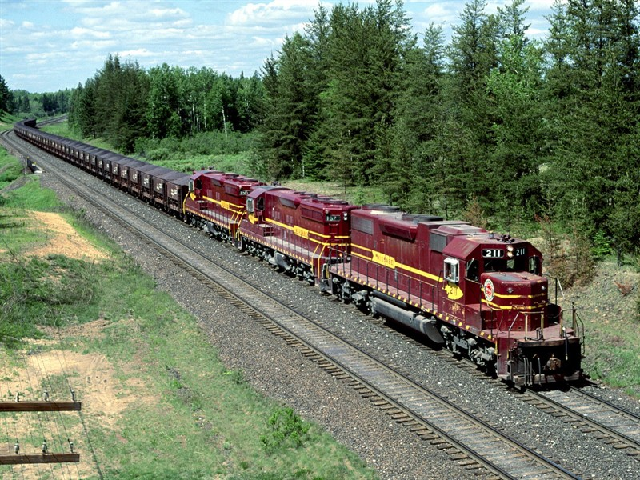
Rather than the train all the way,
Jack took the aeroplane to some places.
take
rather than
与其，不愿
+(to) verb

Slide 9
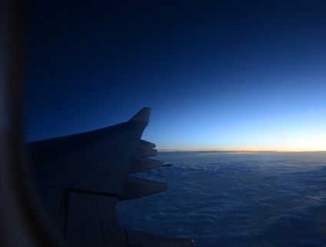
After settling down in his seat, Jack managed to
catch sight of twinkling stars outside the window.
settle down
manage to do
catch sight of
平静下来
设法做 =succeed in doing sth
看见，瞥见

Slide 10
What did Jack do in Canada?

Slide 11
urban
Jack stayed in area and went to see the night
view of . He taking photos and
took this beautiful photo to record.
harbour
has a gift for

Slide 12
urban
adj.城市的，市镇的

Slide 13
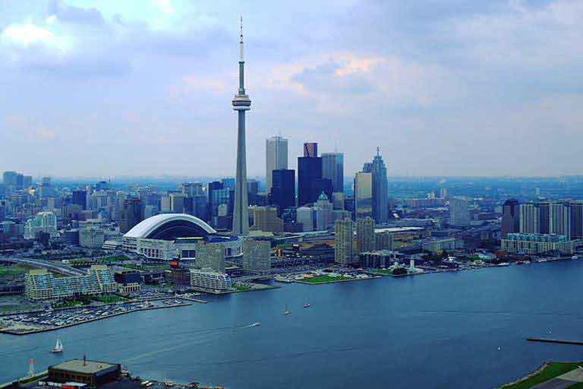
harbour(=harbor)
n. 海港

Slide 14
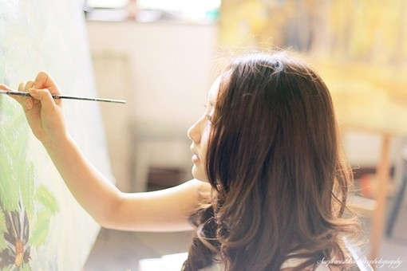
have a gift for
对……有天赋
The girl has a gift for playing the piano.
She has a gift for painting.

Slide 15
What did Jack do next?

Slide 16
Going eastward, Jack saw
many tall trees, some
measuring over 90 metres.
eastward
east+ward
adv.向东
westward
upward
adv.向西
adv.向上
measure
v.长度（或距离、宽度）为……

Slide 17
And Jack saw farms that cover thousands of acres.
acre
n.英亩

Slide 18
Read after me, think of the meaning of these words
and then use these words to retell Jack’s travel
experience.
continent
scenery
baggage
rather than
settle down
manage to do
catch sight of
urban
harbour
have a gift for
eastward
measure
acre

Slide 19
Thank you !

