Slide 1
SKIMMING
John Snow defeats “king cholera”
华南师范大学
2013级英师4班
刘滟婷Tiffany

Slide 2
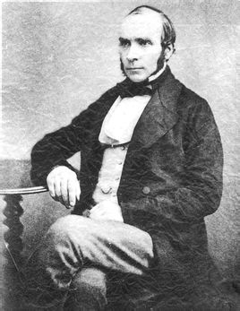
John Snow

Slide 3
General Idea

Slide 4
WHO?
WHEN?
HOW MANY?
WHAT?
WHY?
HOW TO SOLVE THE PROBLEM?
#GENERAL IDEA

Slide 5
WHO?
Who defeats “King Cholera”?

Slide 6
#Who defeats “King Cholera”?
PARAGRAPH 1
…John Snow wanted to face the challenge and solve this problem.

Slide 7
WHEN?
When did it happen?

Slide 8
#When did it happen?
PARAGRAPH 3
John Snow suspected that the second theory was correct but he needed evidence.so when another outbreak hit london in 1854…

Slide 9
HOW MANY?
How many people died in the accident?

Slide 10
#How many people died in the accident?
PARAGRAPH 3
…the cholera outbreak was so severe that more than 500 people died in ten days…

Slide 11
WHAT?
What happened?

Slide 12
#What happened?
PARAGRAPH 1
…but he became inspired when he thought about helping ordinary people exposed to cholera.this was the deadly disease of its day.Neither its cause nor its cure was understood.So many thousands of terrified people died every time there was an outbreak.John Snow wanted to face the challenge and solve this problem .He knew that cholera would never be controlled until its cause was found.

Slide 13
WHY?
Why was there no death at No. 20 and 21 Broad Street as well as at No. 8 and 9 Cambridge Street?

Slide 14
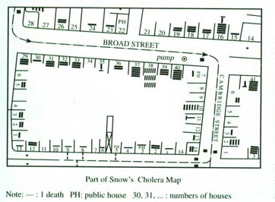
#Why is there no death at No. 20 and 21 Broad Street as well as at No. 8 and 9 Cambridge Street?
Many of the deaths were near the water pump in Broad Street(especially numbers 16,37,38and40).He also noticed that some houses(such as 20 and 21 Broad Street and 8and 9 Cambridge Street)had had no deaths.He had not foreseen this,so he made further investigations.He discovered that these people worked in the pub at 7 Cambridge Street.They had been given free beer and so had not drunk the water from the pump.It seemed
that the water was to blame.

Slide 15
HOW
How to solve the problem

Slide 16
The METHOD of scientific research

Slide 17
#How to solve the problem
Basic steps of scientific research
-Find a problem
-Make a question
-Think of a method
-Collect results
-Analyse result
-Find supporting evidence
-Draw a conclusion

Slide 18
Why theses steps are necessary for scientific research?

Slide 19
#Why theses steps are necessary for scientific research?
1.To help us to think logically
2.To understand the passage better
3.To learn how to solve problem
4....
Do you have more idea?
Share with us!

Slide 20
#How to solve the problem
-Find a problem
-Make a question
-Think of a method
-Collect results
-Analyse result
-Find supporting evidence
-Draw a conclusion
-What causes cholera?
-Which theory is correct?
-Gather information when another outbreak hit London in 1854
-Make a map to find out where people died or did not died
-Look into the source of water and analyse the water
-Find supporting evidence from two other deaths
-The polluted water carried the virus

Slide 21
In conclusion
1.Remove the handle from the pump
2.The source of all the water be examined
3.Water companies were instructed not to exposed people to polluted water anymore.

Slide 22
Hope you enjoy!
By Tiffany

