Slide 1
The Political System
of the UK
吴勉如 Rebecca

Slide 2
Question
Who is the real ruler of the UK?

Slide 3
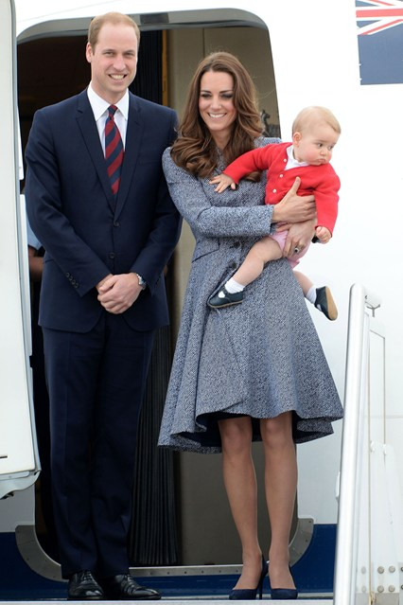
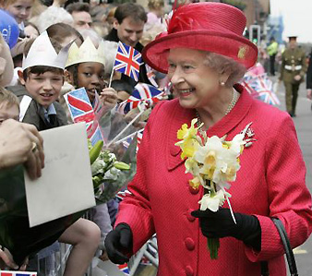
Do you know who he is?
George
Prince William and Kate
Her Majesty Queen Elizabeth II

Slide 5
The British Monarchy

Slide 6
Do you know who he is?
The Prime Minister: David Cameron

Slide 8
The British governmental model
1) a constitutional monarchy
2) a parliamentary system

Slide 9
The British monarchy
The monarch has a number of roles, and serves formally as:
1) head of state
2) head of the executive
3) head of the judiciary
4) head of the legislature
5) commander-in-chief of the armed forces
6) supreme governor of the Church of England

Slide 10
ACTUALLY,
the monarch doesn’t have real power. He or she undertakes constitutional and representational duties and they acts only on the advice of political ministers.
The monarch can not
make laws
impose taxes
spend public money

Slide 11
British Parliament
British Parliament consists of:
the House of Lords
the House of Commons
Parliament has a maximum duration of five years

Slide 12
House of Lords
consists of the Lords Temporal and the Lords Spiritual
This is the upper chamber but the one with less authority.
The House of Commons
consists of Members of Parliament (MPs) who arc elected by the adult suffrage of the British people

Slide 14
The Prime Minister
The Prime Minister is head of the UK government. He is ultimately responsible for all policy and decisions. He:
oversees the operation of the Civil Service and government agencies
appoints members of the government
is the principal government figure in the House of Commons
the most important person in the British political system is the Prime Minister.

Slide 15
Political Parties
The Labour Party
The Conservative Party
The Liberal Democrat Party

Slide 16
Who is the real ruler of the UK?
Queen or Prime Minister?

Slide 17
Thank you!

