Slide 1
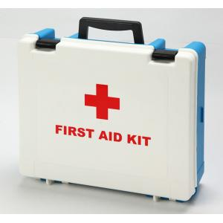
Unit5
First Aid
2013级英语师范5班
20130201167陈雅婷

Slide 2
Useful & Important
Attention

Slide 3
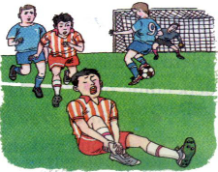
Special situation
Must Not! (not professional)
Broke
Vital

Slide 4
Severe
Not Sure
Professional
CPR

Slide 5
What’s CPR？
CPR(心肺复苏术) is short for cardiopulmonary (心肺的) resuscitation(复苏), an emergency procedure(步骤) performed in an effort to manually(人工地) preserve intact(完好无损的) brain function(功能) until further measures are taken to restore(使恢复) spontaneous(自发的；自然的) blood circulation(血液循环) and breathing in a person who is in cardiac arrest(心脏停搏).

Slide 6
When you are giving first aid to others, make sure you are not in danger.

Slide 7
Emergency telephone numbers (China)
120
Emergency Medical Service
(EMS)
119
Fire Department
110
Police Department
http://en.wikipedia.org/wiki/Main_Page

Slide 8
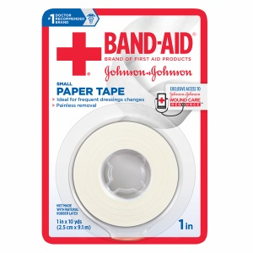
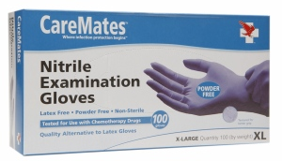
Bandage
Ointment
软膏；药膏
Gloves

Slide 9
Stay Away Form Danger!
Prevention is better than cure.
You can never be too careful.

Slide 10
You can never be too careful.
再小心也不为过。

Slide 11
Homework

Slide 12
Thank You!
2013级英语师范5班
20130201167陈雅婷

