Slide 1
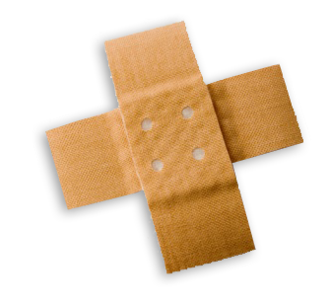
First Aid
Unit 5
Roman 罗文敏

Slide 2

What is first aid?
Simple
medical treatment that is given to somebody a doctor comes or before the person can be taken to a hospital.
before

Slide 3

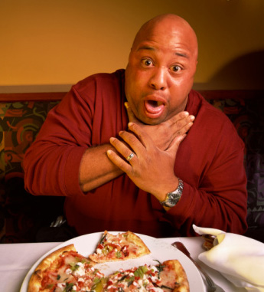
Minutes could
make a difference

Slide 4
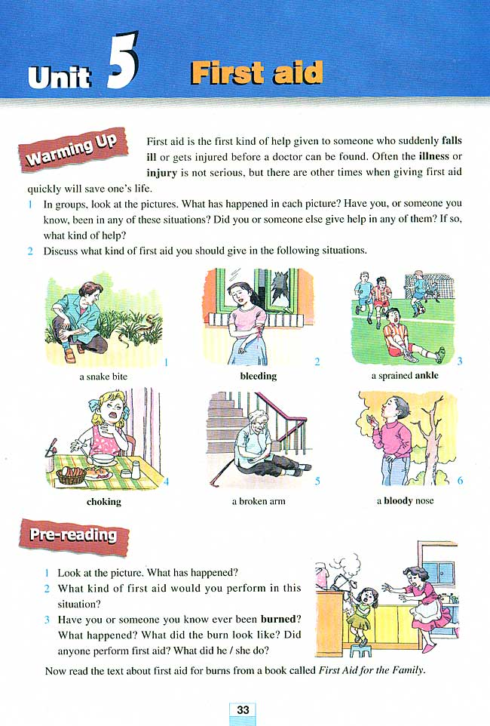
What should we do?

Slide 5
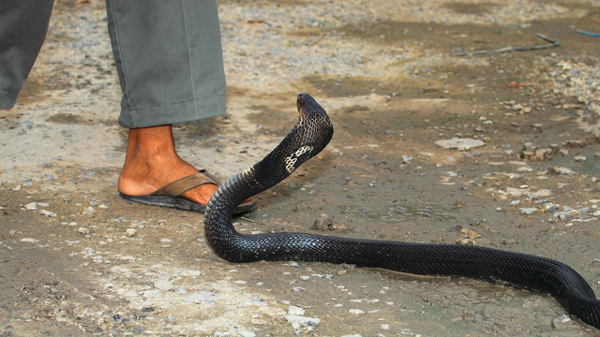
Q1. What should you do to help someone who is bitten by a snake ?
get a doctor or go to hospital
Speed is very important.
tell the doctor what kind of snake it was, or describe the situation.

Slide 6
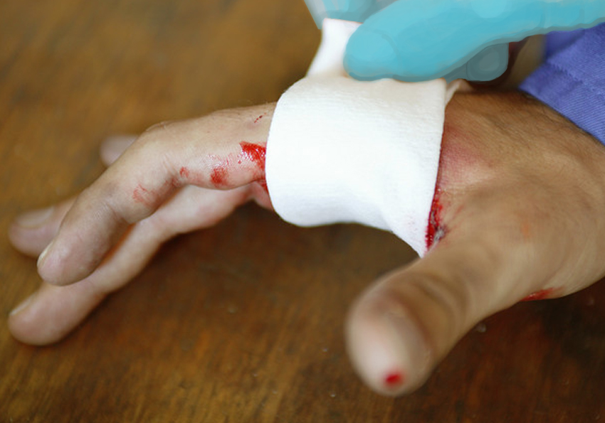

Q2. If someone is bleeding from a wound, what can you do to help?
Let the blood drain out.
Put pressure on the injury.
Tie a tourniquet above the injury

Slide 7
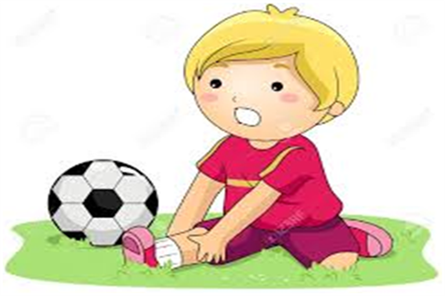
Q3. What would be the correct way to apply to a sprained ankle to reduce aching?
  tied with medical bandage.
  avoid walking with the injured ankle.
  use ice bag for removing pain and bleeding
  won’t influence our own body healing.

Slide 8
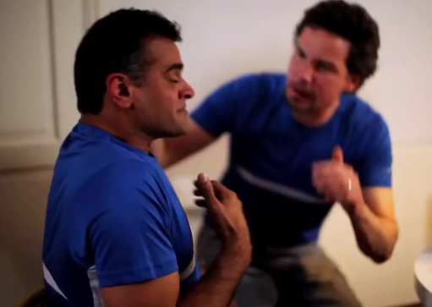
Q4. What should you do to help someone who is choking?
Encourage them to breathe through their nose.
Help them drink some water to dislodge the object.
Hit them firmly on their back between the shoulder blades

Slide 9
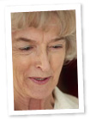
Q5. What should you do if you think someone has broken a leg?
Ask them to lean on their leg to check if it is painful.
Help them support their leg using a cushion or some clothing.
Leave it for a while to see if the pain gets better.

Slide 10
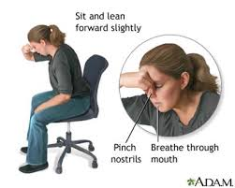
Q6. If you get a nosebleed, gently let your head back to stop the bleeding.
A. True.
B. False.
It may lead the blood into the throat and easily cause choking.

Slide 11
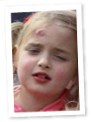
Q7. Which item below would be the best thing to apply to a head injury to reduce swelling?
A bag of frozen vegetables wrapped in cloth.
A wet cloth.
A can of cold soft drink.

Slide 12
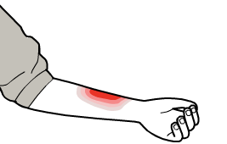
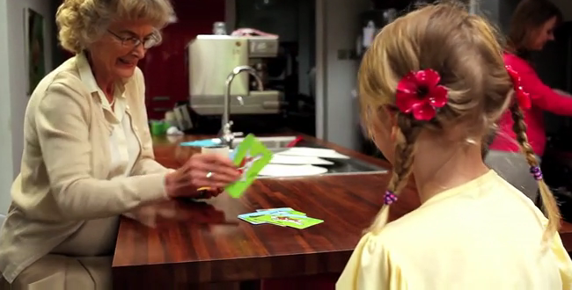
Q 8. What is the most important thing to do to help someone who has a burn?
Wrap the burn in cling film or a clean plastic bag.
Wipe the burn with antiseptic wipes.
Cool the burn under cold running water.

Slide 13
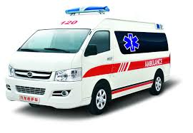

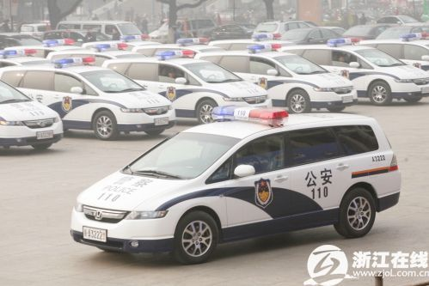
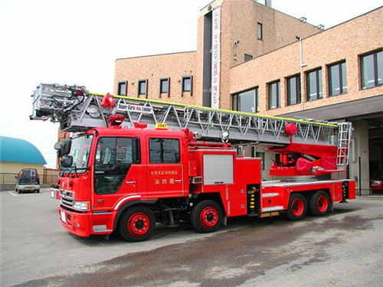
Listen！What are they?
fire engine

Slide 14
Important Numbers
120
119
110
Emergency medical service
Fire department
Police department

Slide 15

Assignment: role-play
Act out one, act out the situation we talk today for next class.

Slide 16
Thank you!

