Slide 1
Book 6 Unit 5 The Power of Nature
华南师范大学外国语言文化学院
夏嘉琪

Slide 2
What is the power of nature?

Slide 3
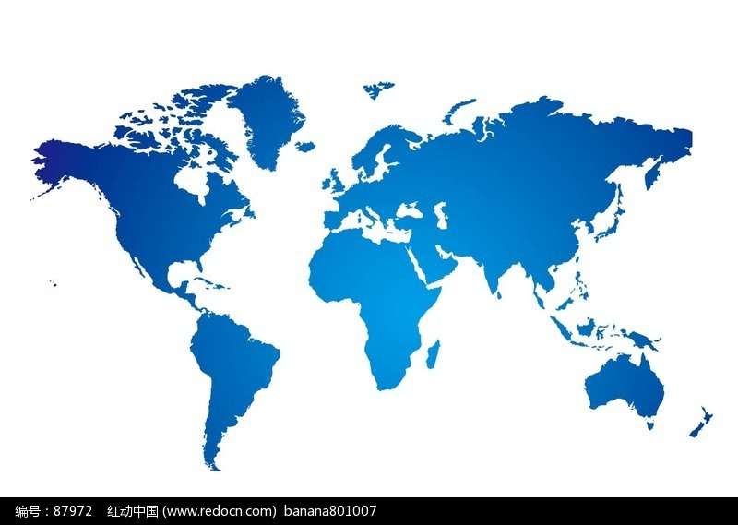
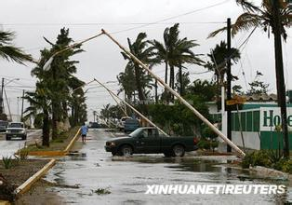
California, America
美国加利福尼亚
hurricane
/ˈhʌrikən/
n. 飓风；台风

Slide 4
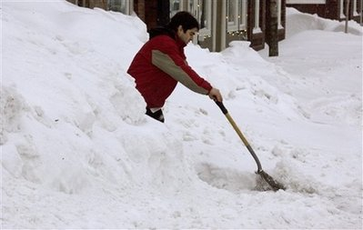
Boston, America
美国波士顿
snowstorm
/ˈsnəustɔːm /
n. 暴风雪；雪灾

Slide 5
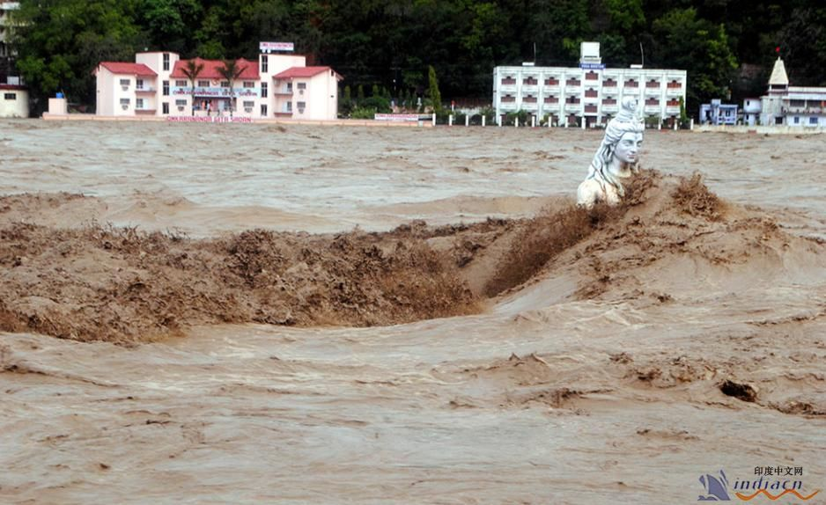
North Akandebang, India
印度北阿坎德邦
flood
/flʌd/
n. 洪水; 涨潮; 水灾

Slide 6
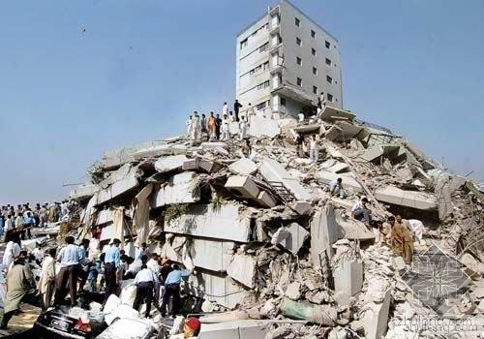
Wenchuan, China
中国汶川
earthquake
/’E:T,kwek/
n. 地震

Slide 7
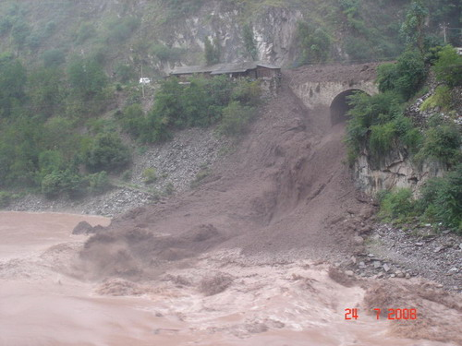
Zhouqu, China
中国舟曲
mudslide
/ˈmʌdslaɪd/
n. 泥石流

Slide 8
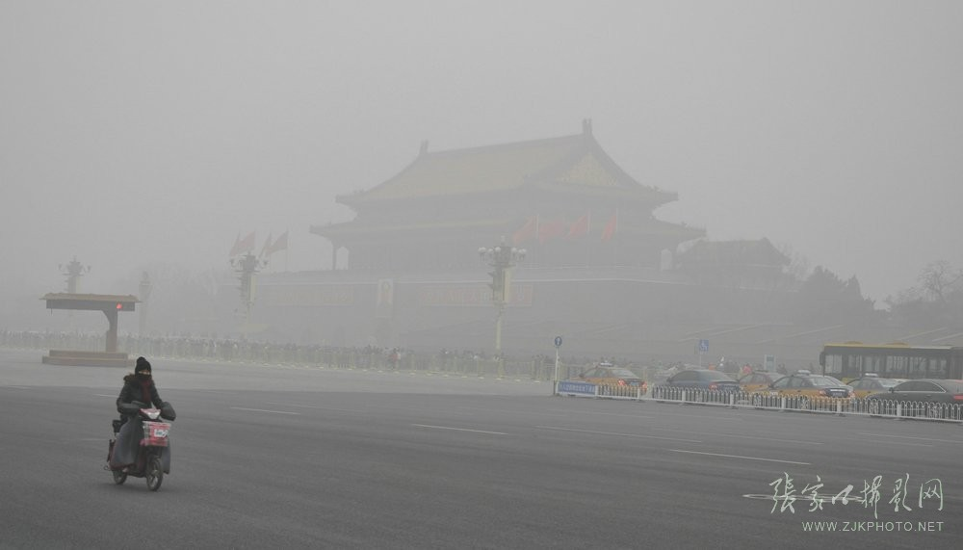
Beijing, China
中国北京
smog
/smɒg/
n. 雾霾；烟雾

Slide 9
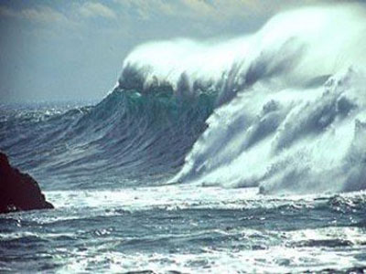
Sumtra, Indenesia
印尼苏门答腊
tsunami
/tzu:’nami/
n. 海啸

Slide 10
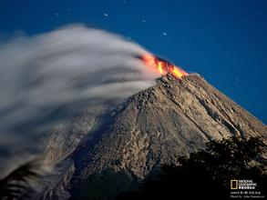
Sumtra, Indenesia
印尼苏门答腊
volcanic eruption
/vɔlˈkeɪnik/ /ɪˈrʌpt/
n. 火山爆发

Slide 11
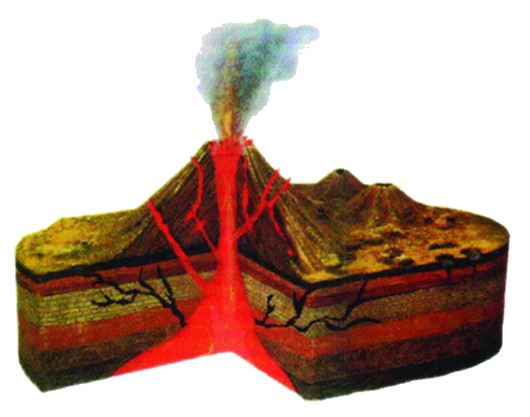
The Framework of A Volcano
Ash cloud
火山灰
crater
火山口
Main vent
火山通道
lava
熔岩
Magma Chamber
熔浆

Slide 12
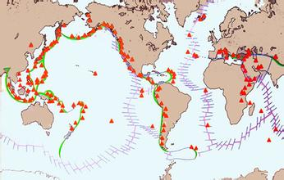
Where do volcanic eruptions happen frequently?
Circum-Pacific seismic belt
（环太平洋火山地震带）
Mediterranean - Himalaya Range seismic belt
（地中海—喜马拉雅火山地震带）

Slide 13
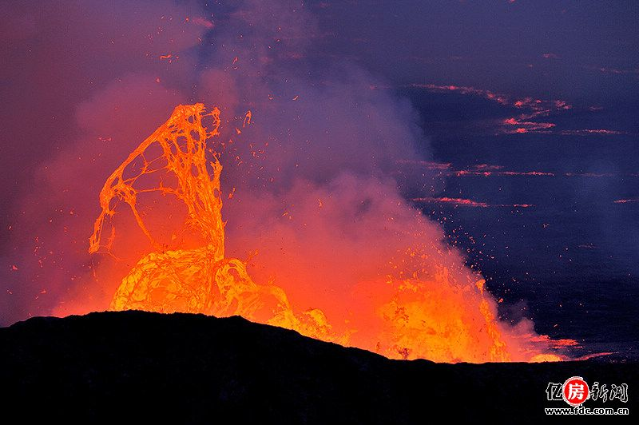
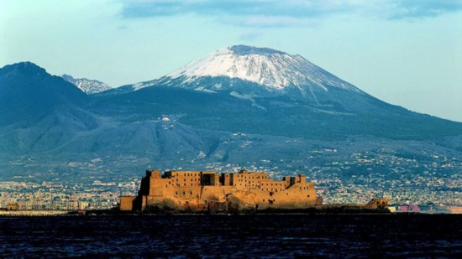
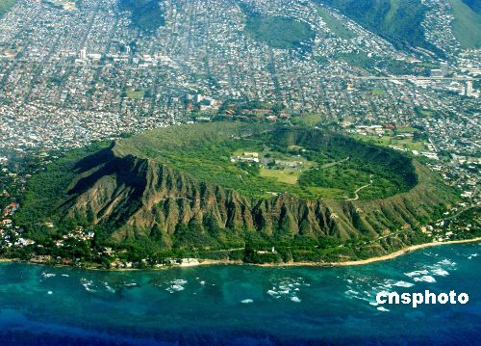
How many types of volcanos?
Active volcano(one that may erupt at any time)
Dormant volcano(one that had erupted before)
Extinct volcano(one that no longer erupts)

Slide 14
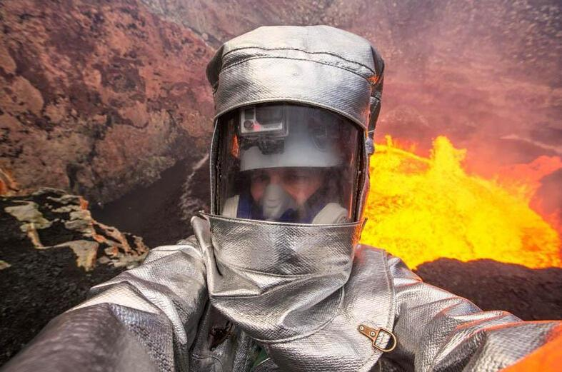
One kind of job…
Name: John
Job: volcanologist /,vɒlkən’ɒlədʒɪst/

Slide 15
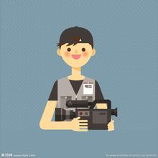
An interview with John
John
You

Slide 16
An interview with John
0:01
0:02
0:03
0:04
0:05
0:01
0:02
0:03
0:04
0:05
你是如何成为火山学家的？
Time’s up!
Time’s up!
I was born in Hawaii, one of the places where volcanos are most active in the world. Being very interested in volcanos, I majored in volcanology and became a volcanologist 20 years ago.
火山学家的工作是什么？
Volcanologists are responsible for recording the conditions of volcanos and assess if they are active. In addition, studying about the rocks along with them is helpful.

Slide 17
An interview with John
0:01
0:02
0:03
0:04
0:05
0:01
0:02
0:03
0:04
0:05
你如何保护自身安全？
Time’s up!
Time’s up!
We will pick the right time and right place ahead of the our move. What’s more, everyone should put on the protective suit so as to prevent heat as much as possible.
这份工作有趣在哪里？
Seeing the inside of a volcano is extremely exciting. Every time you have to be quick and decisive because you can’t stay there for a long time.

Slide 18
A self-evaluation about yourself
Questionaire | Yes | No
1. Do you like working outside as well as inside?
2. Do you enjoy travelling unusual places?
3. Do you enjoy taking risks?
4. Do you dislike doing the same thing every day?
5. Do you like adventure in your life?
6. Are you interested in studying rocks and other things that make up the surface of the earth?
If you answer “yes” for all these questions, then volcanology can be a good career for you.
For more information, you can read my passage below!

