Slide 1
You Raise Me Up
人教版 M1UI Friendship
作者：李嘉敏
单位：华南师范大学外文学院
PPT模板下载：www.1ppt.com/moban/ 行业PPT模板：www.1ppt.com/hangye/
节日PPT模板：www.1ppt.com/jieri/ PPT素材下载：www.1ppt.com/sucai/
PPT背景图片：www.1ppt.com/beijing/ PPT图表下载：www.1ppt.com/tubiao/
优秀PPT下载：www.1ppt.com/xiazai/ PPT教程： www.1ppt.com/powerpoint/
Word教程： www.1ppt.com/word/ Excel教程：www.1ppt.com/excel/
资料下载：www.1ppt.com/ziliao/
PPT课件下载：www.1ppt.com/kejian/
范文下载：www.1ppt.com/fanwen/

Slide 2
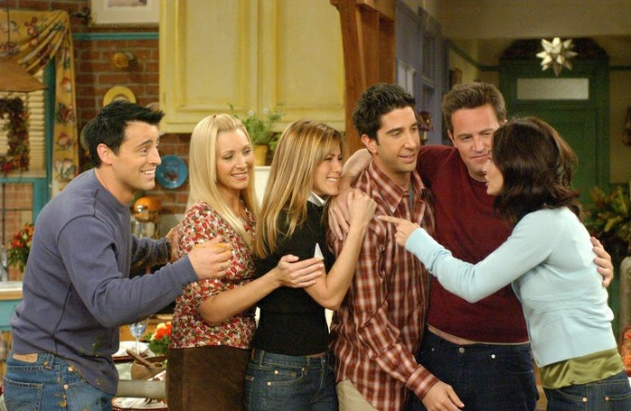
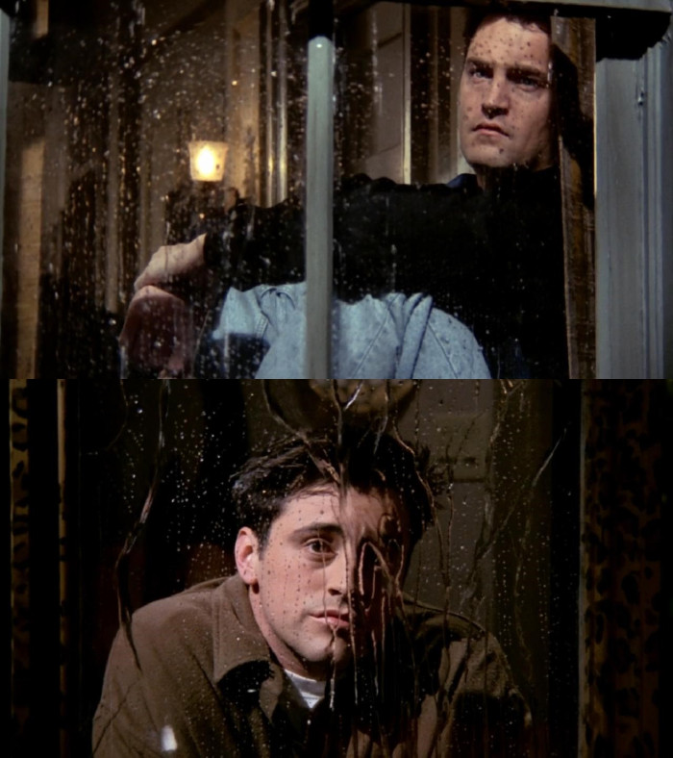
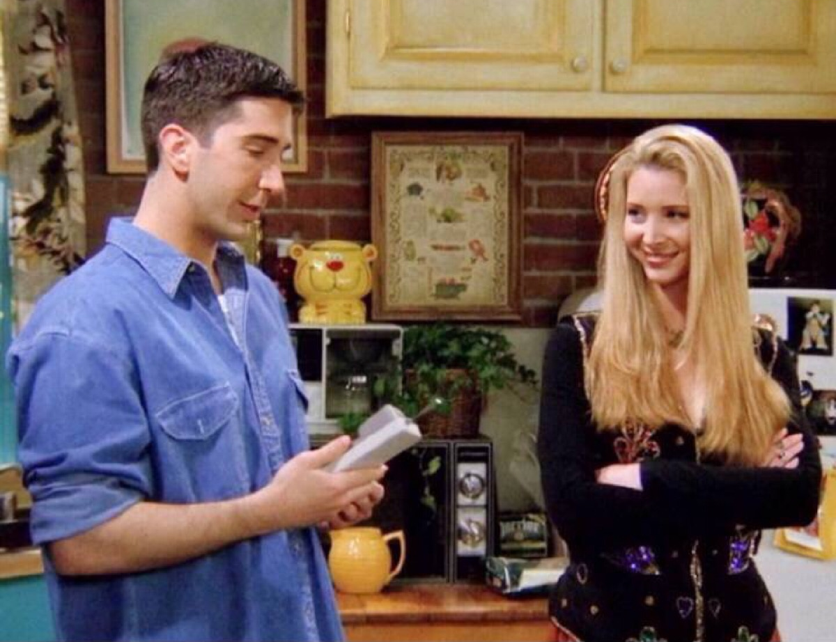
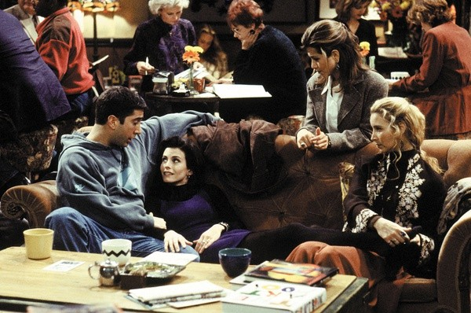
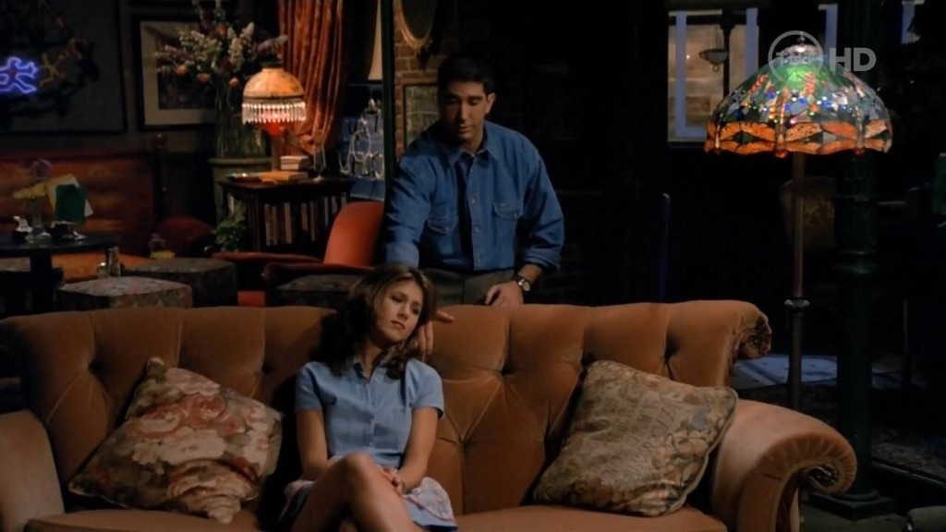
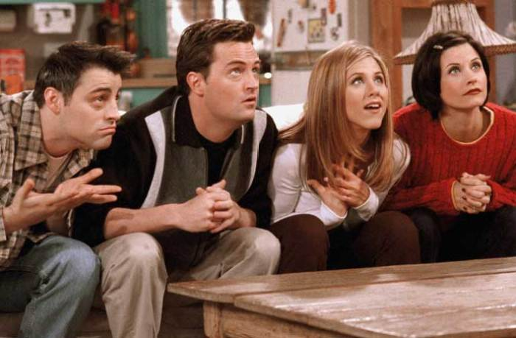
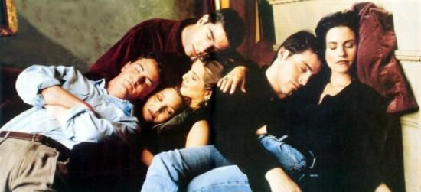
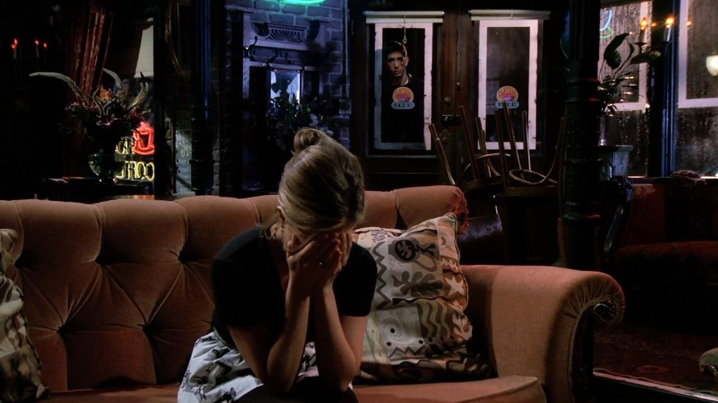
You raise me up,
so I can stand on
the mountains.
You raise me up, so I can stand on mountains.
When troubles come and my heart burdened be.
I am strong, when I am on your shoulders.
You raise me up, to walk on stormy seas.
I am strong, when I am on your shoulders
You raise me up… to more than I can be.
Until you come and sit a while with me.
Then, I am still and wait here in the silence.
You raise me
up,to walk on
stormy seas.
When I am down and, oh my soul, so weary.
You raise me up… to more than I can be.

Slide 3
Thanks for watching!
李嘉敏
20150201024
英师4班

