Slide 1
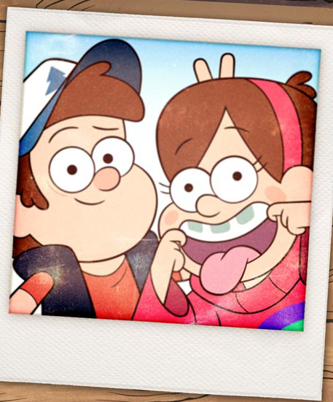
教材版本: 人教版 必修一
课文: Unit 1 Friendship
单位: 华南师范大学外文学院
作者: 林欣

Slide 2
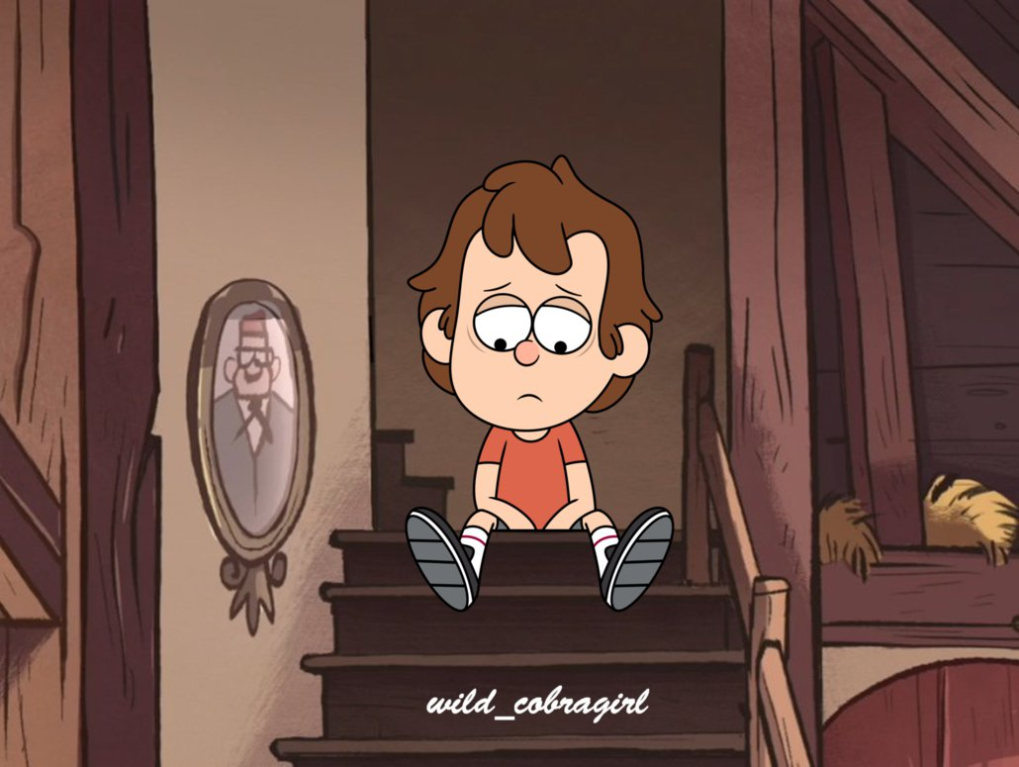
There's a moment in this journey that I gave up

Slide 3
My boots just couldn't walk another mile

Slide 4
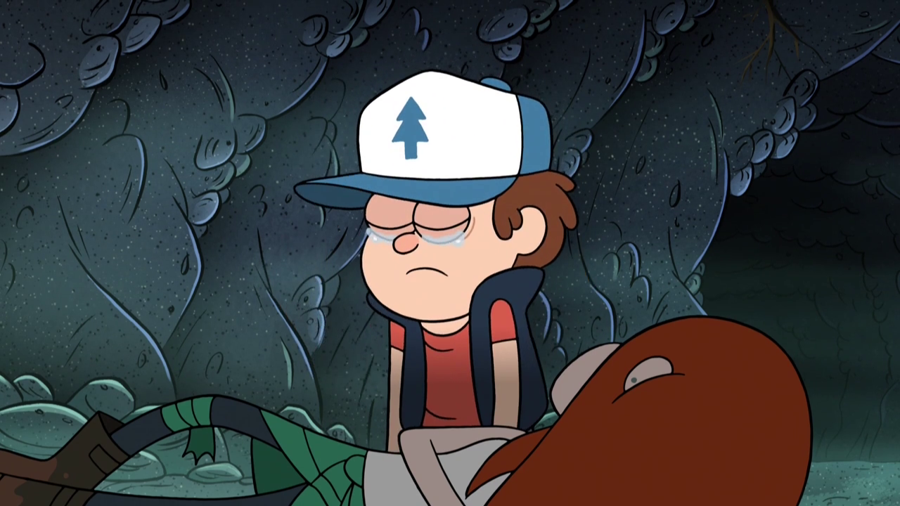
And that cloud above me had no silver lining

Slide 5
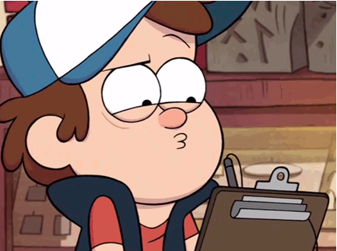
I couldn't buy a break with my last dime

Slide 6
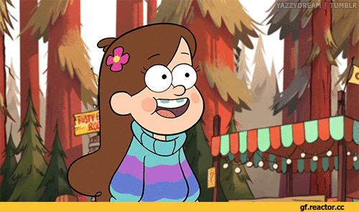
Oh but when I saw you standing in the corner

Slide 7
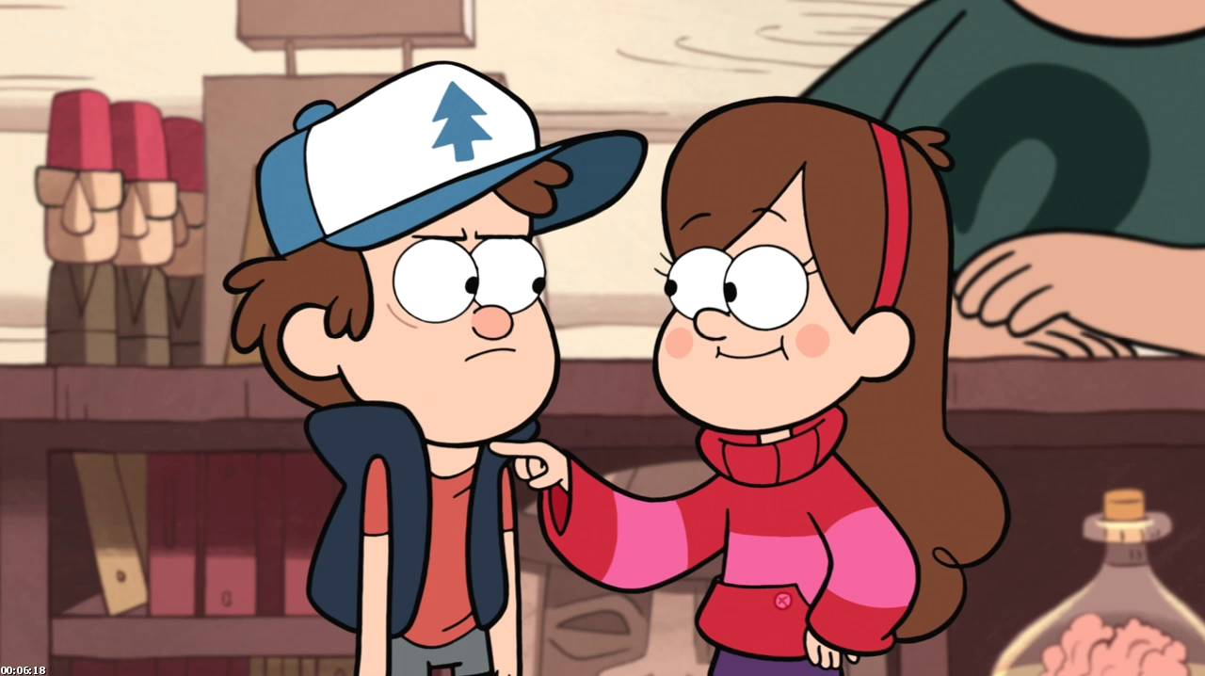
l'd never thought that you would have my back

Slide 8
But then we rolled in like the thunder and the lightening

Slide 9
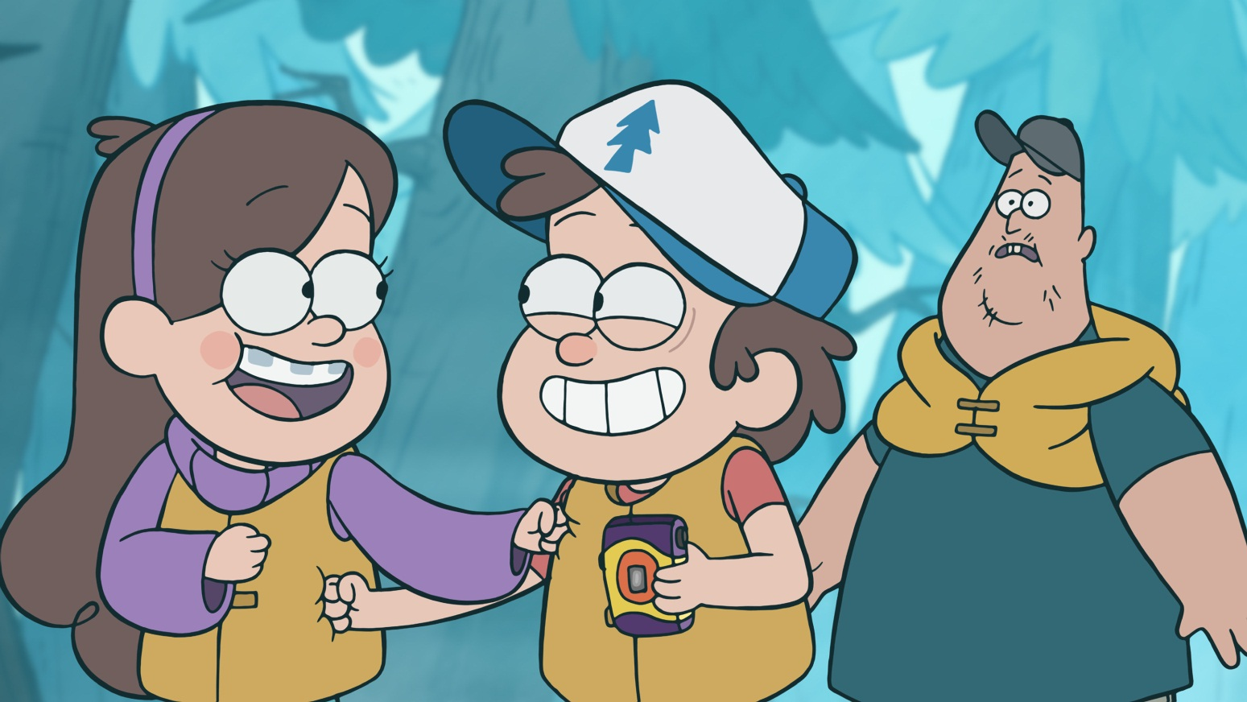
Threw some punches then we had a laugh

Slide 10
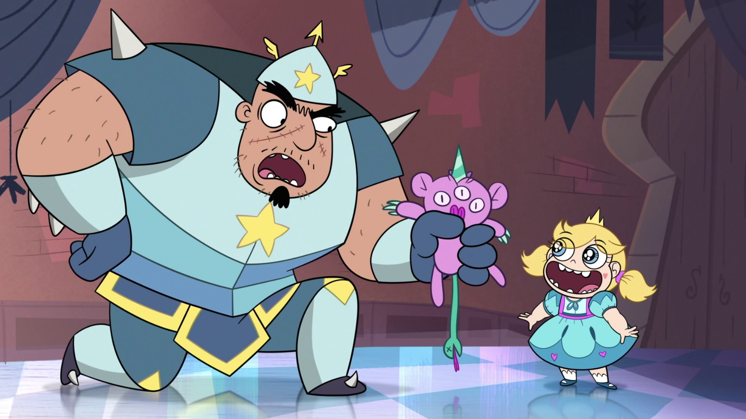
Just some roughed up desperadoes

Slide 11
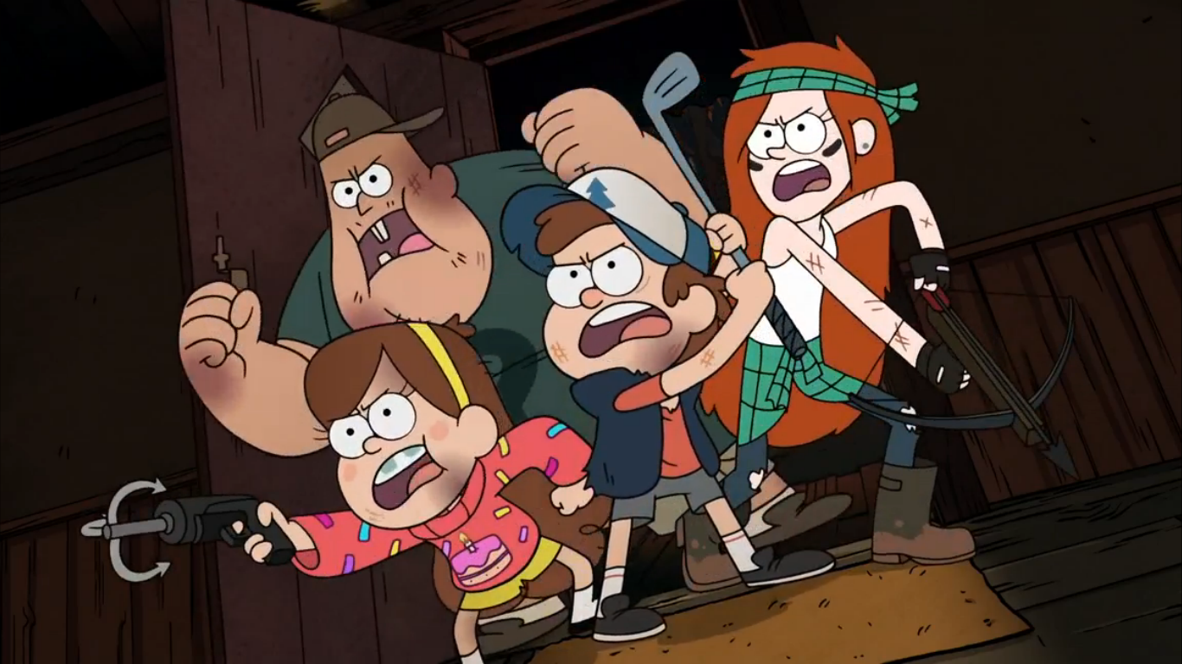
Hanging tough through thick and thin

Slide 12
Kicking up dust wherever we go

Slide 13
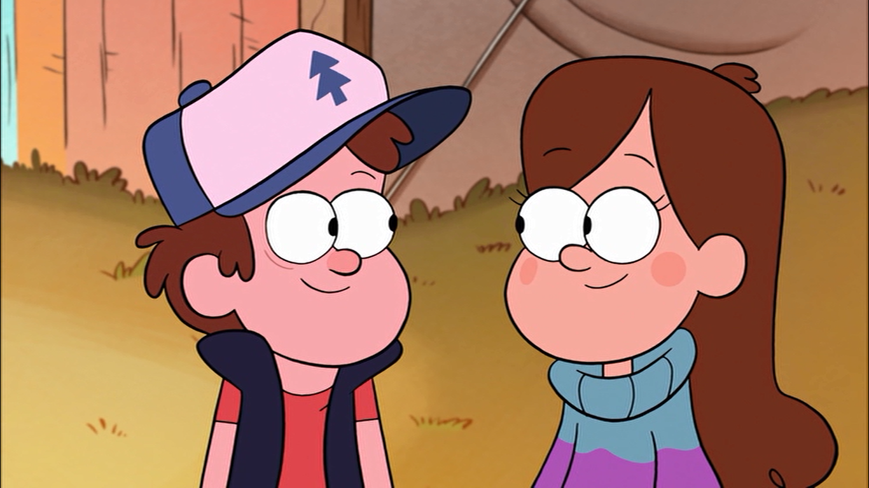
l can see that you and me are gonna be friends

Slide 14
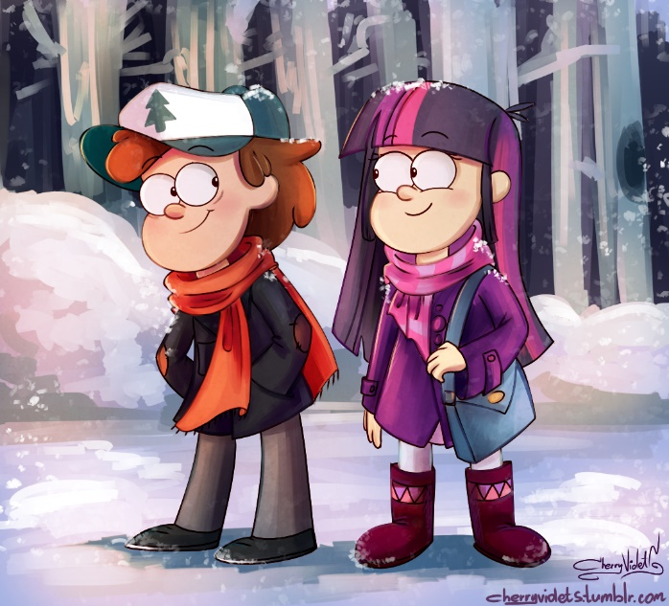
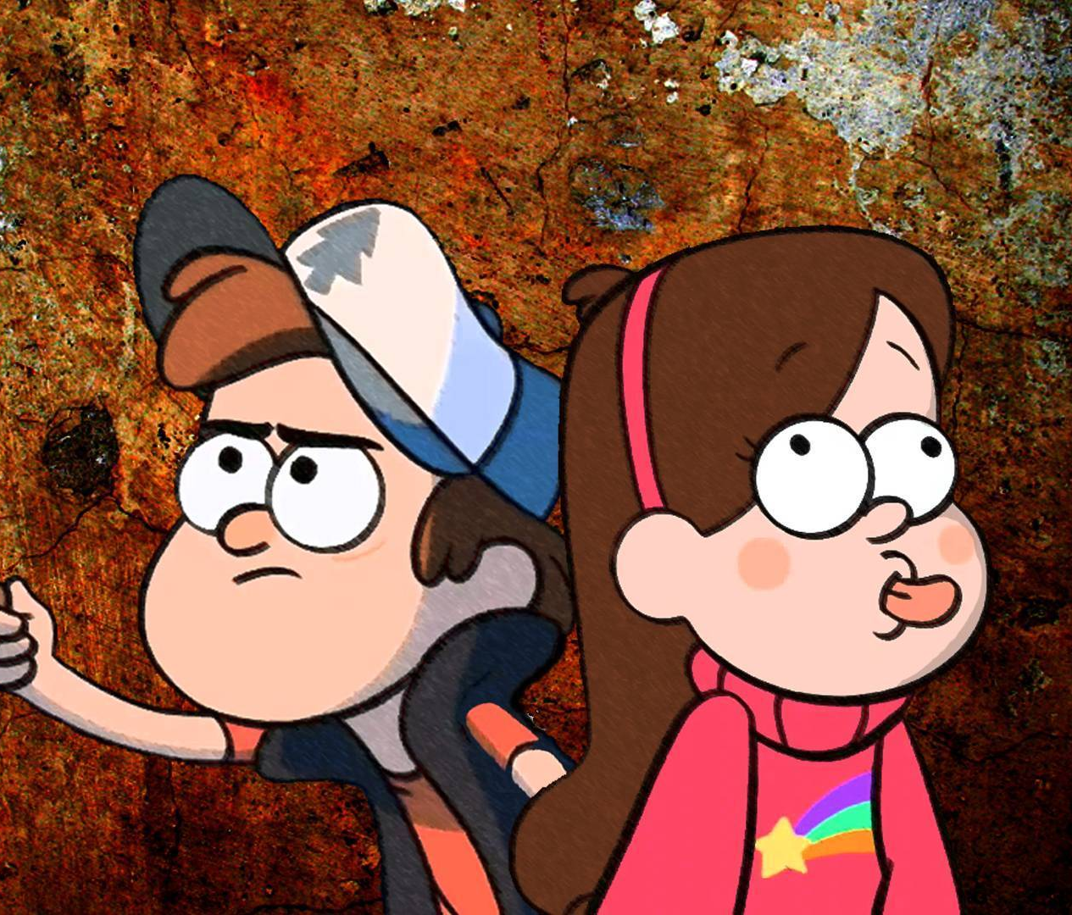

Slide 15
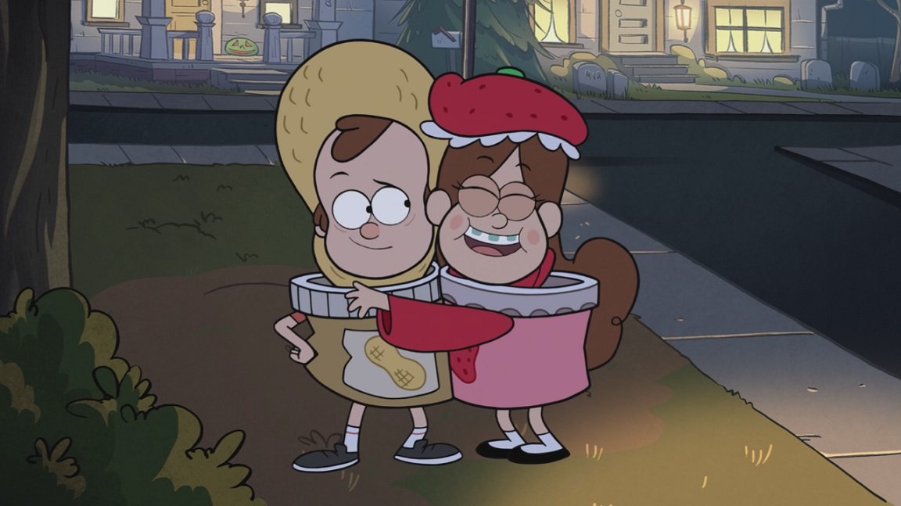
Who'da thought we'd wind up here together?

Slide 16
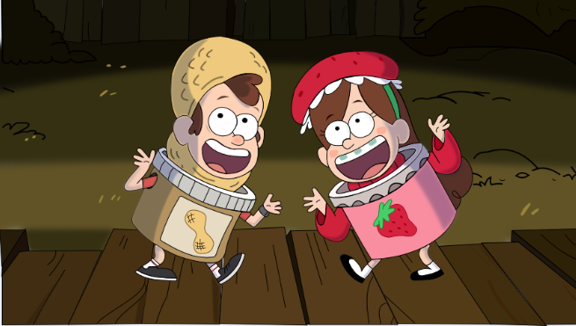
lt's crazy that we're standing side by side

Slide 17
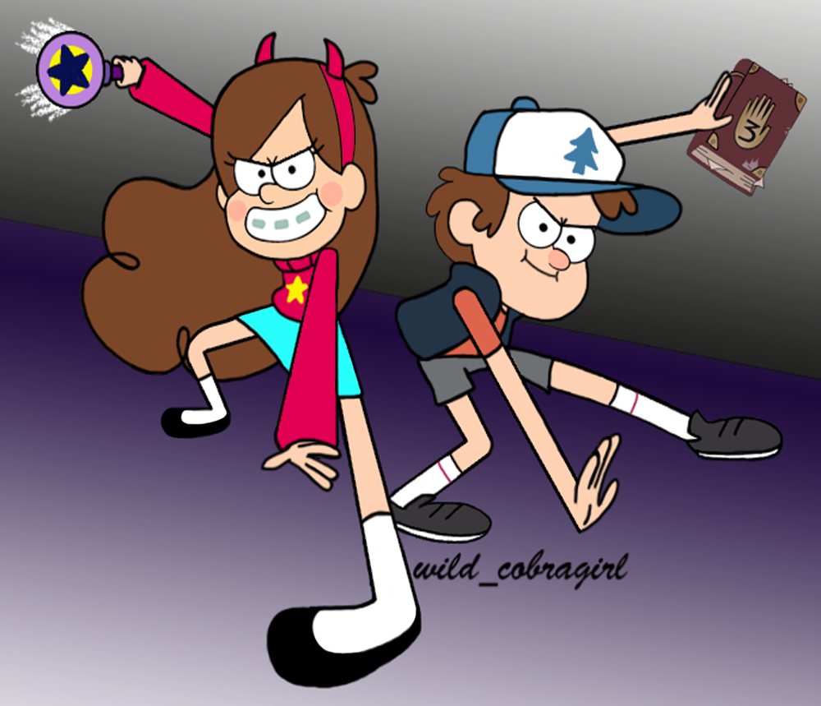
Fighting just like two birds of a feather

Slide 18
Who's gonna tell us now that we can't fly?

Slide 19
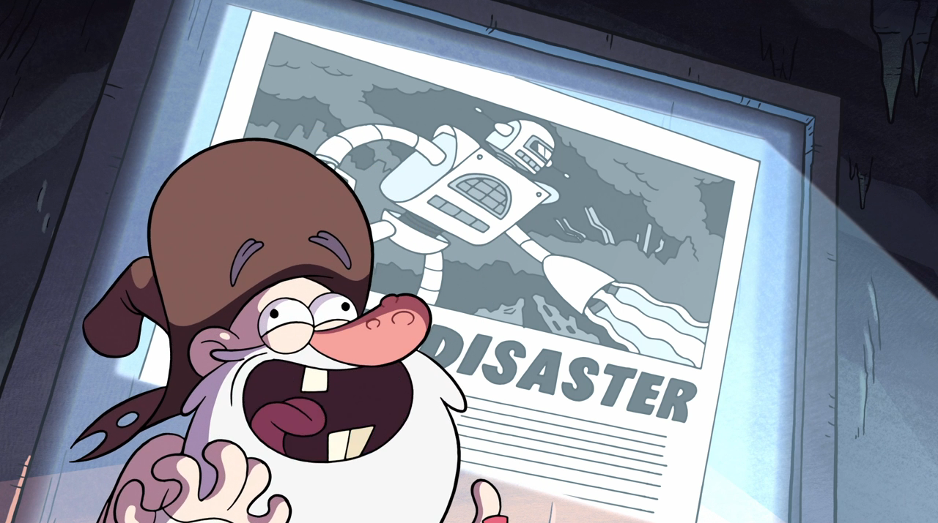
Just some roughed up desperadoes

Slide 20
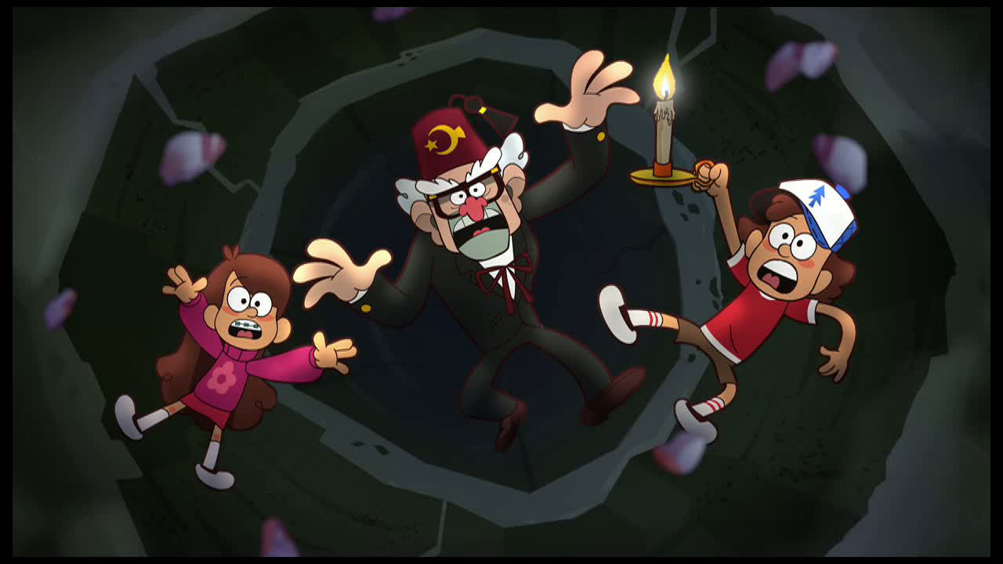
Hanging tough through thick and thin

Slide 21
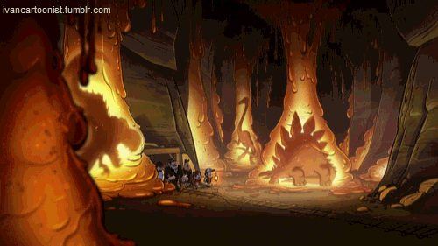
Kicking up dust wherever we go

Slide 22
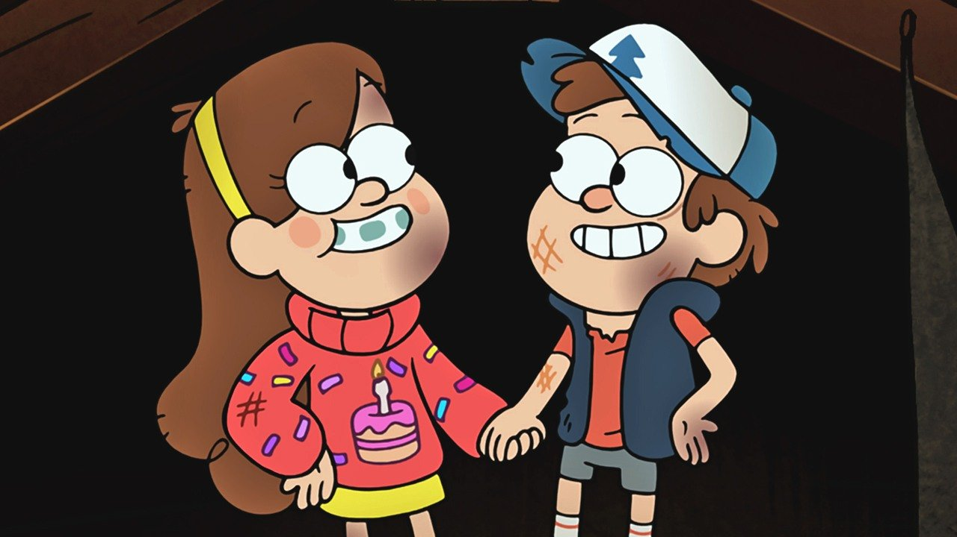
I can see that you and me are gonna be friends

Slide 23
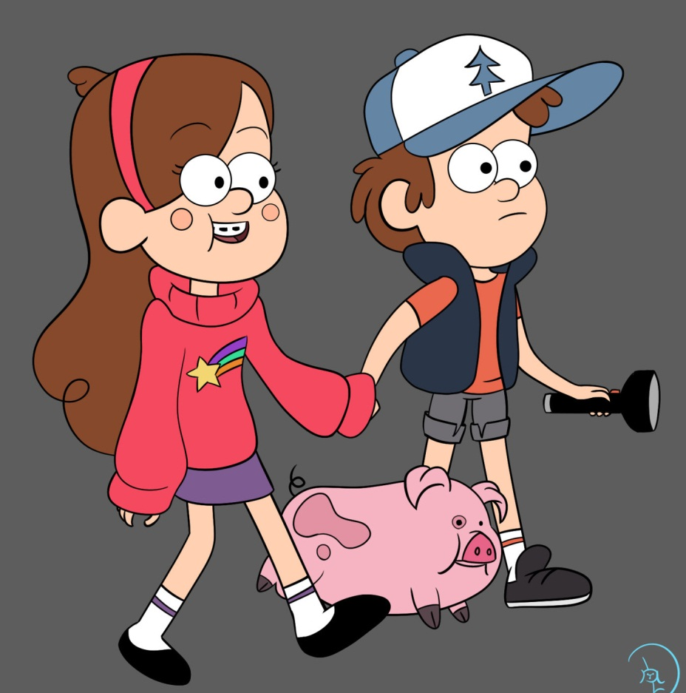
To the end you and me are gonna be friends
Yeah!

Slide 24
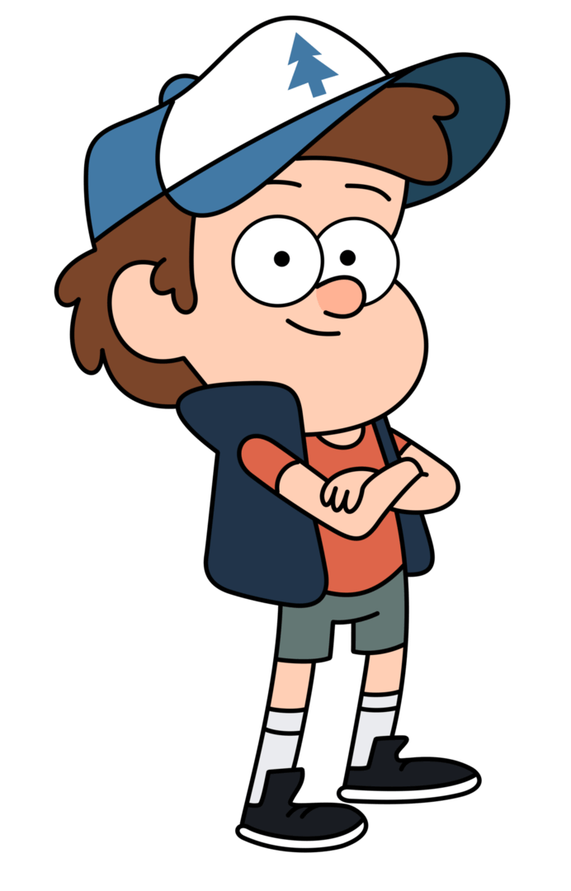
Here we go
Hey hey you and me
Different as different can be

Slide 25
You like to rock I like to roll

Slide 26
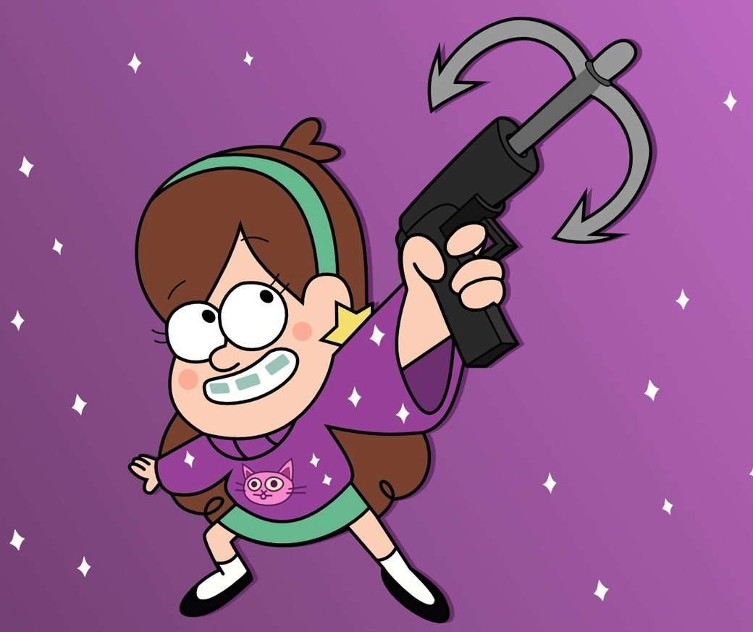
You take the high and I'll take the low

Slide 27
Woah woah-oh woah woah-oh

Slide 28
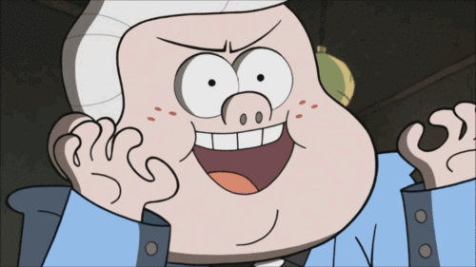
Just some roughed up desperadoes

Slide 29
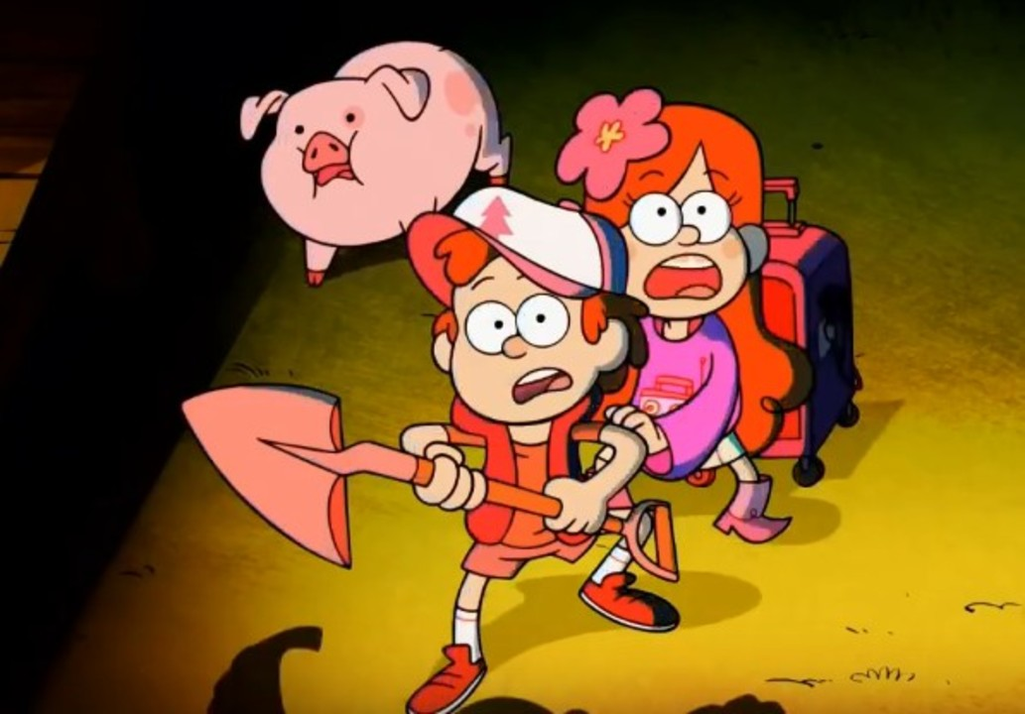
Hanging tough through thick and thin

Slide 30
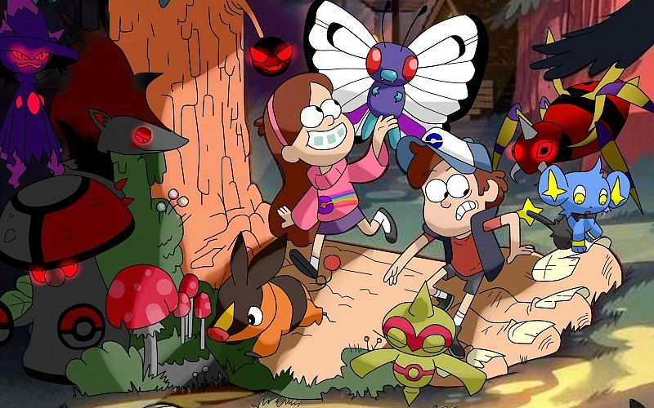
Kicking up dust wherever we go

Slide 31
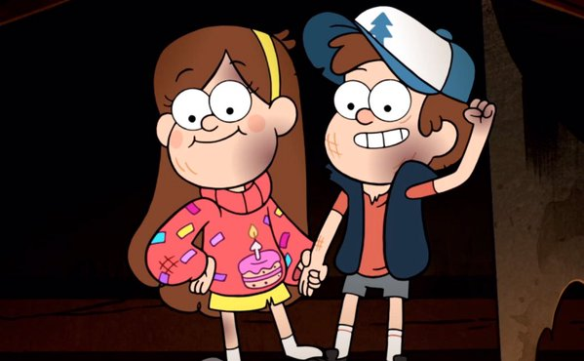
I can see that you and me are gonna be friends

Slide 32
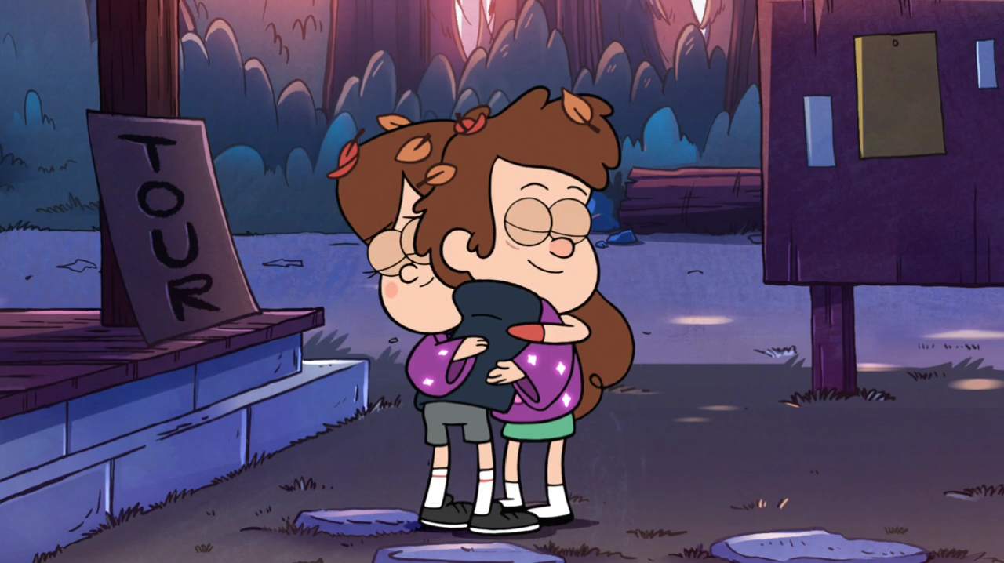
To the end you and me are gonna be friends

Slide 33
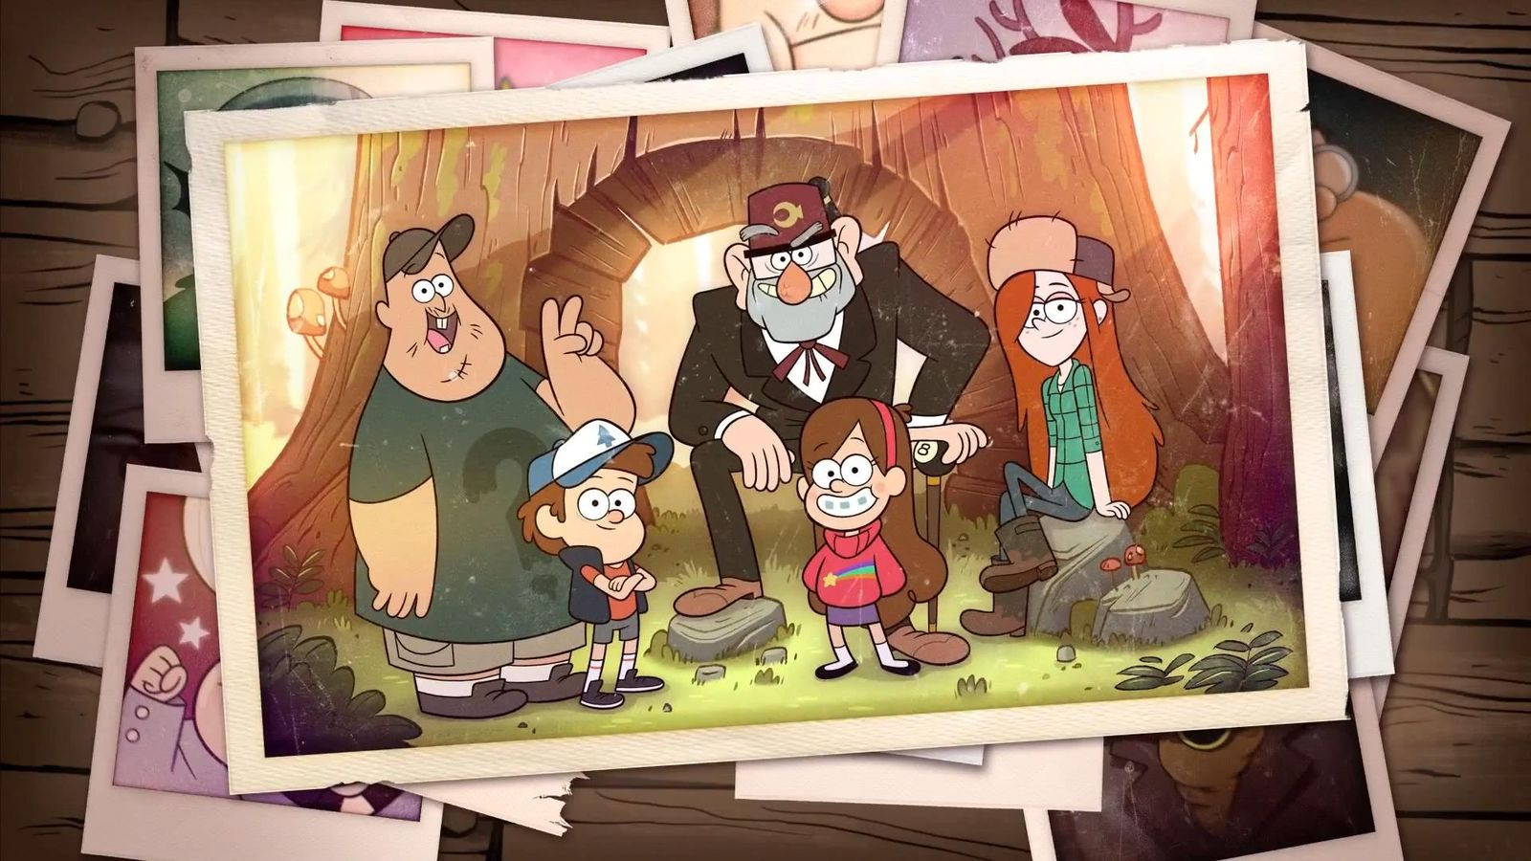
l can see that you and me are gonna be friends

