Slide 1
教材：人教版高一英语必修一
单元：U2 English around the world
课文：The road to modern English
作者：刘倩群
单位：华南师范大学外文学院

Slide 2
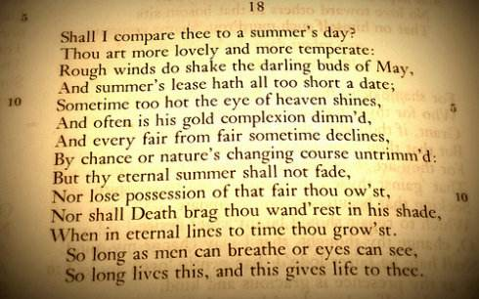
Shall I compare thee

Slide 3
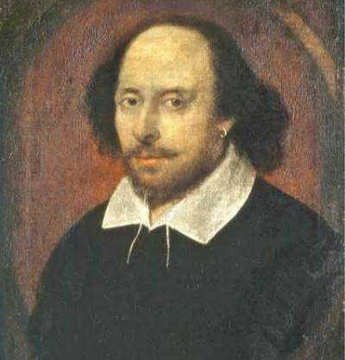
To a summer's day

Slide 4
Thou art more lovely

Slide 5
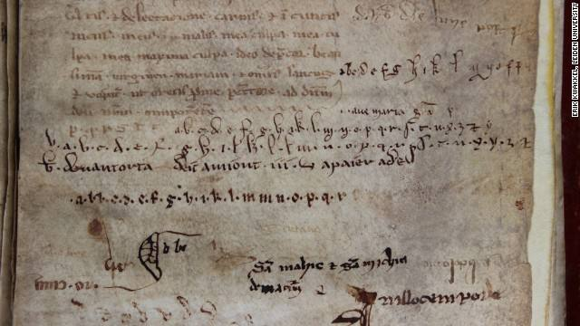
And more temperate

Slide 6
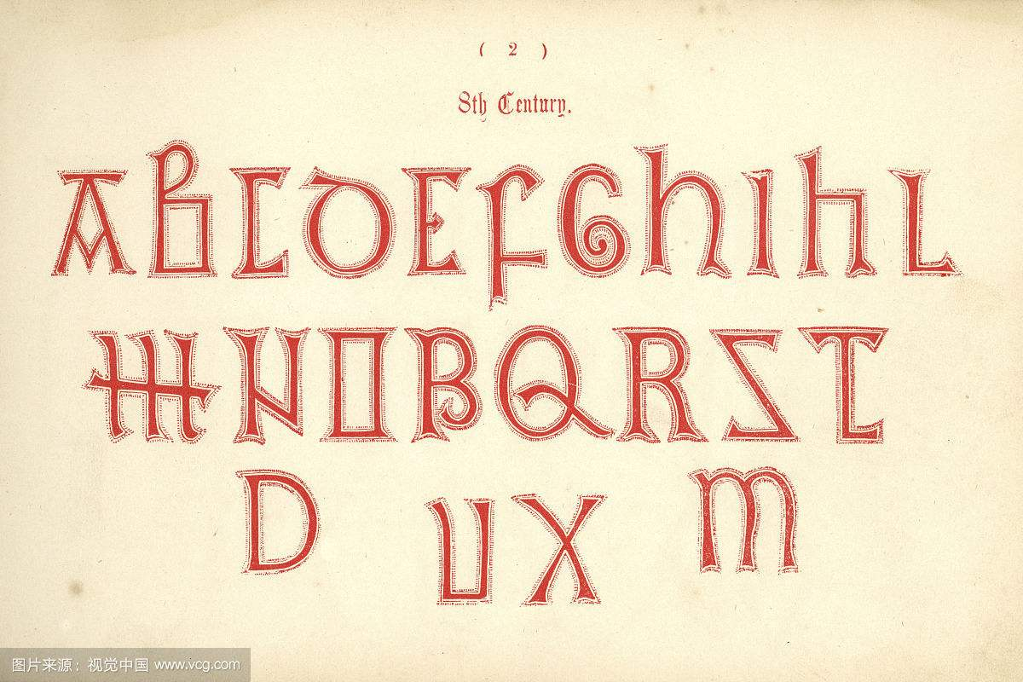
Rough winds do shake

Slide 7
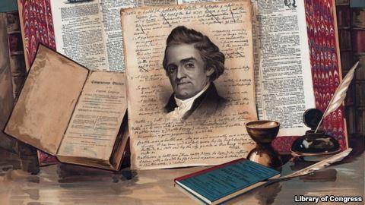
The darling buds of May

Slide 8
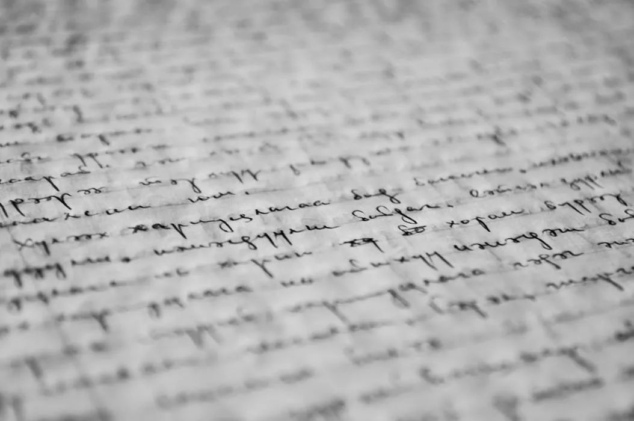
And summer's lease

Slide 9
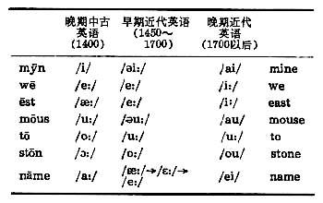
Hath all too short a day

Slide 10
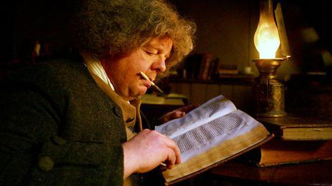
Sometime too hot

Slide 11
The eye of heaven shines

Slide 12
And often is his gold

Slide 13
Complexion dimm'd

Slide 14
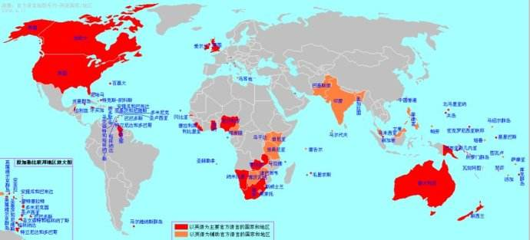
And every fair from fair

Slide 15
Sometime declines

Slide 16
By chance or nature's

Slide 17
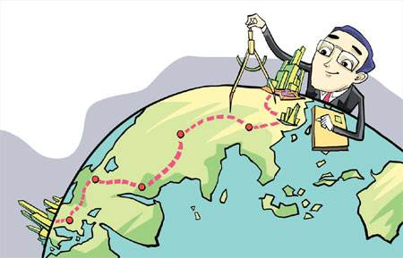
Changing course untrimm'd

Slide 18
But thy eternal summer

Slide 19
Shall not fade

Slide 20
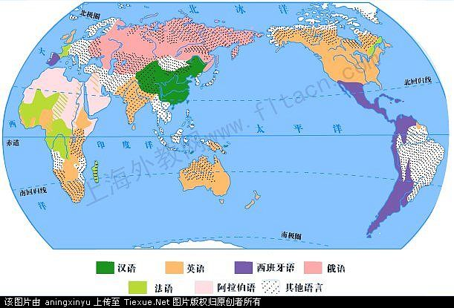
Nor lose possession of

Slide 21
That fair thou owest

Slide 22
Nor shall death brag

Slide 23
Thou wander'st in his shade

Slide 24
When in eternal lines

Slide 25
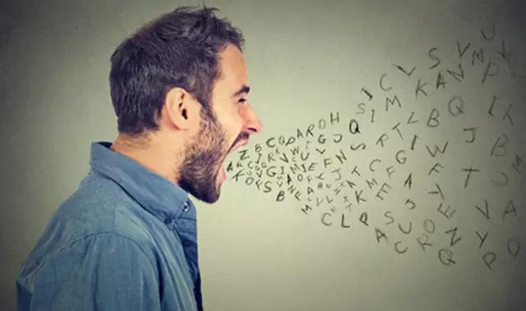
To time thou growest

Slide 26
So long as men can breathe

Slide 27
Or eyes can see

Slide 28
So long lives this

Slide 29
And this gives life to thee

