Slide 1
PEP M1U2
English around the World
华南师范大学外文学院
许慧欣

Slide 2
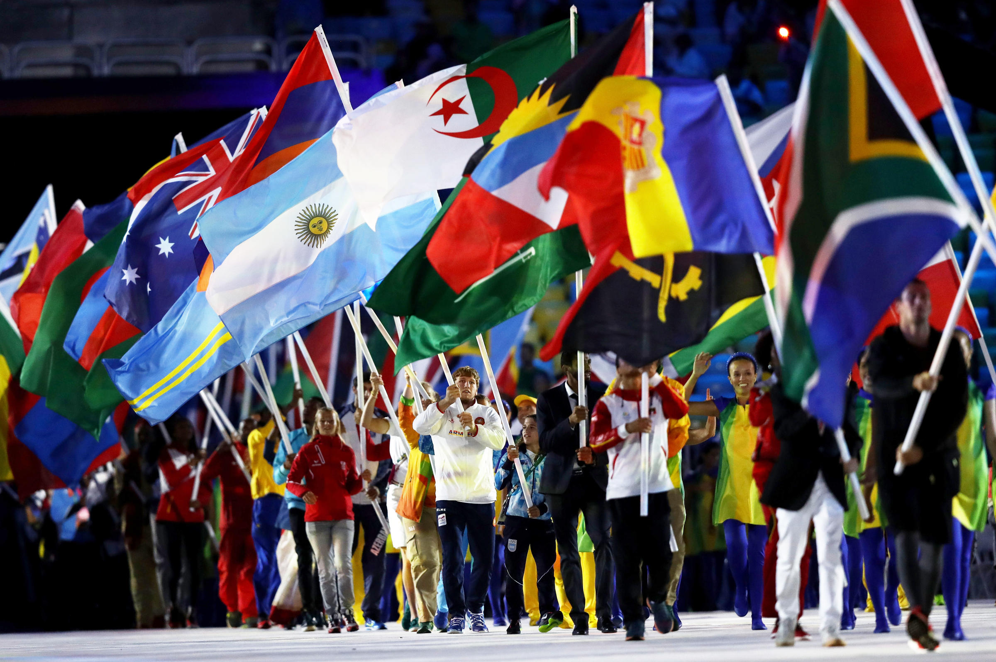
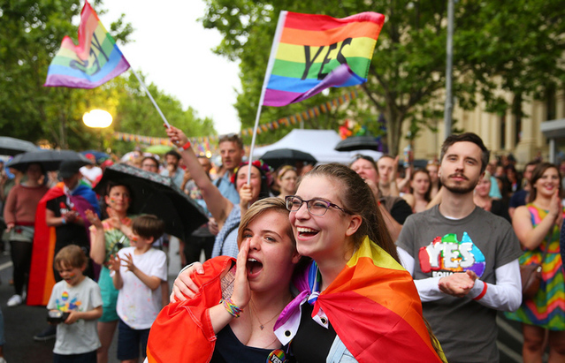
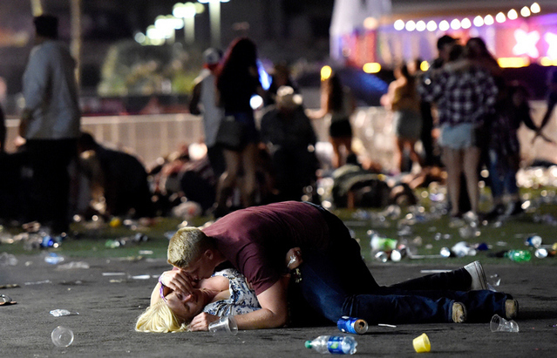
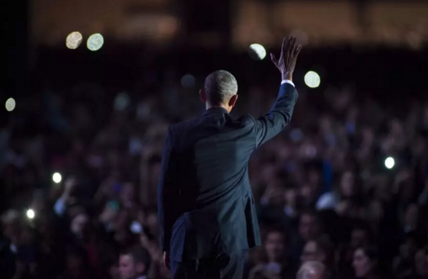
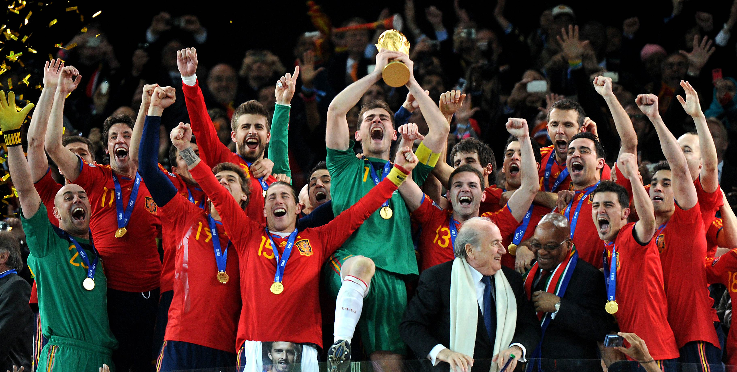
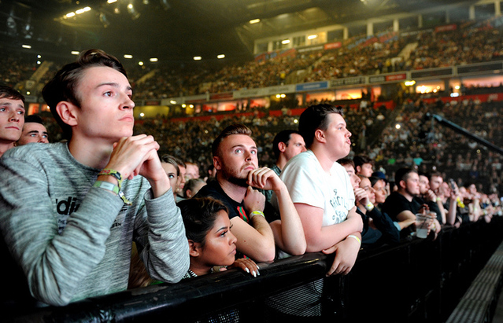
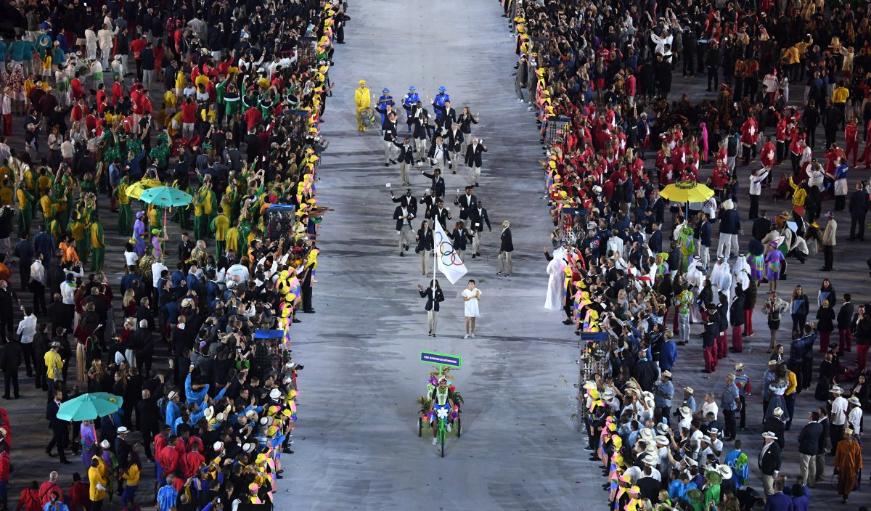
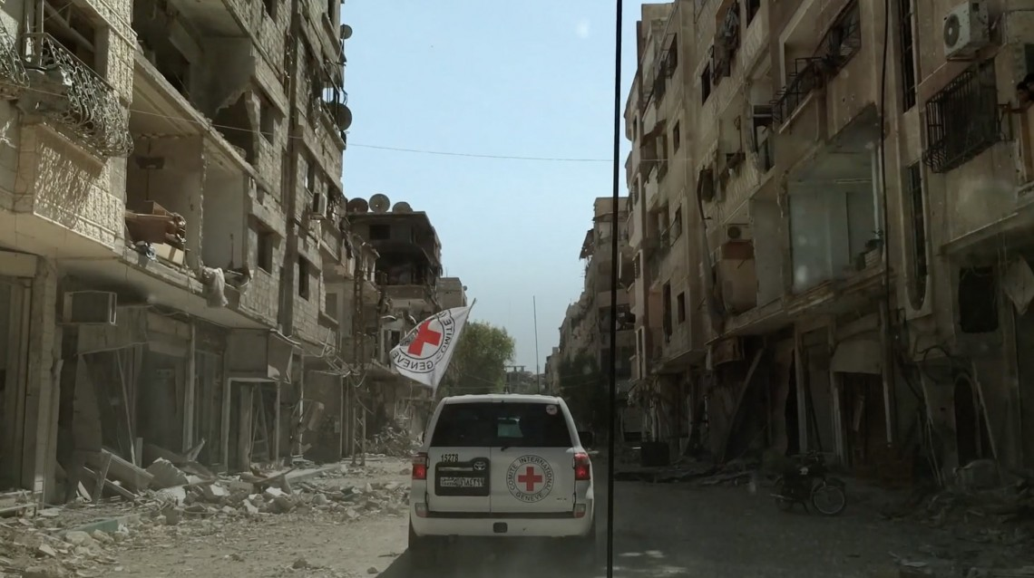
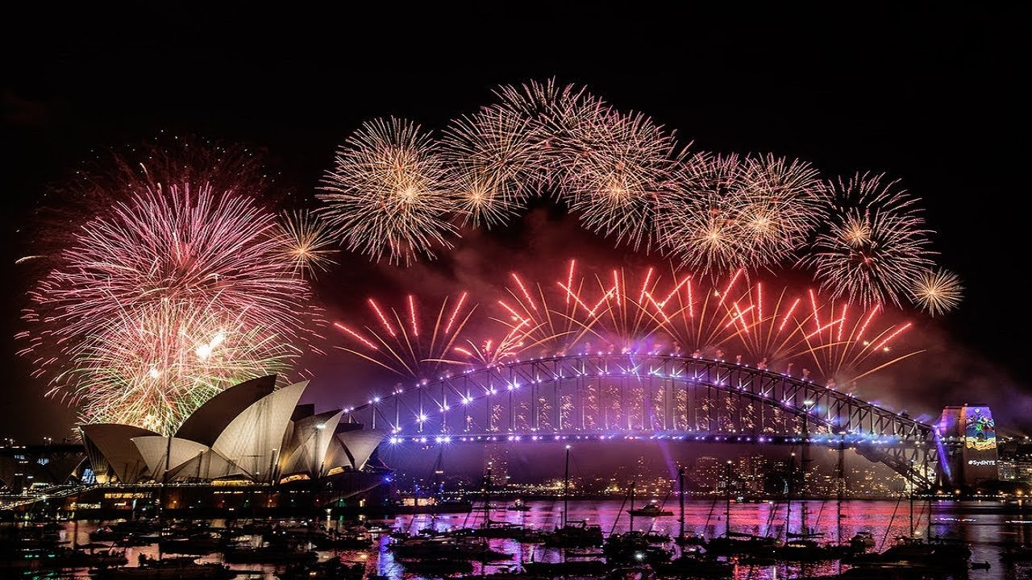
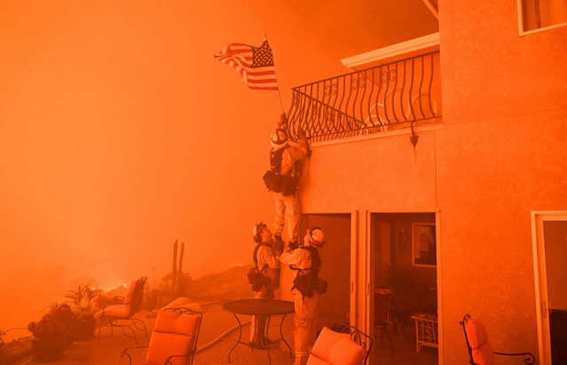
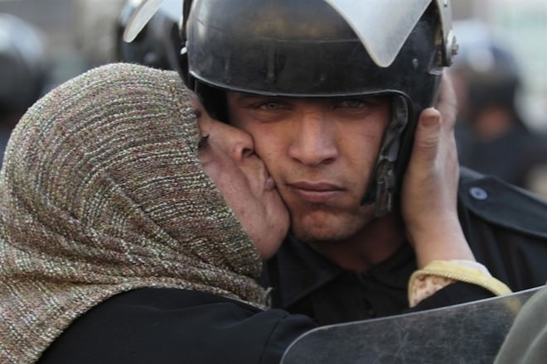
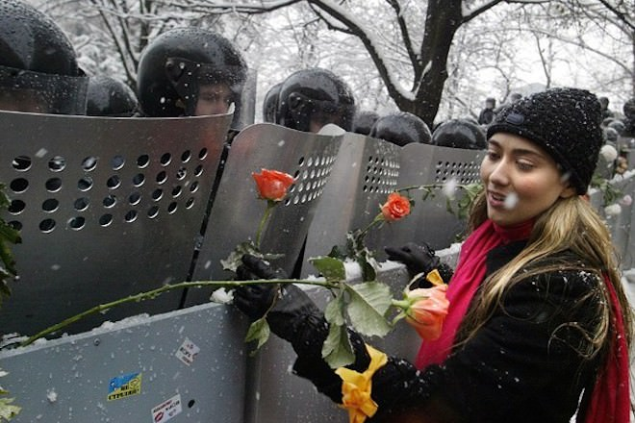
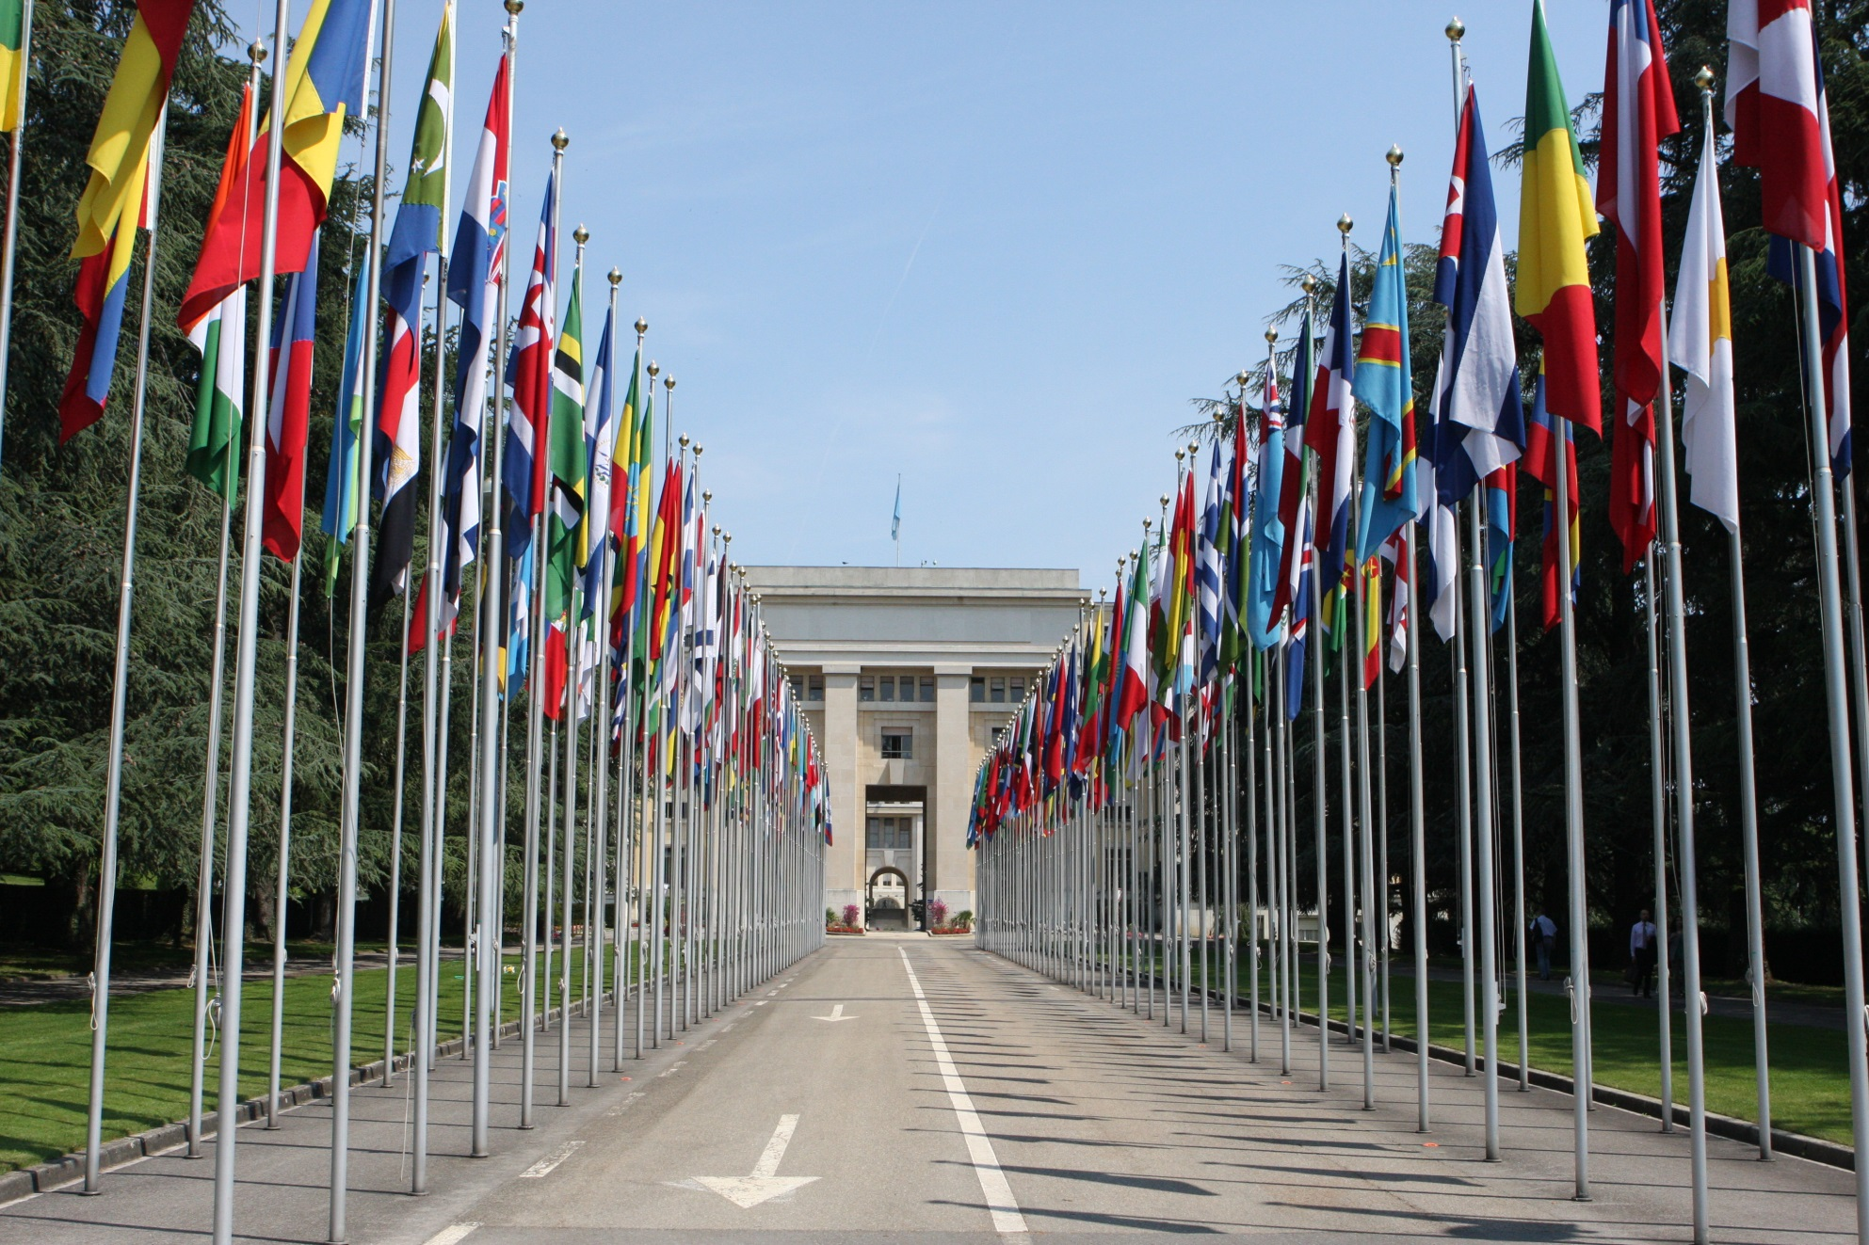
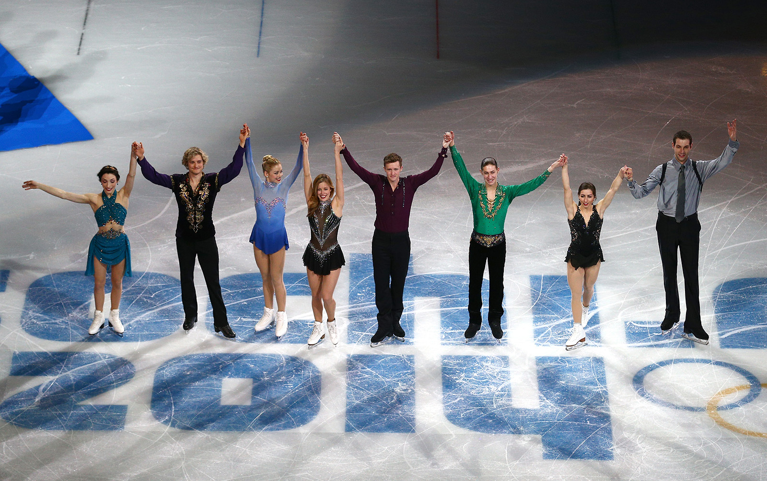
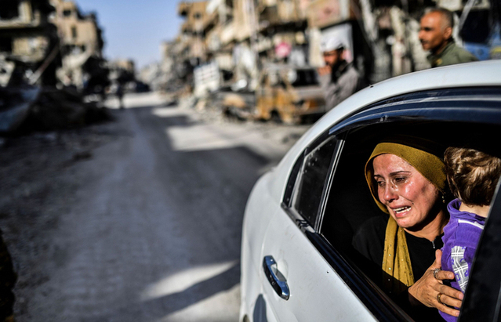
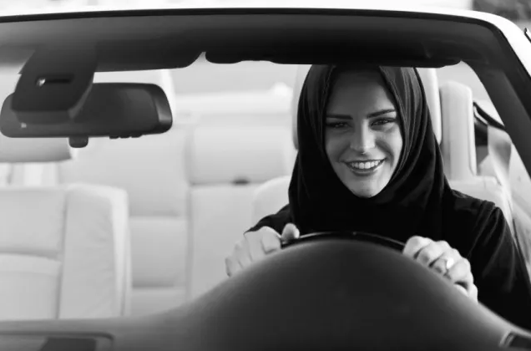
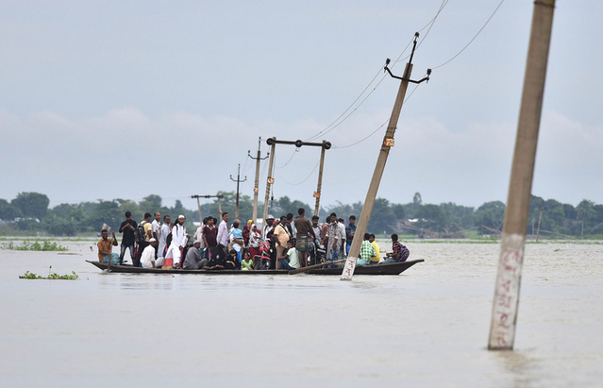
We are the world We are the children
We are the ones who make a brighter day
So let's start giving
We are all a part of God's great big family
And the truth you know love is all we need
But if you just believe
there's no way we can fall
Let us realize that a change can only come
When we stand together as one
We are the world We are the children
We are the ones who make a brighter day
So let's start giving
There's a choice we're making
We're saving our own lives
It's true we'll make a better day
Just you and me
There are people dying
And it's time to lend a hand to life
The greatest gift of all
We are the world
We are the children
We are the ones who make a brighter day
So let's start giving
There's a choice we're making
We're saving our own lives
There's a choice we're making
We're saving our own lives
It's true we'll make a better day
Just you and me
Send them your heart so they'll know that someone cares
There comes a time when we hear a certain call
When the world must come together as one
That someone somewhere
will soon make a change
When you're down and out
There seems no hope at all
It's true we'll make a better day
Just you and me
As God has shown us by turning stones to bread
So we all must lend a helping hand
We can’t go on pretending day by day
And their lives will be stronger and free
Skip

