Slide 1
高中英语人教版必修1
Unit 3 Travel journal
Journey down the Mekong
作者：陈颖琪
单位：华南师范大学外文学院

Slide 2
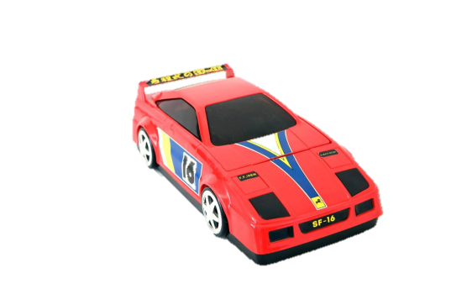
When you're tired of your toys,
and of your games, and of the television,

Slide 3
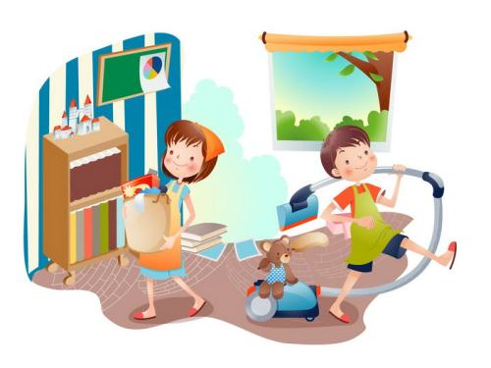
When you're done with chores and homework.
Then it's time to make a big decision.

Slide 4
You might need a change of scenery,
It might be time to go

Slide 5
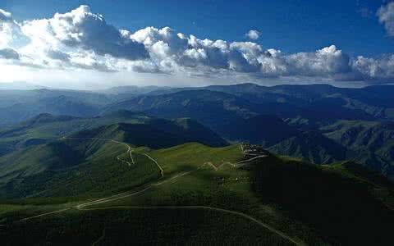
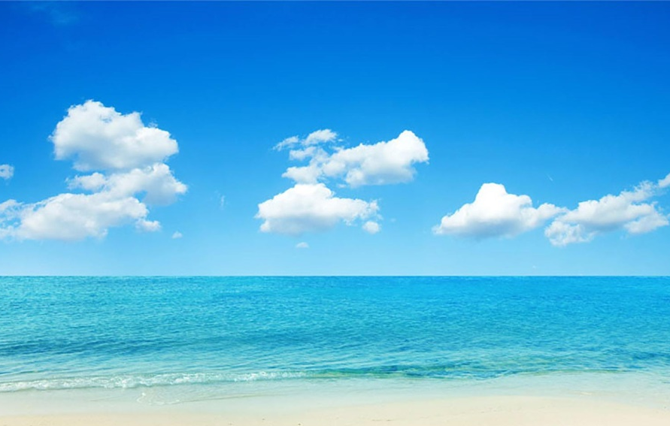
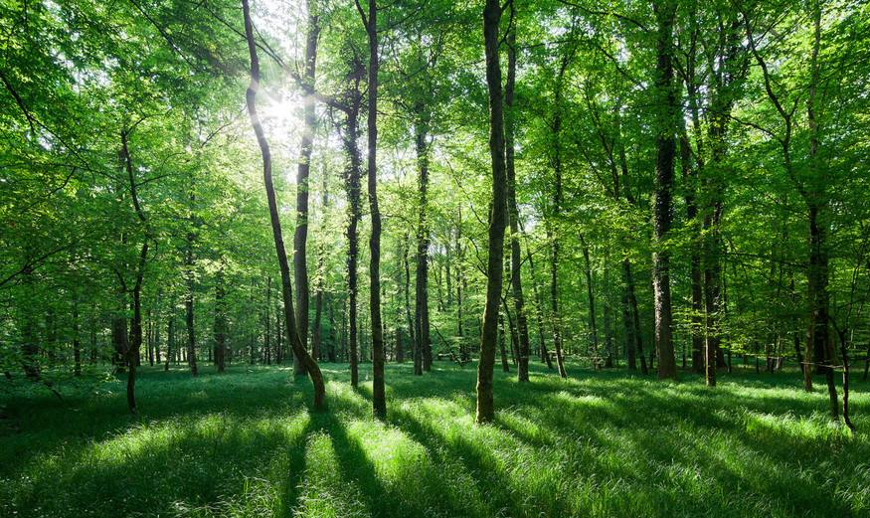
over mountains,
over oceans,
through dark jungles
down below

Slide 6
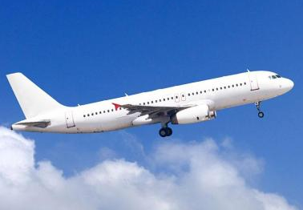
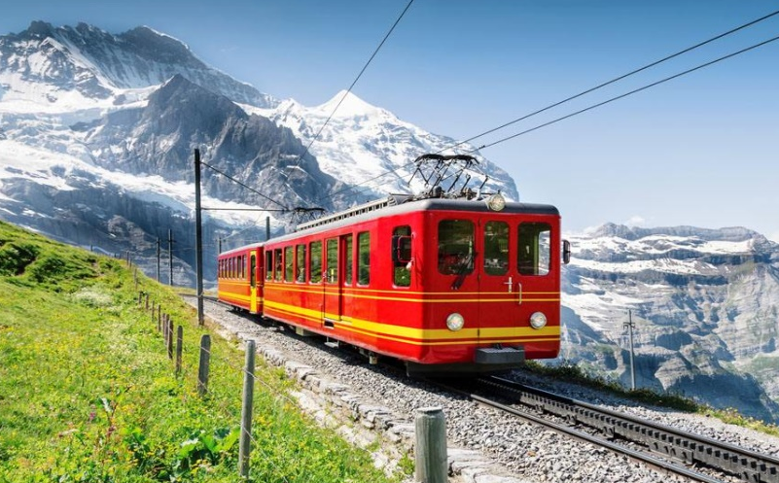
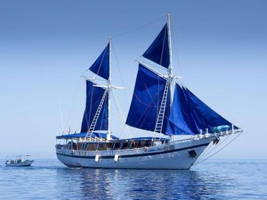
On an airplane, on a railroad
On a tall ship with the tide

Slide 7
All you need's a little music.
How’s about it,
what do you say with
buckle up and we go for a little ride?

Slide 8
Let’s go everywhere, man
Let’s go everywhere, man

Slide 9
There's lots of fun out there, man
We gotta have our share, man

Slide 10
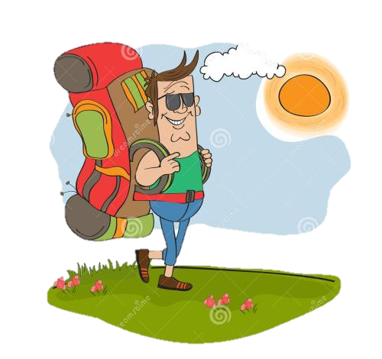
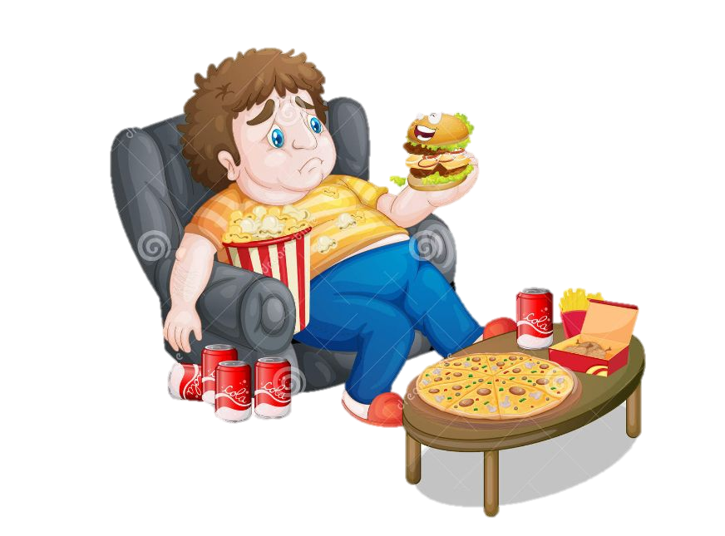
Get out of your chair, man
Let's go everywhere.

Slide 11
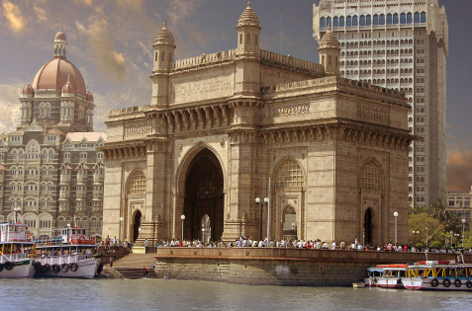
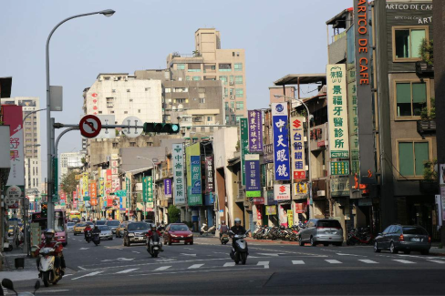
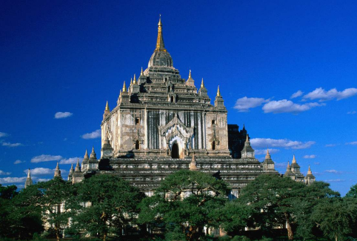
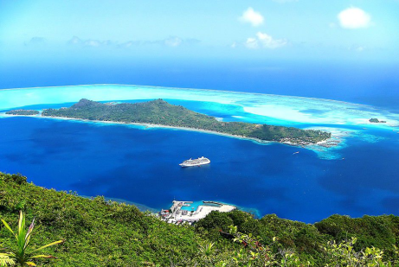
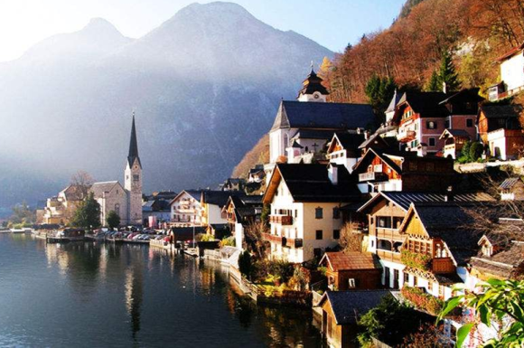
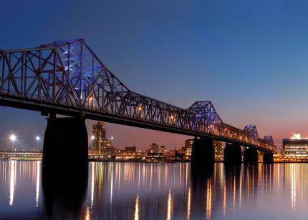
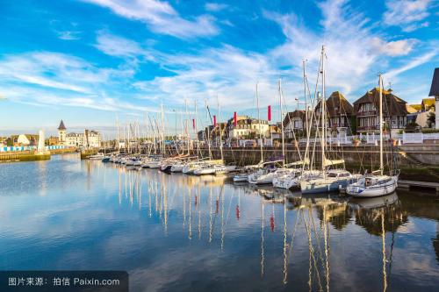
Mumbai
Taipei
Mandalay
Bora Bora
We’ll go to
Glocca Morra
Whoville
Louisville
Deauville

Slide 12
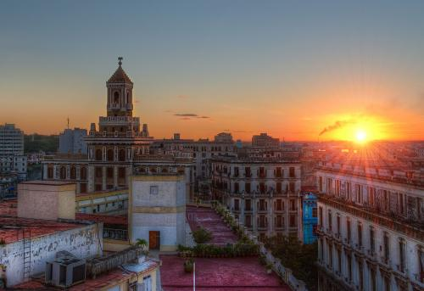
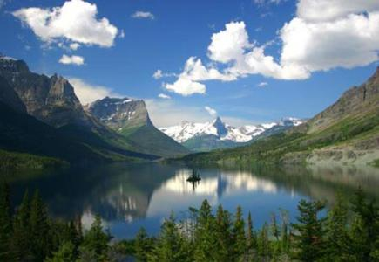
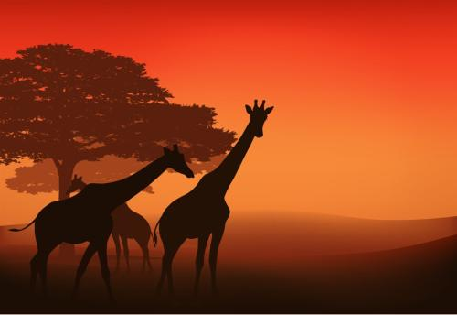
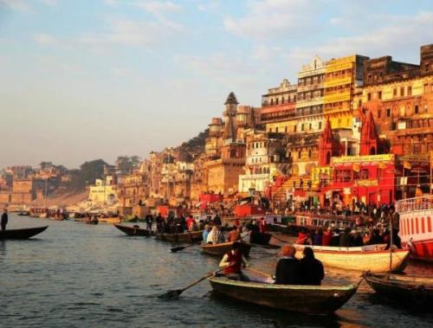
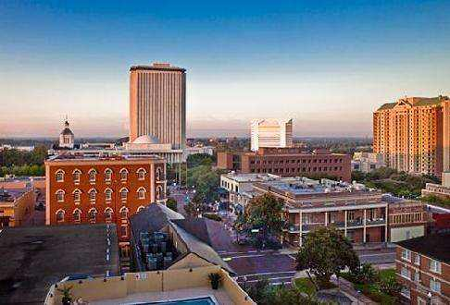
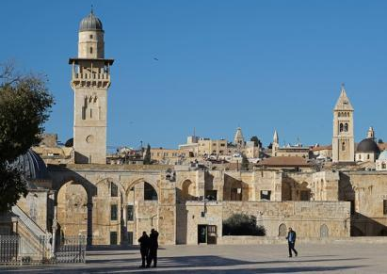
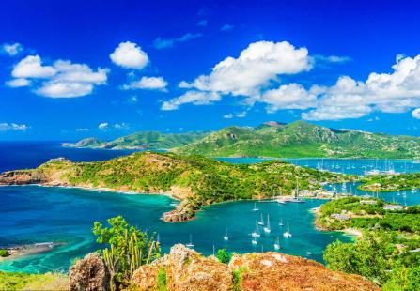
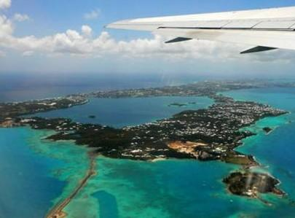
Havana
Montana
Savannah
Varanasi
We’ll go to
Tallahassee
Or Yehuda
Barbuda
Bermuda

Slide 13
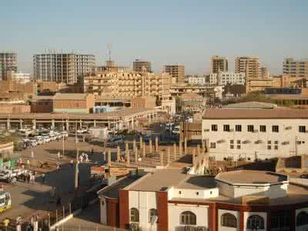
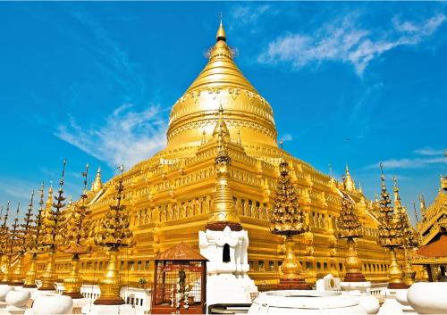
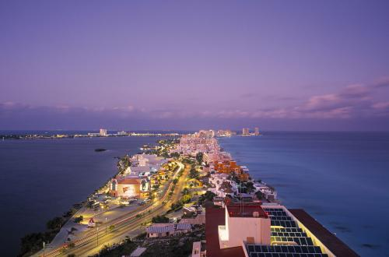
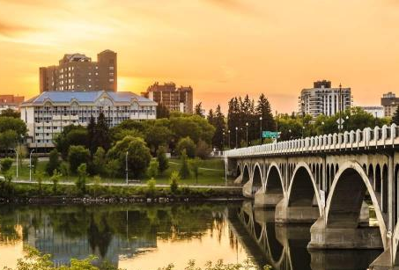
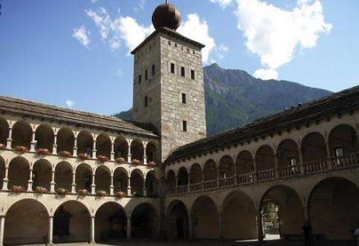
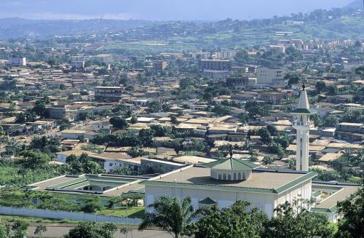
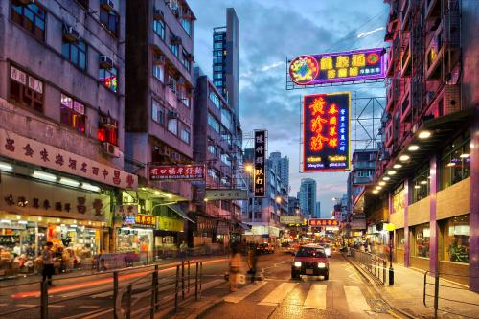
Khartoum
Rangoon
Cancuna
Saskatoon
We’ll go to
to the moon!
Brigadoon
Cameroon
Kowloon

Slide 14
Let’s go everywhere, man
Let’s go everywhere, man

Slide 15
There's lots of fun out there, man
We gotta have our share, man

Slide 16
Get out of your chair, man
Let's go everywhere.

Slide 17
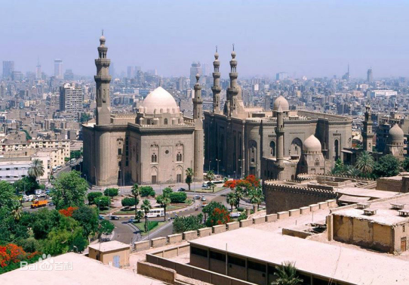
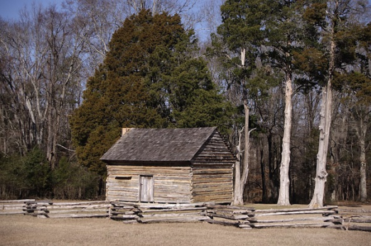
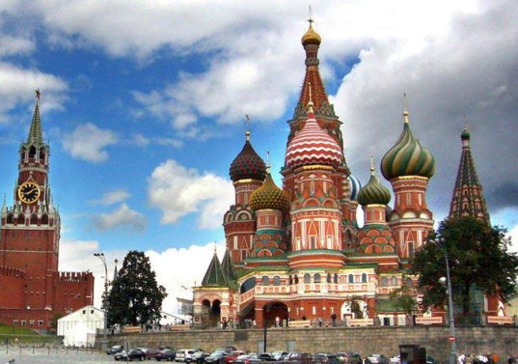
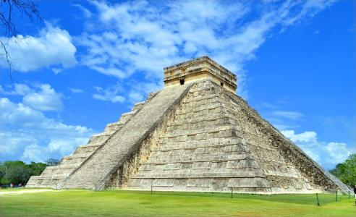
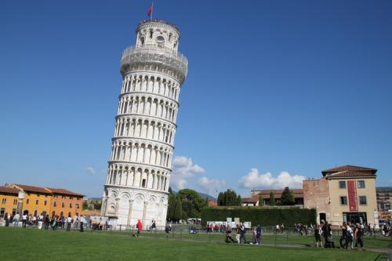
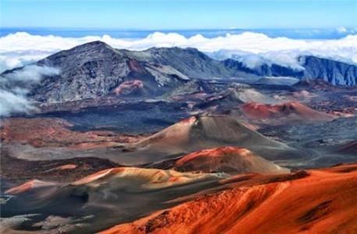
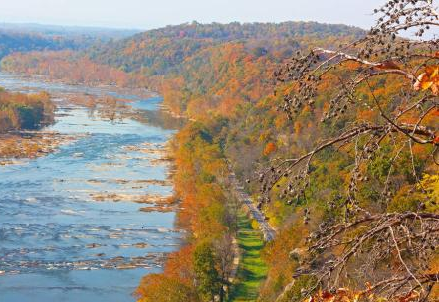
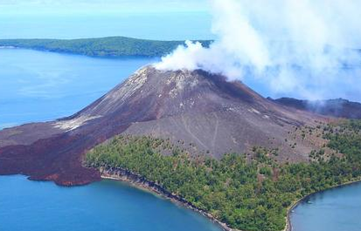
Cairo
Shiloh
Moscow
Chichen Itza
Tower of Pisa
Mauna Loa
Shenandoah
Krakatoa

Slide 18
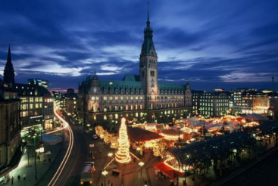
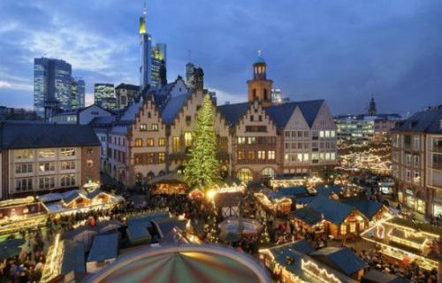
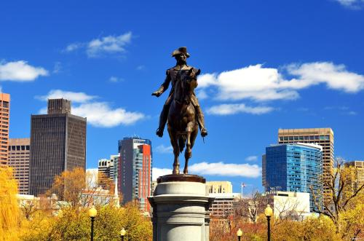
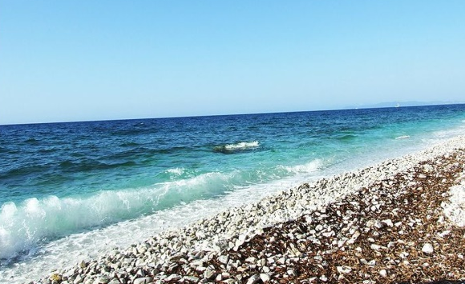
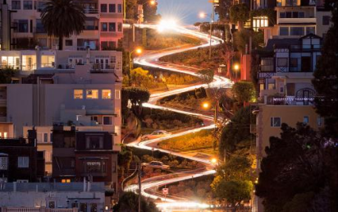
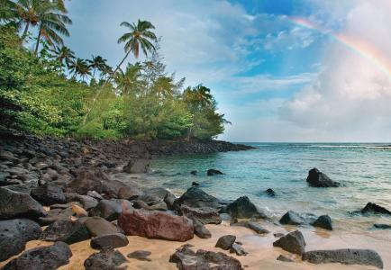
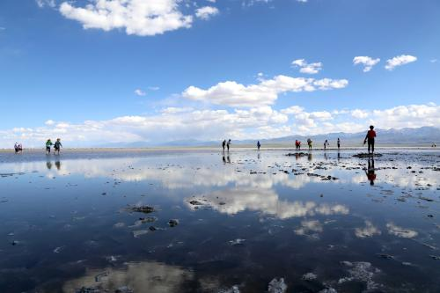
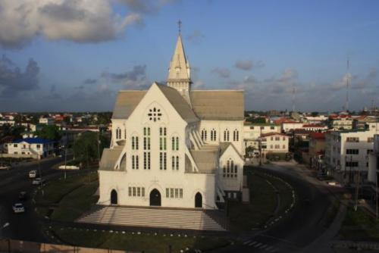
Hamburg
Frankfurt
Beantown
Montecristo
San Francisco
Cocoa Beach
Salt Lake
Cayenne

Slide 19
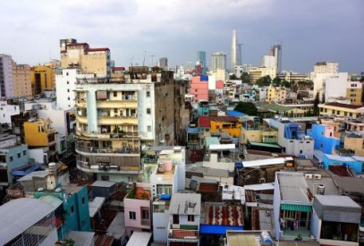
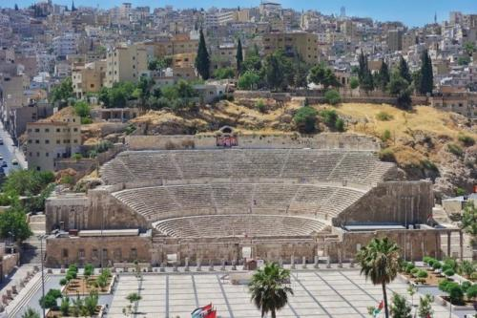
Saigon
Amman
Dijon
don‘t forget to call your mama！
Grand Bahama
Tijuana
Yokohama

Slide 20
Let’s go everywhere, man
Let’s go everywhere, man

Slide 21
There's lots of fun out there, man
We gotta have our share, man

Slide 22
Get out of your chair, man
Let's go everywhere.

Slide 23
Xi'an
San Juan
Pusan
Sri Lanka
Casablanca
Avalon
Canton
Chambertin

Slide 24
Warsaw
Aqaba
Shangri-La
Transylvania
Mauretania
Lyon
Stockholm
Rome
Nome

Slide 25
Hong Kong
Guangdong
Haiphong
Tonga
sing-a-long-a！
Salamanca
Rarotonga
Cucamonga

Slide 26
Let’s go everywhere, man
Let’s go everywhere, man

Slide 27
There's lots of fun out there, man
We gotta have our share, man

Slide 28
Get out of your chair, man
Let's go everywhere.

Slide 29
Xanadu
Kathmandu
Timbuktu
Santiago
Pago Pago
Rumania
Slovenia
Tasmania

Slide 30
Sedona
Pamplona
Daytona
Patagonia
Caledonia
Barcelona
Bologna
Winona

Slide 31
Bangkok
Sliding Rock
Antioch
Tuba City
ain't it pretty
Sun City
Cloud City
Emerald City

Slide 32
Let’s go everywhere, man
Let’s go everywhere, man

Slide 33
There's lots of fun out there, man
We gotta have our share, man

Slide 34
Get out of your chair, man
Let's go everywhere.

