Slide 1
教材：人教版高中英语M1U3
作者：刘惠晓
单位：华南师范大学外文学院

Slide 3
Well I was doubling over the load on my shoulders
Was a weight I carried with me every day

Slide 4
Crossing miles of frustrations and rivers a raging

Slide 5
Picking up stones I found along the way

Slide 6
I staggered and I stumbled down
Pathways of trouble

Slide 7
I was hauling those souvenirs of misery
And with each step taken my back was breaking

Slide 8
Till I found the One
who took it all from me

Slide 9
Down by the riverside
(Down by the riverside)

Slide 10
I laid my burdens down
Now I'm traveling light

Slide 11
My spirit lifted high
(I found my freedom now)
I found my freedom now
And I'm traveling light

Slide 12
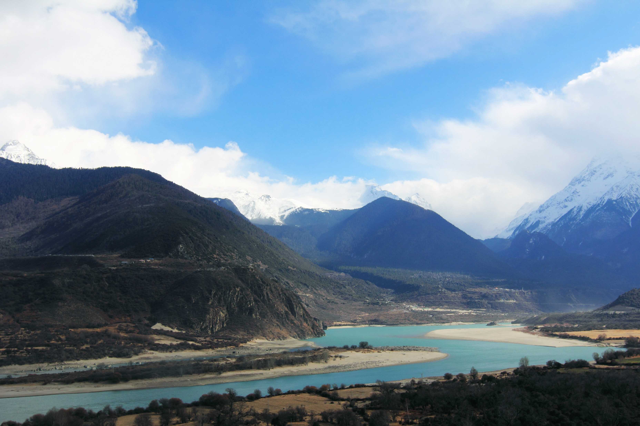

Slide 13
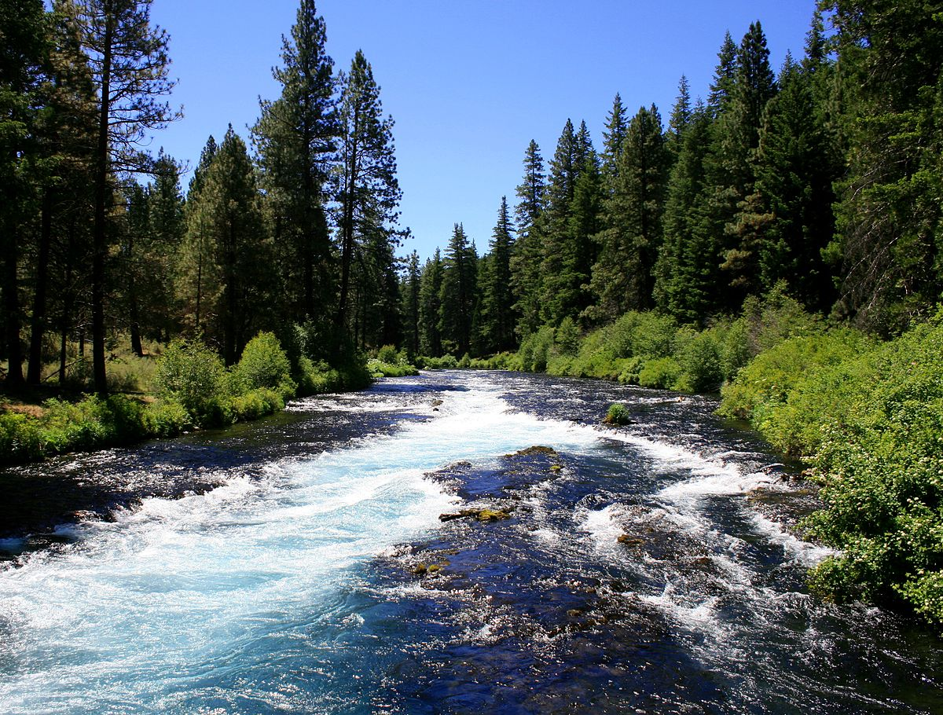

Slide 14
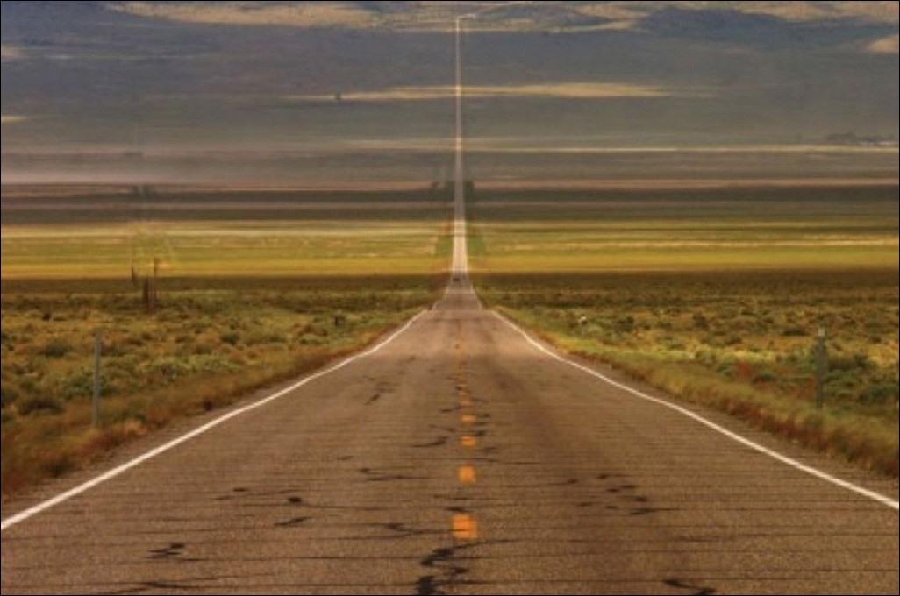
Through the darkest alleys and loneliest valleys
I was dragging those heavy chains of doubt and fear

Slide 15
Then with the one word spoken the locks were broken
Now He's leading me to places
Where there are no tears

Slide 16
Down by the riverside
(Down by the riverside)

Slide 17
I laid my burdens down
Now I'm traveling light

Slide 18
My spirit lifted high (I found my freedom now) I found my freedom now And I'm traveling light

Slide 19
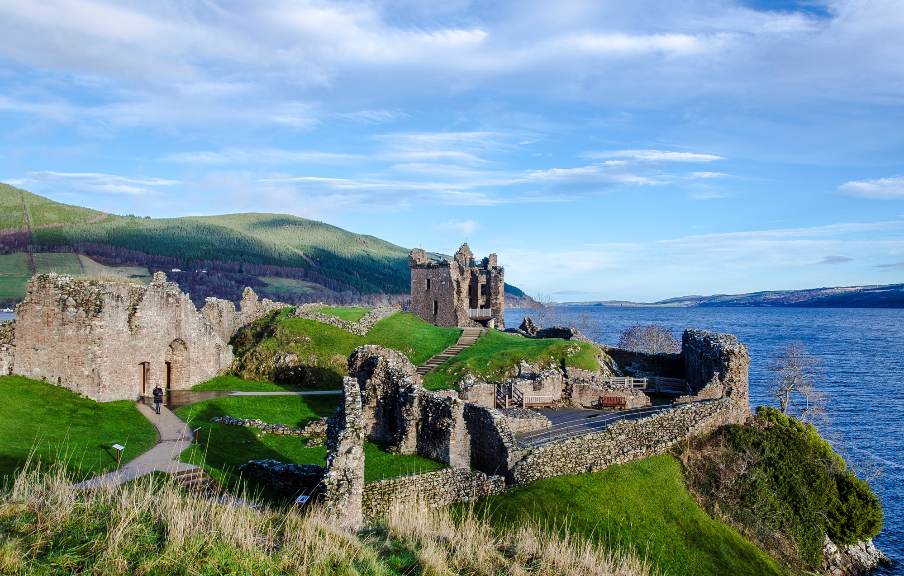
Down by the riverside

Slide 20
Down by the riverside
Now I am traveling light

Slide 21
Down by the riverside I laid my burdens down Now I am traveling light

Slide 22
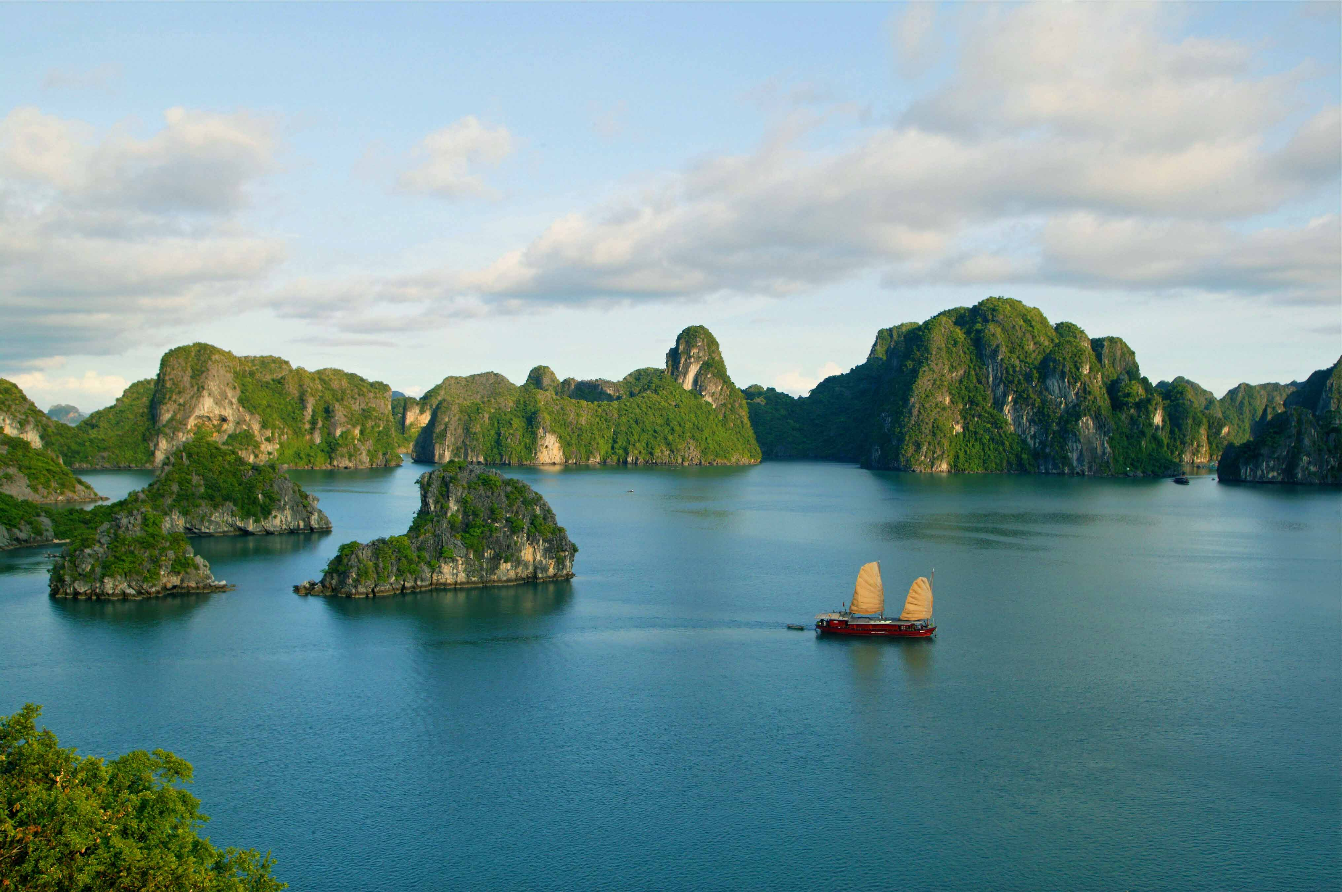
My spirit lifted high
I found my freedom now
And I'm traveling light

Slide 23
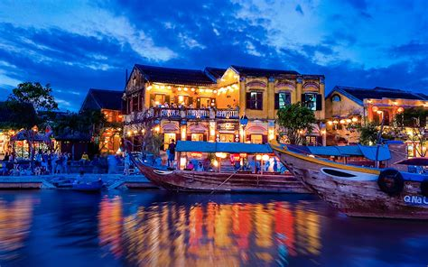
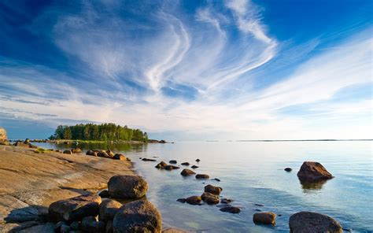
Down by the riverside
(Down by the riverside)

Slide 24
I laid my burdens down Now I'm traveling light My spirit lifted high (I found my freedom now) I found my freedom now And I'm traveling light

Slide 25
Down by the riverside
I laid my burdens down
And I am traveling light
My spirit lifted high
I found my freedom now
And I am traveling light traveling light
I found my freedom now
I am traveling light

