Slide 1
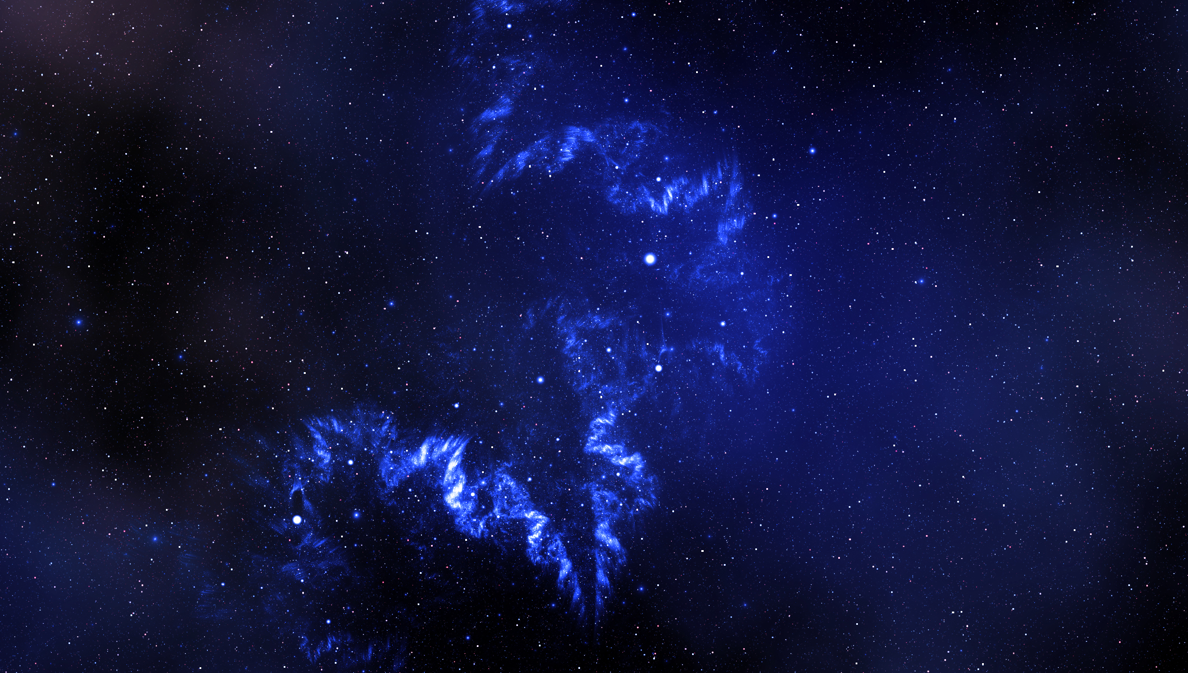
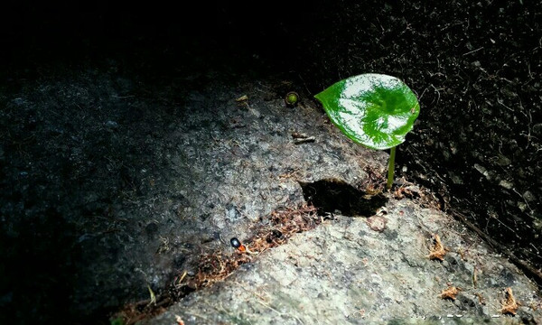
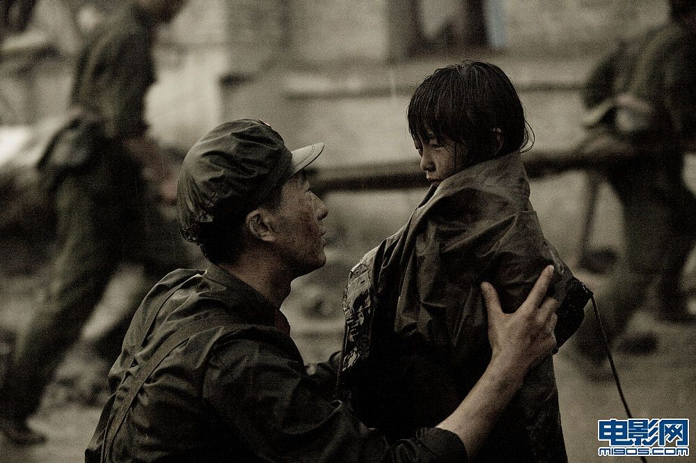
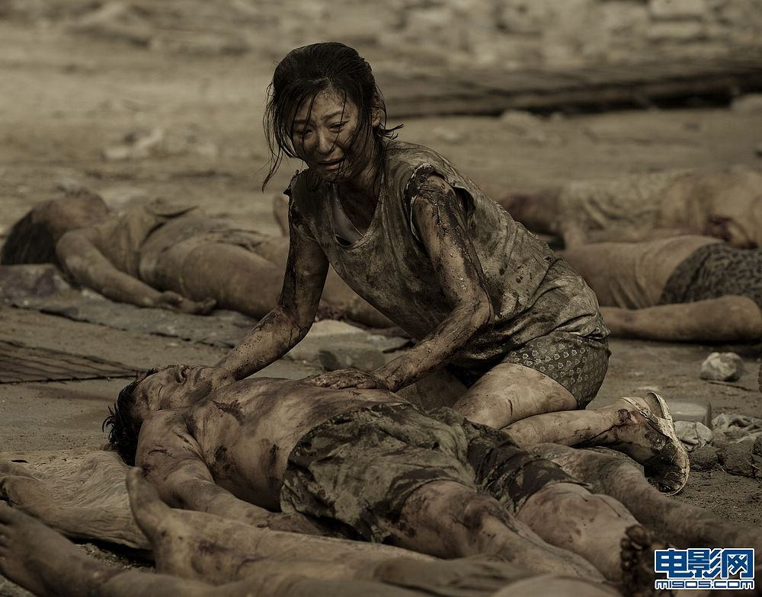
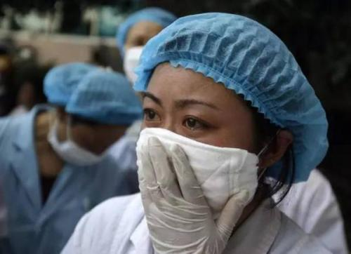
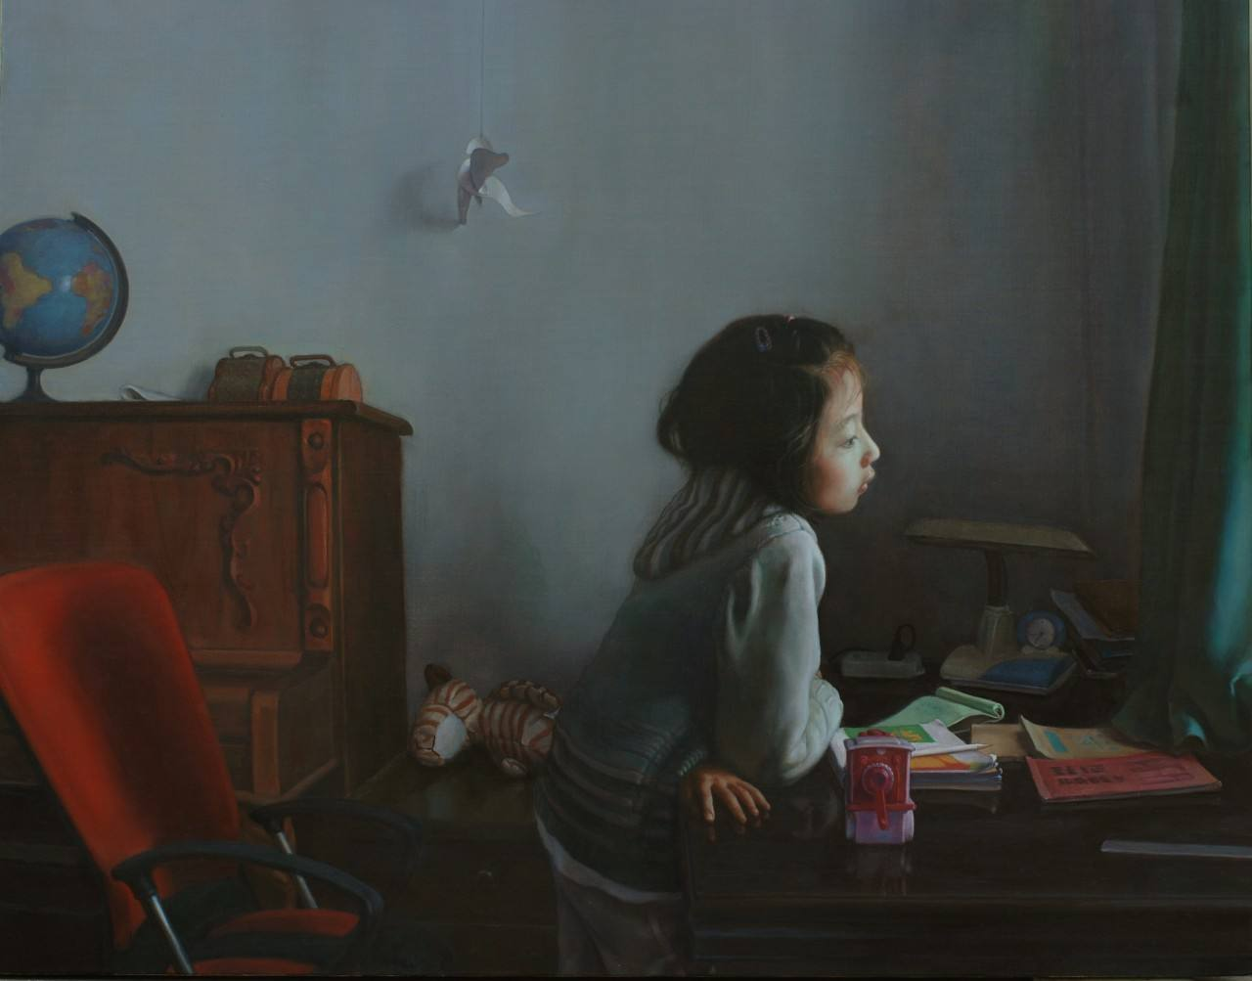
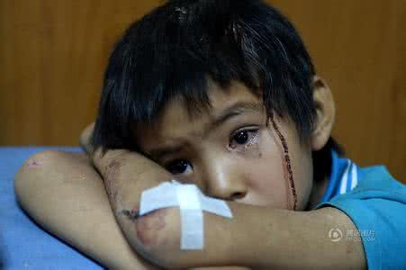
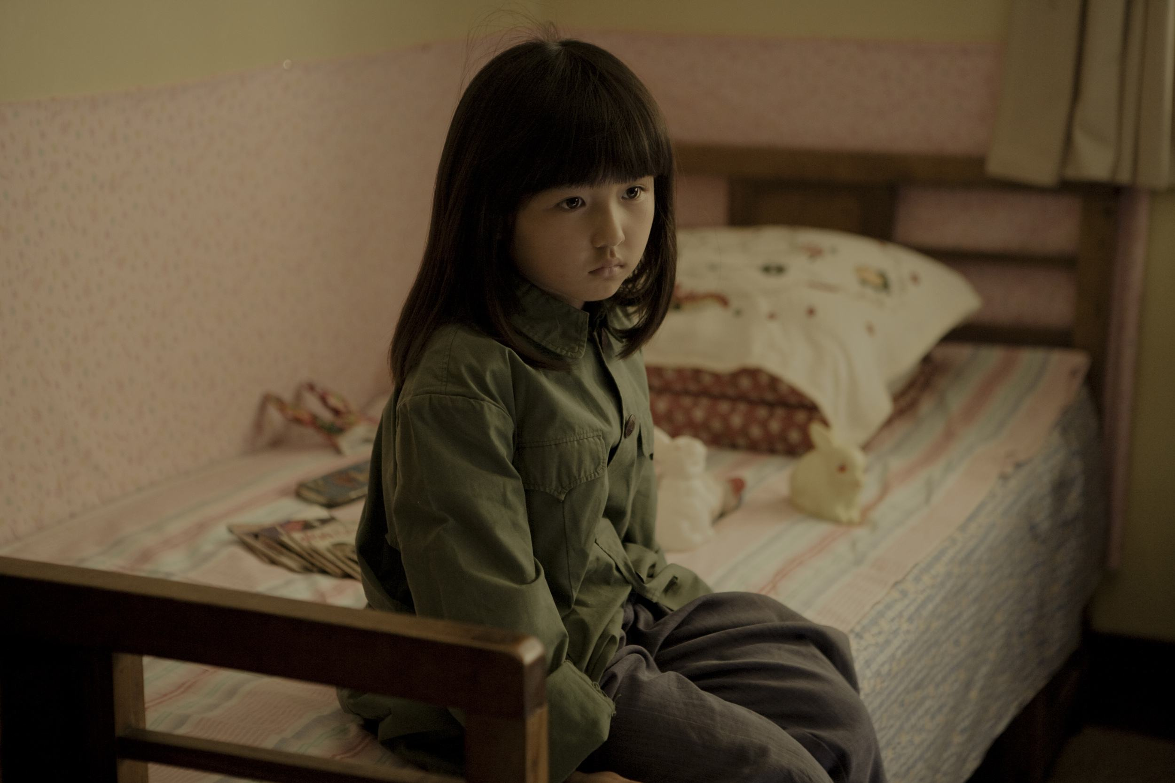
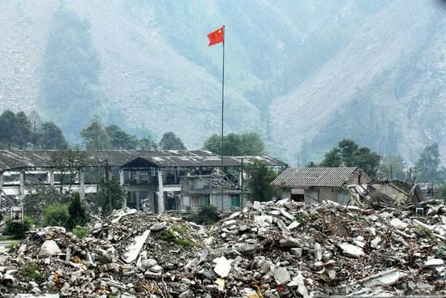
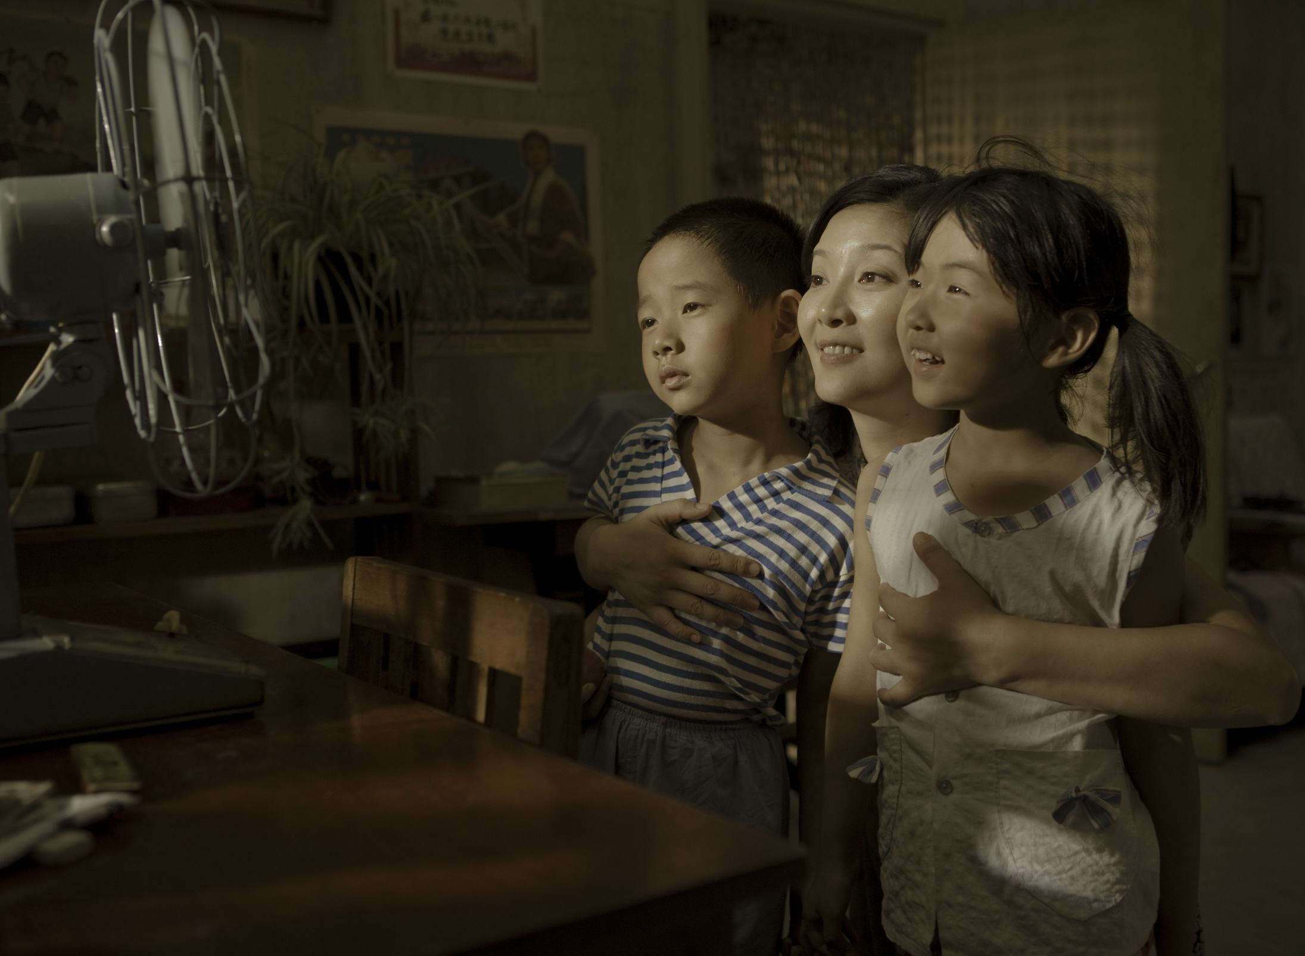
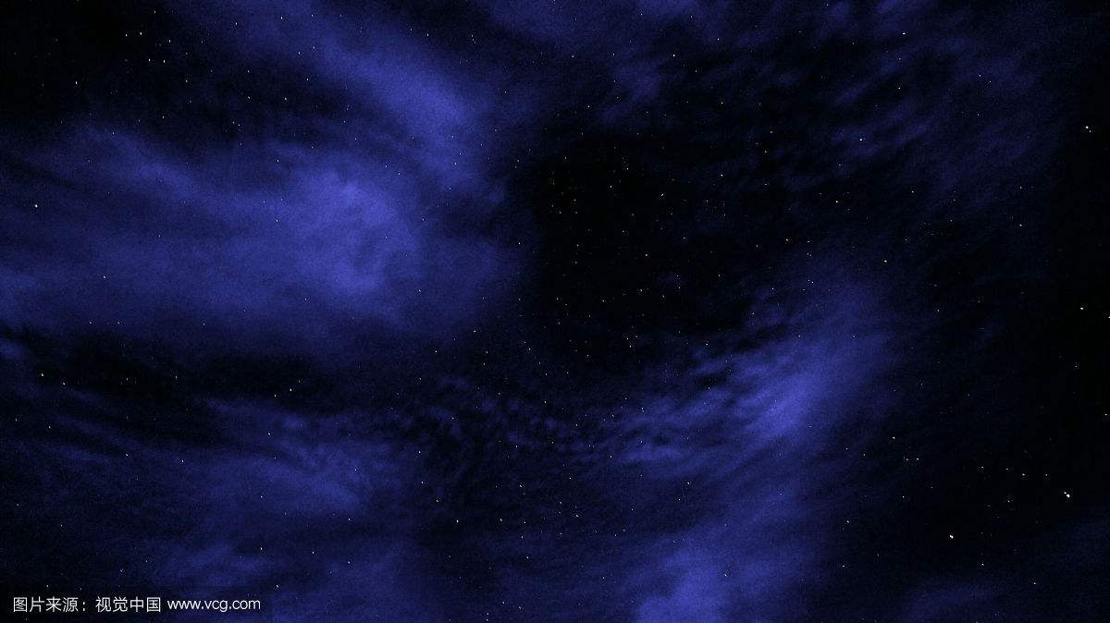
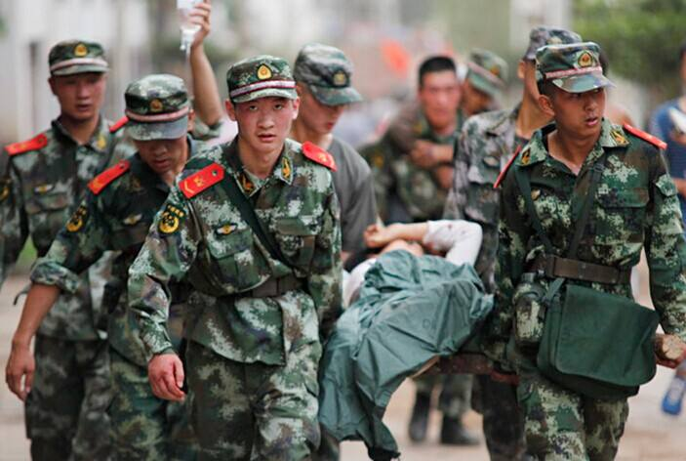
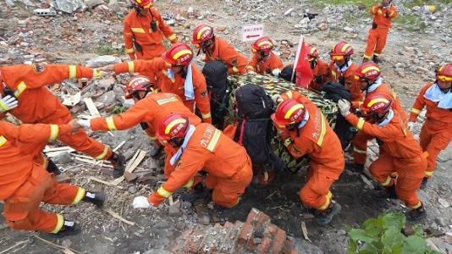
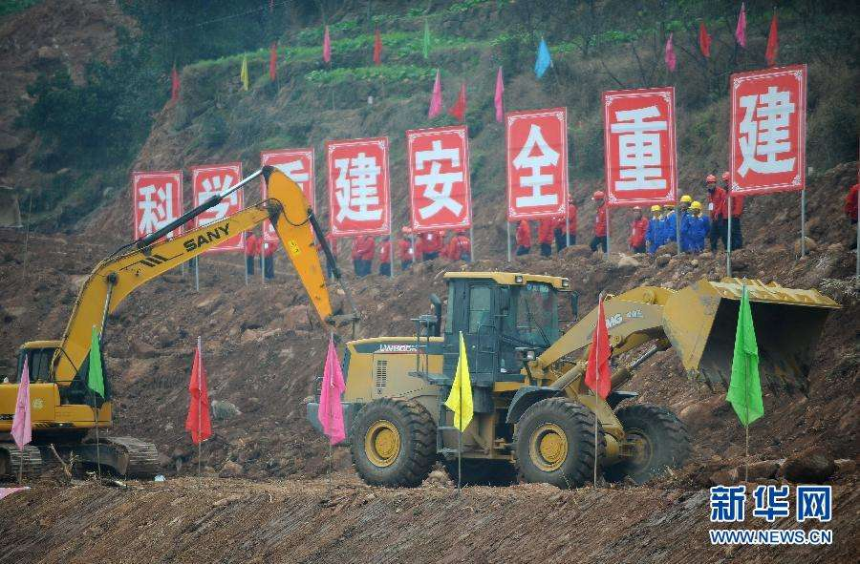
Even when the music's gone, gone...
Hold on to this lullaby
You'll be all right, no one can hurt you now.
Come morning light, you and I'll be safe and sound.
You'll be all right, no one can hurt you now.
Just close your eyes, the sun is going down.
PEP M1U4: Earthquakes
Song: Safe and sound
Singer: Taylor Swift
The war outside our door keeps raging on
But all that's dead and gone and past tonight.
Come morning light，you and I'll be safe and sound
作者: 冯家会
单位：华南师范大学外文学院
Don't you dare look out your window
Darlin' everything's on fire
Just close your eyes, the sun is going down.
I remember tears streaming down your face
When I said I'll never let you go.
I remember you said don't leave me here alone
When all those shadows almost killed your light

