Slide 1
Nelson Mandela
— A Modern Hero
教材：高中英语必修1 Unit 5
作者：柯树雯
单位：华南师范大学外文学院

Slide 2
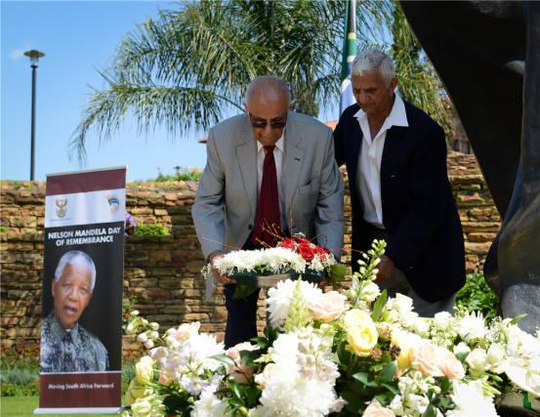
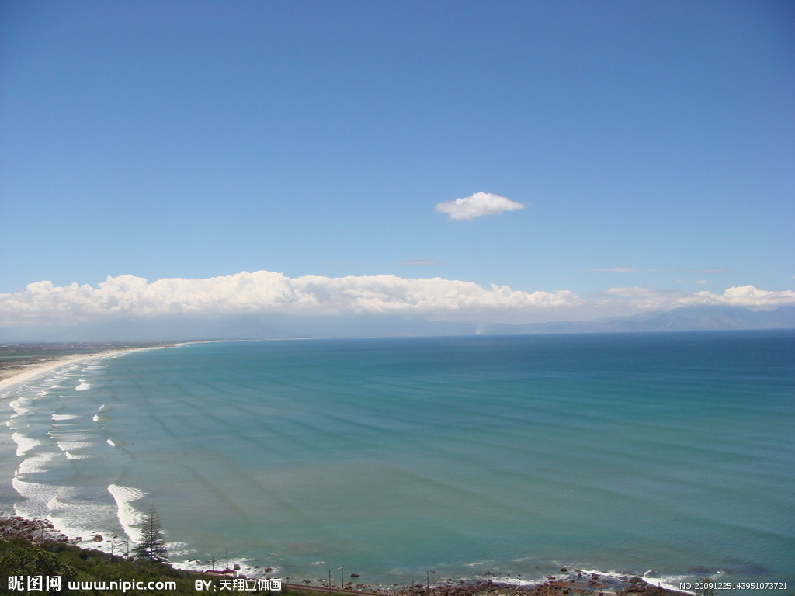
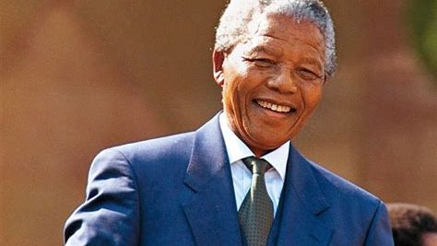
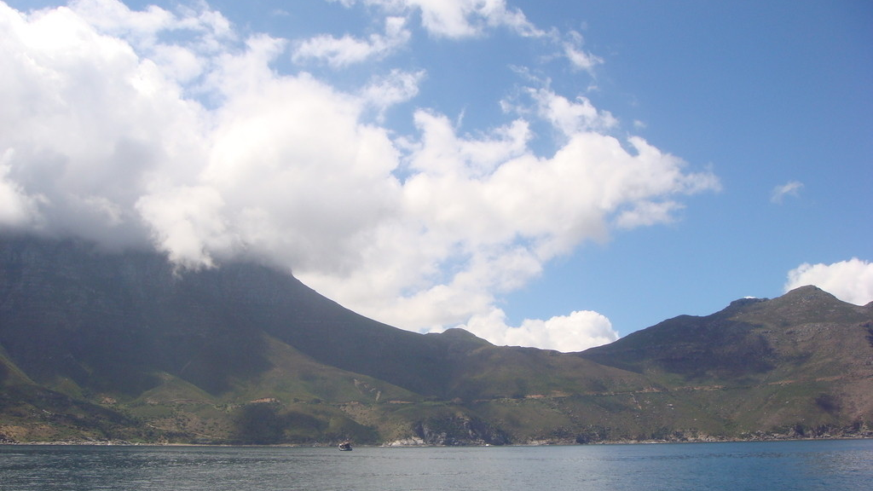
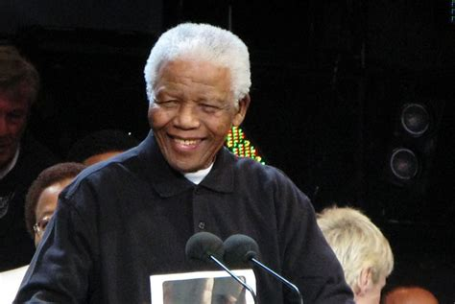
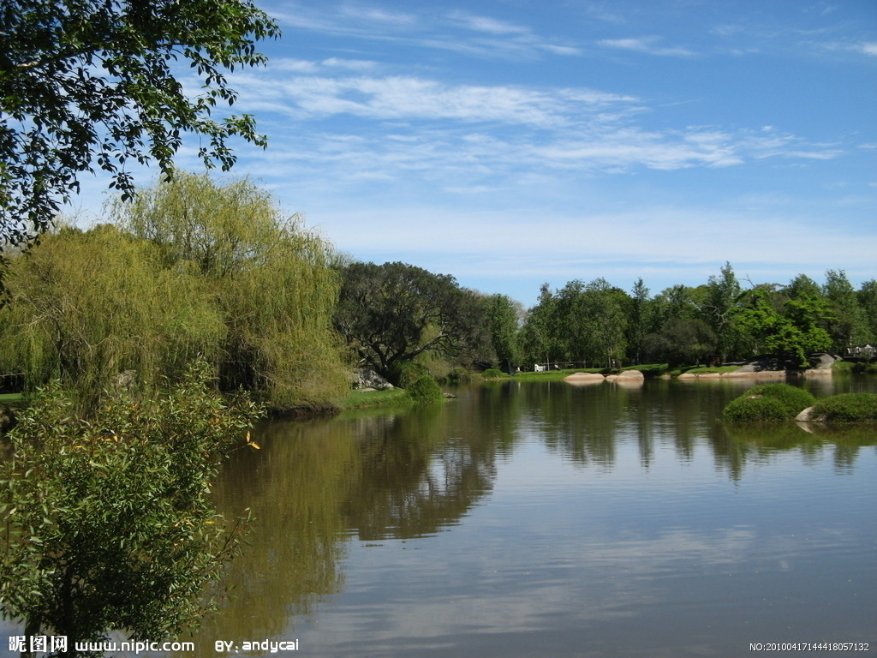
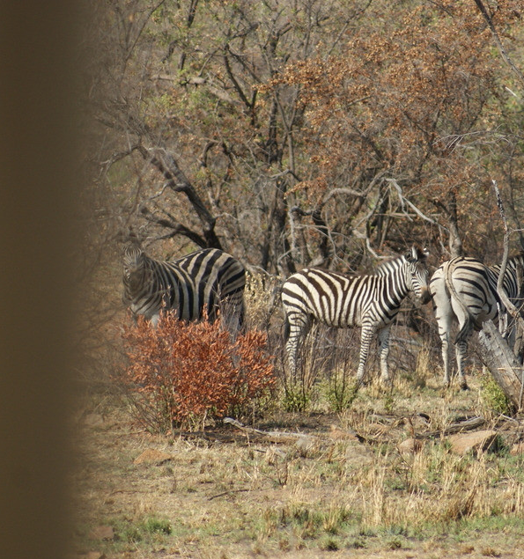
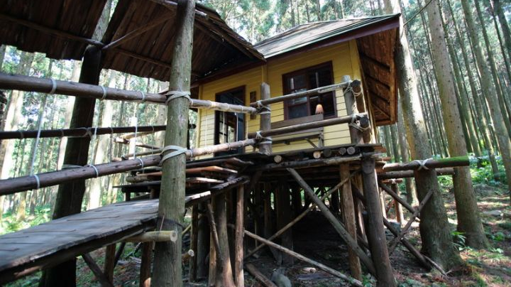
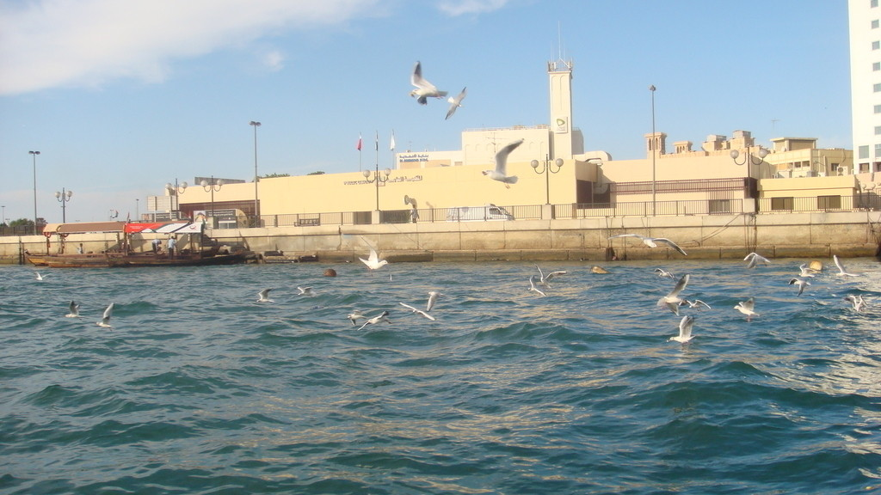
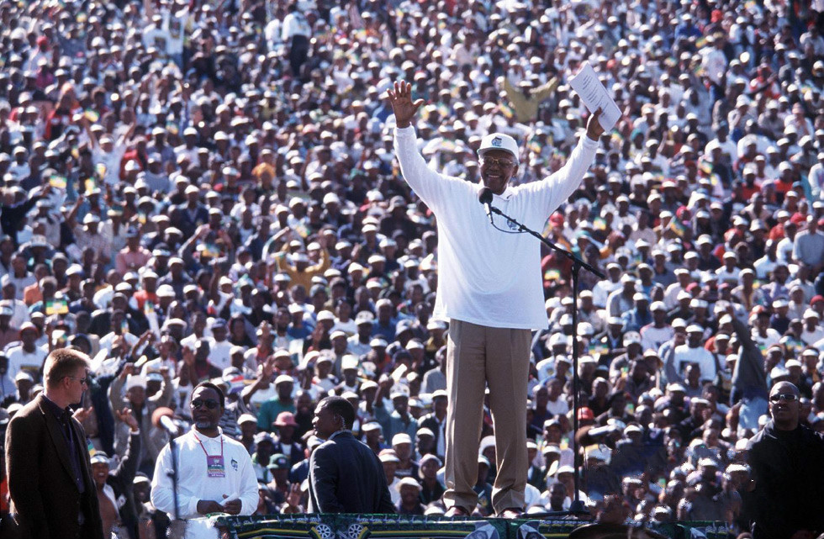
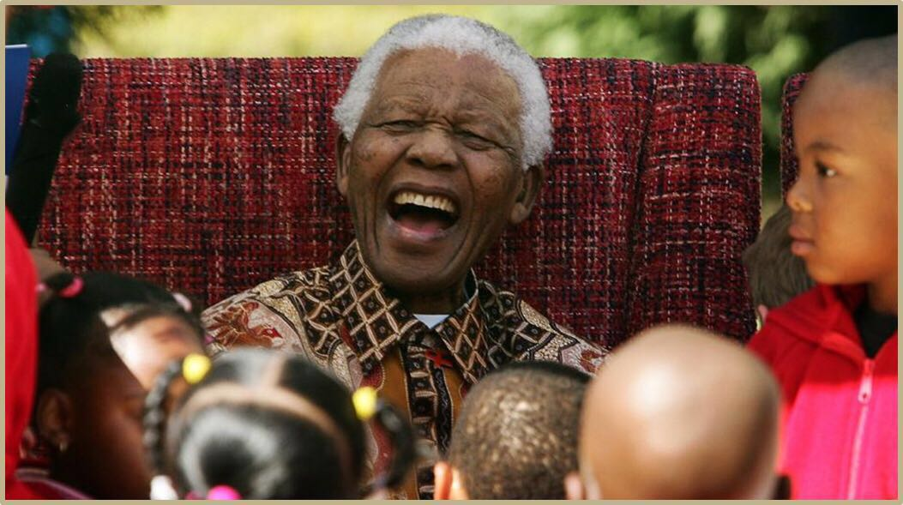
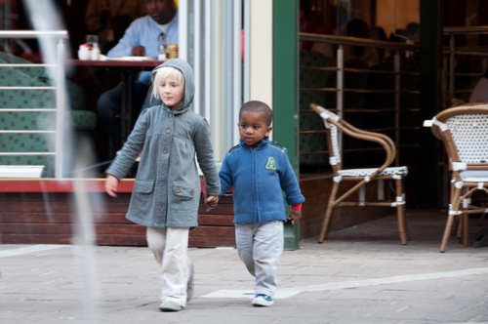
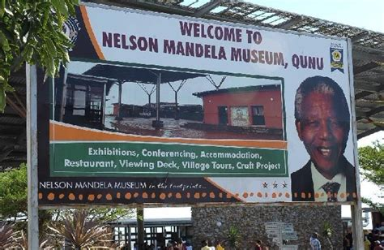
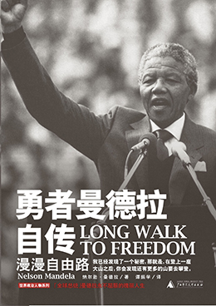
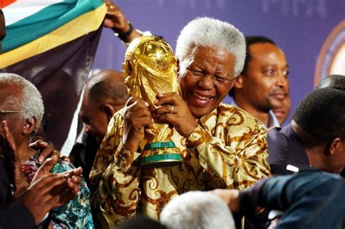
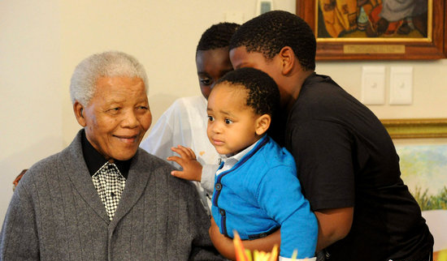
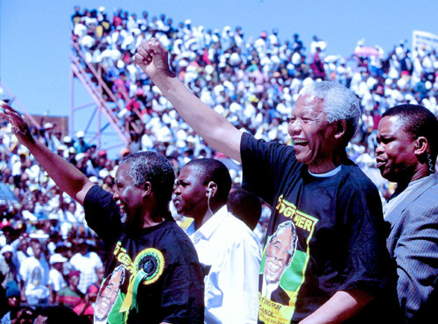
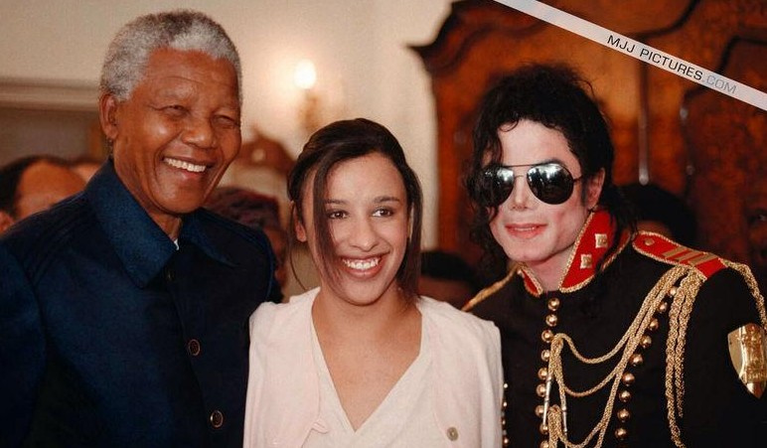
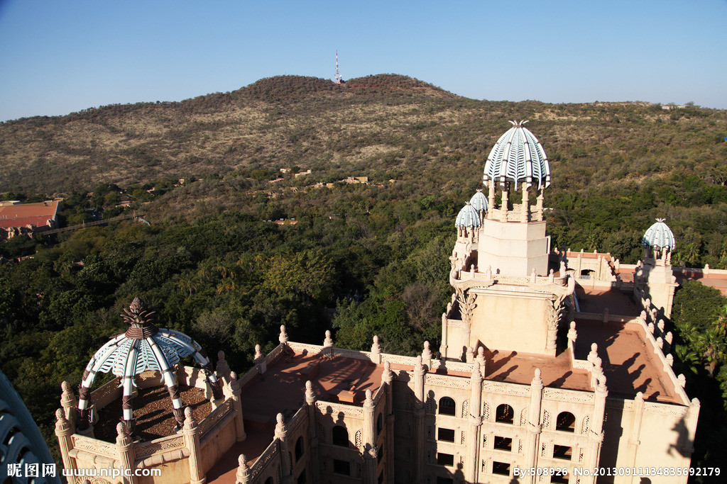
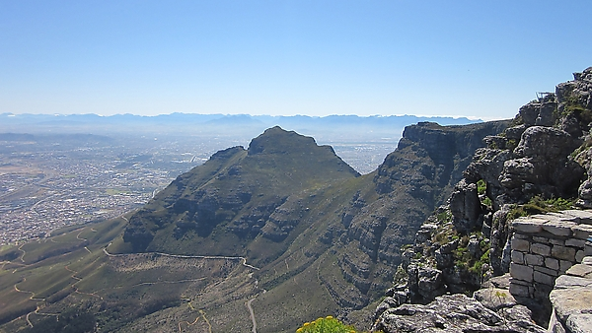
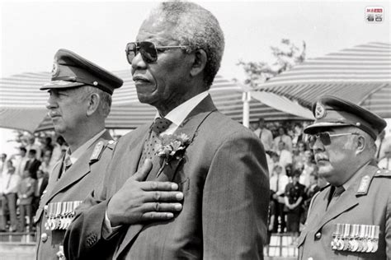
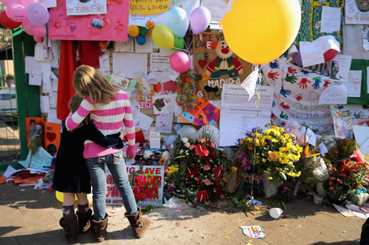
The same wind will
take care of you and I
The sea throws rock together but time
We can't fall any further
And we can't reach any higher
Cause we can't fall any further
leaves us polished stones
If we can't feel ordinary love
If we can't feel ordinary love
it's you
I'm fighting for
All the beauty
that's been lost before
wants to find us again
By U2
And we can't reach any higher
For years I would believe that
the world couldn't wash it away
Your heart is on my sleeve
We'll build our house
in the trees
If we can't deal with
ordinary love
Birds fly high in the summer sky
and rest on the breeze
The sea wants to kiss the golden shore
Ordinary love
if we can't deal with ordinary love
I can't fight you any more
Nelson Mandela
The sunlight warms your skin
Did you put it there with a magic marker

Slide 3
Thank you

