Slide 1
PEP M3U5: Nelson Mandela— a modern hero
Song: Ordinary Love-U2
作者：邱海恩
单位：华南师范大学外文学院

Slide 3
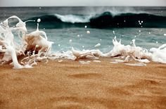
The sea wants to kiss the golden shore

Slide 4
The sunlight warms your skin

Slide 5
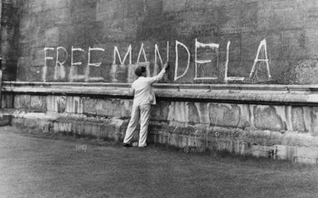
All the beauty that's been lost before

Slide 6
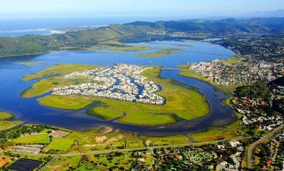
Wants to find us again

Slide 7
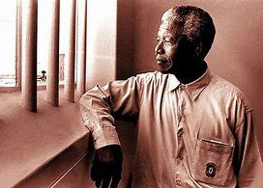
I can't fight you anymore

Slide 8
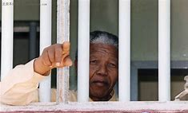
It's you I'm fighting for

Slide 9
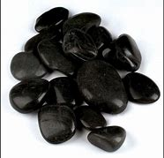
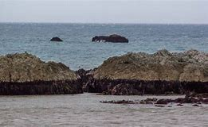
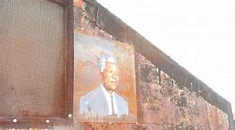
The sea throws rocks together
But time leaves us polished stones

Slide 10
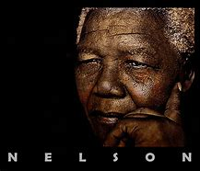
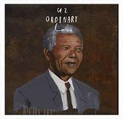
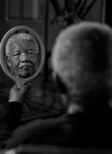
We can't fall any further
If we can't feel ordinary love

Slide 11
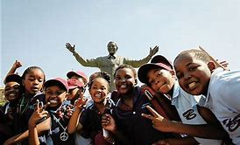
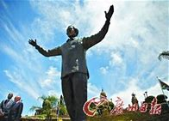
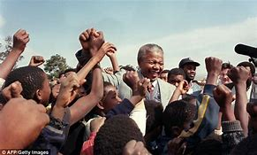
We cannot reach any higher
If we can't deal with ordinary love

Slide 12
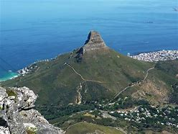
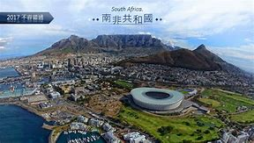
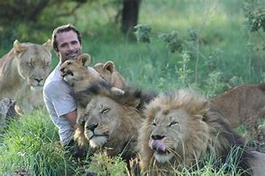
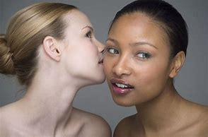

Slide 13
Birds fly high in the summer sky
And rest on the breeze

Slide 14
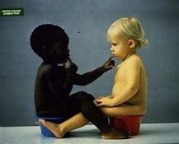
The same wind will take care of you and

Slide 15
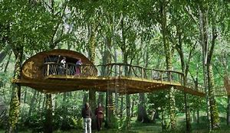
I will build our house in the trees

Slide 16
Your heart is on my sleeve

Slide 17
Did you put it there with a magic marker

Slide 18
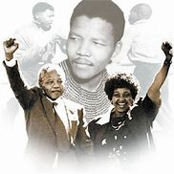
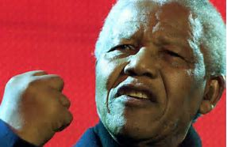
For years I would believe
That the world couldn't wash it away

Slide 19
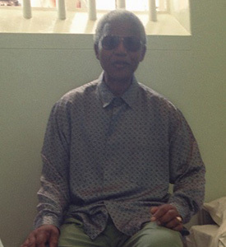
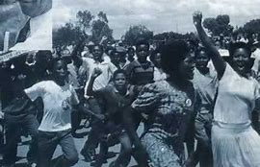
'Cause we can't fall any further

Slide 20
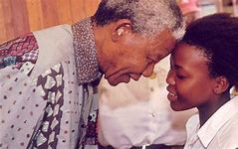
If we can't feel ordinary love
And We cannot reach any higher

Slide 21
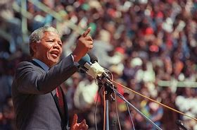
If we can't deal with ordinary love

Slide 22
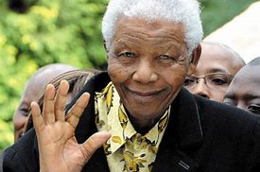
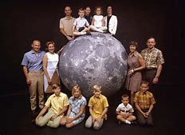
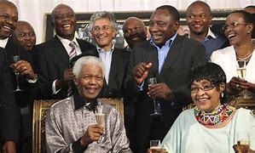

Slide 23
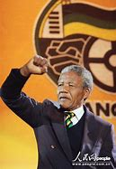
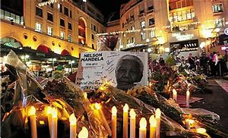
Are we tough enough
For ordinary love

Slide 24
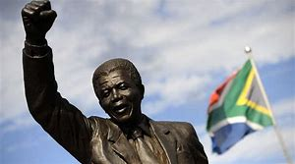

Slide 25
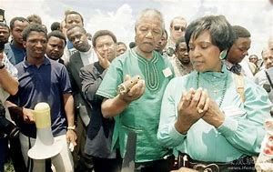
We can't fall any further
If we can't feel ordinary love

Slide 26
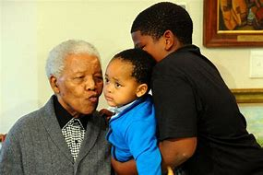
We cannot reach any higher
If we can't deal with ordinary love

Slide 27
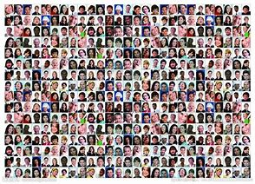
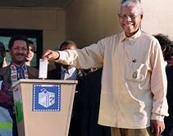
If we can't feel ordinary love
And We cannot reach any higher

Slide 28
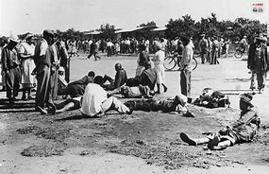
If we can't deal with ordinary love

Slide 29
