Slide 1
Mandela (Bring Him Back Home)
MV
人教版高中英语M1U5
Nelson Mandela - a modern hero
温嘉恩
华南师范大学外文学院

Slide 3
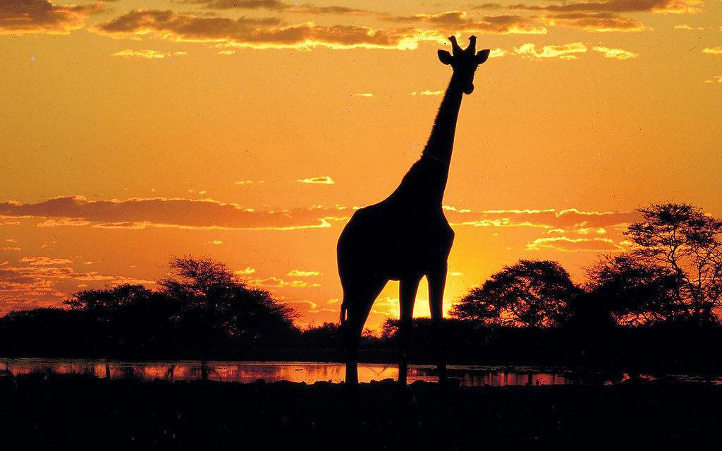
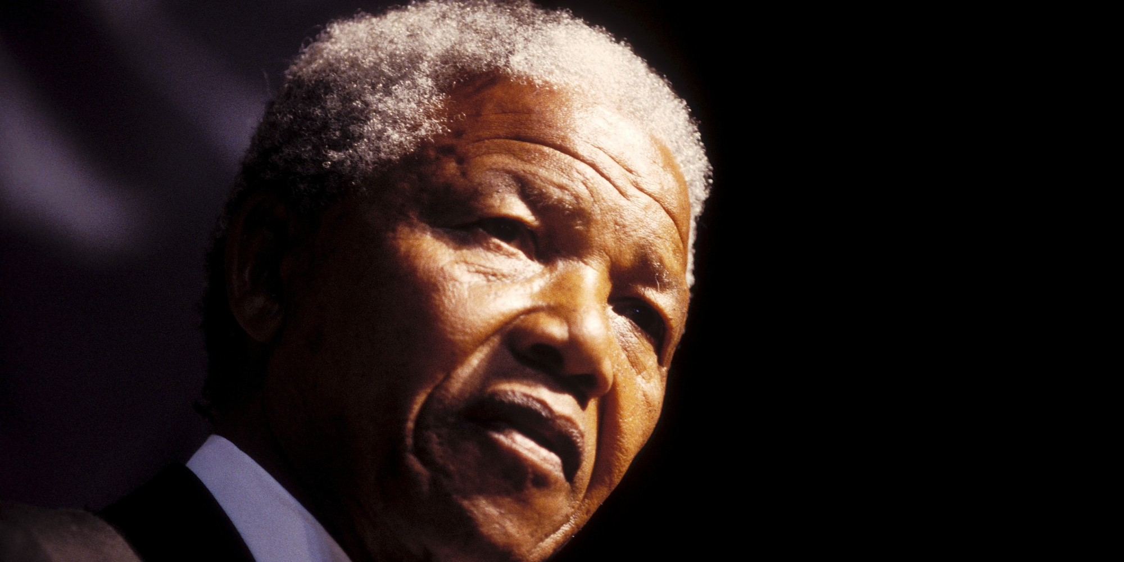
Bring back Nelson Mandela

Slide 4
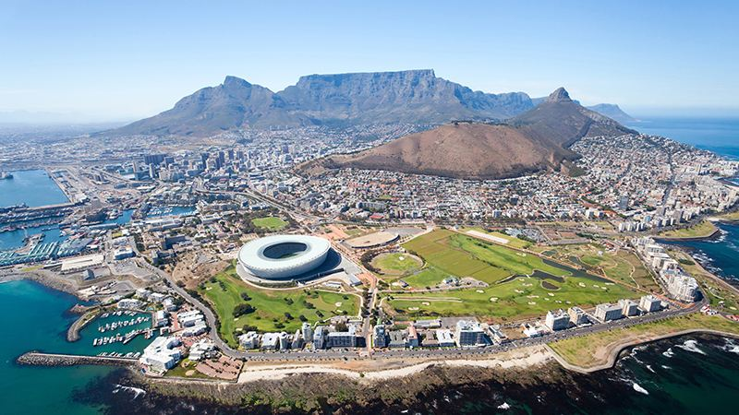
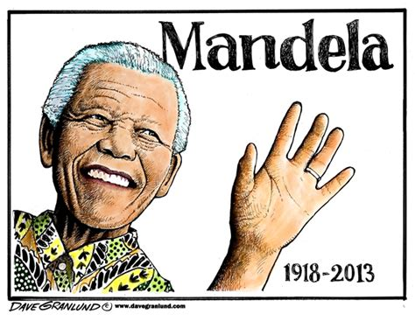
Soweto
Bring him back home to

Slide 5
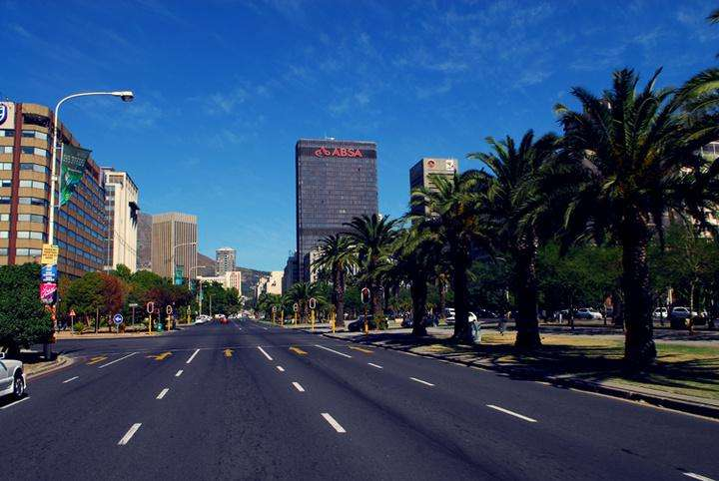
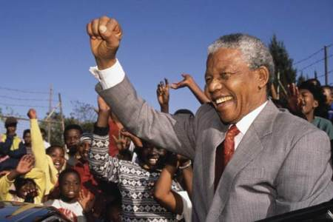
I want to see him walking down the street of South Africa
Tomorrow

Slide 6
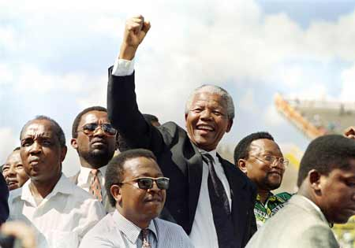
Bring back Nelson Mandela
Bring him back home to

Slide 7
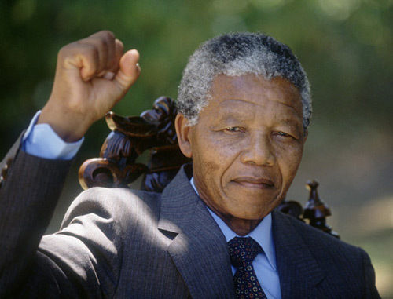
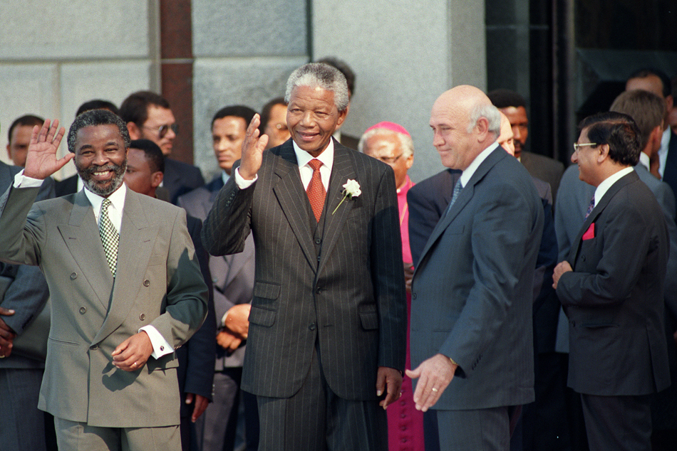
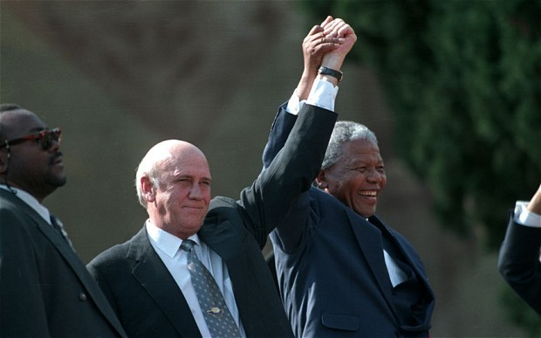
So
we
to

Slide 8
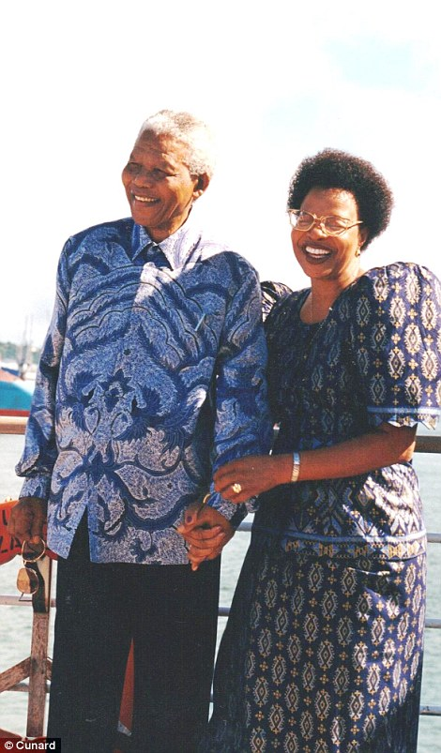
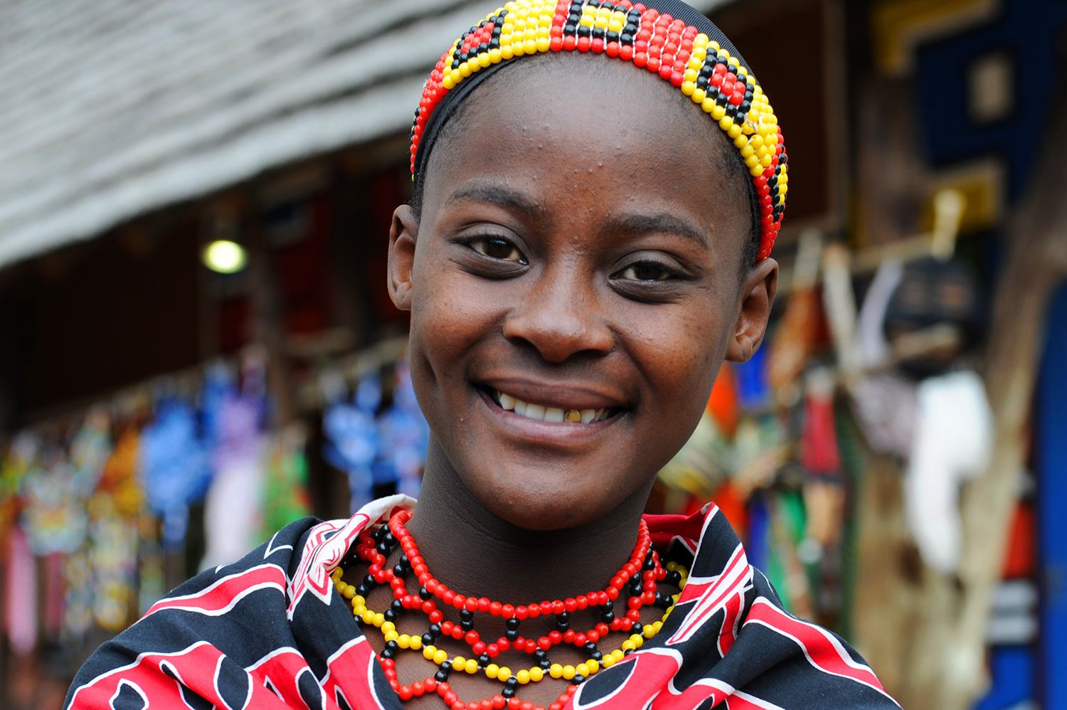
no no Nomzamo
I want to see him walking down the street of South Africa

Slide 9
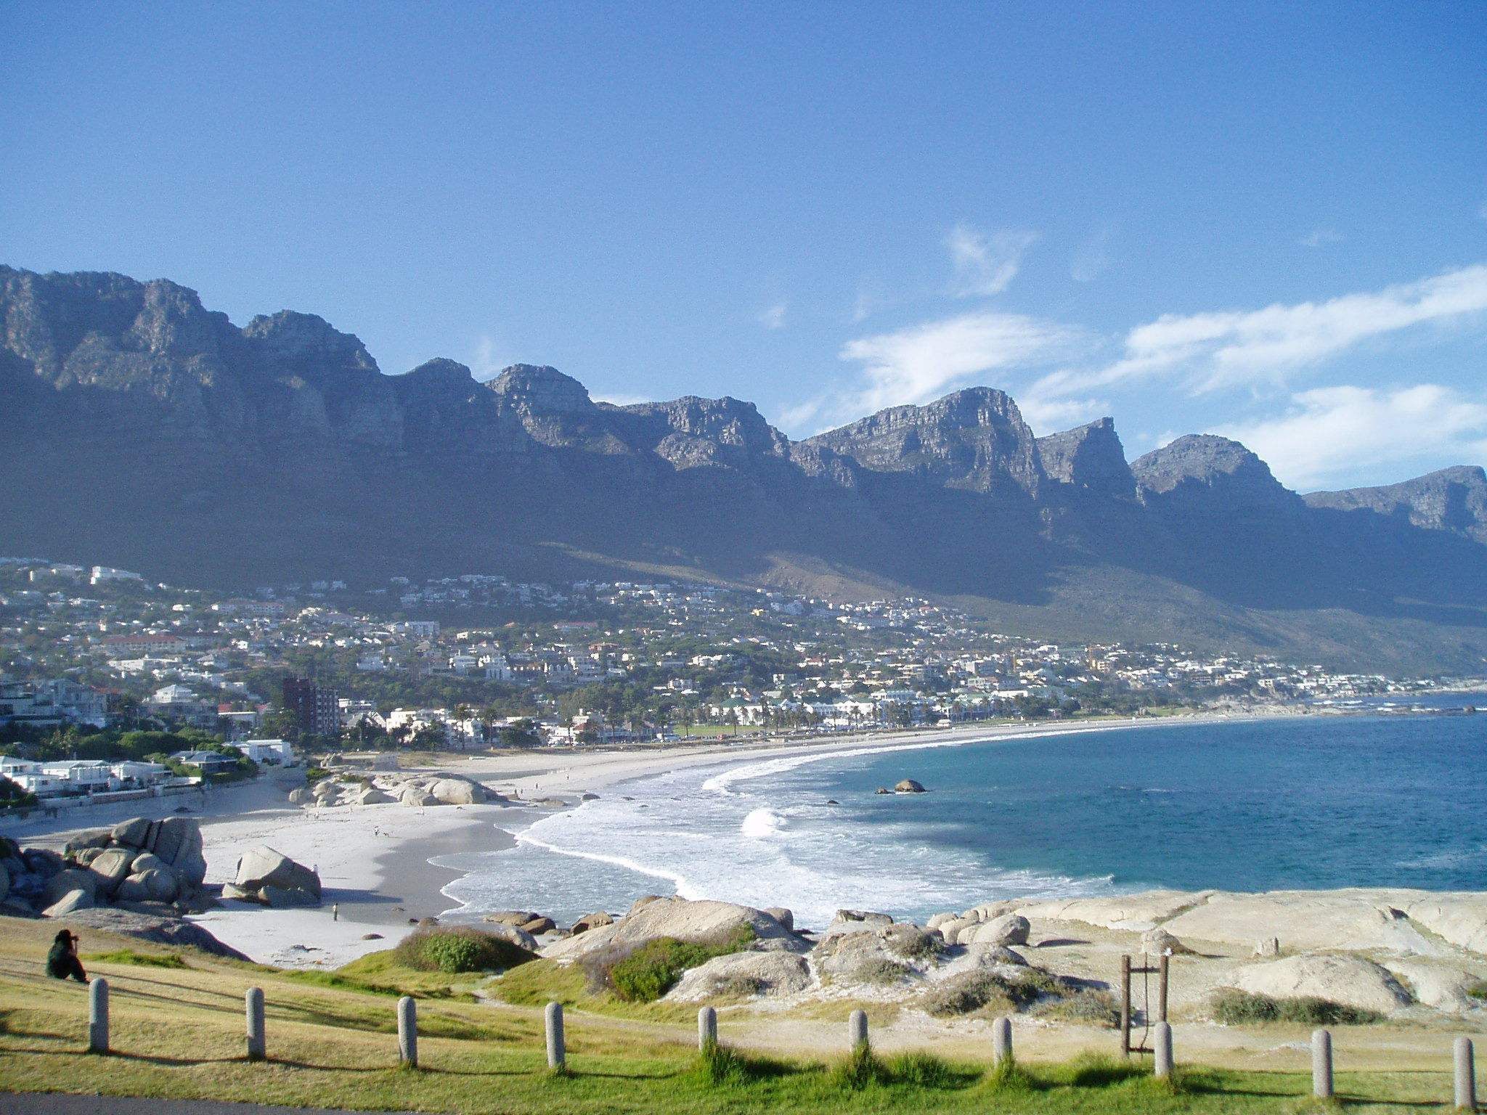
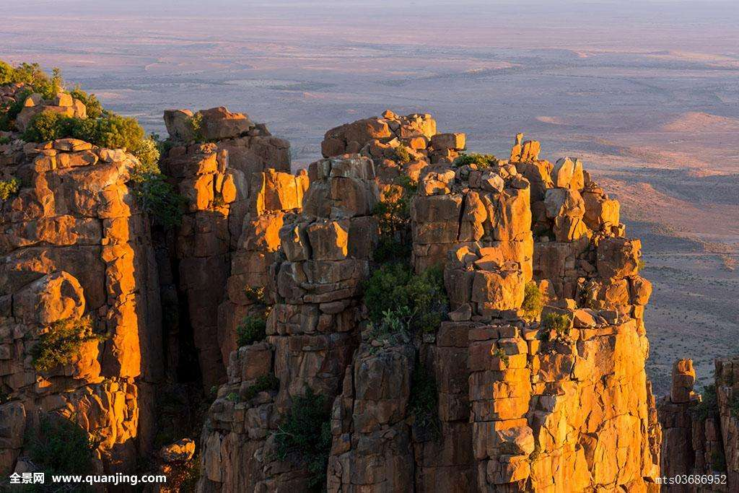
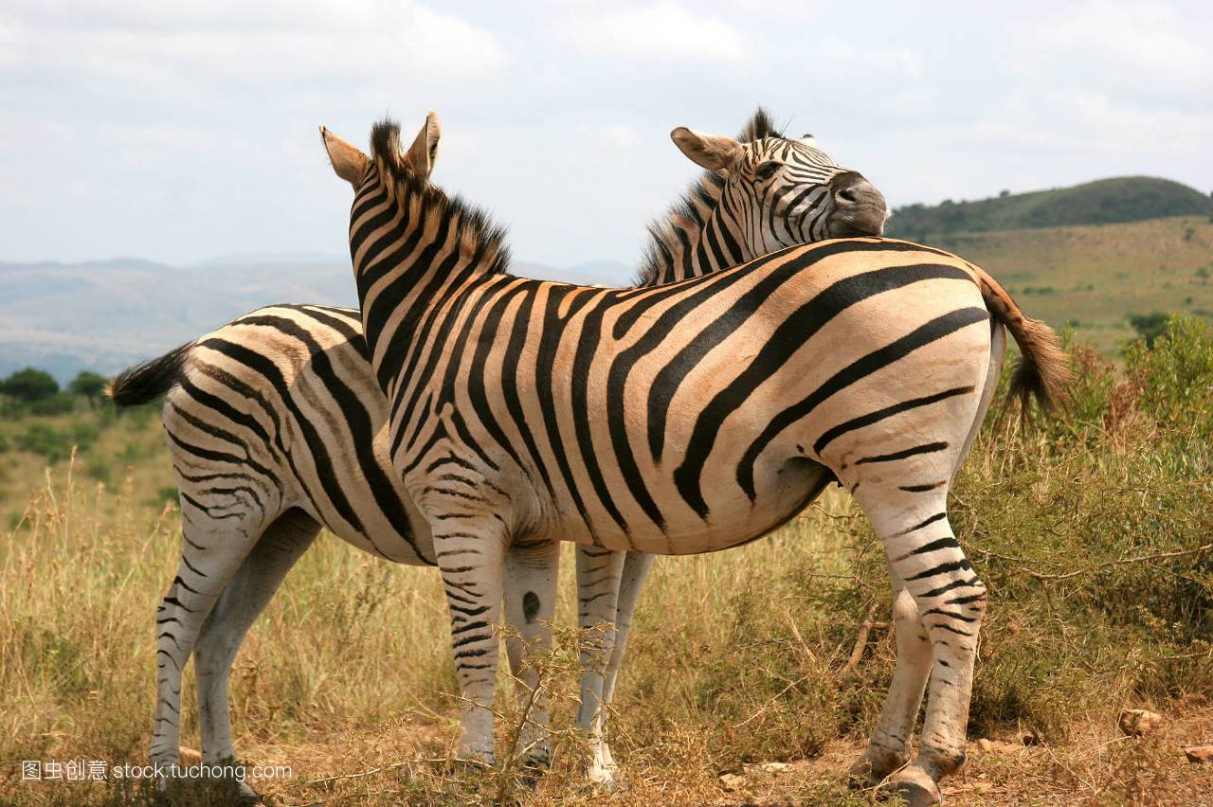
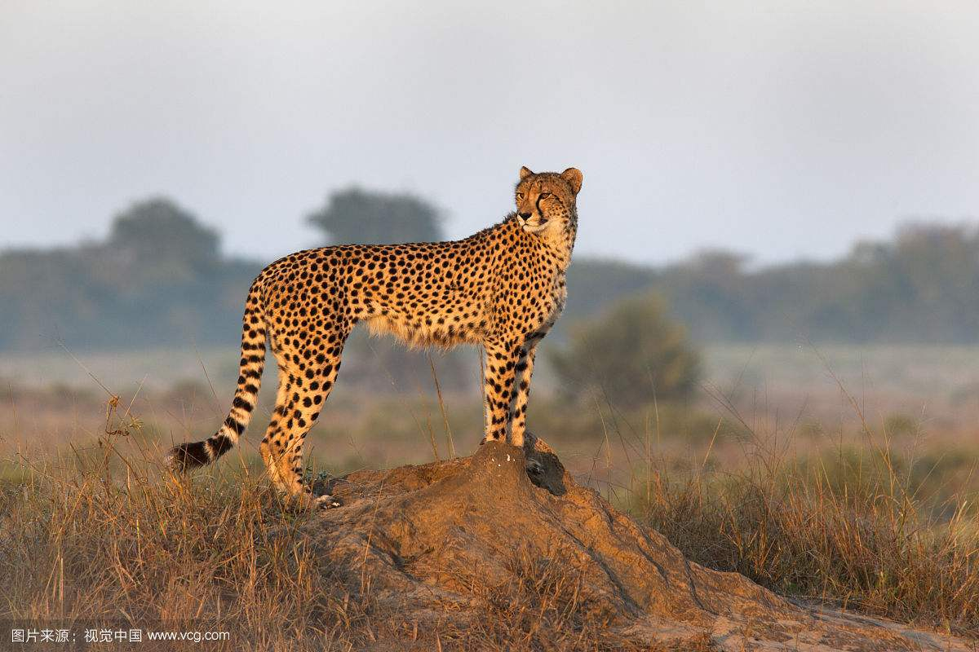
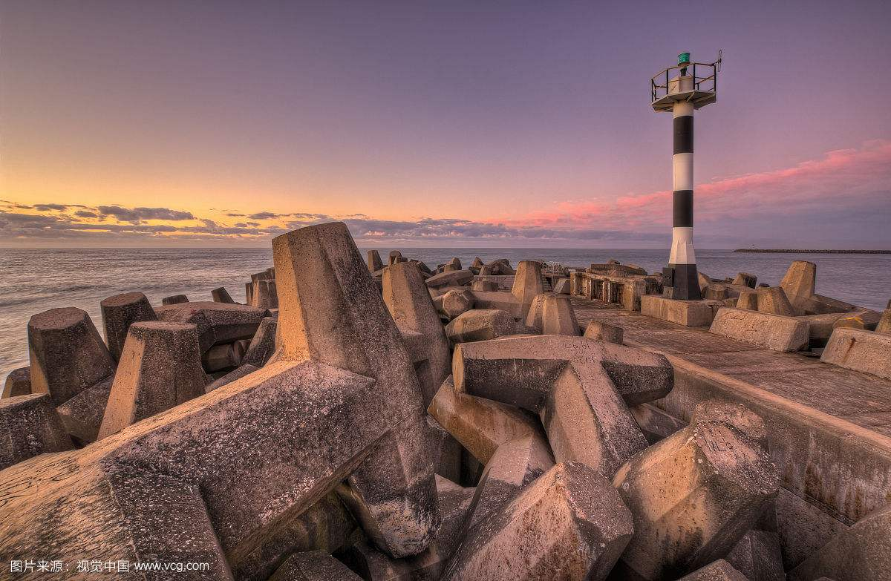
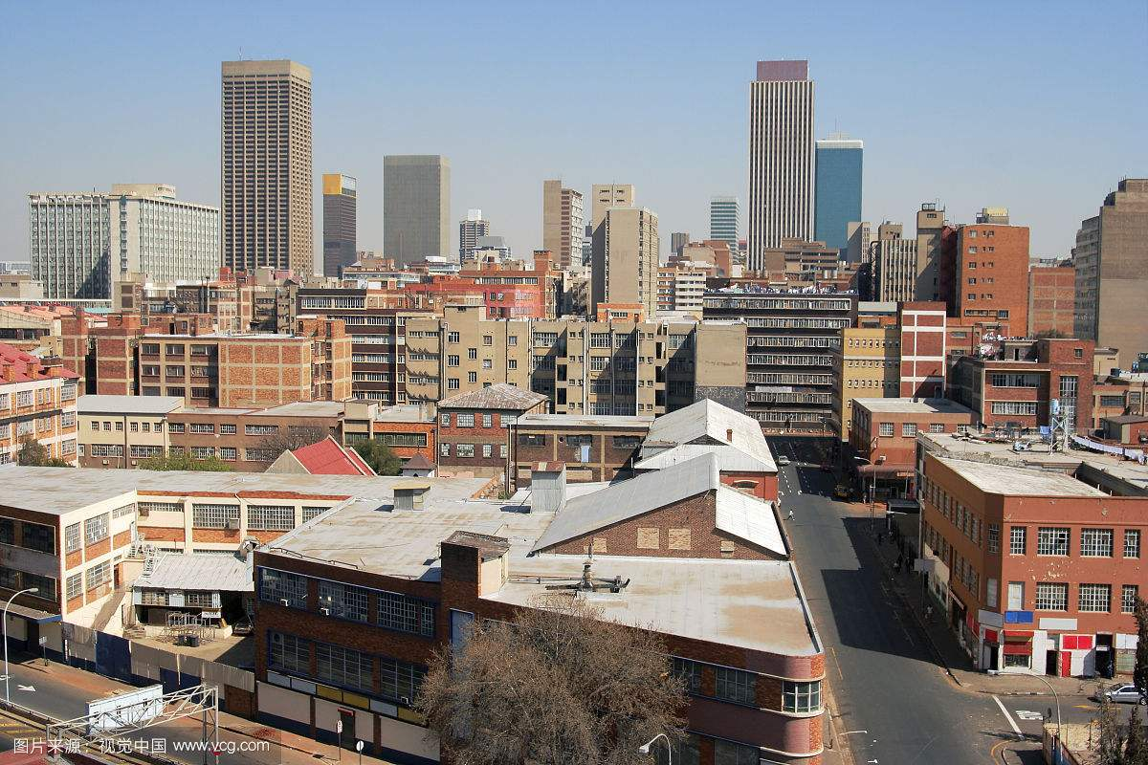

Slide 10
Bring back Nelson Mandela
I want to see him walking down the street of South Africa
I want to see him walking down the street of South Africa
Bring back Nelson Mandela
Bring him Back home to
Bring him Back home to
Soweto
Soweto
-no no Nomzamo
-Tomorrow

Slide 11
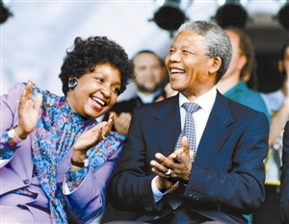
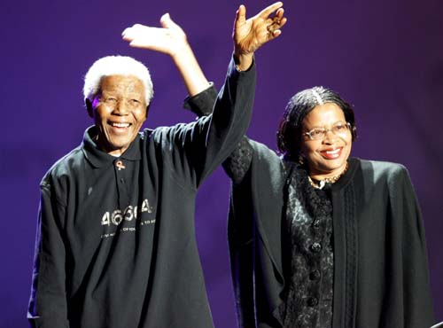
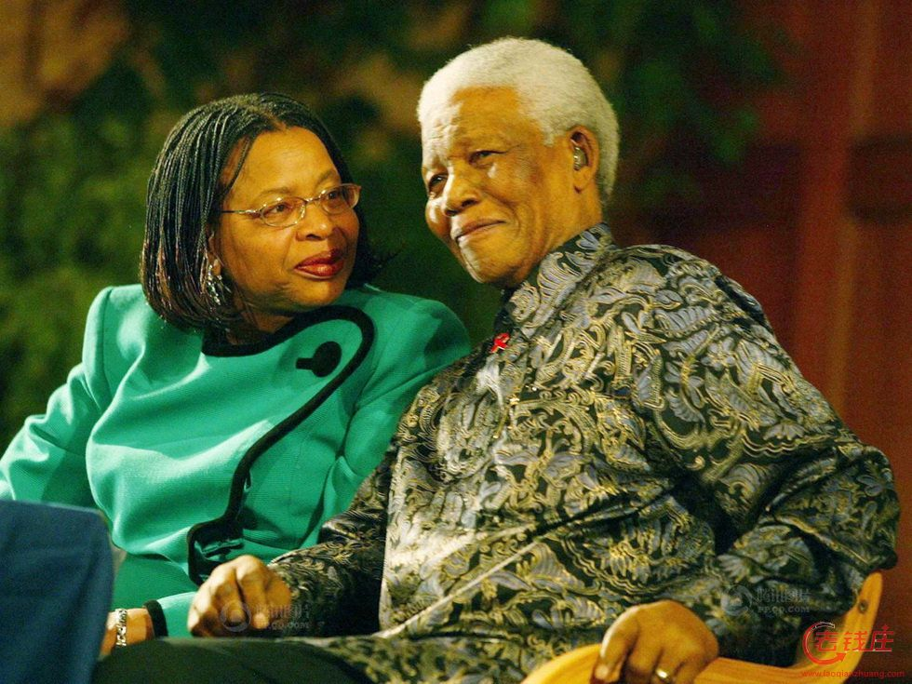
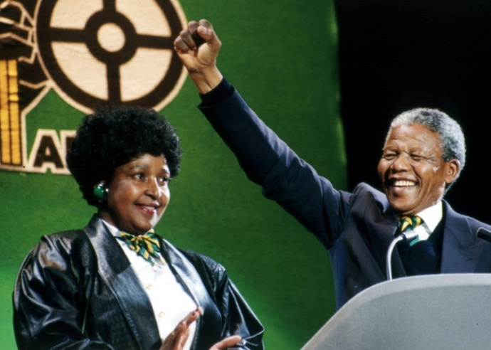
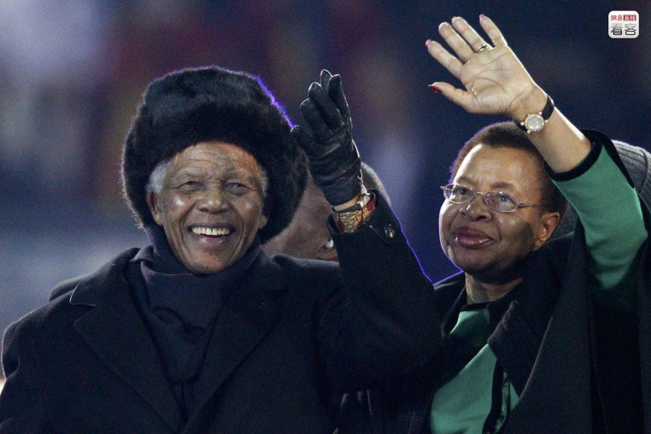

Slide 12
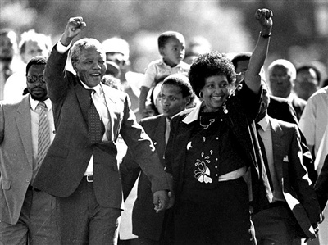
I want to see him walking down the street of South Africa
Nelson Mandela
Bring him Back home to
Soweto
-Tomorrow

Slide 13
I want to see him walking down the street of South Africa
Bring back Nelson Mandela
Bring him Back home to
-Soweto
- no no Nomzamo

Slide 14
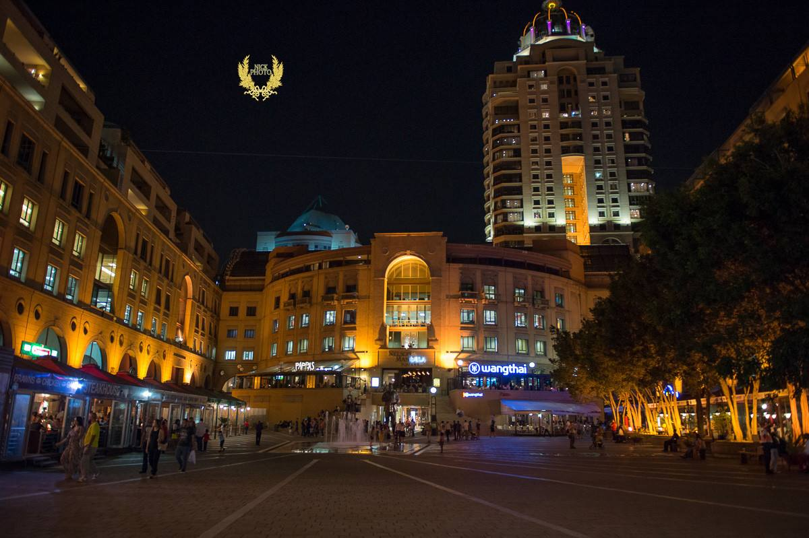
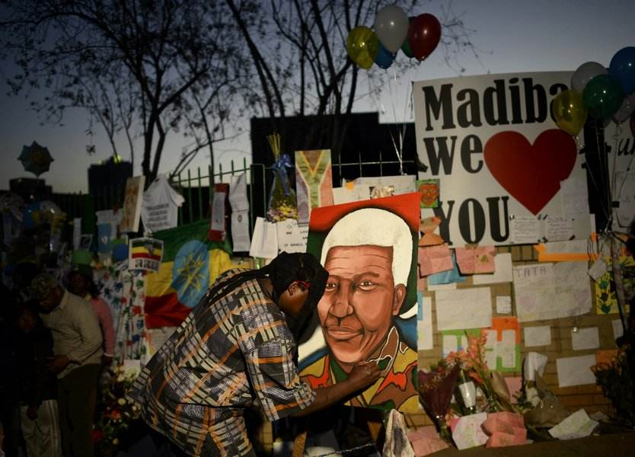
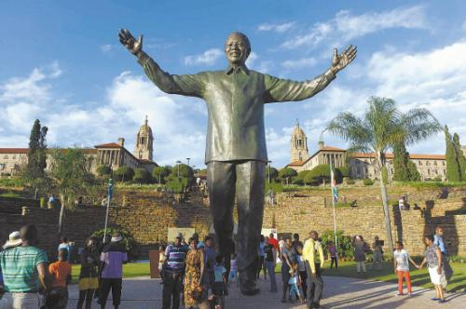
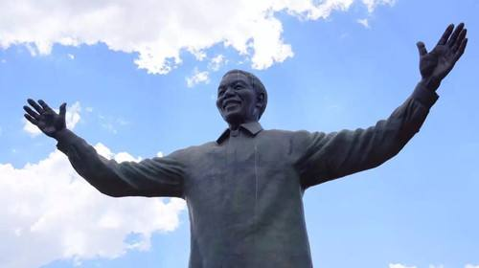

Slide 15
-The End

