Slide 7
7
1
1
0

Slide 8
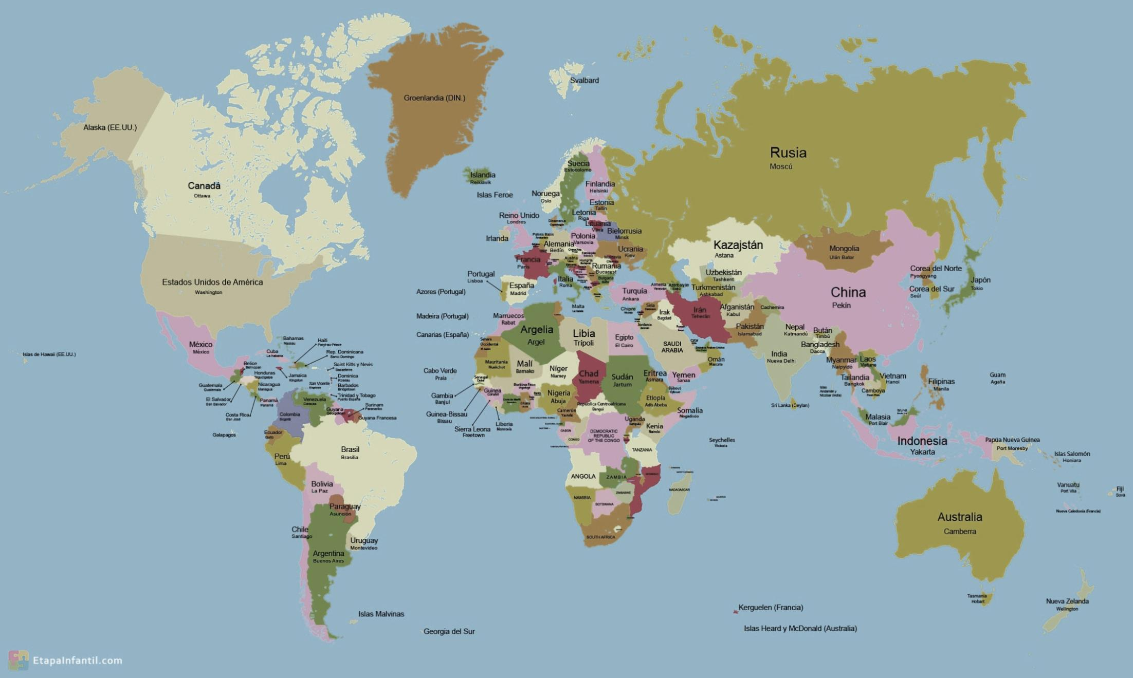

Slide 9
P
r
u
s
s
i
A,
g
e
r
m
a
n
y

Slide 10
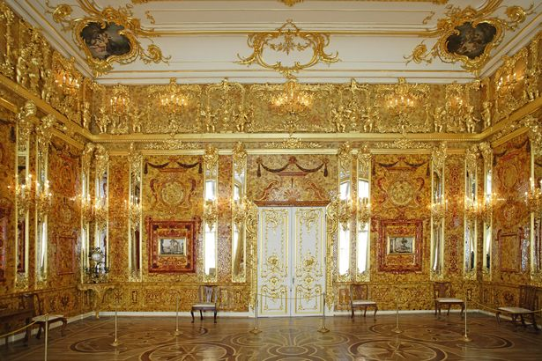
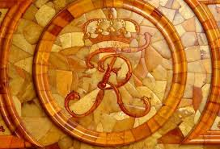
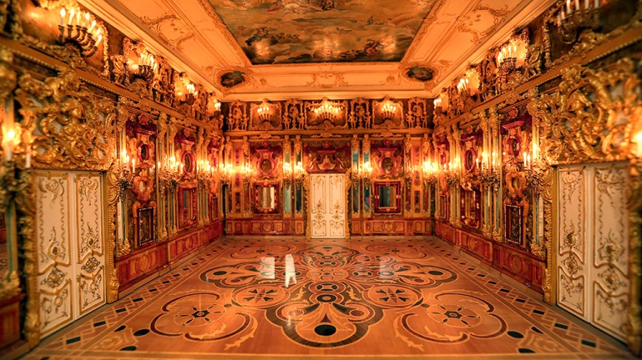
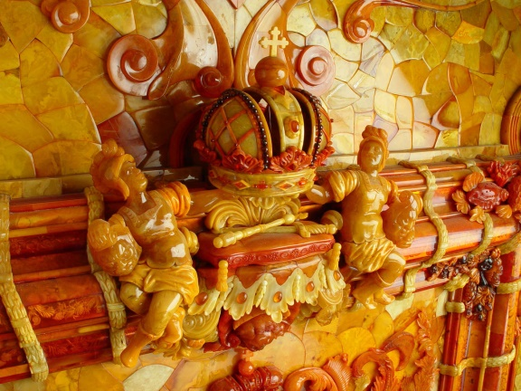
r
t
h
e
a
m
b
e
r
o
o
m

Slide 11
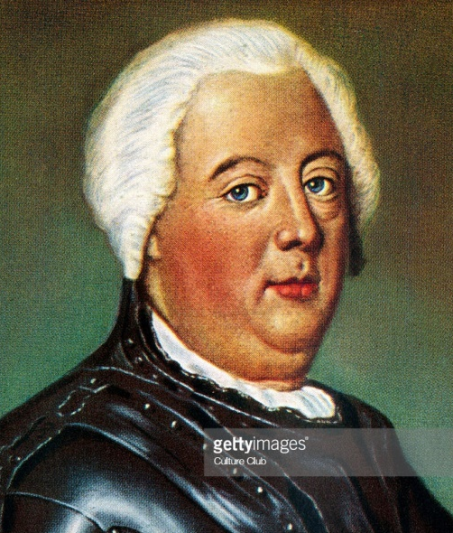
r
t
h
e
a
m
b
e
r
o
o
m
w
a
s
m
a
d
e
f
r
o
Frederick William I
(King of Prussia)

Slide 12
7
6
1
1

Slide 13
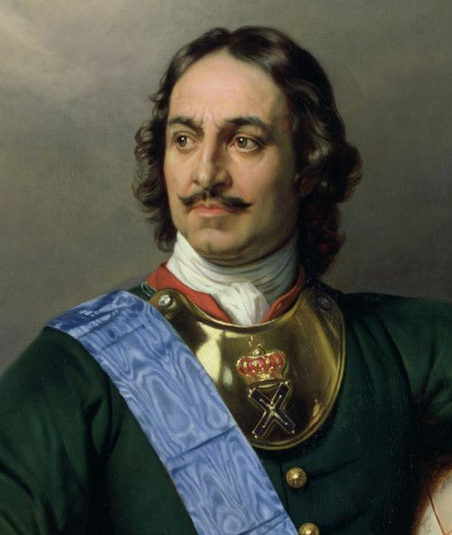
g
a
v
e
t
o
Frederick William I
(King of Prussia)
Peter the Great
(King of Russia)

Slide 14
7
0
1
7

Slide 15
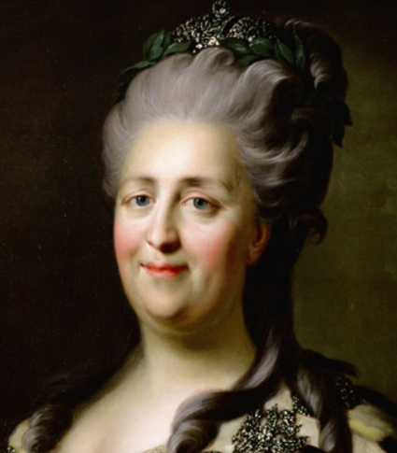
d
e
t
i
l
s
a
d
d
m
o
r
e
a
Catherine Ⅱ
(Empress of Russia)

Slide 16
9
1
1
4

Slide 17
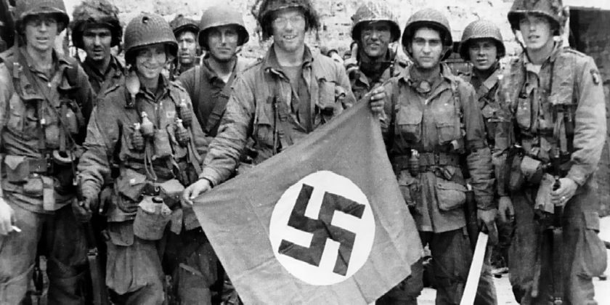
s
t
o
l
e
Nazis army

Slide 18
r
T
h
e
n
t
h
e
a
m
b
e
r
o
o
m
.
w
a
s
m
i
.
.
.
.
.
s
s
i
n
g

Slide 19
u
L
2
0
0
3
n
t
i

Slide 20
r
.
o
o
m
l
t
h
e
a
m
b
e
r
w
a
s
r
e
b
u
i
t

Slide 22
t
n
h
e
e
d

