Slide 1
PEP M2U1: Cultural Relics
Song: Viva la Vida
Singer: Coldplay
作者：钟婉琴
单位：华南师范大学外文学院

Slide 2
Coldplay - Viva la Vida

Slide 3
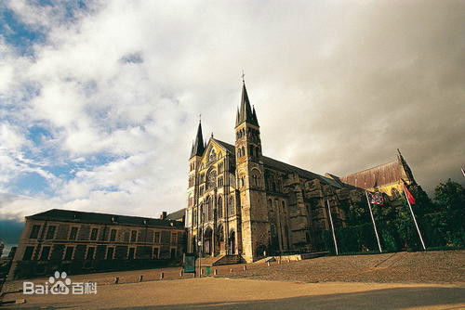

Slide 4
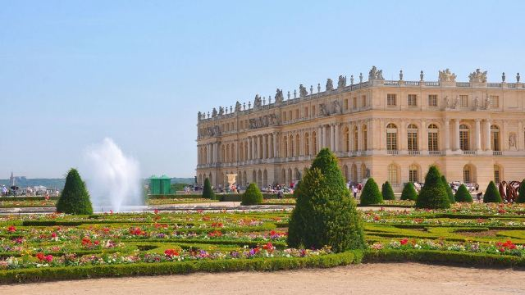
I used to rule the world

Slide 5
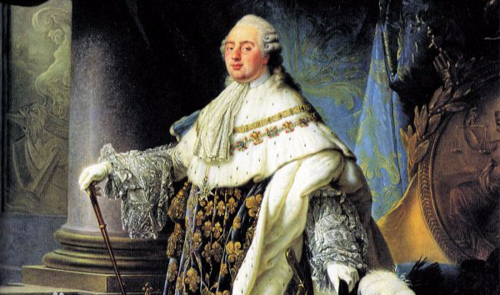
Seas would rise when I gave the word

Slide 6
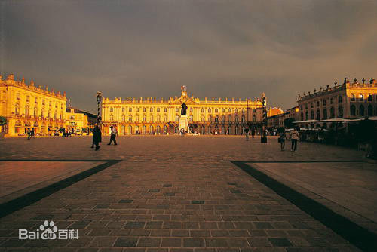
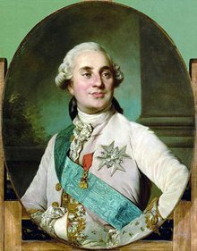
Now in the morning I sweep alone
Sweep the streets I used to own

Slide 7
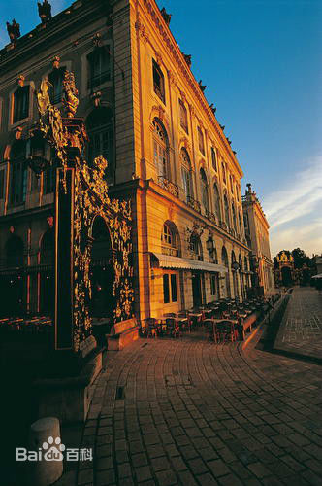
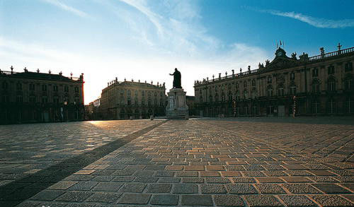

Slide 8
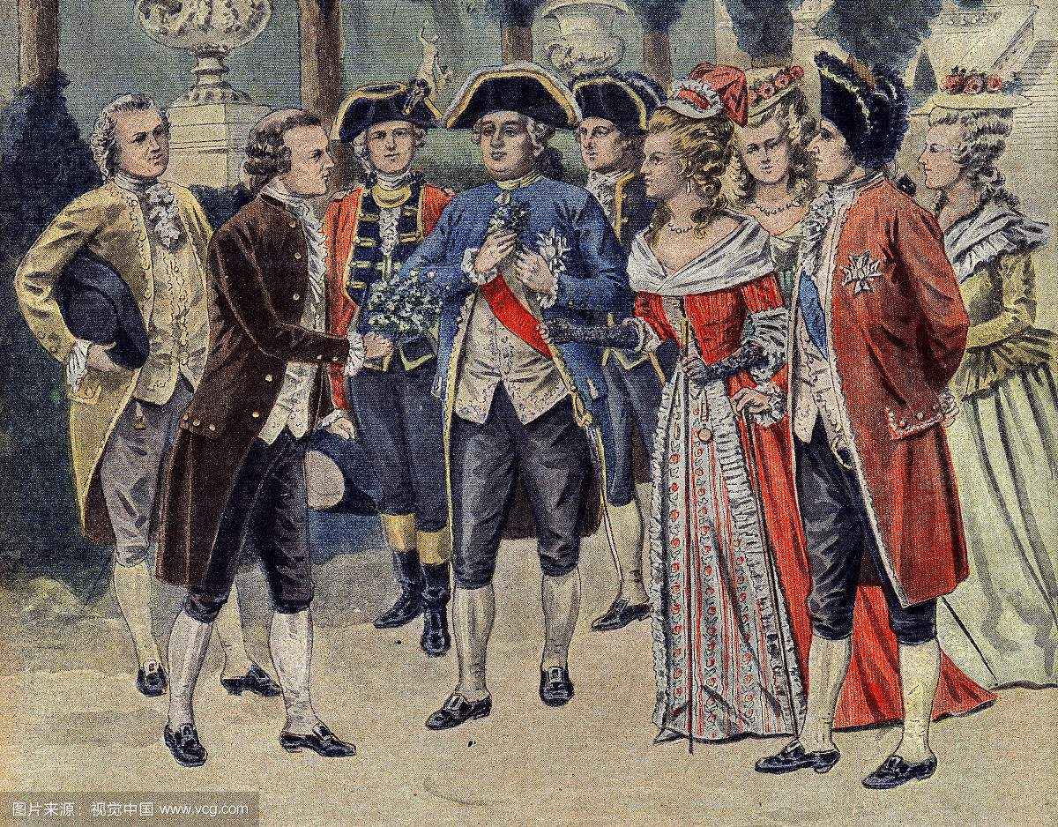
I used to roll the dice
Feel the fear in my enemy's eyes

Slide 9
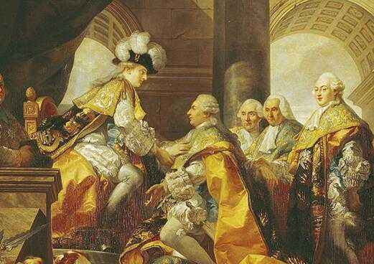
Listen as the crowd would sing:
"Now the old king is dead
Long live the king "

Slide 10
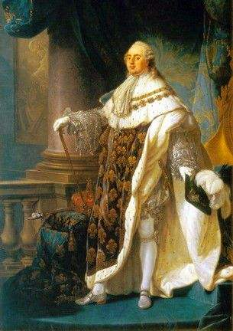
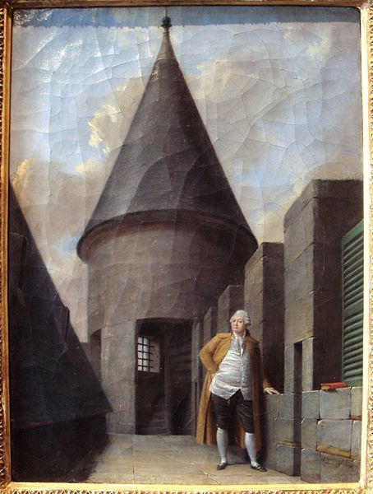
One minute I held the key
Next the walls were closed on me

Slide 11
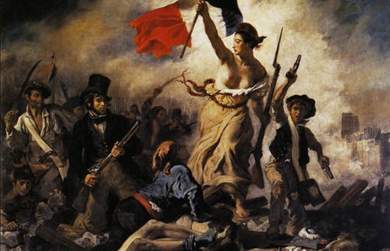
And I discovered that my castles stand
Upon pillars of salt, pillars of sand

Slide 12
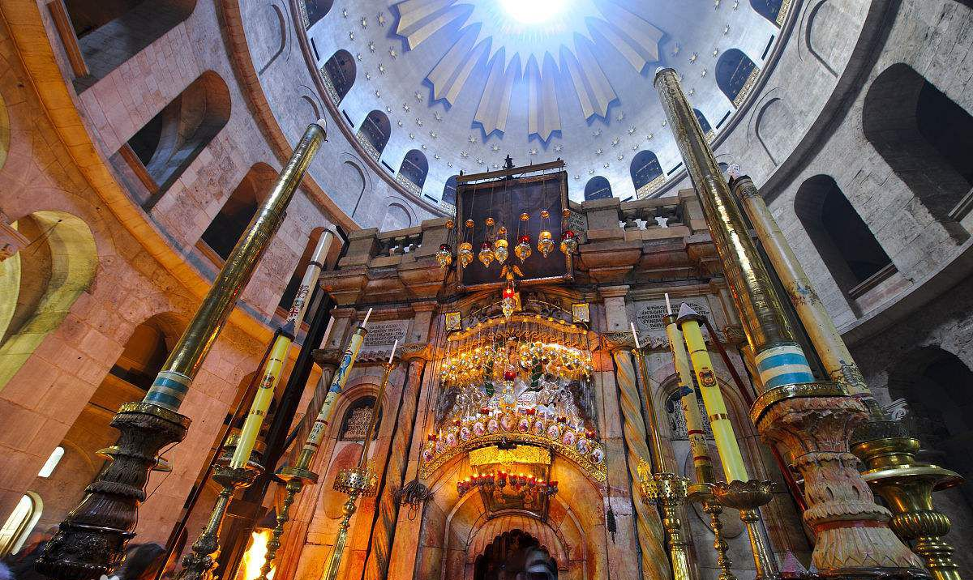
I hear Jerusalem's bell's ringing

Slide 13
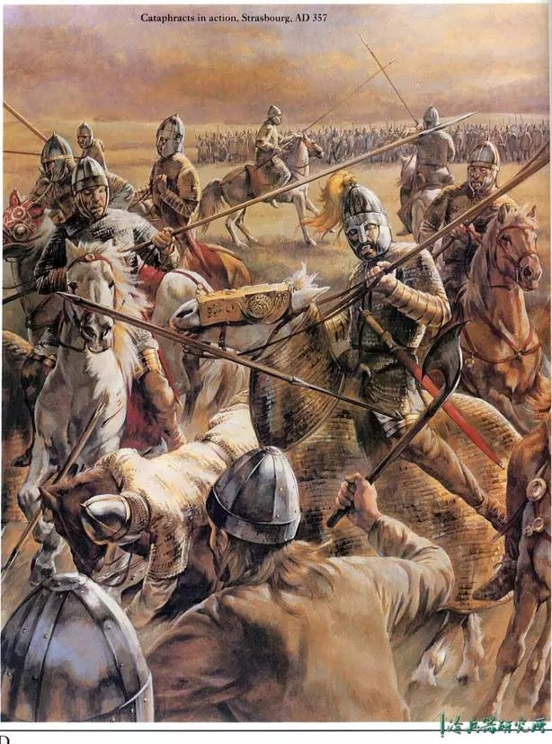
Roman Cavalry choirs are singing
Be my mirror my sword and shield

Slide 14
My missionaries in a foreign field

Slide 15
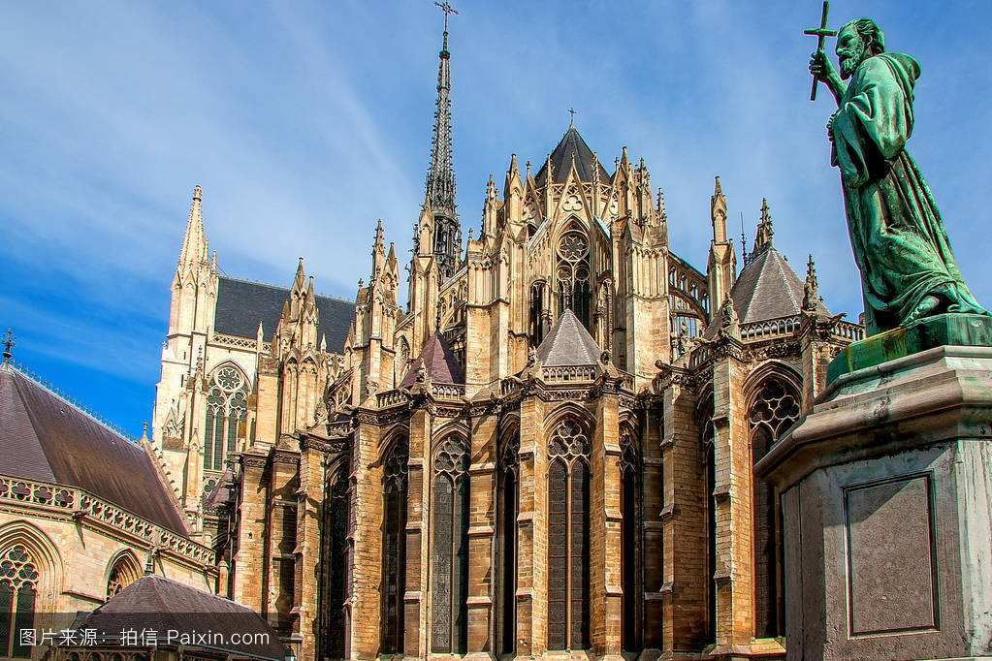
For some reason I can't explain

Slide 16
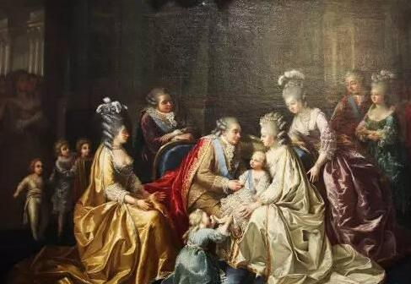
Once you know
there was never'
Never an honest word

Slide 17
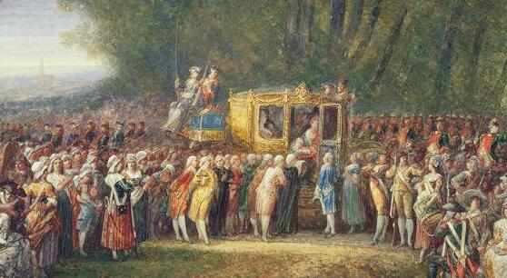
That was when I ruled the world

Slide 18
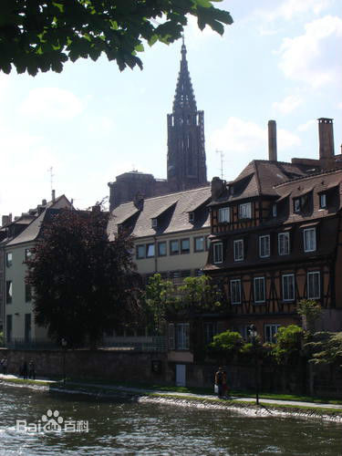
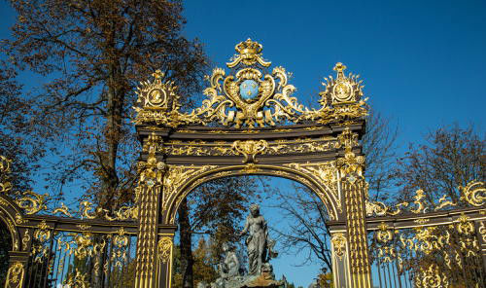

Slide 19
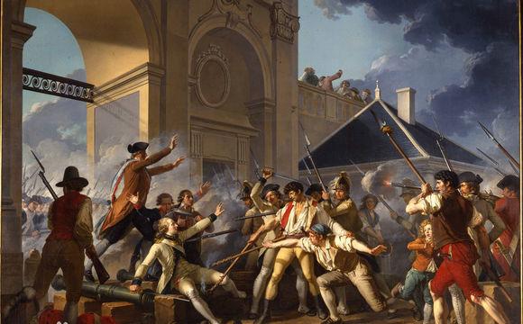
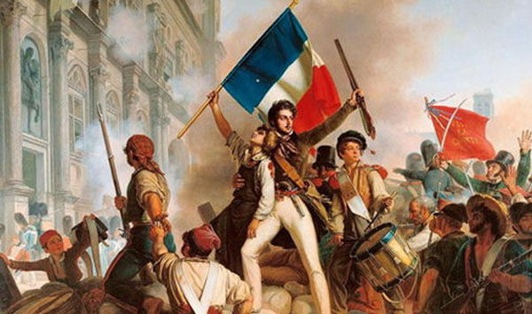
It was the wicked and wild wind
Blew down the doors to let me in.

Slide 20
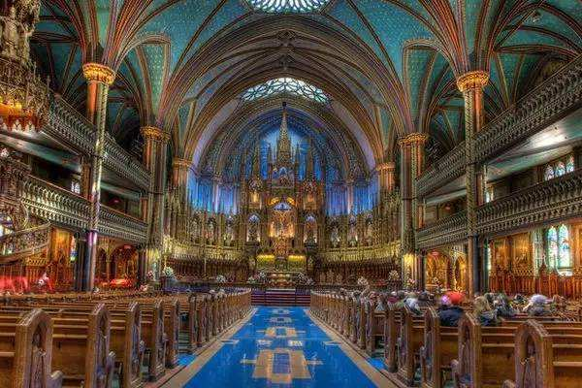
Shattered windows and the sound of drums
People couldn't believe what I'd become

Slide 21
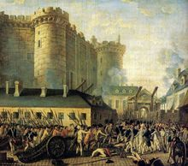
Revolutionaries Wait

Slide 22
For my head on a silver plate
Just a puppet on a lonely string

Slide 23
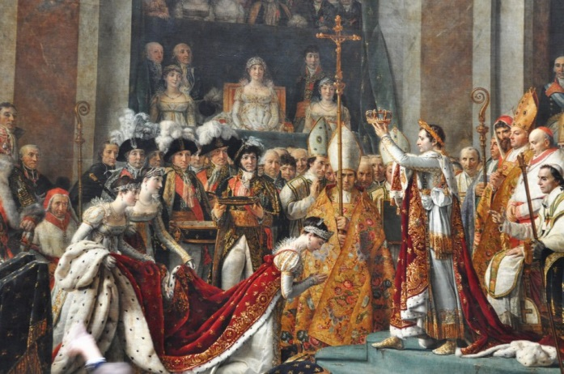
Oh who would ever want to be king?

Slide 24
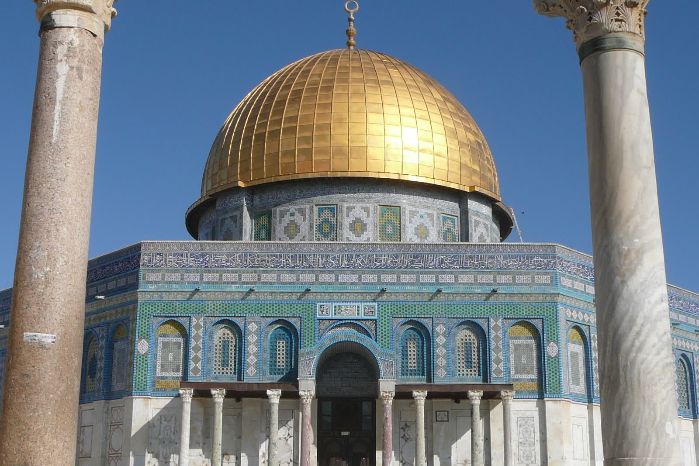
I hear Jerusalem's bell's ringing

Slide 25
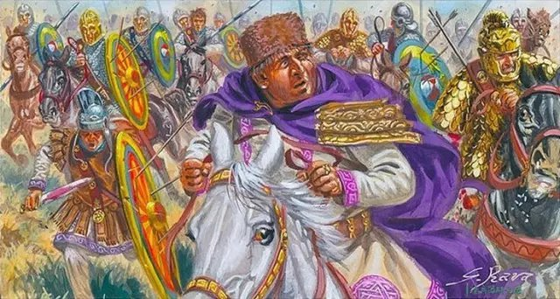
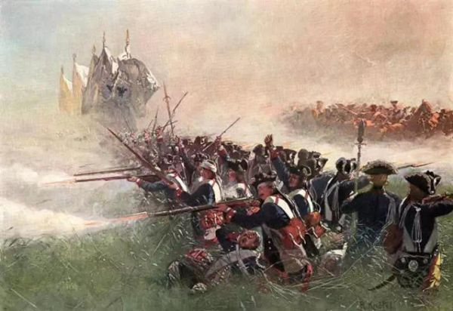
Roman Cavalry choirs are singing
Be my mirror my sword and shield

Slide 26
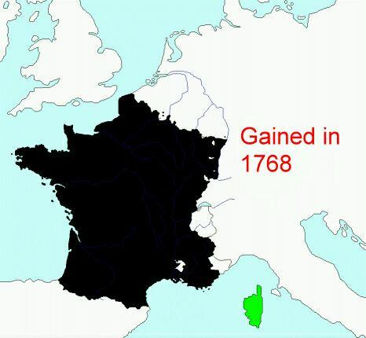
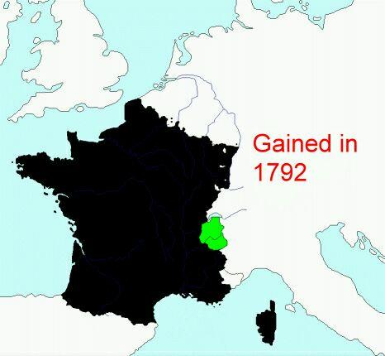
My missionaries in a foreign field
For some reason I can not explain

Slide 27
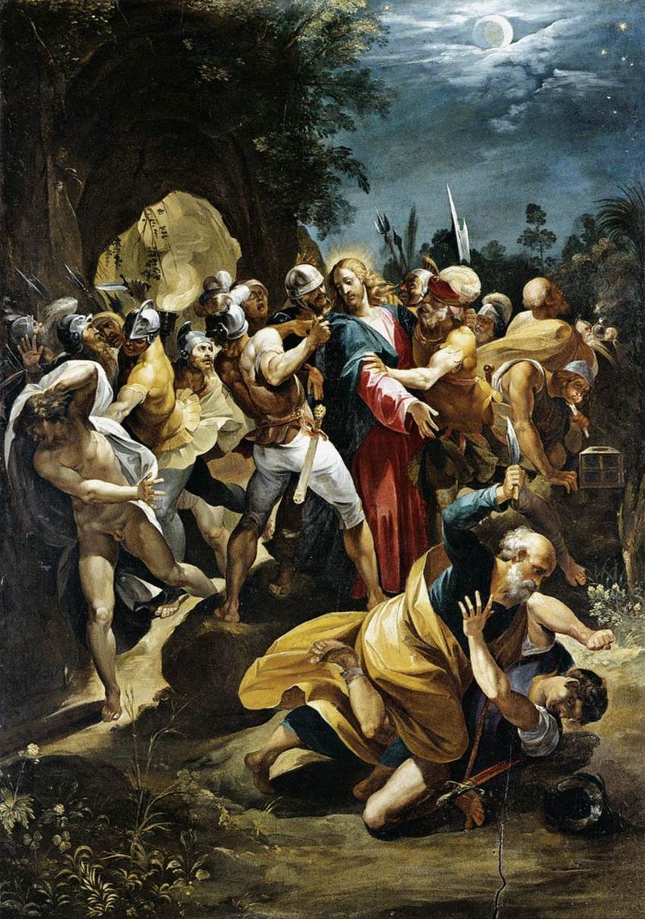
I know Saint Peter won't call my name
Never an honest word

Slide 28
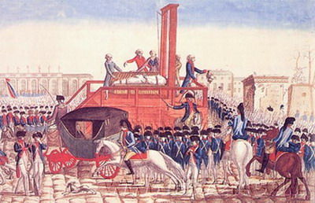
But that was when I ruled the world

Slide 29
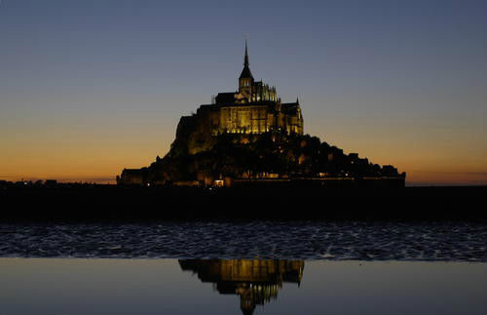

Slide 30
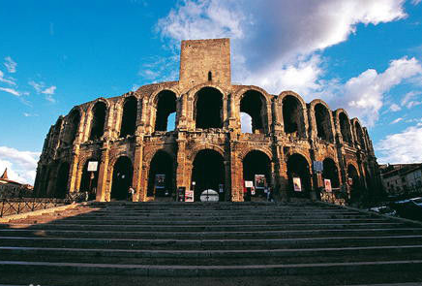
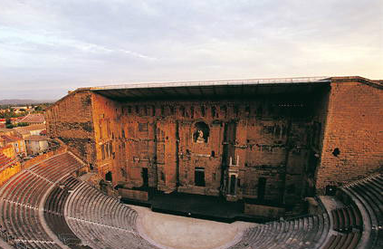

Slide 32
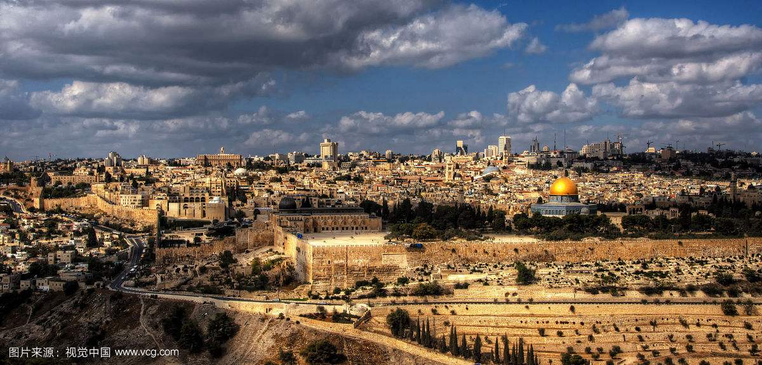
Hear Jerusalem's bell's ringing

Slide 33
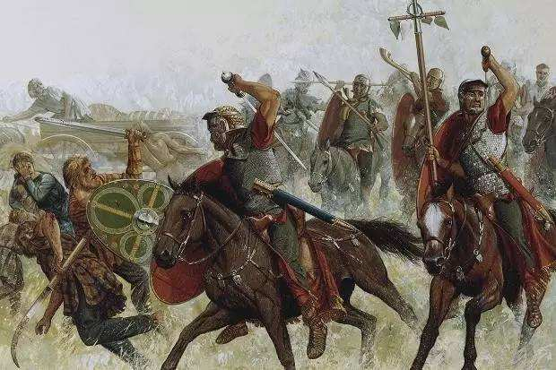
Roman Cavalry choirs are singing
Be my mirror my sword and shield

Slide 34
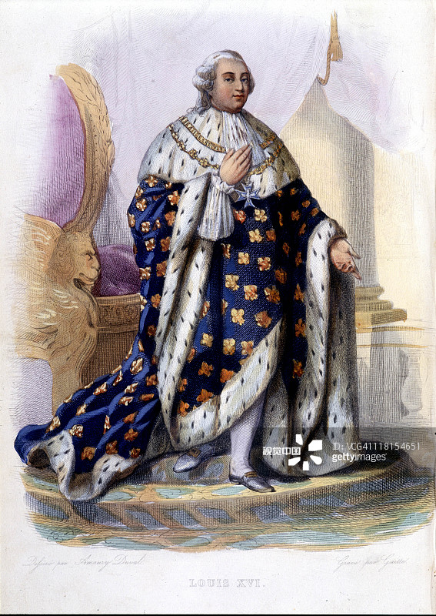
My missionaries in a foreign field

Slide 35
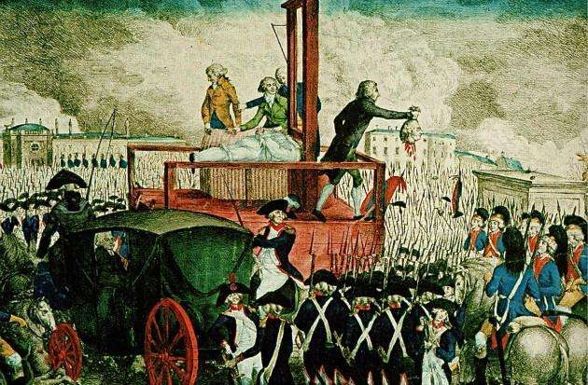
For some reason I can not explain

Slide 36
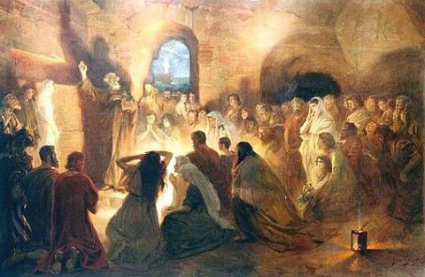
I know Saint Peter won't call my name

Slide 37
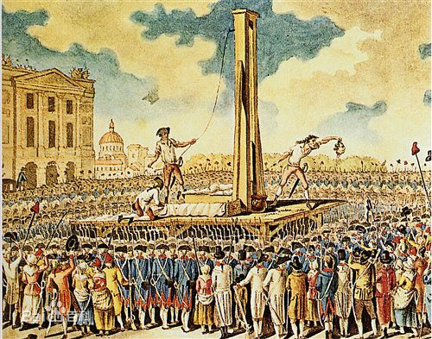
Never an honest word

Slide 38
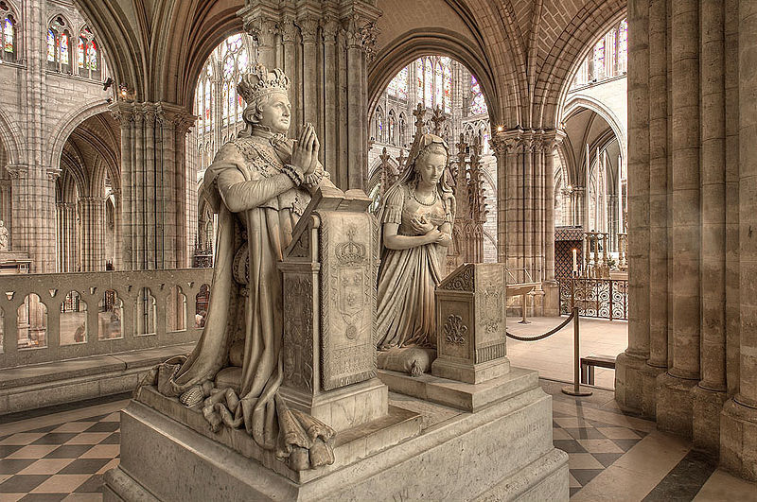
But that was when I ruled the world

Slide 39
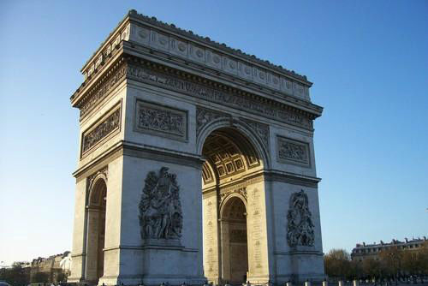

Slide 40
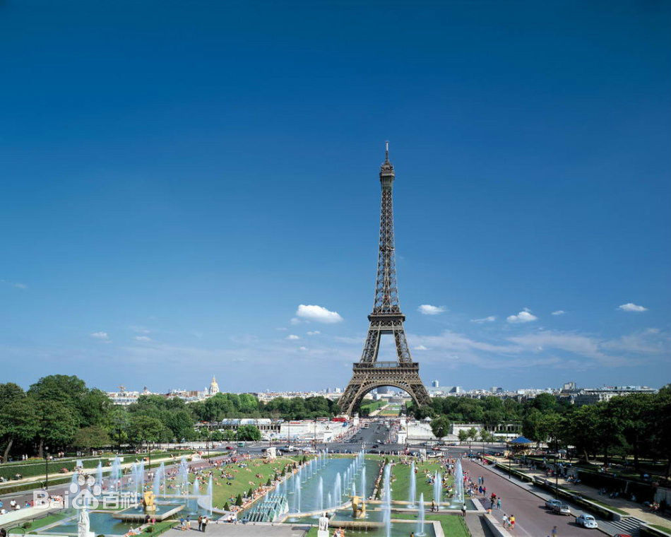
Thank You!

