Slide 1
人教版必修2 Unit 1 Cultural relice
主题： Protecting the cultural heritage
周晓琳
华南师范大学外文学院20150201003 英师3班

Slide 2
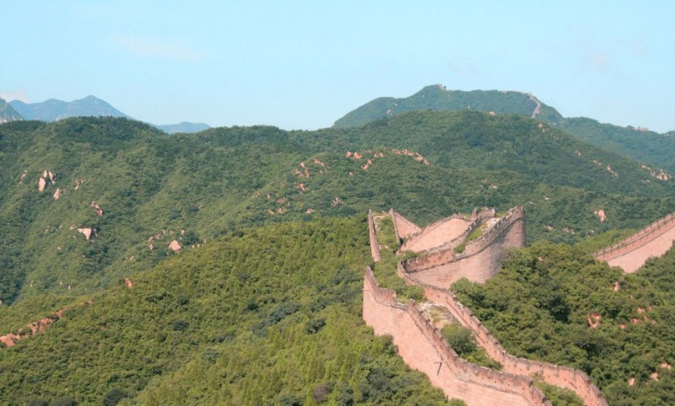
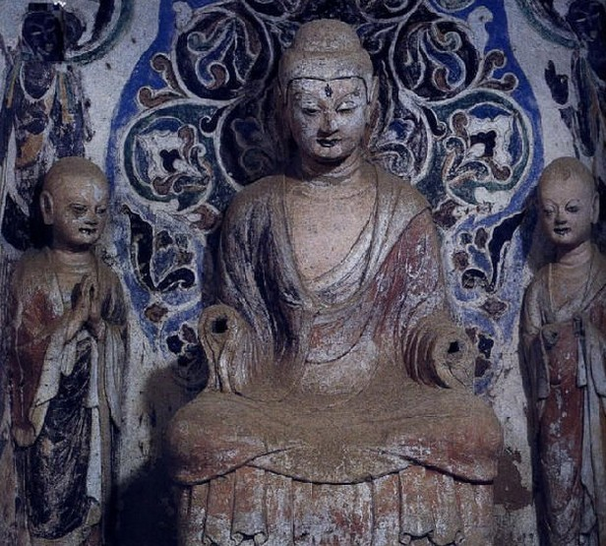
Protecting the cultural heritage
The Great Wall
Dunhuang Mogao Grottoes

Slide 3
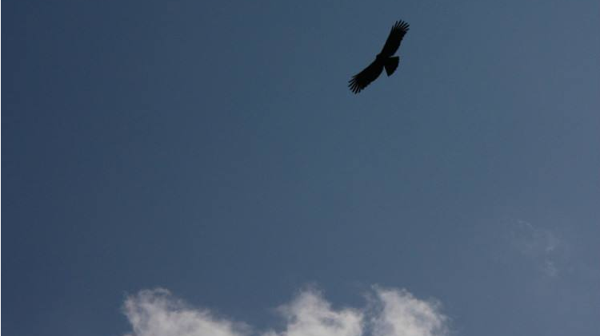
Skip>>
This melody <El Condor pasa> has been
included in the UN World Heritage Site.
The English version is <I can fly>.

Slide 4
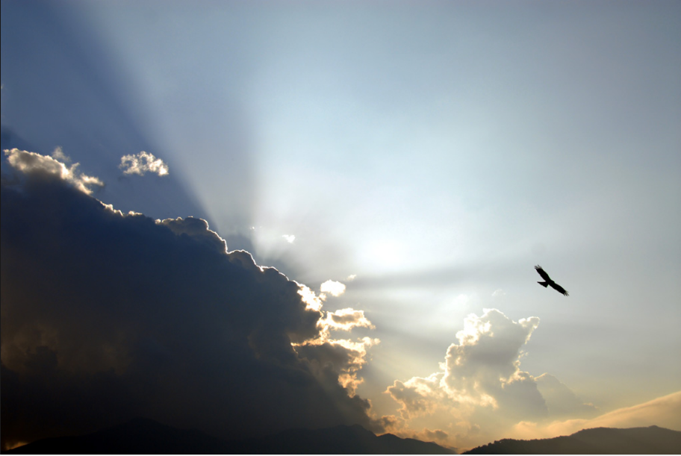
Skip>>
In 1780, Tupac Amaro, a Peruvian freedom fighter,
was killed in a revolt against the Spaniards.
After he died,
he turned into an eagle and
soared over the Andean mountains of the motherland.

Slide 5
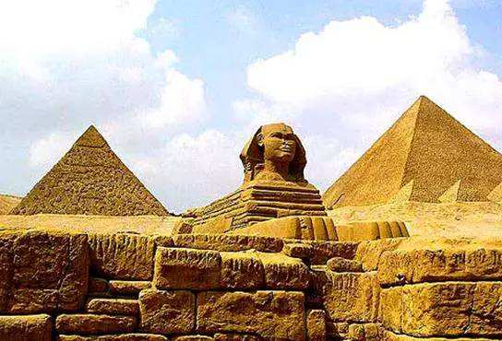
Pyramid
Skip>>
I'd rather be a sparrow
than a snail

Slide 6
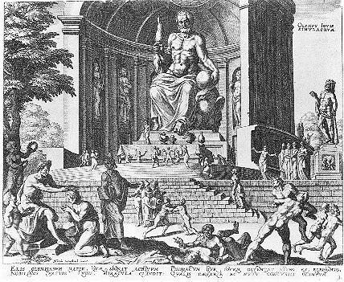
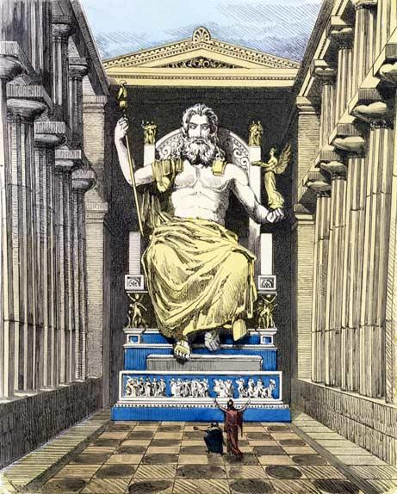
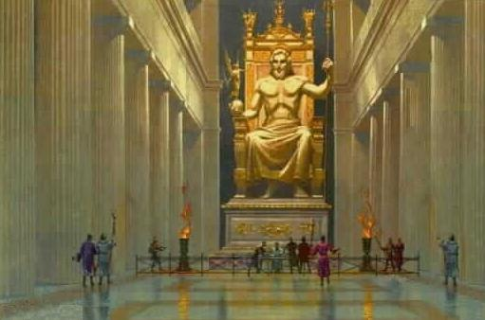
Zeus statue
Skip>>
I surely would
If I could
Yes I would

Slide 7
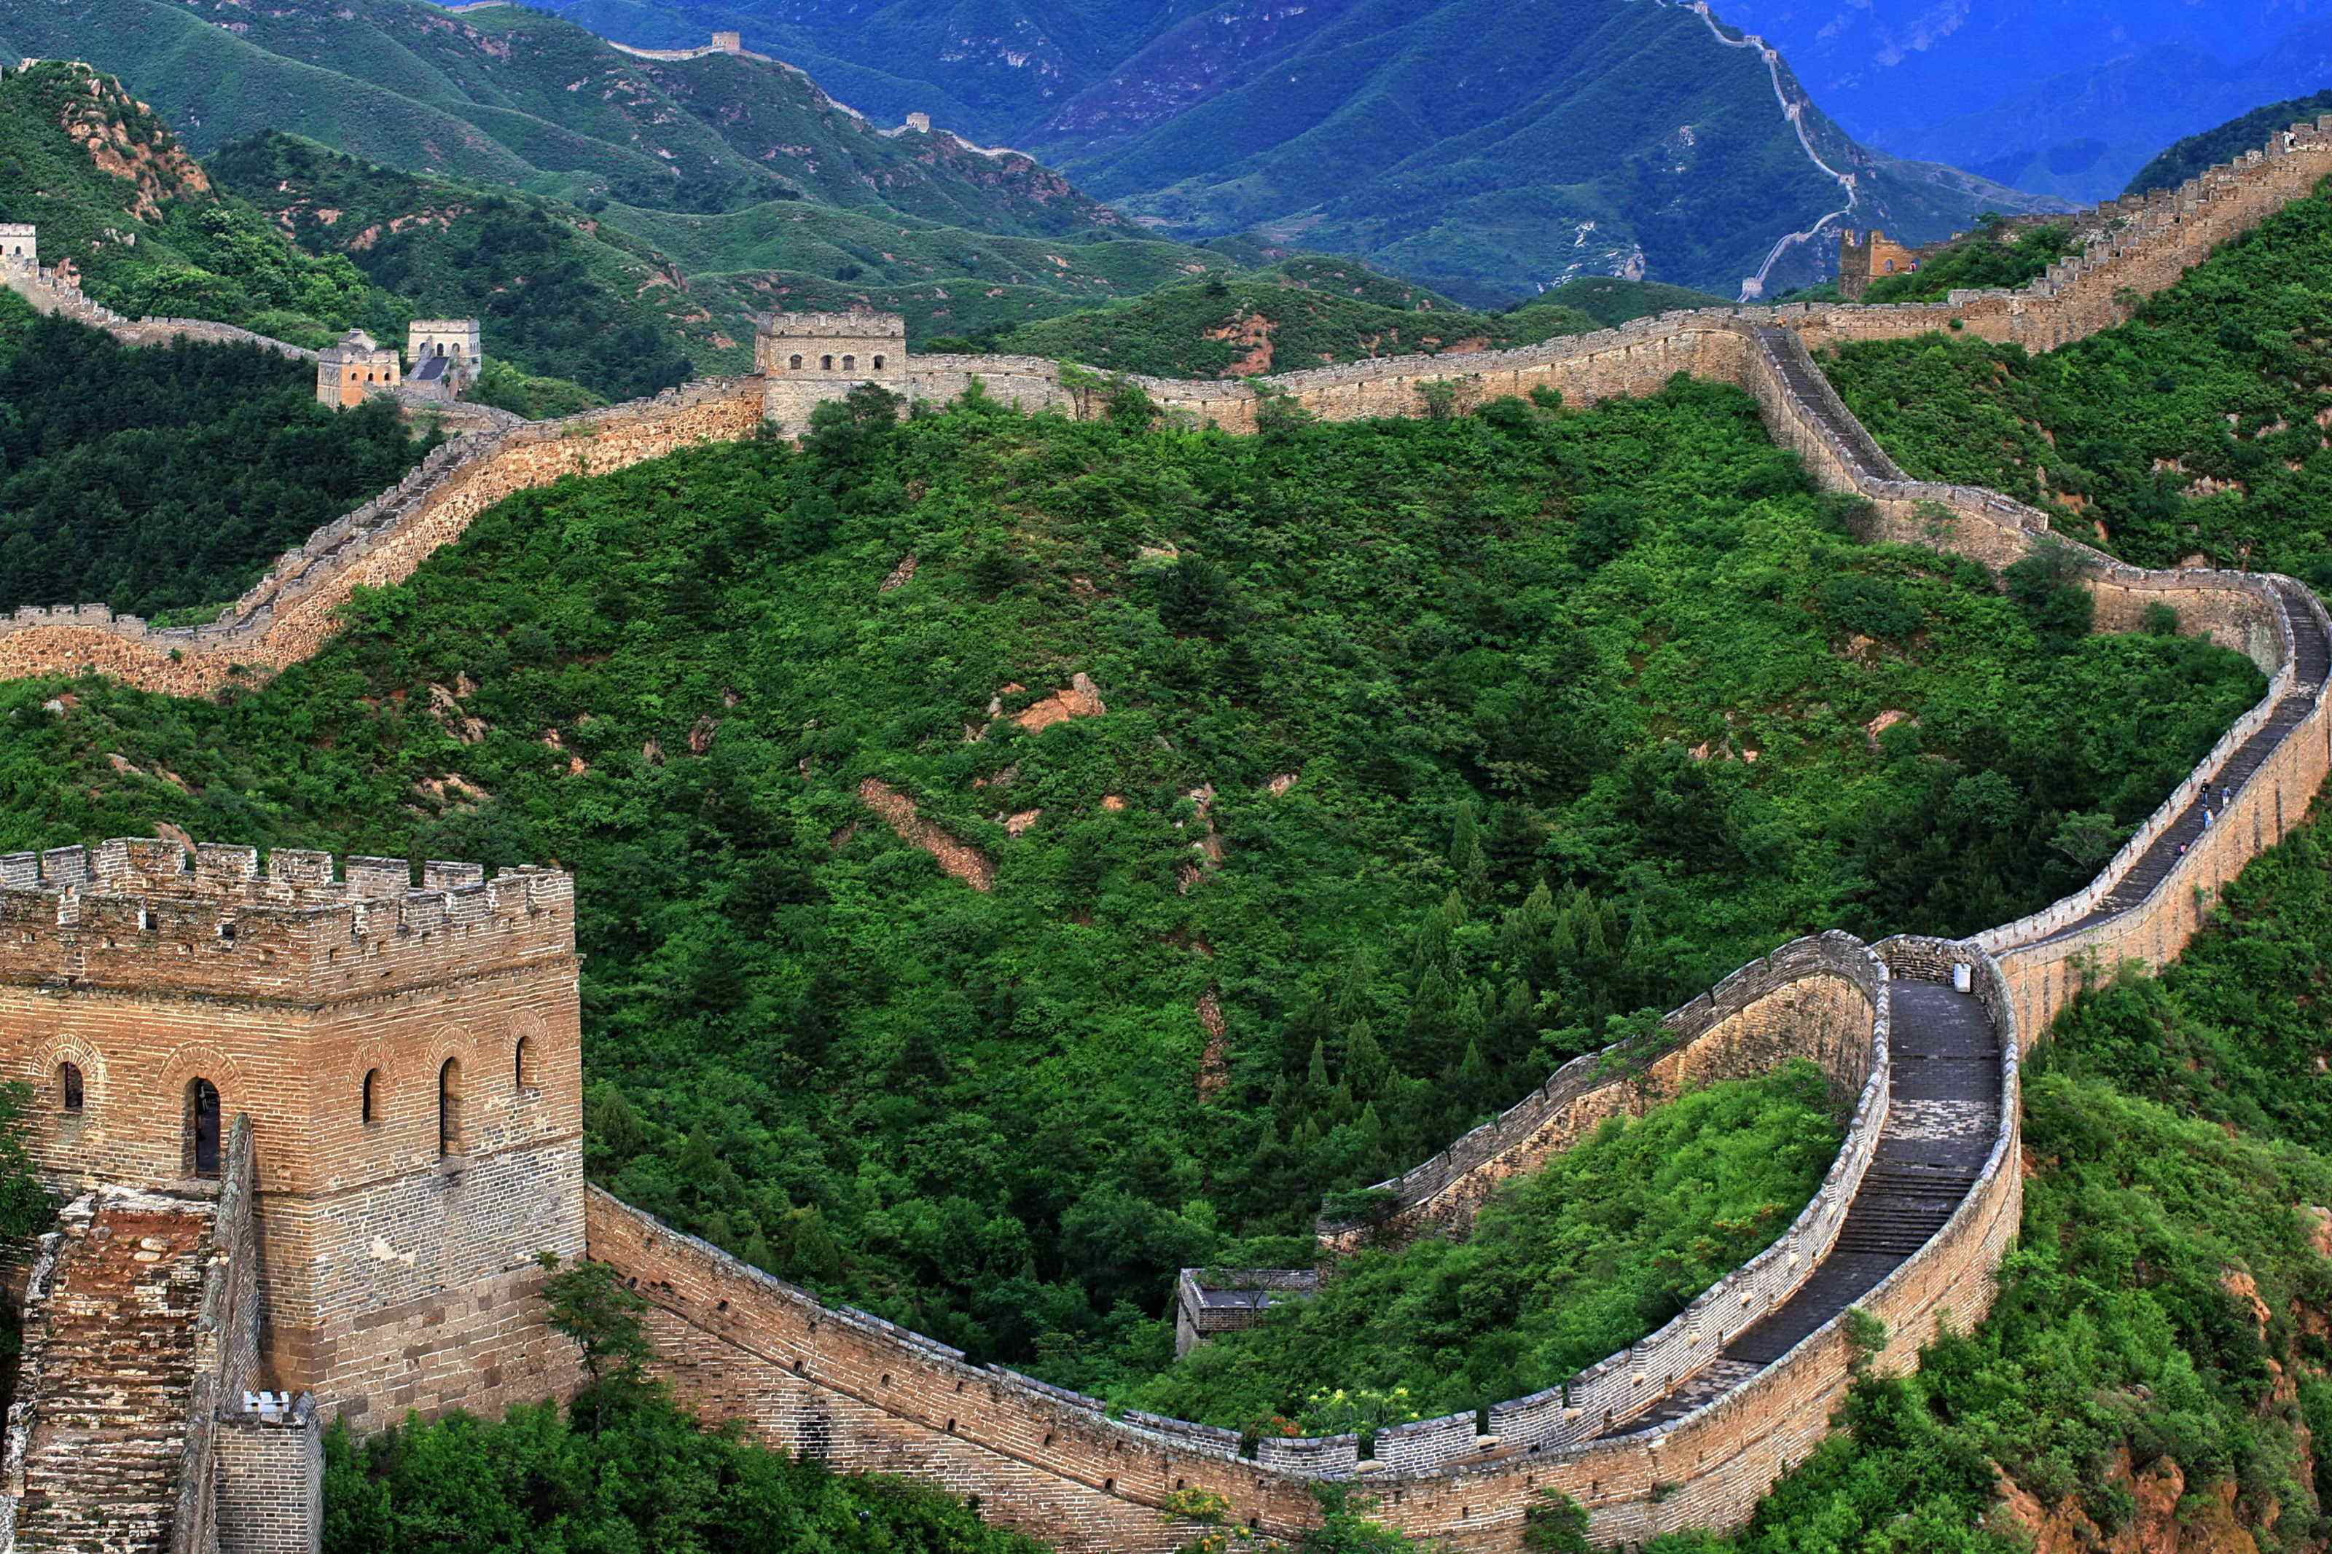
Great Wall
Skip>>
I'd rather be a hammer than a nail

Slide 8
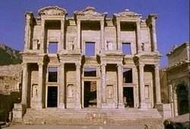
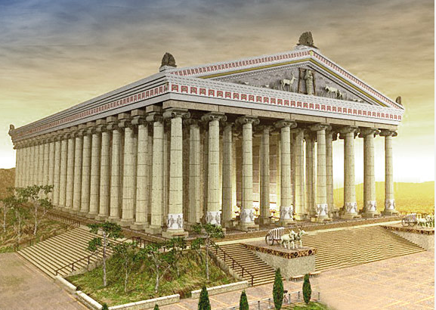
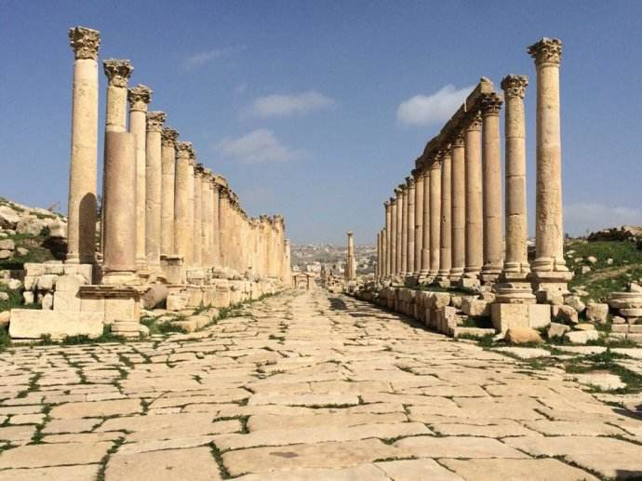
Temple of Artemis
Skip>>
If I only could
Yes I would
I surely would

Slide 9
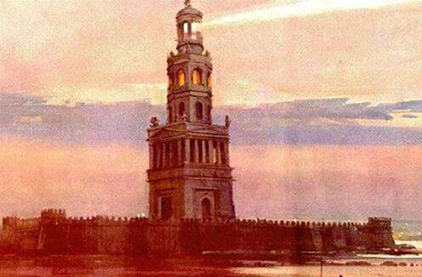
The Lighthouse of Alexandra
Skip>>
Away, I'd rather sail away

Slide 10
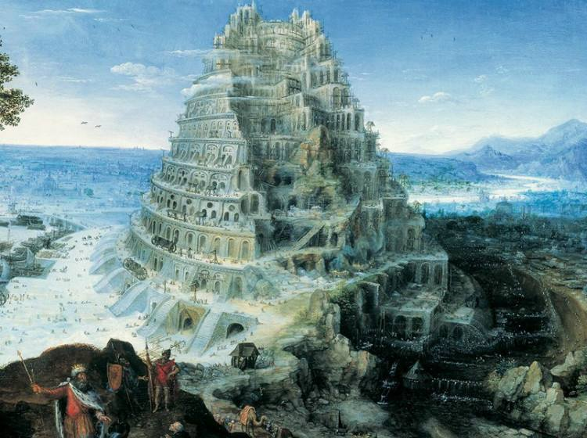
Babylon Sky Garden
Skip>>
Like a swan
That's here and gone

Slide 11
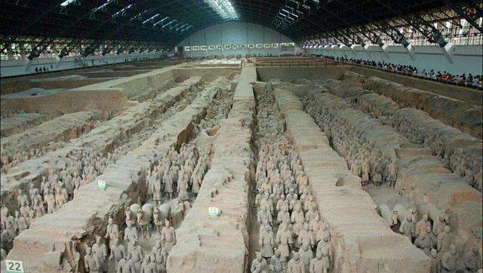
Terracotta Warriors
Skip>>
A man gets tied up
to the ground

Slide 12
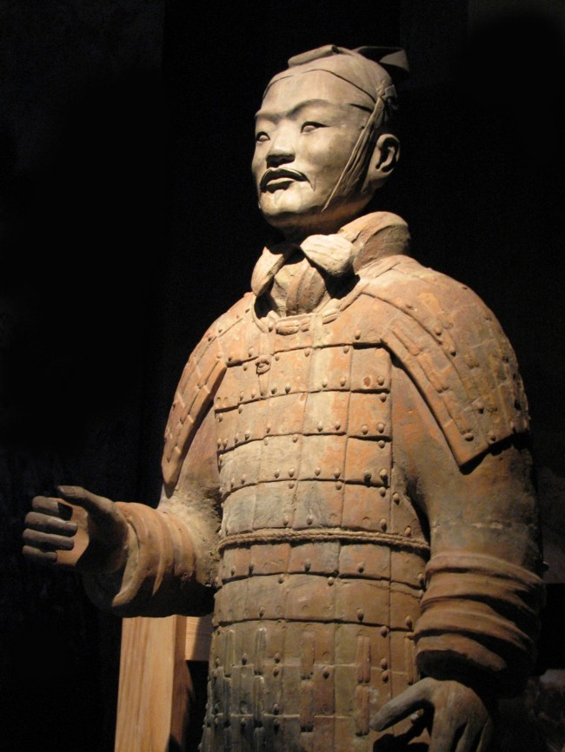
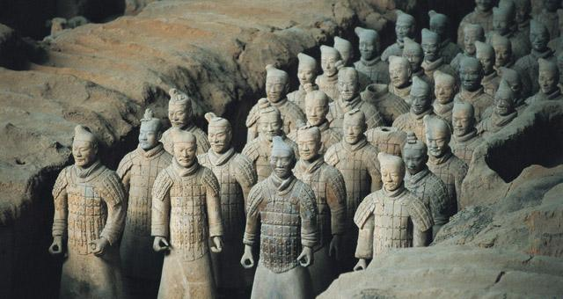
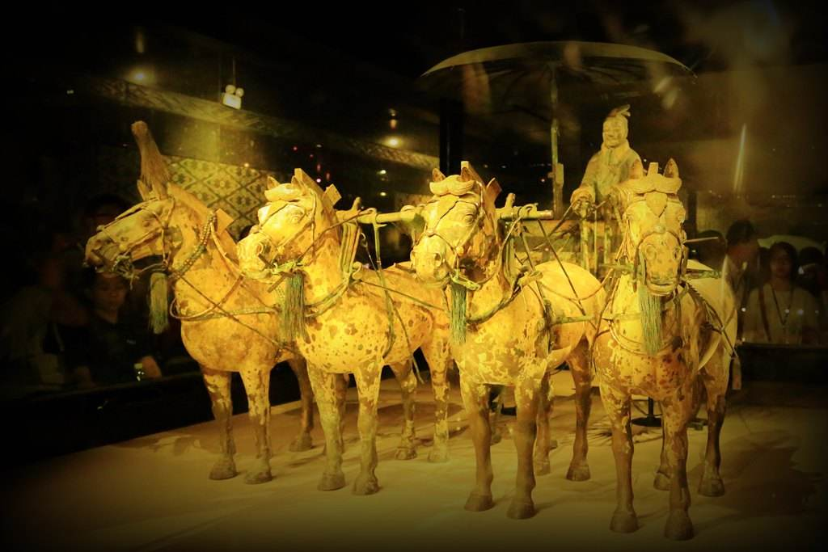
Terracotta Warriors
Skip>>
Its saddest sound
Its saddest sound
He gives the world

Slide 13
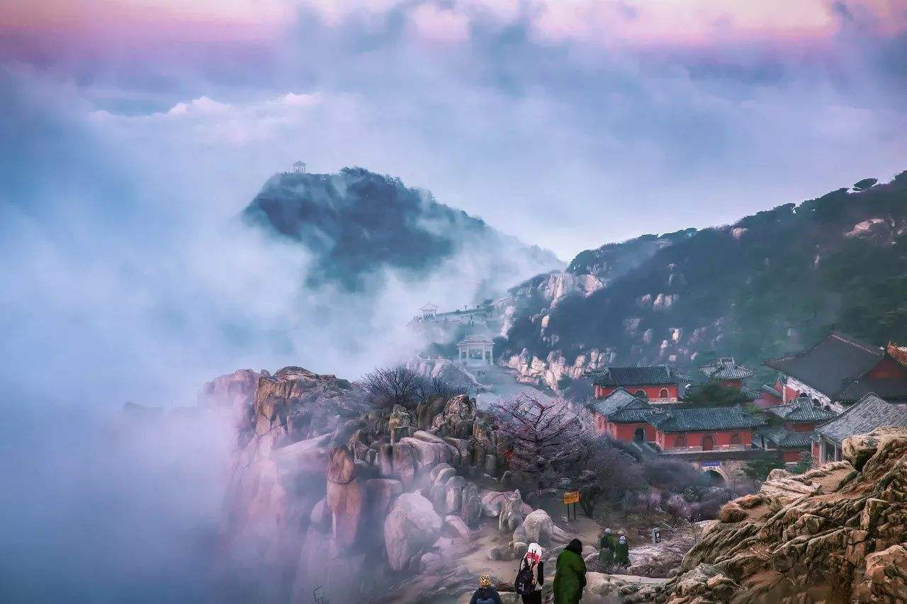
Taishan Mountain
Skip>>
I'd rather be a forest
than a street

Slide 14
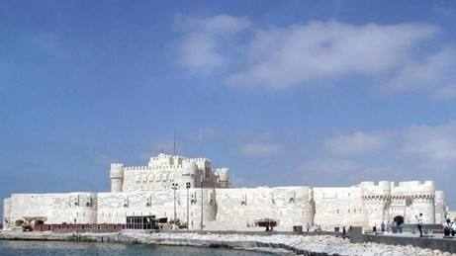
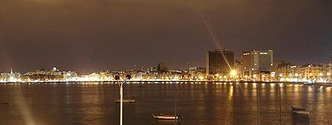
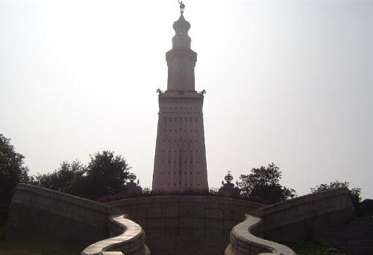
Port Alexandrou
Skip>>
I surely would
Yes I would
If I could

Slide 15
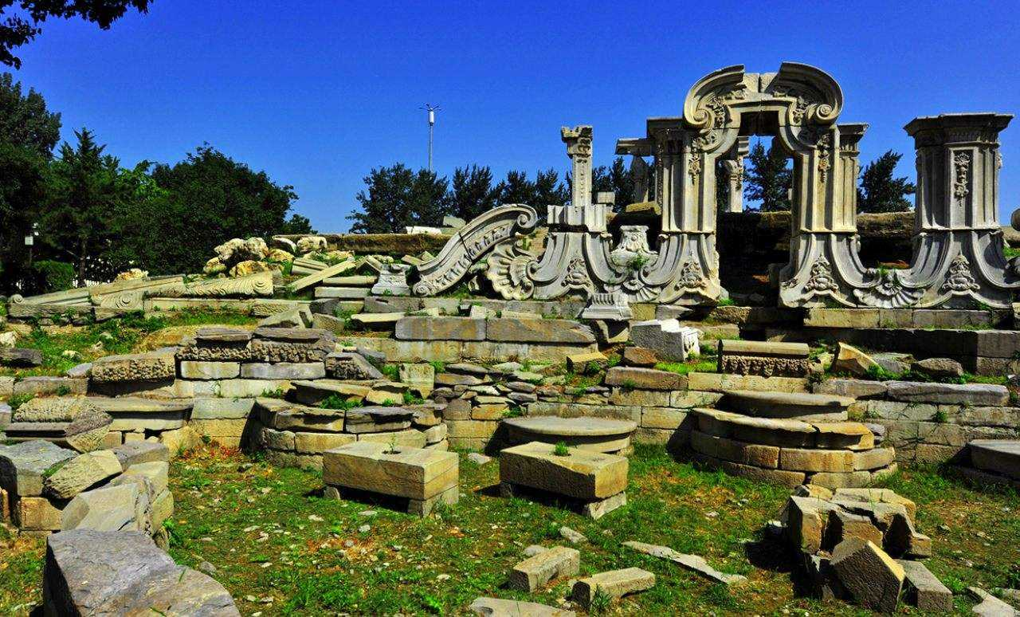
Summer Palace
Skip>>
I'd rather feel the earth
beneath my feet

Slide 16
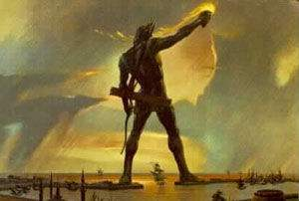
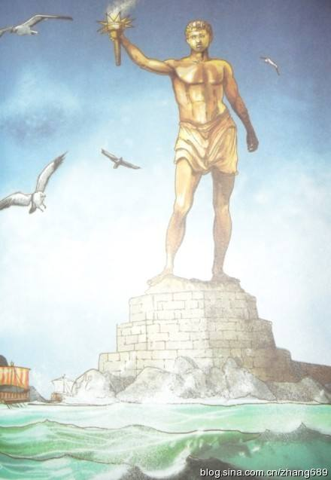
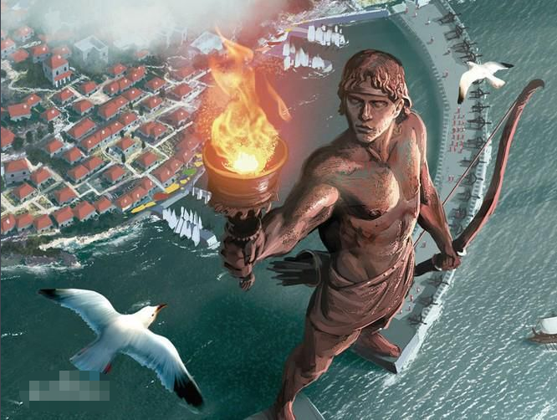
Colossus of Rhodes Island
Skip>>
I surely would
Yes I would
If I only could

Slide 17
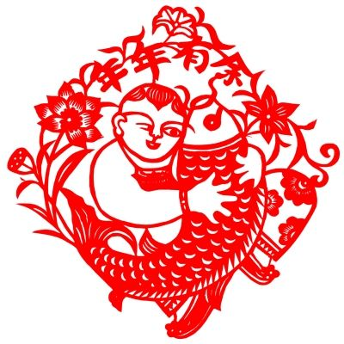
Skip>>
Protecting cultural heritage is everyone's responsibility
Thank you

