Slide 1
人教版M2U3 Computer
冯锌仪
华南师范大学外文学院

Slide 2
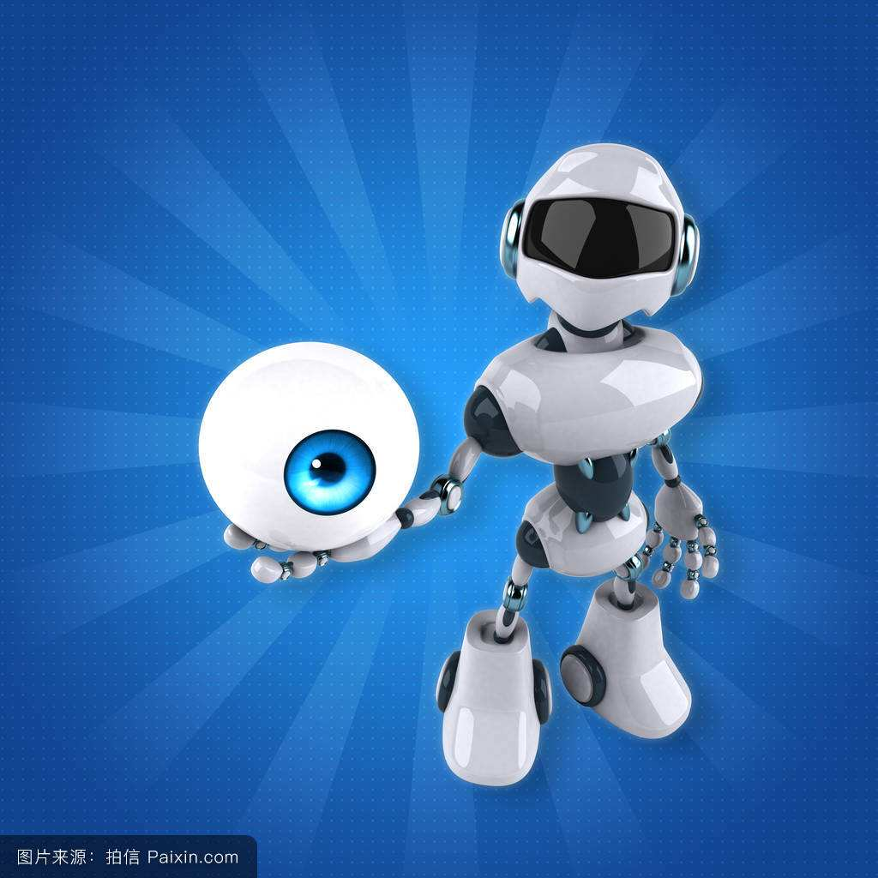
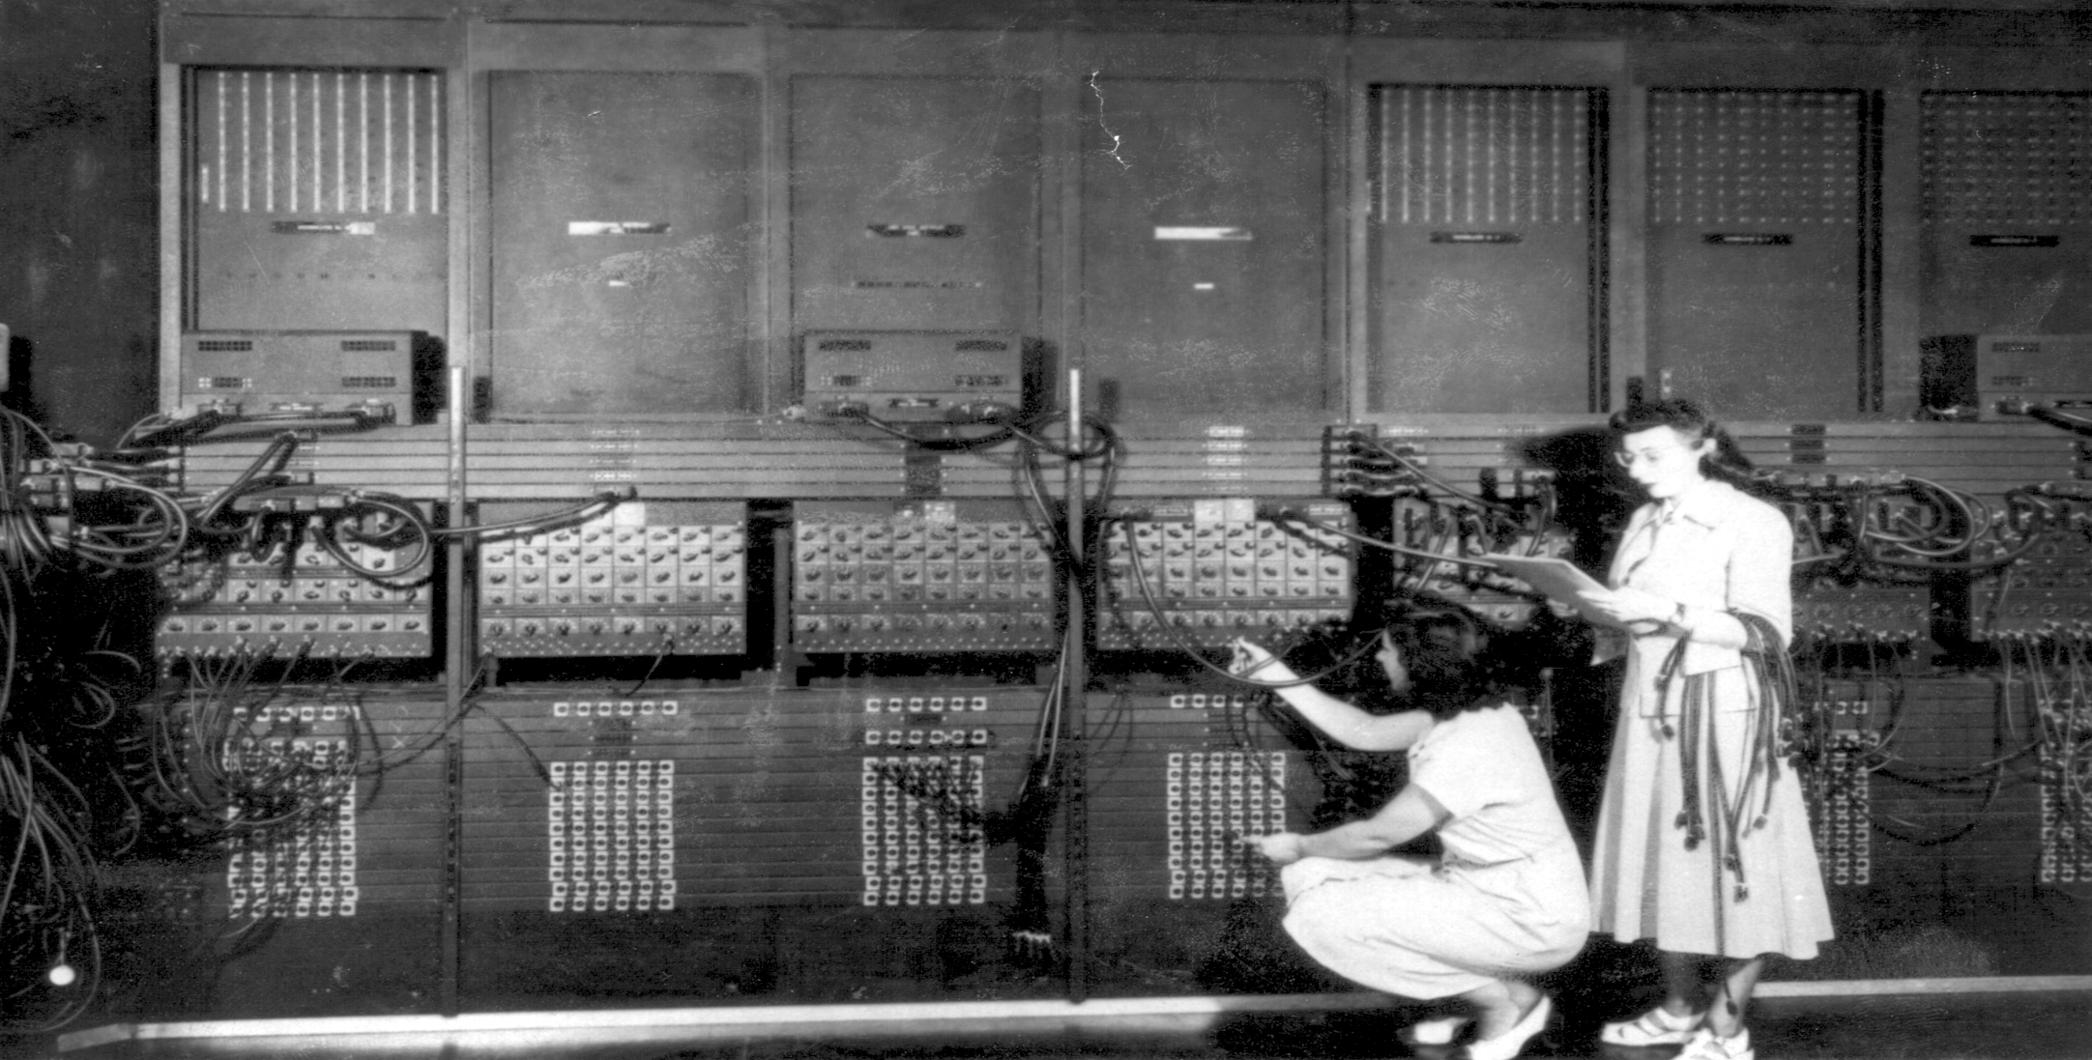
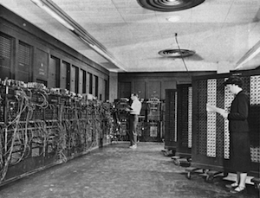
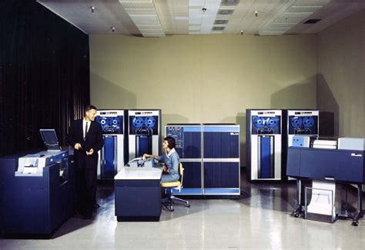
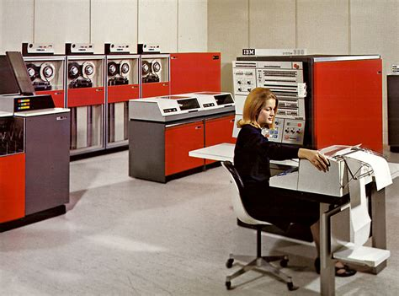
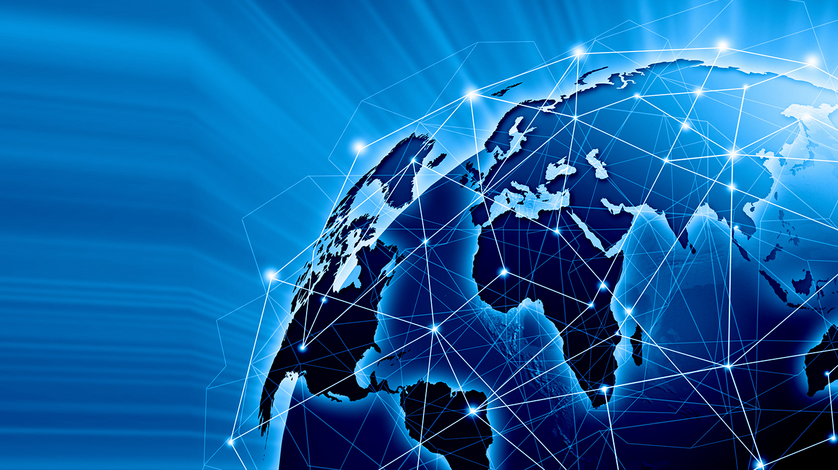
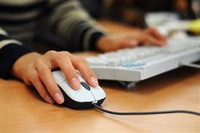
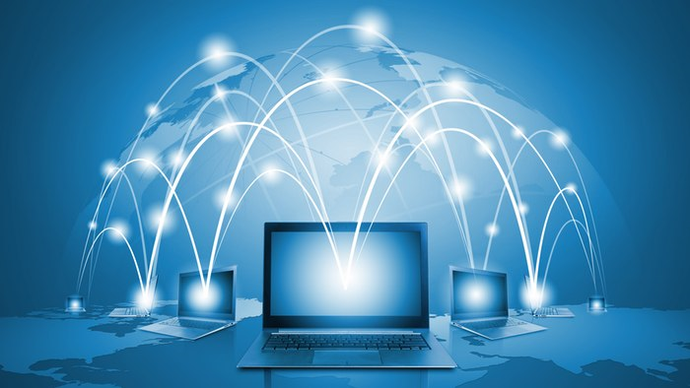
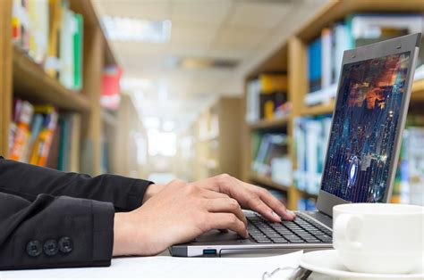
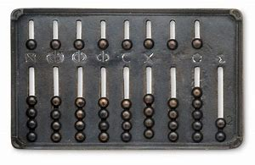
Nowadays computer technology has expanded to the field of artificial intelligence.
The personal computers we are familiar with appeared in Fourth Generation Computers (1971 – present)
The second generation of computers(1955-1960) came about thanks to the invention of the transistor
History of The Computers
The earliest computer was the abacus, used to perform basic arithmetic operations
First Generation Computers were invented in the 1940s – 1950s
Electronic computers were invented in the last century
The first portable computer
was commercialized in 1981
Computers make our life more and more colorful
Third Generation Computers (1960s) minicomputers were first appeared.
First electronic computers were huge and complex

