Slide 1
Computer Boy
人教版高中英语 M2U3 Computers
卢绮林 华南师范大学外文学院

Slide 2
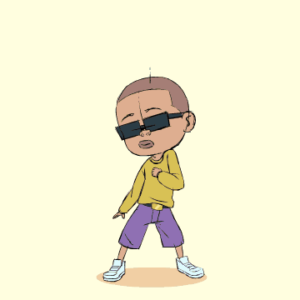
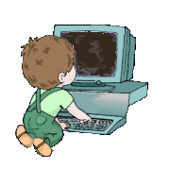

Boy,
boy,
boy,
boy
I'm in love with my favorite toy
Can't go a day without Computer Boy

Slide 3
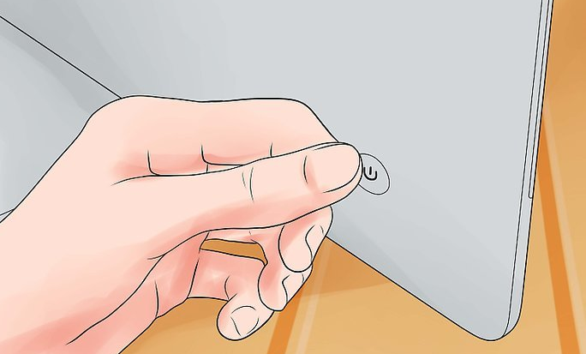

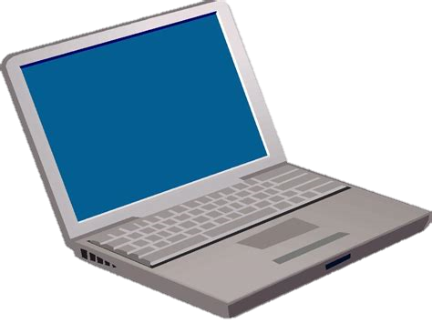

I smile at him while I turn him on
I'm so happy until Computer's gone

Slide 4




I don't care, and I won't change myself
I don't want anybody else

Slide 5


I fell in love with the man of the future
I've got a thing for my laptop computer

Slide 6


I'm so in love with the man of the future
The only one who brings me joy is my computer boy

Slide 7
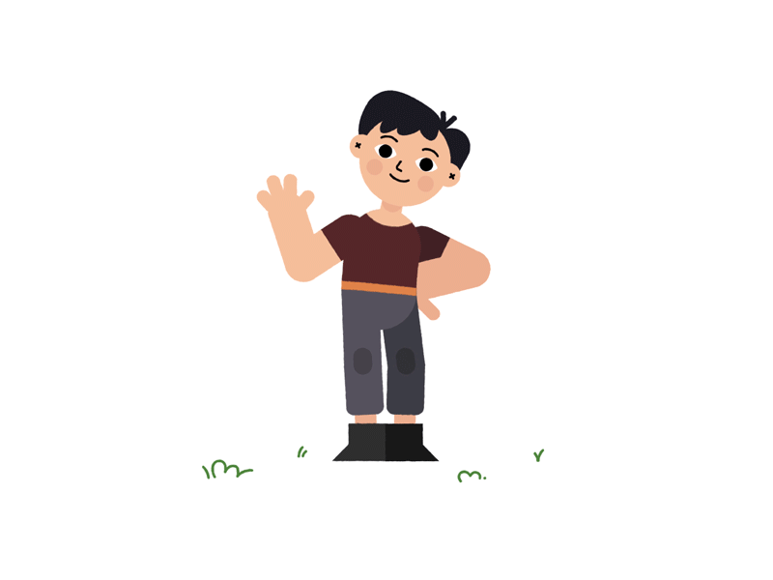
Boy,
boy,
boy,
boy,
boy

Slide 8


But no one else gets me like you do (Like you do)
I'm trying not to get attached to you (Attached to you)

Slide 9
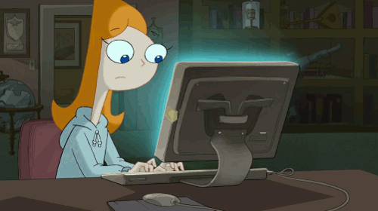


When you glow on my face you make me come alive
I want your floppy disk to be my hard drive

Slide 10

I don't care, and I won't change myself
I don't want anybody else

Slide 11


I fell in love with the man of the future
I've got a thing for my laptop computer

Slide 12
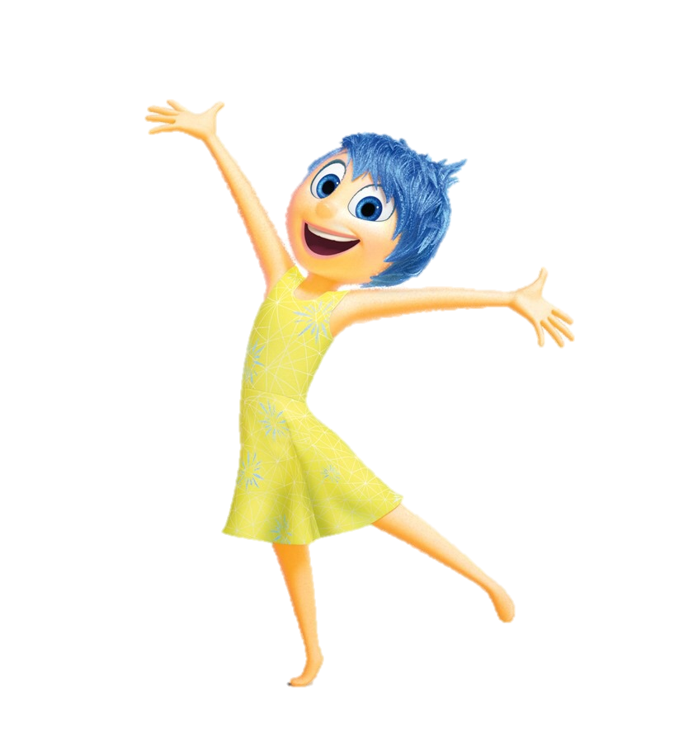


I'm so in love with the man of the future
The only one who brings me joy is my computer boy

Slide 13

Ooh, ooh oh ooh, ooh, ooh oh ooh
Don't ever leave me or go to sleep without me

Slide 14

Ooh, ooh oh ooh, ooh, ooh oh ooh
Please stand by my side forever and never talk to anyone else

Slide 15


Ooh, ooh oh ooh, ooh, ooh oh ooh
My dearest
Boy,
boy,
boy,
boy,
Computer Boy
boy

Slide 16



I don't care, and I won't change myself
I don't want anybody else

Slide 17
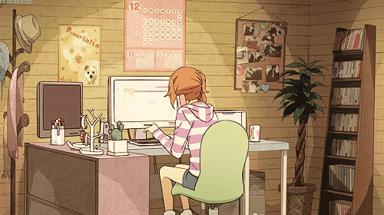
No, I don't plan to change myself
To be with anybody
Computer Boy!

Slide 18

I fell in love with the man of the future
I'm so in love with the man of the future
The only one who brings me joy is my computer
I've got a thing for my laptop computer

Slide 19
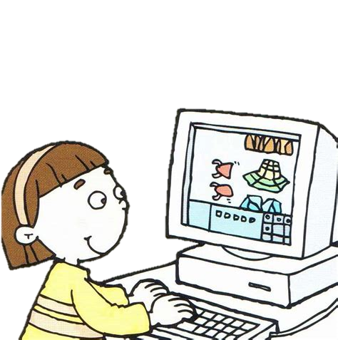
I fell in love with the man of the future
I'm so in love with the man of the future
The only one who brings me joy is my computer
I've got a thing for my laptop computer

Slide 20


The only one who brings me joy is my computer
The only one who brings me joy is my computer boy

Slide 21
Thank you !

