Slide 1
M2U2: COMPUTER
SONG: THE COMPUTER SONG
作者：伍琳欣
单位：华南师范大学外文院

Slide 2
I'm a computer
I'm a computery guy

Slide 3
Everything made out of

Slide 4
I'd like to show you
inside my digital life

Slide 5
Inside my mind there is a digital mind

Slide 6
Oh maybe you can help us answer this question
What is the biggest thing...

Slide 7
I'm very clevery guy
clever

Slide 8
Count to a fifty in the blink of my eye

Slide 9
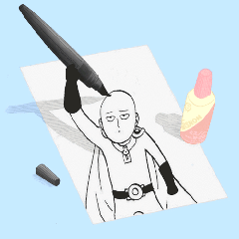
And print a picture

Slide 10
And then I tell you the time

Slide 11
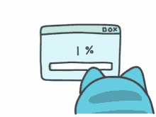
Help you to find something you're wanting to find

Slide 12
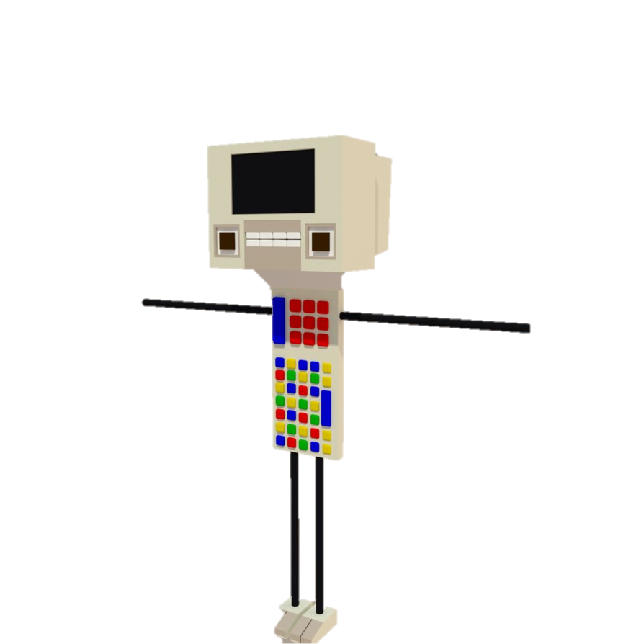
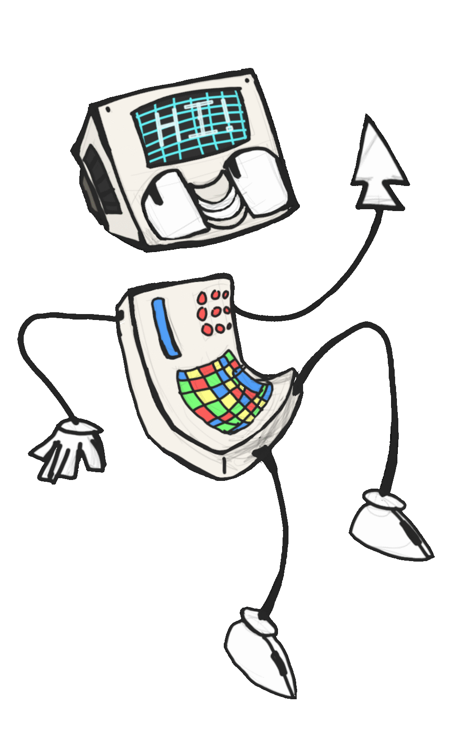
Now it's easy to be a clever smart boy like me
If you can do it all digitally

Slide 13
I'd like to be as smart as a computer

Slide 14
Actually we already have a computer

Slide 15
Great news

Slide 16
Now before we begin our journey
I just need to get some information from you

Slide 17
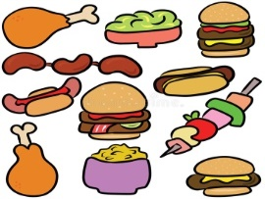

Slide 18
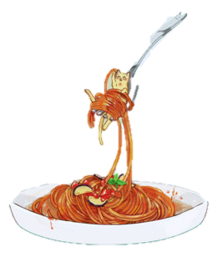
Great news
Spaghetti
I live in my house

Slide 19
Now just a few more questions
And we'll be on our way

Slide 21
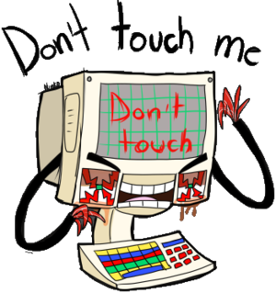

Slide 23
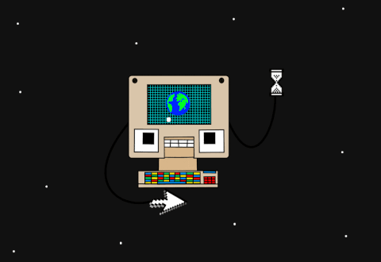

Slide 24
The end

