Slide 1
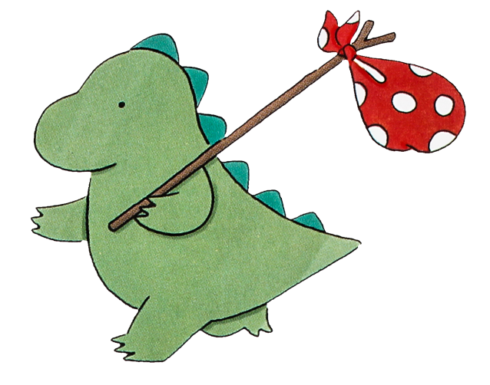
人教版 M2 U4 Wildlife Protection
Animal Extinction
Music: The Dinosaurs Song
制作：华南师范大学外文学院 胡雪芬

Slide 2
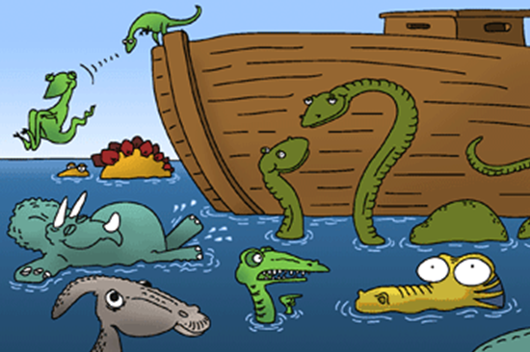
they used to fly with a toothy grin
they used to swim
they used to walk

Slide 3
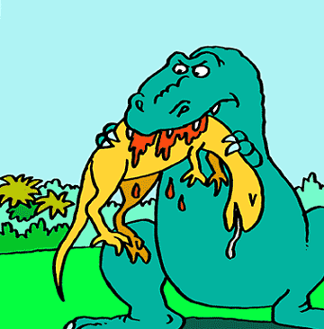
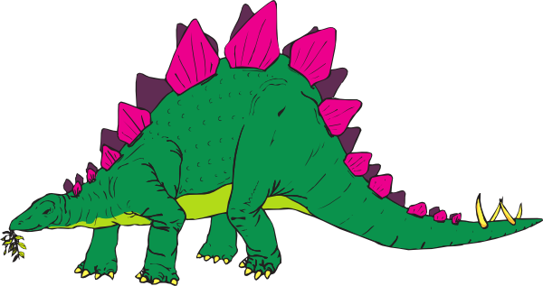
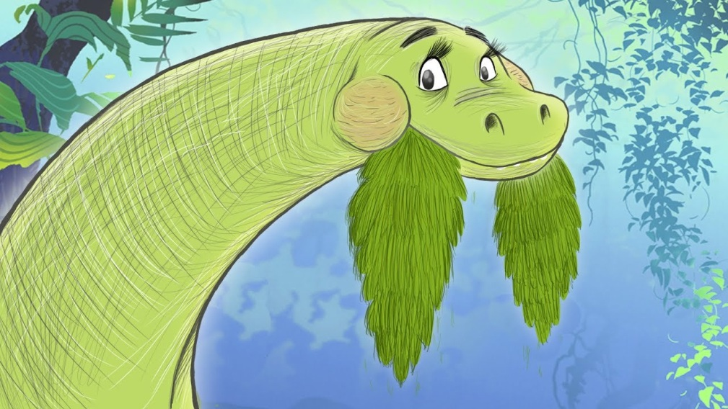
Some ate plants
and some ate meat
some walked around on just two feet

Slide 4
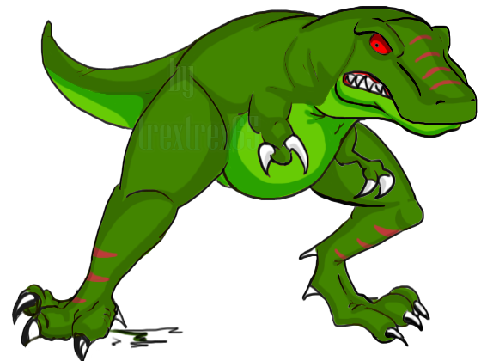
Oh, the dinosaurs
big as trees
Dinosaurs
brains like peas
Jaws and claws
and teeth and bone
that used to growl
and groan and moan

Slide 5
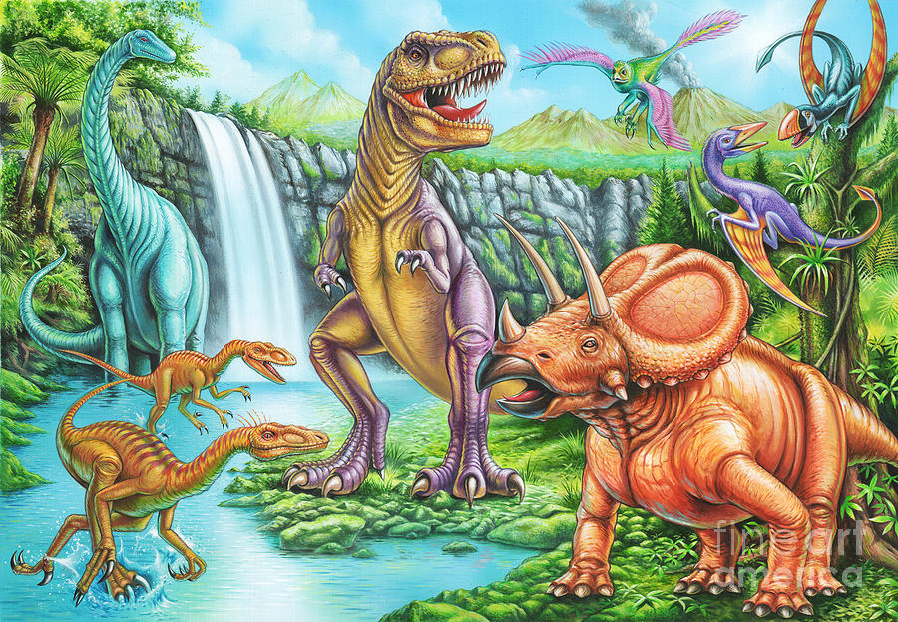
Some had feathers, some had scales
Spikes and claws and whip-like tails

Slide 6
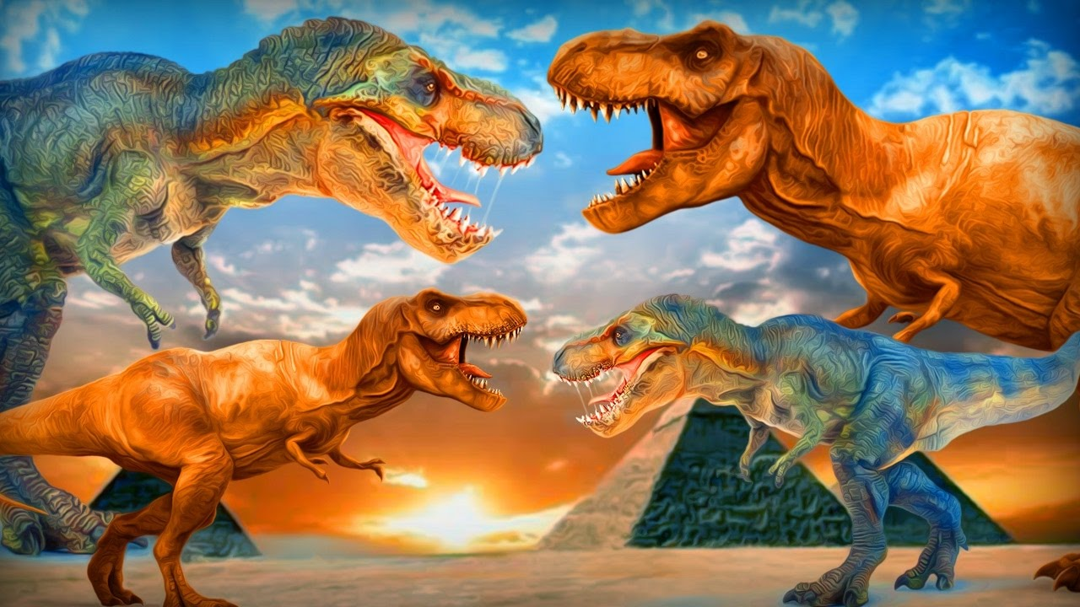
They fought like dragons
the earth sure shook
the volcanoes sizzled
and the lava cooked

Slide 7
Oh, the dinosaurs
big as trees
Dinosaurs
brains like peas
Jaws and claws
and teeth and bone
that used to growl
and groan and moan

Slide 8
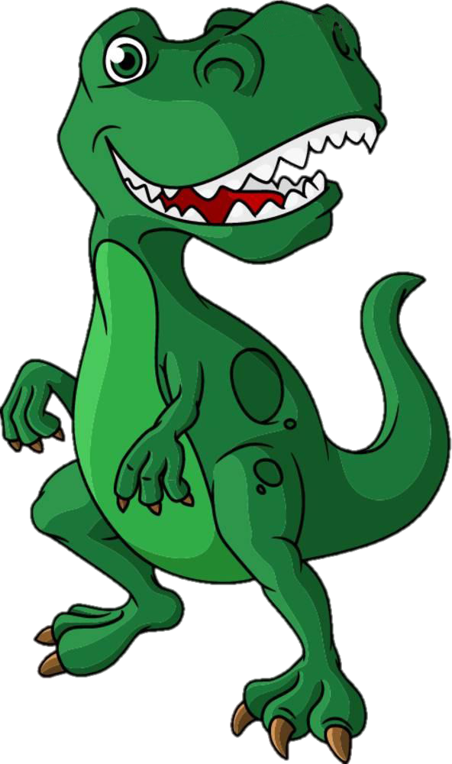
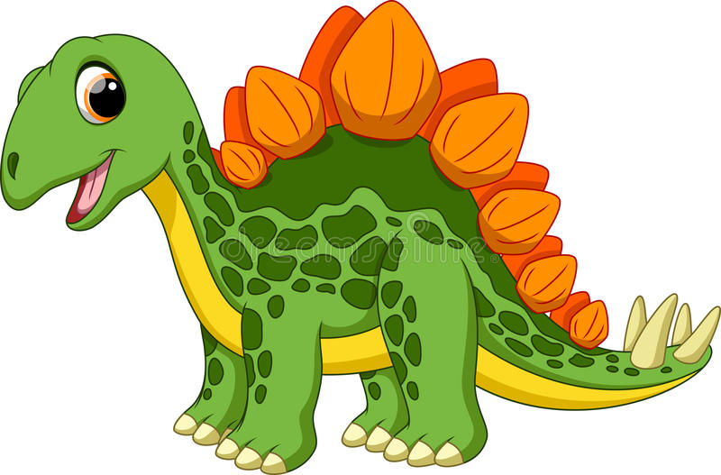
Tyranossaur was a terrible king
stecossaurs tail could really swing

Slide 9
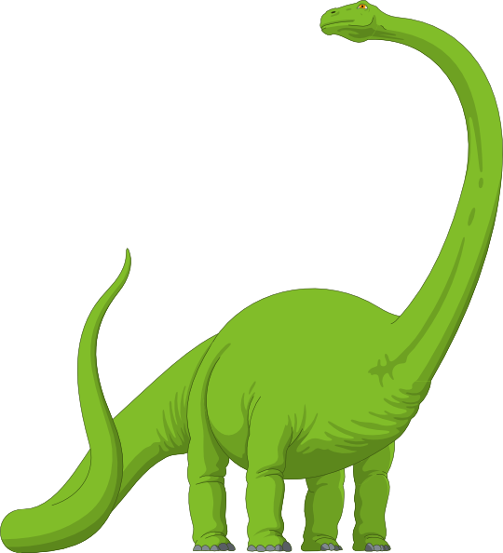
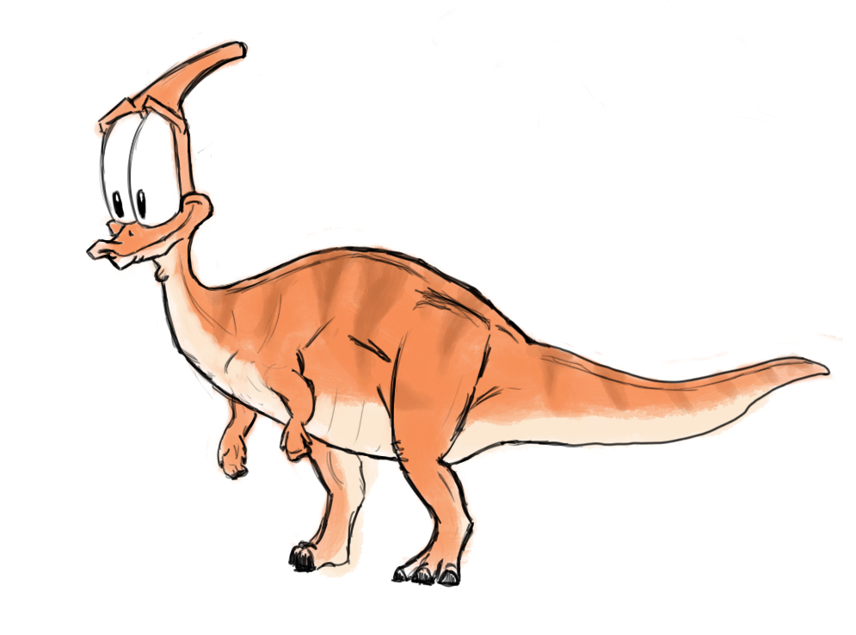
Brachiosaurus liked to stomp
trachodon would chew and chomp

Slide 10
Oh, the dinosaurs
big as trees
Dinosaurs
brains like peas
Jaws and claws
and teeth and bone
that used to growl
and groan and moan

Slide 11
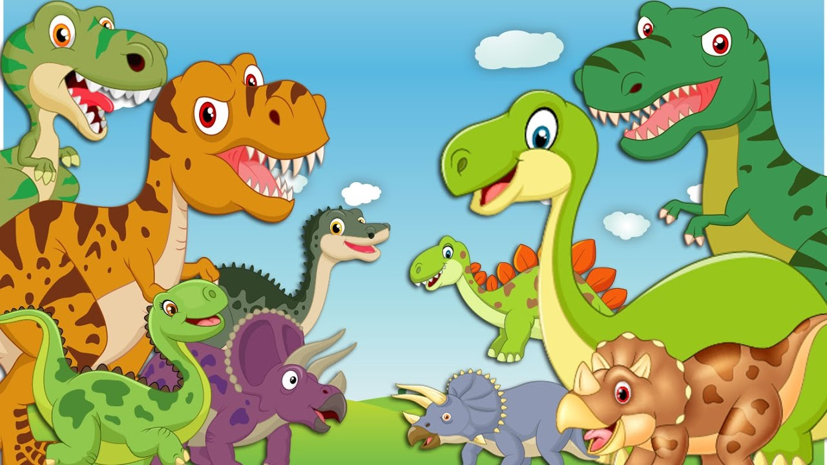
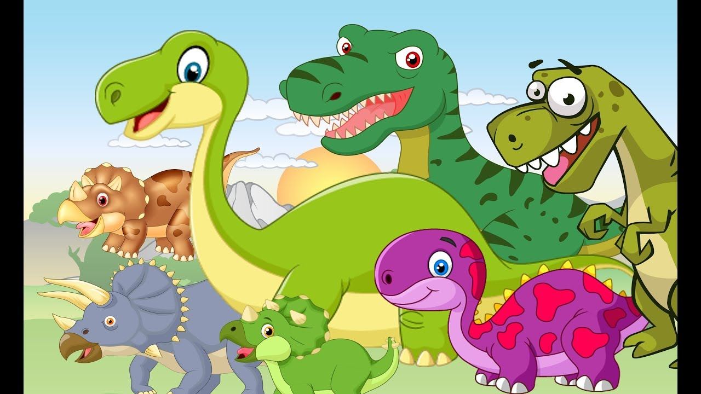
They ruled the Earth a hundred million years, without worries, cares or fears.

Slide 12
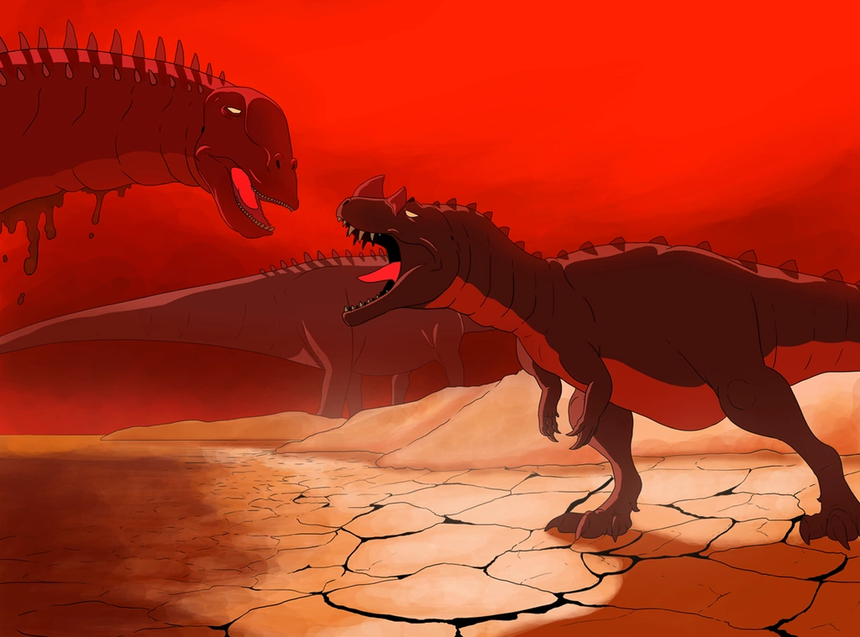
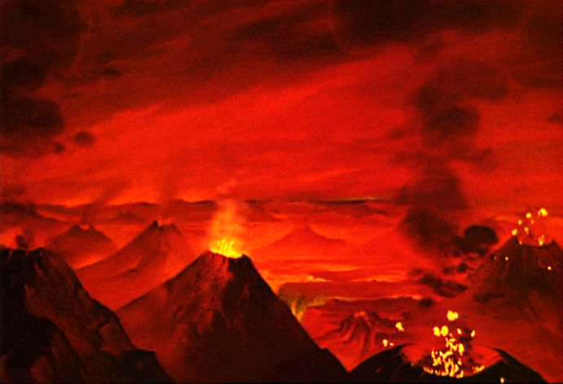
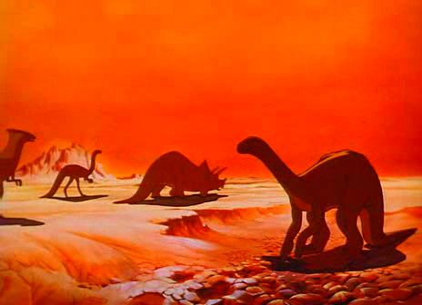
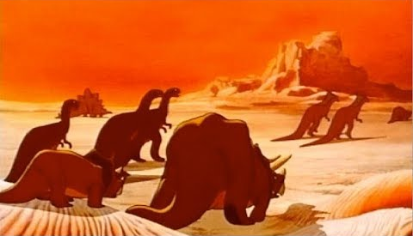
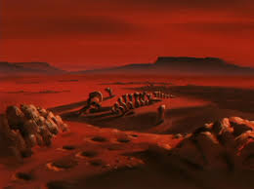

Slide 13
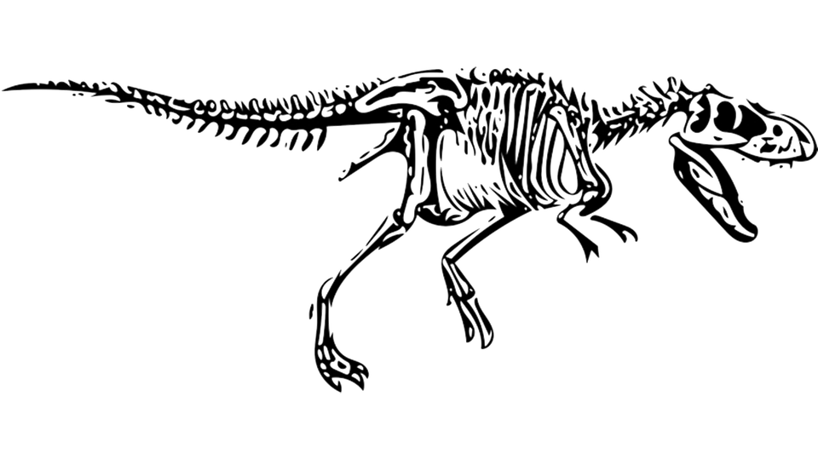
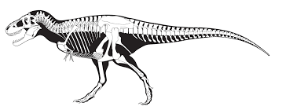
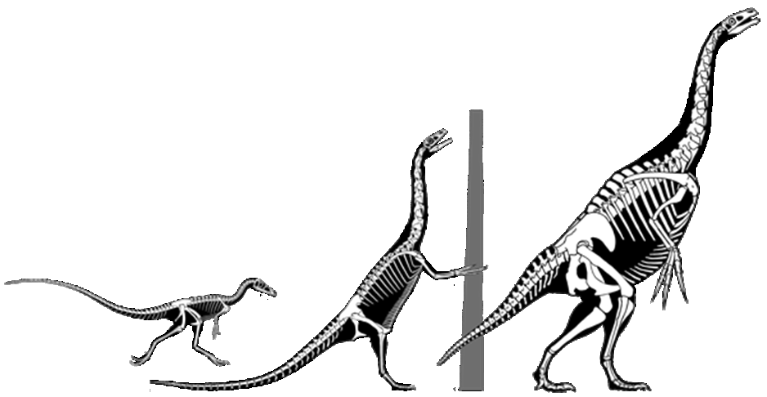
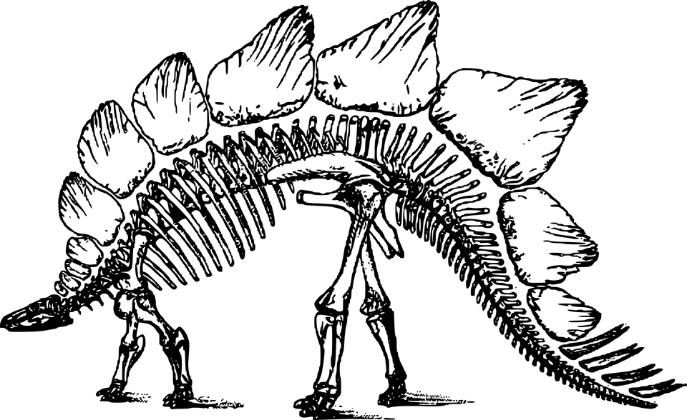
Then one day, they hit the soil now, they’re fossils, gas, and oil.

Slide 14
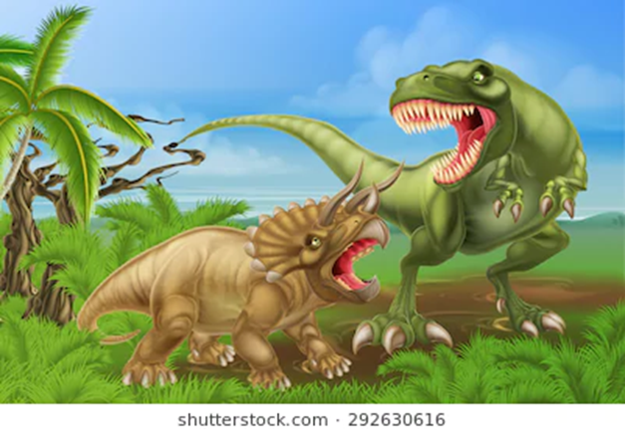
Oh, the dinosaurs
big as trees
Dinosaurs
brains like peas
Jaws and claws
and teeth and bone
that used to growl
and groan and moan

Slide 15
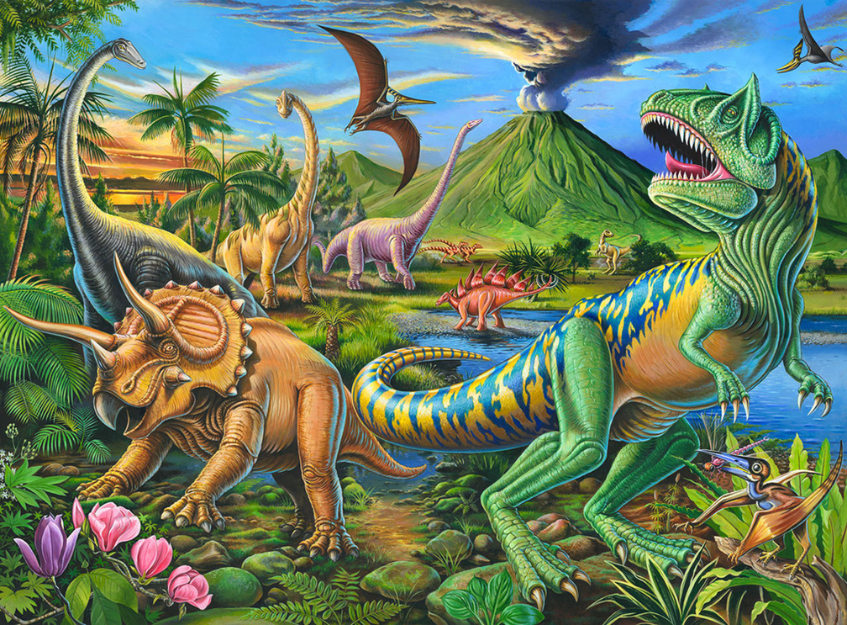
Oh, the dinosaurs
big as trees
Dinosaurs
brains like peas
Jaws and claws
and teeth and bone
that used to growl
and groan and moan

Slide 16
The Dinosaurs Song

