Slide 1
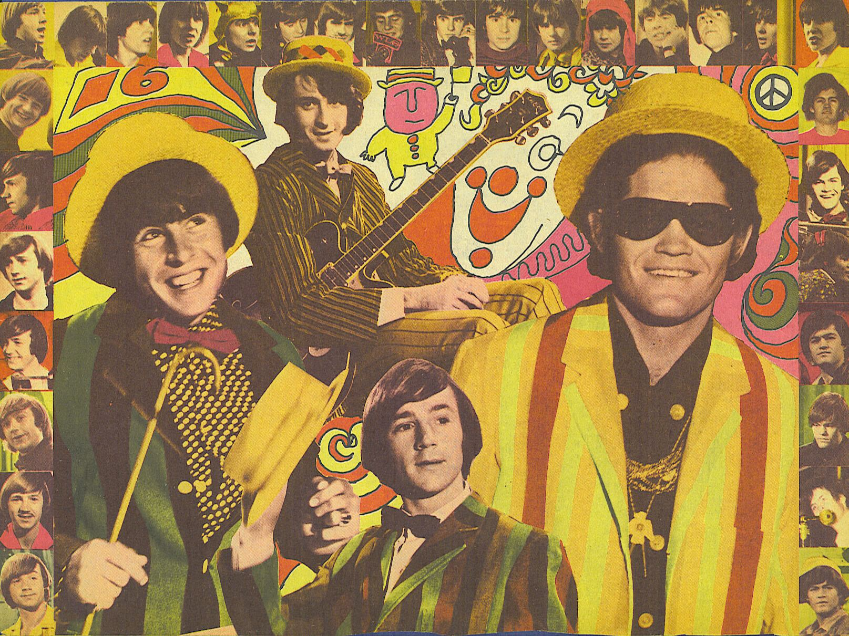
2
PEP, M2U5, Music
Song: A Pleasant Valley Sunday
Singer: The Monkees
Editor: 戴舒瑜
单位：华南师范大学外文学院

Slide 2
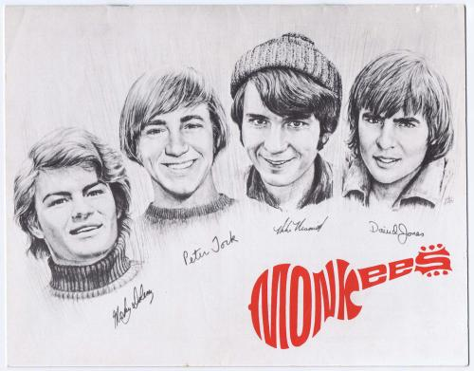
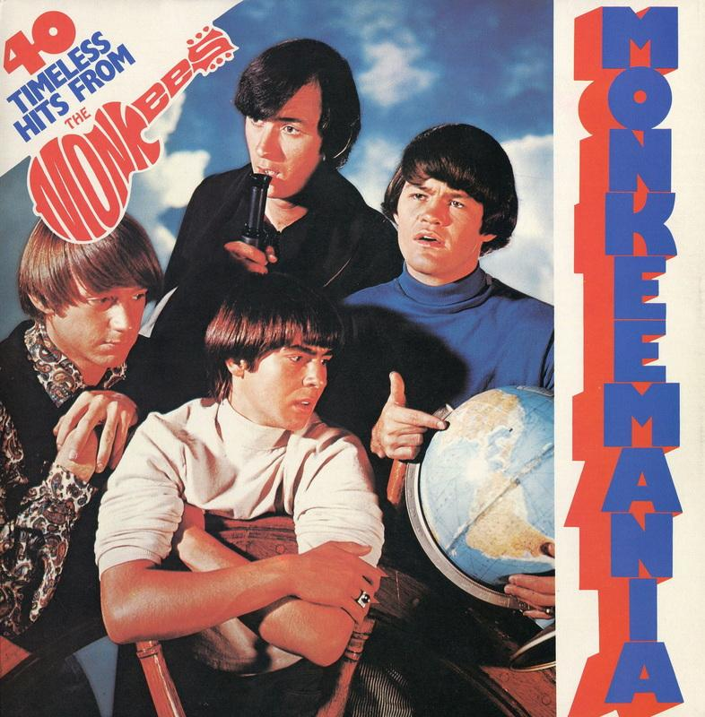
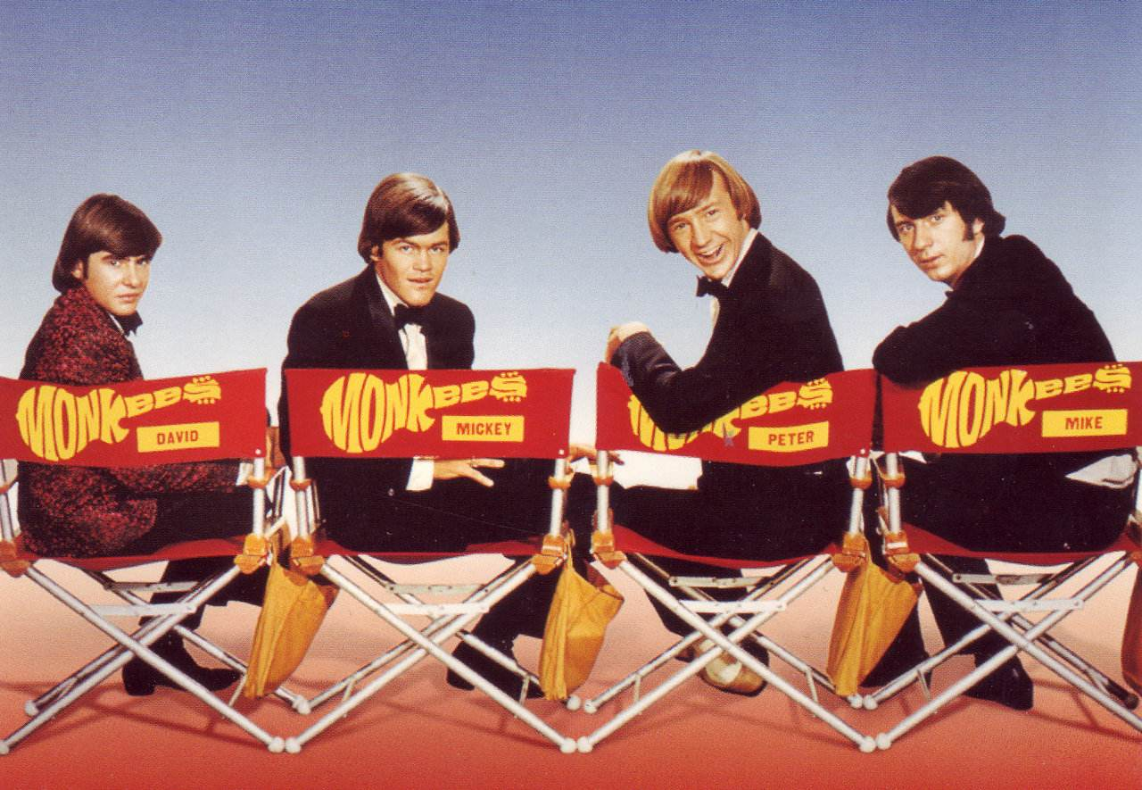

Slide 3
The local rock group down the street Is trying hard to learn their song

Slide 4
To Seranade the weekend squire Who just came out to mow his lawn

Slide 5
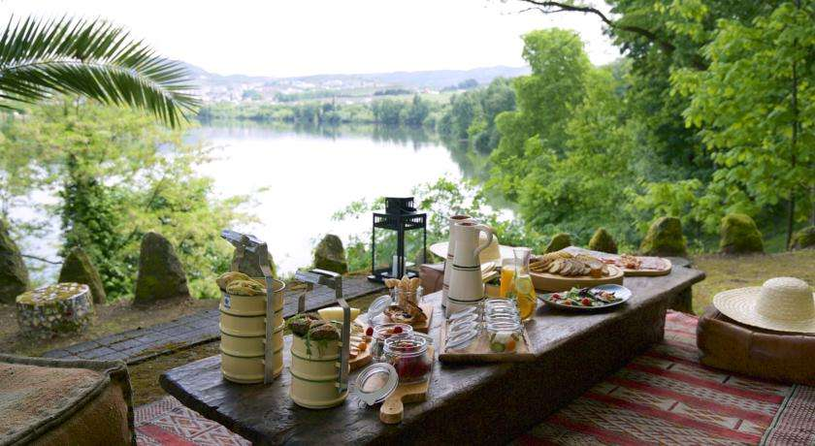
Another
Pleasant
Valley
Sunday

Slide 6
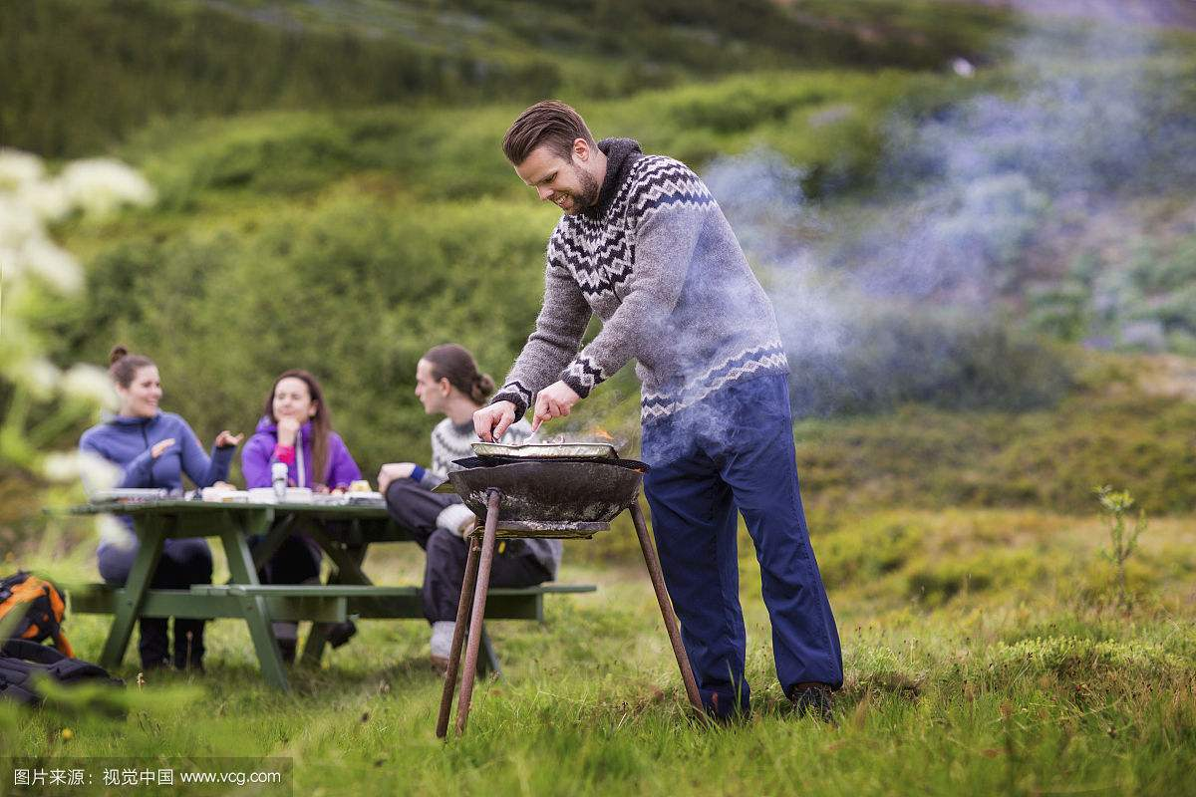
Charcoal burning everywhere

Slide 7
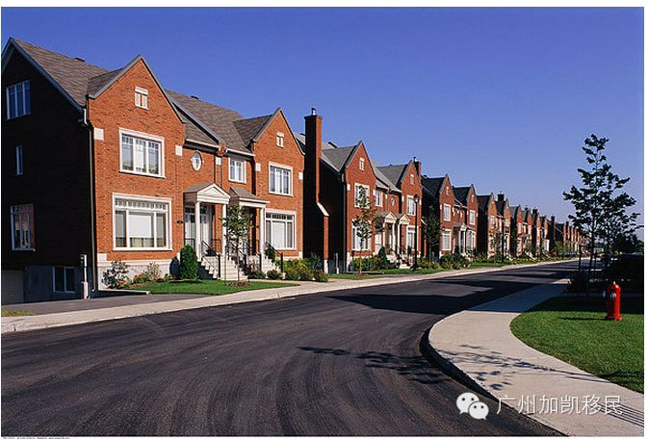
And no one seems to care
Rows of houses that are all the same

Slide 8
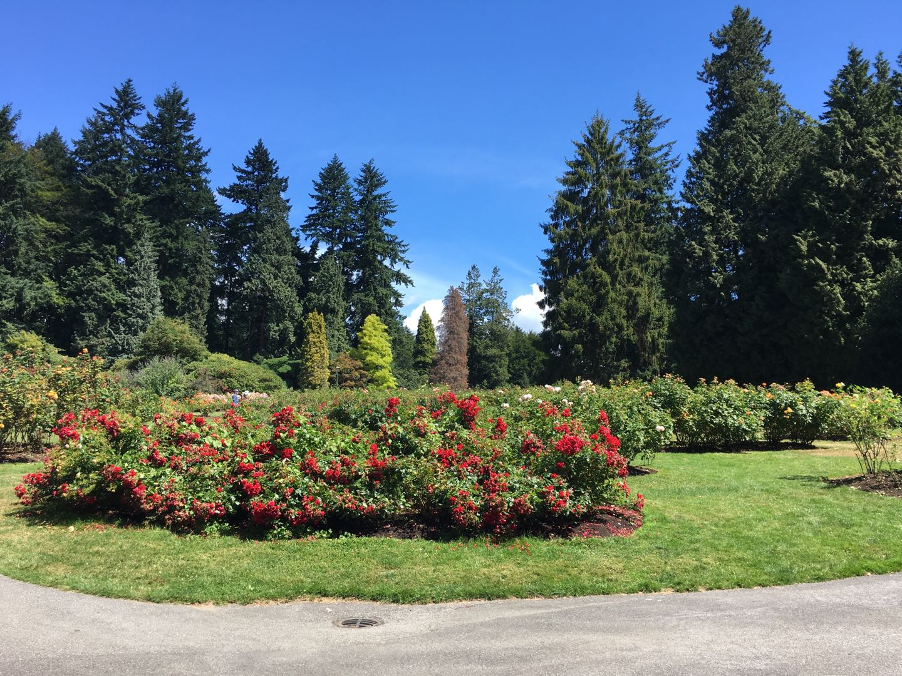
See Mrs. Gray she’s proud today
Because her roses are in bloom

Slide 9
And Mr Green he’s so serene He’s got a TV in room
EVERY

Slide 10
Another
Pleasant
Valley
Sunday

Slide 11
Here in status symbol land

Slide 12
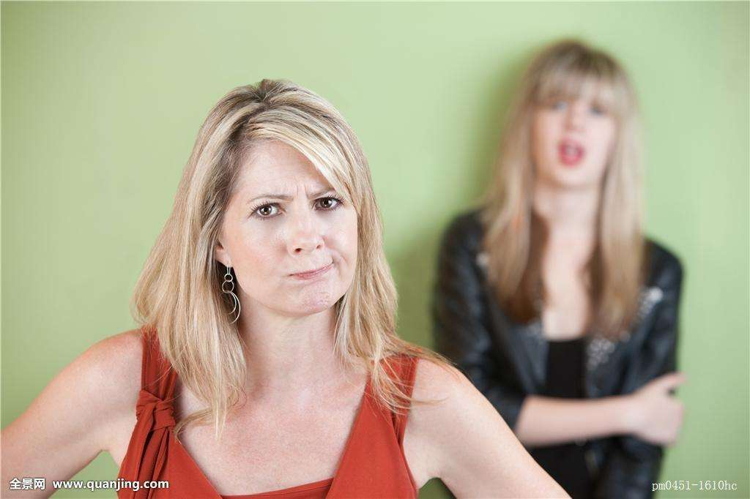
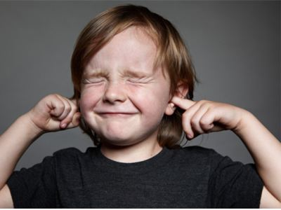
Mothers complain about how hard life is
And the kids just don’t understand

Slide 13
Creature comfort goals They only numb my soul
And make it hard for me to see

Slide 14
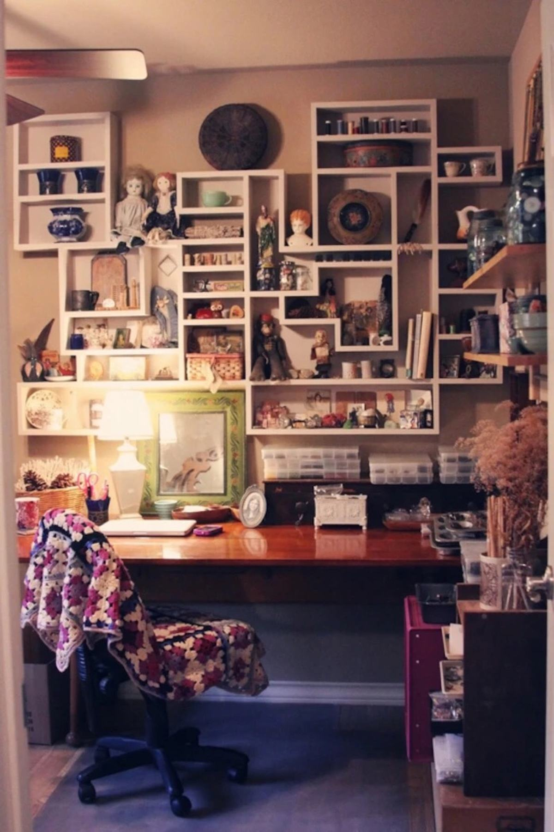
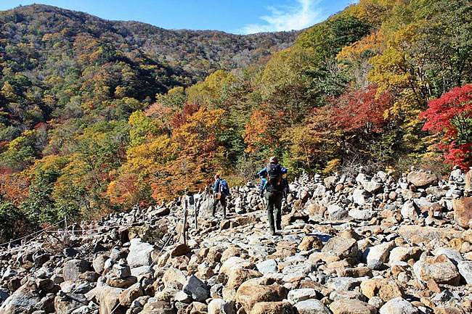
My thoughts all seem to stray to places far away
I need a change of scenery

Slide 15
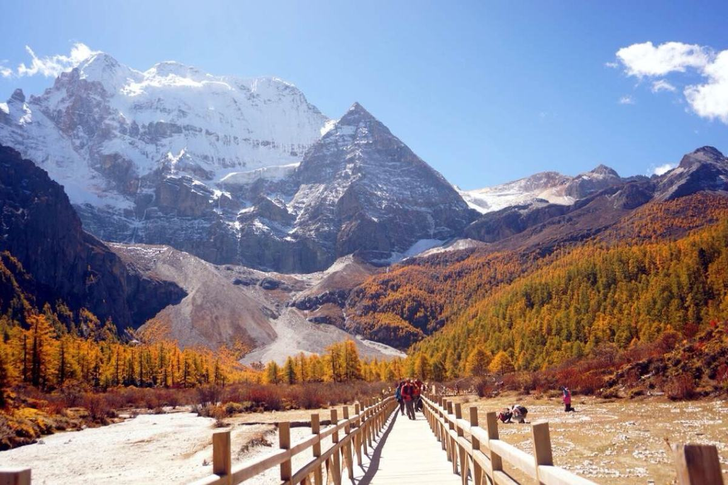
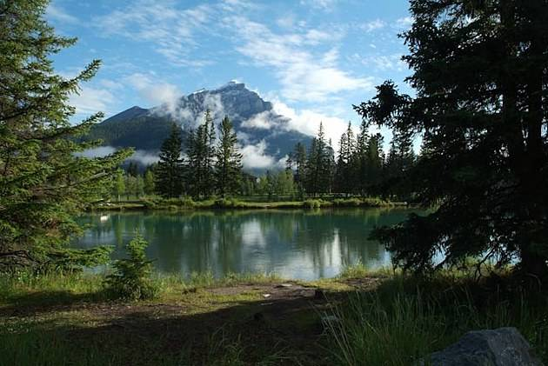
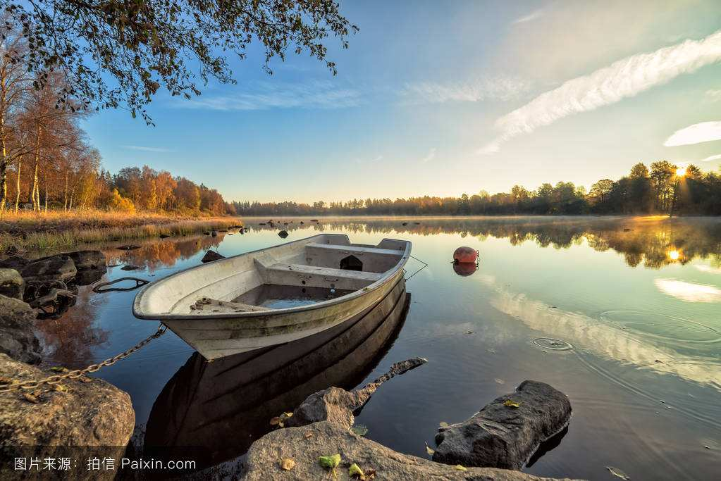

Slide 16
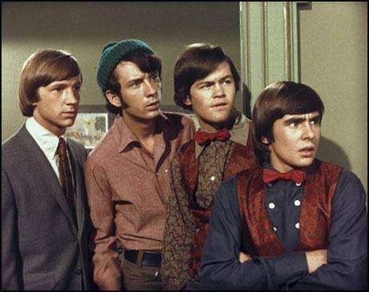
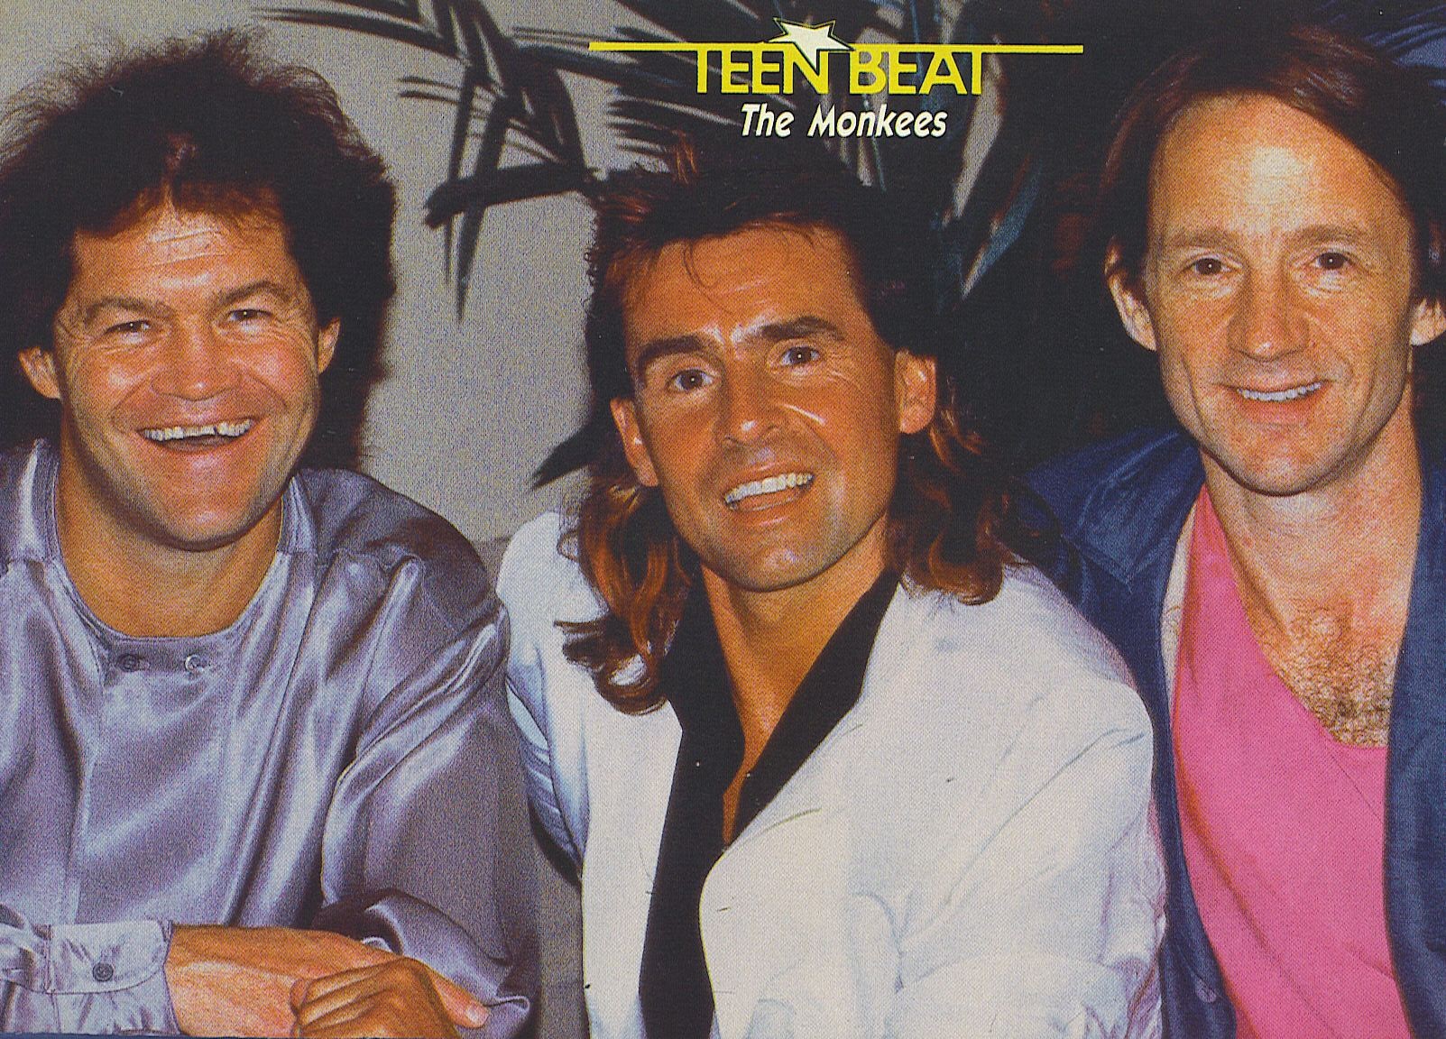

Slide 18
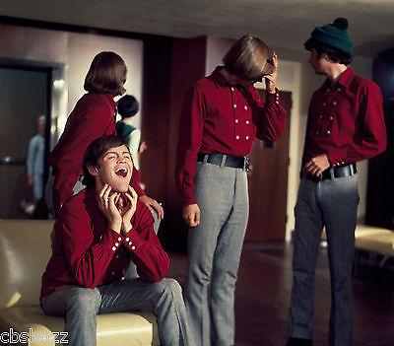

Slide 21
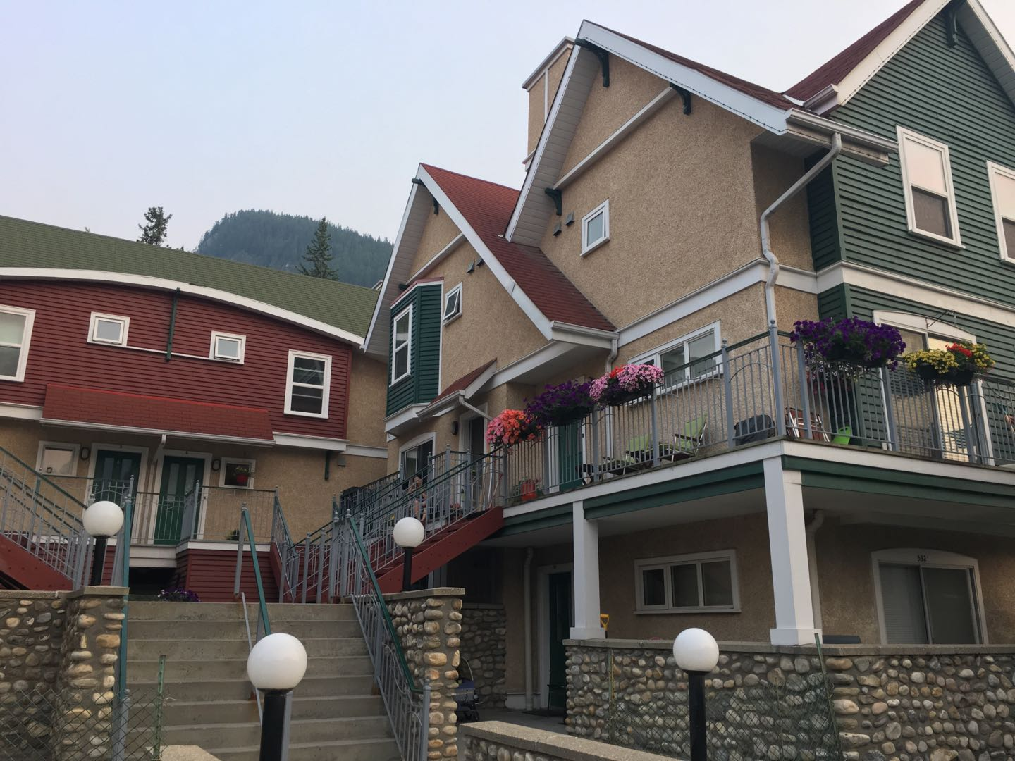
Another
Pleasant
Valley
Sunday

Slide 22
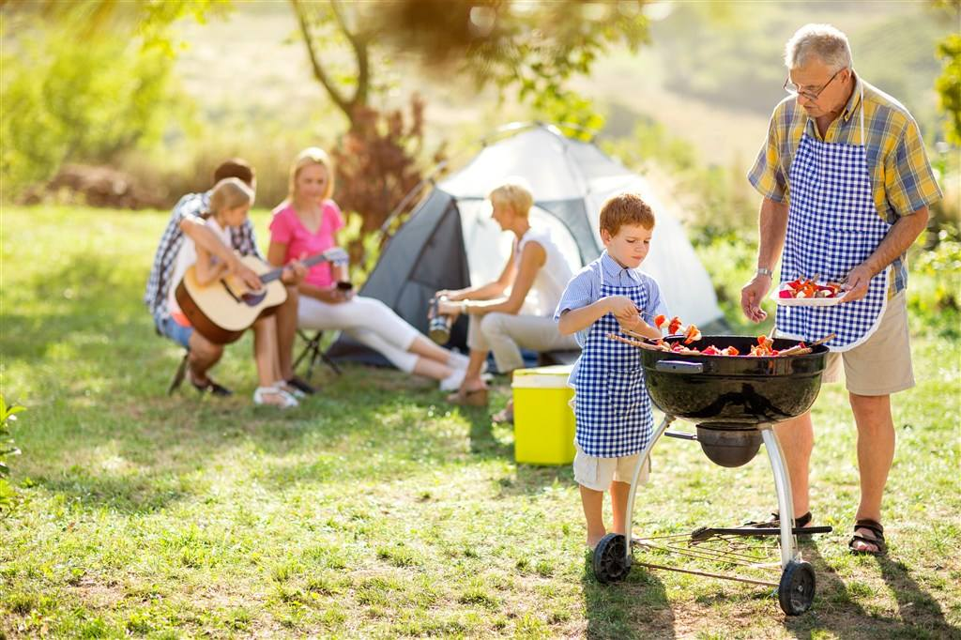
Charcoal burning everywhere

Slide 23
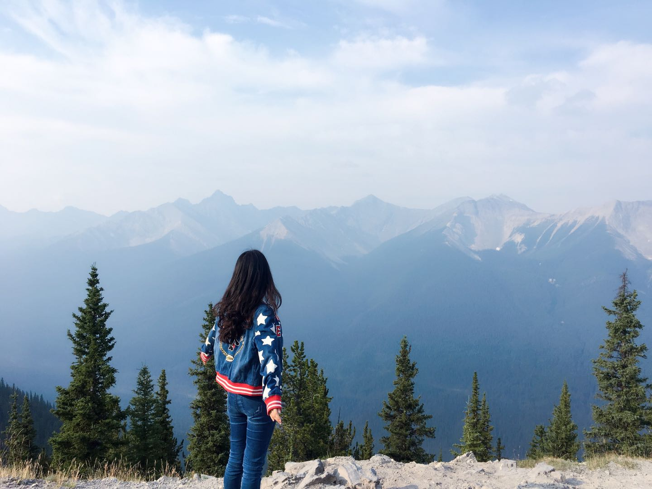
Another
Pleasant
Valley
Sunday

Slide 24
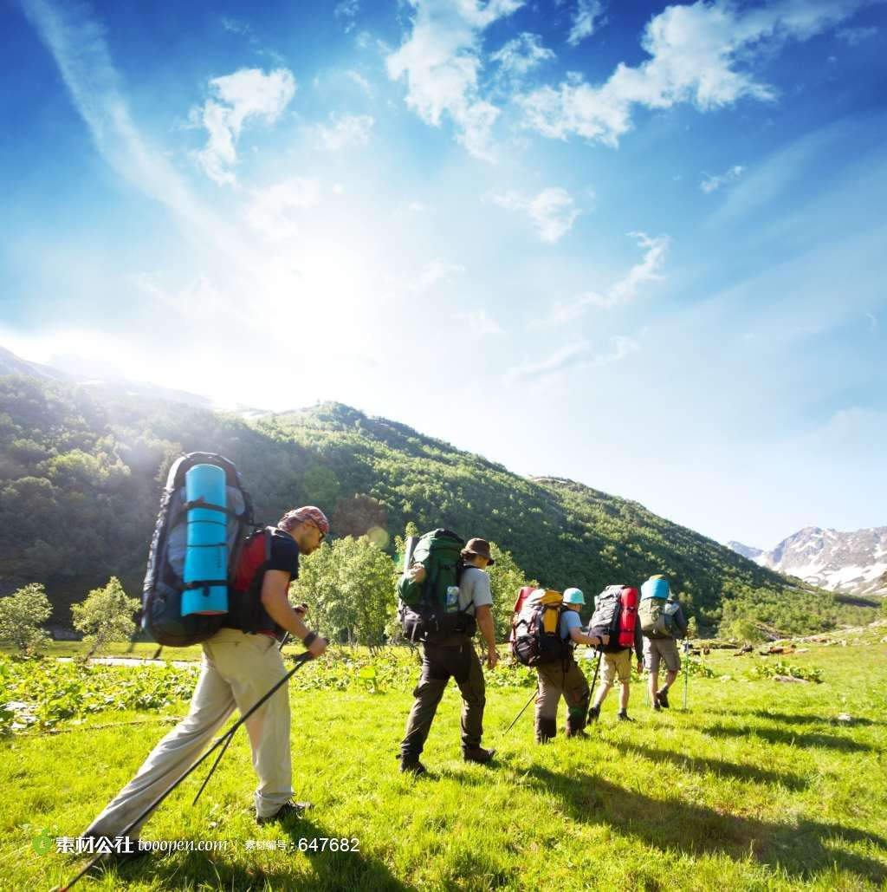
Here in status symbol land

Slide 25
Another
Pleasant
Valley
Sunday

Slide 26
Another
Pleasant
Valley
Sunday

Slide 27
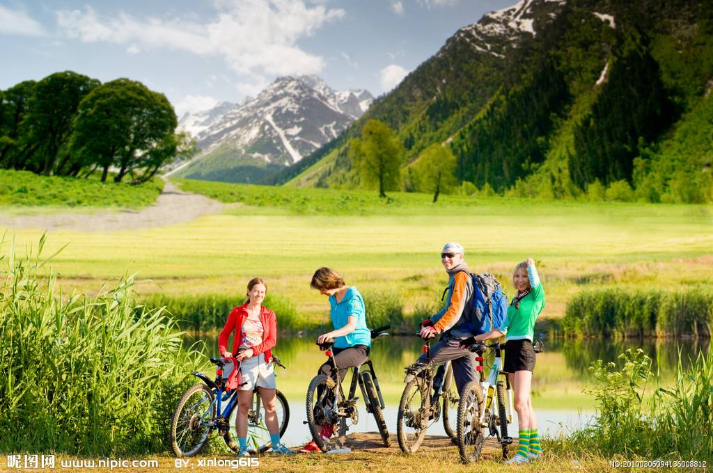
Another
Pleasant
Valley
Sunday

Slide 28
Another
Pleasant
Valley
Sunday

Slide 29
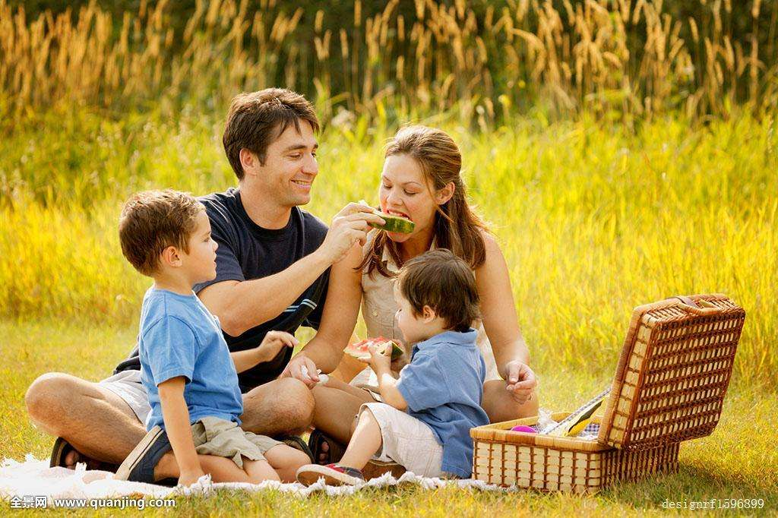
Another
Pleasant
Valley
Sunday

Slide 30
Another
Pleasant
Valley
Sunday

Slide 31
2
Thank you for watching

Slide 32
2
Thank you for watching

