Slide 1
人教版必修二Unit5 Music
刘雪仪 华南师范大学外文学院

Slide 2
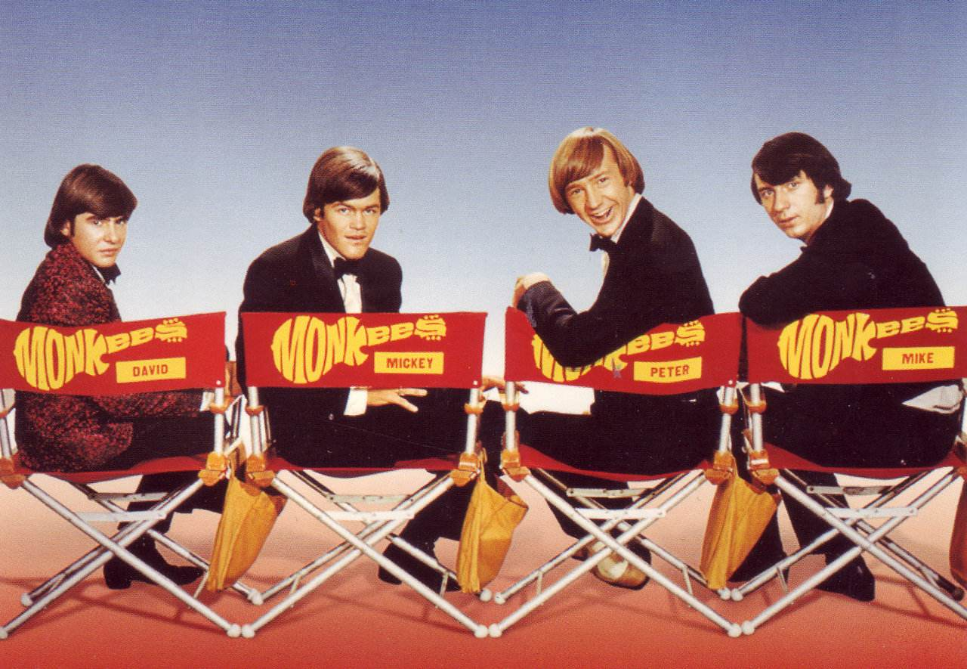
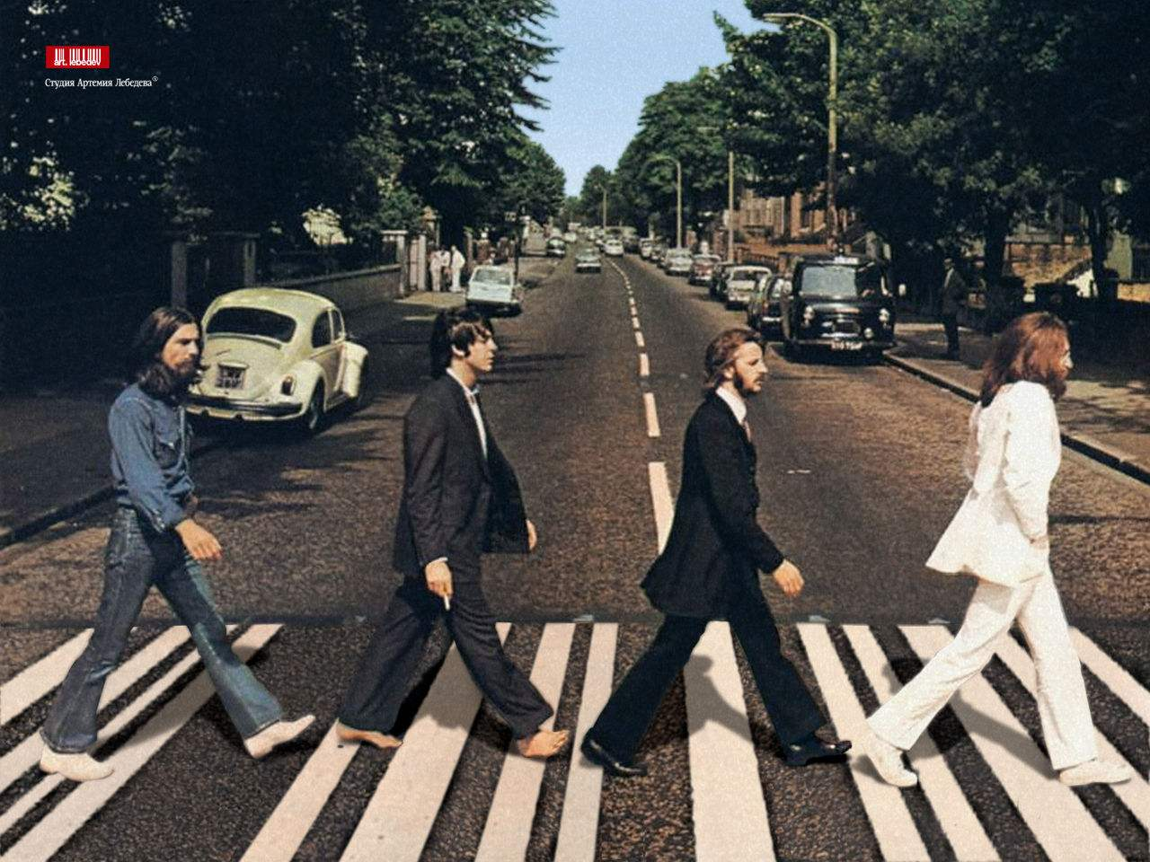
And never never never stop for anyone. Tonight let's get some and live while we're young
Yeah we'll be doing what we do
Yeah we'll be doing what we do
And girl you and I
Just pretending that we're cool so tonight
Just pretending that we're cool and we know it too
We're about to make some memories tonight
Yeah we'll keep doing what we do
Just pretending that we're cool so tonight
I wanna live while we're young
We wanna live while we're young
and live while we're young
Hey girl it's now or never
it's now or never
And if we get together yeah get together
And live while we're young
Don't over-think just let it go
Tonight let's get some and live while we're young
Don't let the pictures leave your phone
Let's go crazy crazy crazy 'til we see the sun
And never never never stop for anyone
Tonight let's get some and live while we're young
I know we only met but let's pretend it's love
Come on and let me sneak you out
Tonight let's get some and live while we're young
Hey girl I'm waiting on ya~ I'm waiting on ya
Let's go crazy crazy crazy 'til we see the sun. I know we only met but let's pretend it's love~
And have a celebration a celebration The music up the windows down

