Slide 1
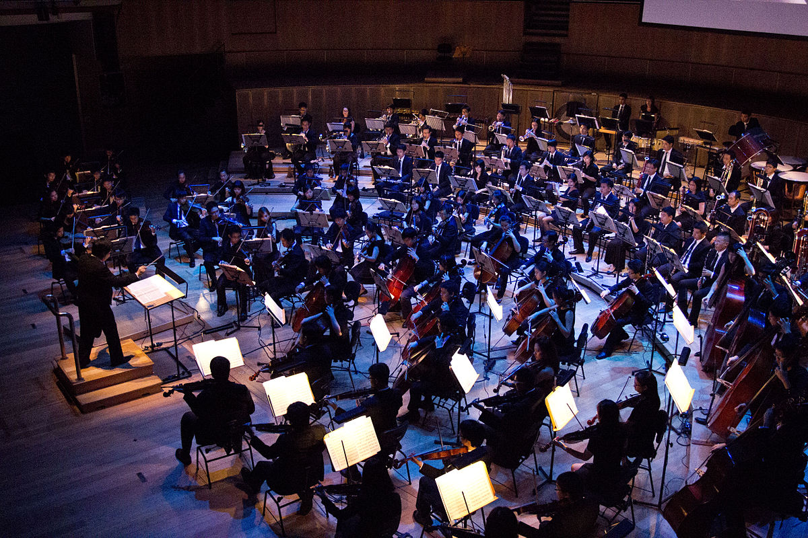
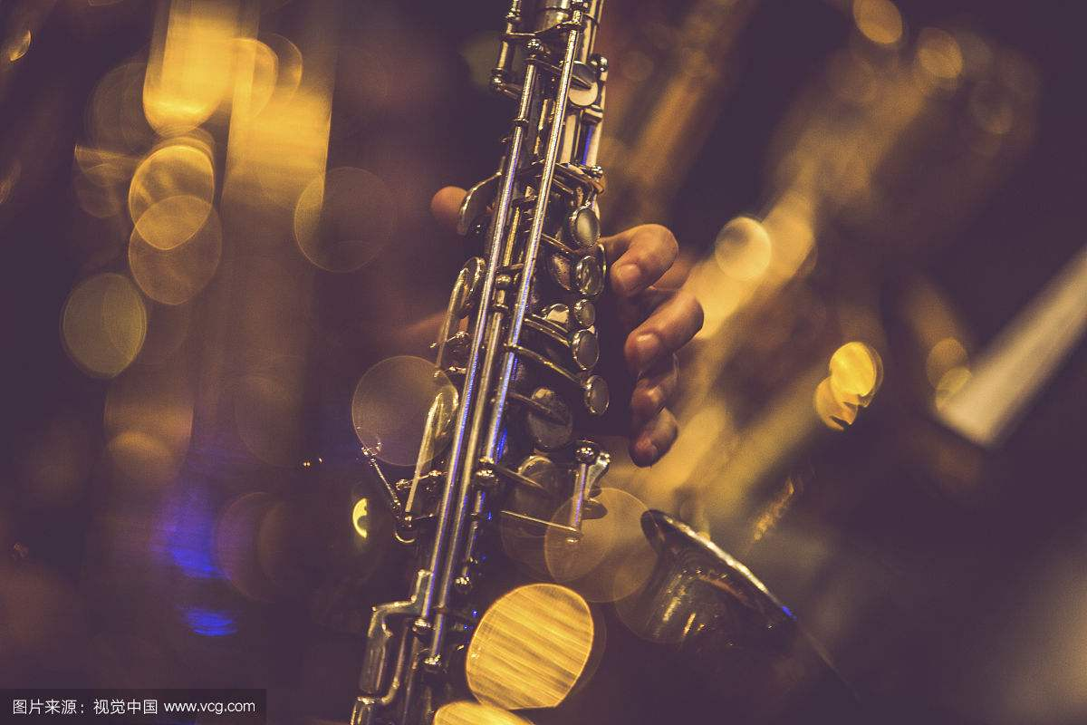
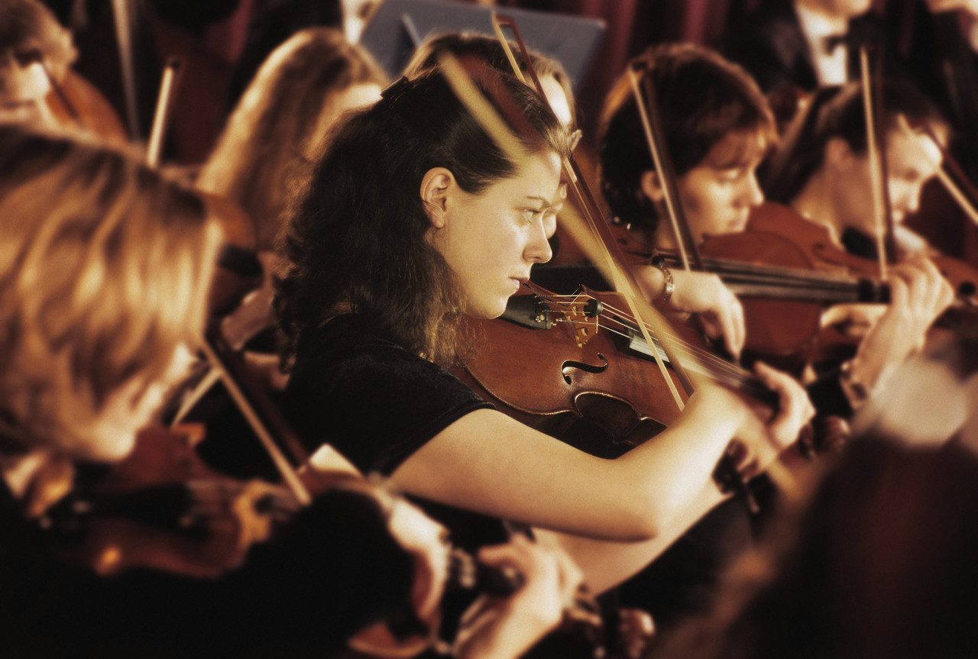
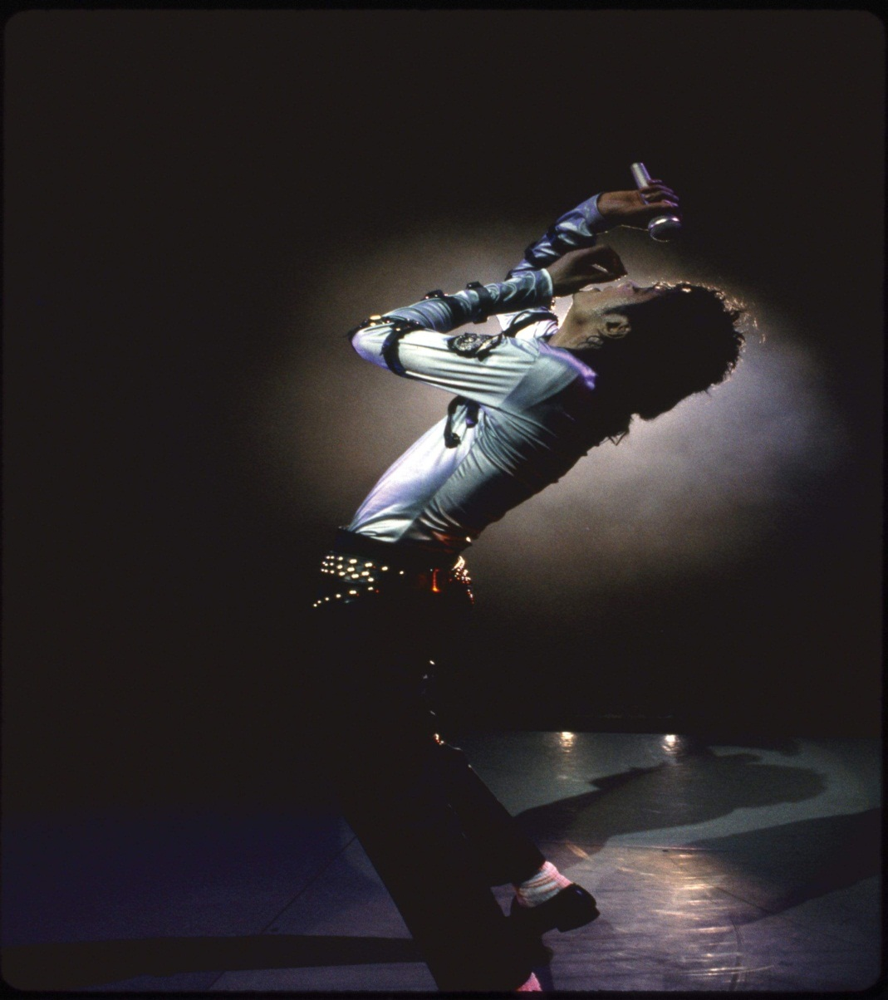
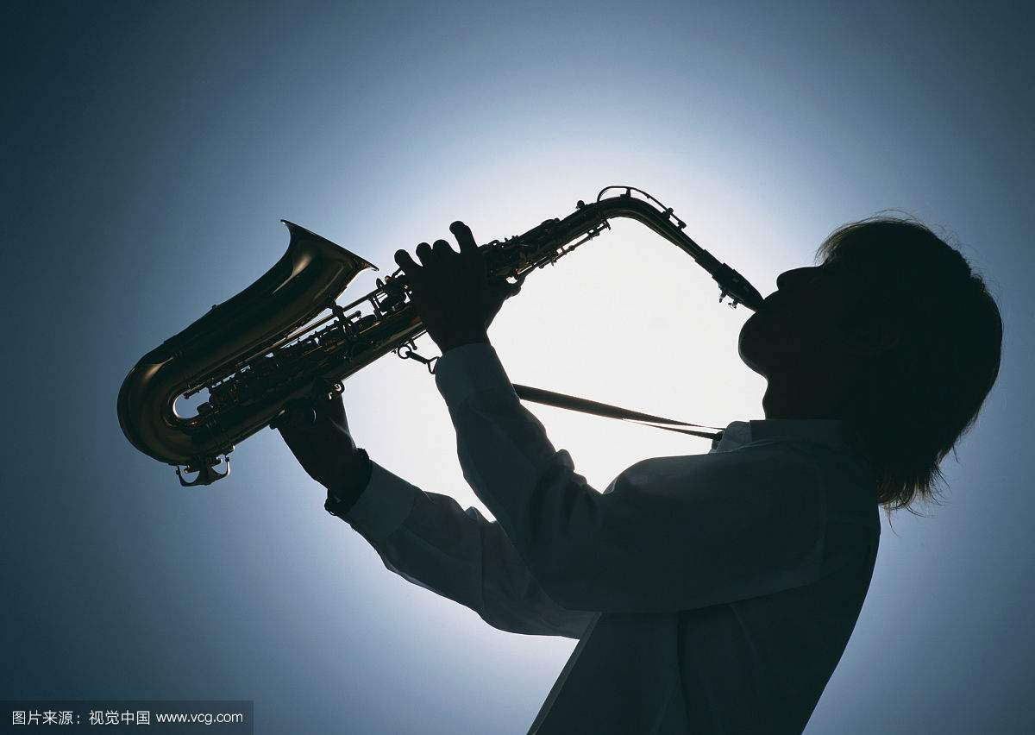
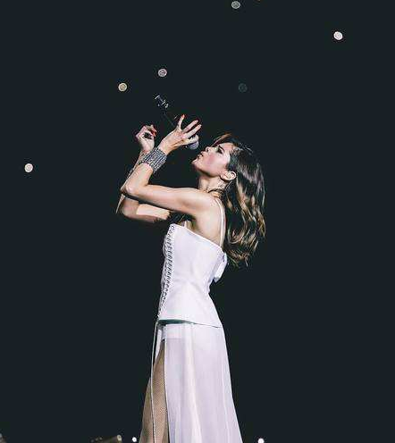
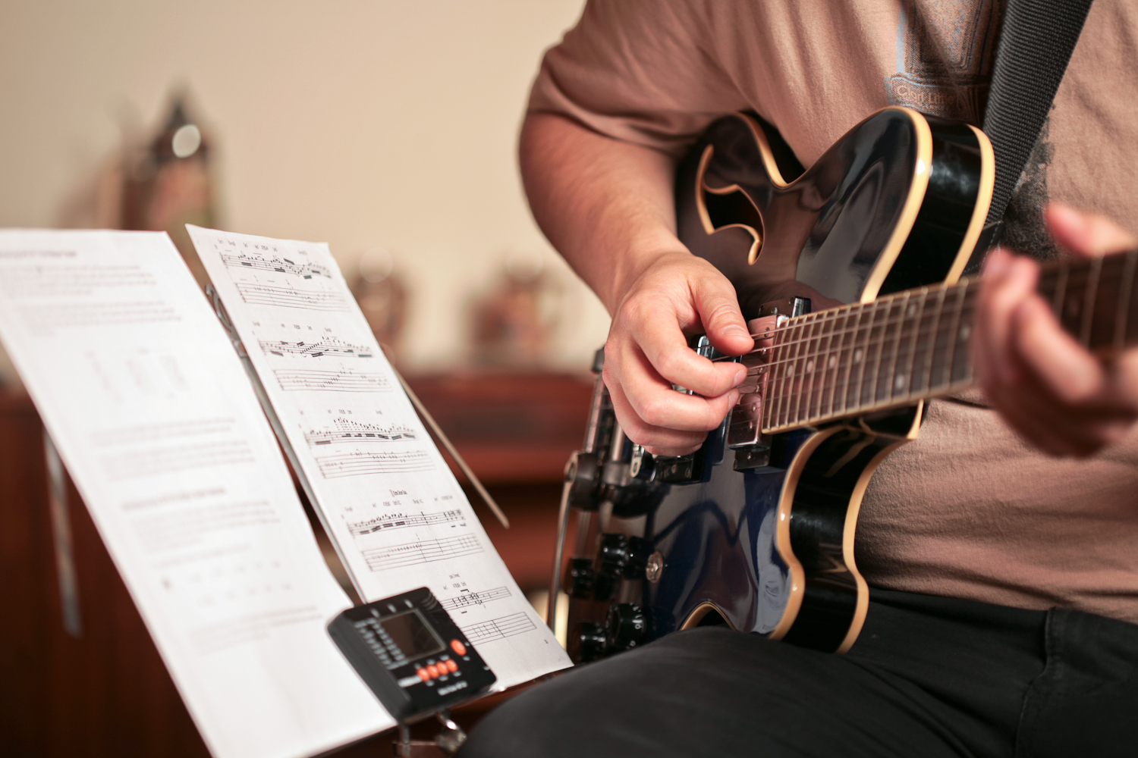
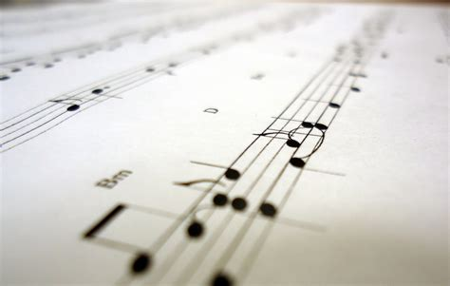
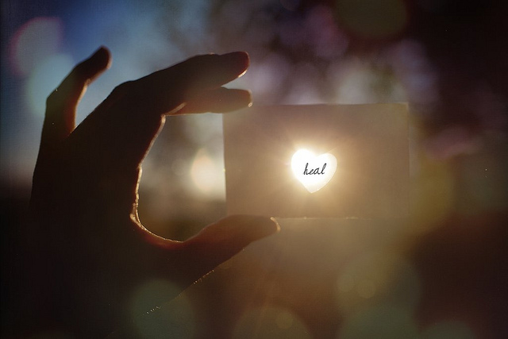
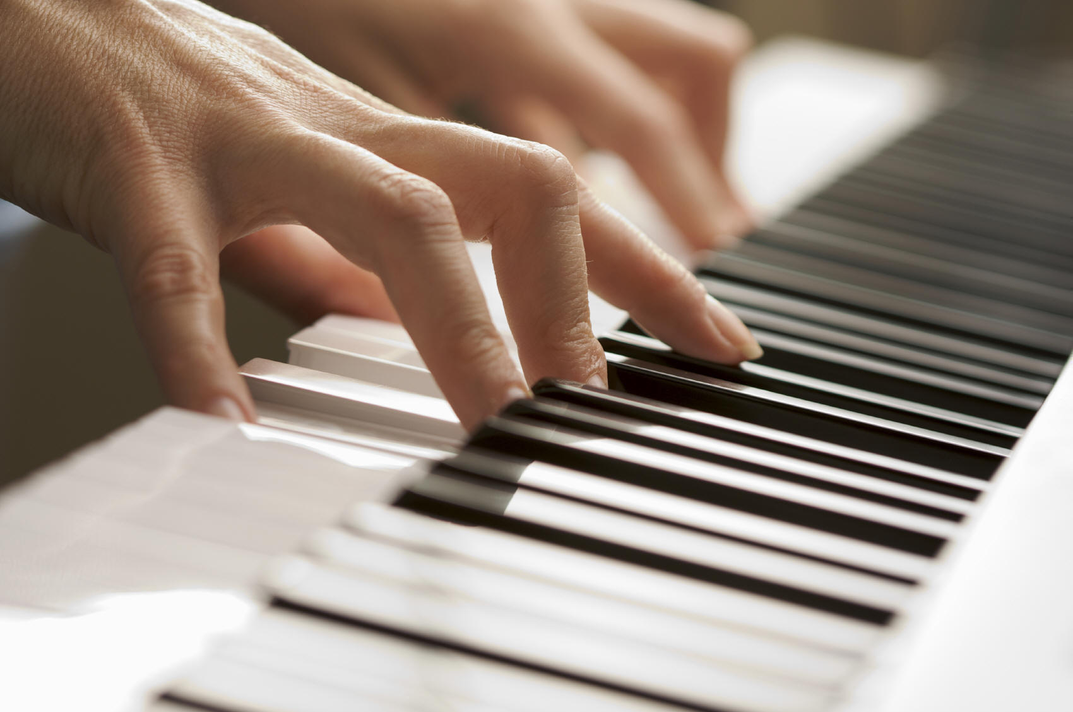
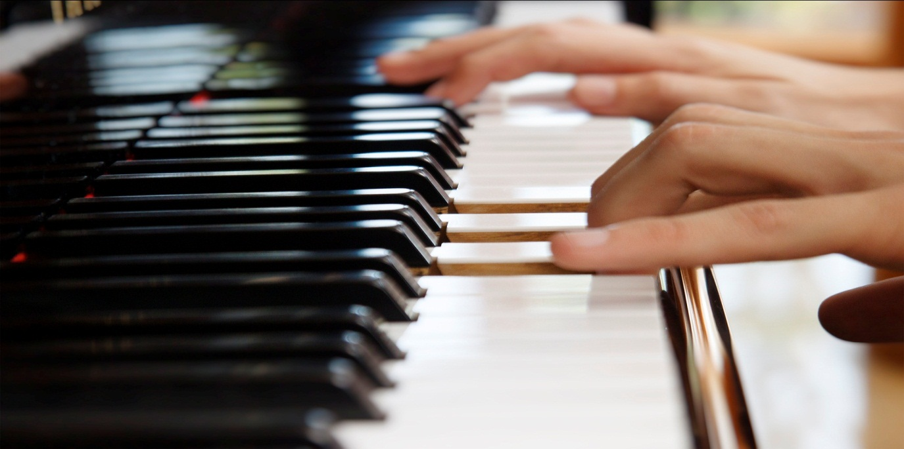
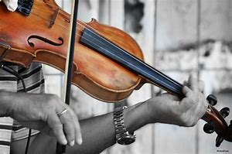
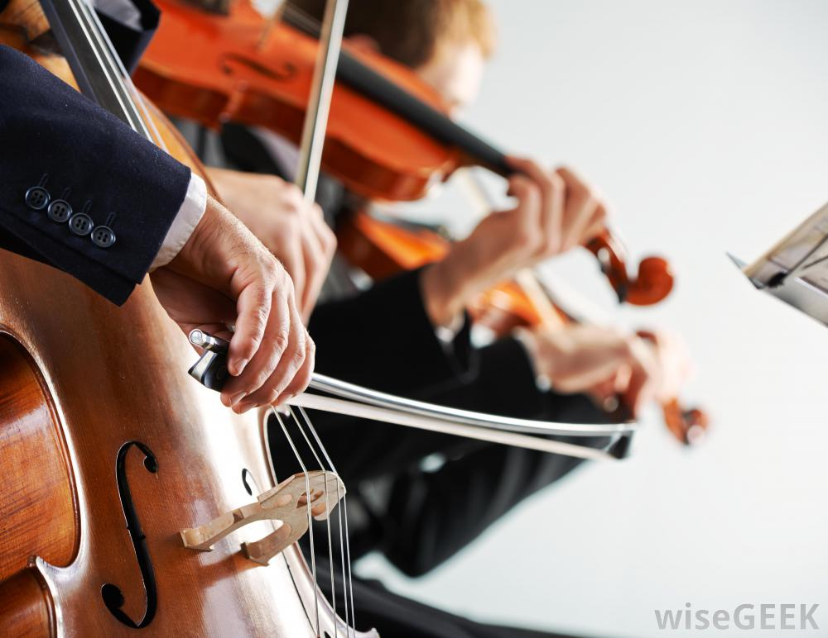
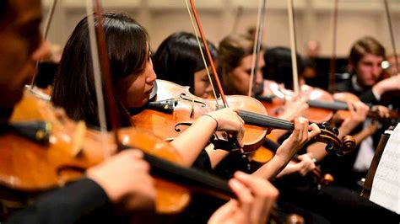
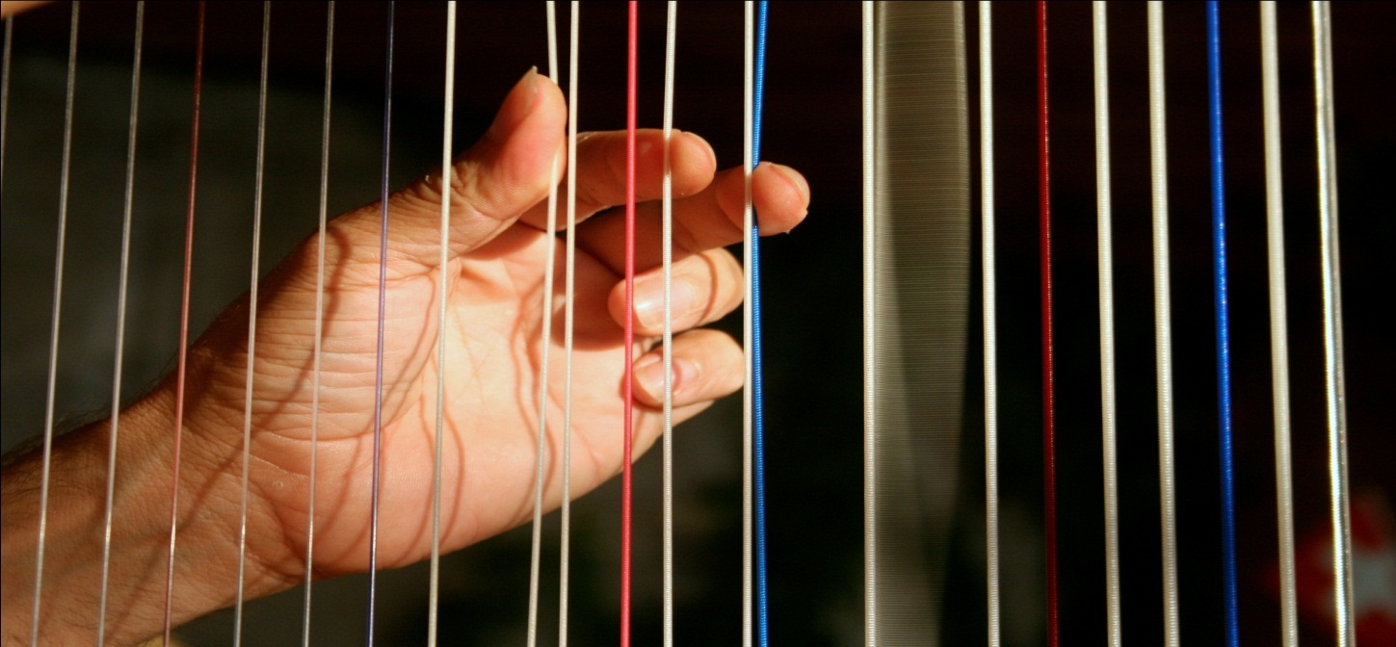
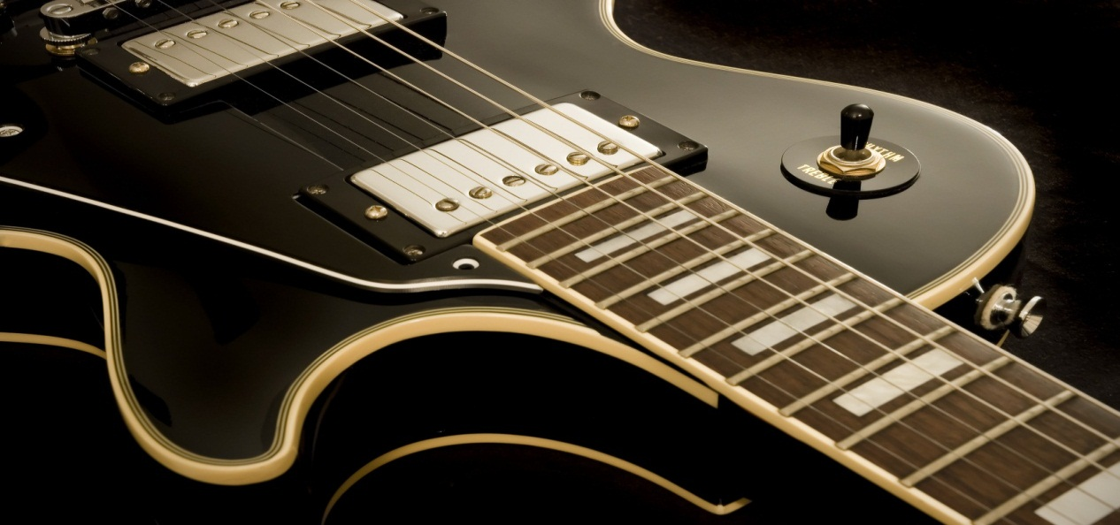
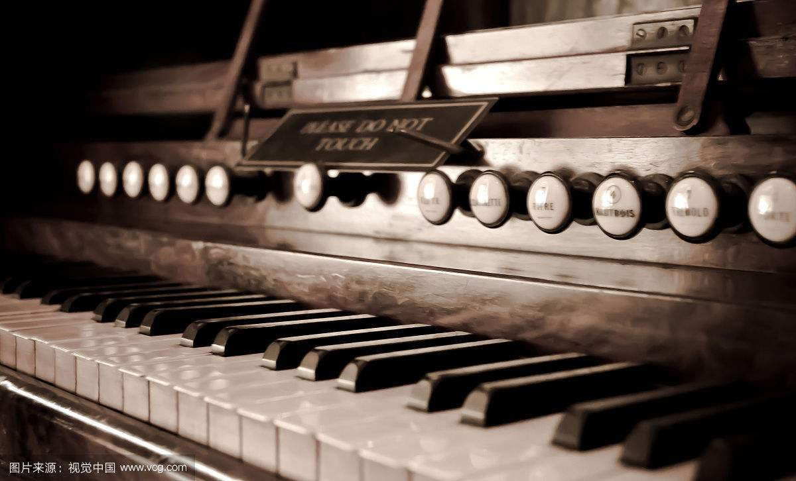
The End
With the old piano
And maybe, you can hear them sing
Let the music take control
Let the music give you
the power to move any mountain
Oh, sometimes,
you can hear them say
Let the music take control
Just a song,
where his feelings show
Let the music
heal your soul
So melodic, and endearing too
Let the music give you
the power to move any mountain
Oh, oh yes.
Let the music take control
Let the music heal your soul
Let the music heal your soul
But it also, also heals your soul
Let the music
heal your soul
Let the music
take control
Music gives
you happiness or sadness
Let the music heal your soul
But it also,
it also heals your soul
And if someone feels the same,
About that simple song
Oh ,if someone plays piano
With some simple chords
Let the music heal your soul
Music gives you happiness or sadness
Oh if someone writes a song
Let the music heal your soul
Let the music heal your soul
With a simple round
Let the music heal your soul
Let the music take control
Let the music heal your soul
I know if someone plays guitar
Let the music take control
人教版U2M5 Music
华南师范大学外文学院 张诗慧
Let the music take control

