Slide 1
人教版高中英语 Module 3
Unit 2 Healthy Eating
Chicken Fried --- Shawn Smith
洪铭婕 华南师范大学外文学院

Slide 2
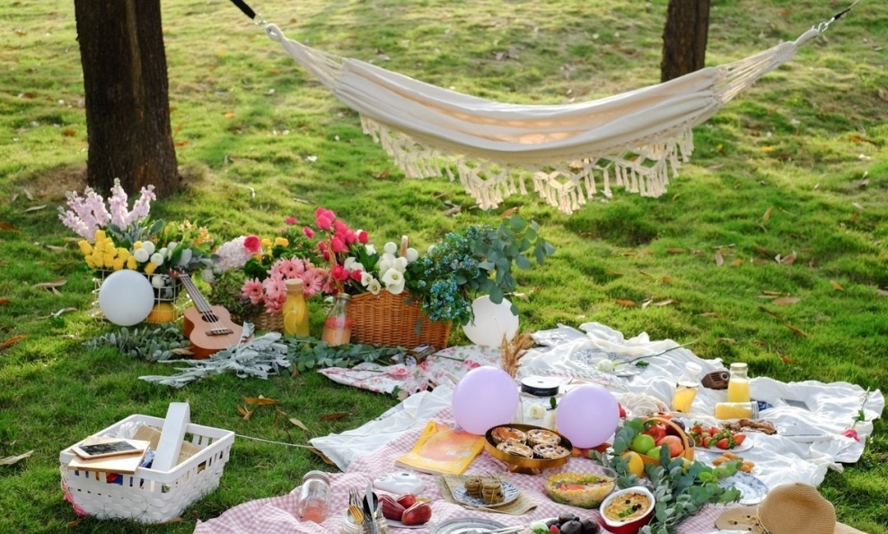
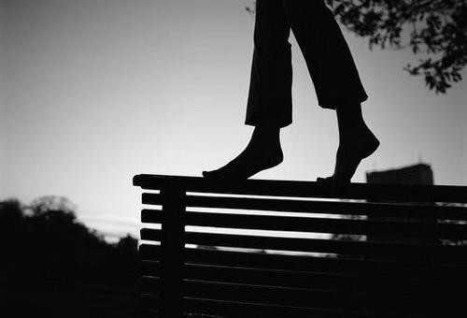
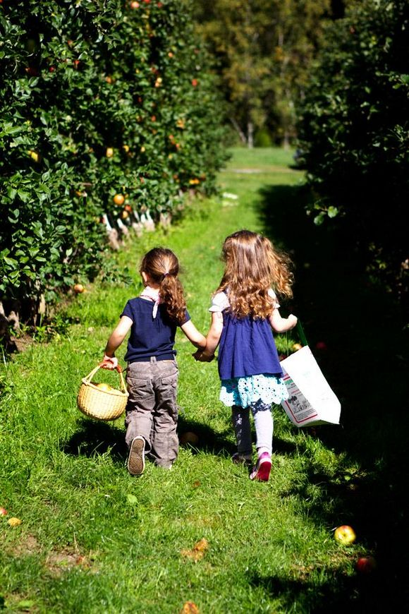
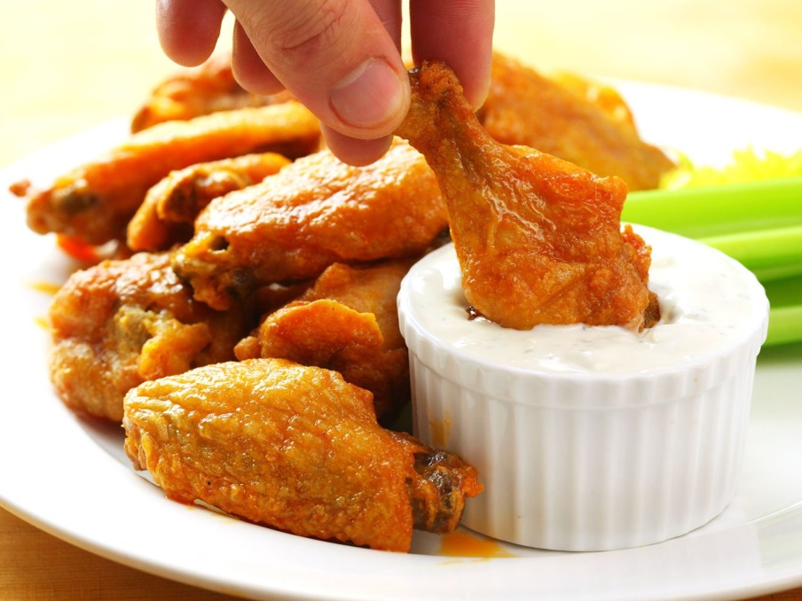
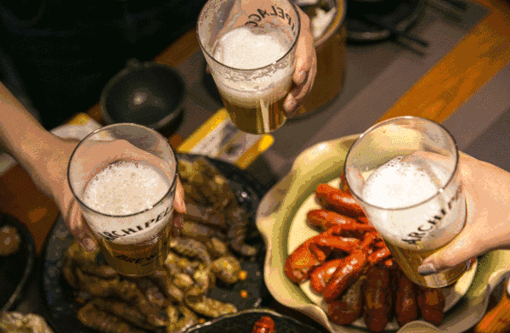
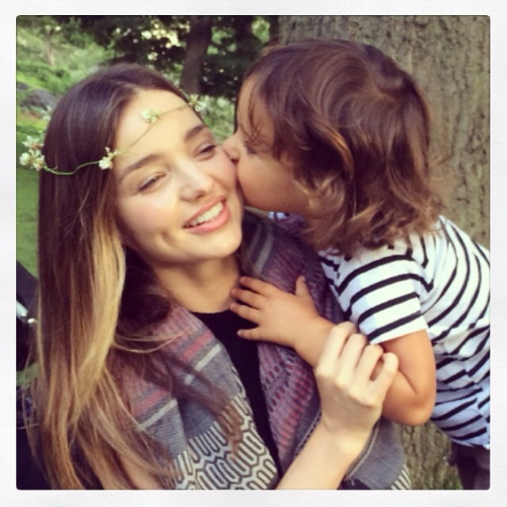
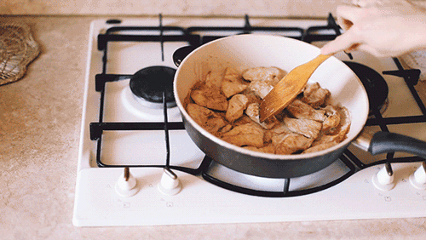
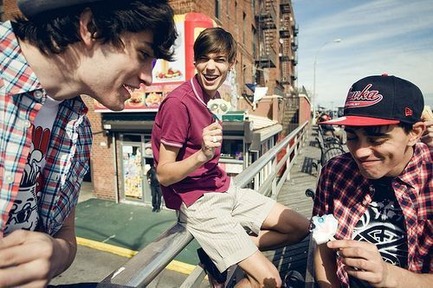
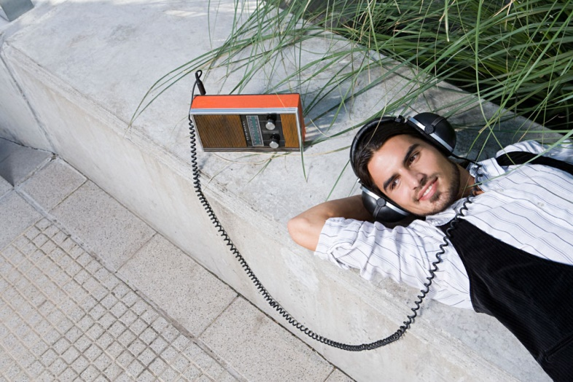
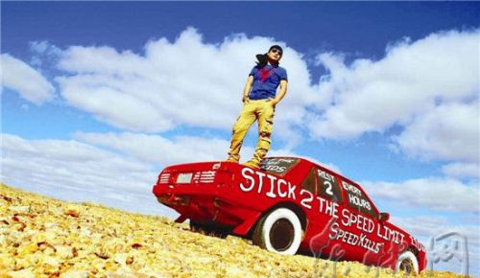
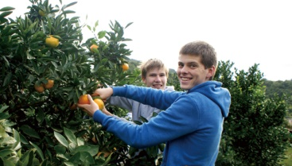
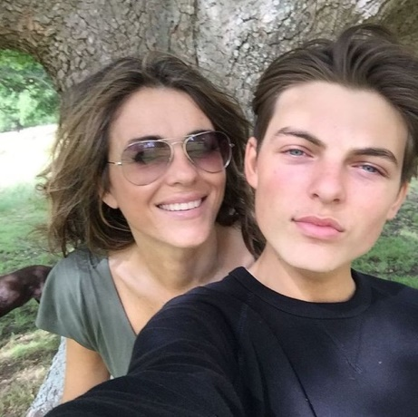
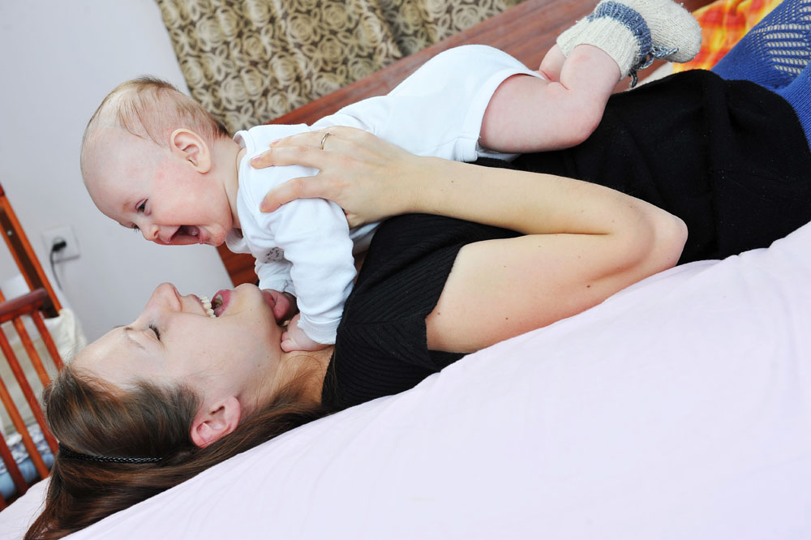
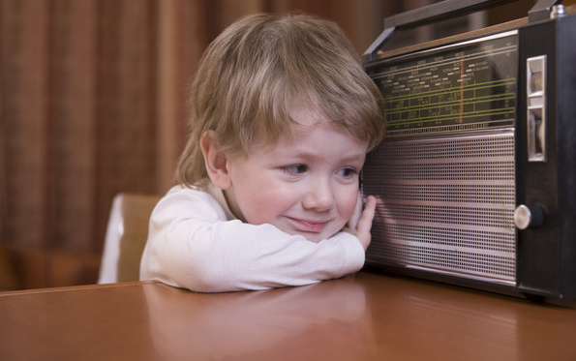
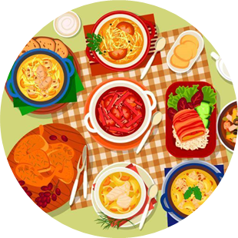
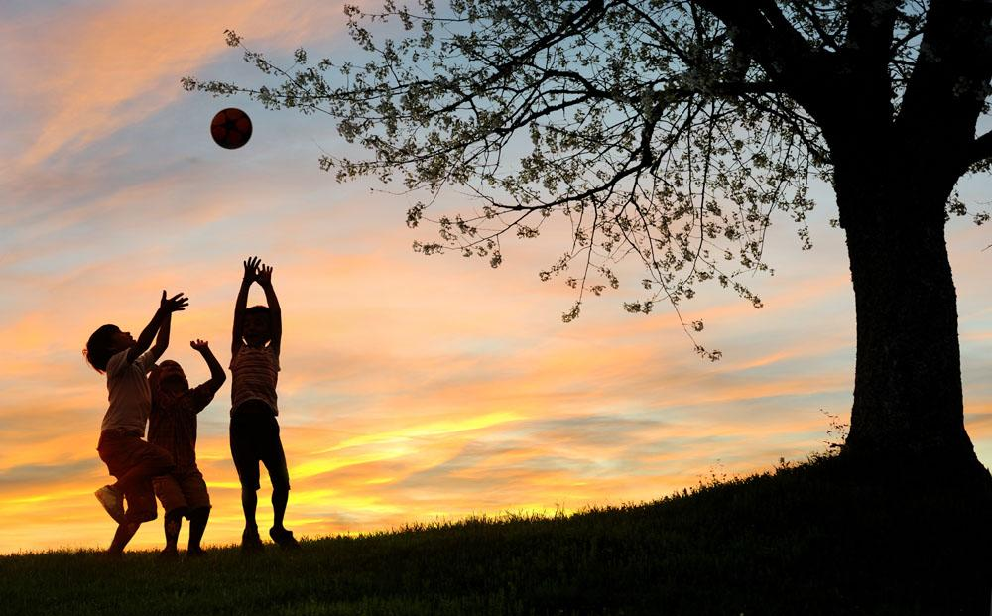
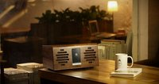
Chicken Fried
Shawn Smith
进度条时间 228s
There's no dollar sign on a peace of mind,
this I've come to know
Not where you live or the car you drive
or the price tag on your clothes
It's funny how it's the little things in life
that mean the most
But it's filled with love that's grown
in southern ground
And that's home you know
Feel the touch of a precious child
A pair of jeans that fit just right
And the radio on
Where the peaches grow
I was raised up beneath the shade of a Georgia Pine
A pair of jeans that fit just right
I love to see the sun rise
And the radio on
And a little bit of chicken fried
To a little bit of chicken fried
Cold beer on a Friday night
Sweet tea, pecan pie, and homemade wine
You know I like my chicken fried
Cold beer on a Friday night
See the love in my woman's eyes
And my house it's not much to talk about
Cold beer on a Friday night
A pair of jeans that fit just right
So if you agree have a drink with me
Feel the touch of a precious child
See the love in my woman's eyes
And the radio on
And know a mother's love
I love to see the sun rise
Raise you glasses for a toast
And know a mother's love

Slide 3
THE END

