Slide 1
M3U2:
Healthy Eating
song:
Eat Like A Rainbow
-Jay Mankita
作者：刘安琪
单位：华南师范大学外文学院

Slide 2
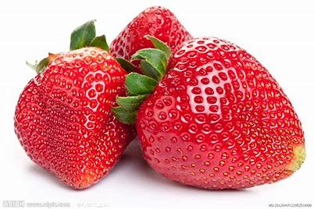
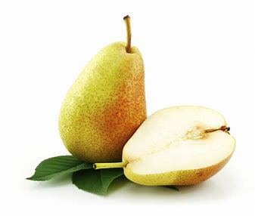
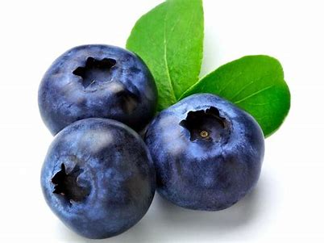
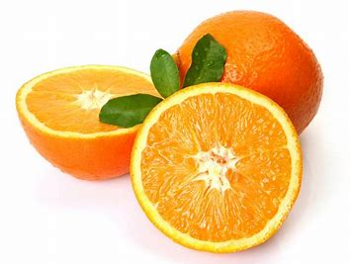
I like to eat like a rainbow

Slide 3
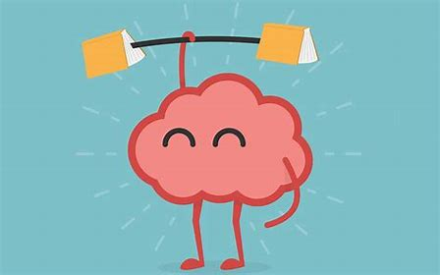
目录
0 1
0 3
Just for today I will try to live through this day only and not tackle my whole life problem at once.
Just for today I will try to live through this day only and not tackle my whole life problem at once.
0 2
0 4
Just for today I will try to live through this day only and not tackle my whole life problem at once.
Just for today I will try to live through this day only and not tackle my whole life problem at once.
Builds my body and it makes my brain grow

Slide 4
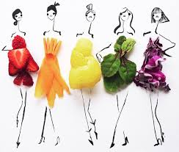
Helps my heart beat and my blood flow, I like to eat like a rainbow

Slide 5
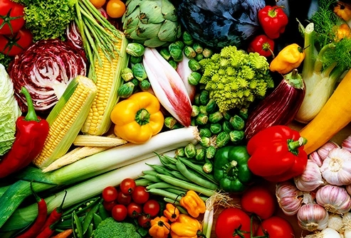
I like to eat like a rainbow

Slide 6
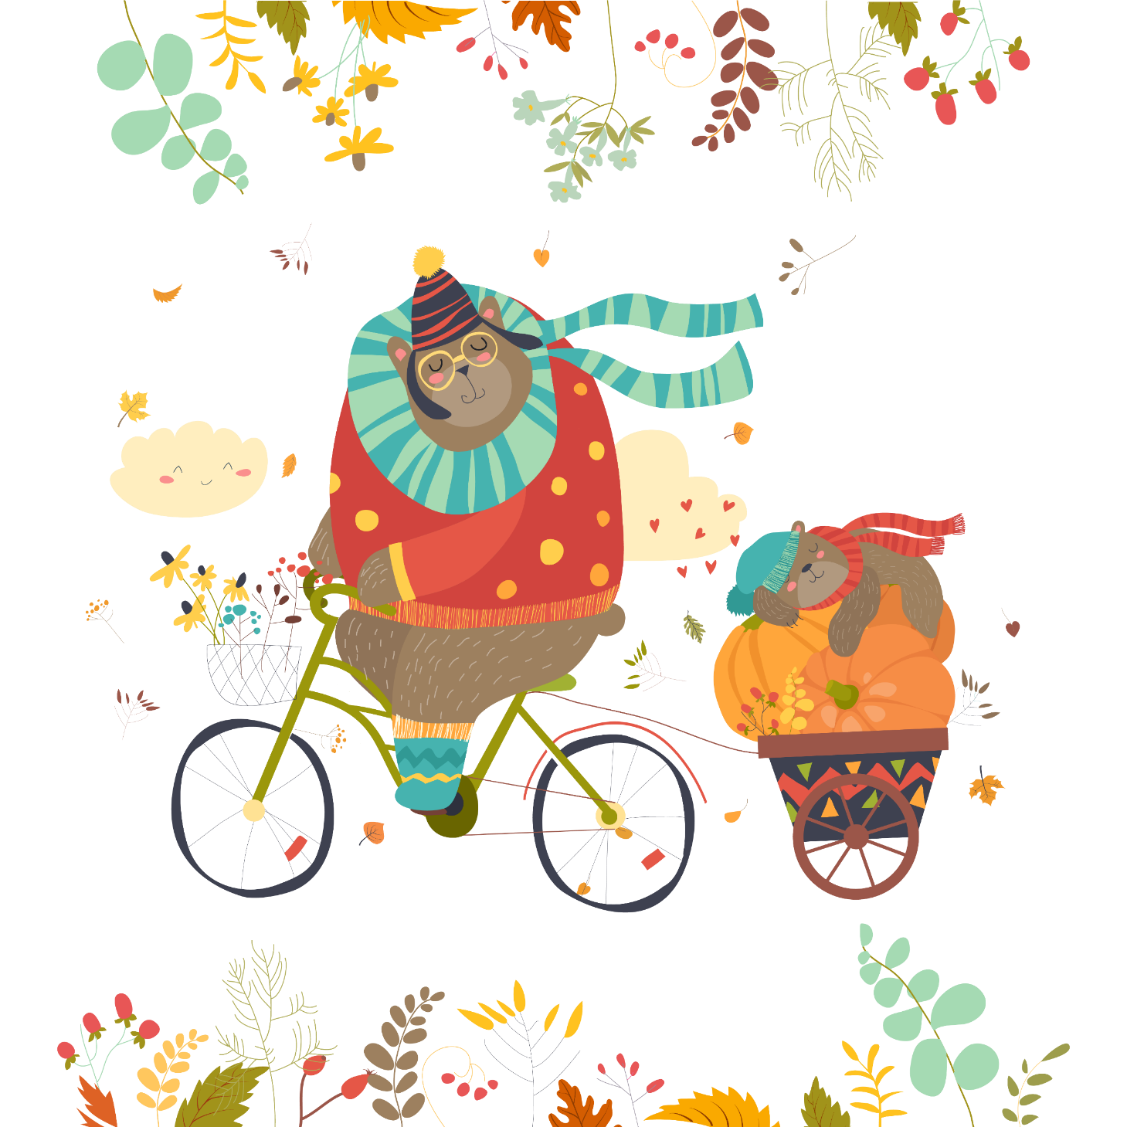
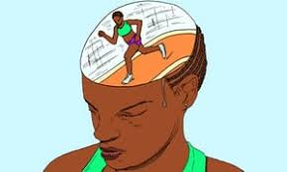
Builds my body and it makes my brain grow

Slide 7
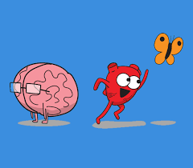
Helps my heart beat and my blood flow, I like to eat like a rainbow

Slide 8
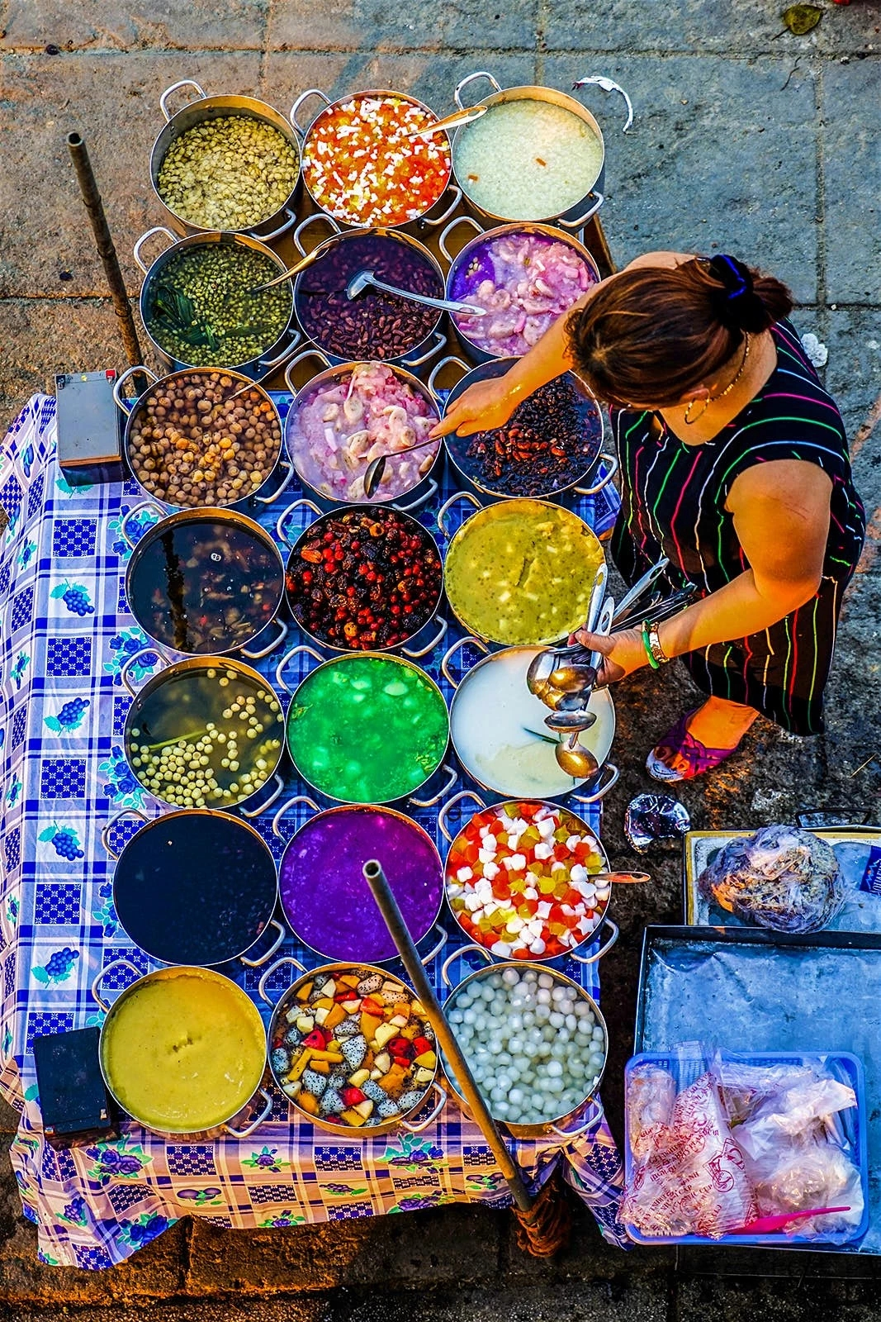
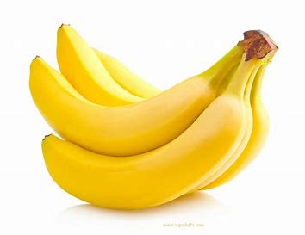
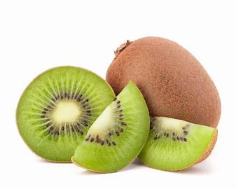
I like to eat like a rainbow Red, orange, yellow, and green,
目录
0 1
0 3
Just for today I will try to live through this day only and not tackle my whole life problem at once.
Just for today I will try to live through this day only and not tackle my whole life problem at once.
0 2
0 4
Just for today I will try to live through this day only and not tackle my whole life problem at once.
Just for today I will try to live through this day only and not tackle my whole life problem at once.

Slide 9
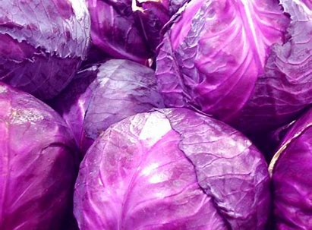
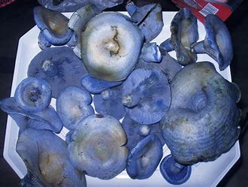
The tastiest colors I've seen I like to eat food that's purple and blue;

Slide 10
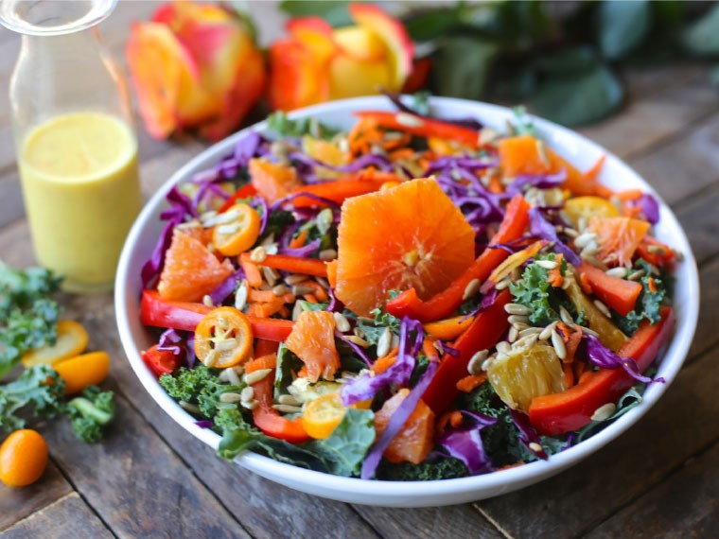
colorful foods are healthier too

Slide 11
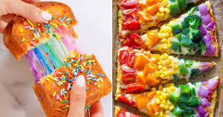
I like to eat like a rainbow

Slide 12
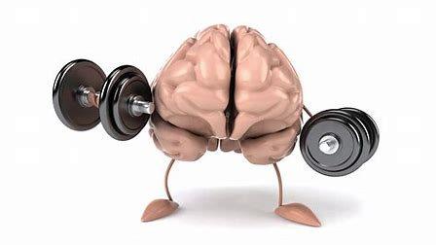
目录
0 1
0 3
Just for today I will try to live through this day only and not tackle my whole life problem at once.
Just for today I will try to live through this day only and not tackle my whole life problem at once.
0 2
0 4
Just for today I will try to live through this day only and not tackle my whole life problem at once.
Just for today I will try to live through this day only and not tackle my whole life problem at once.
Builds my body and it makes my brain grow

Slide 13
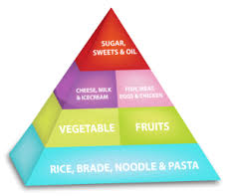
Helps my heart beat and my blood flow, I like to eat like a rainbow

Slide 14
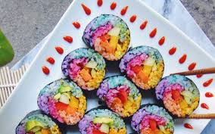
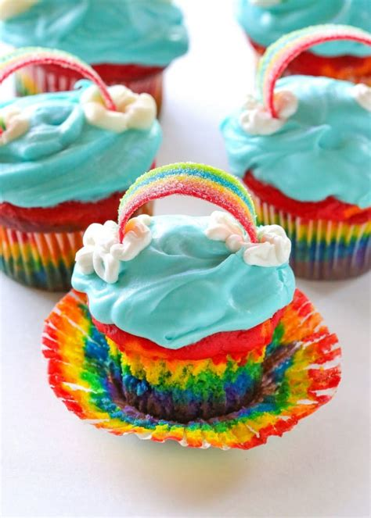
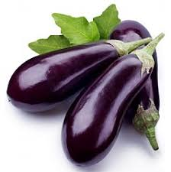
Builds my body and it makes my brain grow
Helps my heart beat and my blood flow,
I like to eat like a rainbow

Slide 15
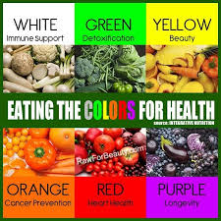
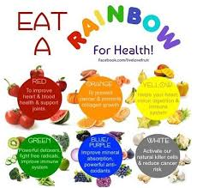
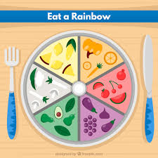
I like to eat like a rainbow
I like to eat like a rainbow

Slide 16
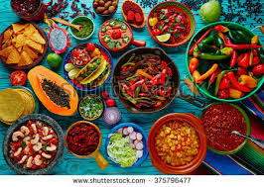
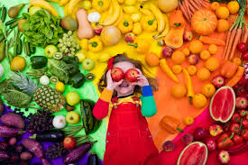
Colorful food makes a colorful meal;
And that really colors the way that I feel

Slide 17
I'm livin' in a colorful way, eat like a rainbow every day

Slide 18
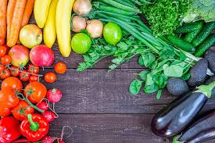
I'm livin' in a colorful way, eat like a rainbow every day

Slide 19
U2 Healthy Eating

