Slide 1
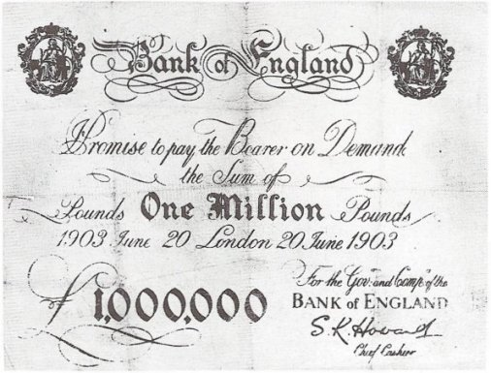
人教版高中英语M3U3 THE MILLION POUND BANK NOTE
华南师范大学外文学院 苏晶晶 制作

Slide 2
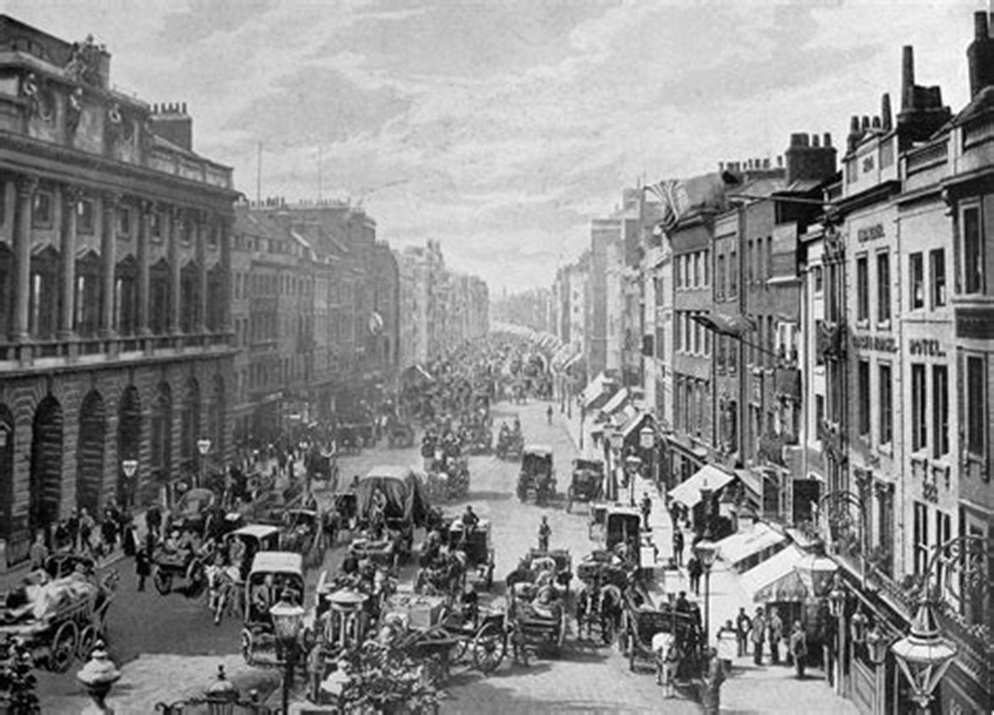
In Victorian London…

Slide 3
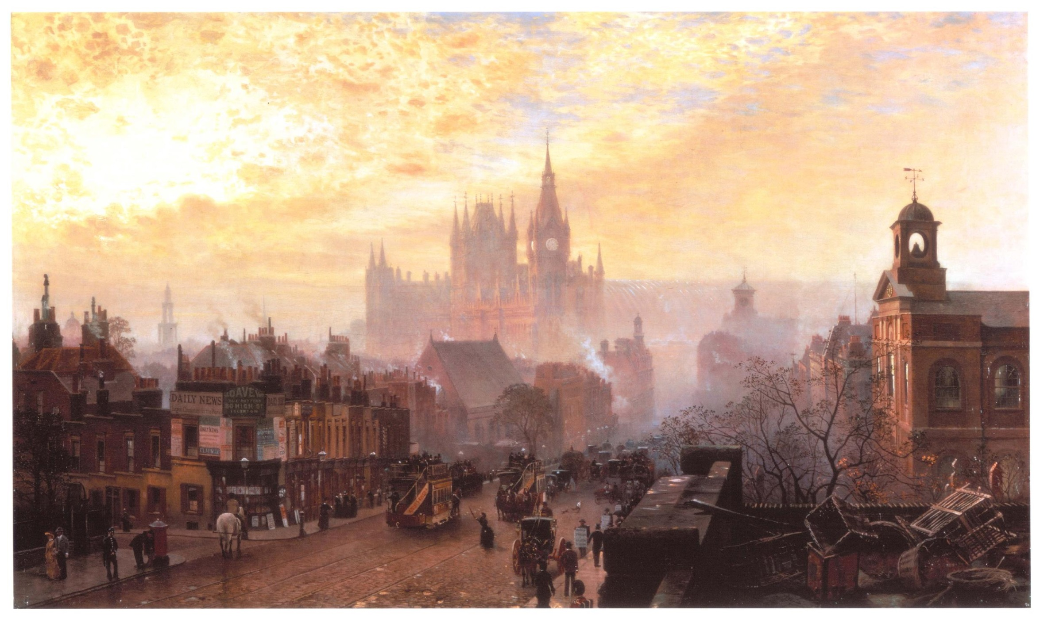
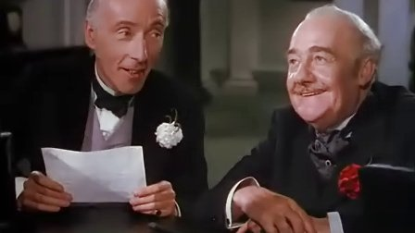
Two
It is the summer of 1903.
Two old and wealthy brothers, Roderick and Oliver, have made a bet.

Slide 4
Two
Oliver believes that with a million pound note, a man could survive a month in London.
His brother Roderick doubts it.

Slide 5
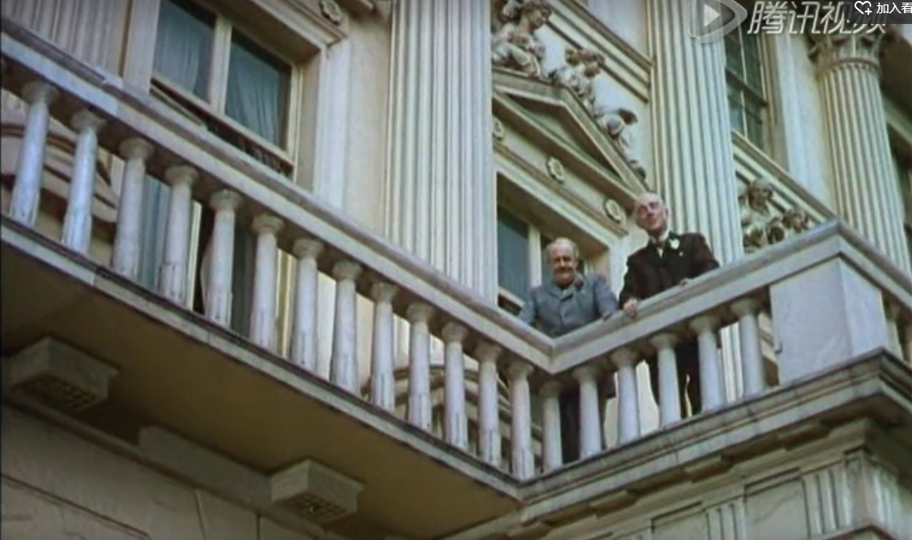
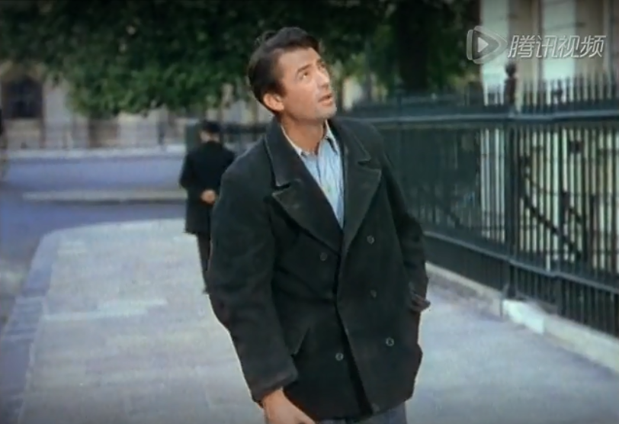
Two
At this moment, they see a penniless young man.
They ask him to come in.

Slide 6
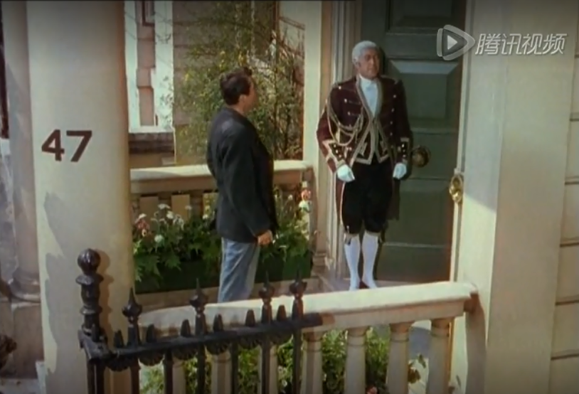

Slide 7
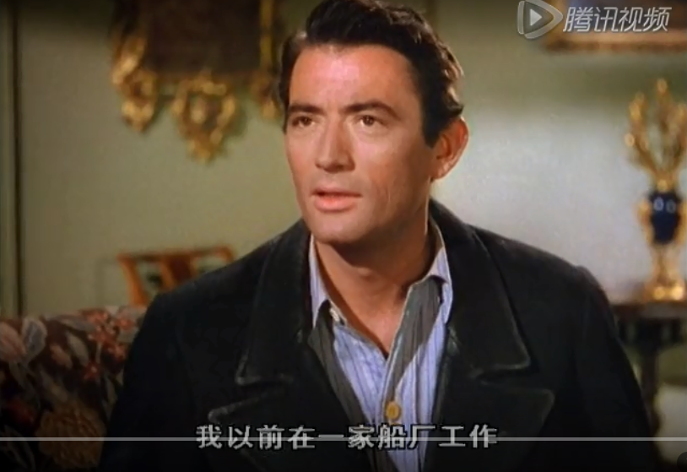
The young man is Henry Adams. He has ended up penniless and in rags after a boating accident in America.

Slide 8
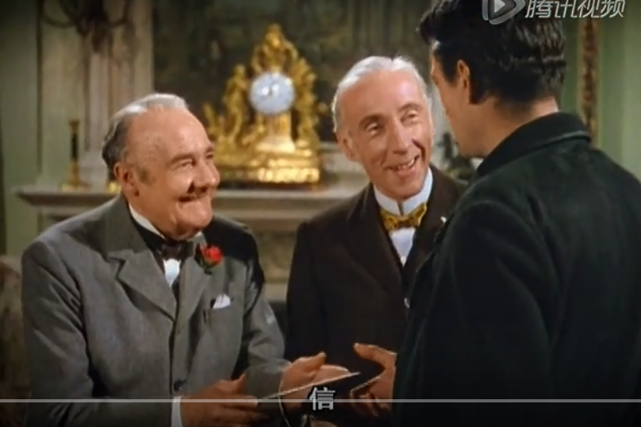
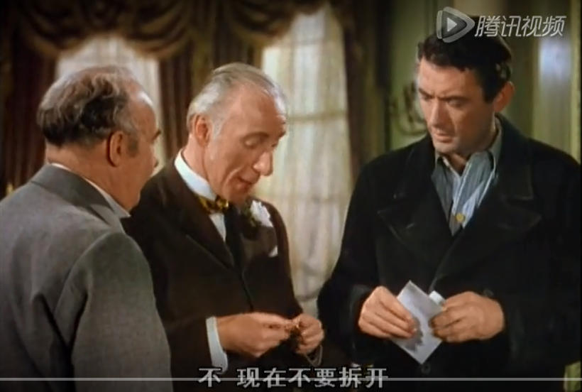
The two very rich brothers give him an envelope and tell him there’s money in it.
But they ask him not to open it until 2 o’clock.

Slide 9
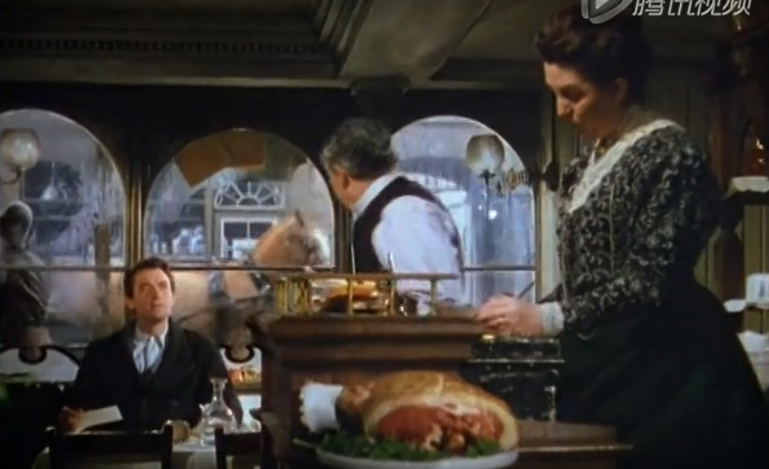
Henry immediately goes to a restaurant.

Slide 10
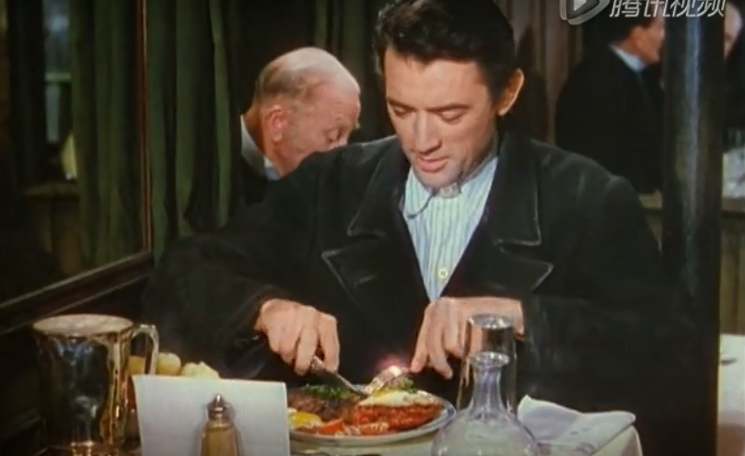
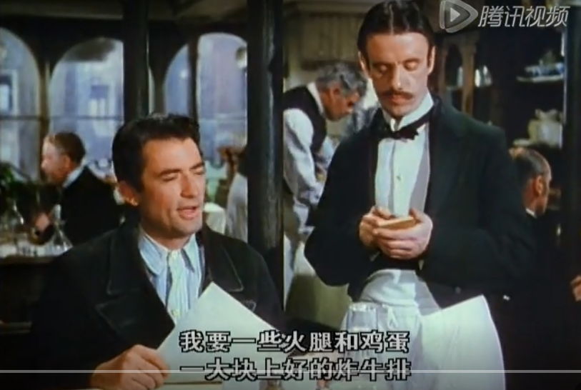
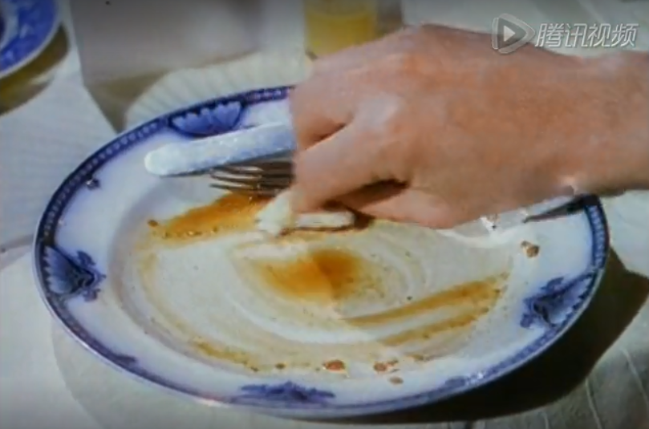
He orders a lot of food.
And he eats like a wolf.

Slide 11
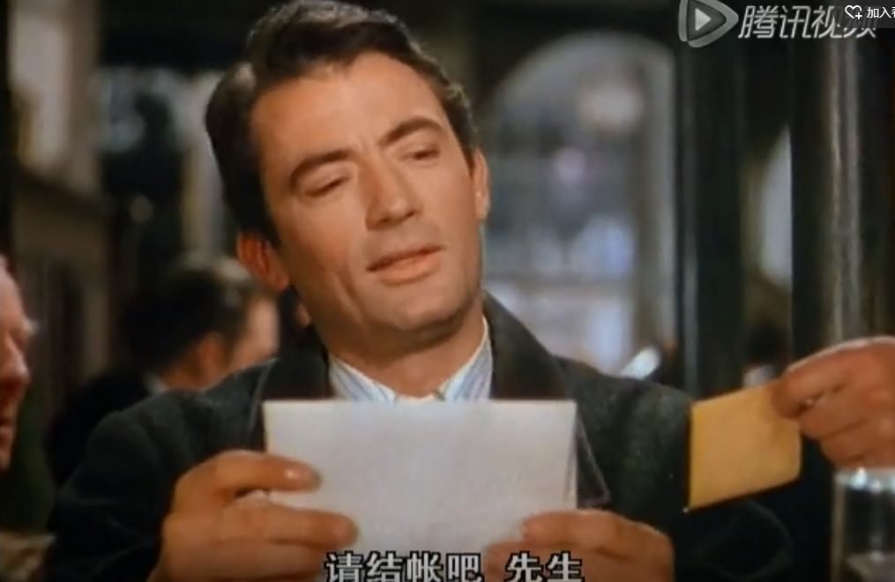
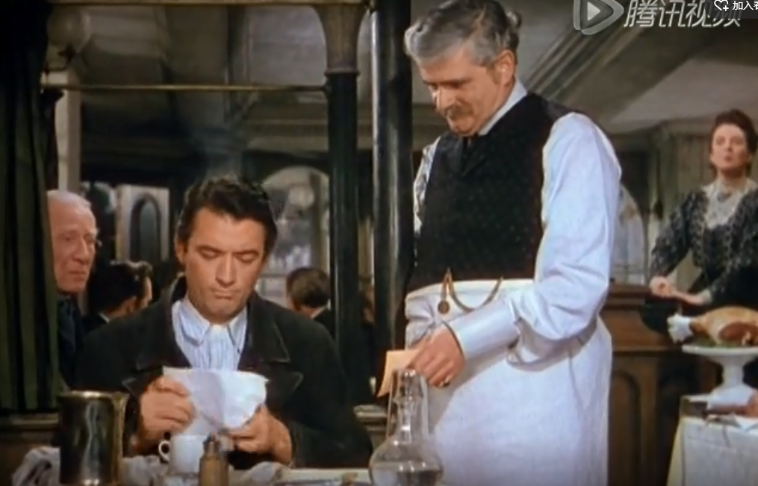
Two
After he eats, the owner asks him to pay the bill.
He pulls the money out of the envelope.

Slide 12
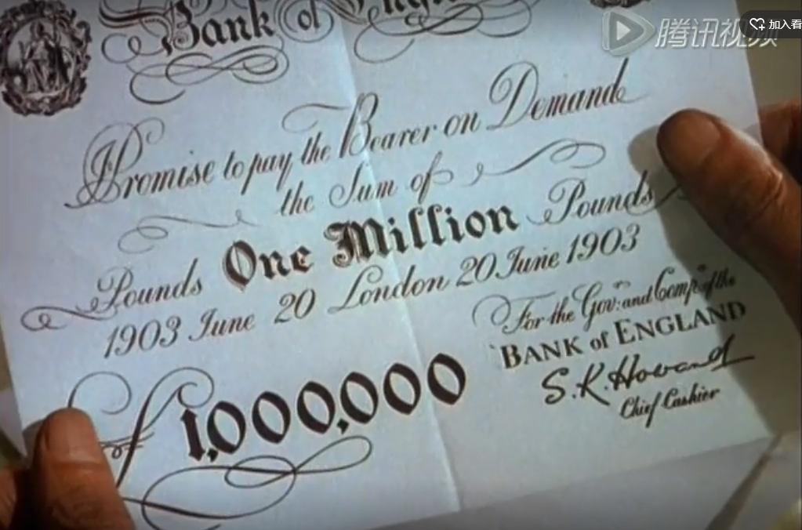
Two
Inside the envelope is a million pound bank note!

Slide 13
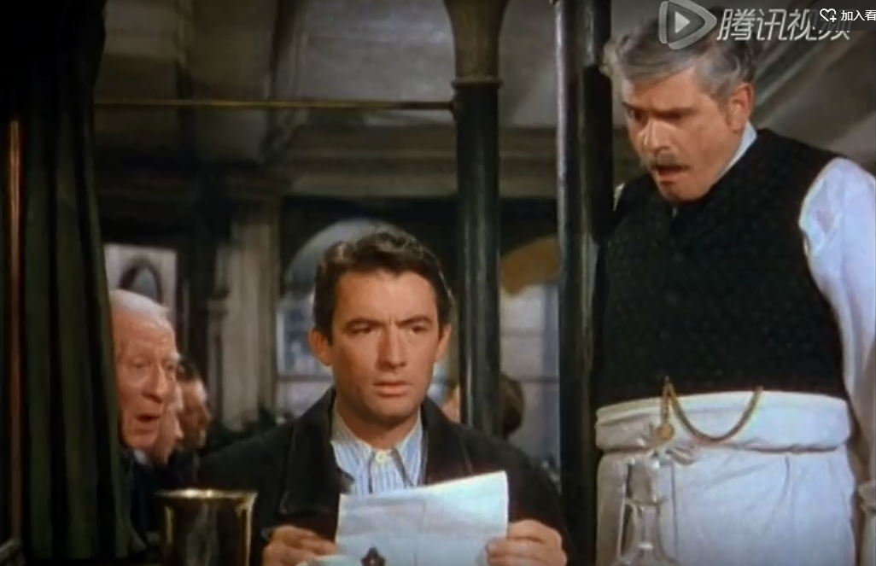
Two
Henry is surprised and the owner is shocked.

Slide 14
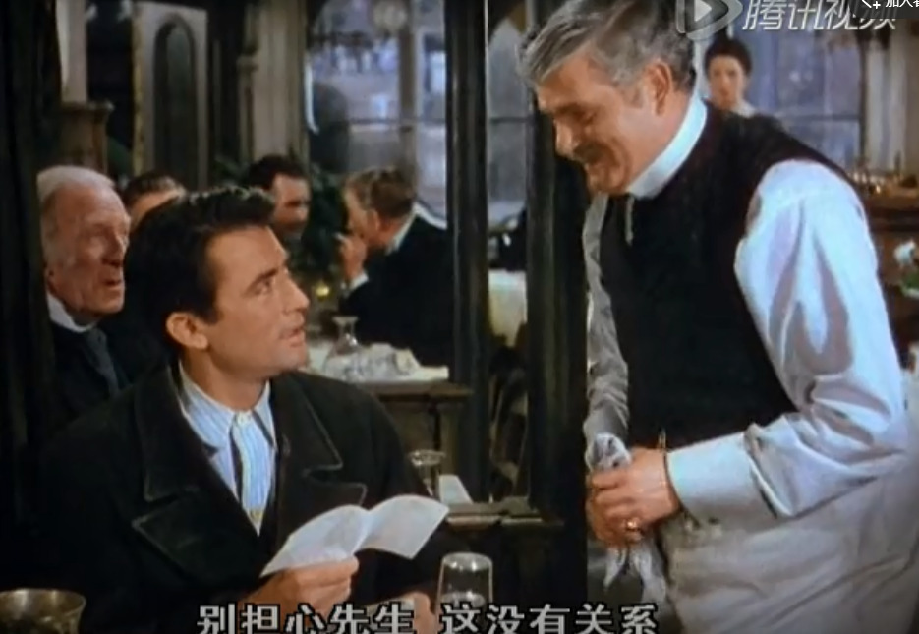
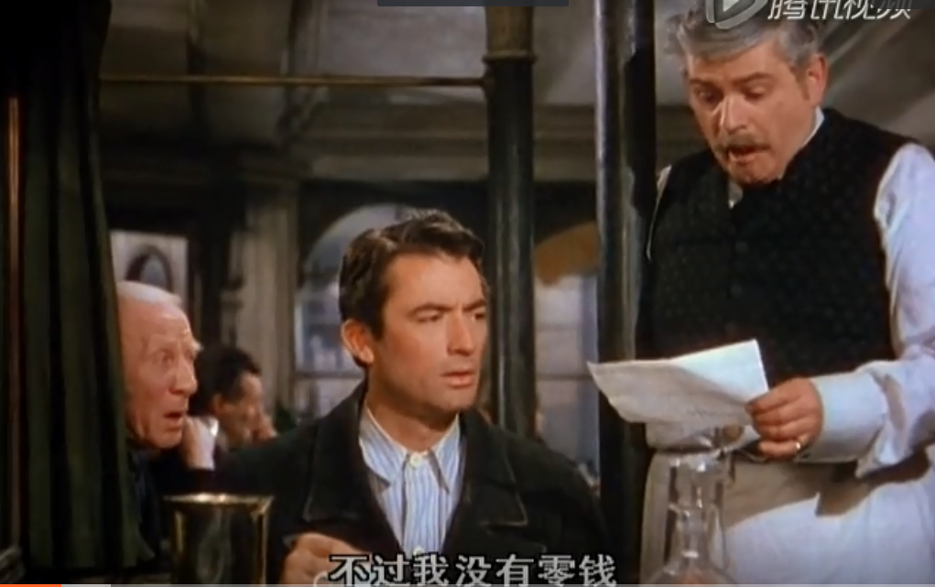
Henry asks the owner for change.
But the owner tells him not to worry about payment.

Slide 15
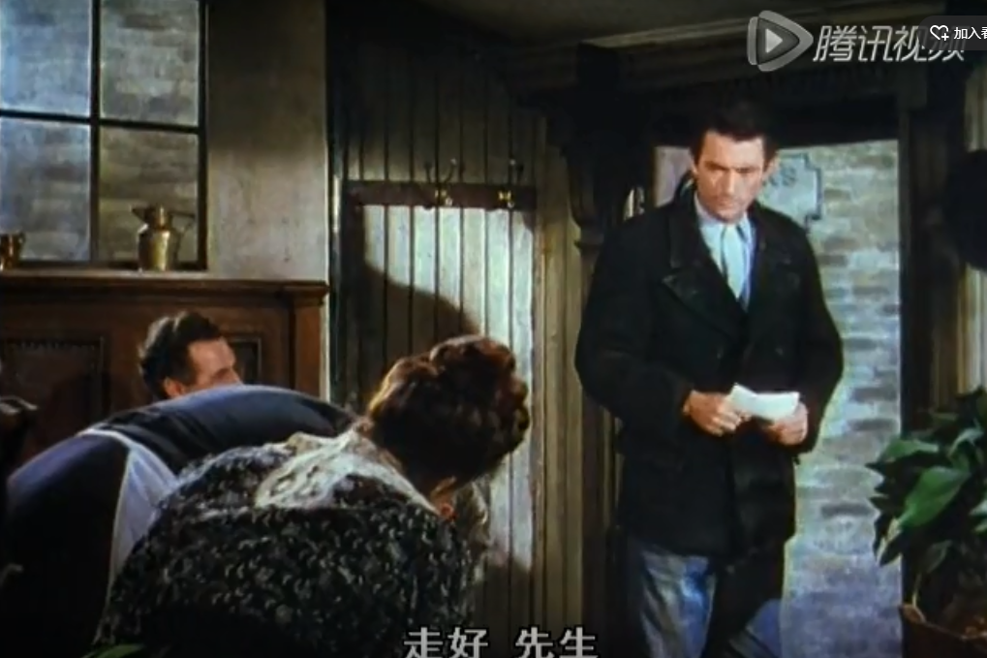
Two
As Henry leaves, the owner, the hostess and the waiter all bow to him.

Slide 16
The Million Pound Bank Note
To be continued…

