Slide 1
人教版高中英语必修3 Unit 4
Astronomy: the science of the stars
作者：黄楚彬
单位：华南师范大学外文学院

Slide 2
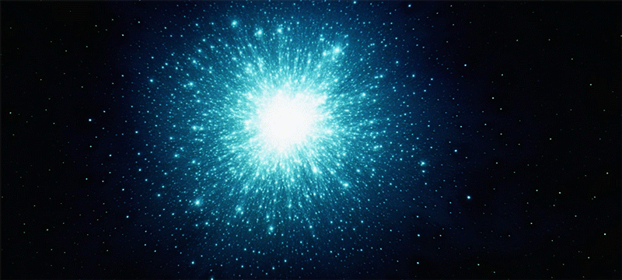
Notes:
gif

Slide 3
Cause you’re a sky
FULL
OF
STARS

Slide 4
content
MY HEART
Please add the title here
Please add the title here
GIVE YOU
I’M Gonna

Slide 5
CAUSE YOU’RE A SKY
FULL OF STARS

Slide 6
CAUSE YOU
LIGHT
UP
THE PATH

Slide 7
I DON’T
CARE
GO ON AND TEAR
IF
D O
ME APART
YOU

Slide 8
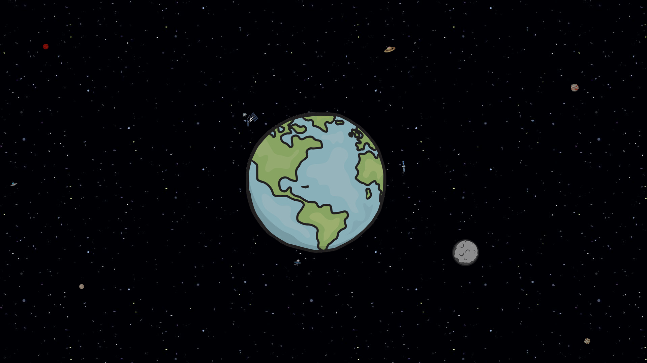
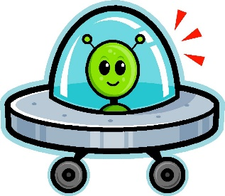
I THINK
CAUSE IN A SKY
I SAW
YOU
CAUSE IN A SKY FULL OF STARS

Slide 9
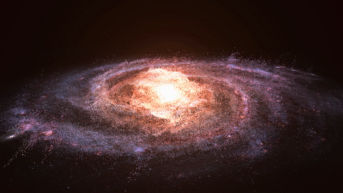

Slide 10
Notes:
gif

Slide 12
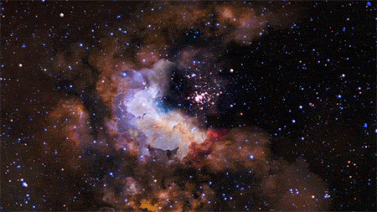

Slide 13
CAUSE YOU’RE A SKY
FULL
STARS
OF
CAUSE YOU’RE A SKY

Slide 14
ARMS
IN
I
WANT
TO
DIE
YOUR

Slide 15
添加ＬＯＧＯ
CAUSE
THE
MORE
GETS
DARK
GET
LIGHTER
YOU
IT

Slide 16
添加ＬＯＧＯ
HEART
MY
I’M
GOING TO
GIVE
YOU

Slide 17
I DON’T CARE
GO ON AND TEAR
DO
ME APART
IF YOU

Slide 18
FULL OF STARS
CAUSE IN A SKY
CAUSE IN A SKY

Slide 19
I
YOU
I
SEE
THINK

Slide 20
I
SEE
YOU
THINK
I

Slide 21
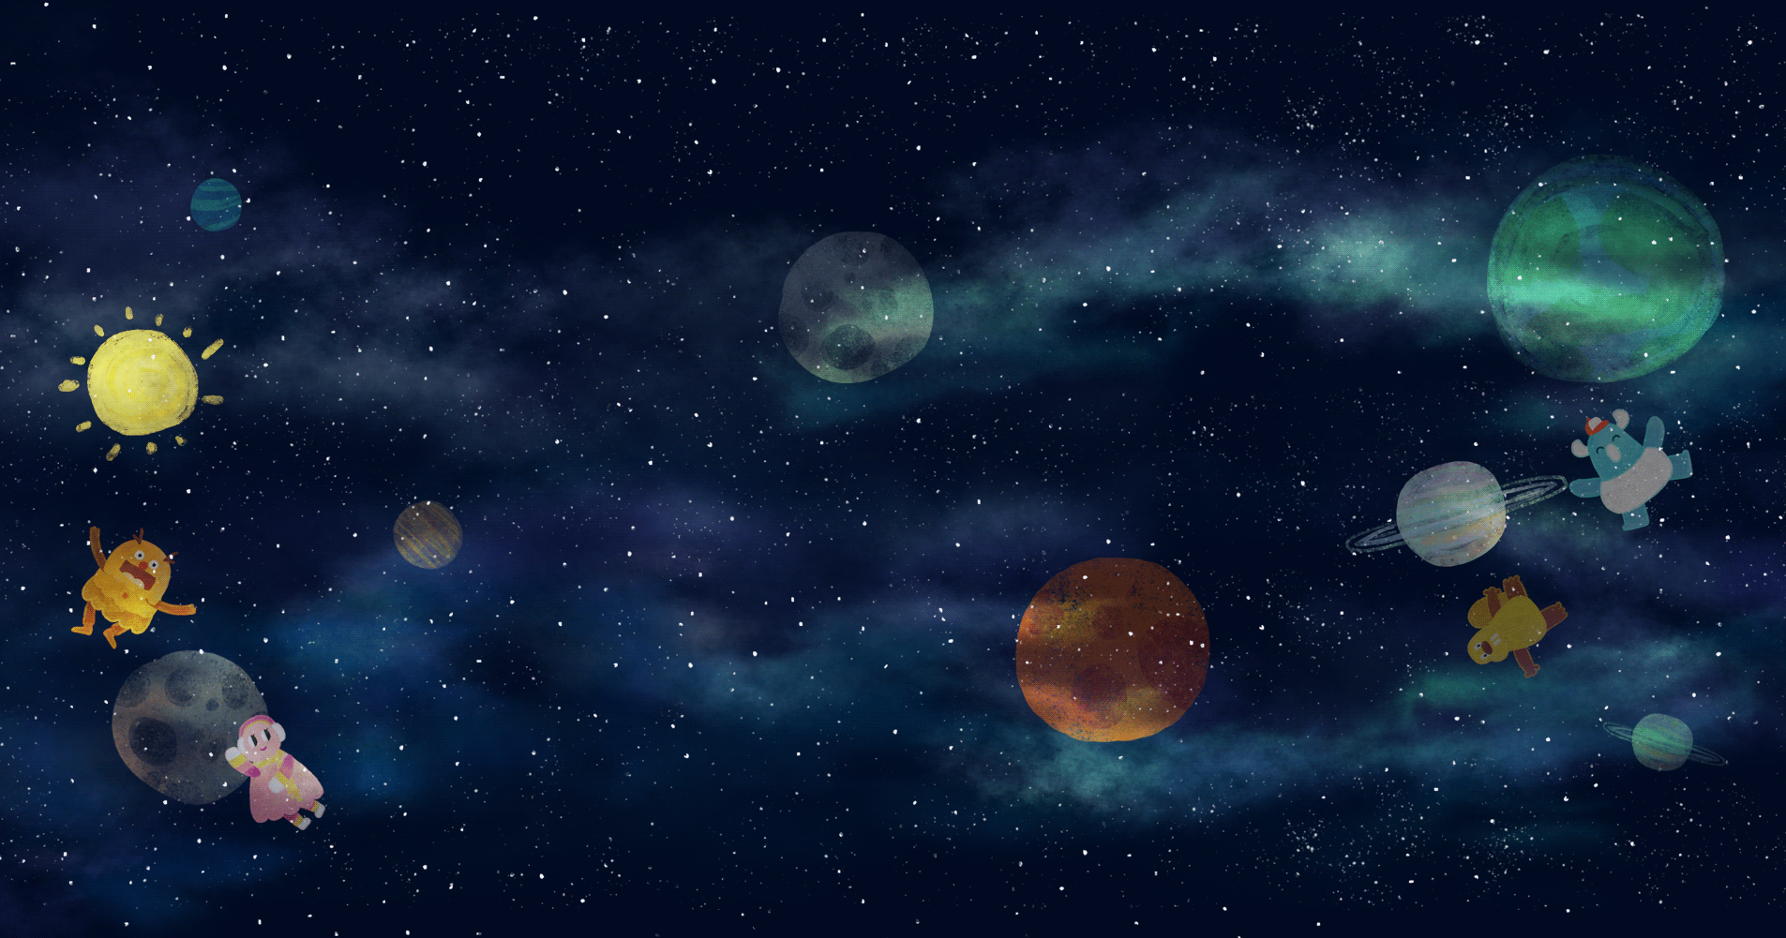
Thanks

