Slide 1


Watcher Of The Skies
人教版/高中英语M3U4
Astronomy: the science of the stars
林思彤
华南师范大学外文学院

Slide 2
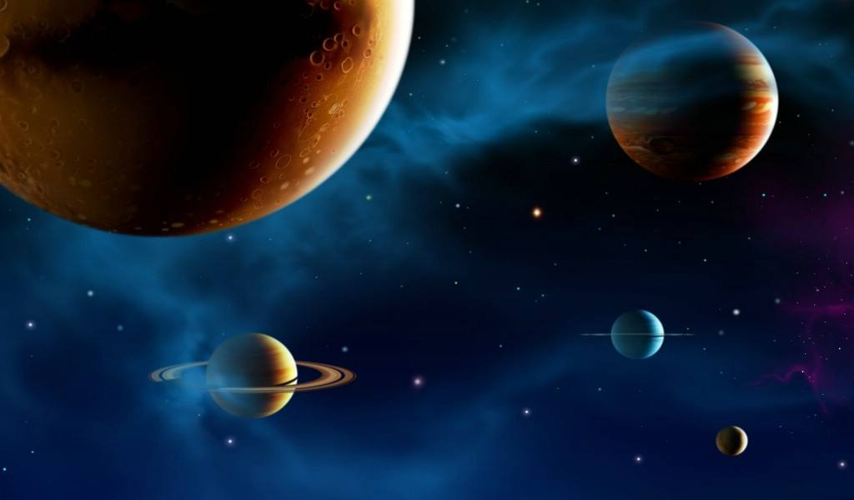
Creatures shaped this planets soil

Slide 3
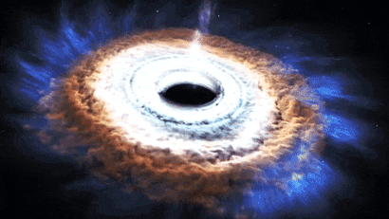
Now their reign has come to an end

Slide 4
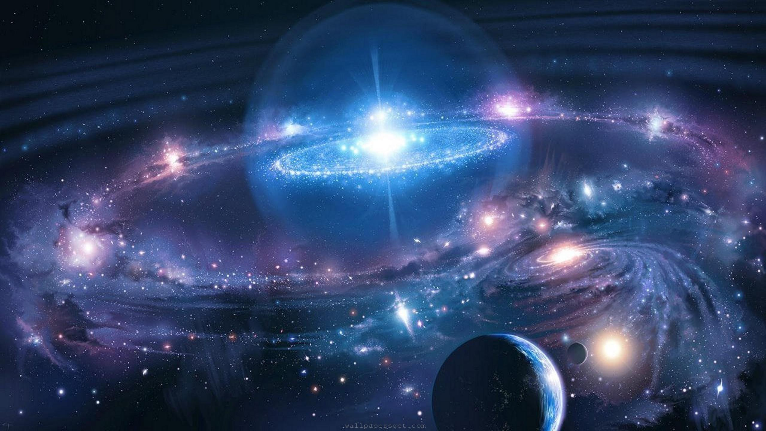
Has life again destroyed life

Slide 5
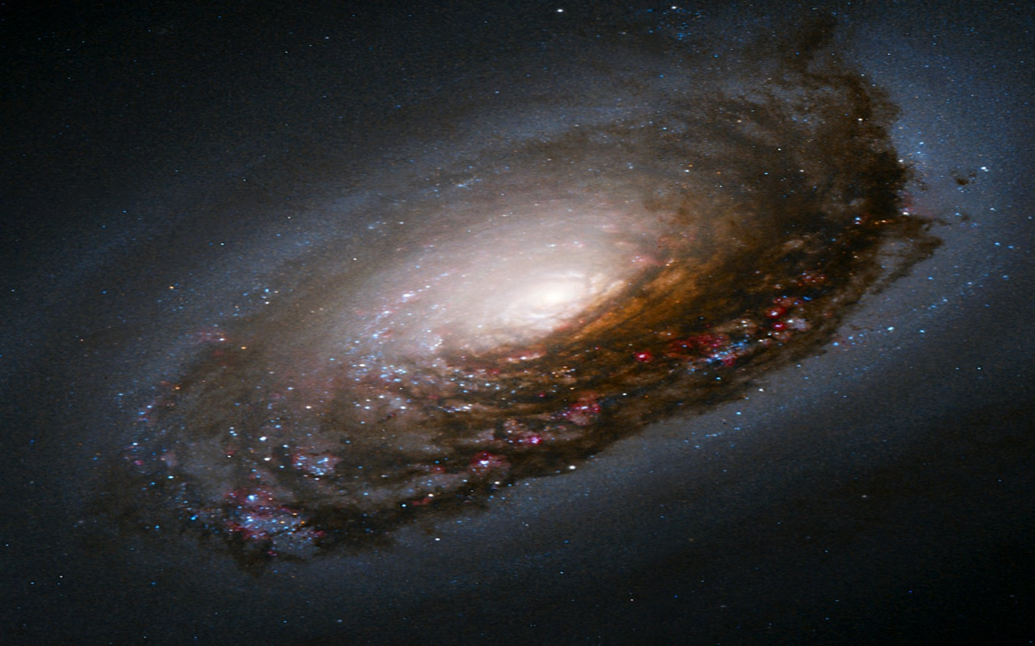
Do they play elsewhere do they know

Slide 6
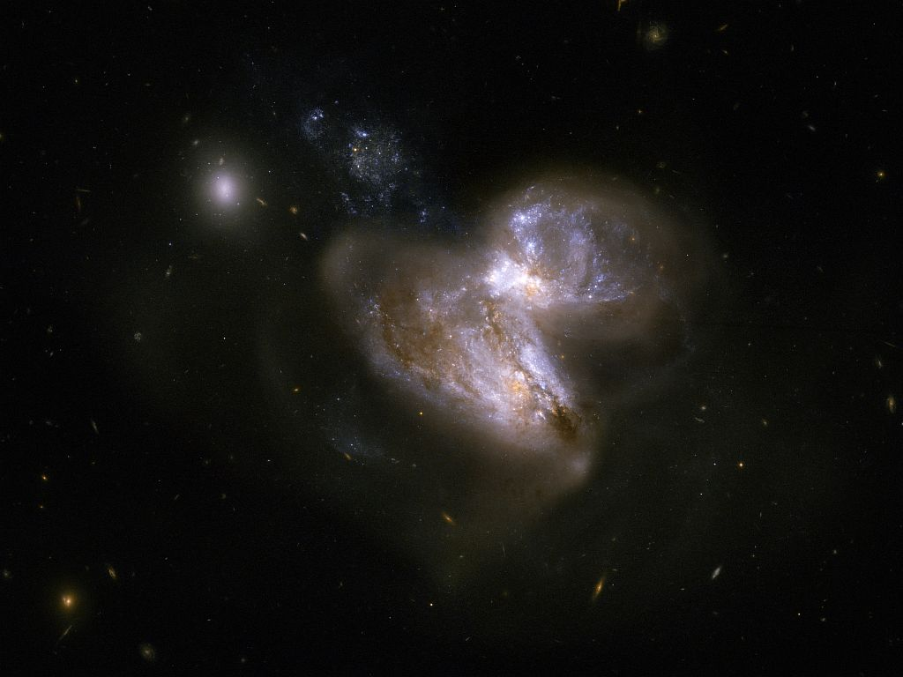
More than their childhood games

Slide 7
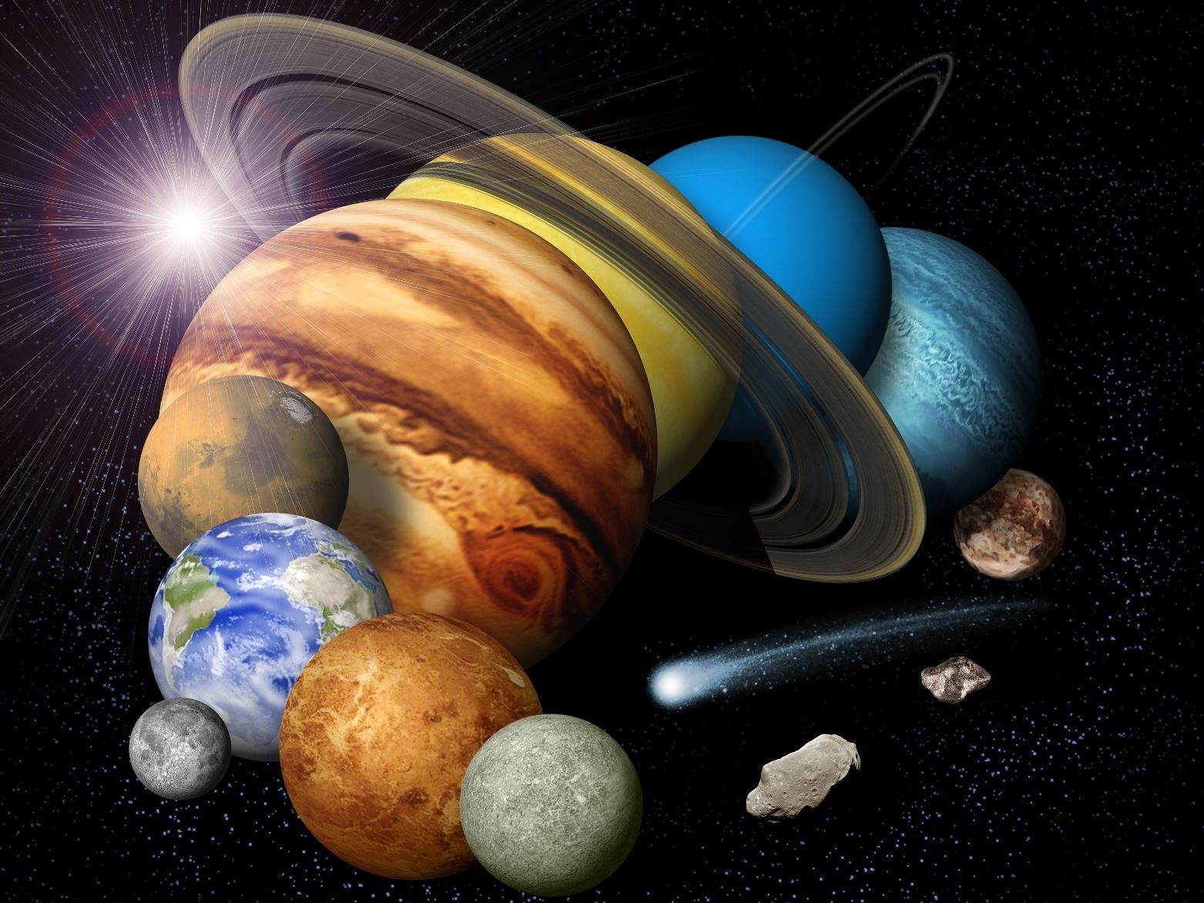
Maybe the lizards shed its tail

Slide 8
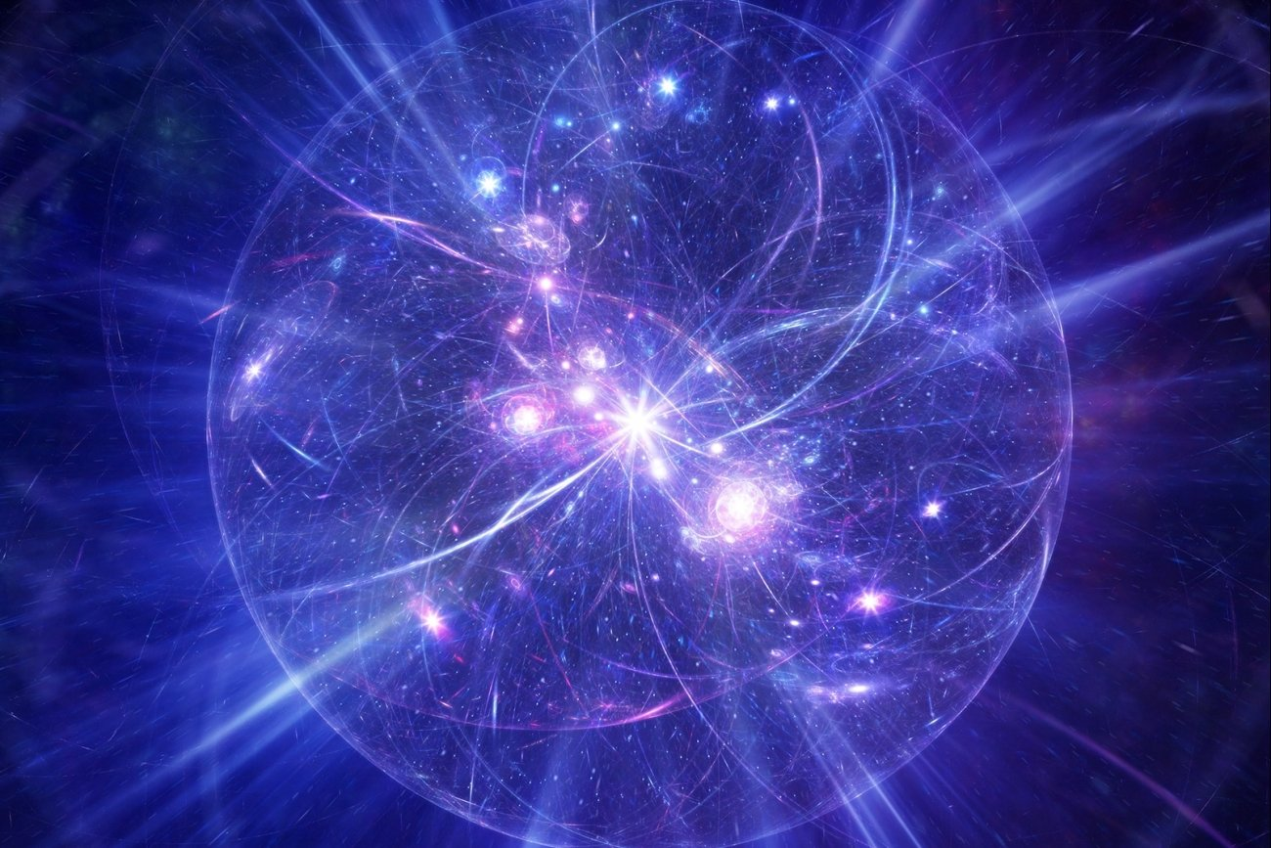
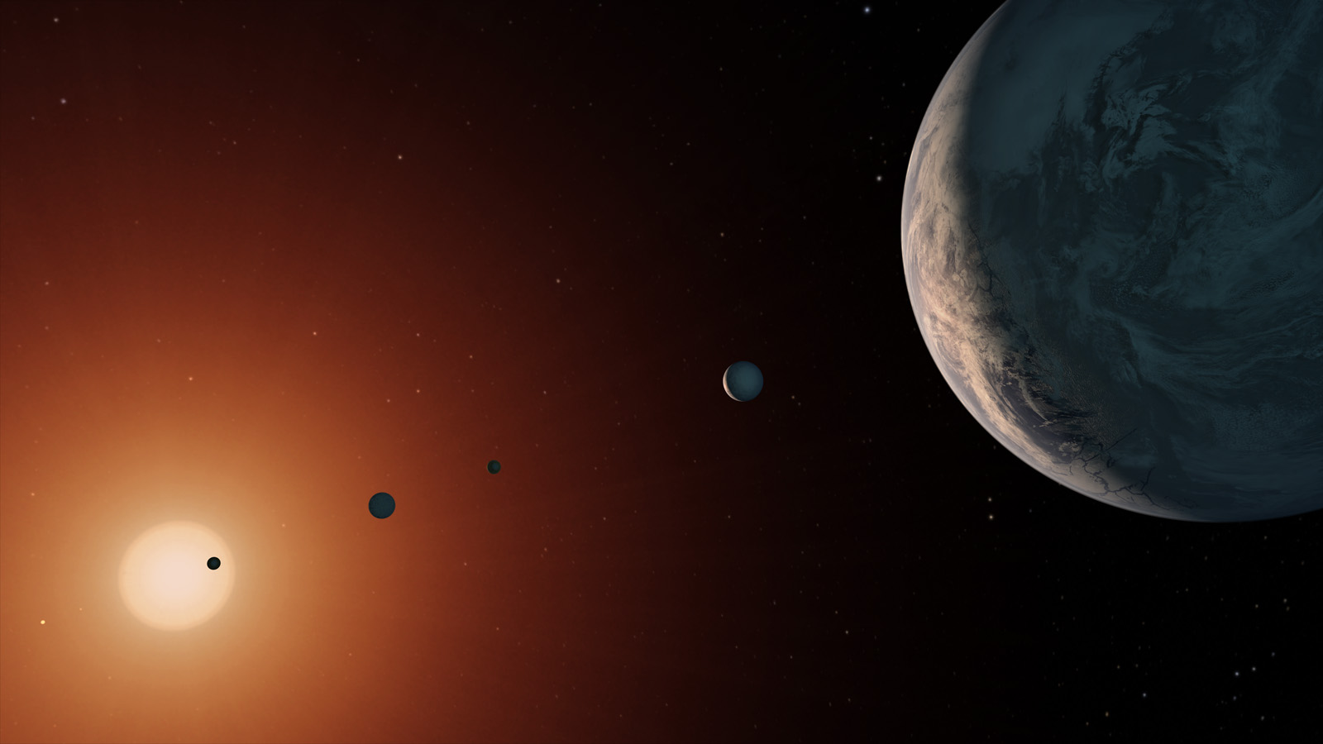
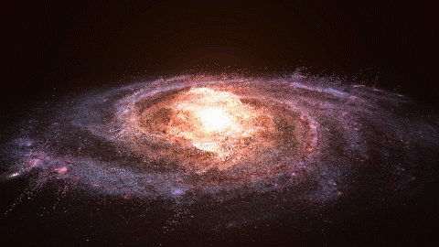
This is the end of mans long union with earth

Slide 9
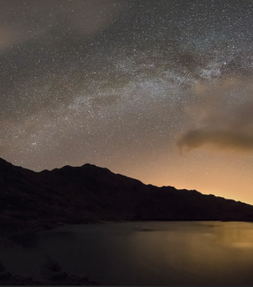
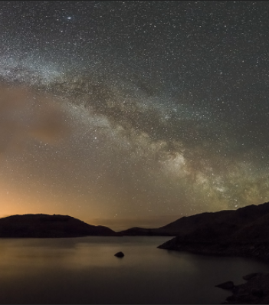
Judge not this race by empty remains

Slide 10
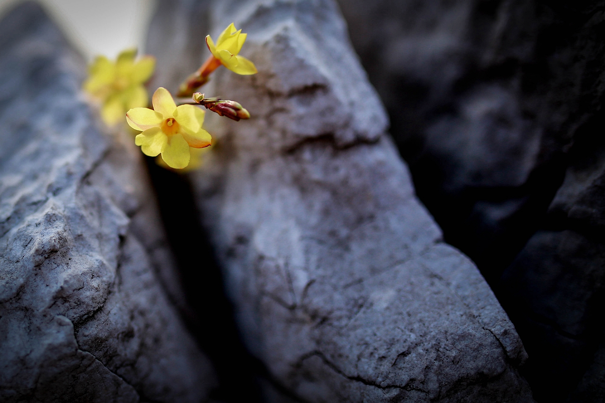
Do you judge God by his creatures when they are dead

Slide 11
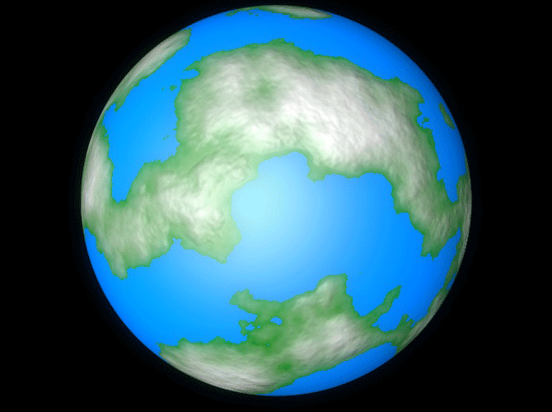
For now
the lizards shed its tail

Slide 12
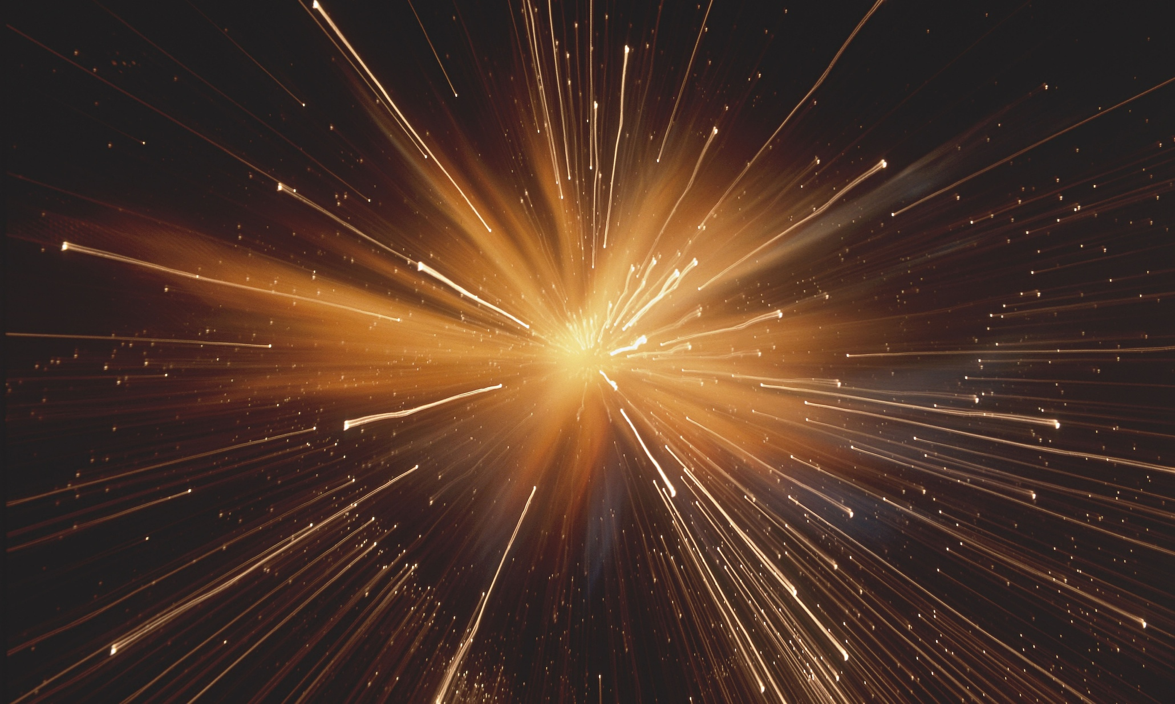
This is the end of mans long union with earth

Slide 13
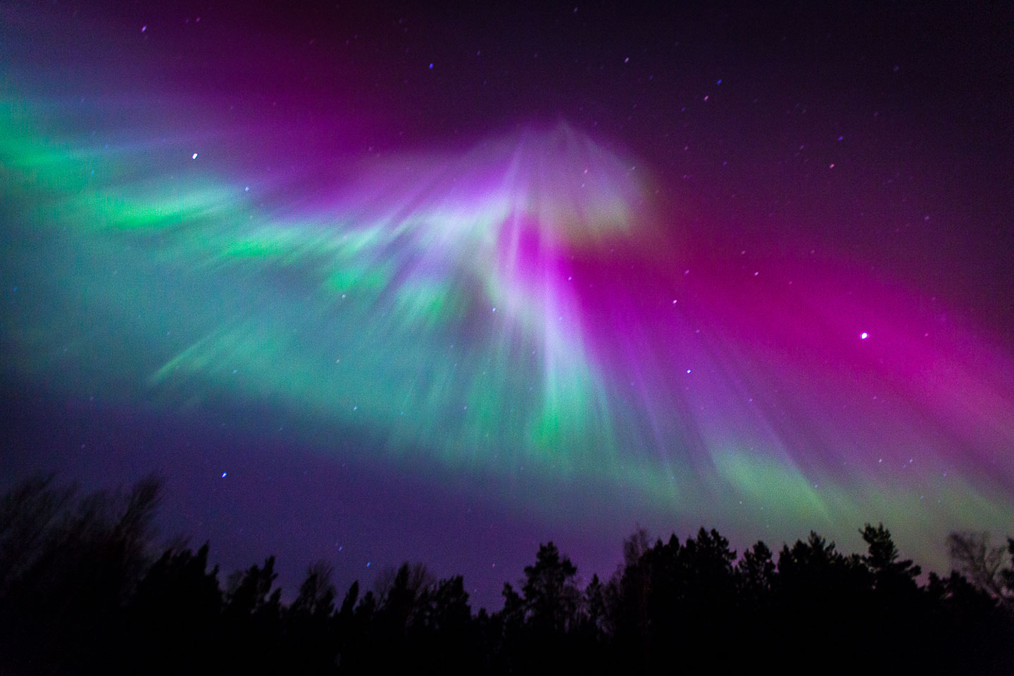
From life alone to life as one

Slide 14
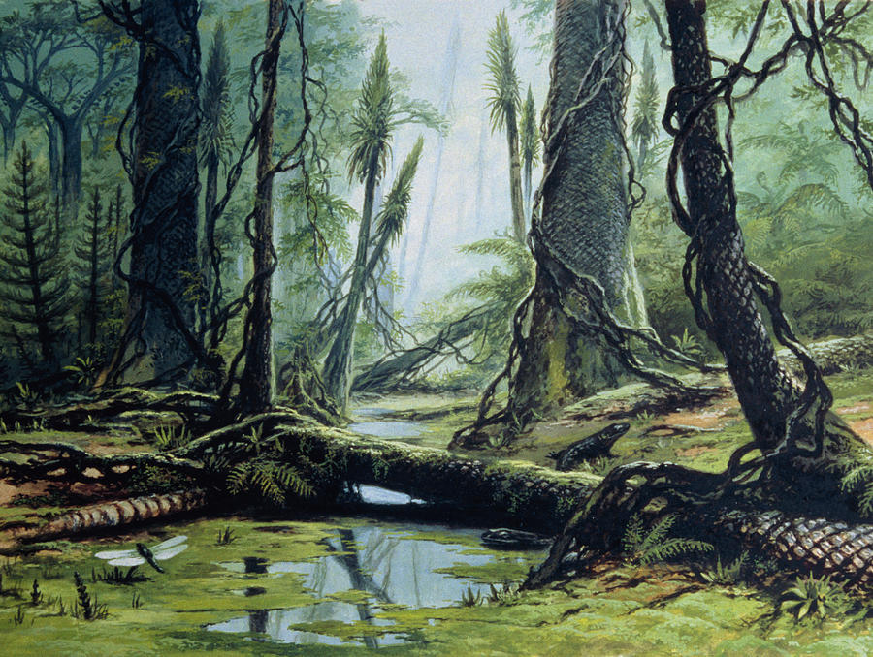
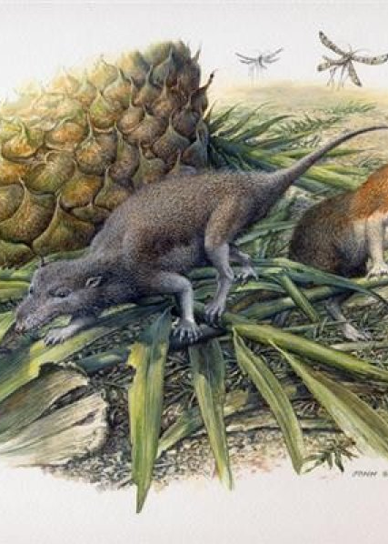
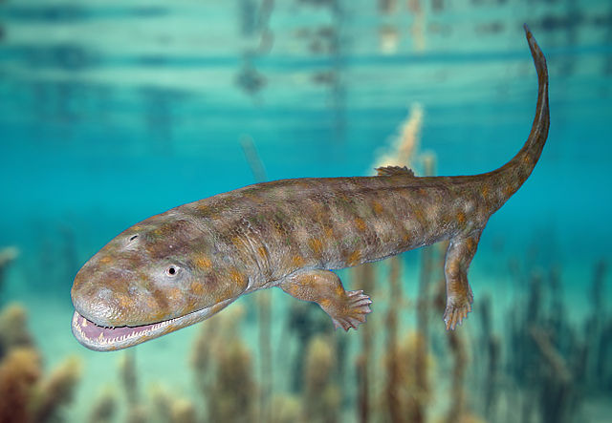
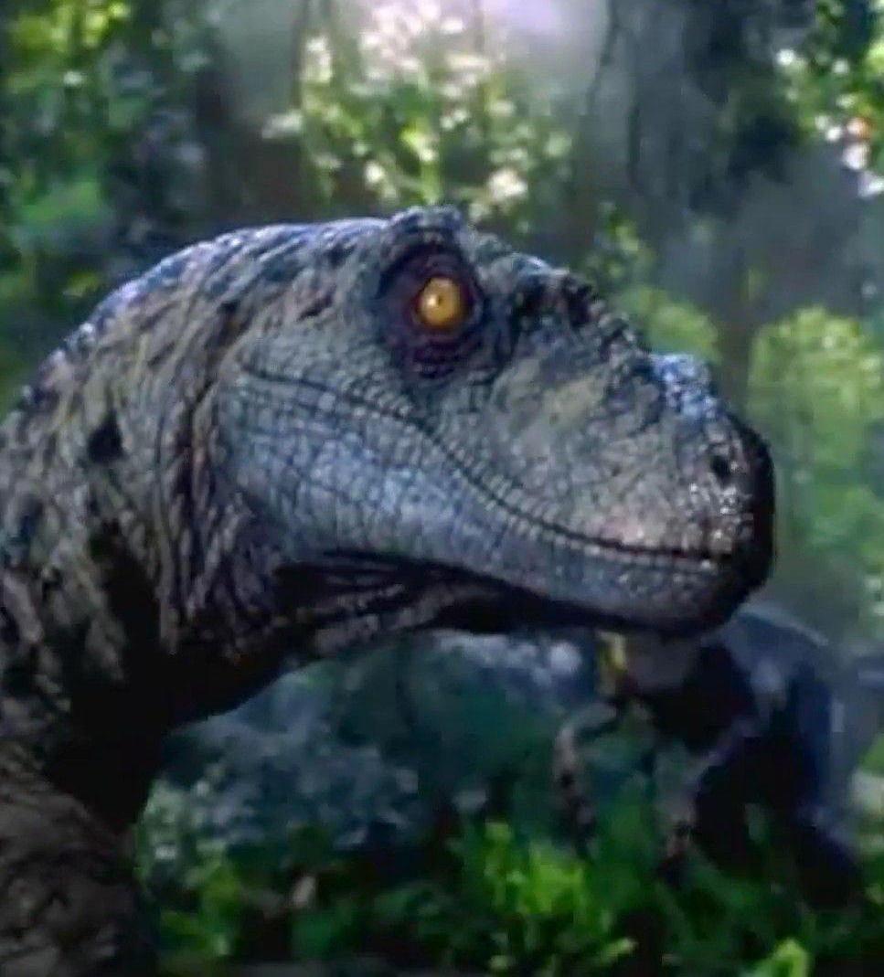
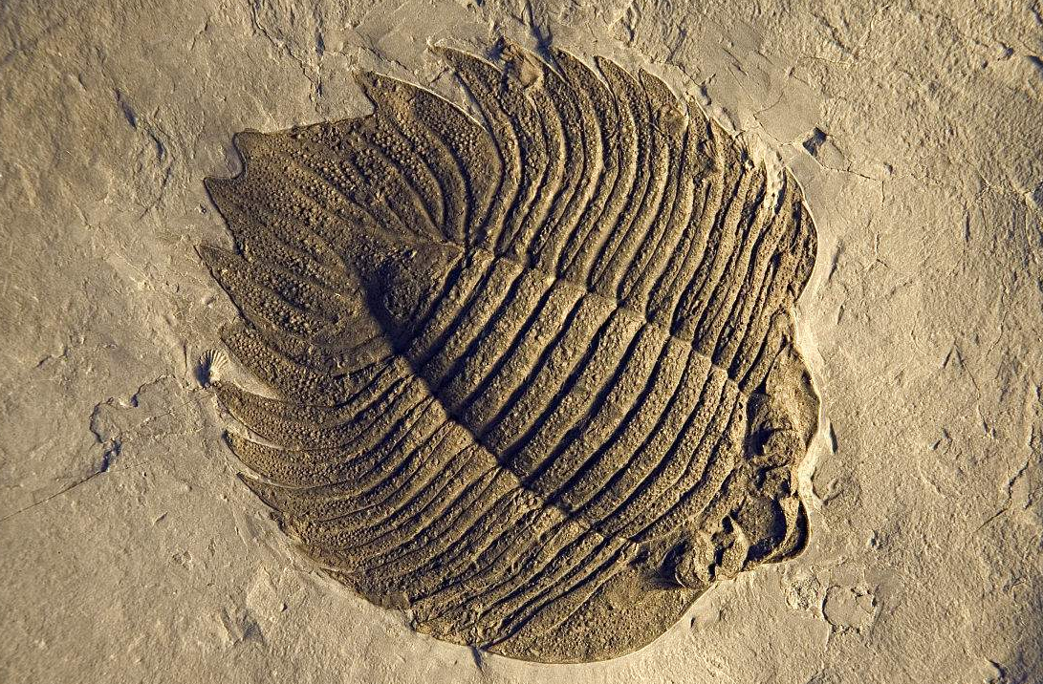
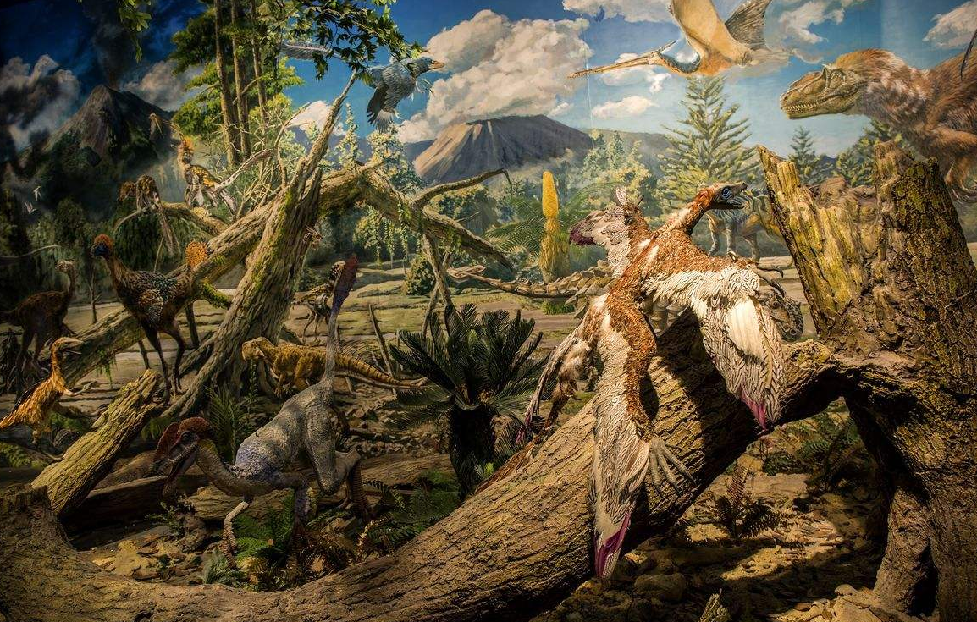
Think not
now your journeys done
For though your ship be sturdy

Slide 15
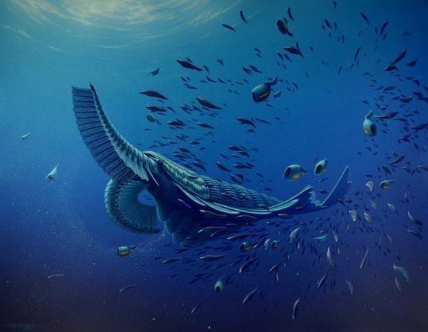
No
Mercy has
The
sea

Slide 16
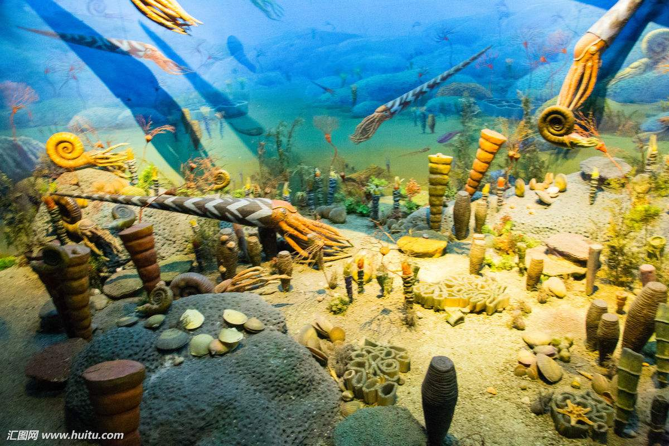
Will you survive on the ocean of being

Slide 17
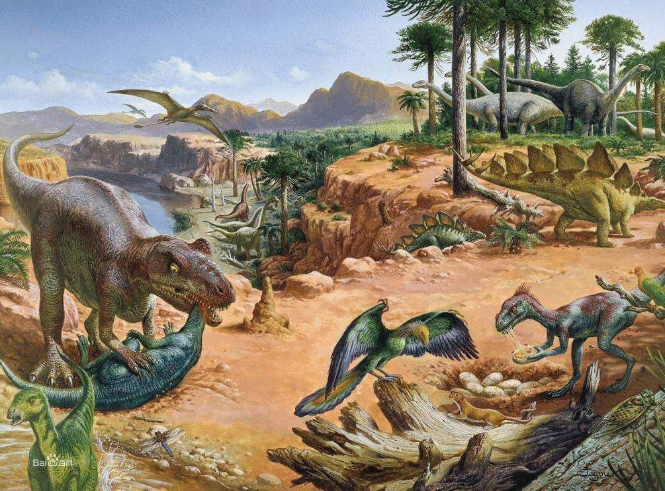
Come ancient children hear what I say

Slide 18
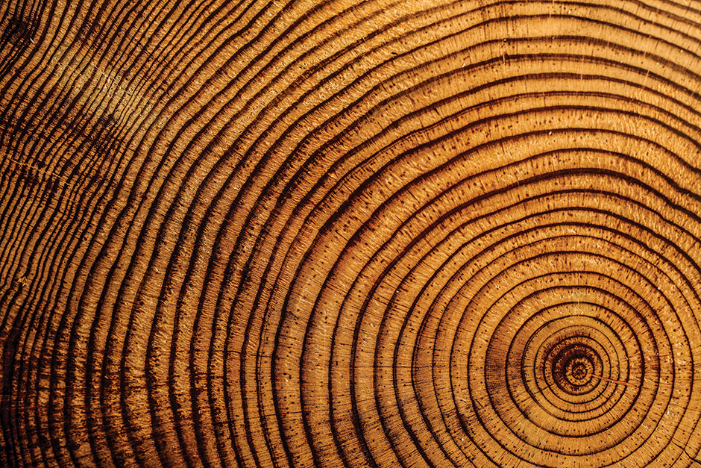
This is my parting council for you on your way

Slide 19
Thanks
0101011100101010101000101010001110101010010110101010111001011100010100101010101110010101010100010
010101110010101010100010101000111010101001011010101011100101110001010010101010111001010101010001010100011
0101011100101010101000101010001110101010010110101010111001011100010100101010101110010101010100010
010101110010101010100010101000111010101001011010101011100101110001010010101010111001010101010001010100011
0101011100101010101000101010001110101010010110101010111001011100010100101010101110010101010100010
010101110010101010100010101000111010101001011010101011100101110001010010101010111001010101010001010100011

