Slide 1
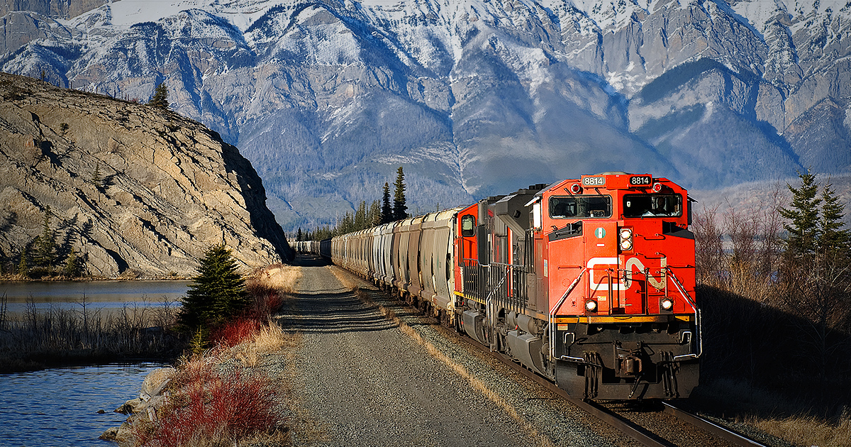
PEP, M3U5, Canada—“The True North”
Song: Canadian Railroad Trilogy
Singer：Gordon Lightfoot
Editor: Tina 李婕
单位：华南师范大学外文学院

Slide 2
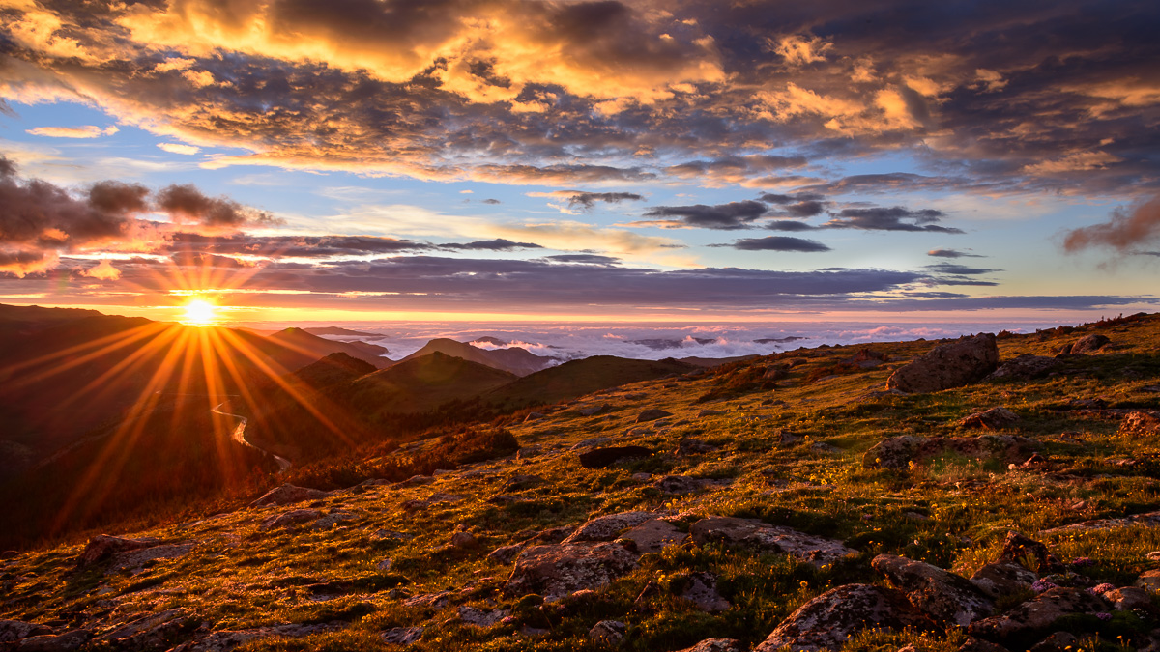
Behind the blue Rockies the sun is declining

Slide 3
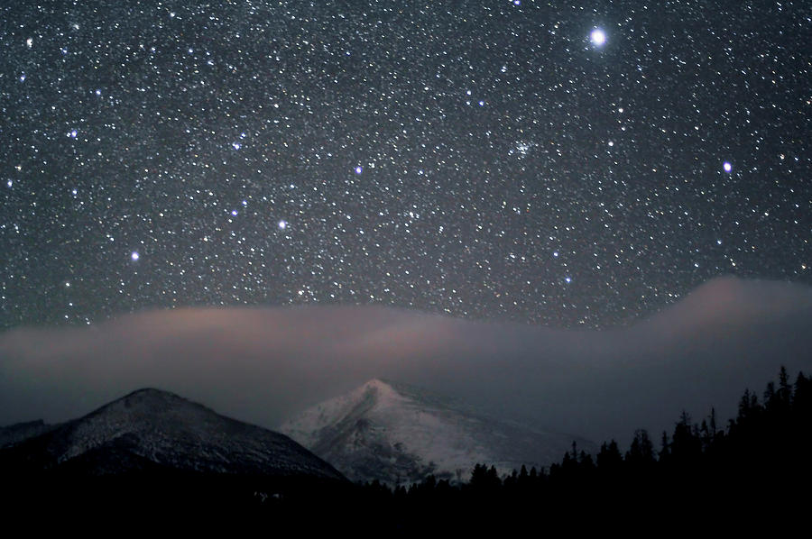
The stars, they come stealing at the close of the day

Slide 4
Across the wide prairie our loved ones lie sleeping

Slide 5
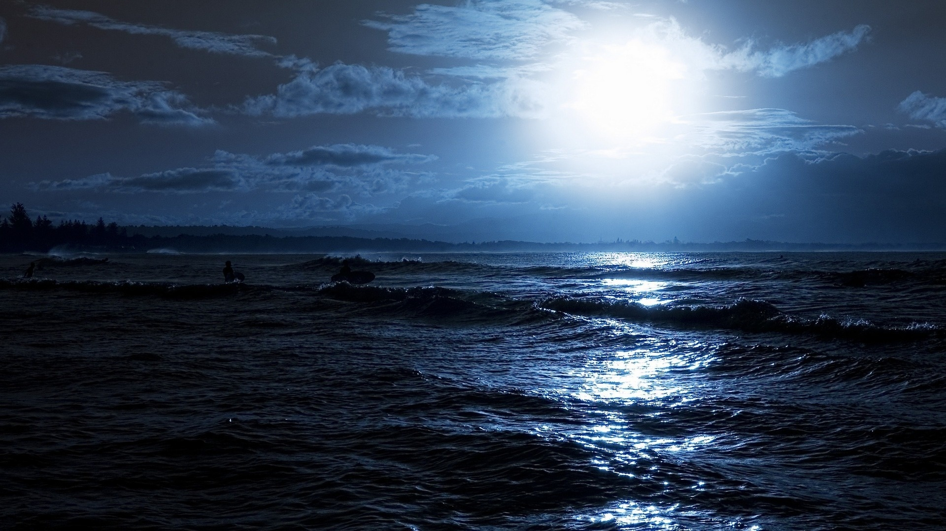
Beyond the dark oceans in a place far away

Slide 6
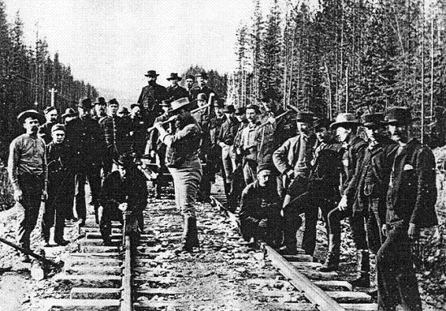
We are the navies who work upon the railway
Swinging our hammers in the bright blazing sun

Slide 7
Living on stew and drinking bad whiskey
Bending our old backs till the long days are done

Slide 8
We are the navies who work upon the railway
Swinging our hammers in the bright blazing sun

Slide 9
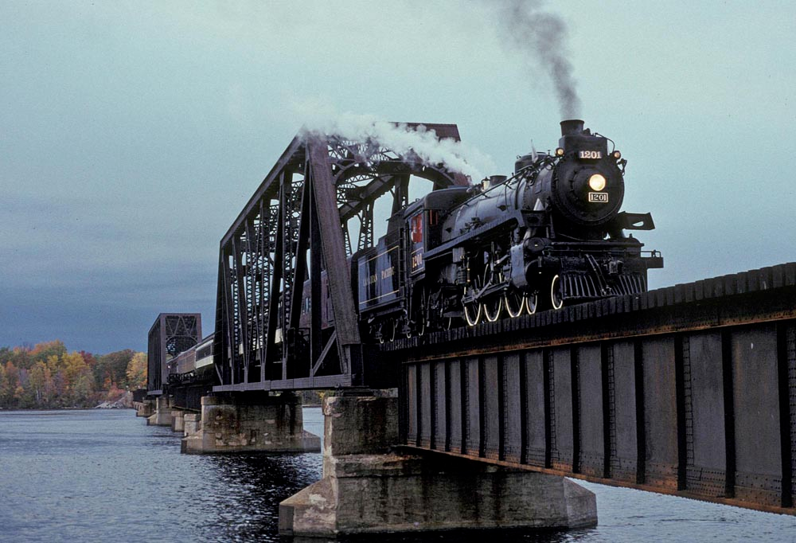
Laying down track and building the bridges
Bending our old backs till the railroad is done

Slide 10
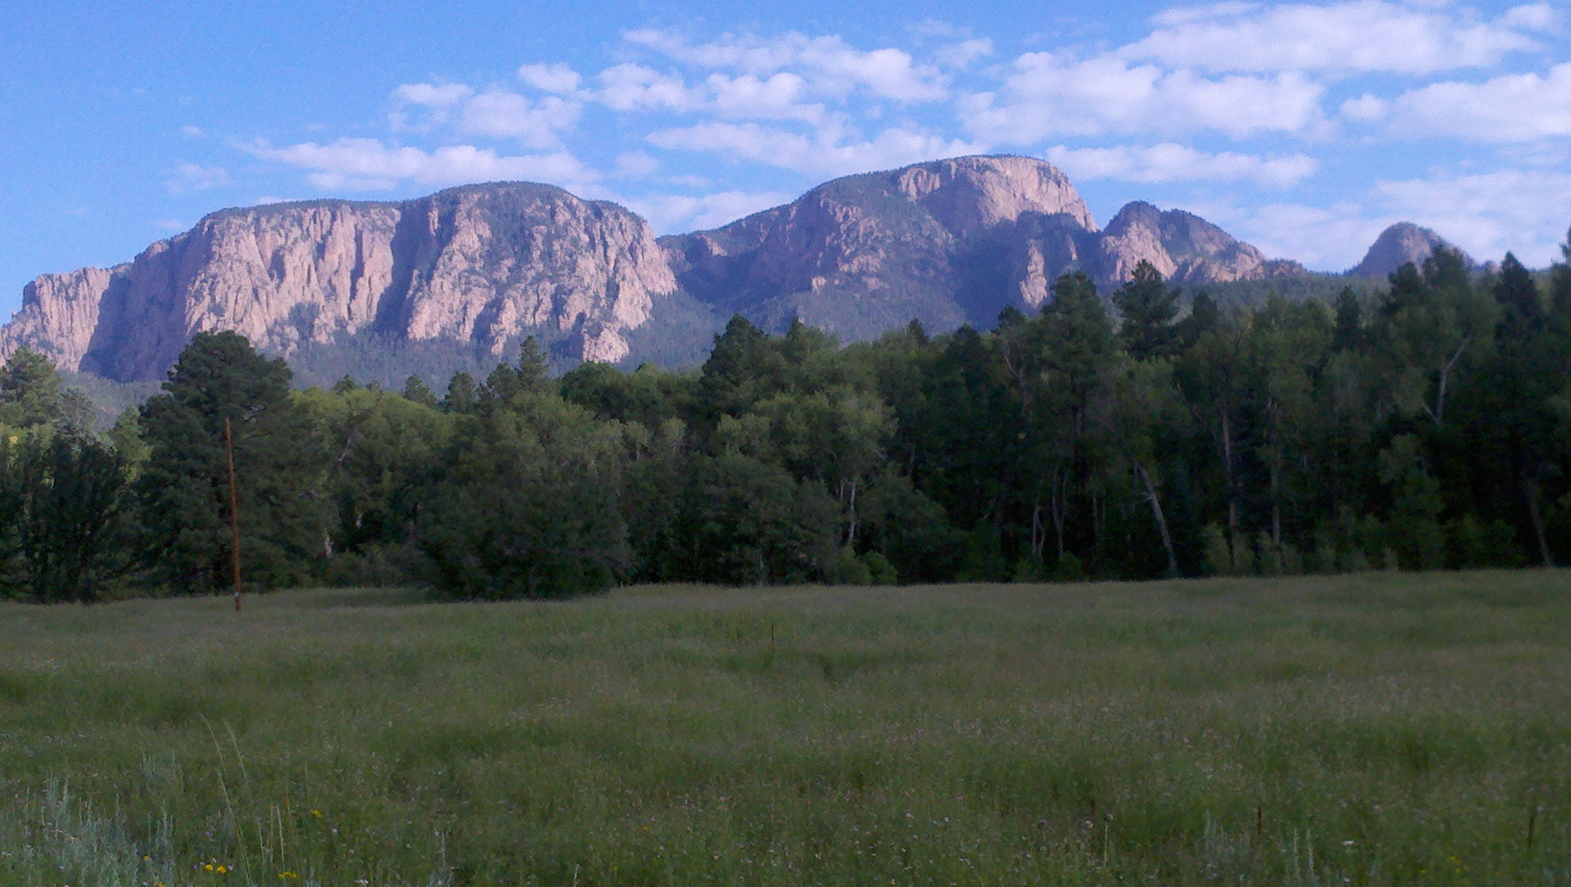
So over the mountains and over the plains

Slide 11
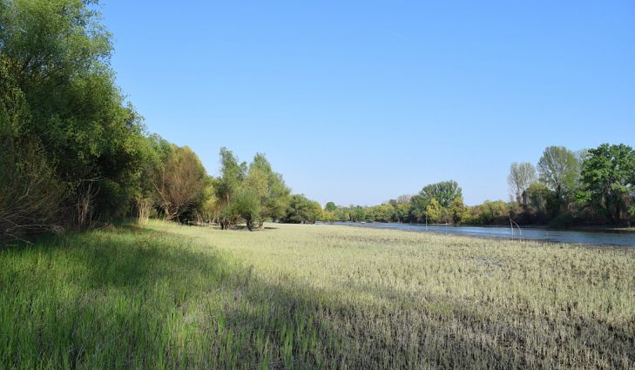
Into the muskeg and into the rain

Slide 12
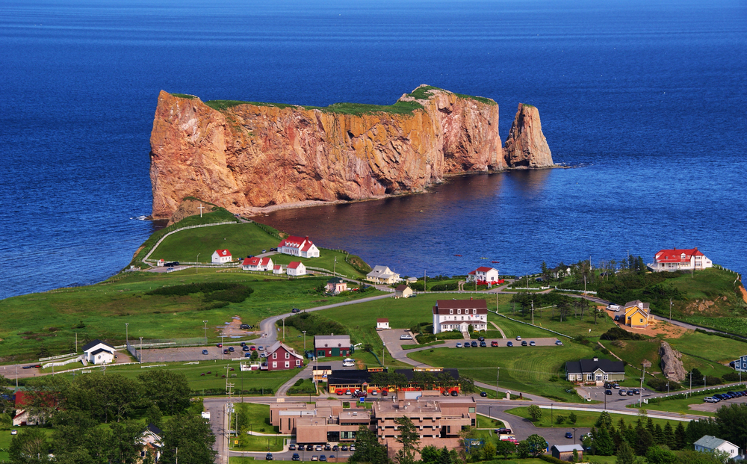
Up the St. Lawrence all the way to Gaspe

Slide 13
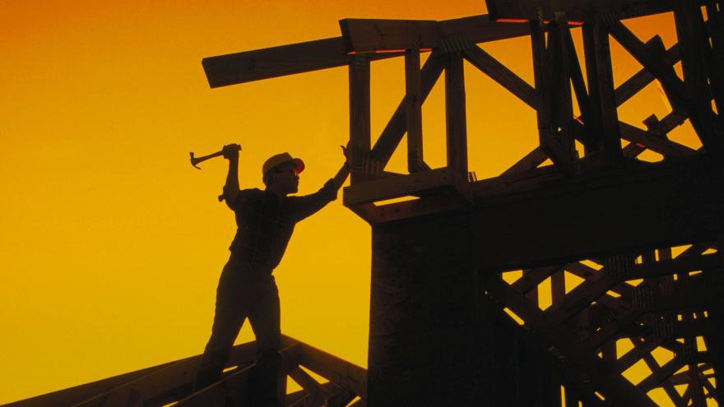
Swinging our hammers and drawing our pay

Slide 14
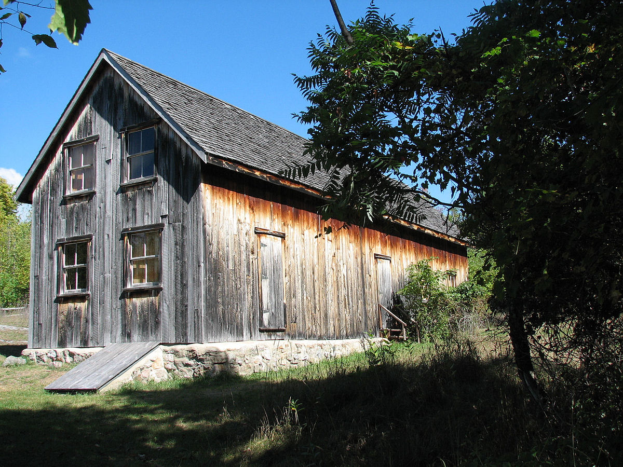
Driving them in and tying them down
Away to the bunkhouse and into the town

Slide 15
A dollar a day and a place for my head
A drink to the living and a toast to the dead

Slide 16
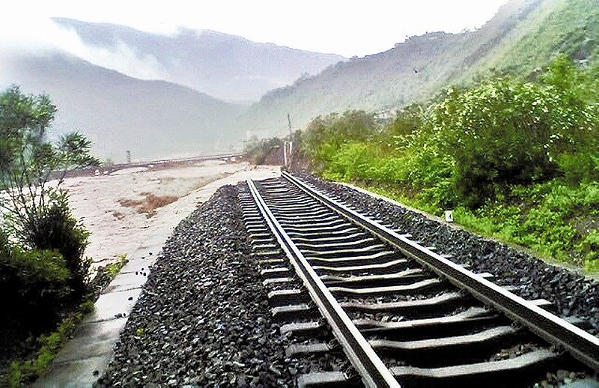
Oh the song of the future has been sung
All the battles have been won

Slide 17
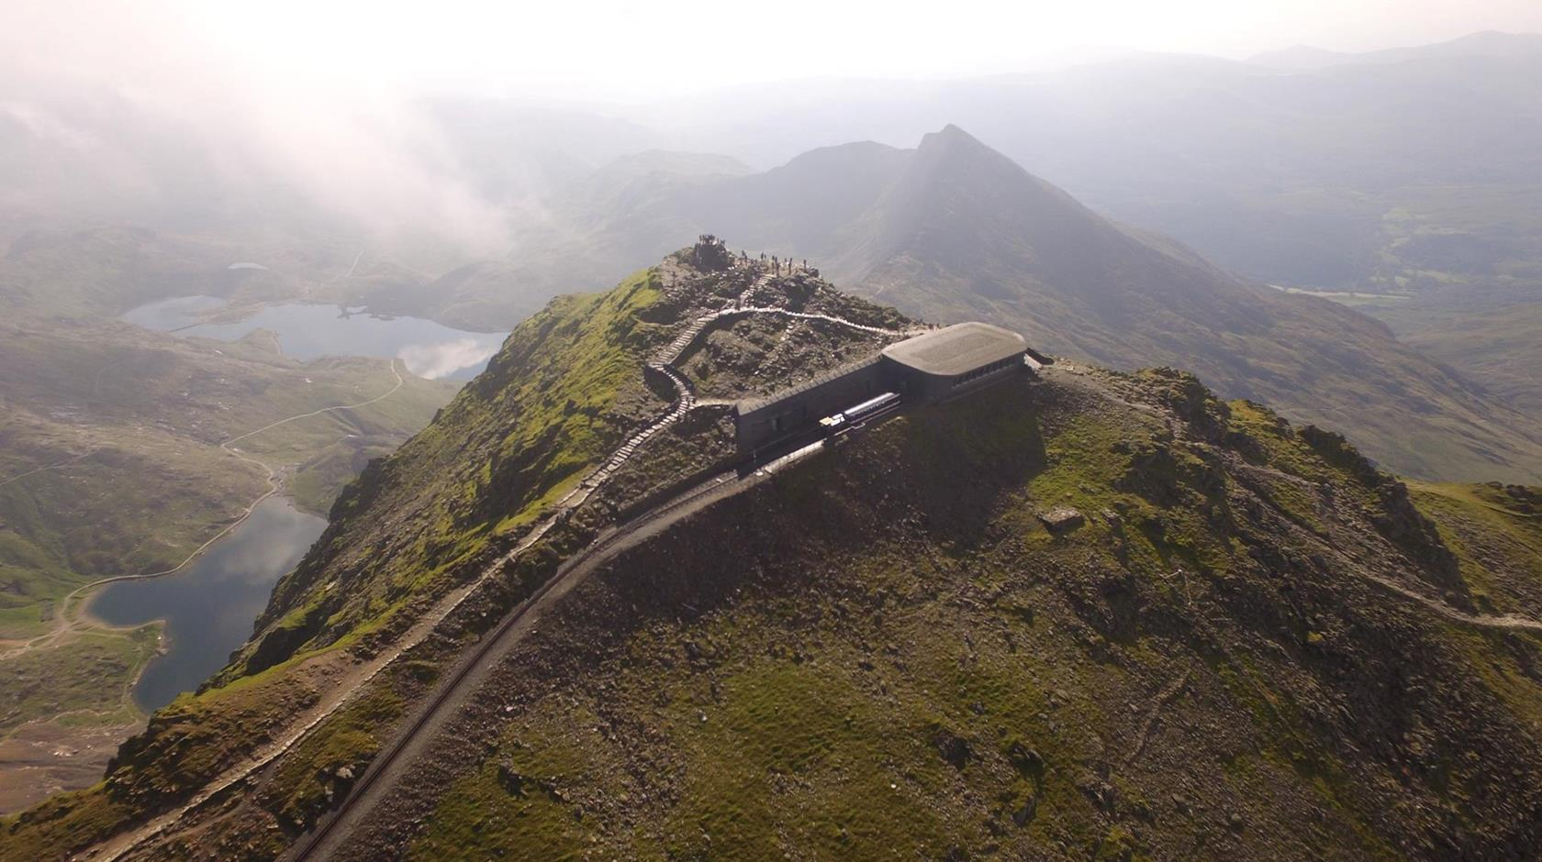
Over the mountain tops we stand
All the world at our command
We have opened up the soil
With our teardrops and our toil

Slide 18
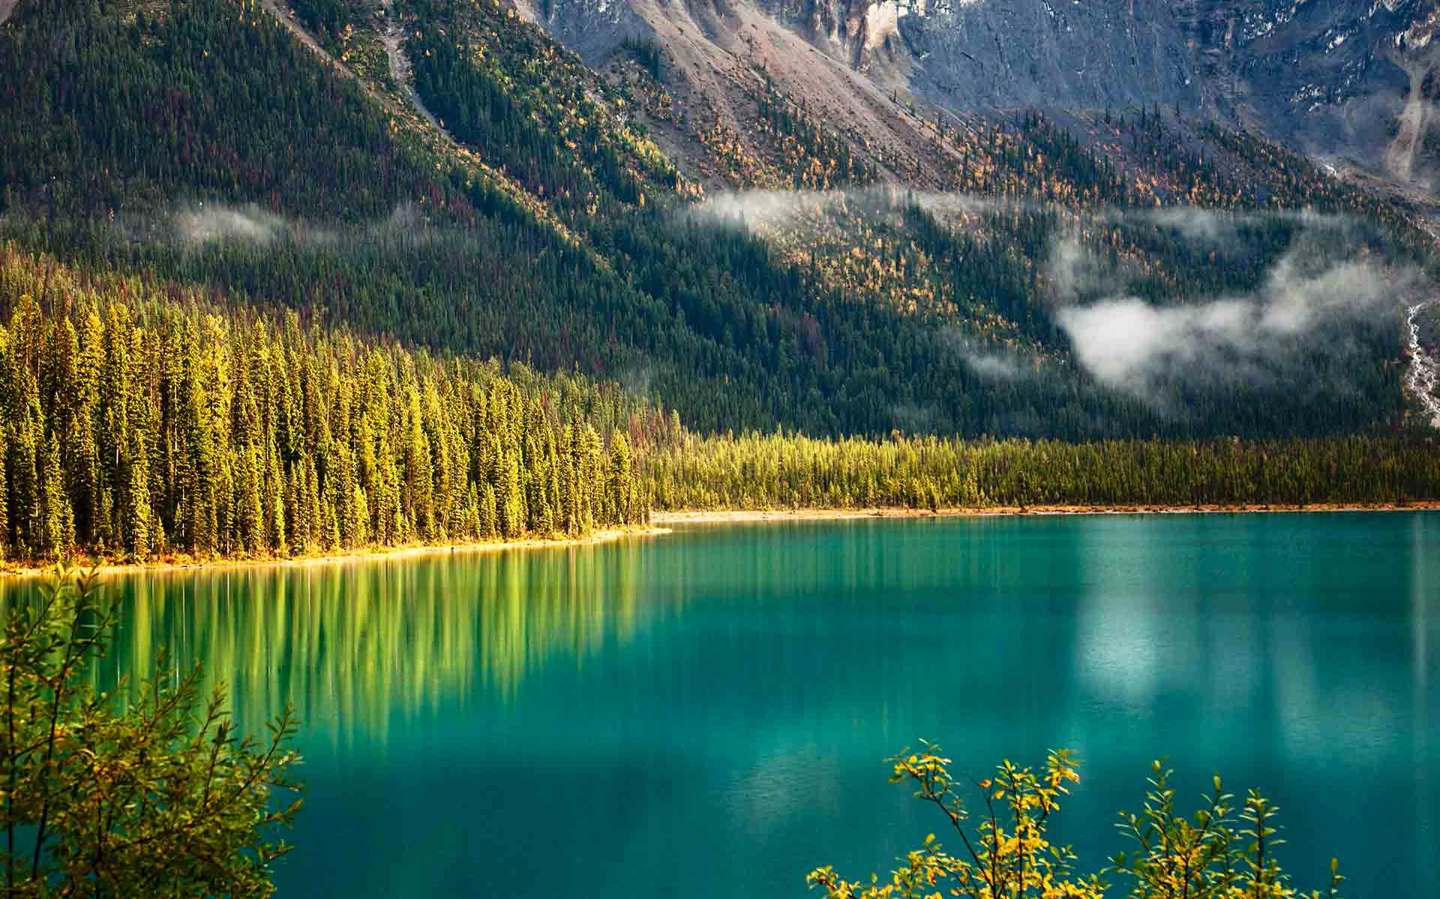
For there was a time in this fair land when the railroad did not run
When the wild majestic mountains stood alone against the sun
Long before the white man and long before the wheel

Slide 19
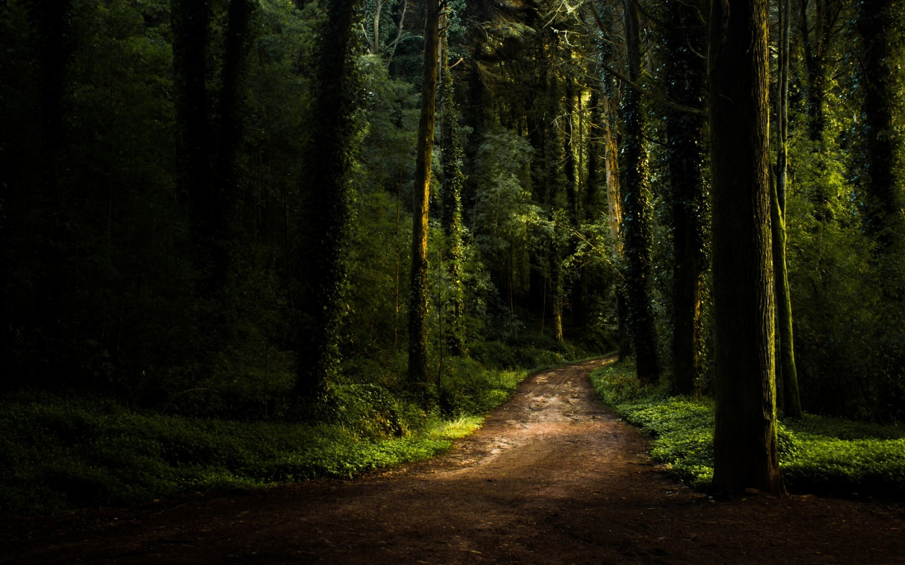
When the green dark forest was too silent to be real
When the green dark forest was too silent to be real

Slide 20
And many are the dead men too silent to be real

Slide 21
Thank you

