Slide 1
Textbook: 人教版高中英语必修三
Unit 5 Canada -- “The True North”
作者：潘纯
单位：华南师范大学外文学院

Slide 2
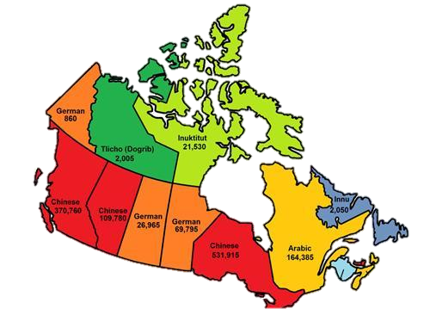

Slide 3
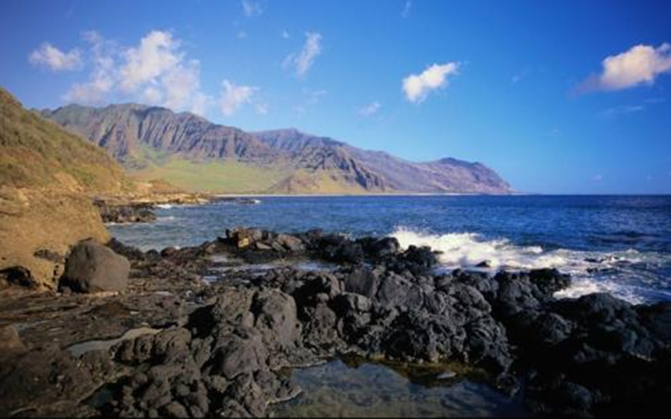
I have felt the wind upon my face
On this Atlantic shore

Slide 4
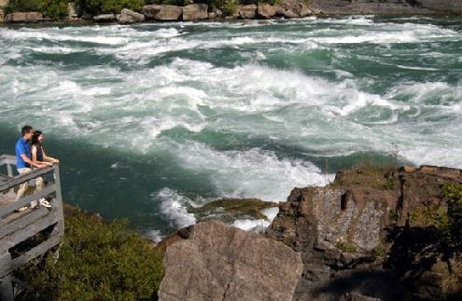
And in the West I've stood and watched
The noble eagles soar

Slide 5
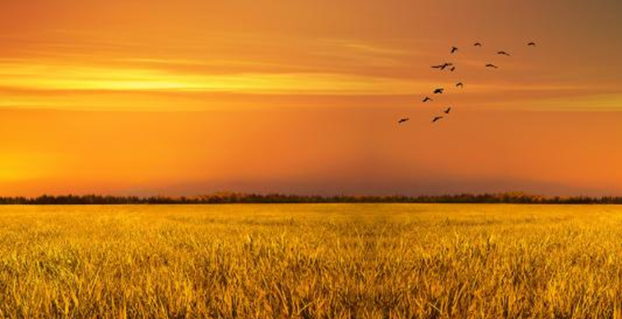
And I have seen the fields of gold

Slide 6
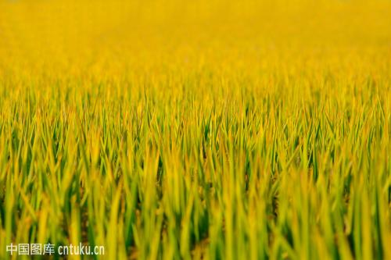
And green and yellow too

Slide 7
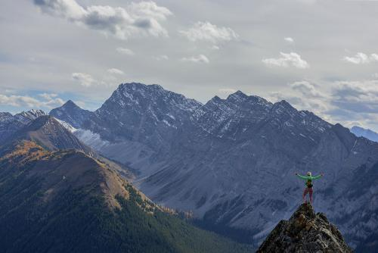
And on the majesty of mountains

Slide 8
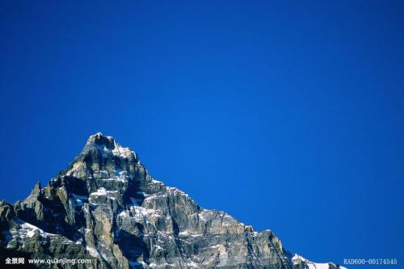
Touching skies of blue

Slide 9
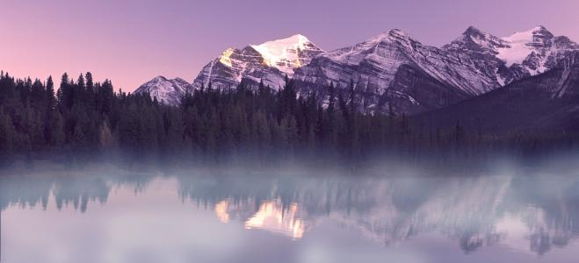
And my heart's overwhelmed

Slide 10
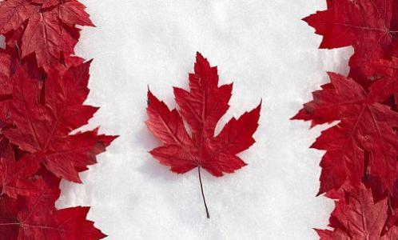
For this nation that I love

Slide 11
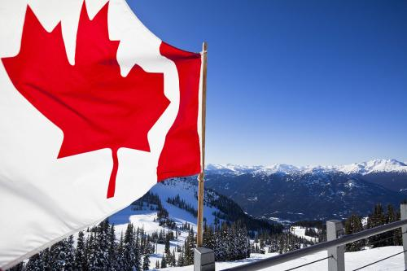
This is my song
for Canada

Slide 12
A song for unity

Slide 13
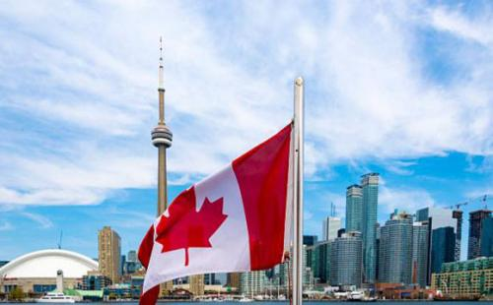
And a song for freedom

Slide 14
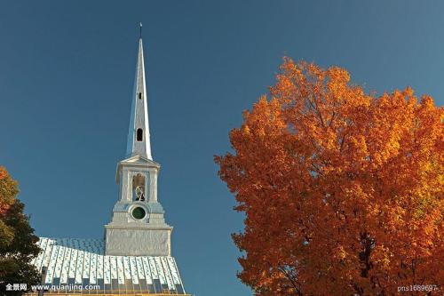
Oh Lord our God

Slide 15
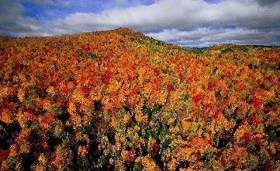
May your healing come

Slide 16
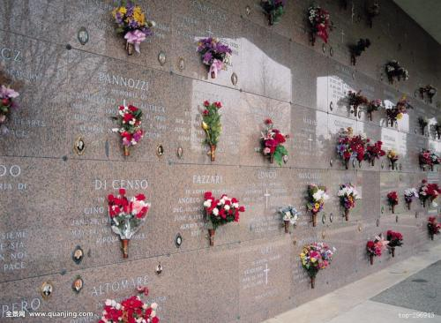
And may the walls that divide us

Slide 17
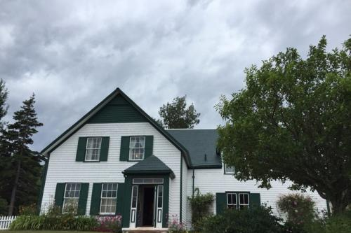
No longer stand

Slide 18
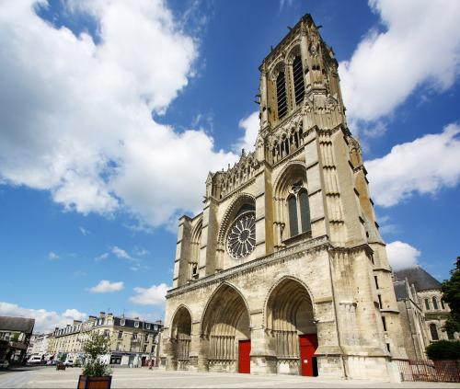
Oh Lord Our God

Slide 19
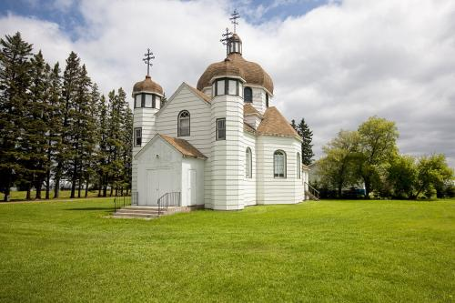
Heal out land

Slide 20
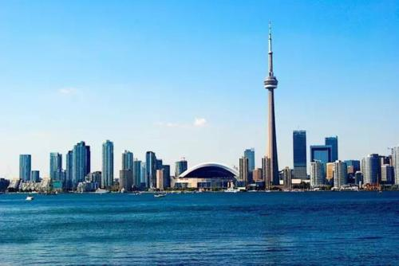

Slide 21
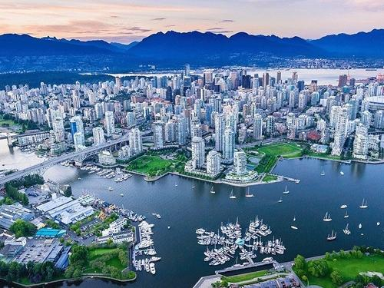

Slide 22
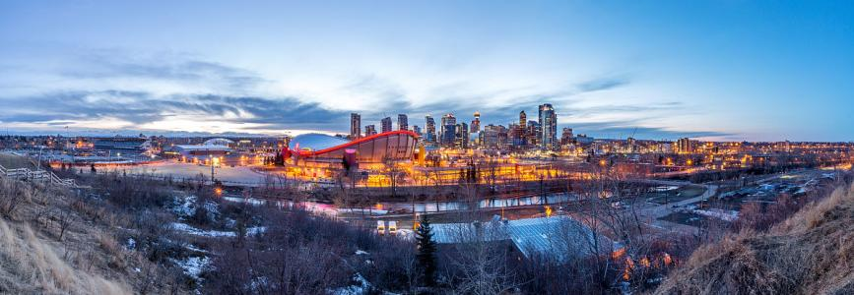

Slide 23
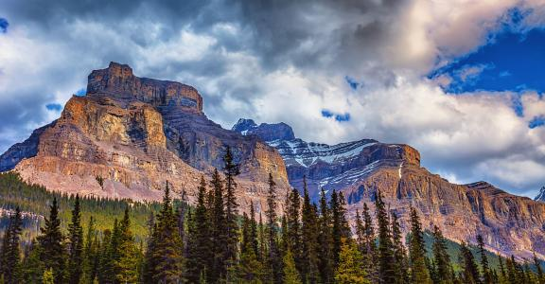

Slide 24
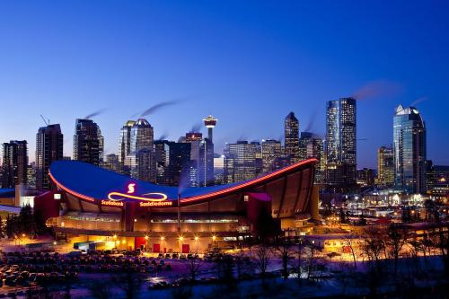
In the colour of the Northern Lights

Slide 25
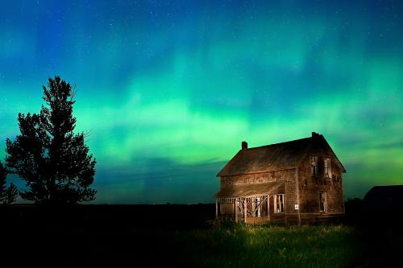
That leap and dance and sing

Slide 26
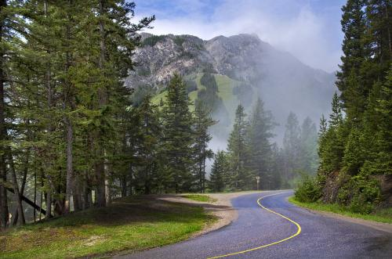
In the stillness of the forest where

Slide 27
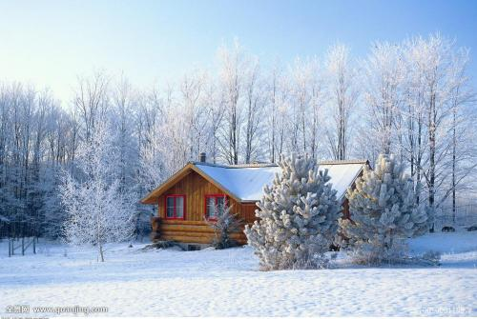
Snow melts in the spring

Slide 28
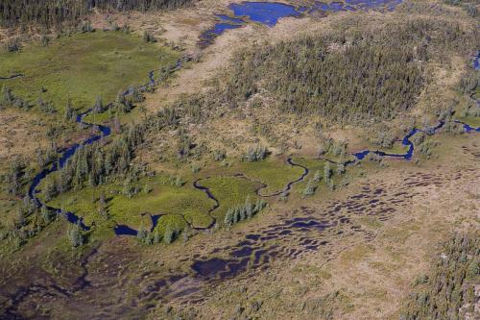
In the beauty of the muskeg
that is

Slide 29
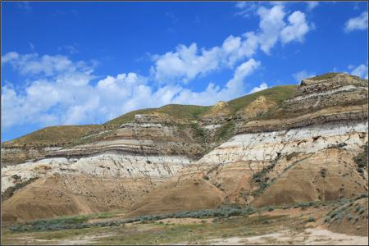
Red and golden brown

Slide 30
In the quiet expectations of
the City before dawn...

