Slide 1
Fight Song
—— Rachel Platten
人教版 必修四
Unit 1 Woman of achievement
作者：傅小如
华南师范大学外文学院

Slide 2
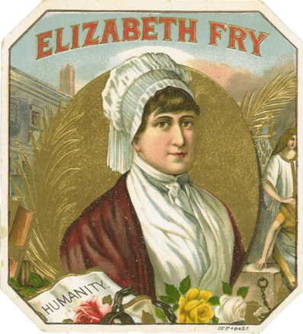
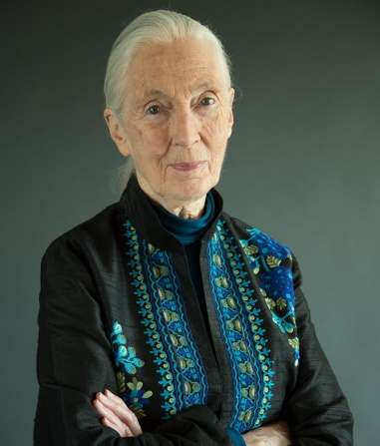
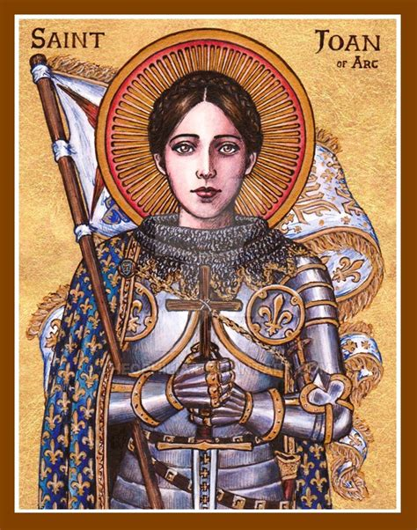
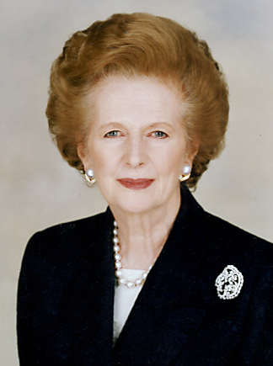
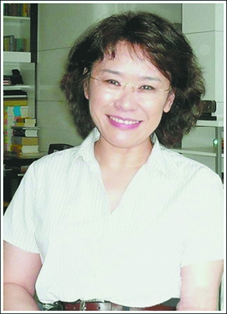
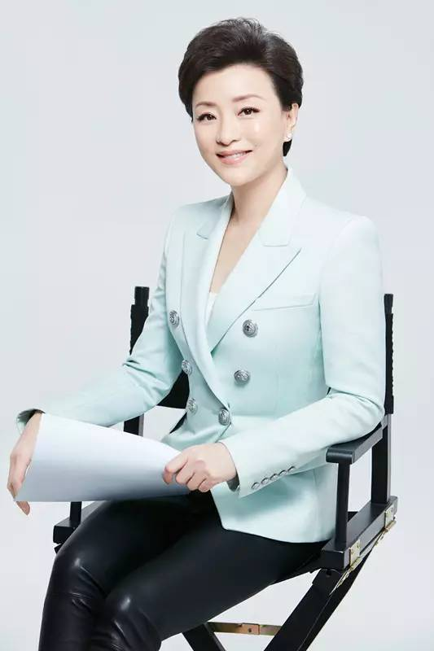
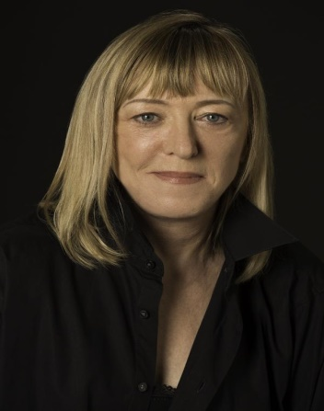
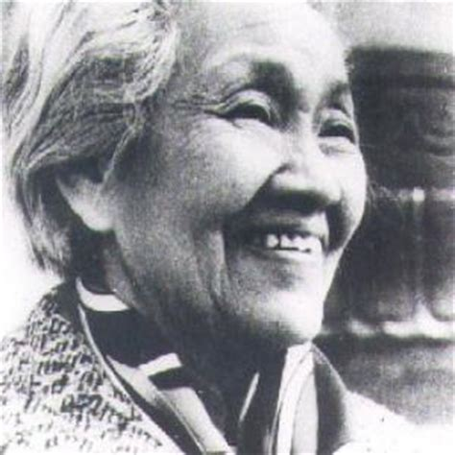
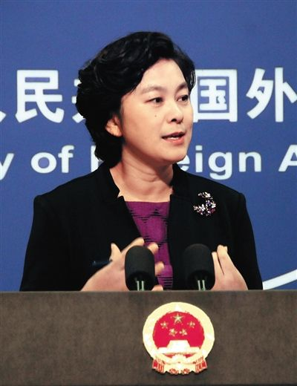
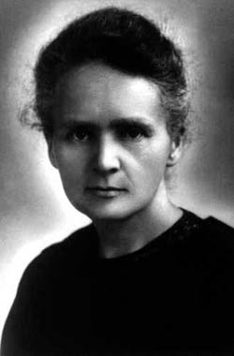
Like how a single word
Sending big waves into motion
Like a small boat on the ocean

Slide 3
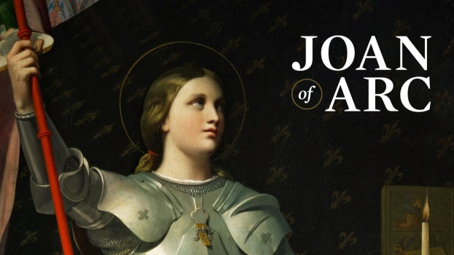
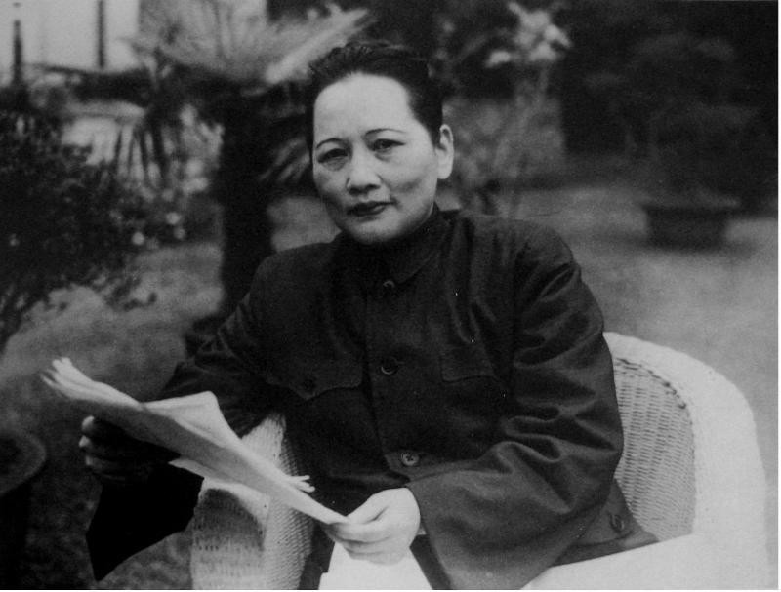
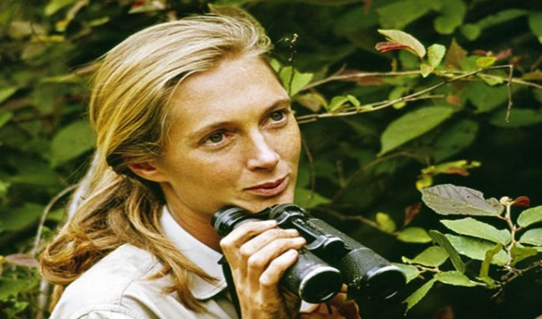
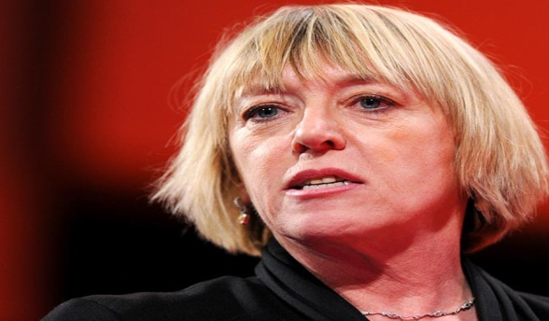
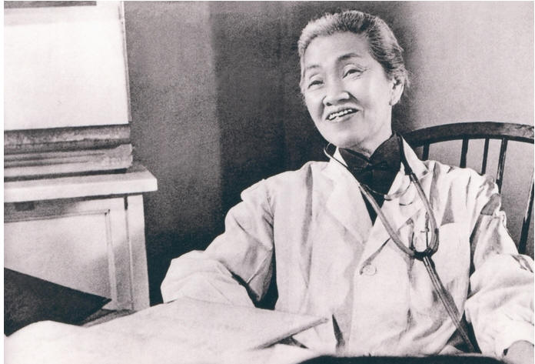
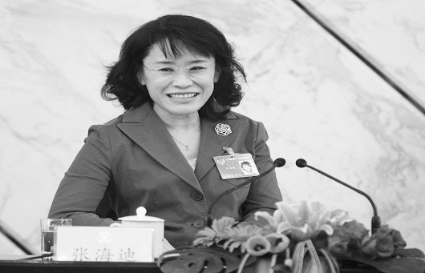
Can make a heart open
I might only have one match
But i can make an explosion

Slide 4
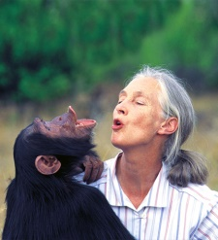
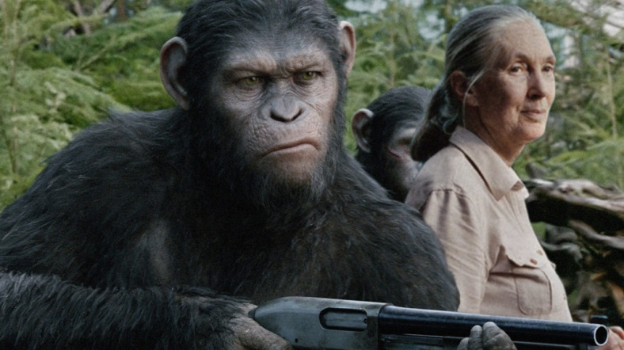
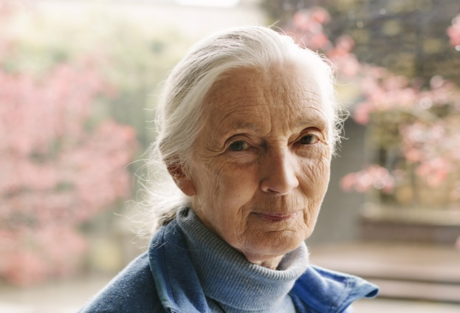
Jane Goodall
And all those things I didn’t say
Wrecking balls inside my brain
I will scream them loud tonight

Slide 5
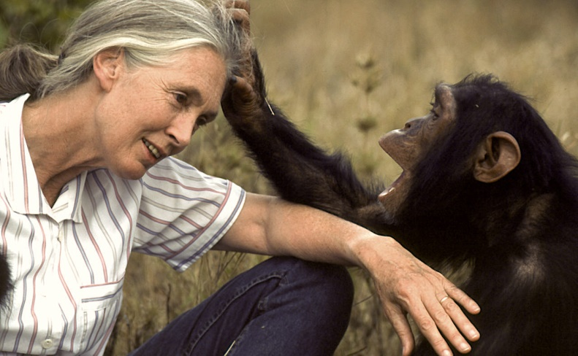
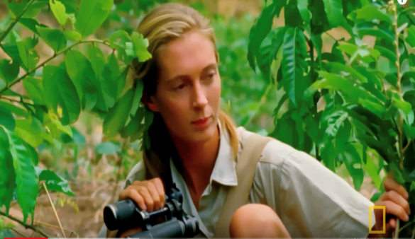
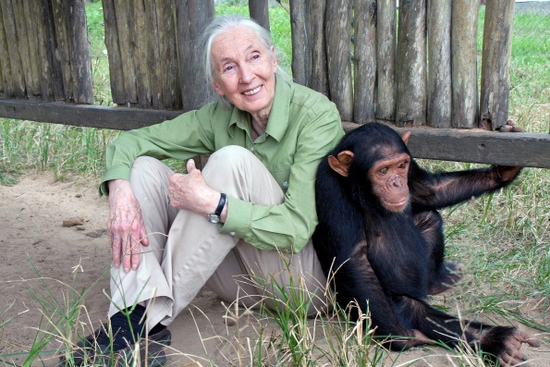
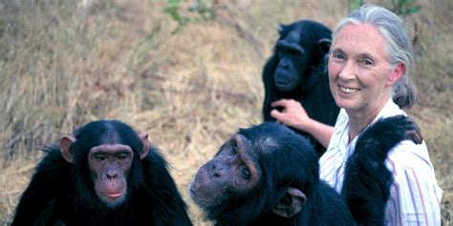
Jane Goodall
Can you hear my voice?
This time this is my fight song
Tack back my life song

Slide 6
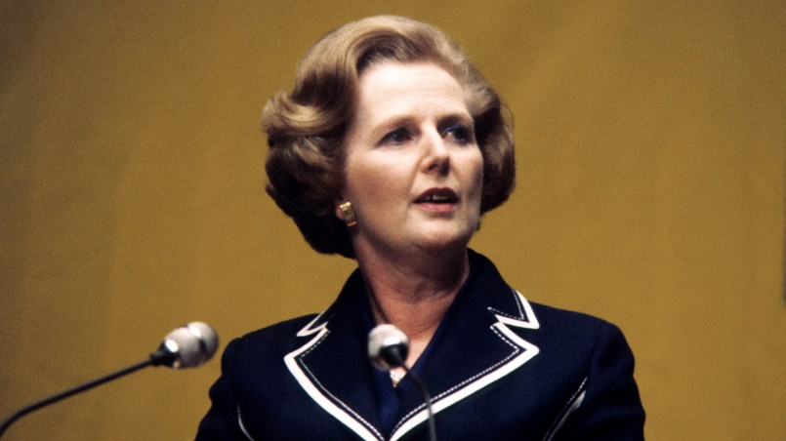
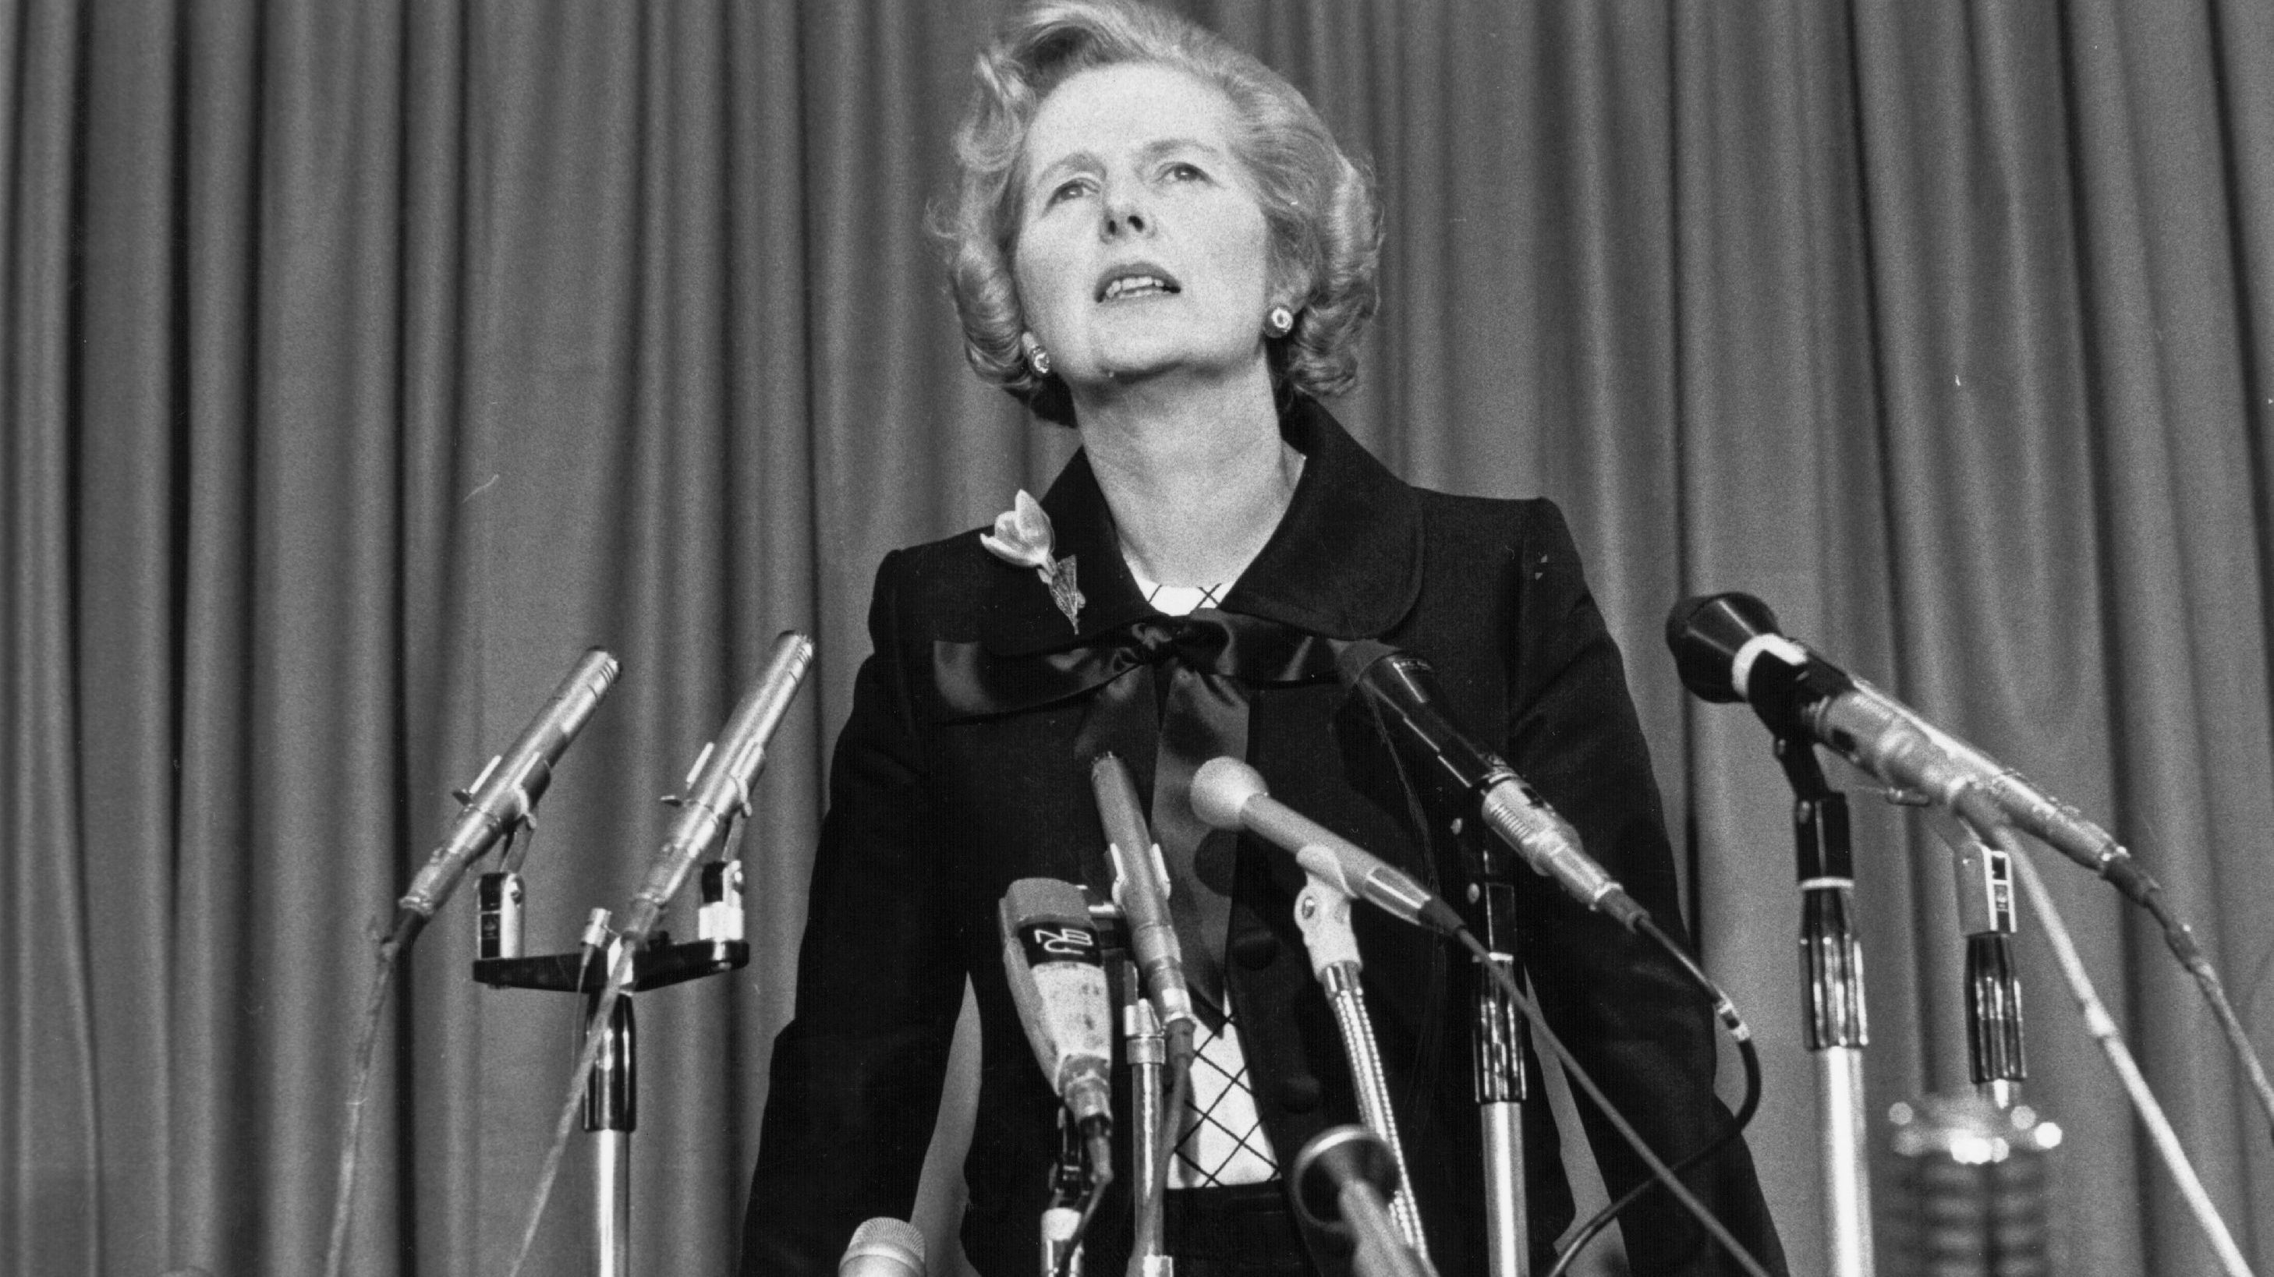
Margaret Thatcher
Prove I’m alright song
My power turned on
Starting right now I’ll be strong

Slide 7
Jody Williams
I'll play my fight song
And i don't really care
If nobody else believes

Slide 8
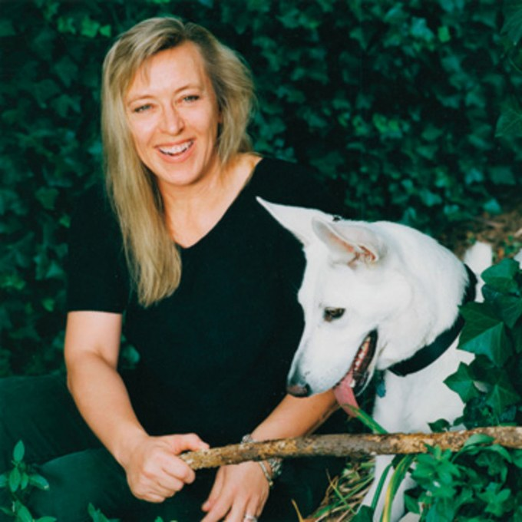
Jody Williams
Cause I’ve still got
A lot of fight left in me

Slide 9
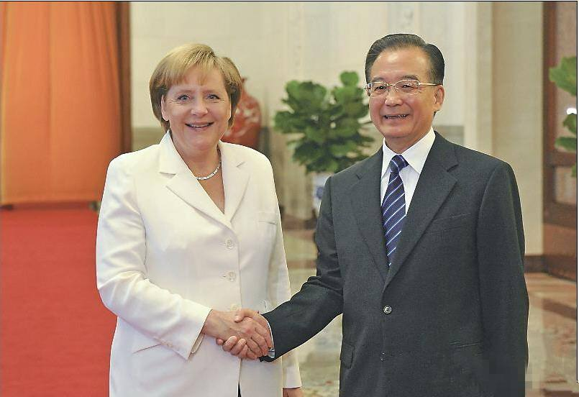
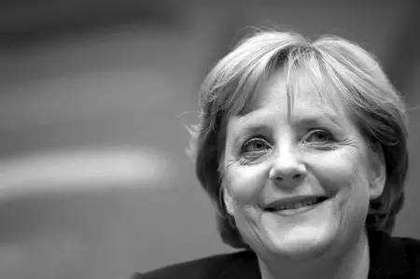
Jody Williams
Losing friends and I’m chasing sleep
Everybody's worried about me
In too deep they say I’m in too deep

Slide 10
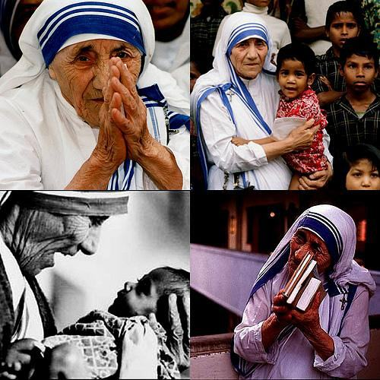
Blessed Teresa of Calcutta
And it's been two years
And i miss my home
There's a fire burning in my bones
Still believe yeah i still believe

Slide 11
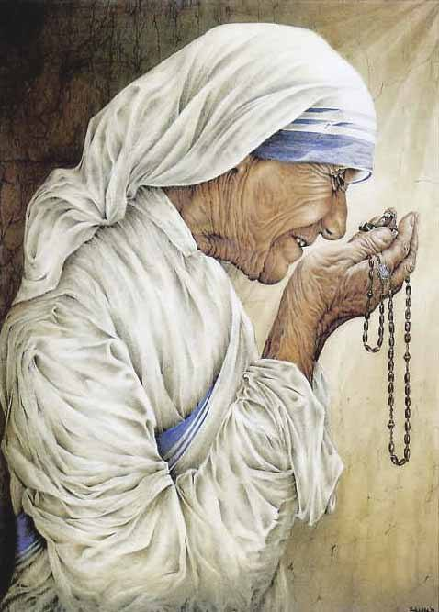
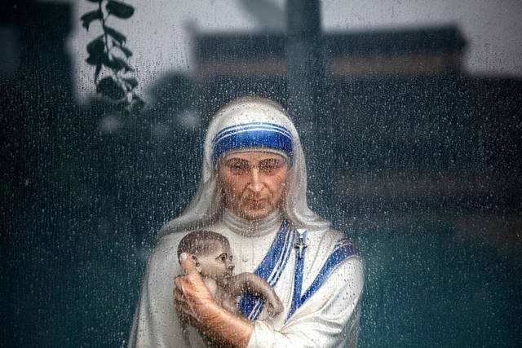
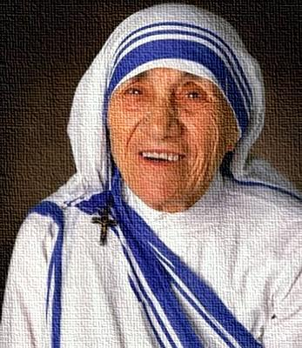
Blessed Teresa of Calcutta
And all those things I didn't say
Wrecking balls inside my brain
I will scream them loud tonight
Can you hear my voice

Slide 12
Lin Qiaozhi
This time this is my fight song
Take back my life song
Prove I’m alright song

Slide 13
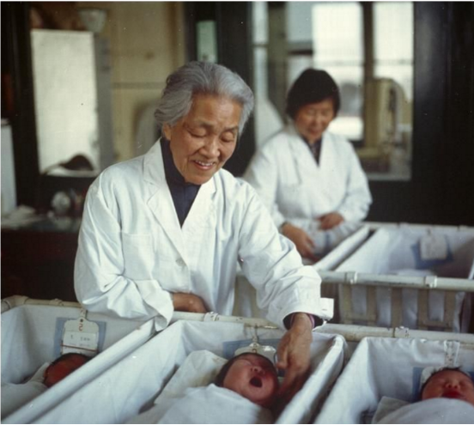
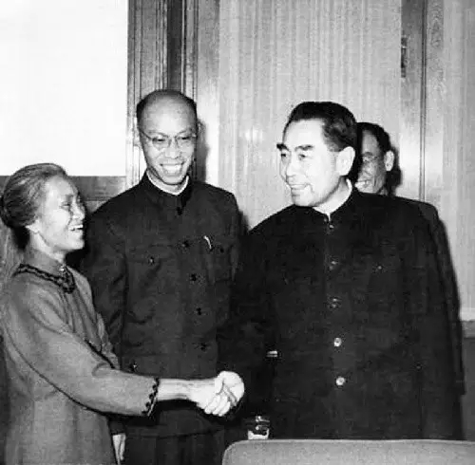
Lin Qiaozhi
My powers turned on
Starting right now i'll be strong
I'll play my fight song
And I don't really care
If nobody else believes

Slide 14
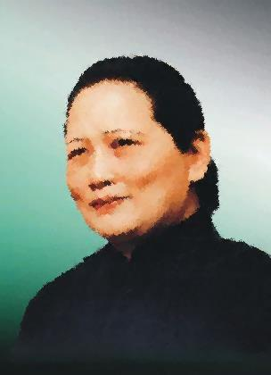
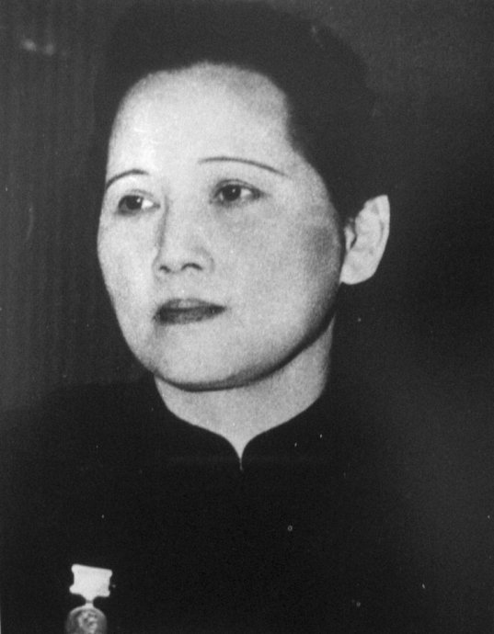
Cause I’ve still got
A lot of fight left in me
A lot of fight left in me
Song Qingling

Slide 15
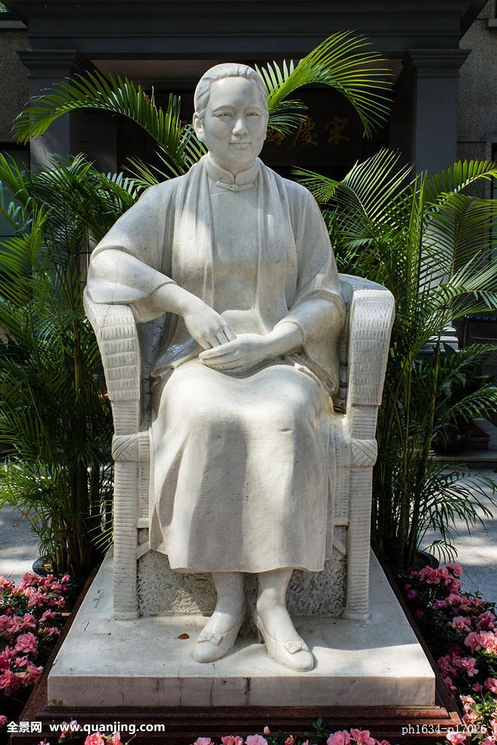
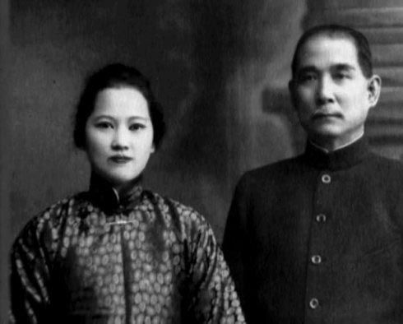
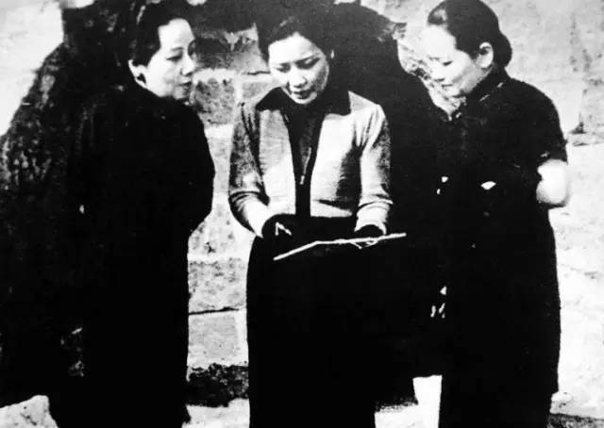
Song Qingling
Like a small boat on the ocean
Sending big waves into motion
Like how a single word
Can make a heart open

Slide 16
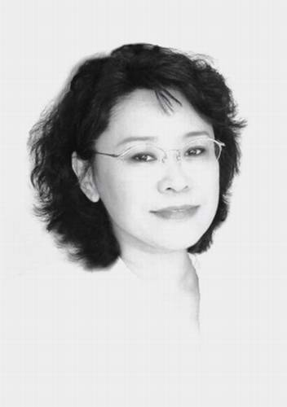
Zhang Haidi
I might only have one match
But I can make an explosion

Slide 17
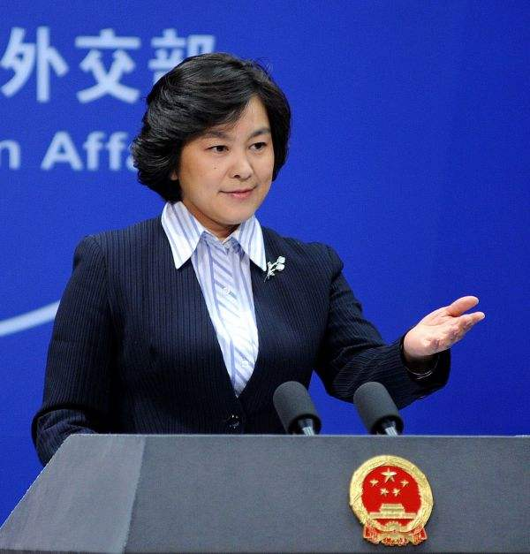
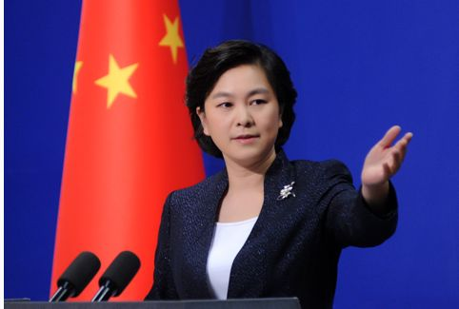
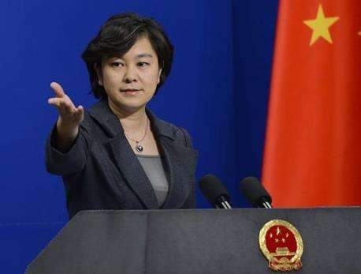
Hua Chunying
This is my fight song
Take back my life song
Prove i'm alright song
My powers turned on
Starting right now i'll be strong

Slide 18
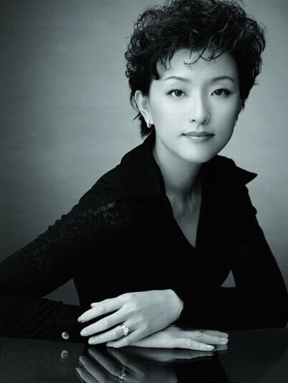
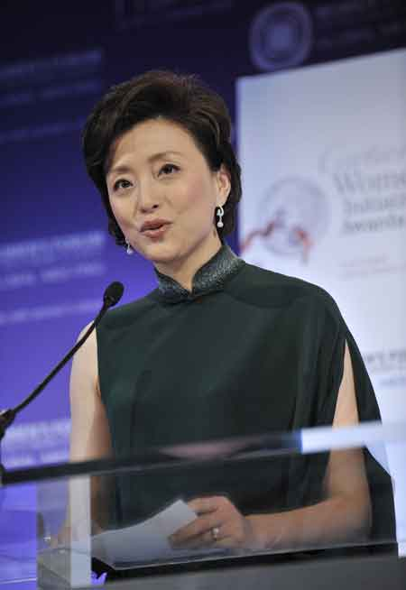
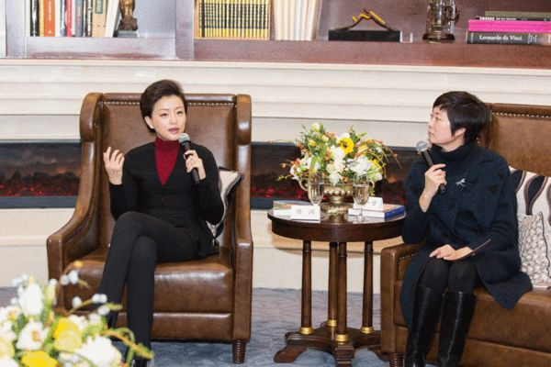
Yang Lan
I'll play my fight song
And i don't really care
If nobody else believes

Slide 19
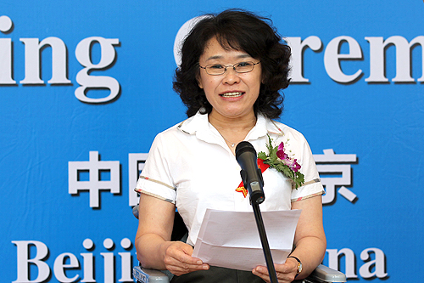
Now I 've still got a lot of fight left in me
A lot of fight left in me
Cause I’ ve still got

Slide 20
THE END
THANK YOU!

