Slide 1
Anthony Hamilton - Freedom
人教版高中英语M4U1：
Women of achievement
作者：李沛忻
单位：华南师范大学外文学院

Slide 2
Joan of Arc (1412-1431):
Helped drive English army out of France

Slide 3
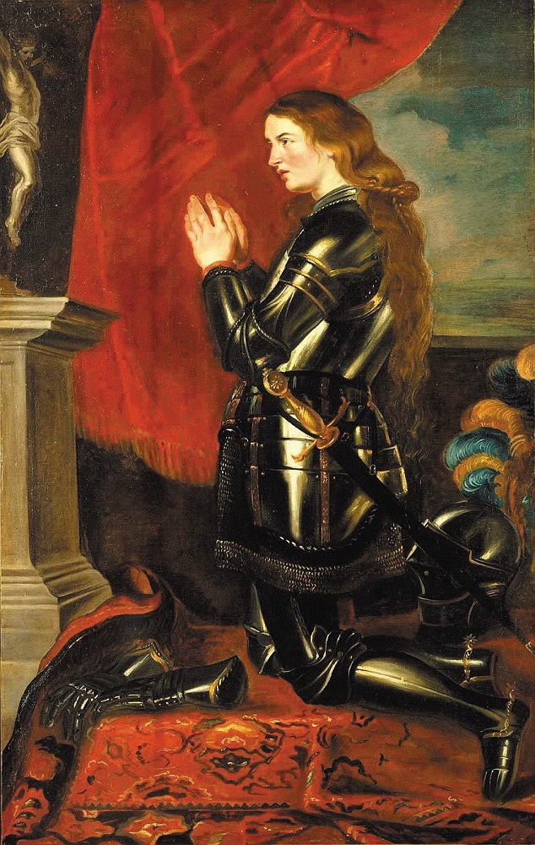
Felt like the weight of the world
was on my shoulders
Pressure to break or retreat
at every turn

Slide 4
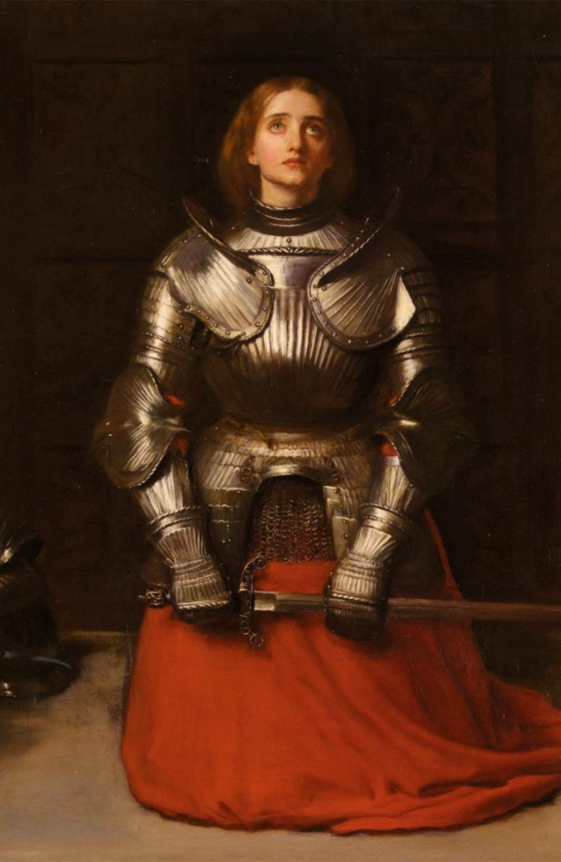
Facing the fear that the truth,
I discovered
No telling how,
all these will work out
But I've come too far
to go back now.

Slide 5
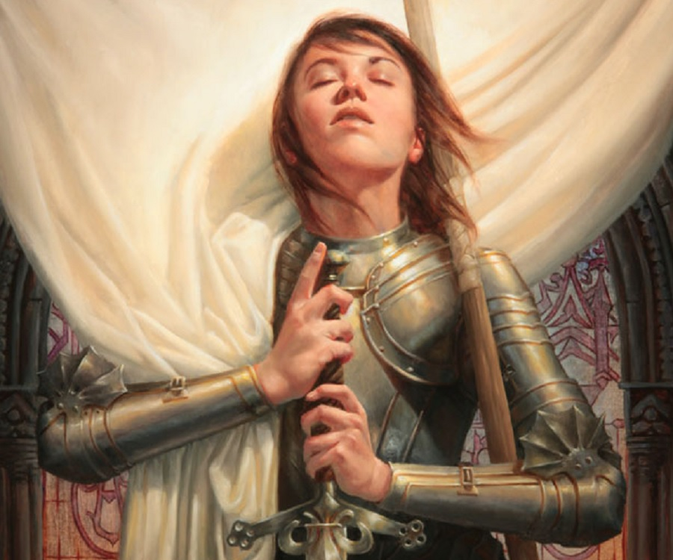
I am looking for freedom,
looking for freedom
And to find it cost me everything I have

Slide 6
Well I am looking for freedom,
looking for freedom
And to find it,
may take everything I have

Slide 7
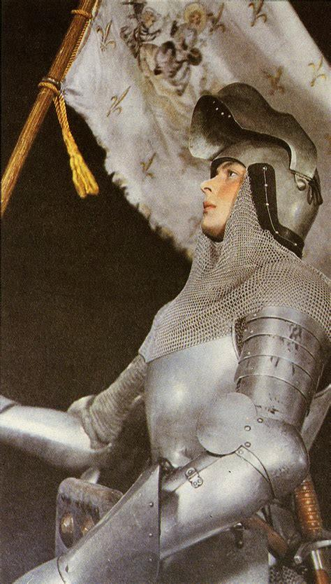
I know all too well
it doesn’t come easy
The chains of the world
they seem to moving tight

Slide 8
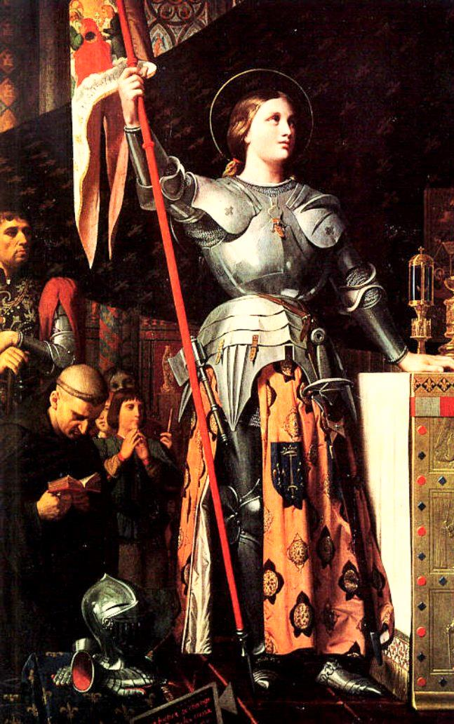
I try to walk around
but stumbling is so familiar
Trying to get up
but the doubt is so strong
There’s gonna be a wind
in my bones

Slide 9
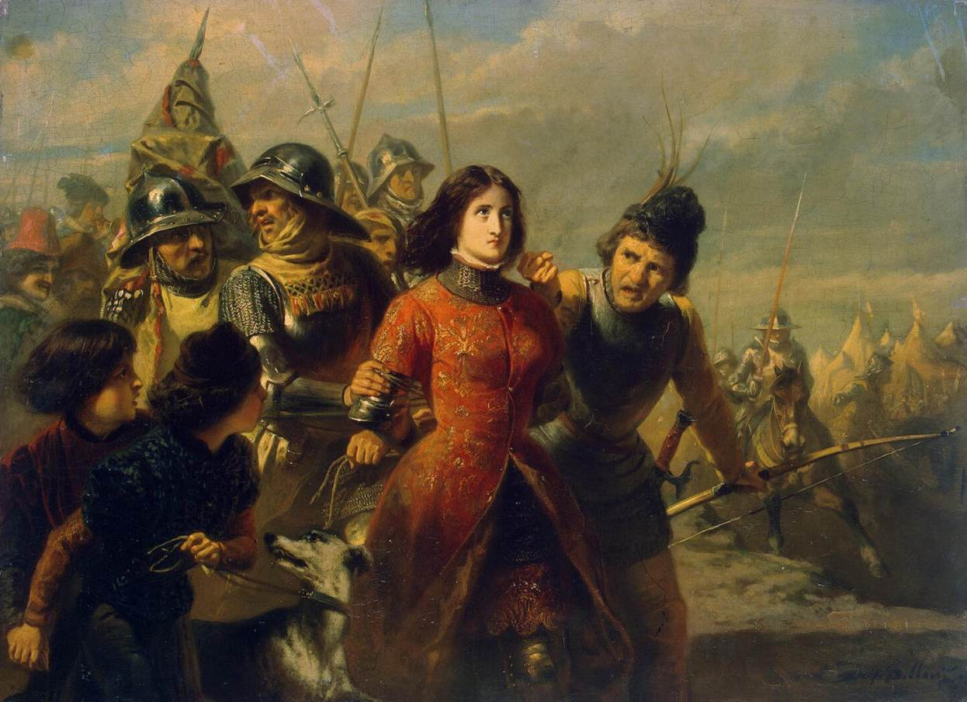
I am looking for freedom,
looking for freedom
And to find it, cost me everything I have

Slide 10
Well I'm looking for freedom,
I'm looking for freedom
And to find it, may take everything I have

Slide 11
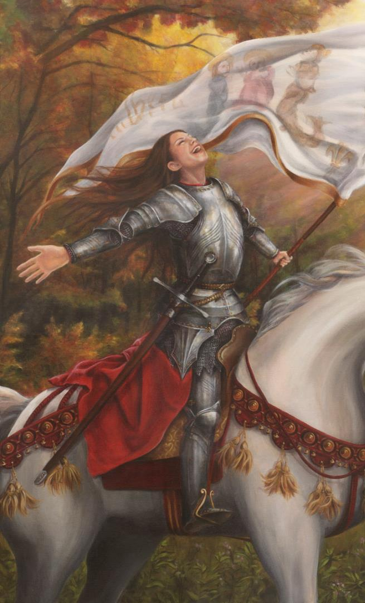
Oh not giving up;
there's always been hard (so hard)
But if I do the things the easy way
I won't get far

Slide 12
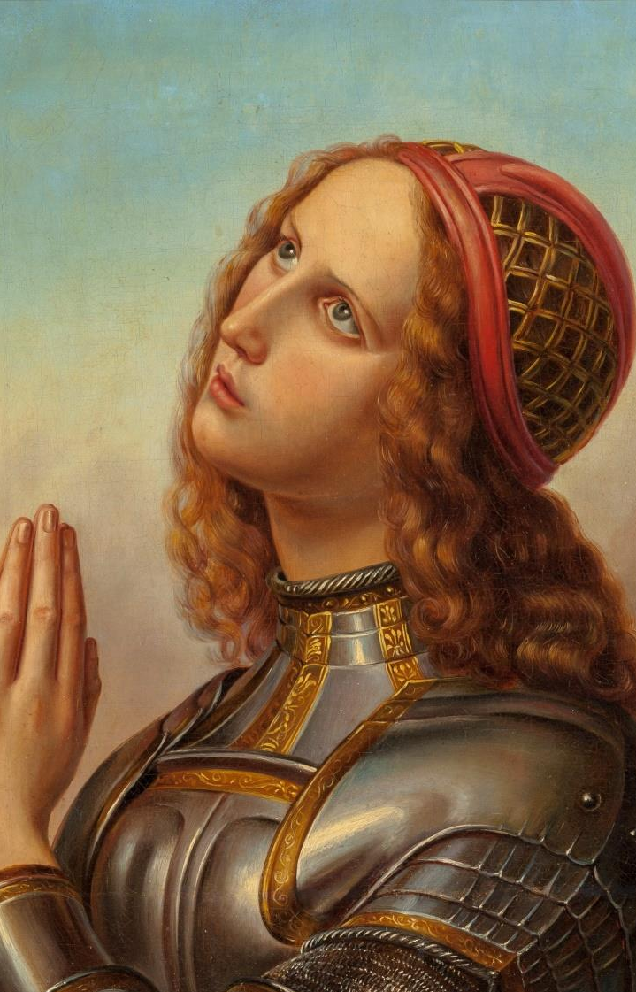
Mm, life hasn't been
very kind to me lately (well)
but I suppose
it's a push for moving on (oh yeah)

Slide 13
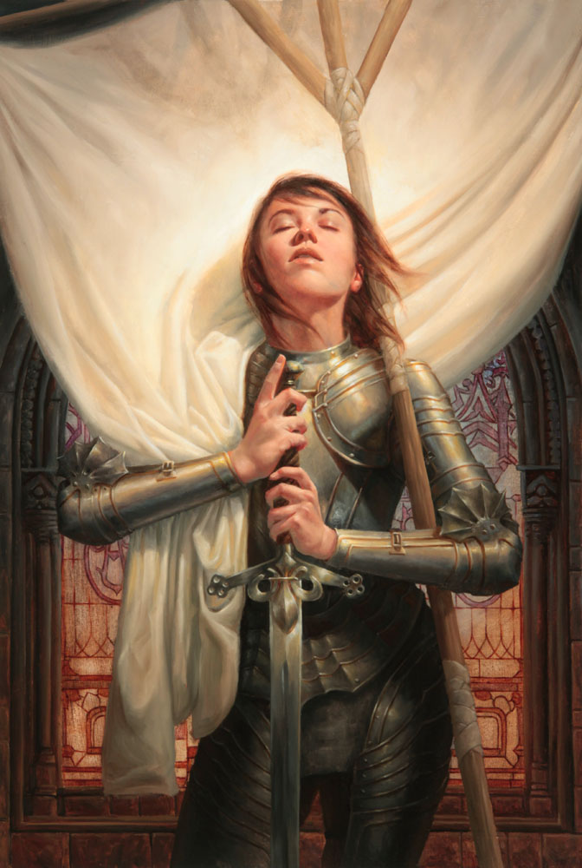
In time the sun's gonna
shine on me nicely(one day yeah)
Shinning tells me
good things are coming
And I ain't gonna not believe

Slide 14
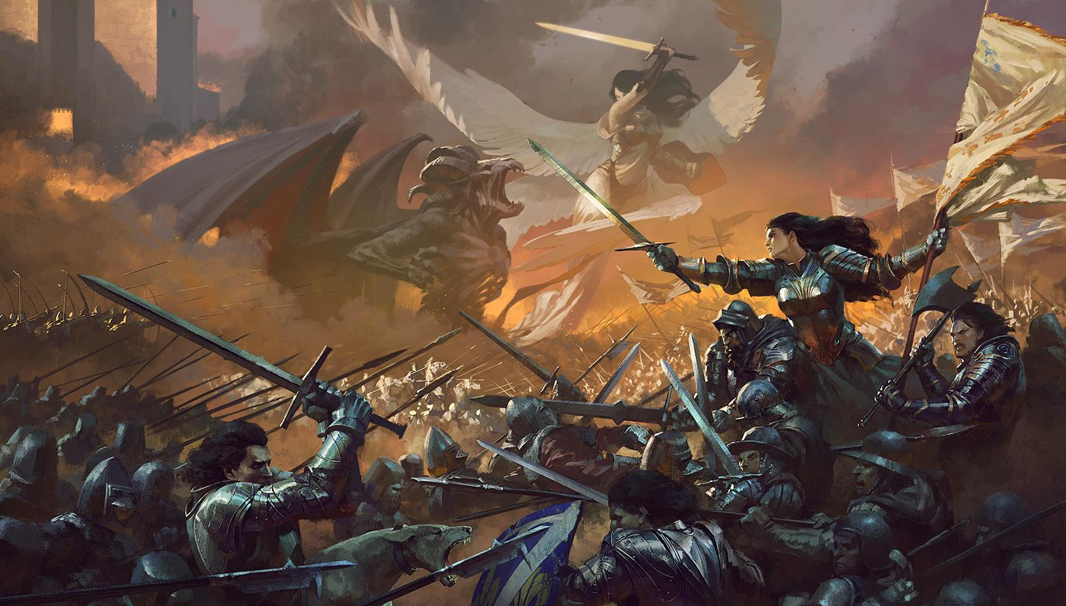
I am looking for freedom,
looking for freedom
And to find it, cost me everything I have

Slide 15
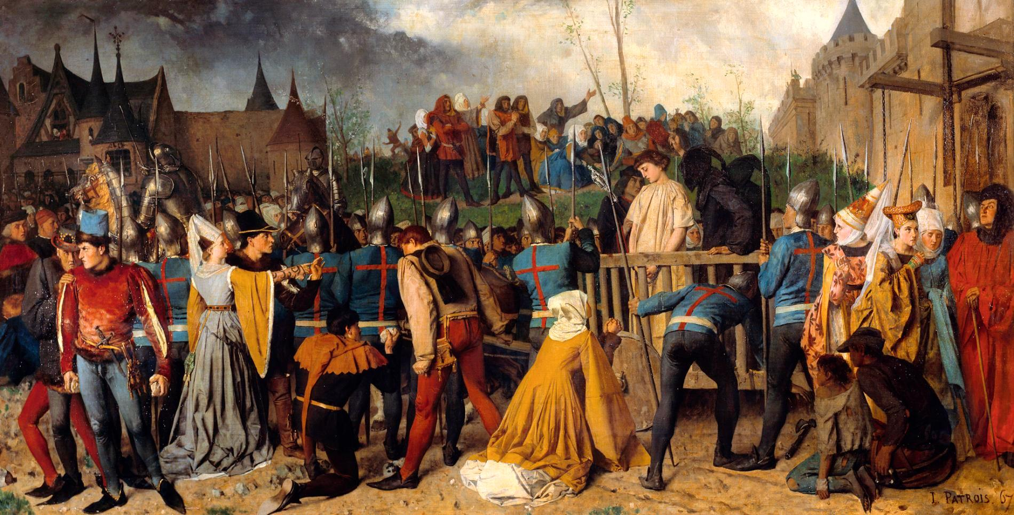
Well I'm looking for freedom,
I'm looking for freedom
And to find it, may take everything I have

Slide 16
The End

Slide 17
Thank you!

