Slide 1
The Climb
高中英语人教版
M1U3 Travel Journal
纪淑儿
华南师范大学外文学院

Slide 2
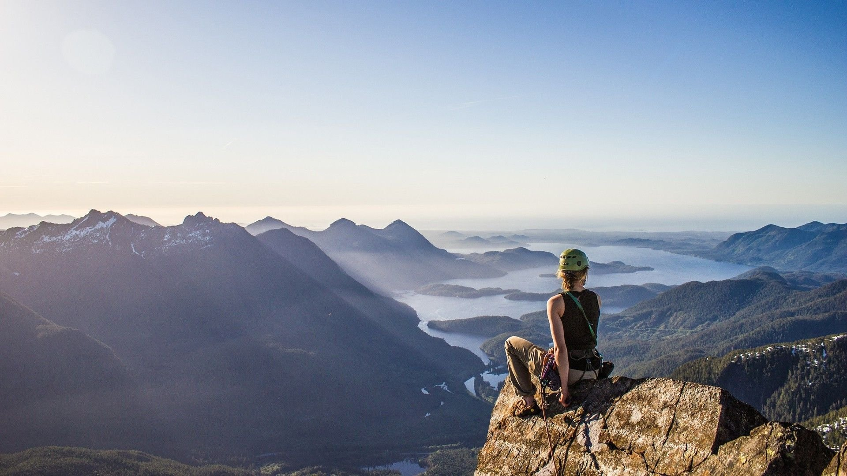
I can almost see it
you'll never reach it
That dream I'm dreaming but
There's a voice inside my head saying

Slide 3
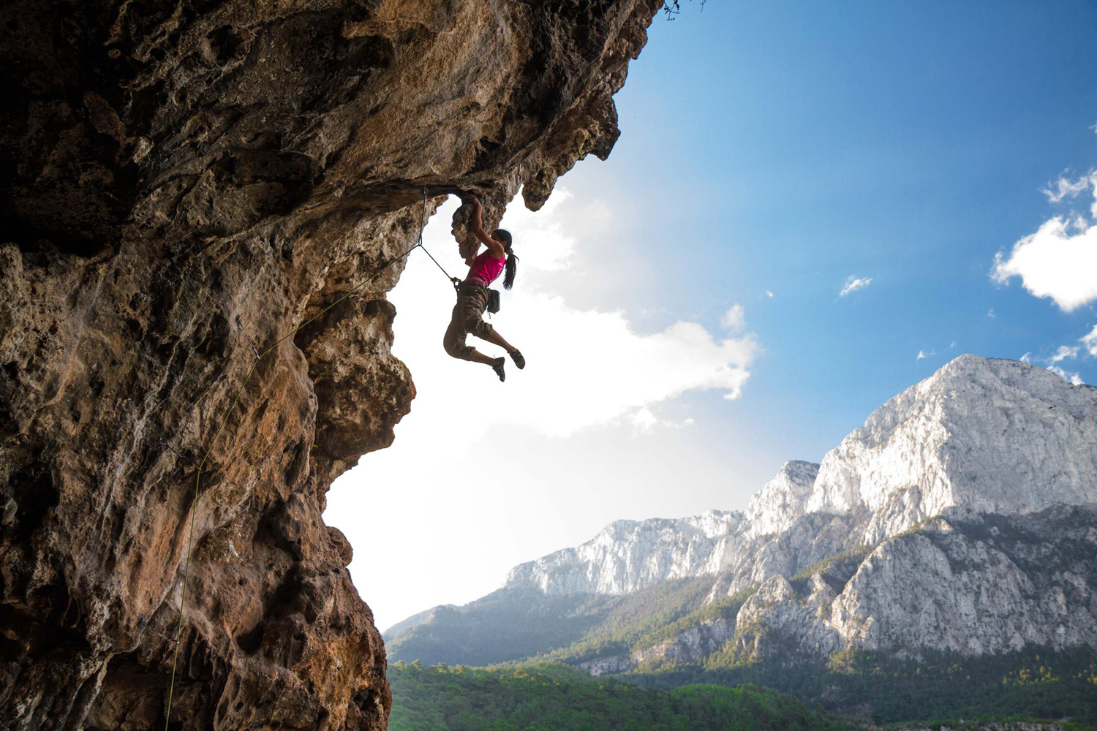
Every step I'm taking
Every move I make feels
My faith is shaking
Lost with no direction

Slide 4
But I, I gotta keep trying
Gotta keep my head held high

Slide 5
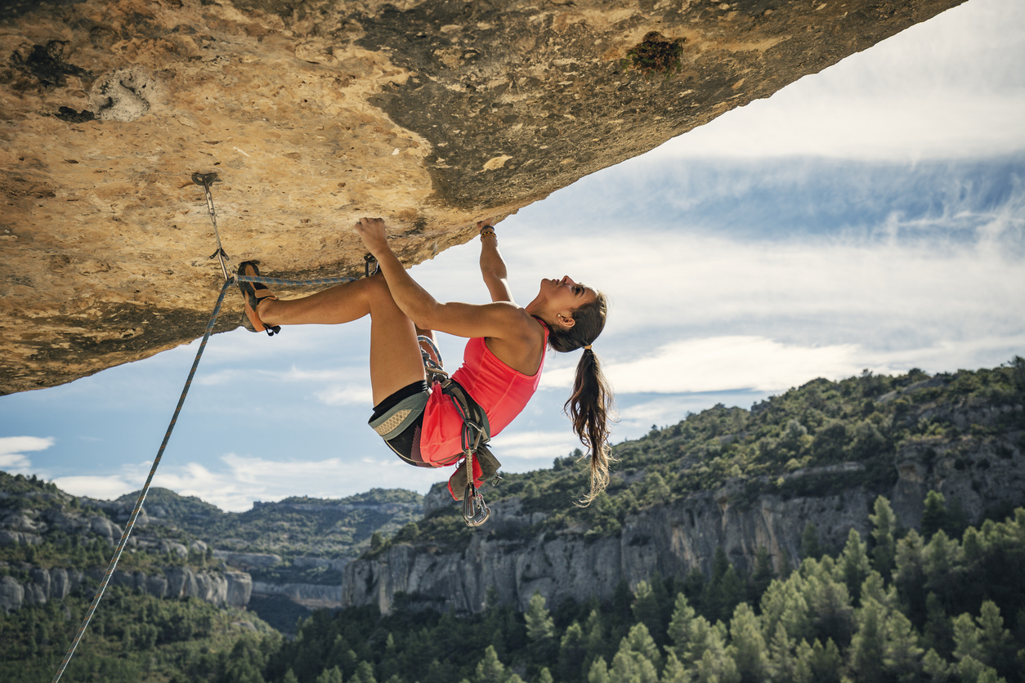
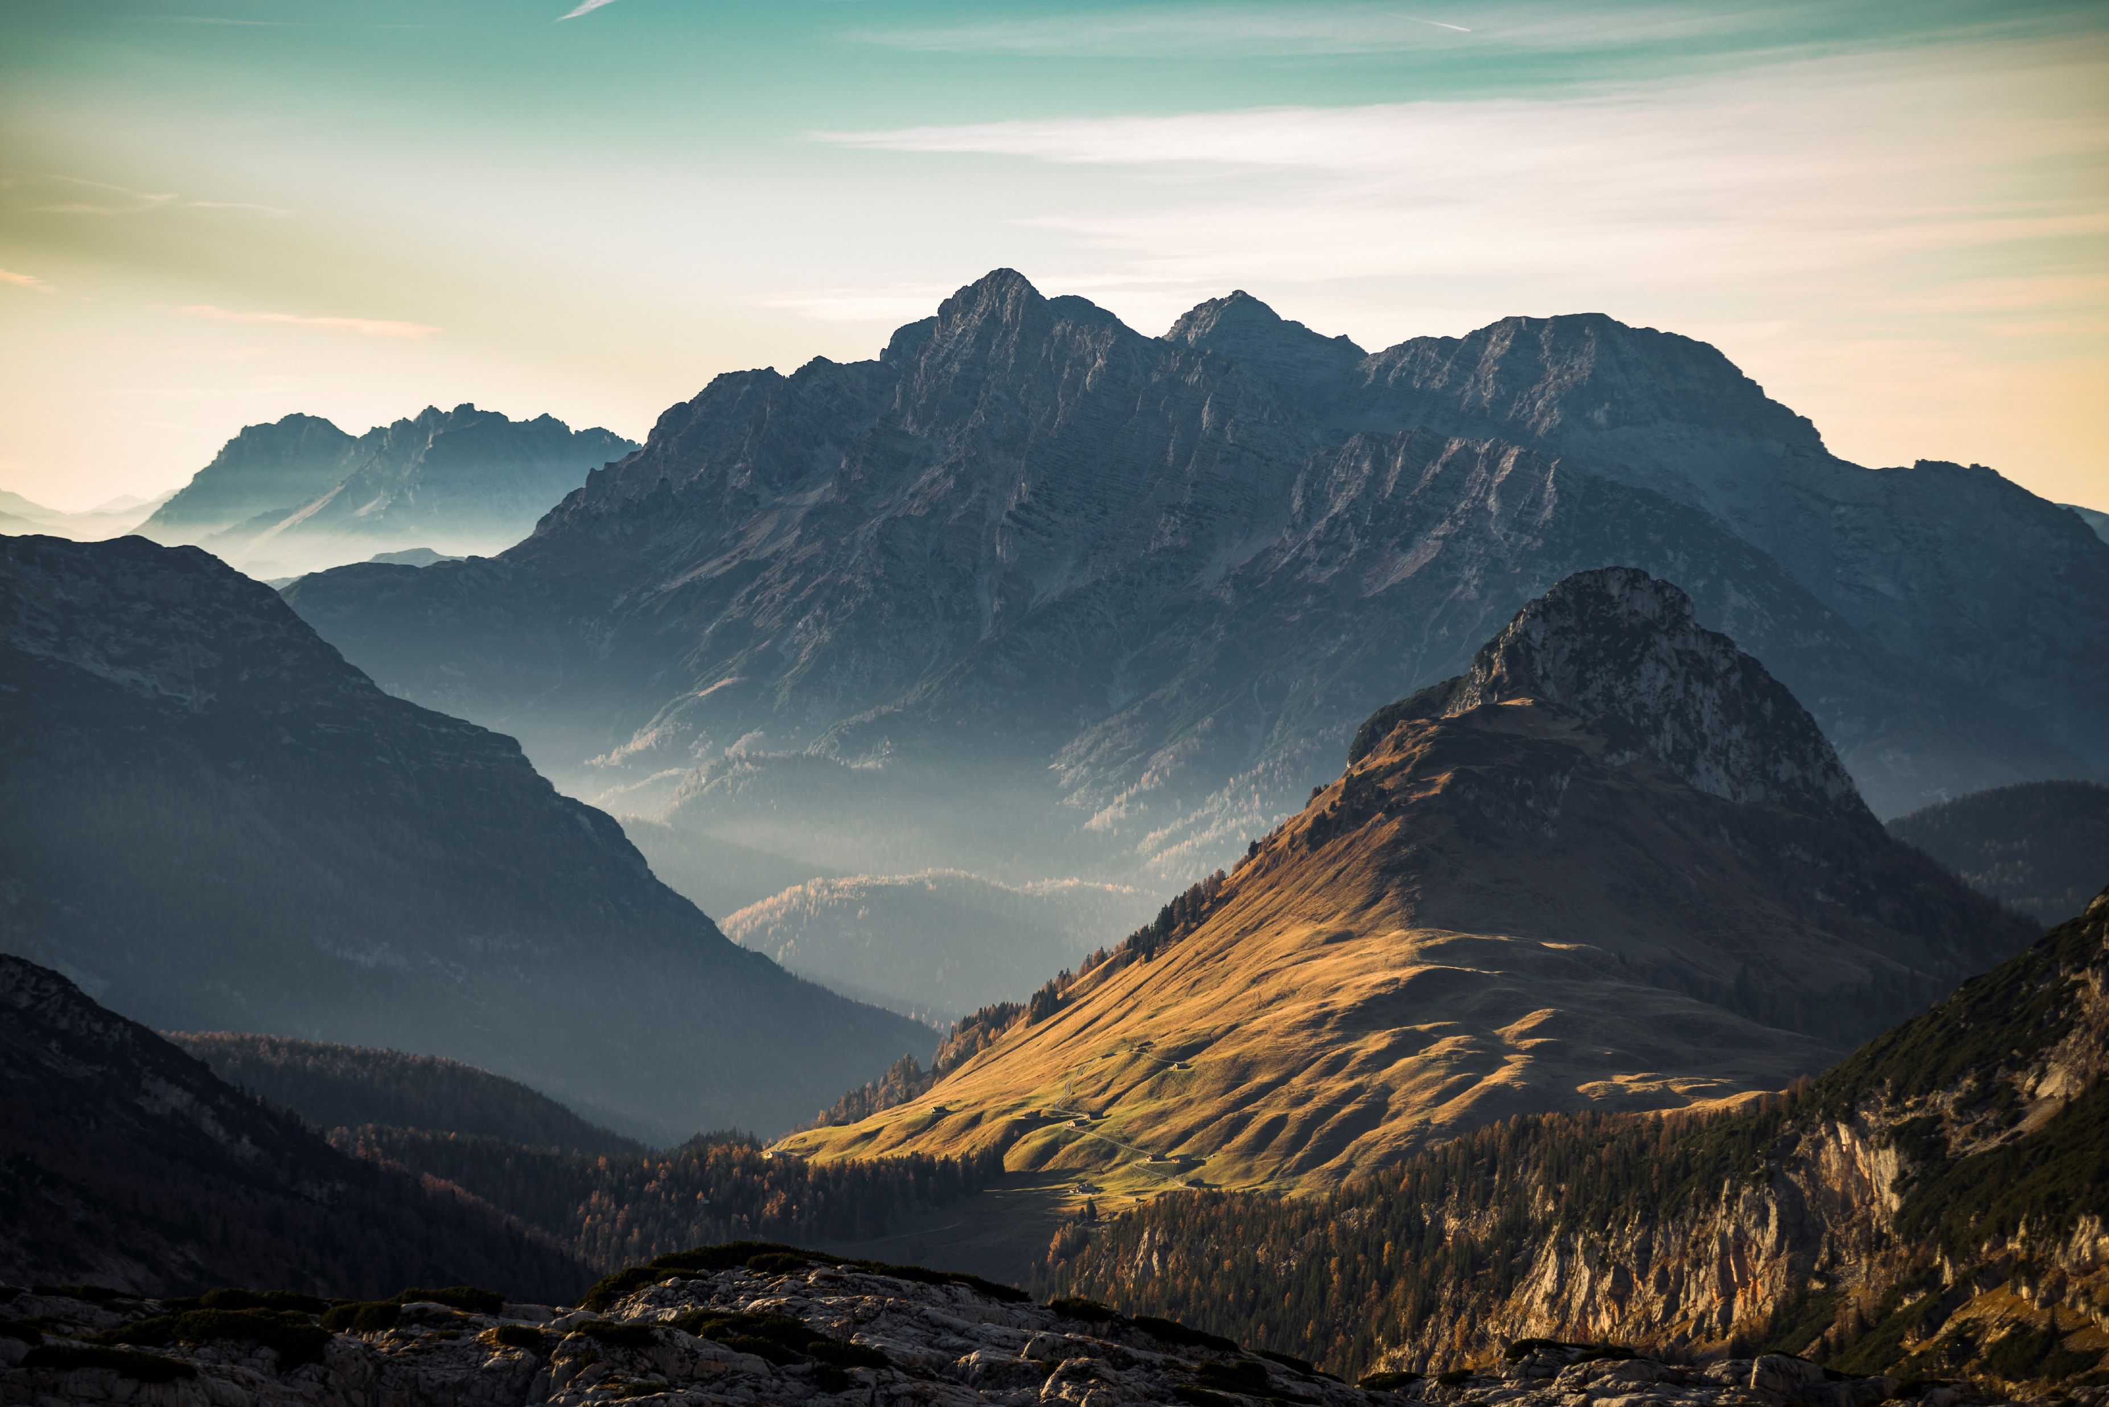
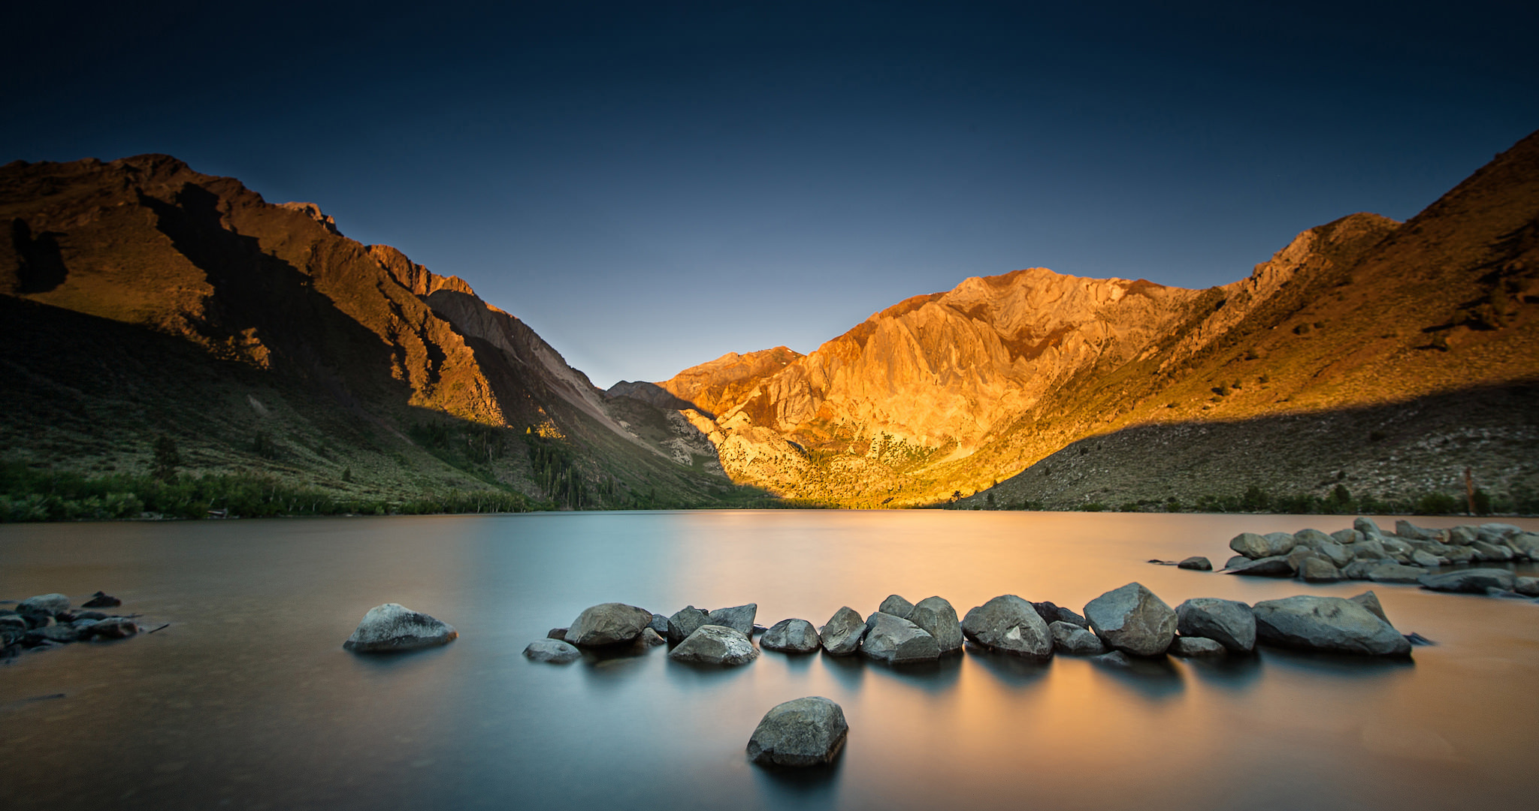
Always gonna be an uphill battle
Sometimes I'm gonna have to lose
There's always gonna be another mountain
I'm always gonna wanna make it move
Ain't about how fast I get there
Ain't about what's waiting on the other side

Slide 6
It's the climb

Slide 7
I may not know it
But these are the moments that
The struggles I'm facing
I'm gonna remember most, yeah
Just gotta keep going
The chances I'm taking
And I, I gotta be strong
Just keep pushing on
Sometimes might knock me down but
No I'm not breaking

Slide 8
Cause…

Slide 9
There's always gonna be another mountain
I'm always gonna wanna make it move
Always gonna be an uphill battle
Sometimes I'm gonna have to lose
Ain't about how fast I get there
Ain't about what's waiting on the other side

Slide 10
It's the climb

Slide 11
Keep on moving
Keep climbing
Keep the faith
Baby
It's all about
It's all about the climb
Keep your faith
Keep your faith

Slide 12
Life is climbing

