Slide 1
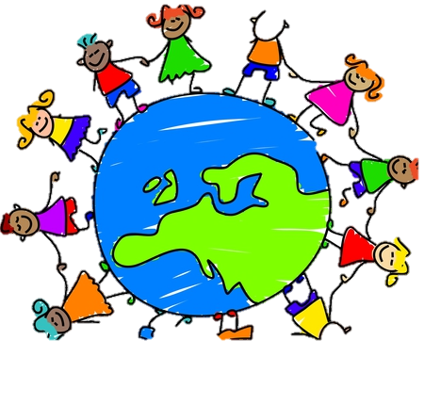
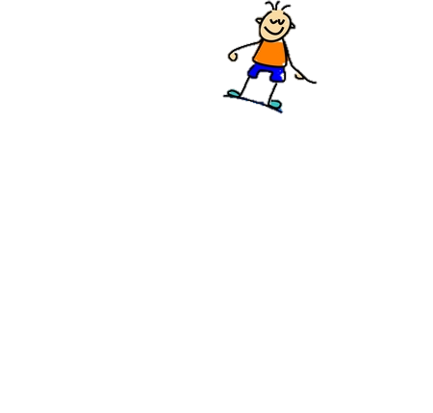
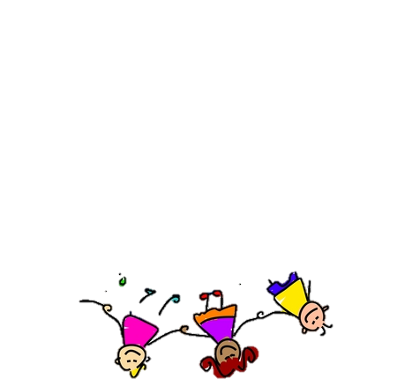
We Are the World
Module4 Unit2 Working the Land
WATCH a MV
Made by 陈子婷

Slide 2
There comes a time when we heed a certain call
When the world must come together as one

Slide 3
There are people dying
Oh it's time to lend a hand to life
The greatest gift of all

Slide 4
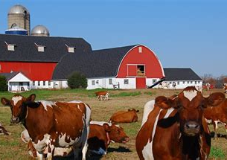
We can't go on pretending day by day
That someone, somewhere will soon make a change

Slide 5
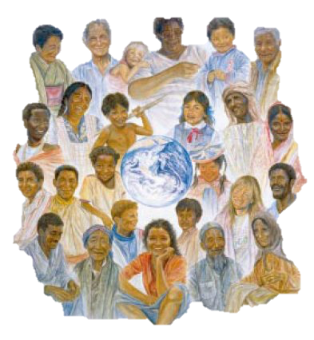
We are all a part of god's great big family
And the truth, you know, love is all we need

Slide 6
We are the ones who make a brighter day so let's start giving
We are the world, we are the children

Slide 7
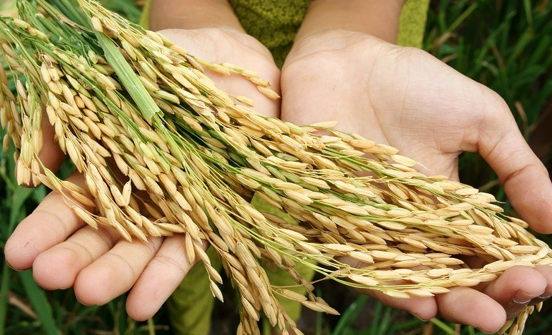
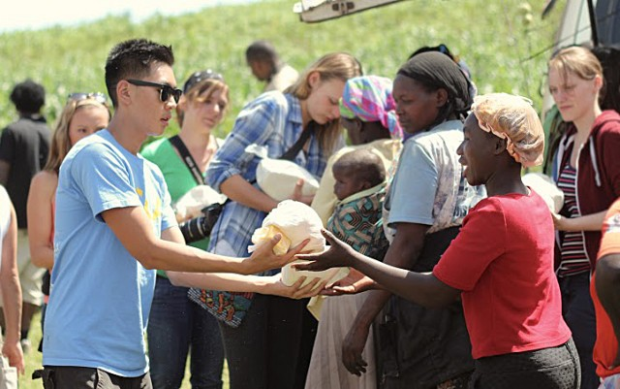
There's a choice we're making
we're saving our own lives
It's true we'll make a better day,
just you and me

Slide 8
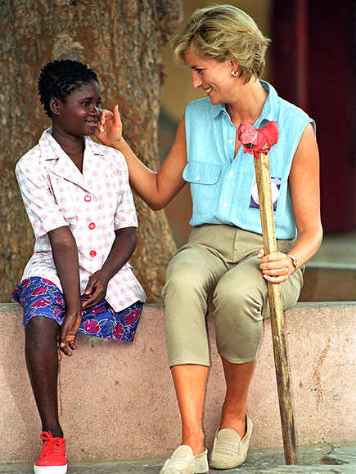
Oh. Send them your heart so they'll know that someone cares
And their lives will be stronger and free

Slide 9
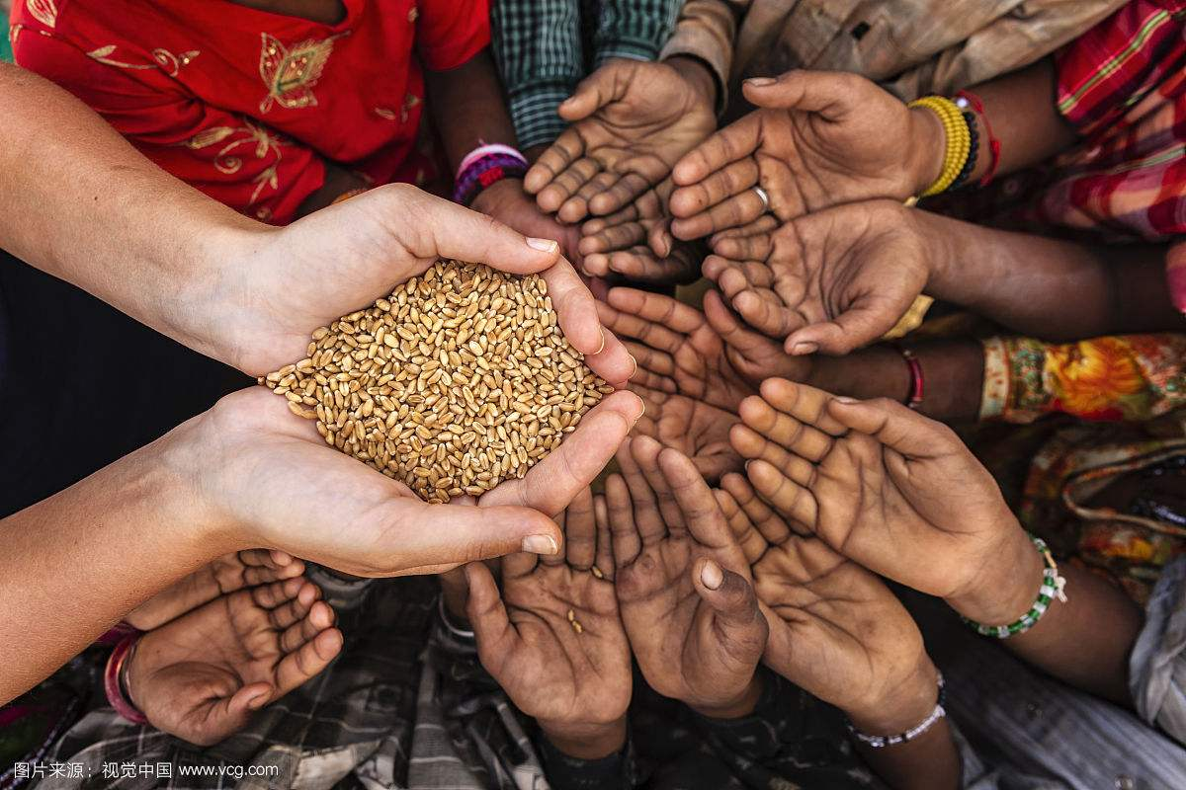
So we all must lend a helping hand
As god has shown us by turning stones to bread

Slide 10
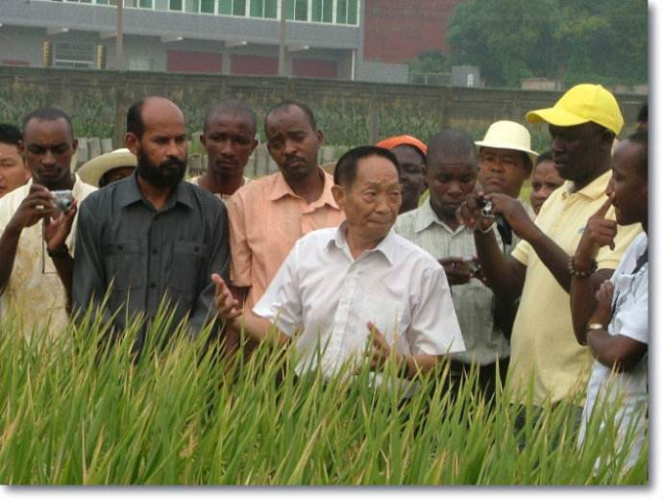
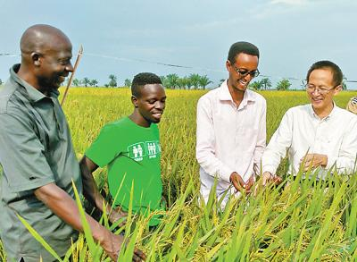
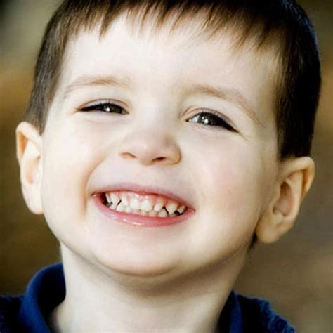
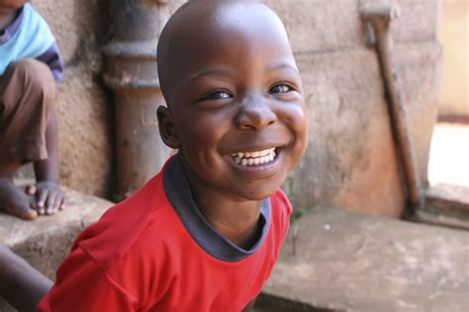
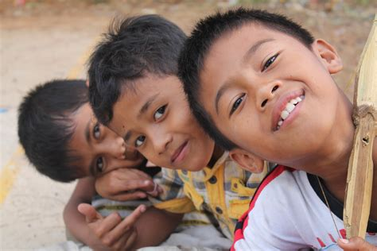
We are the world, we are the children
We are the ones who make a brighter day so let's start giving

Slide 11
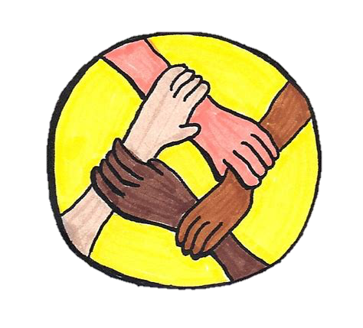
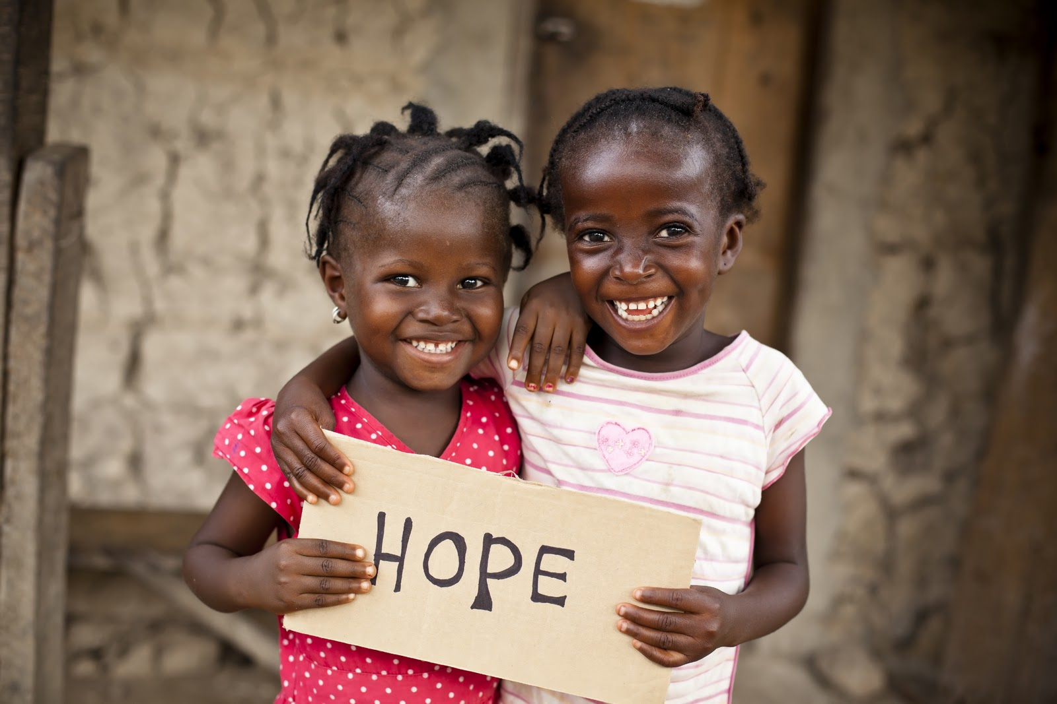
There's a choice we're making
we're saving our own lives
It's true we'll make a better day,
just you and me

Slide 12
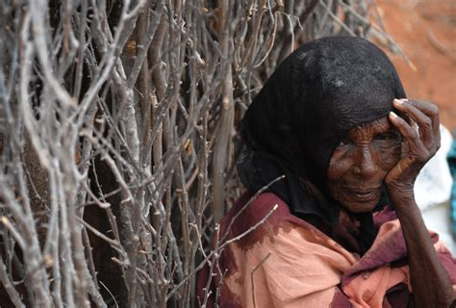
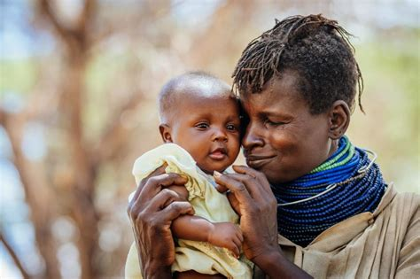
When you’re down and out，there seems no hope at all
But if you just believe there's no way we can fall

Slide 13
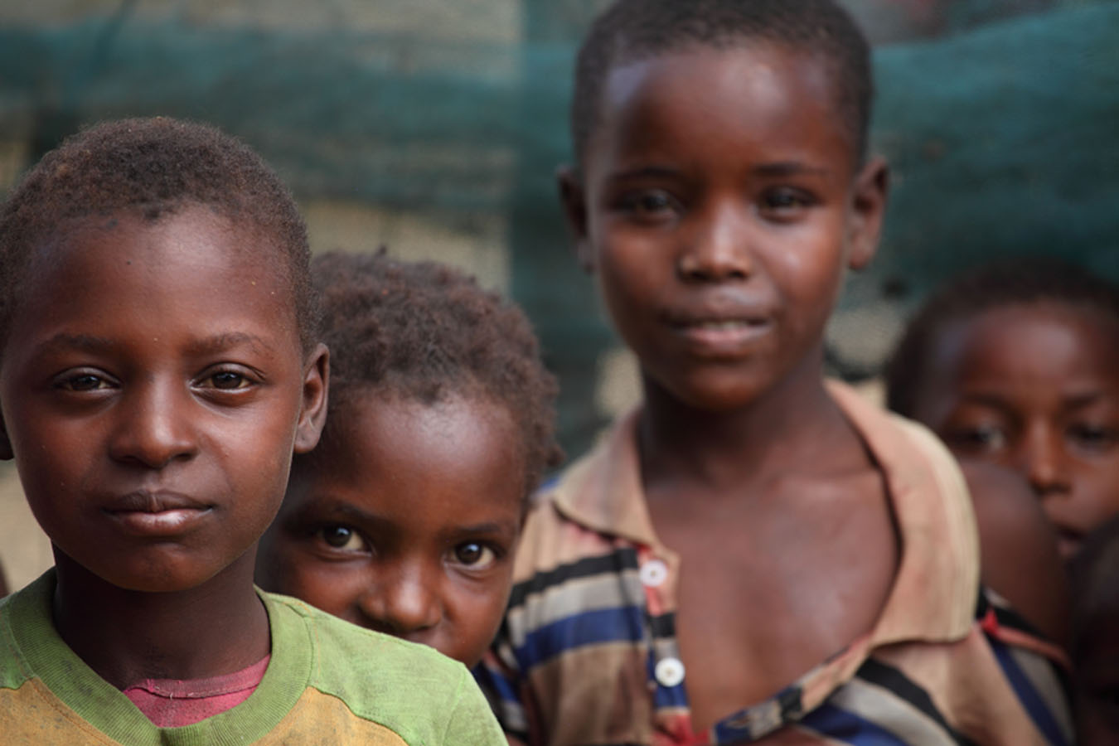
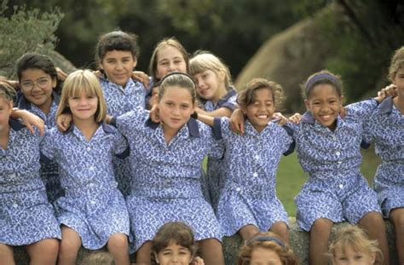
Let us realize that a change can only come
When we stand together as one

Slide 14
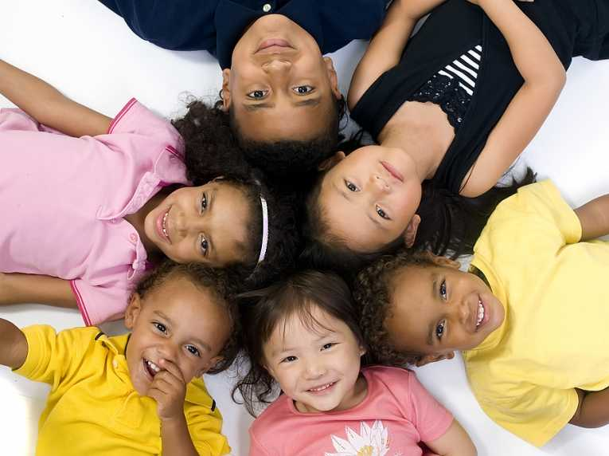
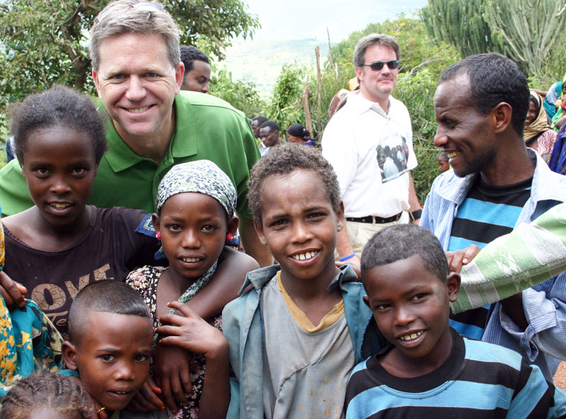
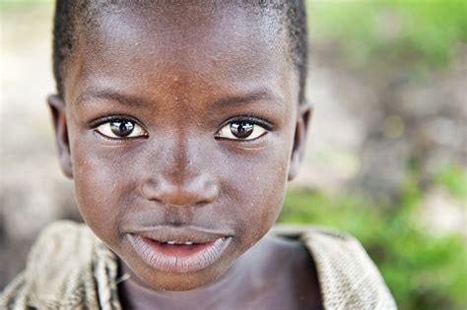
We are the ones
who make a brighter day
so let's start giving
We are the world,
we are the children

Slide 15
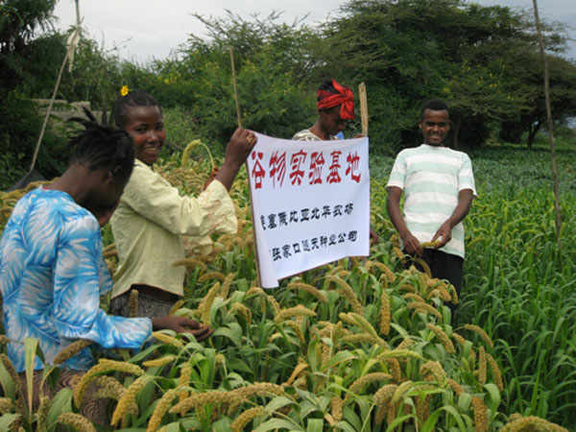
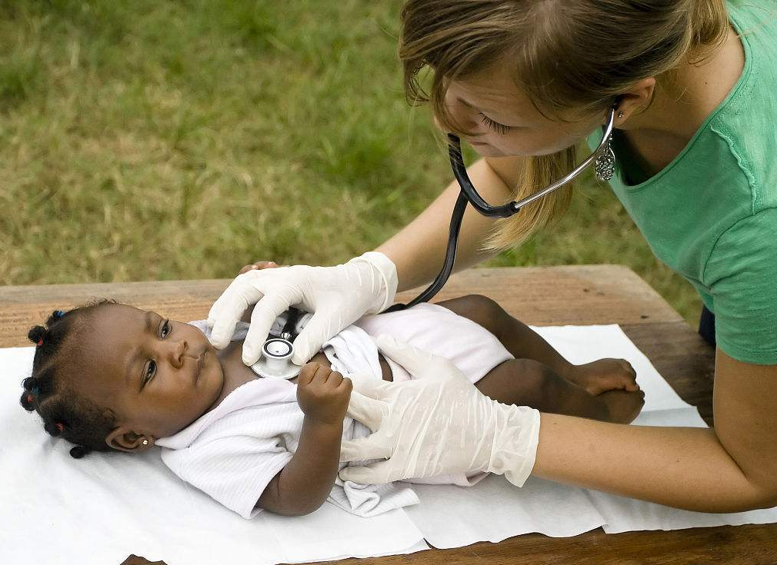
There's a choice we're making
we're saving our own lives
It's true we'll make a better day,
just you and me

Slide 16
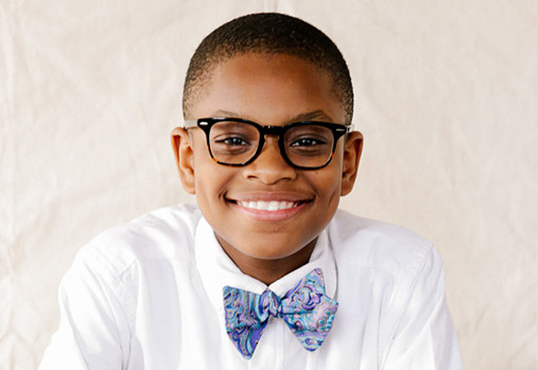
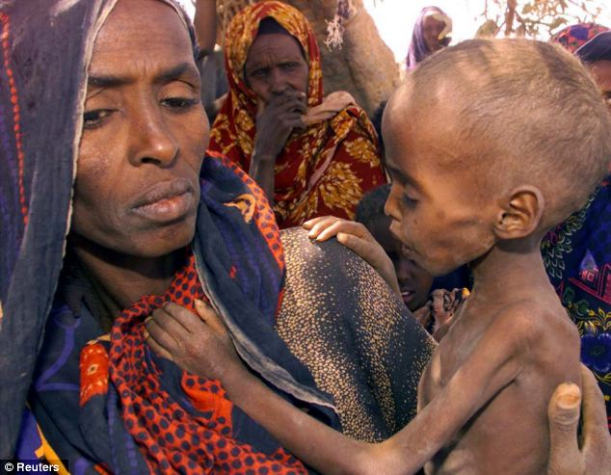
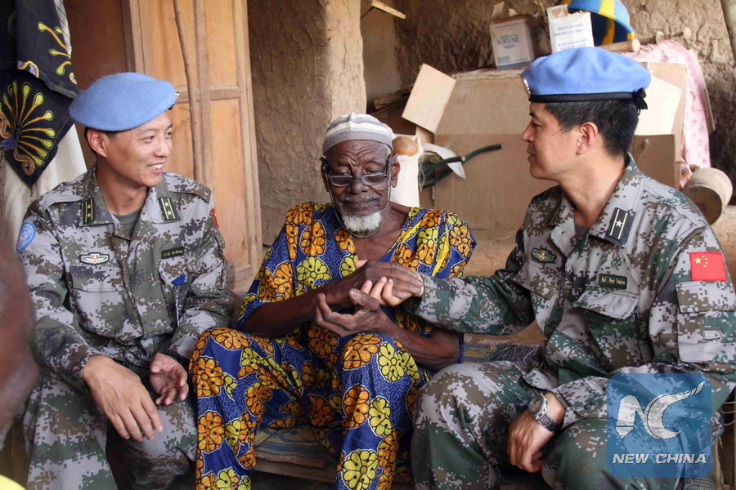
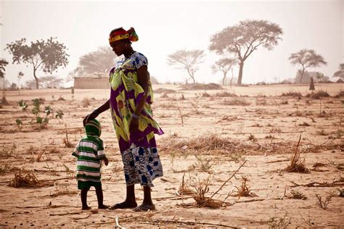
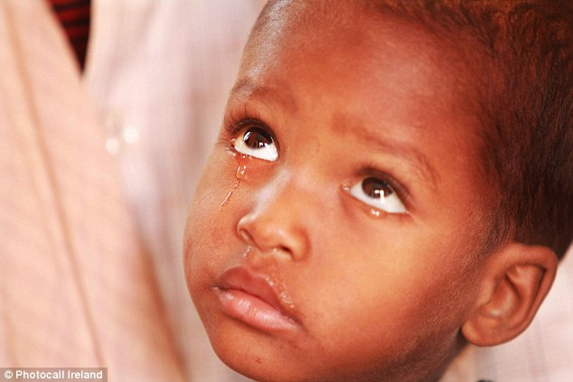
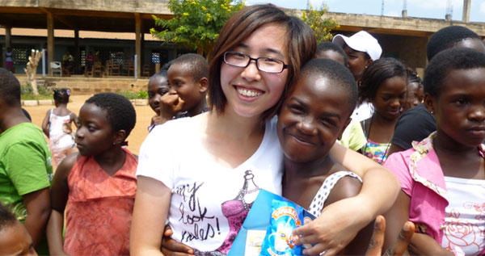
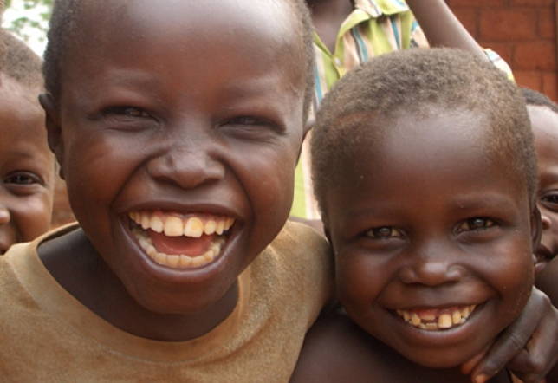
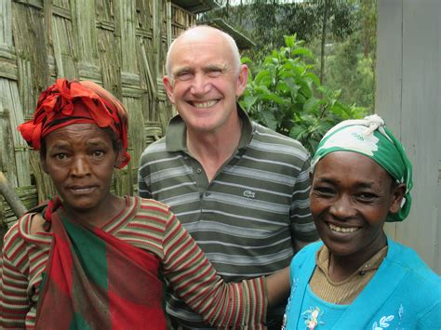
We are the ones who make a brighter day
so let's start giving
We are the world, we are the children

Slide 17
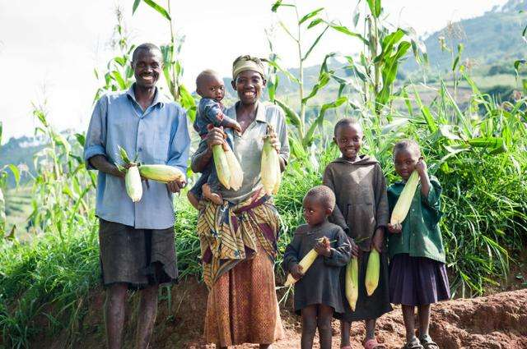
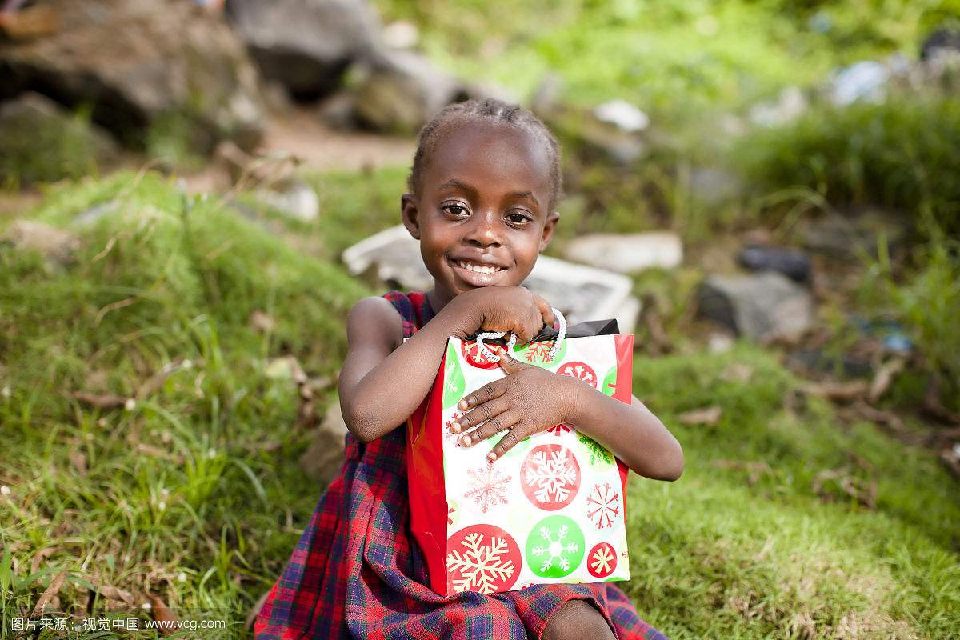
There's a choice we're making
we're saving our own lives
It's true we'll make a better day,
just you and me

Slide 18
Wish no famine in the world any more!

Slide 19
Thank you for your watching!

