Slide 1
Why I Farm
--The Henningsens
教材：人教版M4U2 Working the Land
单位：华南师范大学外国语言文化学院
作者：郑冰纯

Slide 2
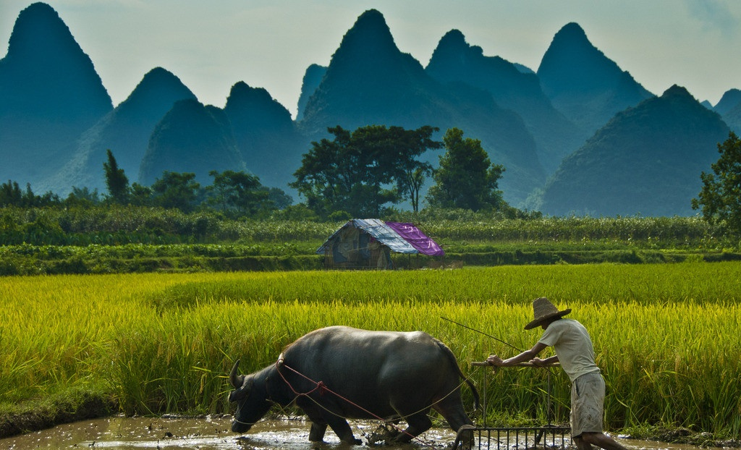
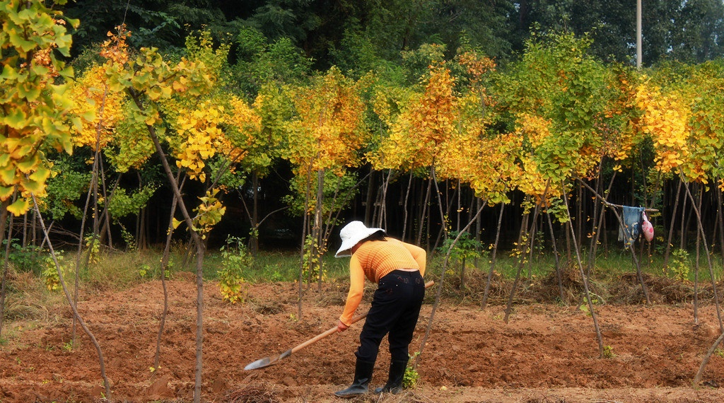
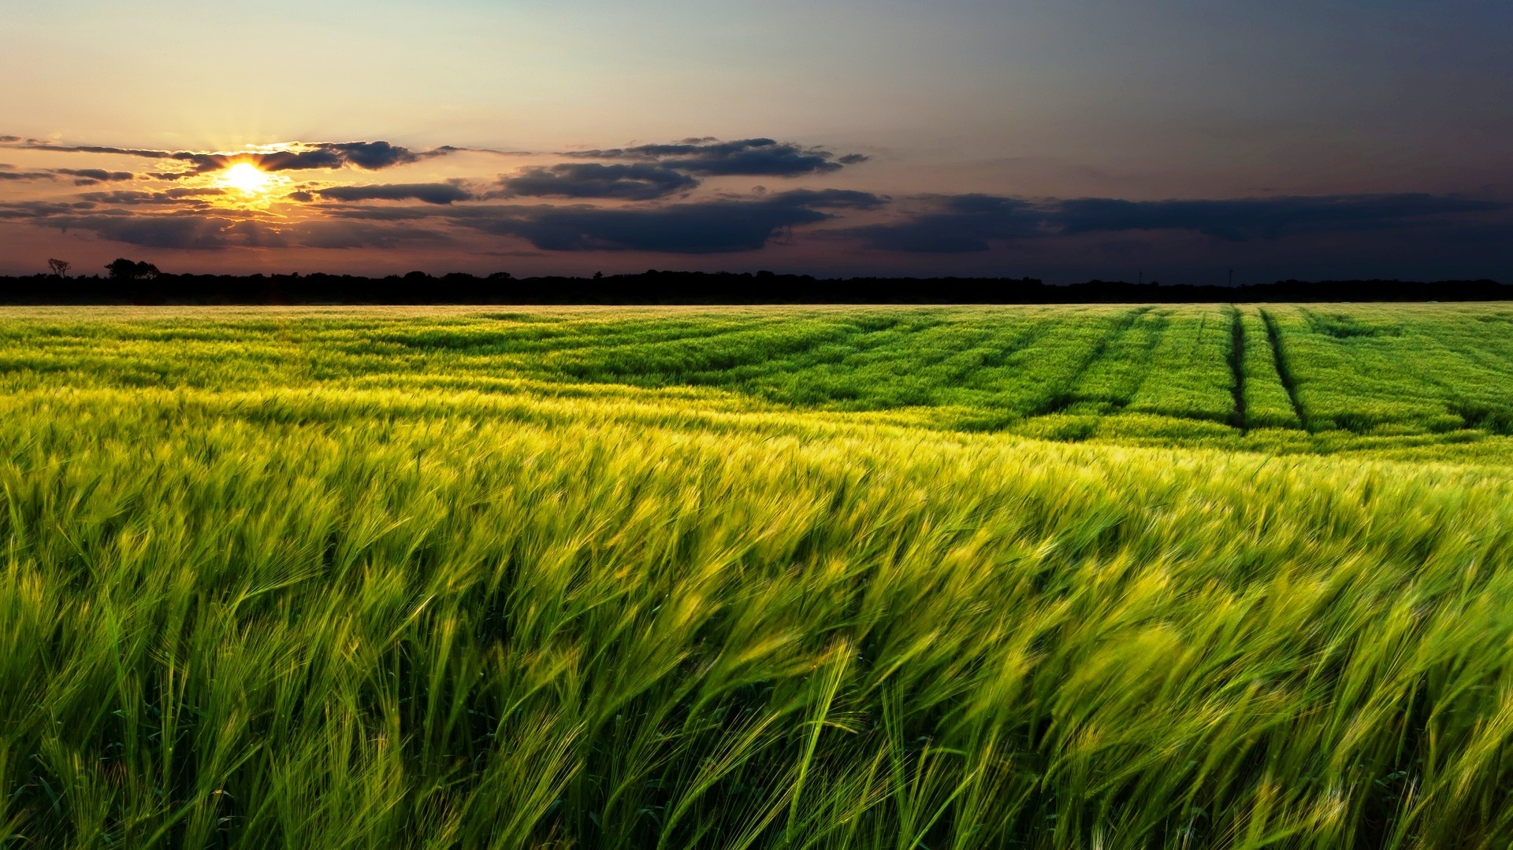
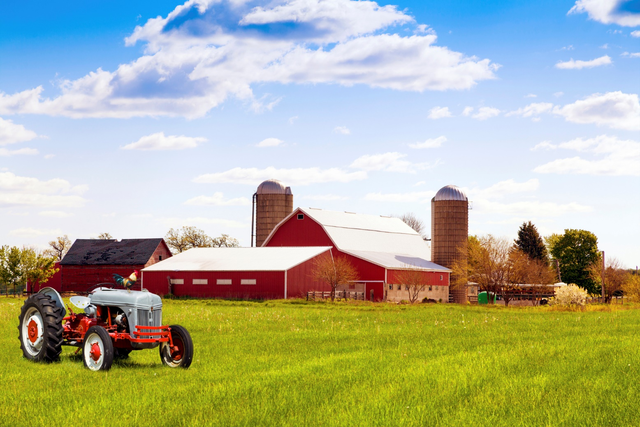

Slide 3
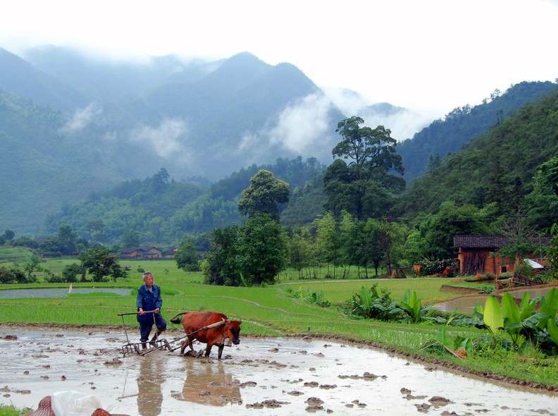
He knows every stone that’s been struck
by the plow

Slide 4
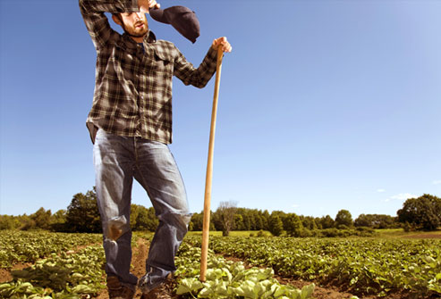
There’s a pile by the barn by the sweat of his brow

Slide 5
The land has his heart and he rarely complains

Slide 6
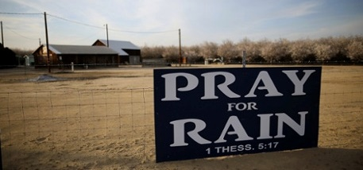
And it holds his knees when he prays for rain
。

Slide 7
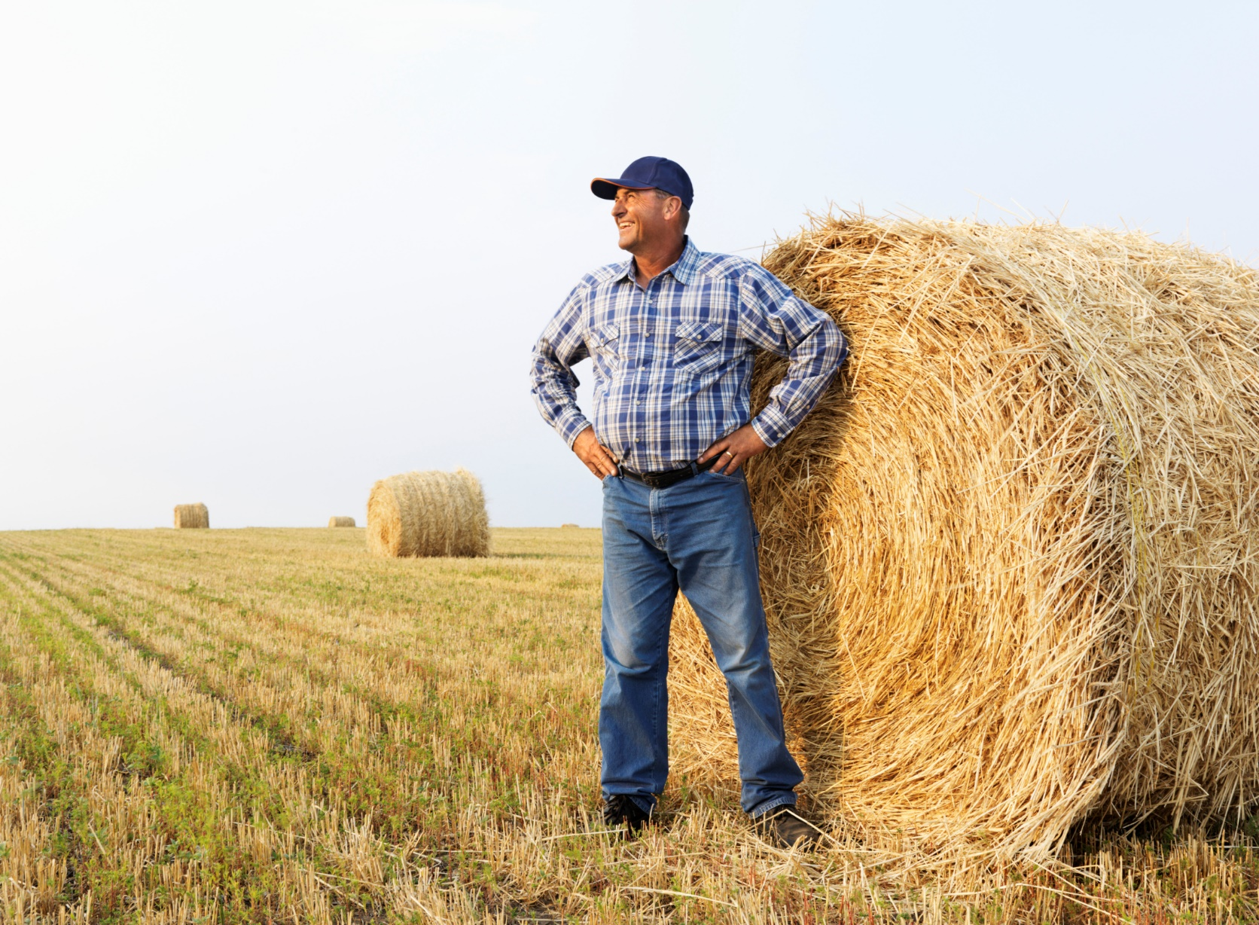
ADD YOUR TITLE.
点击输入您的文字
He’s a dusty old carhartt and the light in the barn

Slide 8
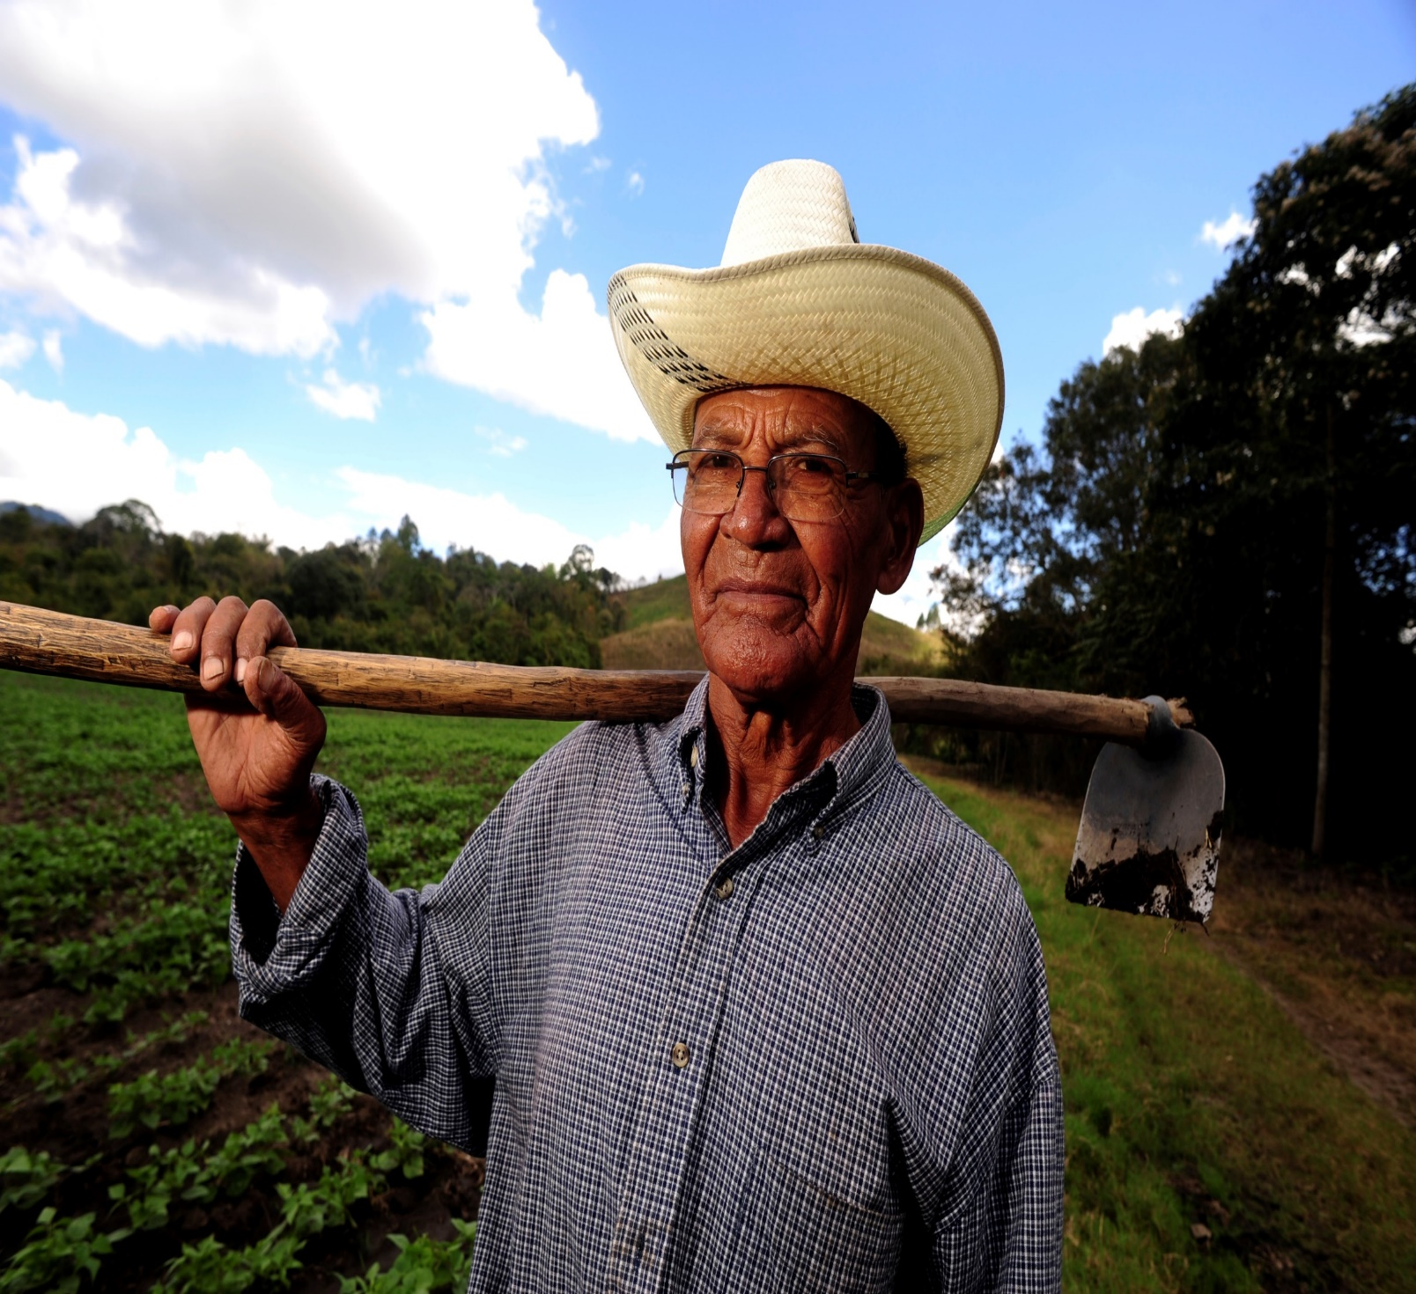
He’ll work the late hours and he’s up before dawn

Slide 9
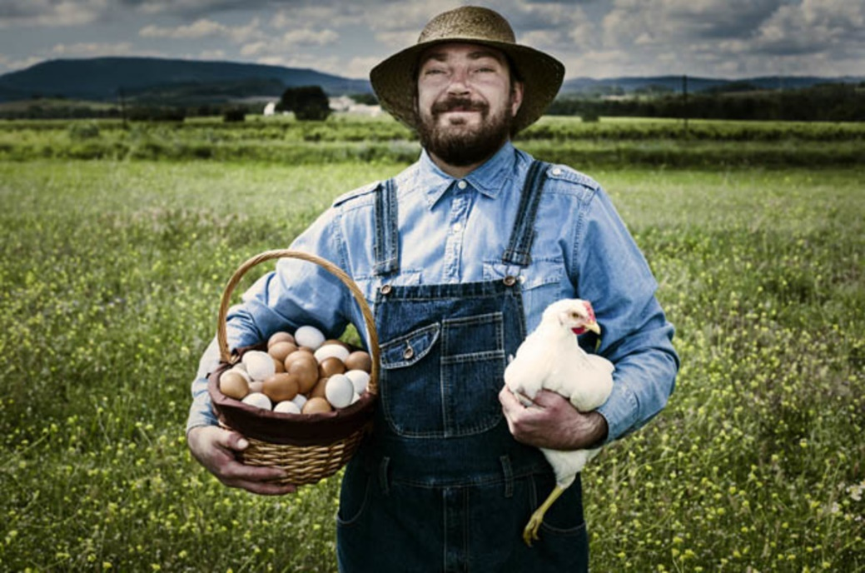
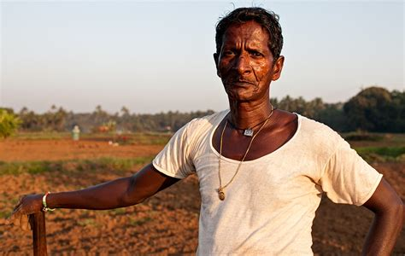
Every man has a story and the story goes on

Slide 10
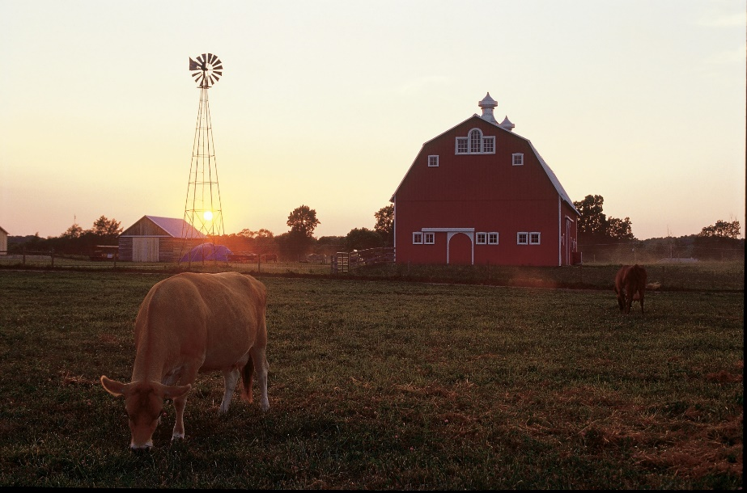
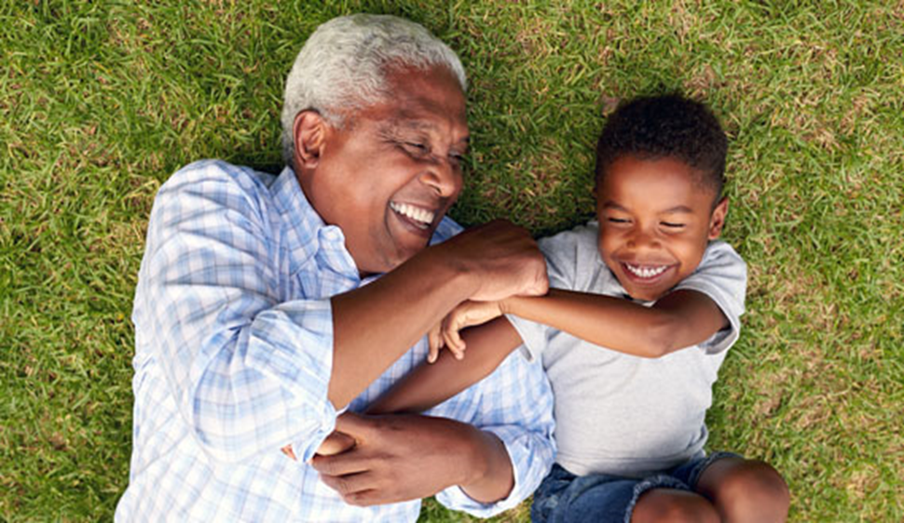
From a grandad’s eyes to a new born son

Slide 11
Why I farm is in my blood, like the sunlight is on my skin

Slide 12
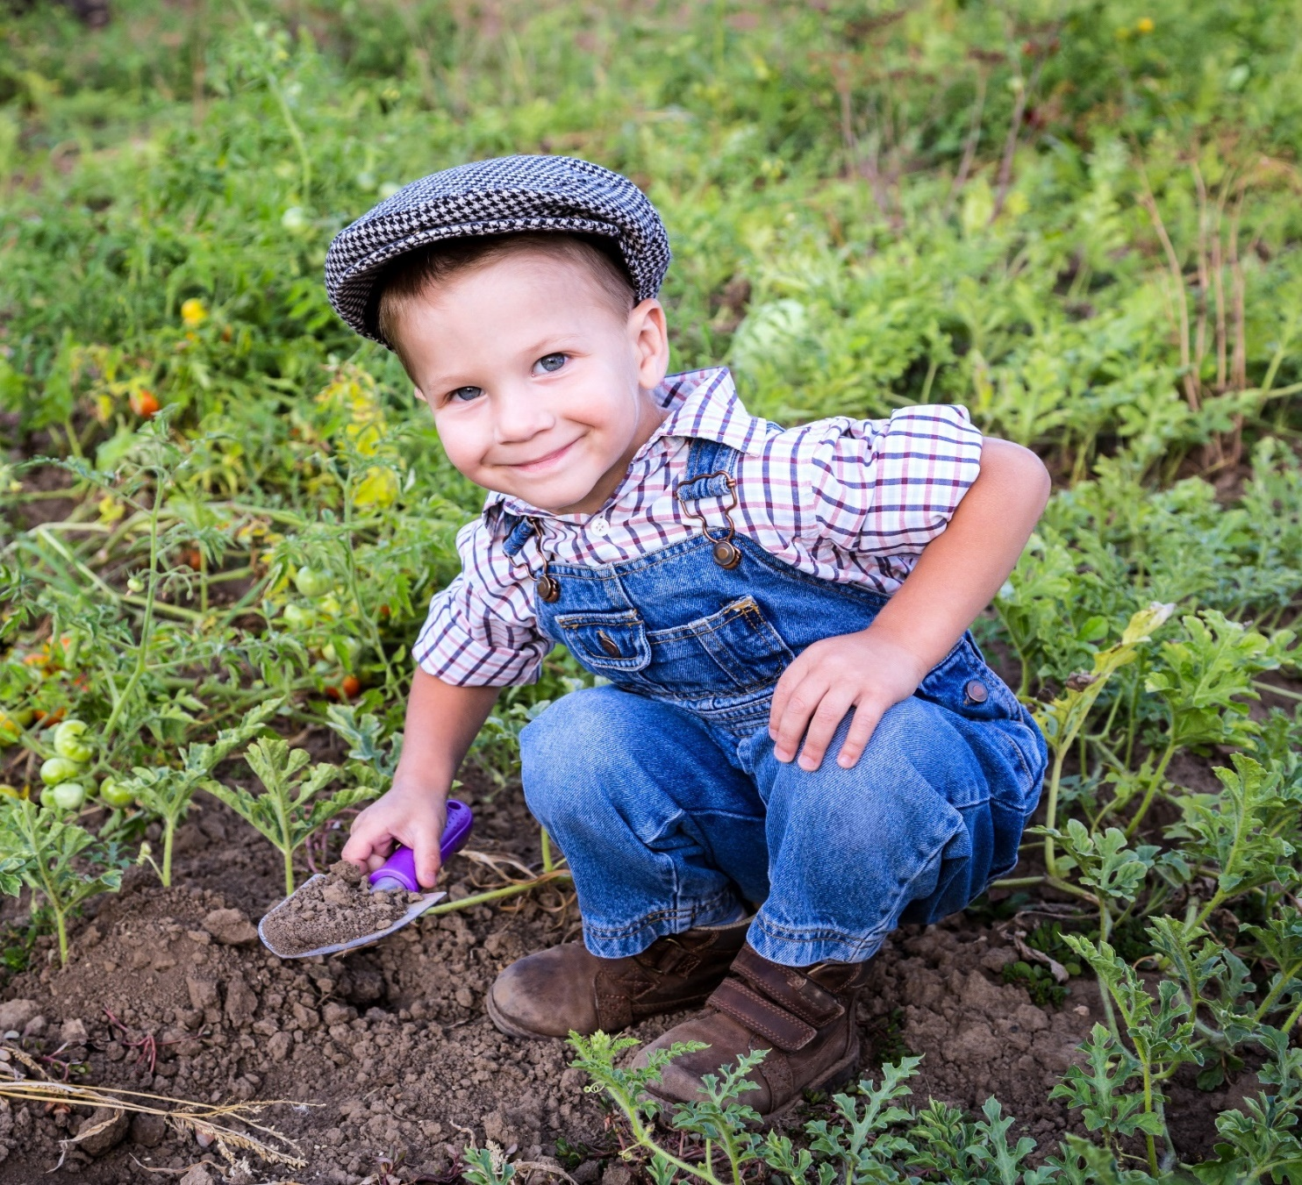
Is who I meant to be,
is who I’ve always been

Slide 13
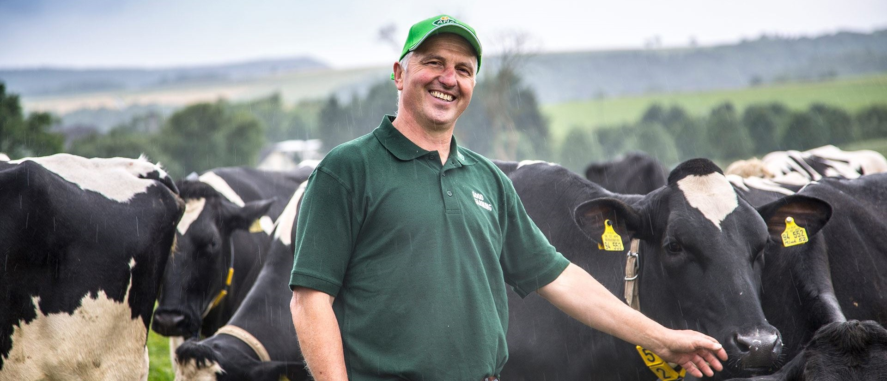
Is more than just a living,
it’s my way of life

Slide 14
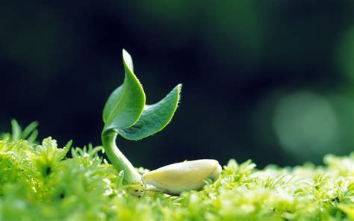
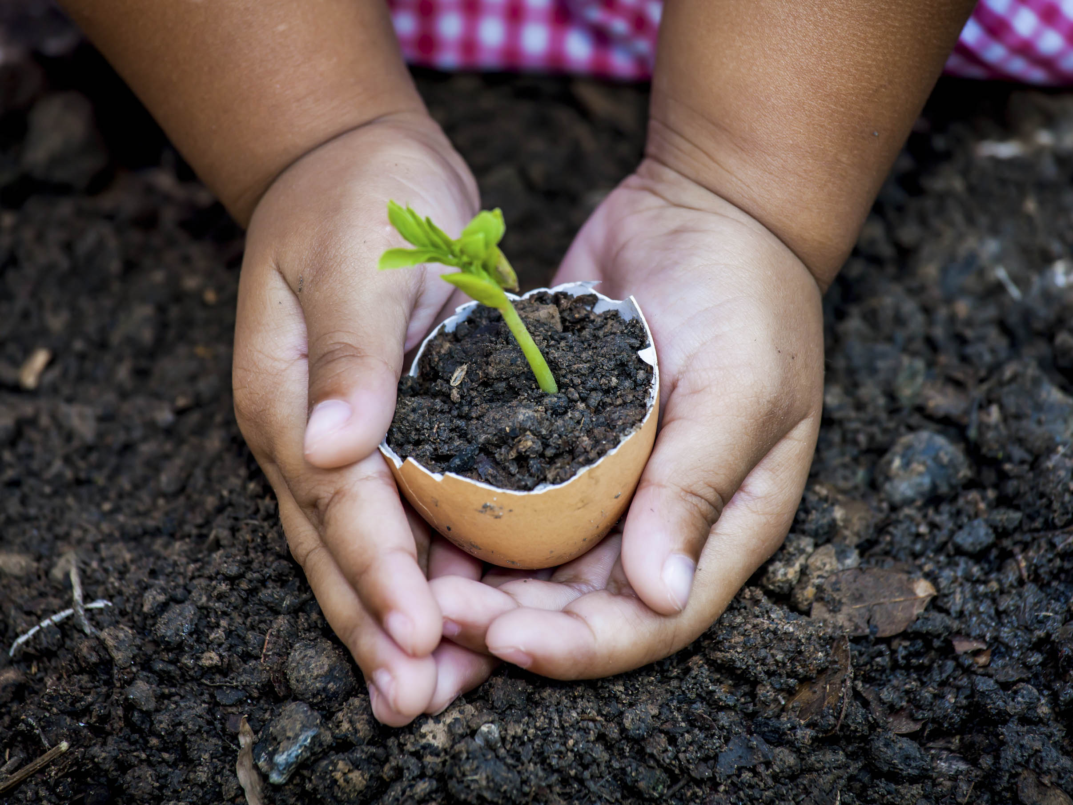
And it grows like
seed inside my heart

Slide 15
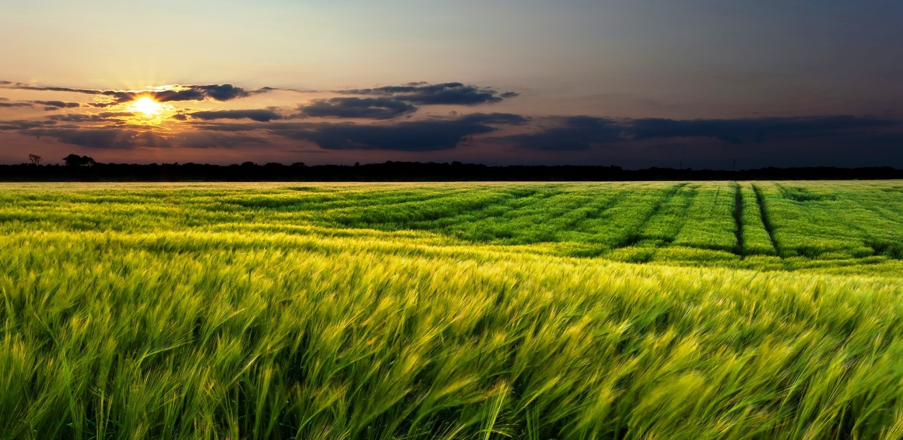
That’s why I farm

Slide 16
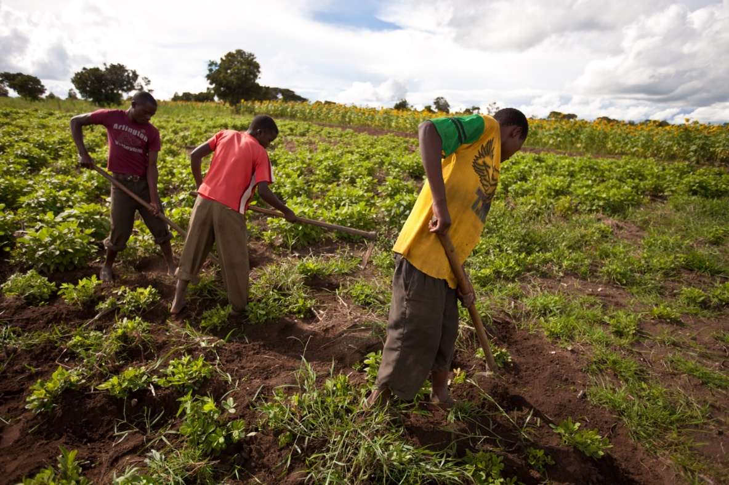
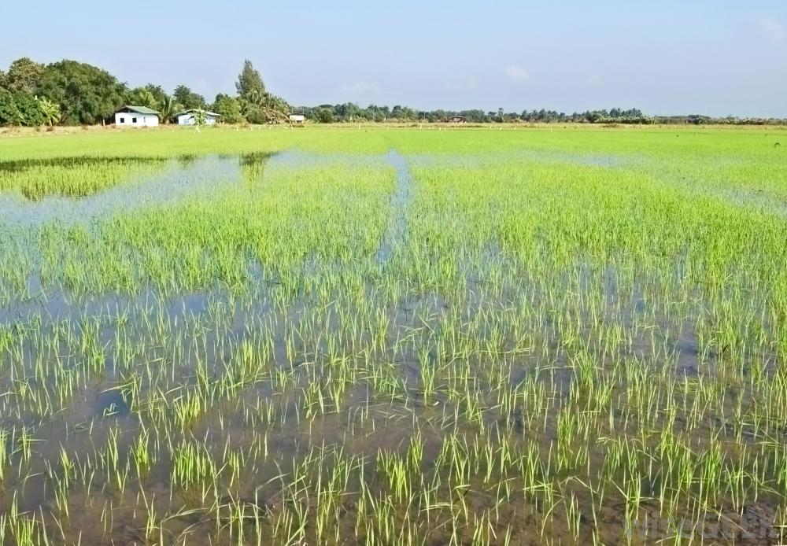
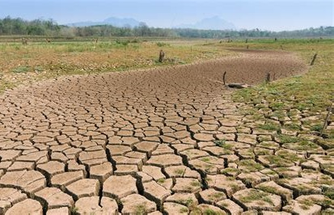
In the flood 93’
in the draught 88’
We always pull through
when we thought
we would brake

Slide 17
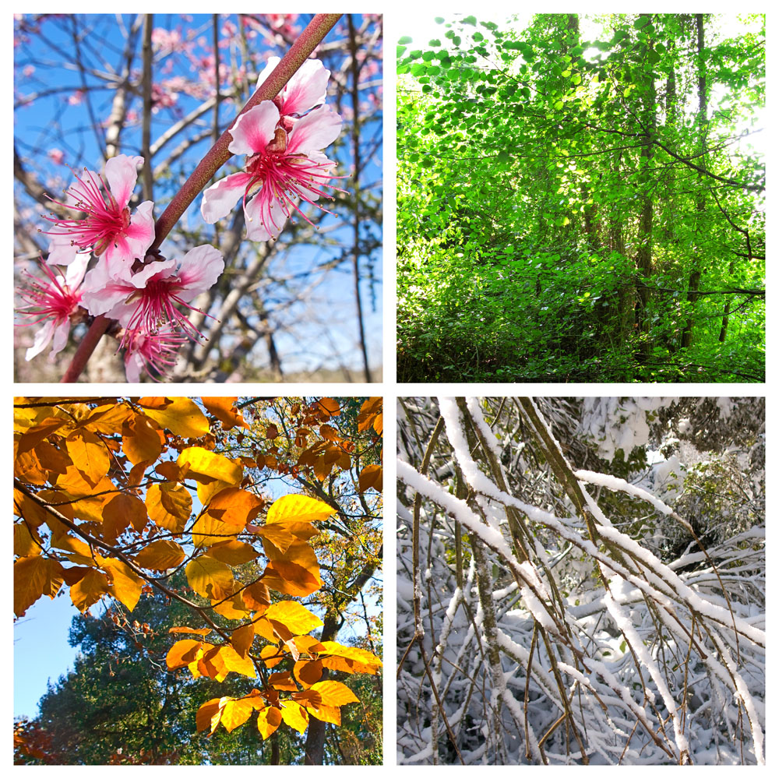
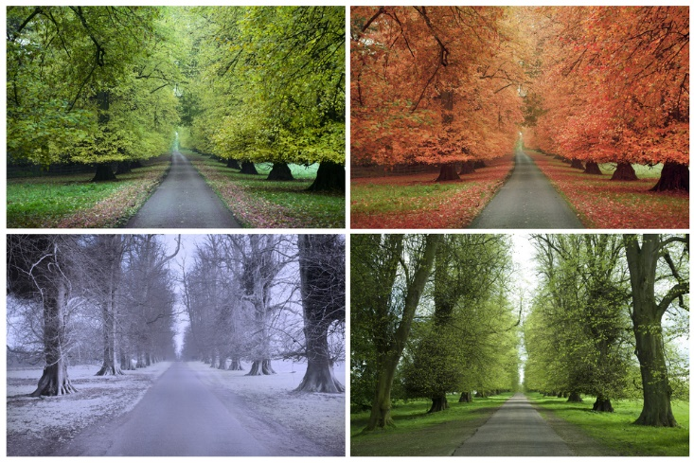
The Lord has his timing ‘cause only he knows

Slide 18
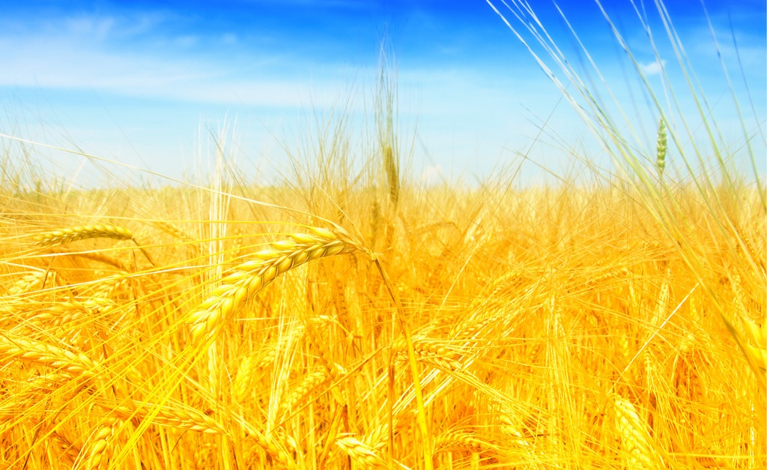
That when next year comes
the crops will grow

Slide 19
Why I farm is
in my blood,
like the sunlight
is on my skin

Slide 20
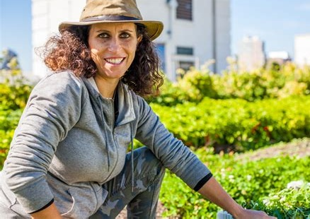
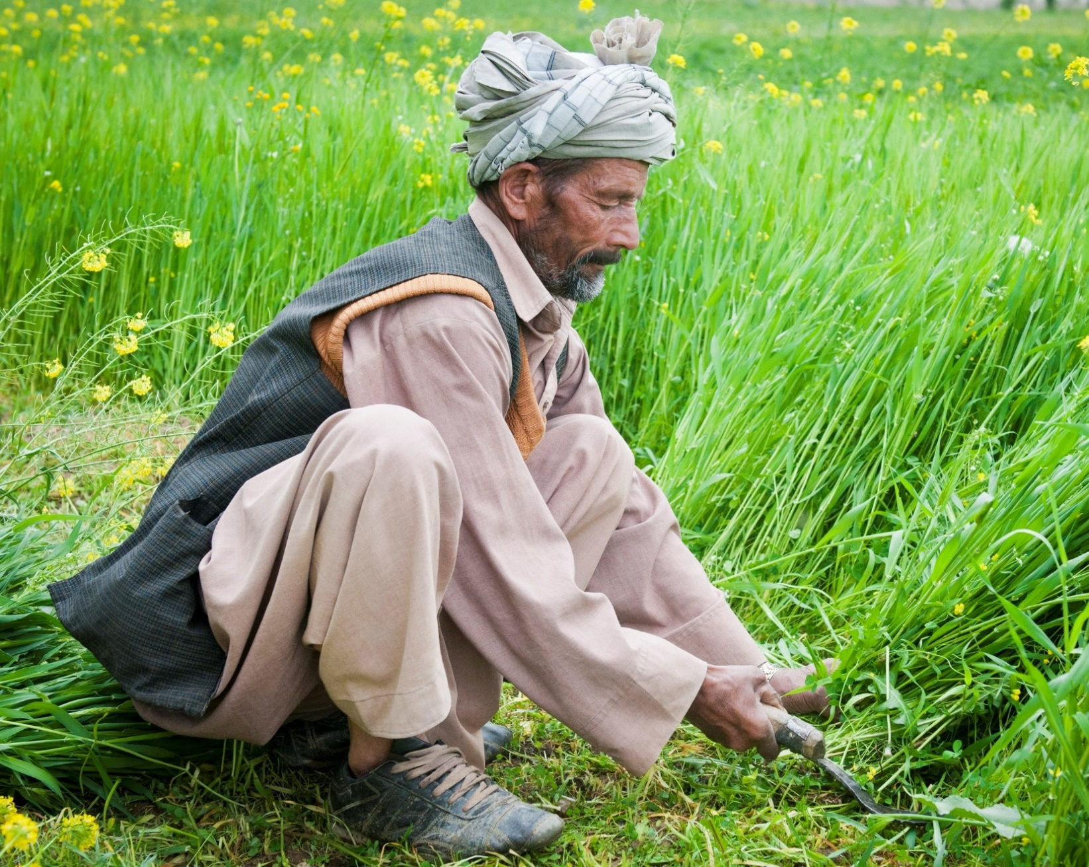
Is who I meant to be,
is who I’ve always been

Slide 21
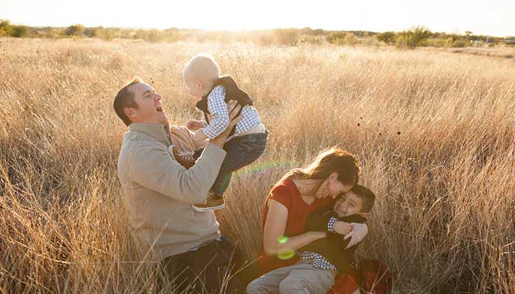
Is more than just a living,
it’s my way of life

Slide 22
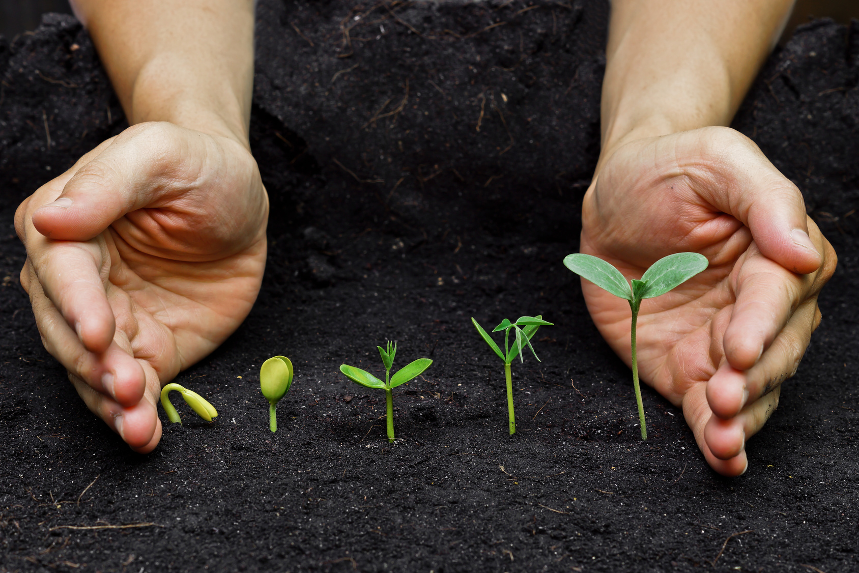
And it grows like seed inside my heart

Slide 23
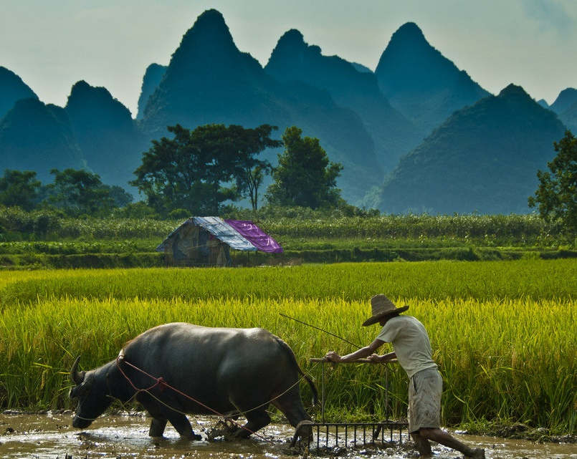
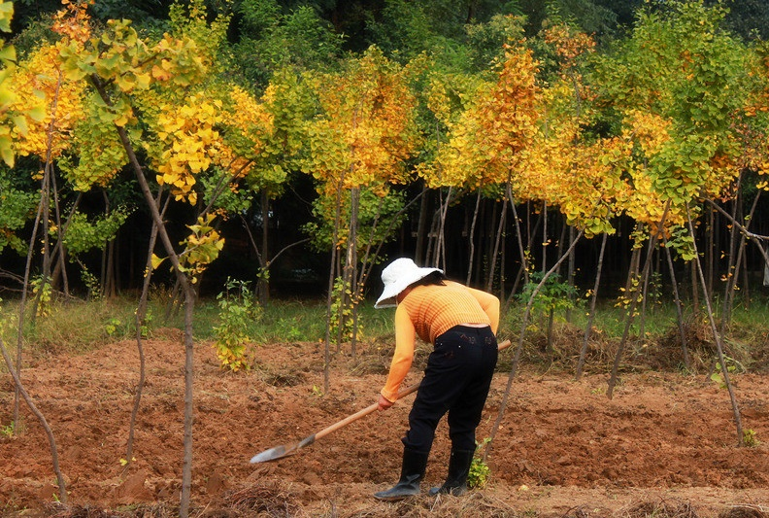
That’s why I farm
That’s why I farm

Slide 24
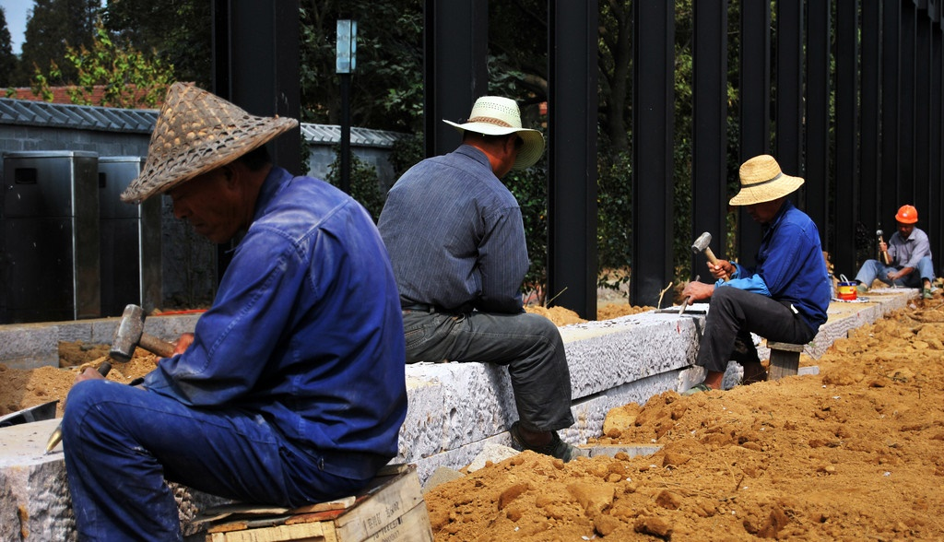
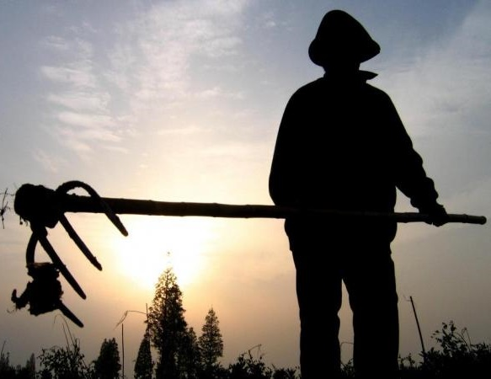
Though the world
may shake
around me
still I am stable
[Still I am stable]

Slide 25
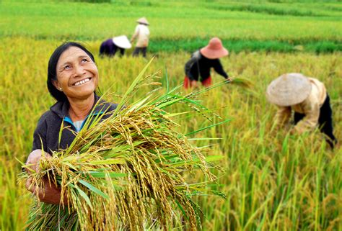
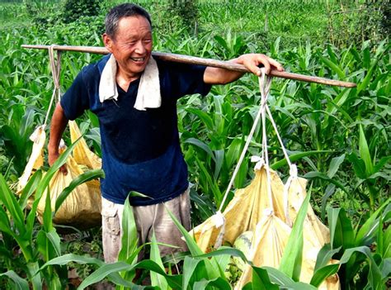
For as long as I am able
[I am able],
I’ll work this way
[It’s who I am]
标题文本预设
此部分内容作为文字排版占位显示
标题文本预设
此部分内容作为文字排版占位显示
标题文本预设
此部分内容作为文字排版占位显示

Slide 26
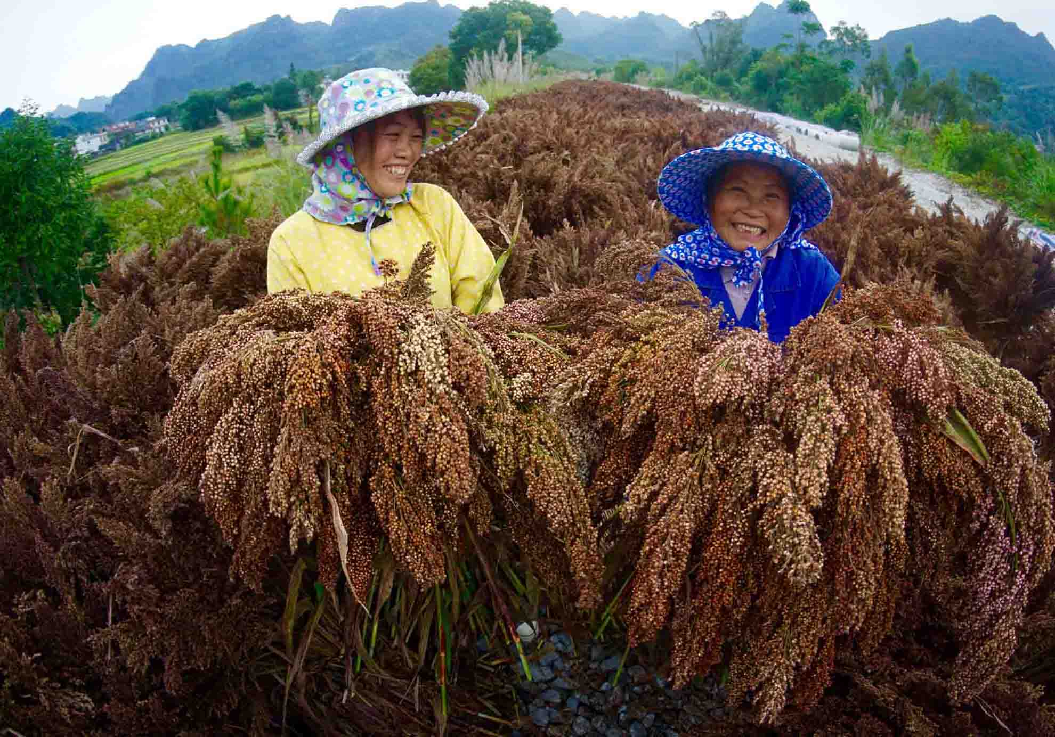
ADD YOUR TITLE.
‘Cause when heaven comes
this close to what you’re holding [Holding]
点击输入您的文字

Slide 27
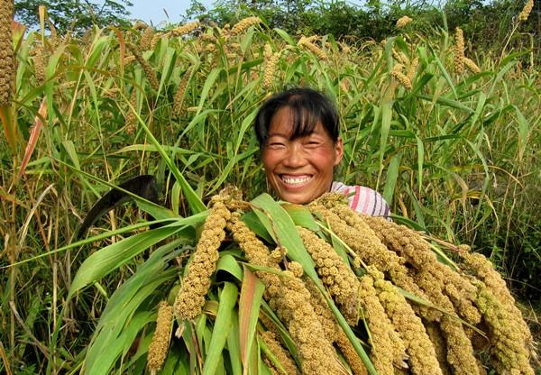
‘‘This life is but a
moment in a bigger plan

Slide 28
Why I farm is in my blood,
like the sunlight is on my skin [That’s why I farm]

Slide 29
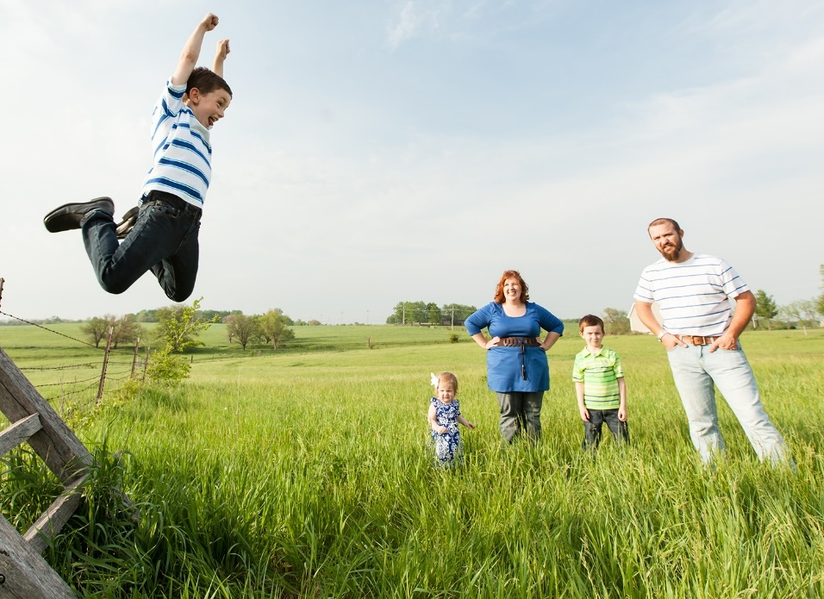
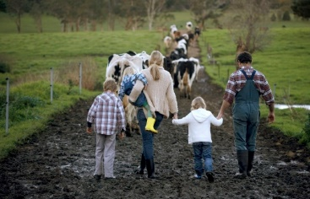
Is who I meant to be,
is who I’ve always been

Slide 30
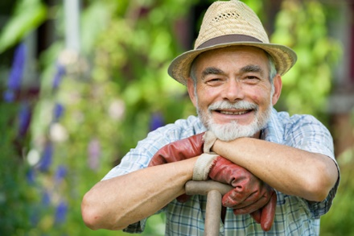
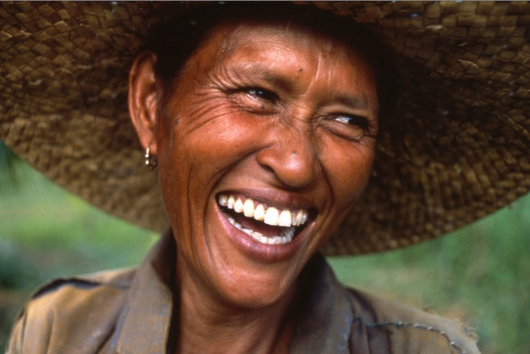
Is more than just a living,
is my way of life

Slide 31
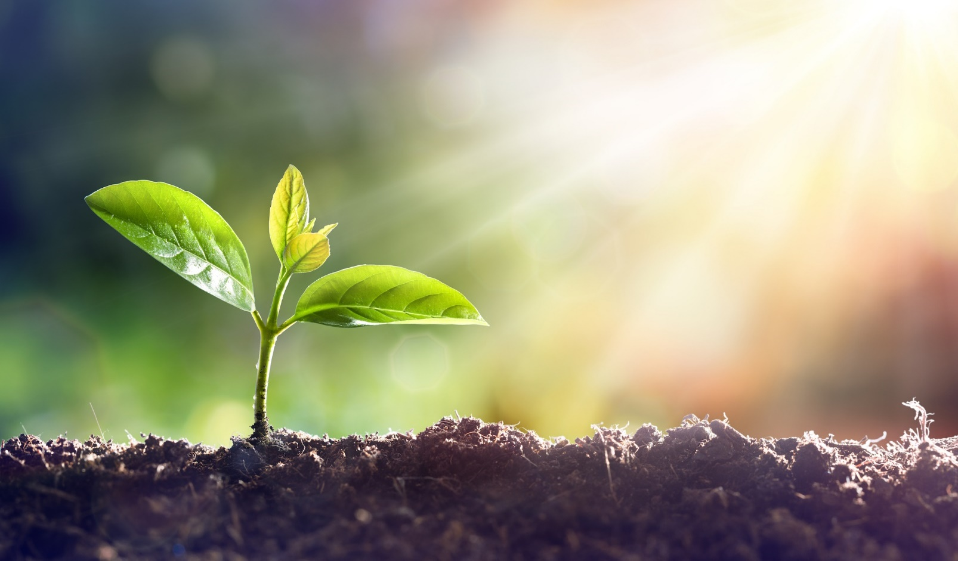
And it grows like seed inside my heart

Slide 32
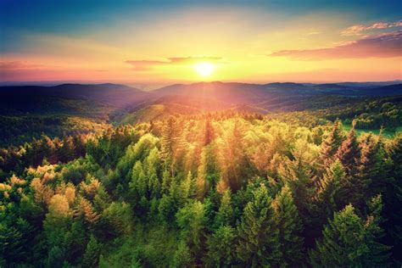
Living on long after I depart

Slide 33
That’s why I farm
That’s why I farm

