Slide 1
高中
人教版
M4U3 A taste of English humor
— HAPPY by Pharrell Williams
制作：沈艳媛
华南师范大学外文学院

Slide 2
WHAT MAKES
YOU HAPPY？

Slide 3
MIGHT
IT
CRAZY
SEEM
WHAT
I'M
ABOUT
SAY
TO

Slide 4
SUNSHINE
SHE'S
HERE
YOU
TAKE
CAN
A
BREAK

Slide 5
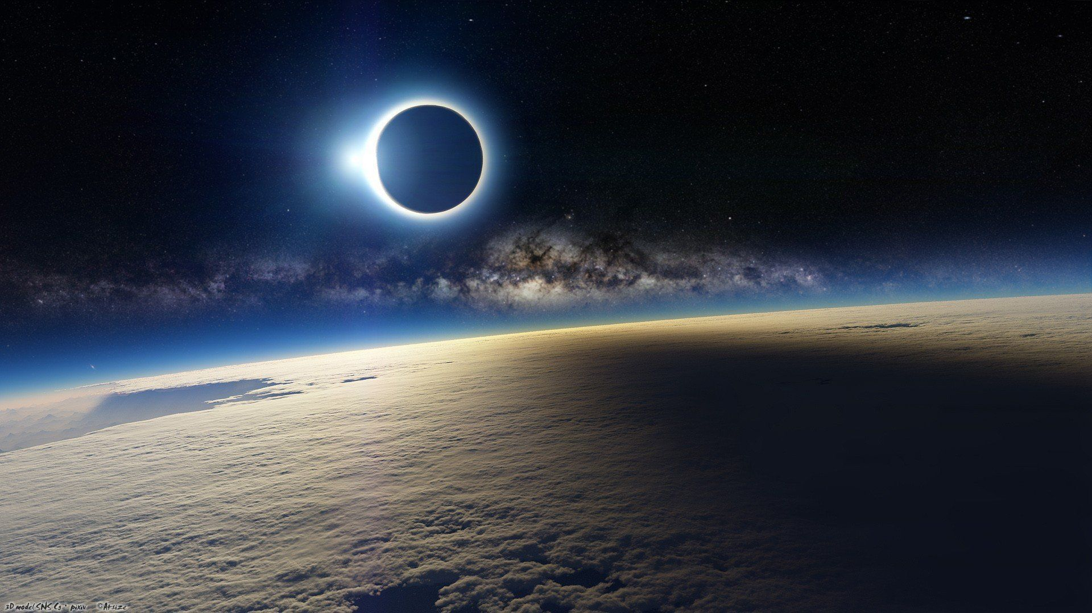
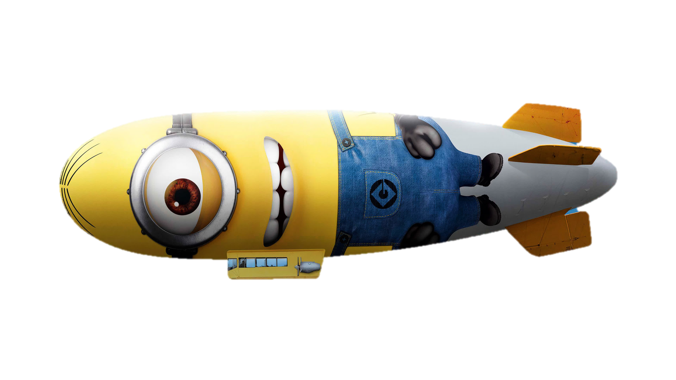
I'M A
HOT AIR BALLOON
THAT COULD GO TO
SPACE

Slide 6
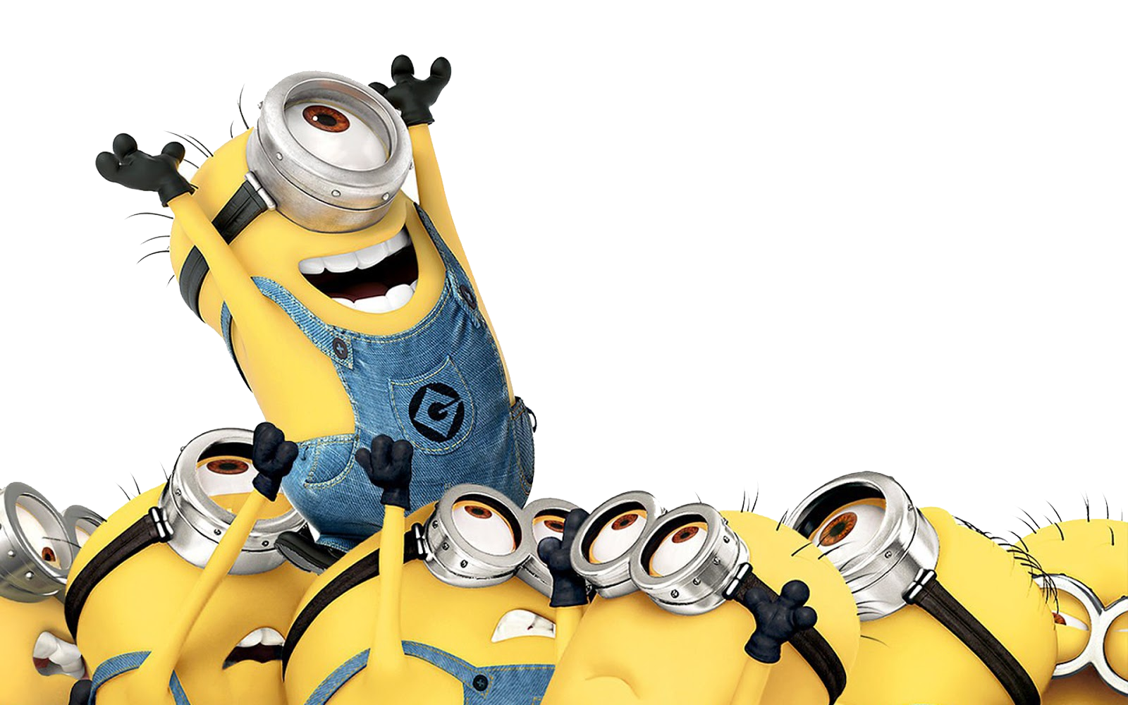
WITH THE AIR
LIKE I DON'T CARE
BABY
BY THE WAY

Slide 7
BECAUSE
CLAP ALONG IF YOU FEEL LIKE A ROOM WITHOUT A ROOF
I'M HAPPY

Slide 8
CLAP ALONG
IF YOU
FEEL LIKE
HAPPINESS
IS THE
TRUTH

Slide 9
BECAUSE
I'M HAPPY
CLAP ALONG IF YOU KNOW WHAT HAPPINESS IS TO YOU
CLAP ALONG IF YOU KNOW WHAT HAPPINESS IS TO YOU
CLAP ALONG IF YOU KNOW WHAT HAPPINESS IS TO YOU

Slide 10
BECAUSE
I'M
CLAP ALONG IF YOU FEEL LIKE
THAT'S WHAT YOU WANT TO DO

Slide 11
HERE COMES
BAD NEWS
TALKING
THIS AND THAT

Slide 12
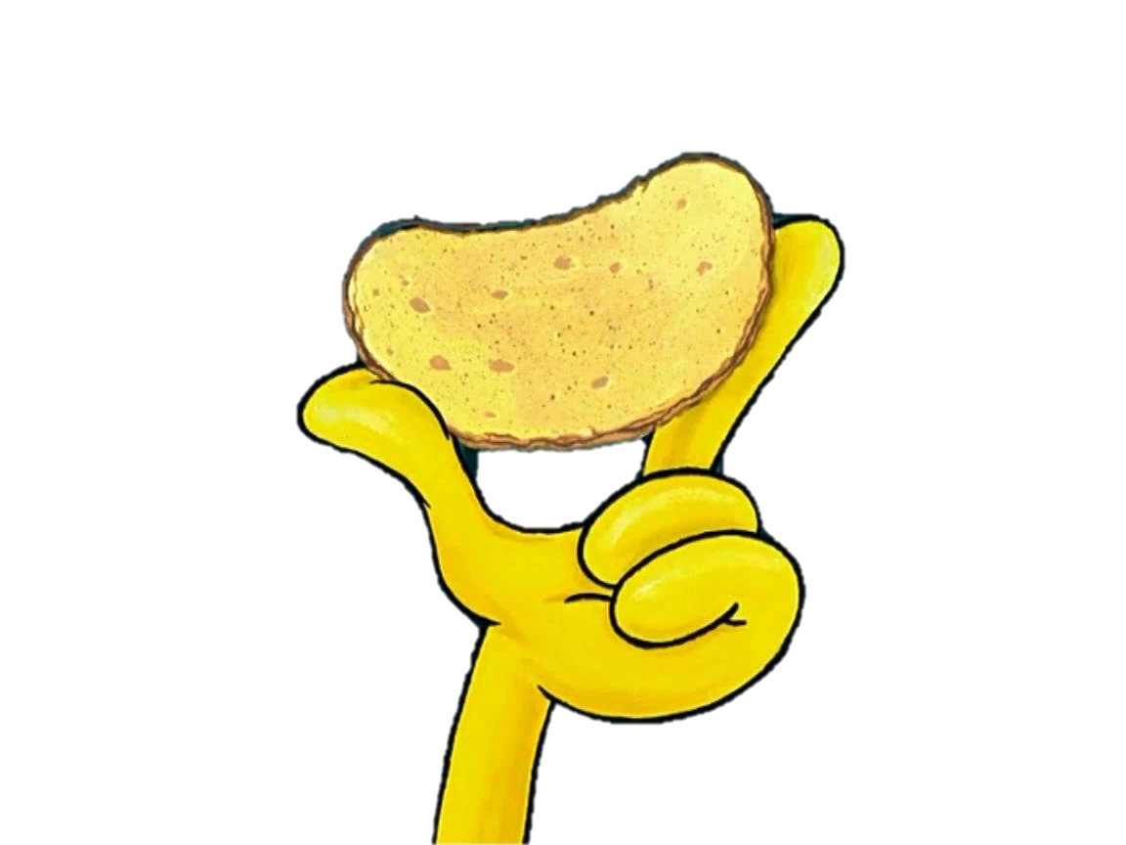
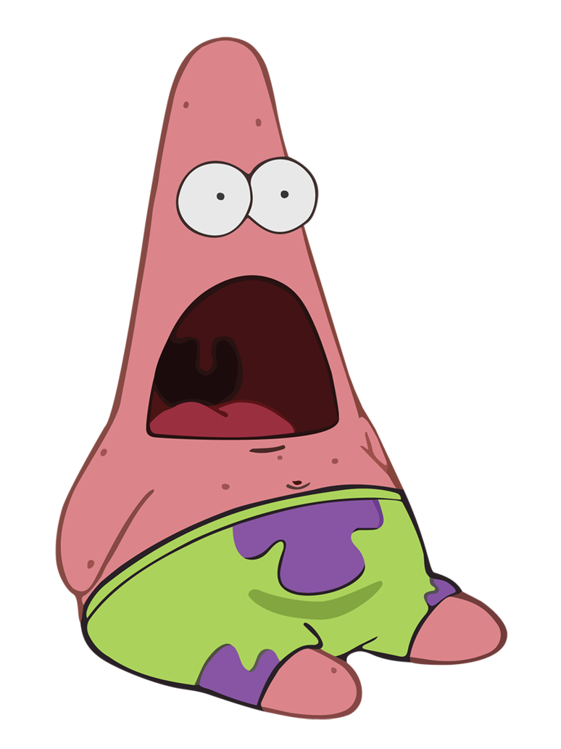
BUT GIVE ME
ALL YOU'VE GOT
AND DON'T
HOLD IT BACK

Slide 13
WELL
I SHOULD PROBABLY
WARN YOU
I'LL BE JUST
FINE

Slide 14
NO OFFENSE TO YOU
DON'T WASTE YOUR TIME
HERE'S WHY

Slide 15
BECAUSE
CLAP ALONG IF YOU FEEL LIKE A ROOM WITHOUT A ROOF
I'M HAPPY

Slide 16
CLAP ALONG
IF YOU
FEEL LIKE
HAPPINESS
IS THE
TRUTH

Slide 17
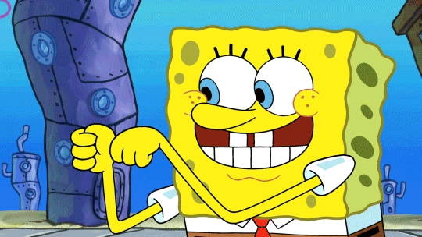
BECAUSE
I'M HAPPY
CLAP ALONG IF YOU KNOW WHAT HAPPINESS IS TO YOU
CLAP ALONG IF YOU KNOW WHAT HAPPINESS IS TO YOU
CLAP ALONG IF YOU KNOW WHAT HAPPINESS IS TO YOU

Slide 18
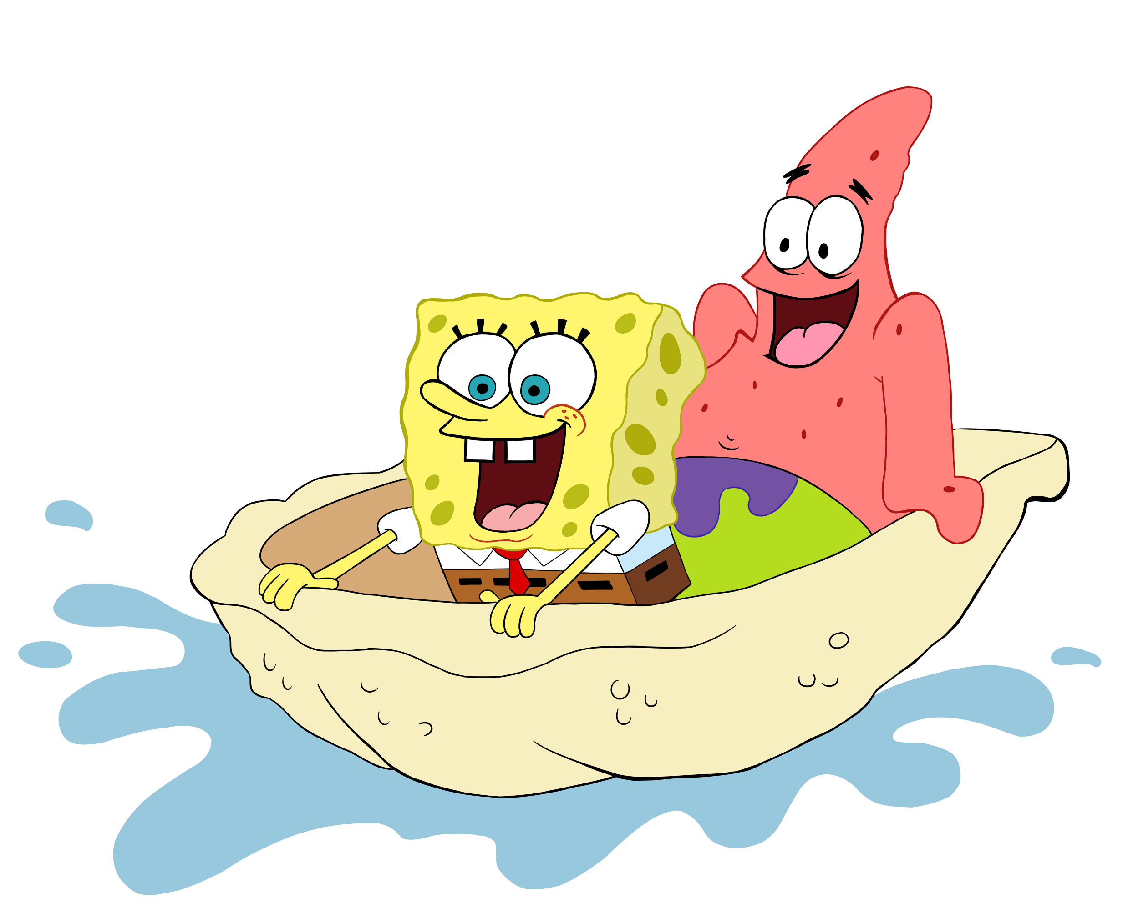
BECAUSE
I'M
CLAP ALONG IF YOU FEEL LIKE
THAT'S WHAT YOU WANT TO DO

Slide 19
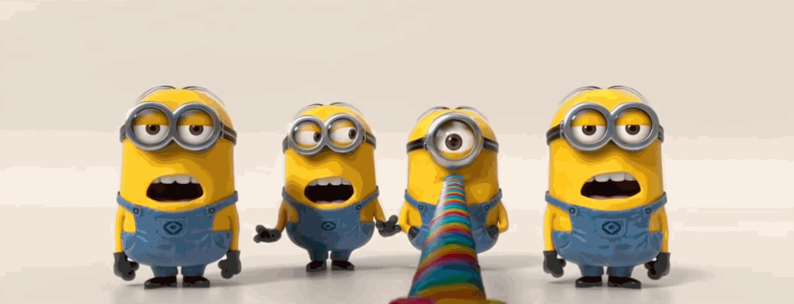

Slide 24
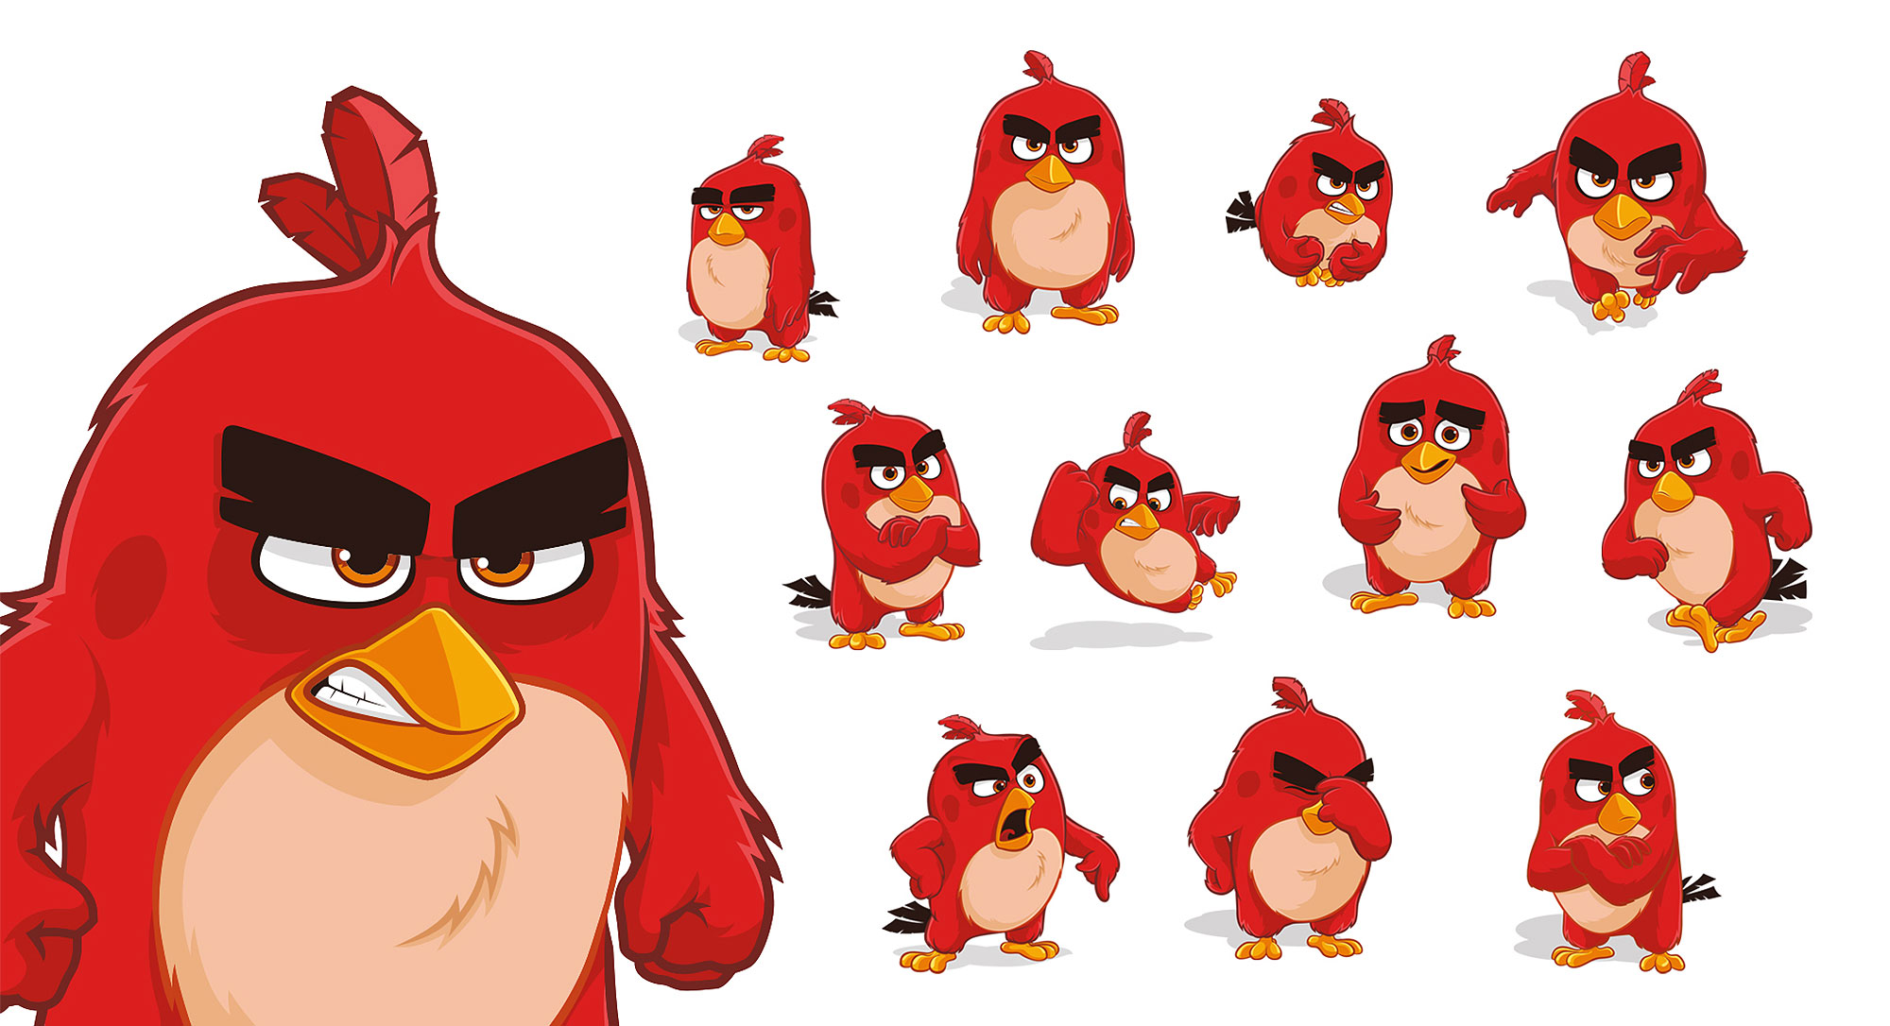

Slide 25
BECAUSE
CLAP ALONG IF YOU FEEL LIKE A ROOM WITHOUT A ROOF
I'M HAPPY

Slide 26
CLAP ALONG
IF YOU
FEEL LIKE
HAPPINESS
IS THE
TRUTH

Slide 27
BECAUSE
I'M HAPPY
CLAP ALONG IF YOU KNOW WHAT HAPPINESS IS TO YOU
CLAP ALONG IF YOU KNOW WHAT HAPPINESS IS TO YOU
CLAP ALONG IF YOU KNOW WHAT HAPPINESS IS TO YOU

Slide 28
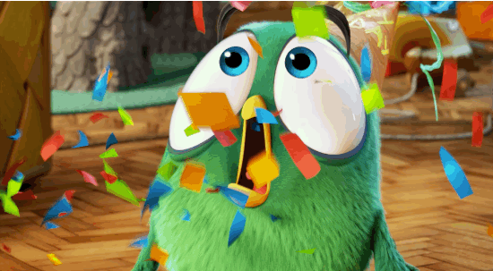
BECAUSE
I'M
CLAP ALONG IF YOU FEEL LIKE
THAT'S WHAT YOU WANT TO DO

Slide 29
BECAUSE
CLAP ALONG IF YOU FEEL LIKE A ROOM WITHOUT A ROOF
I'M HAPPY

Slide 30
CLAP ALONG
IF YOU
FEEL LIKE
HAPPINESS
IS THE
TRUTH

Slide 31
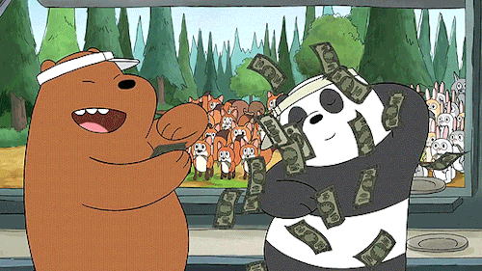
BECAUSE
I'M HAPPY
CLAP ALONG IF YOU KNOW WHAT HAPPINESS IS TO YOU
CLAP ALONG IF YOU KNOW WHAT HAPPINESS IS TO YOU
CLAP ALONG IF YOU KNOW WHAT HAPPINESS IS TO YOU

Slide 32
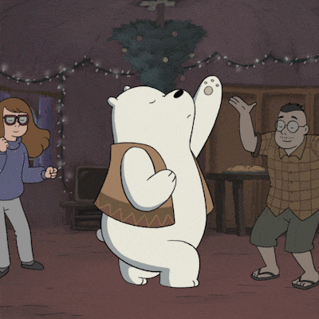
BECAUSE
I'M
CLAP ALONG IF YOU FEEL LIKE
THAT'S WHAT YOU WANT TO DO

Slide 34
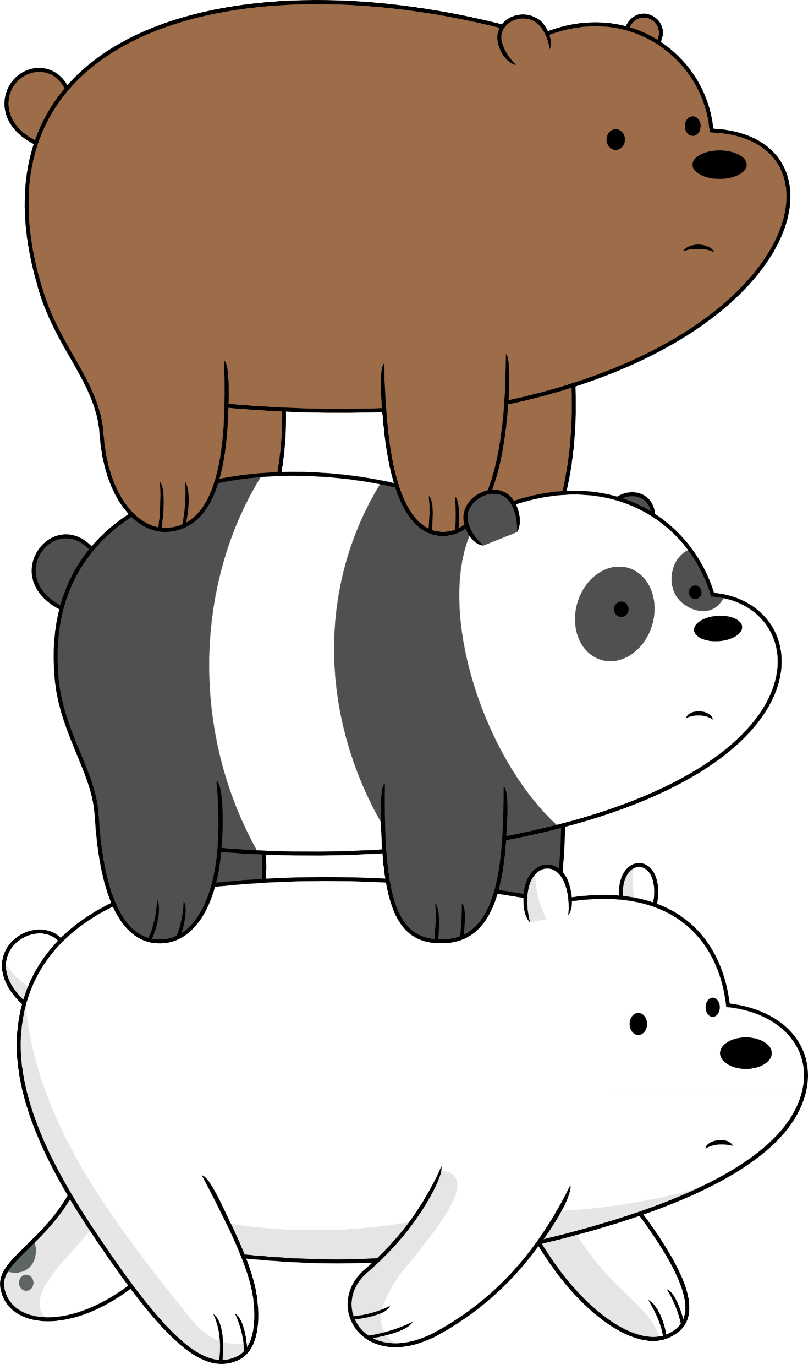

Slide 36
BECAUSE
I'M HAPPY

Slide 37
CLAP ALONG IF YOU FEEL
LIKE A ROOM WITHOUT A ROOF

Slide 38
CLAP ALONG
IF YOU
FEEL LIKE
HAPPINESS
IS THE
TRUTH

Slide 39
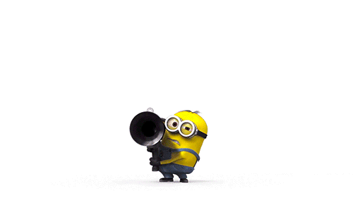
BECAUSE
I'M HAPPY
CLAP ALONG IF YOU KNOW
WHAT HAPPINESS IS TO YOU

Slide 40
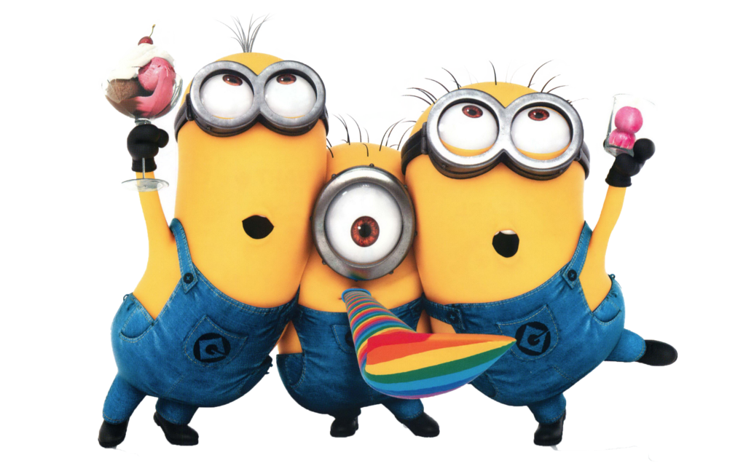
BECAUSE
I'M
CLAP ALONG IF YOU FEEL LIKE
THAT'S WHAT YOU WANT TO DO

Slide 41
BECAUSE
CLAP ALONG IF YOU FEEL LIKE A ROOM WITHOUT A ROOF
I'M HAPPY

Slide 42
CLAP ALONG
IF YOU
FEEL LIKE
HAPPINESS
IS THE
TRUTH

Slide 43
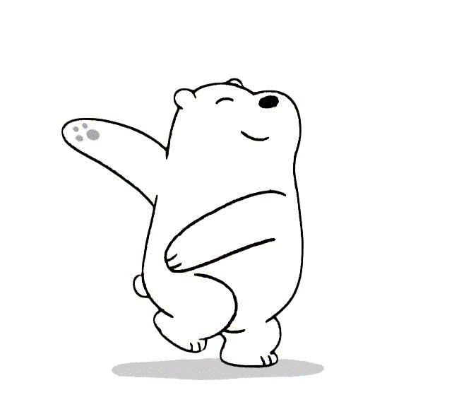
BECAUSE
I'M HAPPY
CLAP ALONG IF YOU KNOW WHAT HAPPINESS IS TO YOU
CLAP ALONG IF YOU KNOW WHAT HAPPINESS IS TO YOU

Slide 44
Funny comedy
is a kind of HUMOR
BECAUSE
I'M
CLAP ALONG IF YOU FEEL LIKE
THAT'S WHAT YOU WANT TO DO

