Slide 1
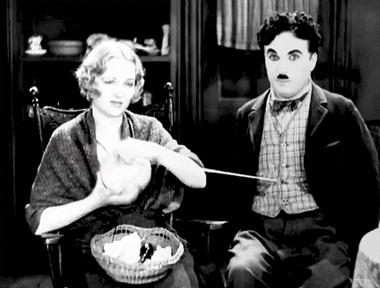
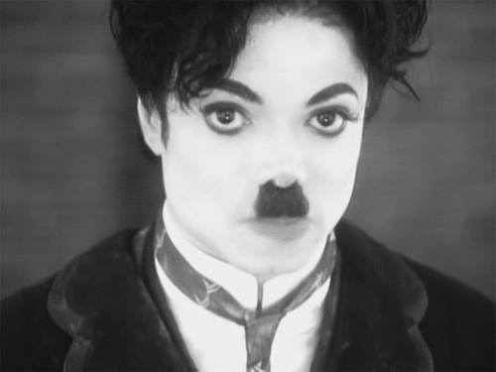
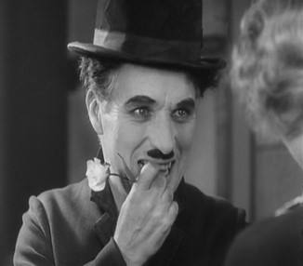
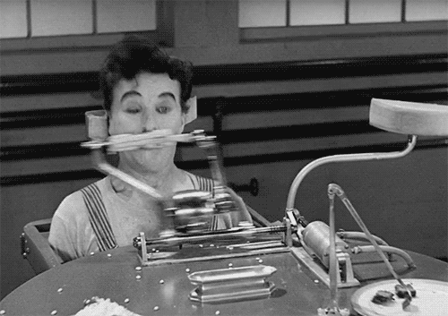
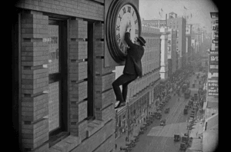
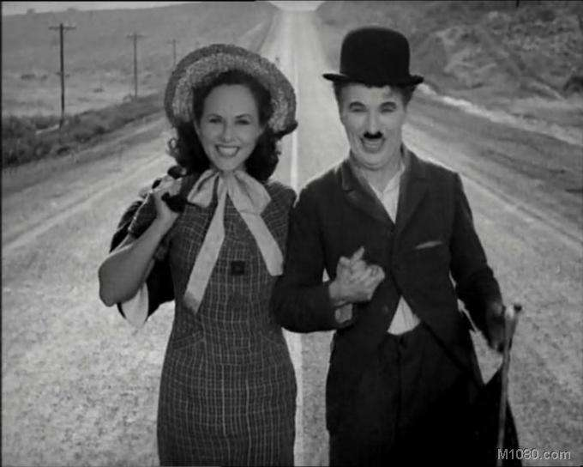
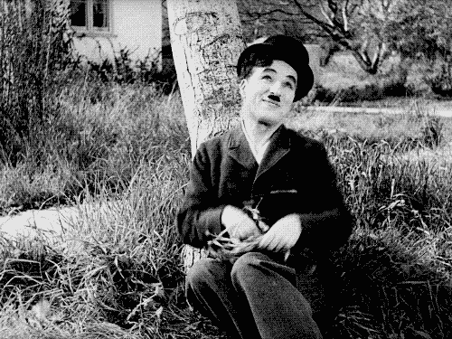
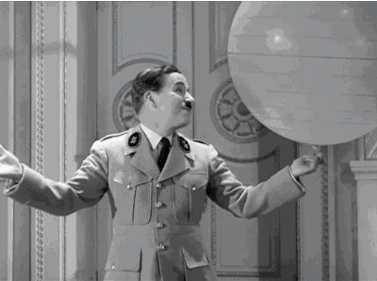
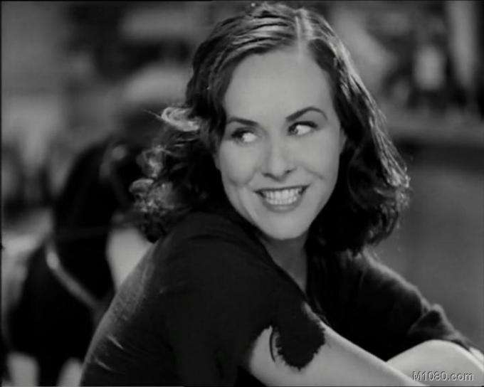
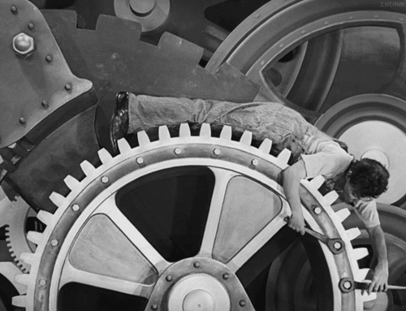
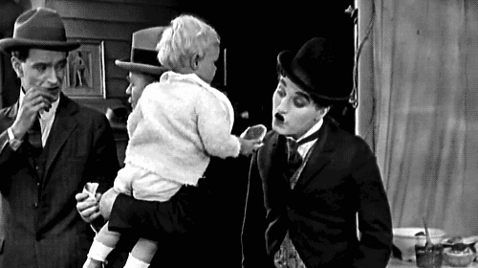
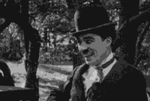
All people love
you still
We'll be laughing
There's something
You can tell us
That worse just couldn't say
You 'll stay a good old friend
and having fun with you
Oh Charly
Oh Charly Chaplin
And your song will never die
In your own special way
Oh Charly
Charly Chaplin
Oh Charly
Oh Charly Chaplin
Tell the world the reason why
Oh Charly
Oh Charly Chaplin
Tears and laughter
belong together
Oh Charly Oh Charly Chaplin
Silent movies will live forever
From London town
to Beverly hills
And our laughing will teach us gently
And though you'll come back never again
Oh Charly Charly Chaplin

