Slide 1
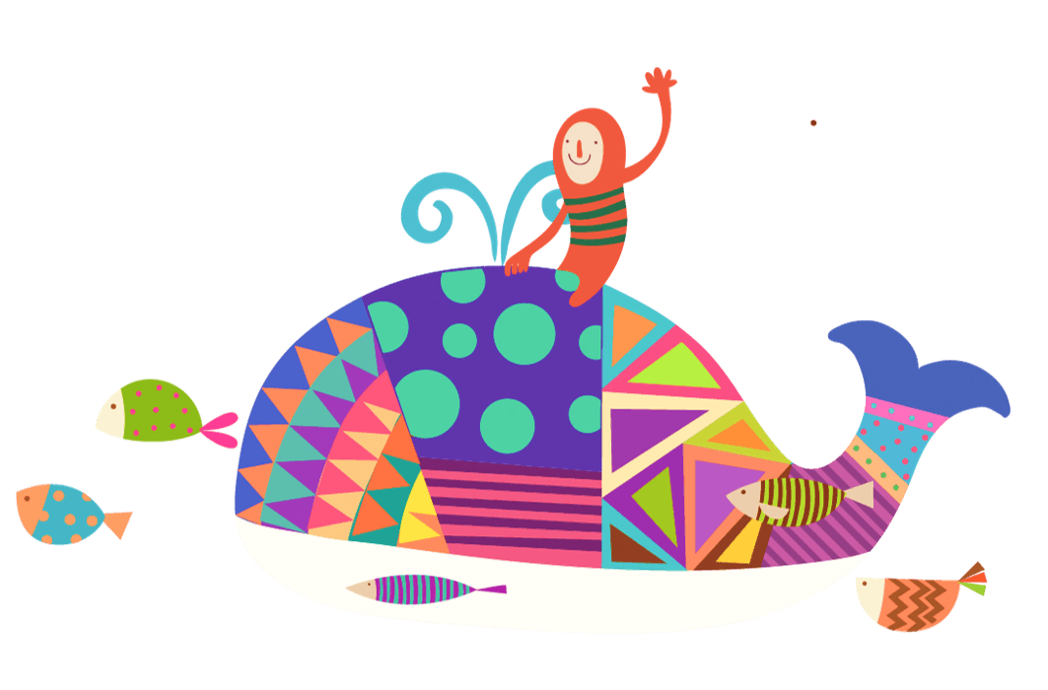
PEP M4U4 Body Language
Song: Head Shoulder Knees And Toes
Singer: Pop Goes The Weasel
作者：蓝晓晴
单位：华南师范大学

Slide 2
Head, shoulders, knees and toes,
knees and toes

Slide 3
knees and toes
Head, shoulders, knees and toes,

Slide 4
One mouth
and nose
Two eyes
two ears

Slide 5
Head
shoulders
knees
and toes

Slide 6
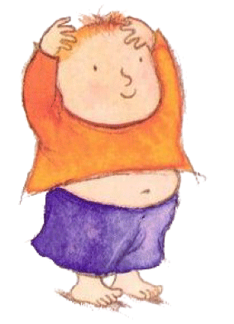

Slide 7
Head, shoulders, knees and toes,
knees and toes

Slide 8
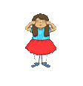
One mouth
and nose
Two eyes
two ears

Slide 9
Head, shoulders, knees and toes,
knees and toes

Slide 10
End

