Slide 1

Body Language
人教版 必修4 unit 4
作者：李康丽
单位：华南师范大学外文学院

Slide 2
If you are happy and you know it

Slide 3

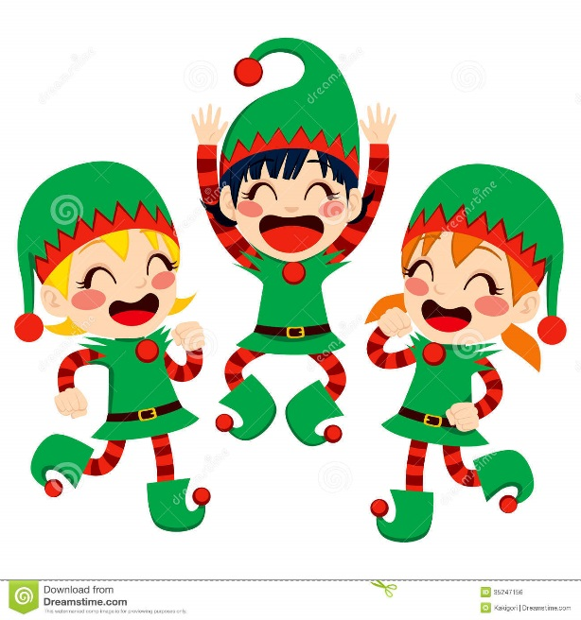
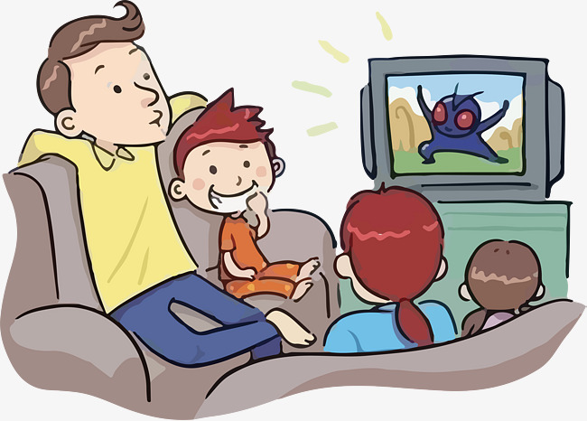
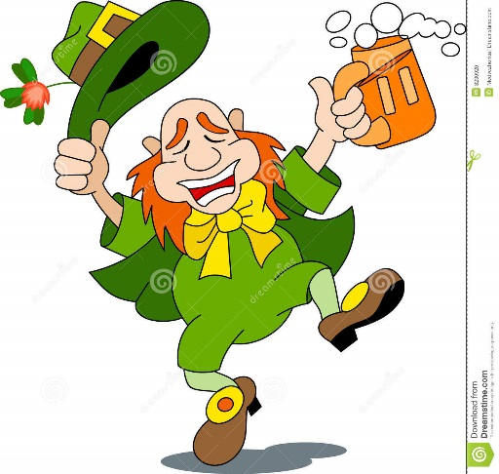
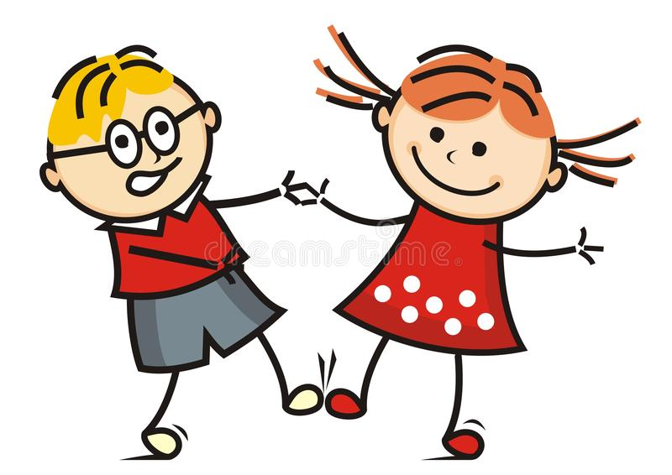
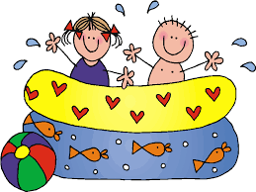

Slide 4

If you're happy
clap your hands
and you know it,

Slide 5
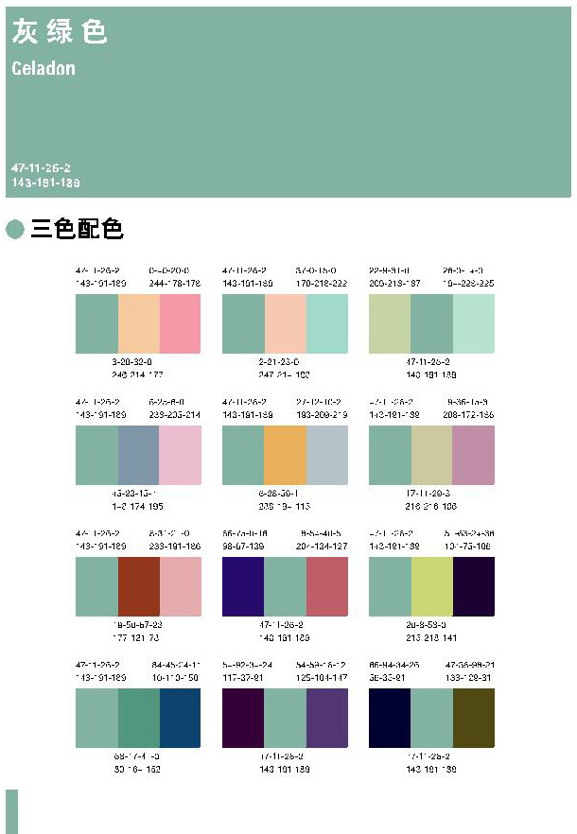
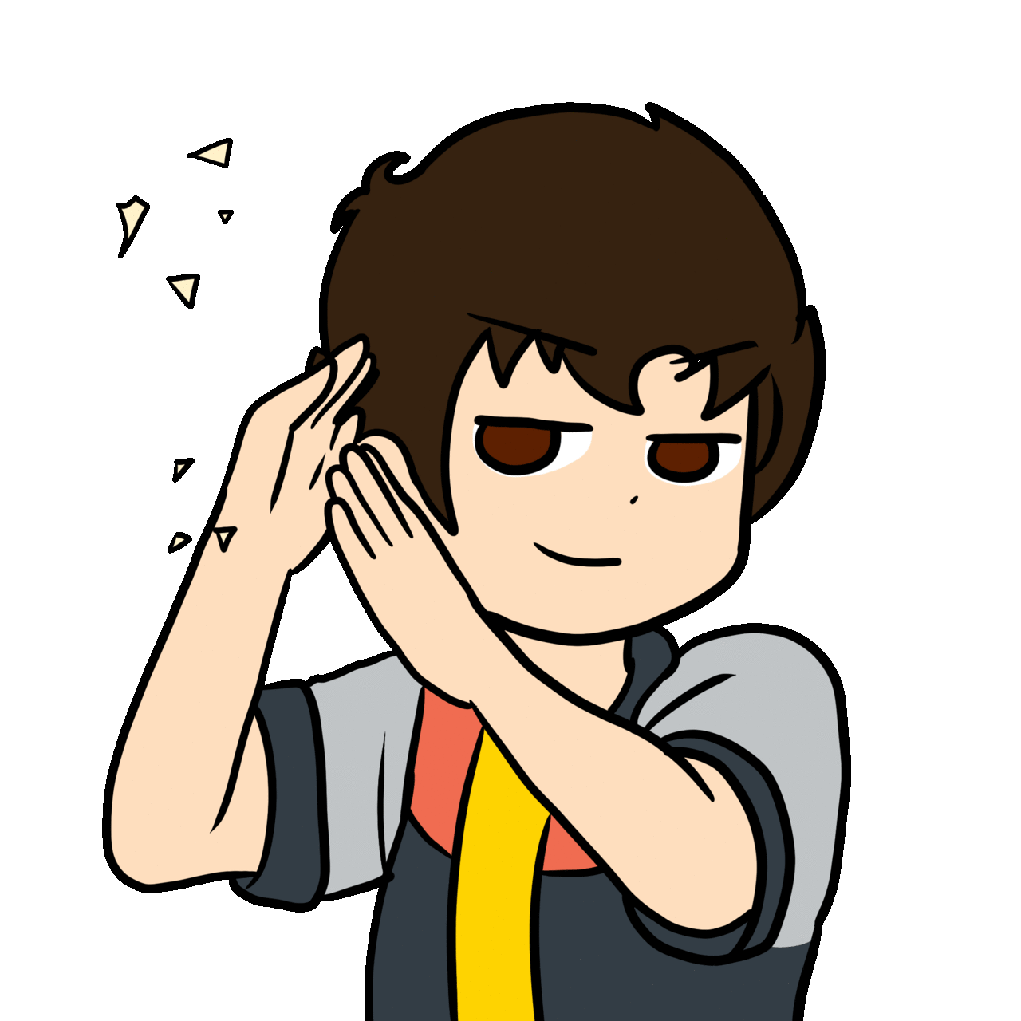
If you're happy and you know it,
clap your hands

Slide 6

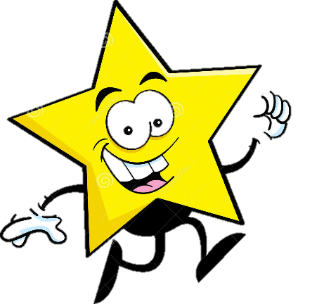

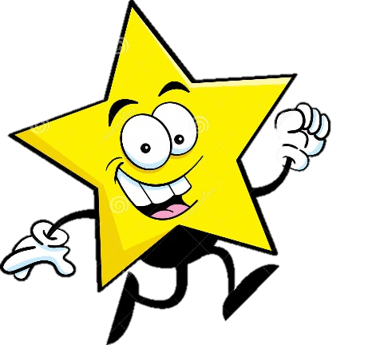

If you're happy and you know it
and you really want to show it.

Slide 7
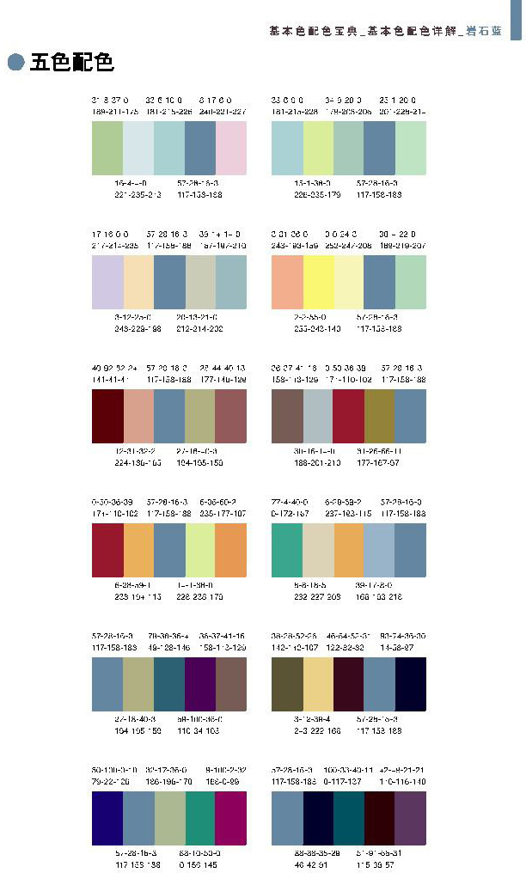
If you're happy and you know it
clap your hands

Slide 8
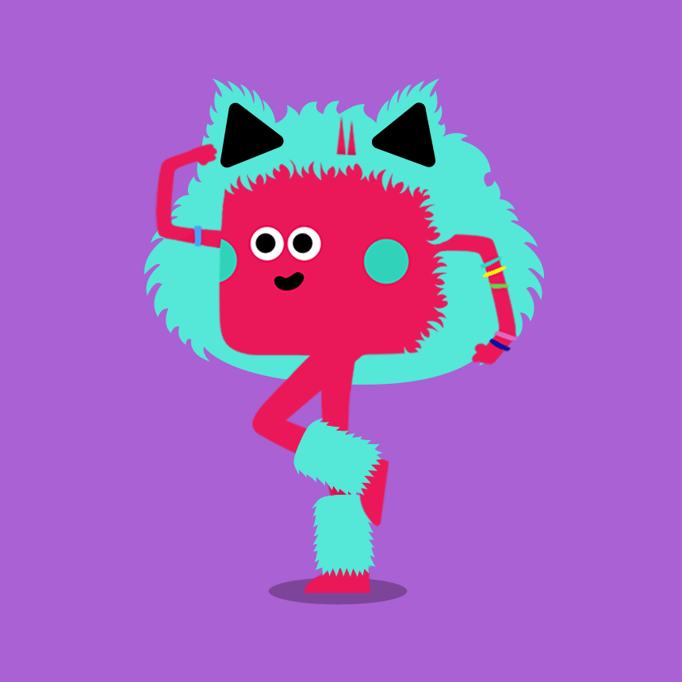
If you're happy and you know it
stomp your feet

Slide 9
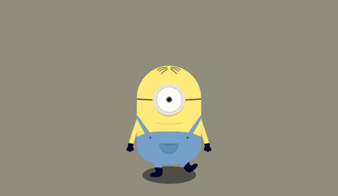
If you're happy and you know it,
stomp your feet

Slide 10
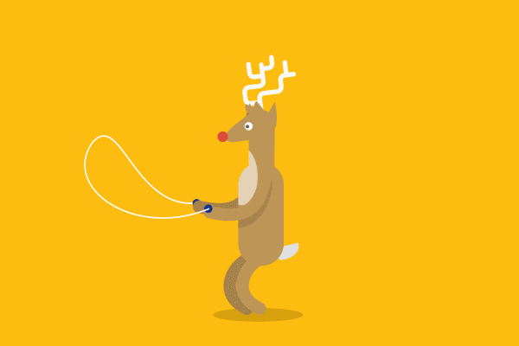
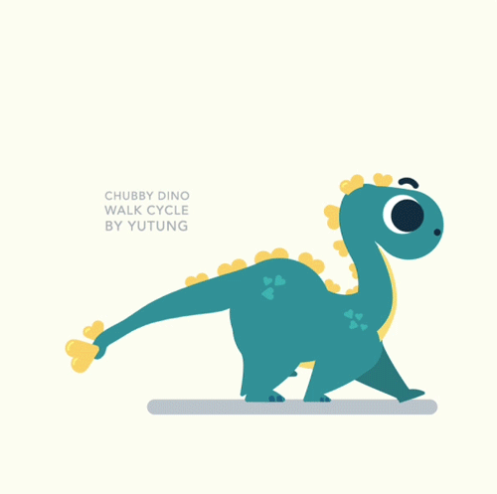
If you're happy and you know it
and you really want to show it.

Slide 11

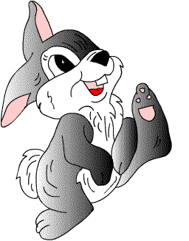
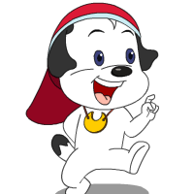
If you're happy and you know it, stomp your feet

Slide 12
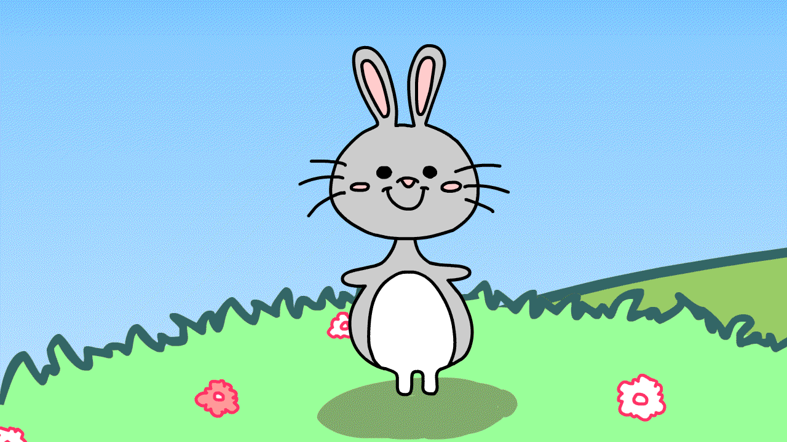
If you're happy and you know it, turn around

Slide 13



If you're happy and you know it, turn around

Slide 14
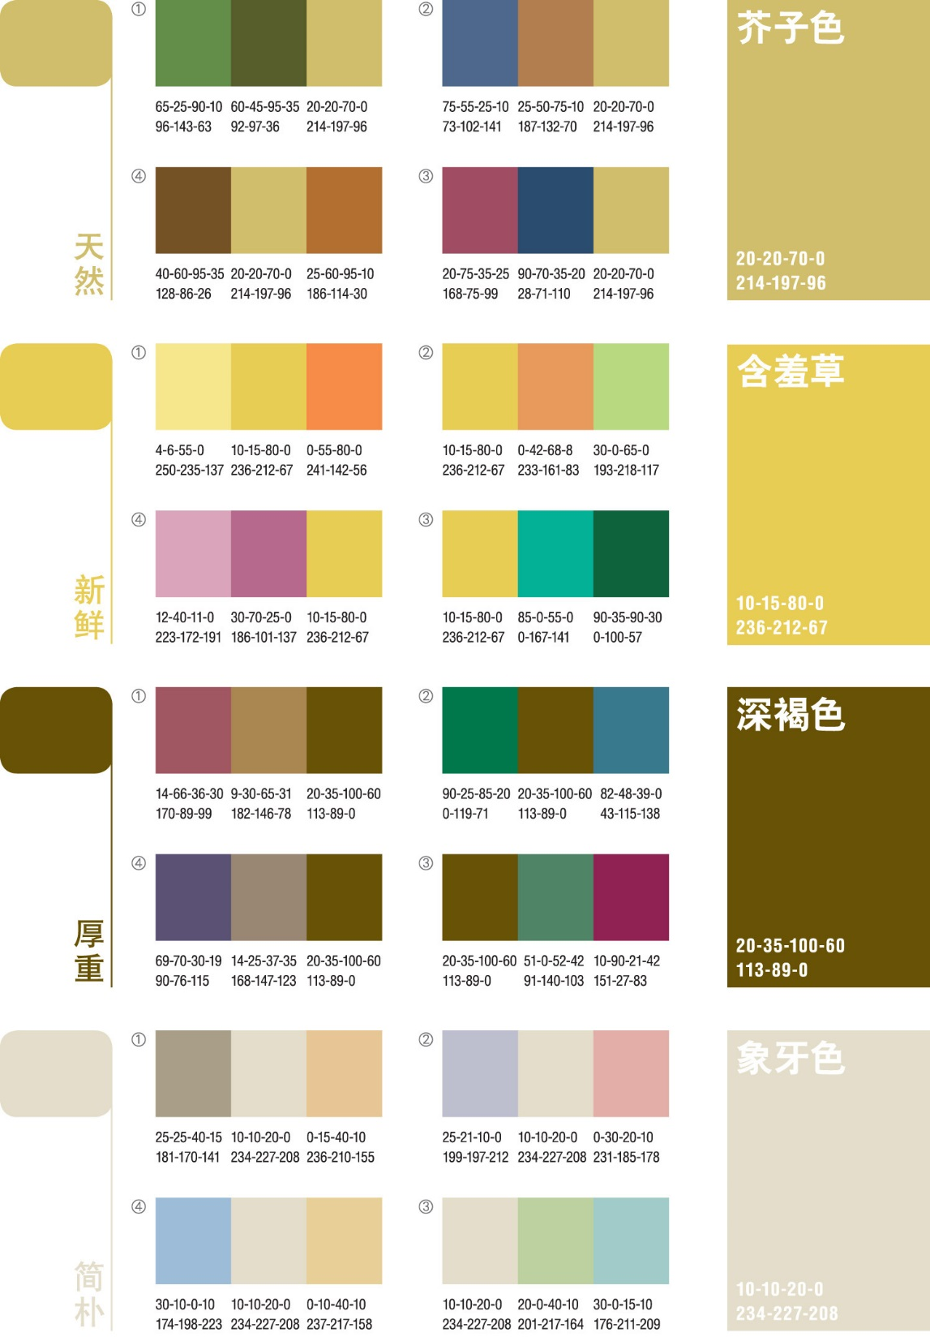
you're
If
and
you
happy
know
it
and you really want to show it.

Slide 15



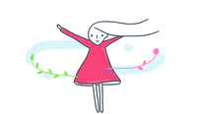
\
If you're happy and you know it, turn around

Slide 16
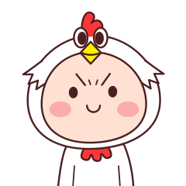
you're
If
you
it
happy
know
and
nod your head

Slide 17
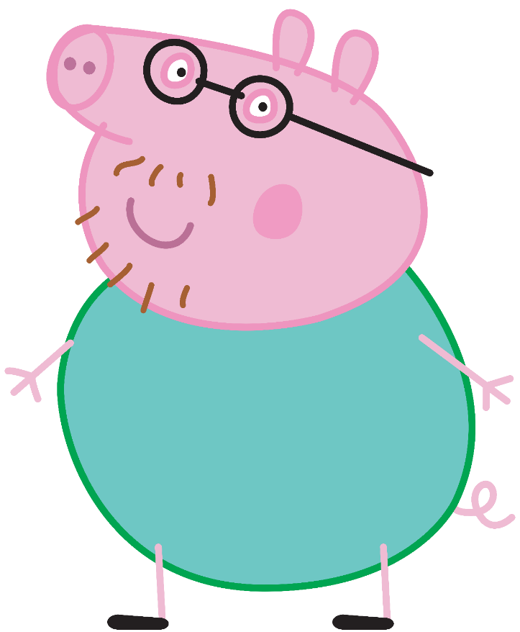
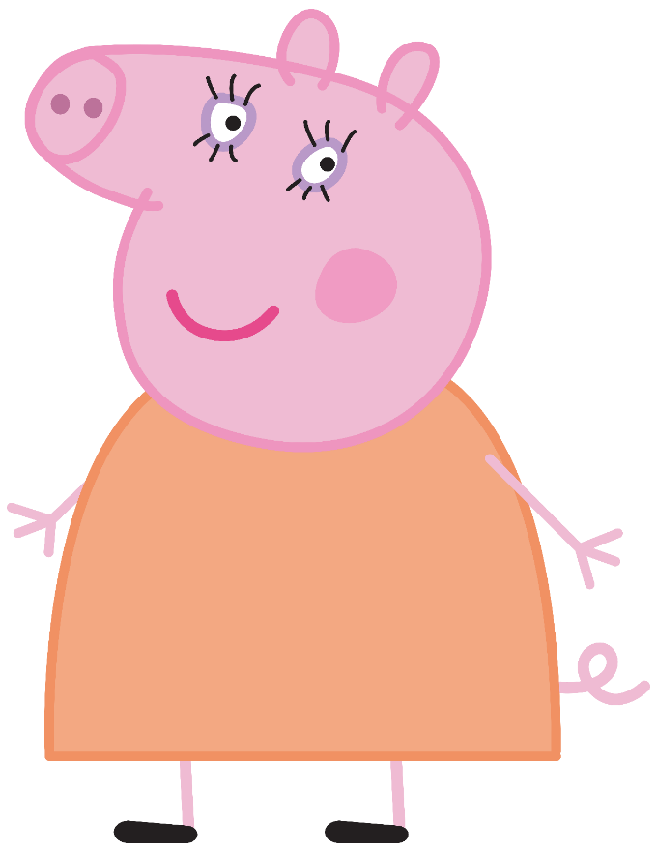
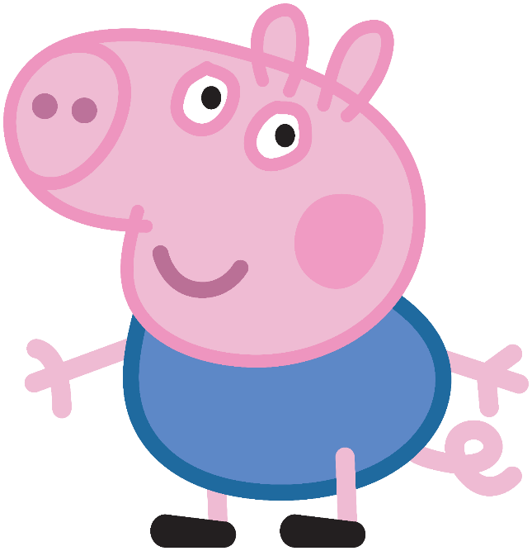
If you're happy
nod your head
and you know it,

Slide 18
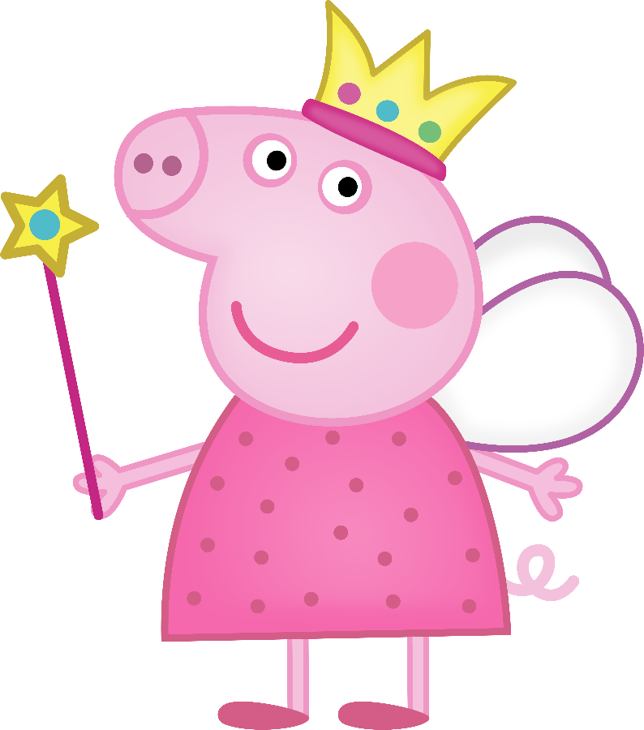
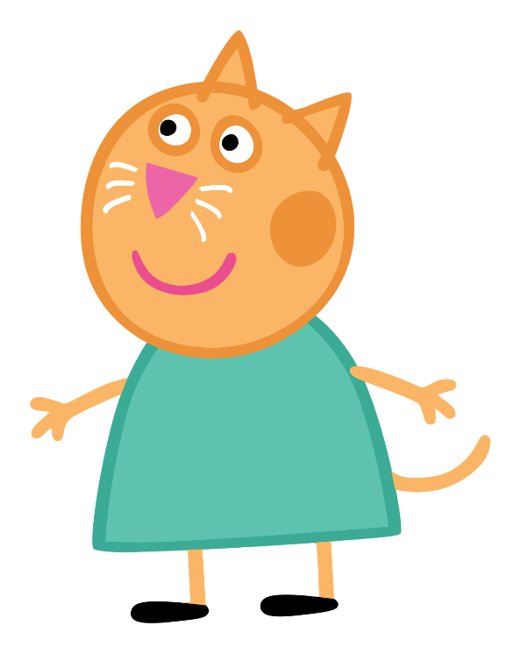
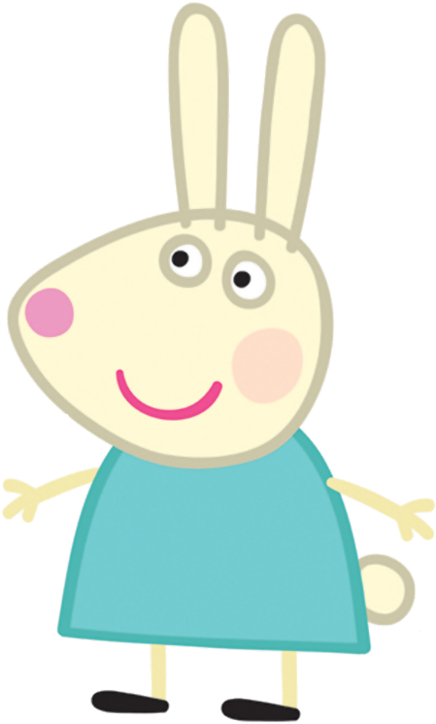
If you're happy and you know it,
and you really want to show it.

Slide 19
1
If you're happy
2
and you know it
3
nod your head

Slide 20
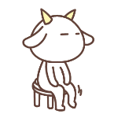
If you're happy and you know it, shake your legs

Slide 21
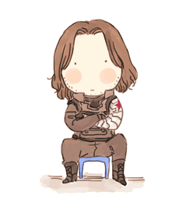

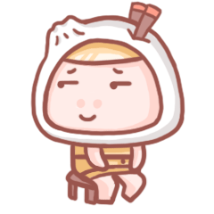
If you're happy and you know it, shake your legs

Slide 22
If you're happy and you know it
and you really want to show it.

Slide 23
If you're happy and you know it, shake your legs

Slide 24
1
If you're happy
2
and you know it
3
snap your fingers

Slide 25

you're
If
you
it
happy
know
and
Snap your fingers

Slide 26
If you're happy and you know it, and you really want to show it

Slide 27
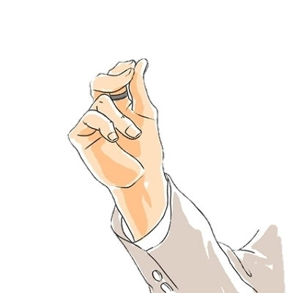
If you're happy and you know it,
Snap your fingers

Slide 28
If you're happy and you know it,
And you really want to show it
If you're happy and you know it,
clap your hands

