Slide 1
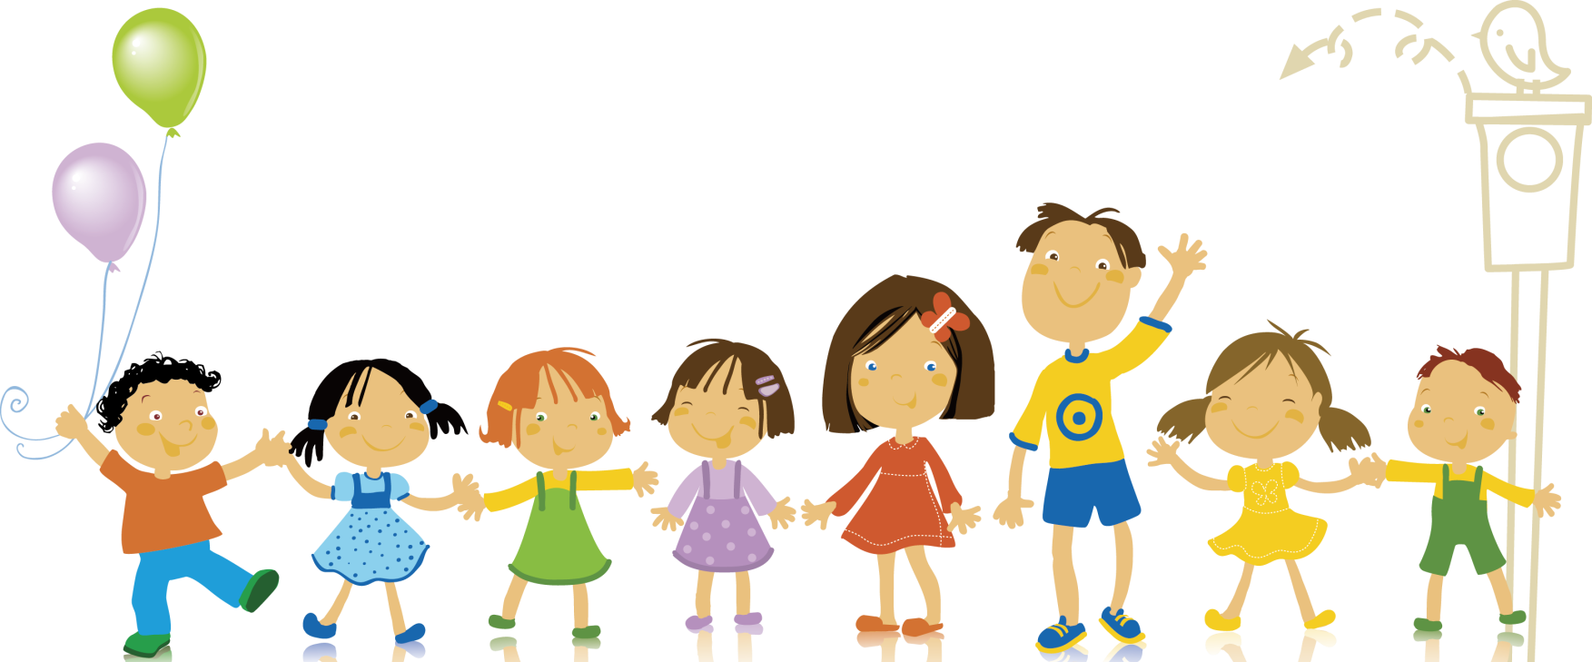
Body Language

Slide 2
M4U4—Body Language
Head, shoulders, knees, and toes
华南师范大学外文学院英语师范专业
余晓淳 20150201005

Slide 3
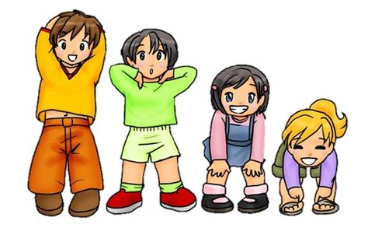
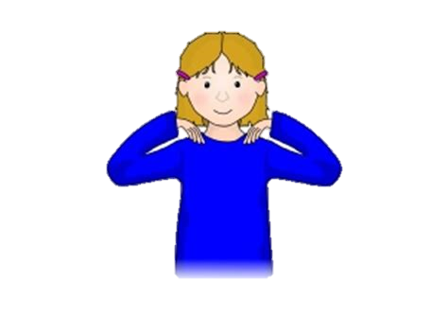
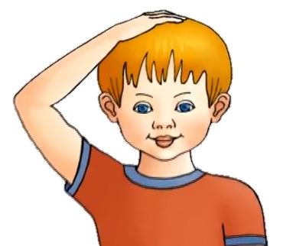
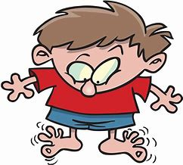
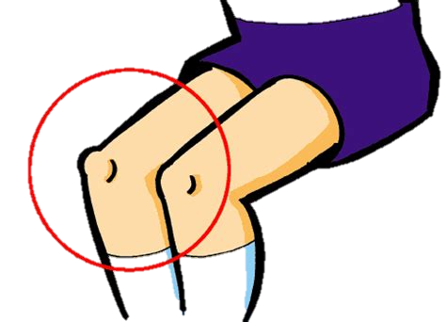
Head, shoulders, knees, and toes, knees and toes

Slide 4
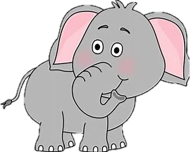
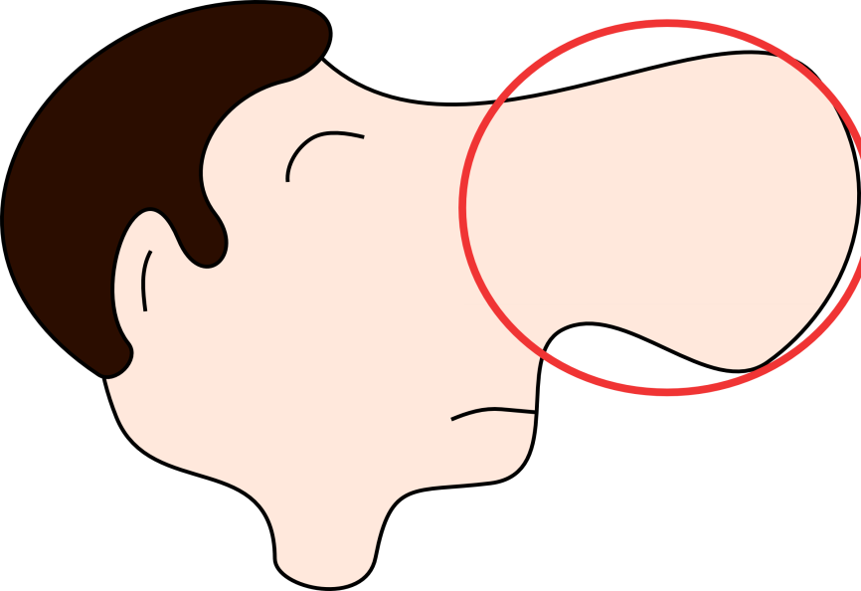
Eyes and ears and mouth and nose

Slide 5
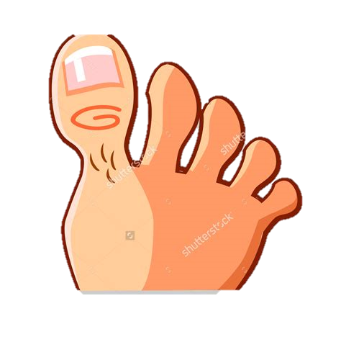
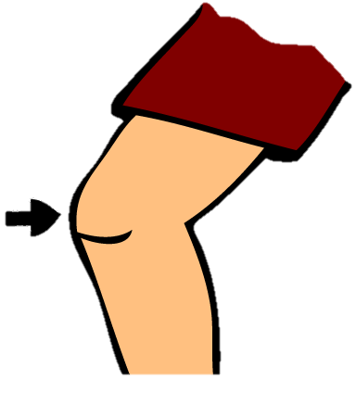
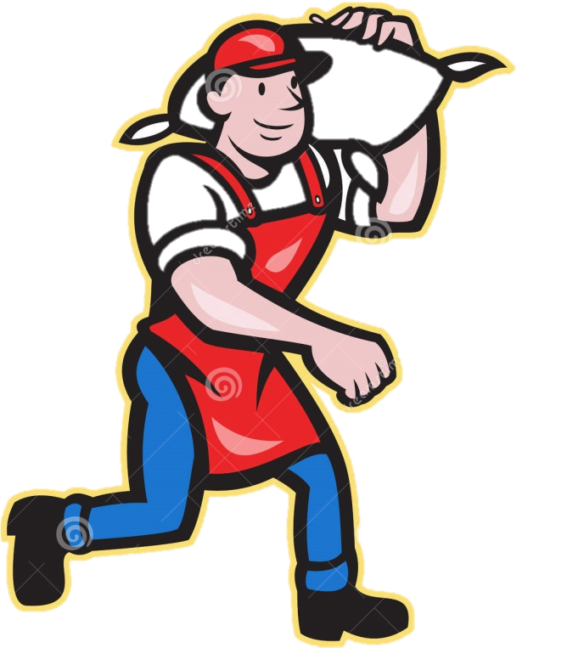
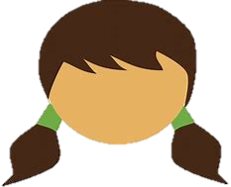
Head, shoulders, knees, and toes, knees and toes

Slide 6
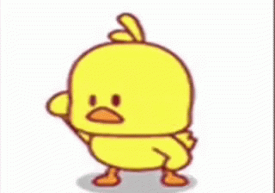
Then how do people from different countries use their body language for greeting?

Slide 7
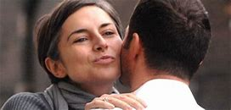
Greeting in different countries
kissing

Slide 8
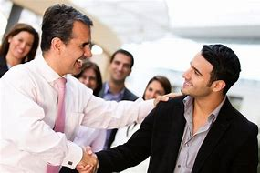
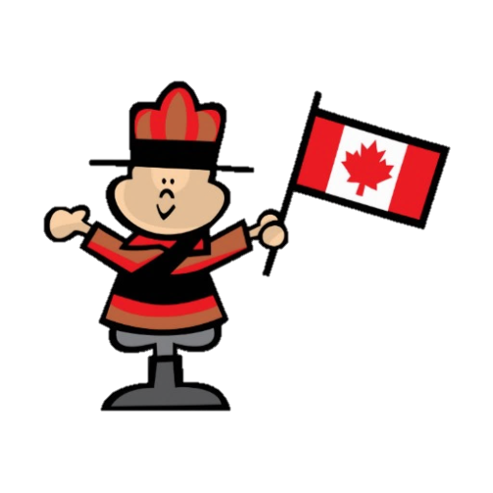
Greeting in different countries
Shake hand

Slide 9
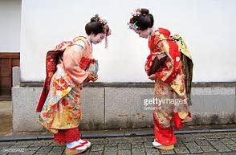
Greeting in different countries
Bow

Slide 10
Then how do Chinese people use their body language for greeting?

Slide 11
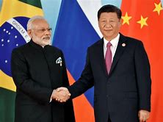
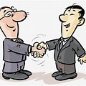
Greeting in different countries
Shake hand

Slide 12
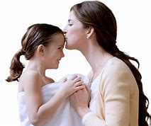
Greeting in different countries
kiss

Slide 13
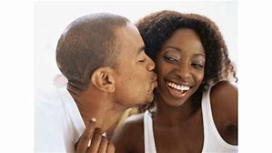
Greeting in different countries
kiss

Slide 14
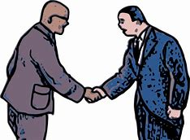
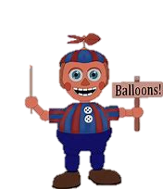
Greeting in different countries
Shake hand

Slide 15
Let’s review our body parts

Slide 16
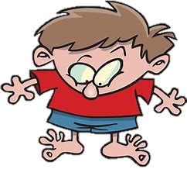
Head, shoulders, knees, and toes, knees and toes

Slide 17
Eyes and ears and mouth and nose

Slide 18
Head, shoulders, knees, and toes, knees and toes

Slide 19
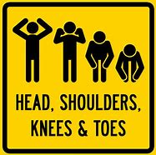
Head, shoulders, knees, and toes, knees and toes

Slide 20
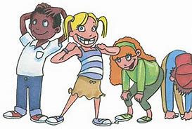
Head, shoulders, knees, and toes, knees and toes

Slide 21
Thanks for watching

