Slide 2
M4 U5 theme park
作者：陈丽君
单位：华南师范大学外国语言文化学院

Slide 3
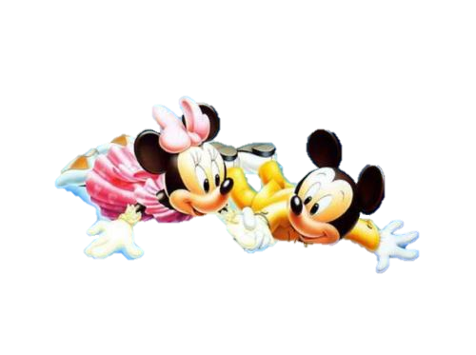
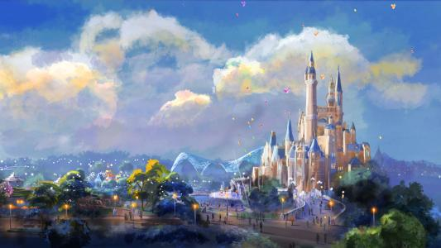
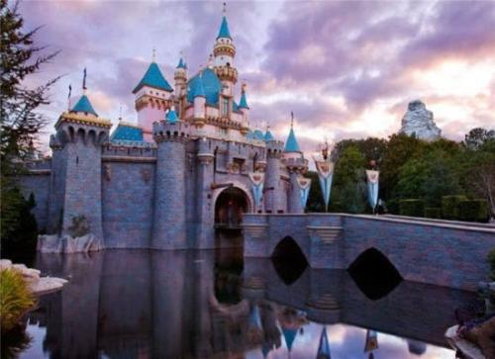
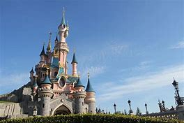
I can show you the world
Shining, shimmering, splendid

Slide 4
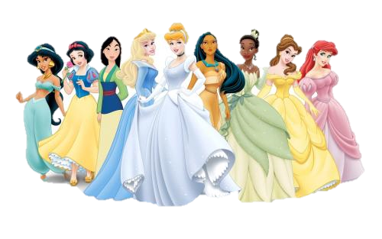
Tell me, princess, now when did
You last let your heart decide?

Slide 5
I can open your eyes
Take you wonder by wonder
Over, sideways and under
On a magic carpet ride

Slide 6
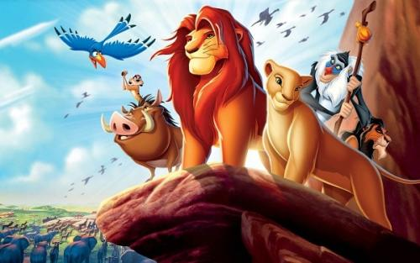
A whole new world
A new fantastic point of view

Slide 7
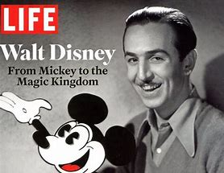
No one to tell us no or where to go,
Or say we're only dreaming

Slide 8
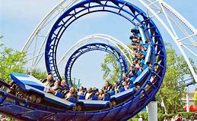
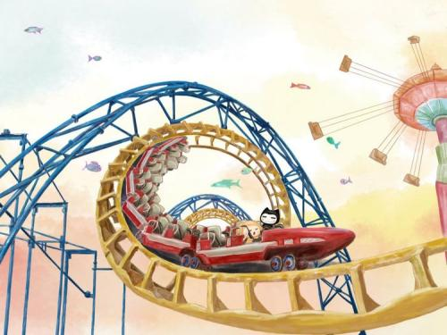
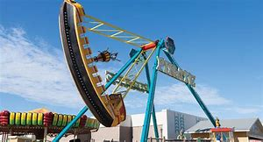
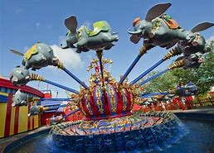
A whole new world
A dazzling place
I never knew

Slide 9
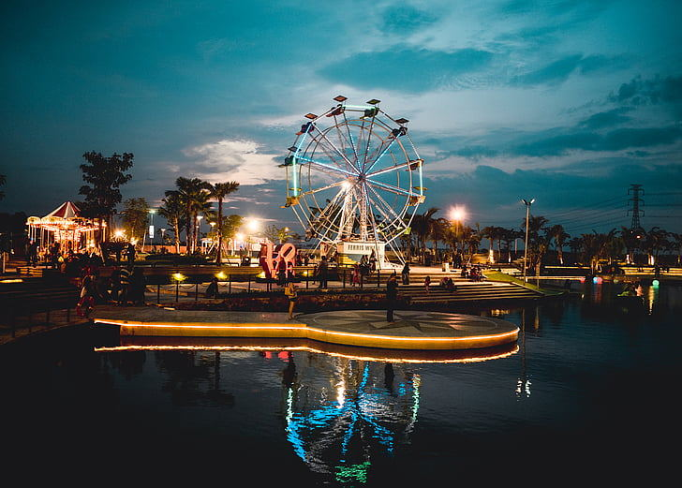
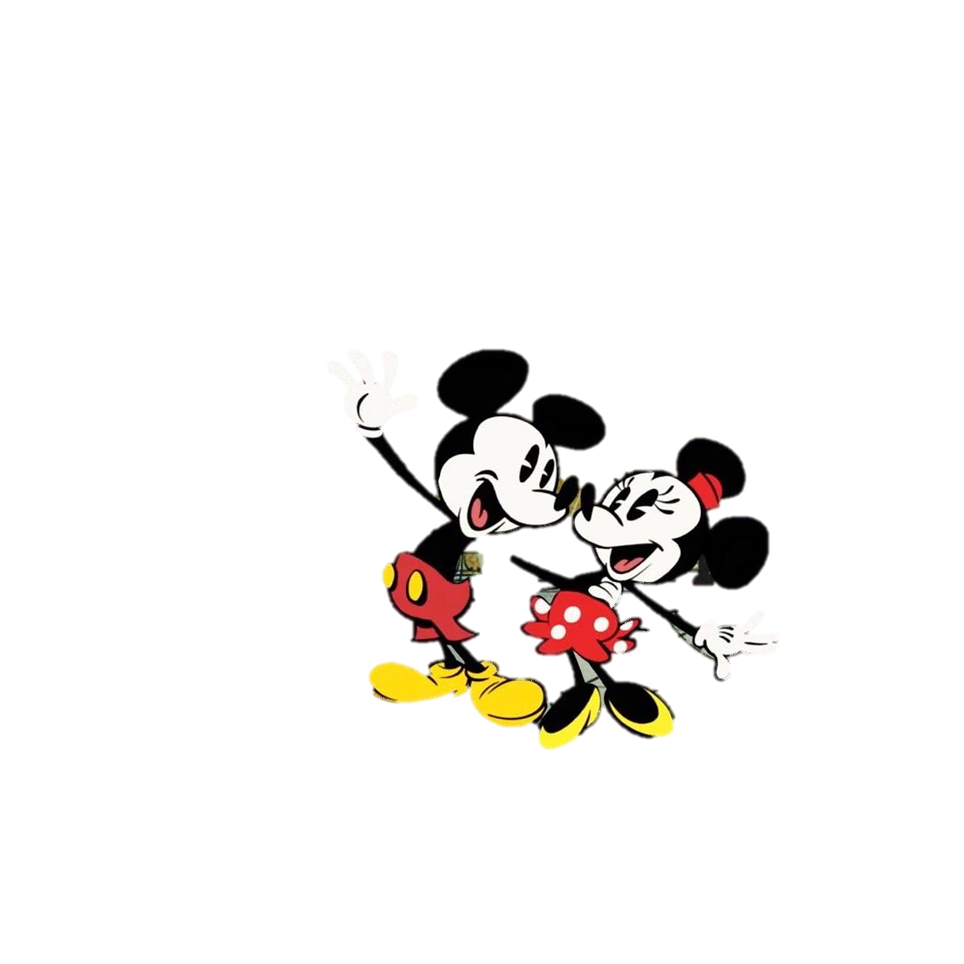
But when I'm way up here
It's crystal clear
that now I'm in a whole new world with you

Slide 10
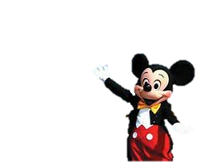
Unbelievable sights
Indescribable feeling
Soaring, tumbling, freewheeling

Slide 11
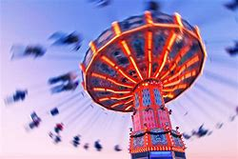
Through an endless diamond sky
A whole new world

Slide 12
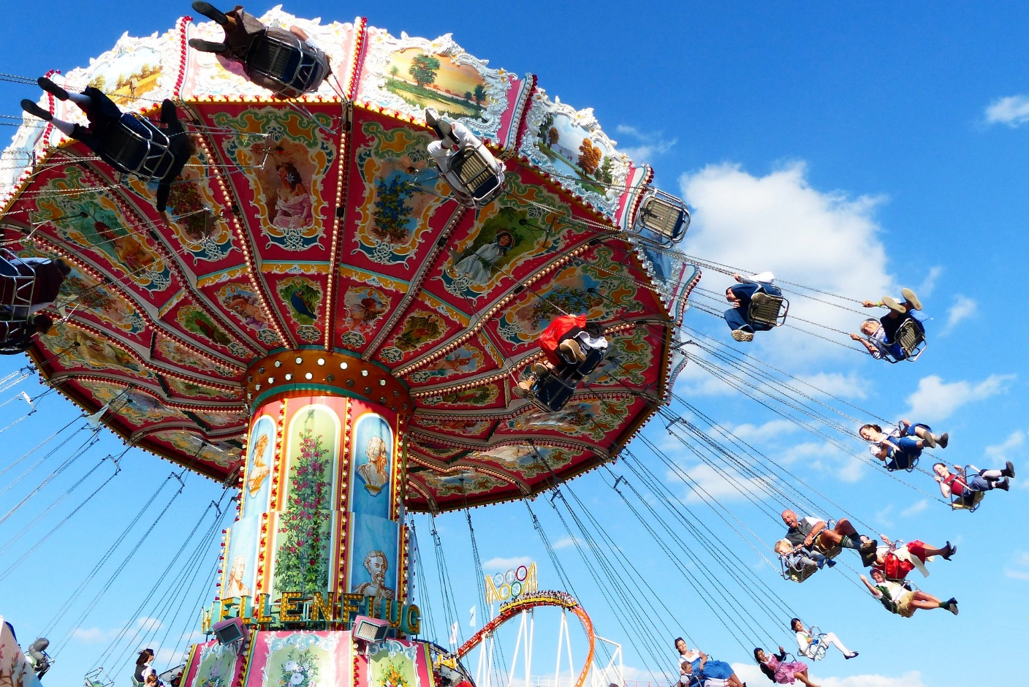
Don't you dare close your eyes
A hundred thousand things to see

Slide 13
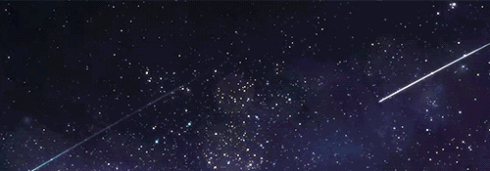
I'm like a shooting star
I've come so far

Slide 14
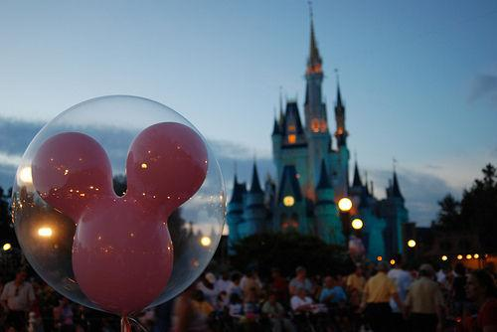
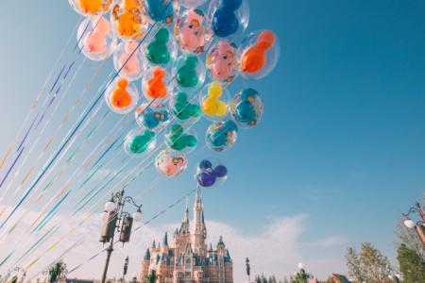
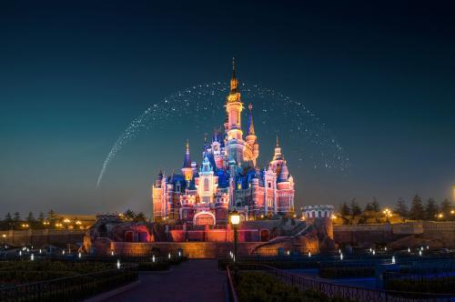
I can't go back to where
I used to be
A whole new world

